Slide 1
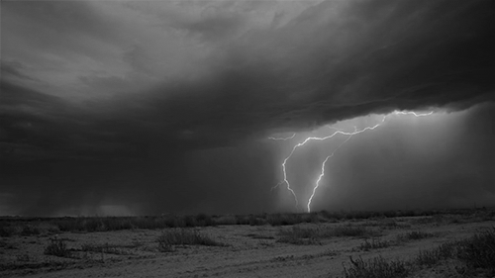
祷告
Today: PRAYER

Slide 2
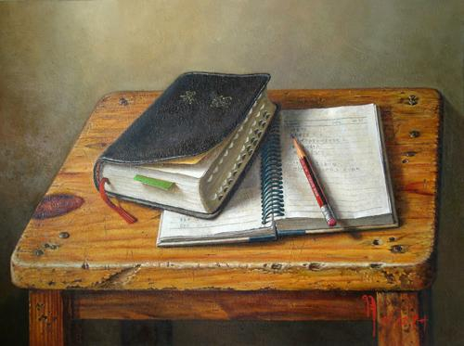
圣经强化培训课程
INTENSIVE BIBLE TRAINING PROGRAM

Slide 3
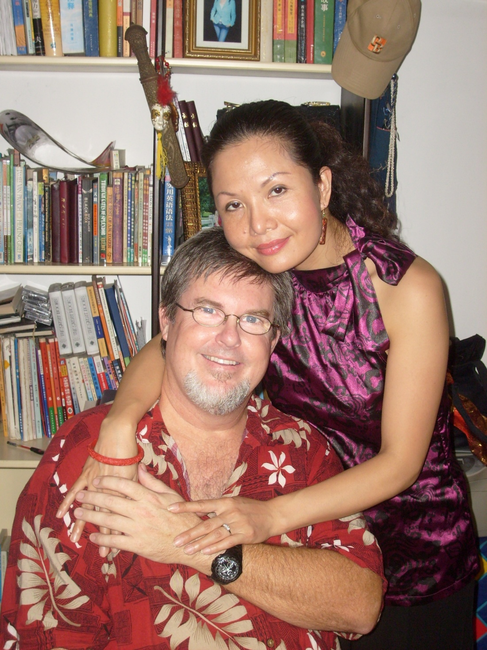
Teachers:
Dr. Jay Barleon
&
SURAN

Slide 4
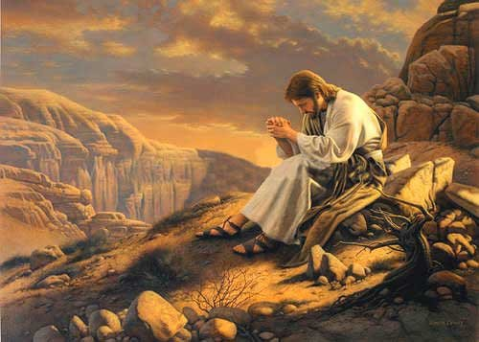
主 祷文 THE LORD’S PRAYER
有关 祷告 THOUGHTS ON PRAYER
祷告时间 PRAYER TIME
休息 (BREAK)
第一课 (1st Hour)
第二课

Slide 5
对祷告的一些思考
A FEW THOUGHTS ON PRAYER

Slide 6
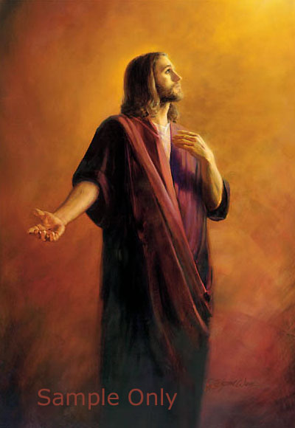
耶稣为我们祷告(约17)
耶稣为所有属于祂的祷告 (将会跟随祂的人)
Jesus prays for ALL who belong to Him (and will ever follow Him)
祂祈求父牢牢地保守我们
He asks God to keep us secure
父神不会拒绝耶稣这一祷告
God will not refuse this prayer to Jesus
耶稣为你祷告得很具体
JESUS PRAYED FOR YOU SPECIFICALLY
Jesus Prays for US (John 17)

Slide 7
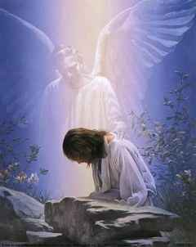
耶稣在客西马尼园的祷告
悲伤到濒临死亡
Sorrowful to the point of death
知道什么事情正在来临
Knew what was coming
不愿意经历十架酷刑
Didn’t want to go through the crucifixion
“不要照我的意思， 只要照你的意思.”
“Not my will but Your will Father”
他这样行是因为他个人对你的爱.
He did this because of His LOVE for you personally
Jesus Prays in Gethsemane

Slide 8
圣灵在祷告中的角色
罗马书8:26-27 “况且我们的软弱有圣灵帮助，我们本不晓得当怎样祷告，只是圣灵亲自用说不出来的叹息，替我们祷告。鉴查人心的，晓得圣灵的意思因为圣灵照着神的旨意替圣徒祈求。”
ROMANS 8:26-27 “ ²⁶ In the same way the Spirit also helps our weakness; for we do not know how to pray as we should, but the Spirit Himself intercedes for us with groanings too deep for words; and He who searches the hearts knows what the mind of the Spirit is, because He intercedes for the ^{[j]}saints according to the will of God.”
The Holy Spirit’s Role in Prayer

Slide 9
我们有一个富有同情心的中保
来 4:14-16 “我们既然有一位已经升入高天尊荣的大祭司，就是神的儿子耶稣，便当持定所承认的道。因我们的大祭司，并非不能体恤我们的软弱。他也曾凡事受过试探，与我们一样。只是他没有犯罪。所以我们只管坦然无惧的，来到施恩的宝座前，为要得怜恤，蒙恩惠作随时的帮助。”
“Heb. 4:14-16 “Therefore, since we have a great high priest who has passed through the heavens, Jesus the Son of God, let us hold fast our confession. For we do not have a high priest who cannot sympathize with our weaknesses, but One who has been tempted in all things as we are, yet without sin. Therefore let us draw near with confidence to the throne of grace, so that we may receive mercy and find grace to help in time of need.”
We have a sympathetic Mediator

Slide 10
罪会拦阻你的祷告
诗66:18 “我若心里注重罪孽，主必不听。”
Psalm 66:18 “If I regard sin in my heart the Lord will not listen to me”
雅4:3 “你们求也得不着，是因为你们妄求，要浪费在你们的宴乐中。”
James 4:3 “You ask and do not receive, because you ask with wrong motives, so that you may spend it on your pleasures”
彼前3:7 “你们作丈夫的，也要按情理和妻子同住。因他比你软弱，与你一同承受生命之恩的，所以要敬重他。这样便叫你们的祷告没有阻碍。”
1 Peter 3:7 “You husbands in the same way, live with your wives in an understanding way, as with someone weaker, since she is a woman; and show her honor as a fellow heir of the grace of life, so that your prayers will not be hindered. “
Sin can hinder prayer

Slide 11
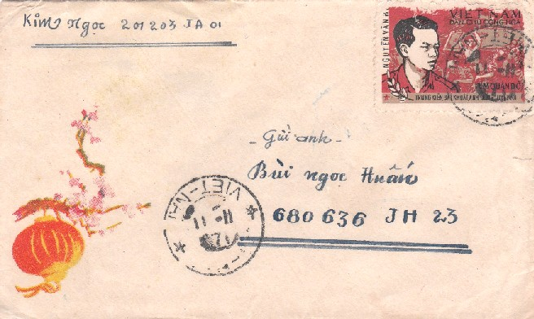
耶稣的名并非一枚信封上的邮票
约14:13-14 “你们奉我的名，无论求什么，我必成就，叫父因子得荣耀。 你们若奉我的名求什么，我必成就。”
John 14:13-14 “Whatever you ask in My name, that will I do, so that the Father may be glorified in the Son. If you ask Me anything in My name, I will do it.”
只求耶稣可能 会 向父祈求的事。
Only ask for those things that Jesus would ask the Father for
Jesus’ NAME is not a stamp on an envelope

Slide 12
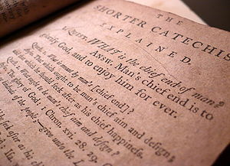
《威斯敏斯特小要理问答》 的第一问是什么？
第一问:人生的首要目的是什么？
答：人生的首要目的就是荣耀上帝并以他为乐，直到永远
Question 1: What is the chief and highest end of man?
Answer: Man's chief and highest end is to glorify God, and fully to enjoy him forever.
Westminster Catechism’s 1st Question

Slide 13
以神为乐

Slide 14
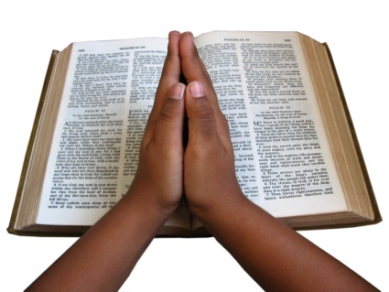
我们要不住地祷告
帖前5:17 “不住地祷告.”
1 Thessalonians 5:17 “Pray without ceasing”
We are to pray without ceasing

Slide 15
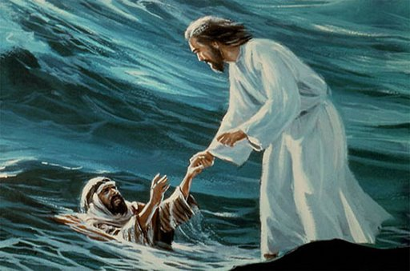
圣经中的祷告姿势
站着，跪着，俯伏在地，躺着， 举手，行走，跑路，溺水，打仗，闭眼， 睁眼, 坐着等。
Standing, kneeling, prostrate, lying down, hands raised, walking, running, drowning, fighting, eyes closed, eyes open, sitting, and more.
The position of prayer in the Bible

Slide 16
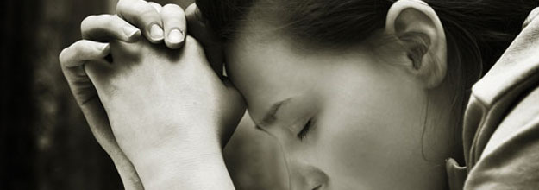
圣经中的祷告种类
求帮助,满足所需;感恩;赞美;惊慌;国民性的；悔改;认罪;愤怒;歌唱;疑问等等。
Asking for help or needs; thanksgiving; praise; panic; national; repentance;
confession; anger; song; questioning; and much more.
Types of prayer in the Bible

Slide 17
祷告有不同的形式
祷告可以是大声的,安静的,写日记方式的,群体的,个人的,歌唱式的,早上,晚上,整晚, 很短,很长,在林子里,在教堂,在家里,在水上，在船上,在十架上,在监狱里,在餐桌上,在街上,在人群中,在小组里,与家人,与朋友,与仇敌等。
Prayer can be aloud, silent, journaling, with a group, individual, singing, early in the morning, late at night, all night, very short, very long, in the forest, in church, at home, on the water, in a boat, on the cross, in jail, over dinner, walking on the street, in a crowd, in small groups, with family, with friends, with enemies, etc.
Prayers can take different forms

Slide 18
祷告时间
分成小组或你独自一人（你自己选择）。
Break into small groups or by yourself (your preference)
每次我给你一个题目，就按着题目祷告直到我改变题目。努力不让自己分心。
Each time I give you a new topic, stay focused on that topic until I change it.
Try not to let your mind get distracted.
我们将使用主祷文做框架，放上你自己的内容。
We will use the Lord’s Prayer as a skeleton upon which you put the flesh
聚焦于神，而不是你自己。
Focus on GOD, not on yourself.
PRAYER TIME

Slide 19
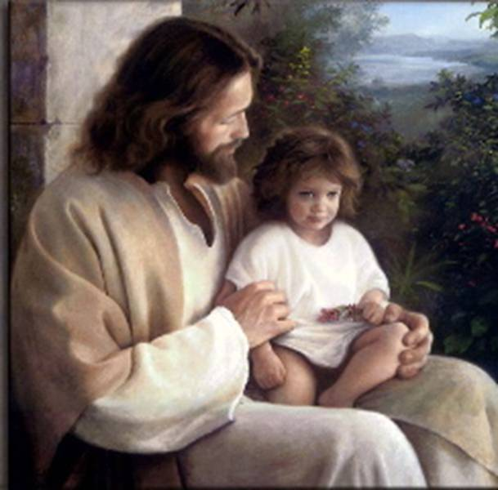
向你的爸爸表达你的爱 Express your love to your daddy

Slide 20
敬拜神的圣洁和祂的其它属性
Worship God for His holiness & other attributes

Slide 21
与神谈谈在其国度与祂共度未来
Talk with God about your future together in His Kingdom

Slide 22
将你的意志降服于神脚前，并向祂寻求指引
Surrender your will to God and ask for His direction

Slide 23
向父祈求你所需
Ask your Father for what you need

Slide 24
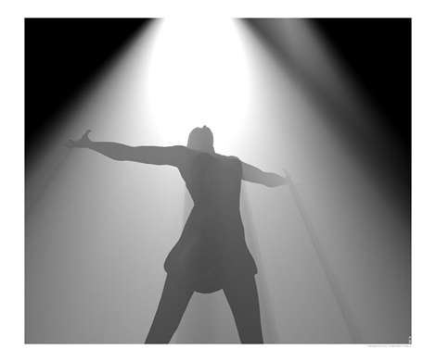
认罪并悔改
Confess and repent of Sin.

Slide 25
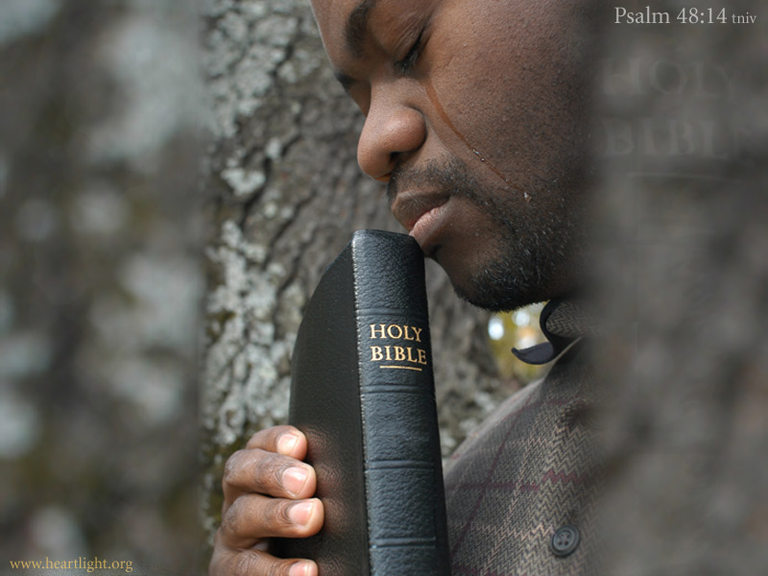
向神求助你能饶恕某些特定的人
Ask
God to help you forgive certain people

Slide 26
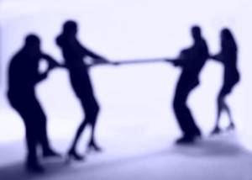
在你易受试探的领域向神求助
Ask God for help in specific areas you are tempted in

Slide 27
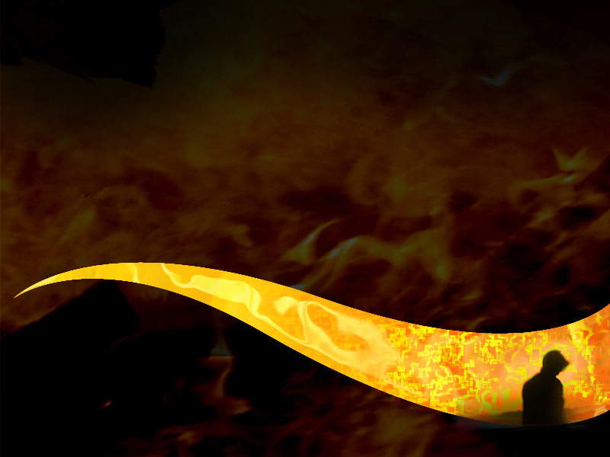
感谢祂。 敬拜祂。 享受祂。
Thank Him. Worship Him. Enjoy Him.

