Slide 1
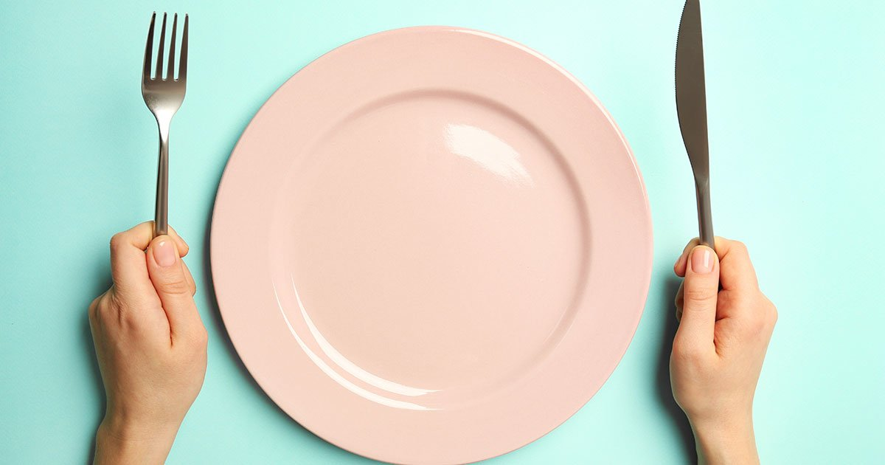
禁食
FASTING

Slide 2
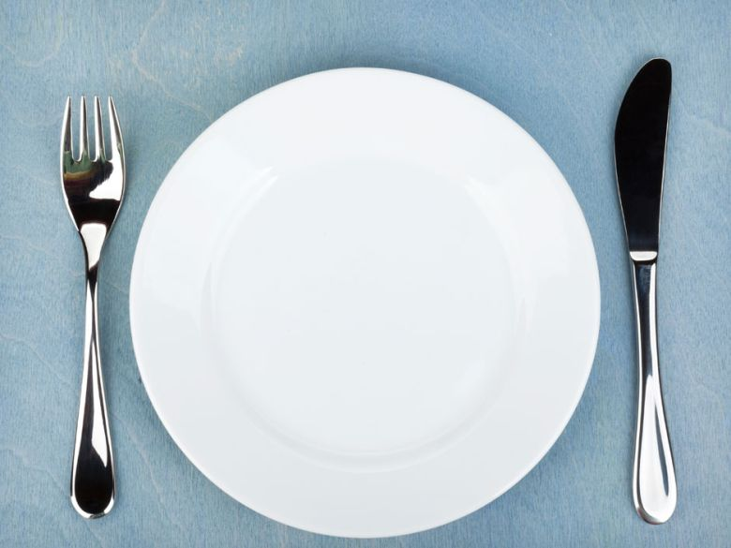
禁食
FASTING
最常问的问题
The Most Commonly
Asked Questions

Slide 3
“谁该禁食？” 耶稣说： “当你禁食时” 不是“如果” 你禁食。
“Who should fast?”
“Jesus said, WHEN you fast, not IF you fast.” （太6:16-18）

Slide 4
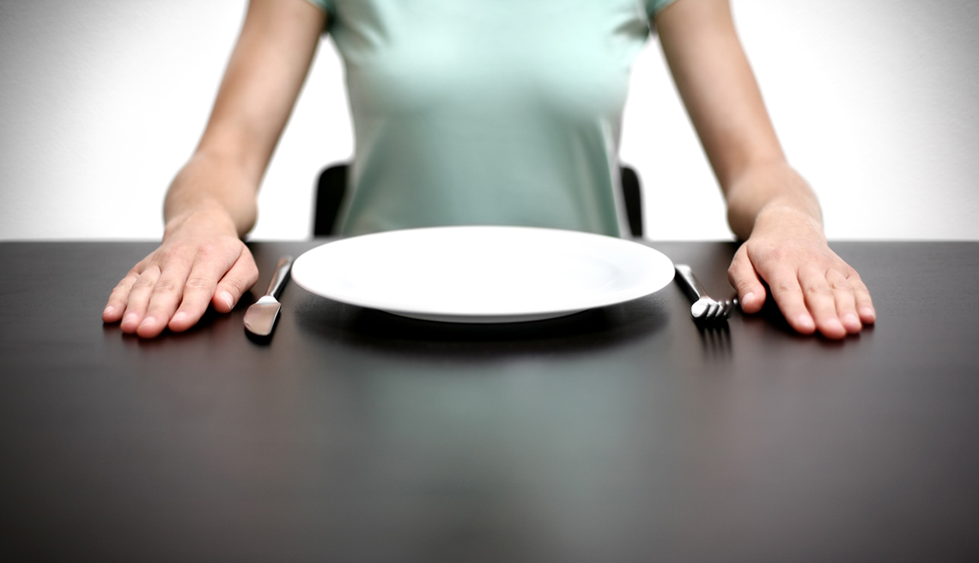
什么是禁食？
“WHAT is Fasting?”

Slide 5
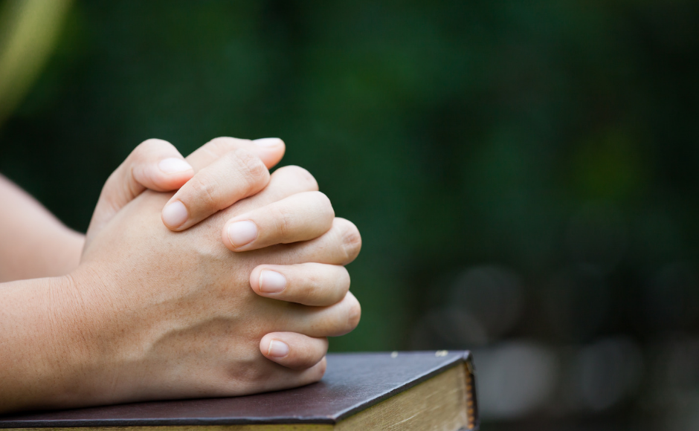
“在指定的时间内不吃东西
（或其它方式）为的是专心祷告.”
“To abstain from easting (or other practices) for a designated period of time in order to devote yourself to prayer.”

Slide 6
为何我要禁食？
“WHY should I Fast?”

Slide 7
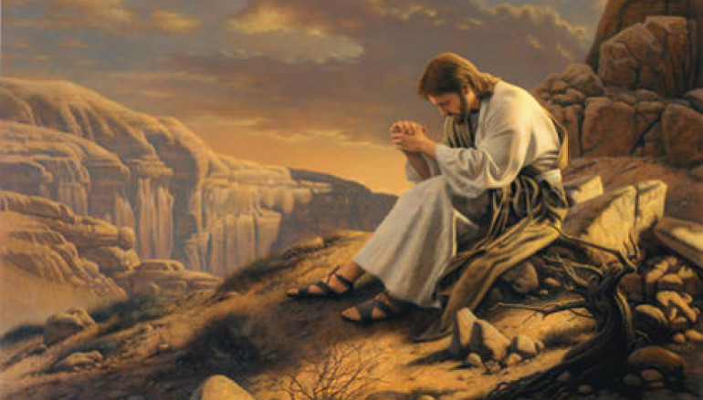
1. 是基督树立的榜样
It is modeled by Christ
太4:2“在他禁食四十个昼夜后,他饿了.”
Matt. 4:2 “After He had fasted forty days and forty nights, He then became hungry.”

Slide 8
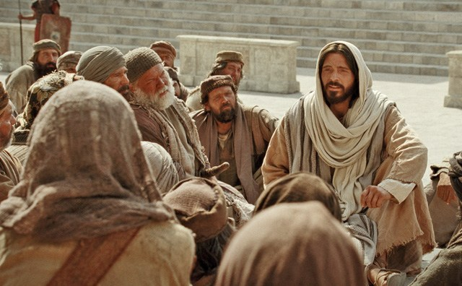
2. 是基督所希望的
It is EXPECTED by Christ
太6:17“你们禁食的时候…”
Matt. 6:17 “but WHEN you fast….”

Slide 9
3. 为了亲近神
To draw closer to God
太6:18: “你父在 暗中察看,必然报答你 .”
Matt. 6:18 “your Father who sees what is done in secret will reward you openly.”

Slide 10
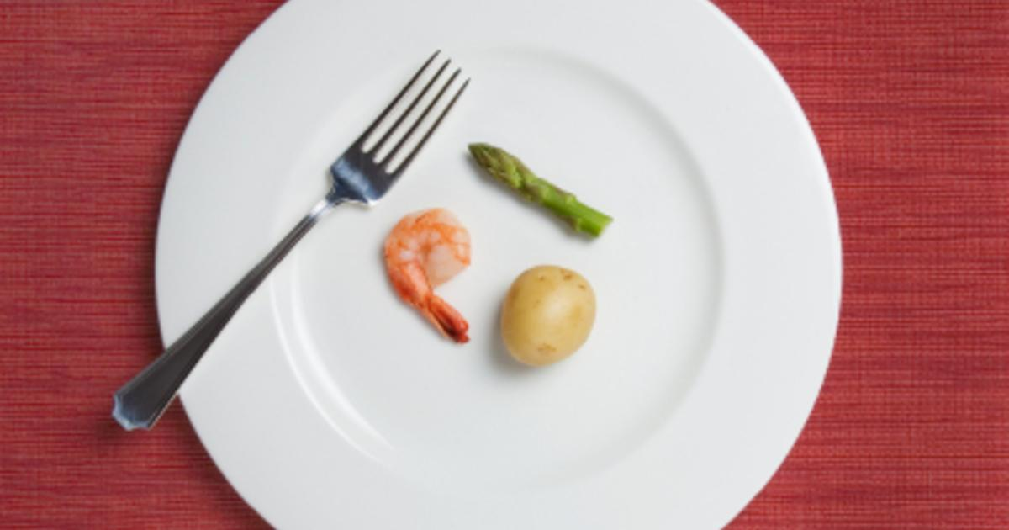
4. 为了操练自律
To develop personal discipline
林前9:27: “我是攻 克己身, 叫身服我 。”
1 Cor. 9:27 “I bring my body under subjection….”

Slide 11
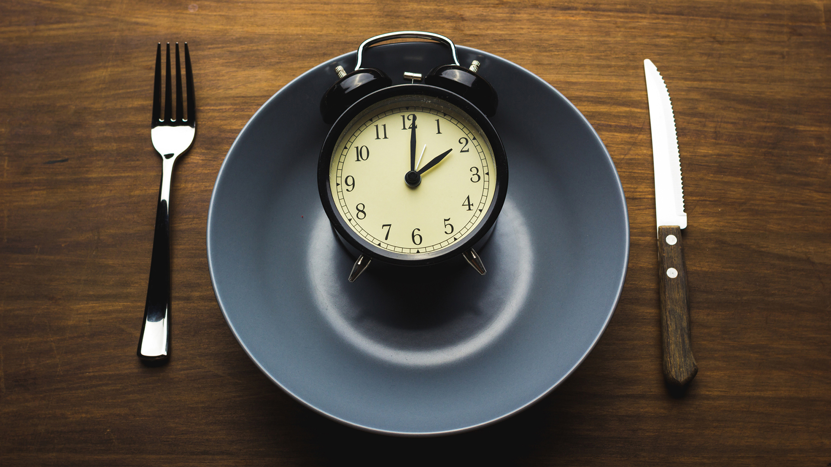
何时该禁食？
“WHEN should I Fast?”

Slide 12
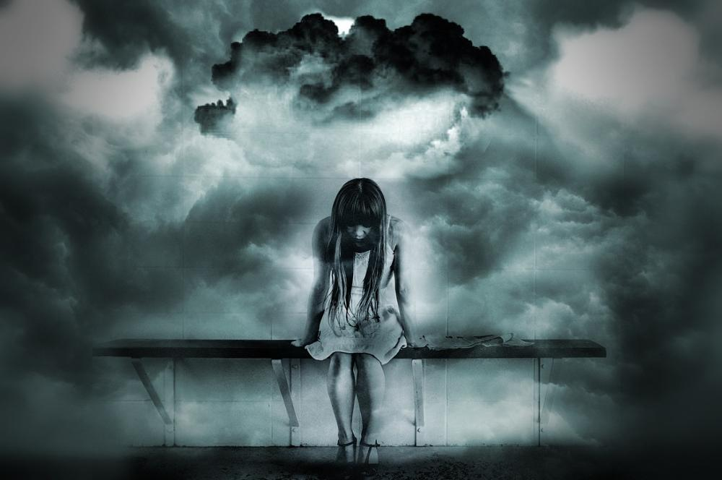
1. 在个人危机或悲伤时
In times of personal crisis or grief（利16:27-31，民29:7）

Slide 13
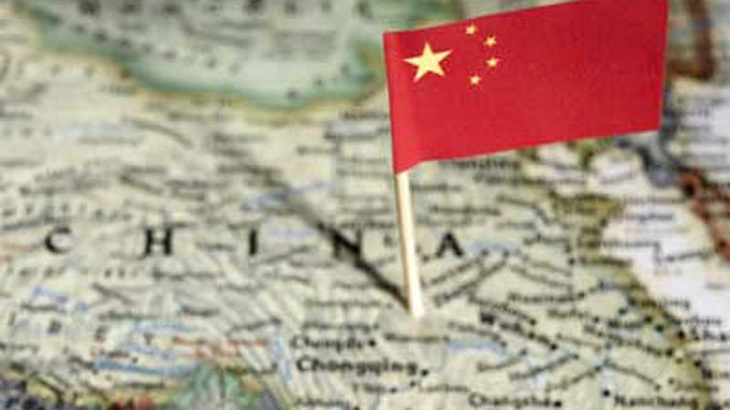
2. 在国家危机时
In times of National Crisis(但9:3,斯3:1-10:3)

Slide 14
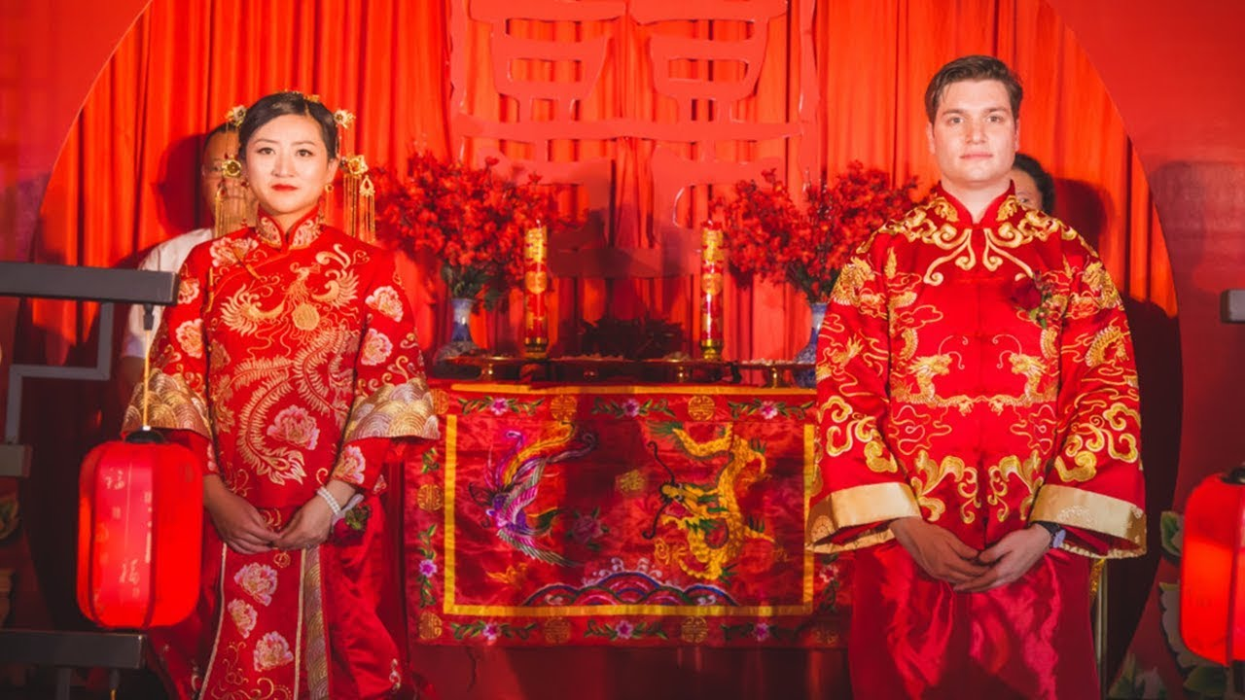
3.要做重要决定时
When facing important decisions(徒13:1-3)

Slide 15
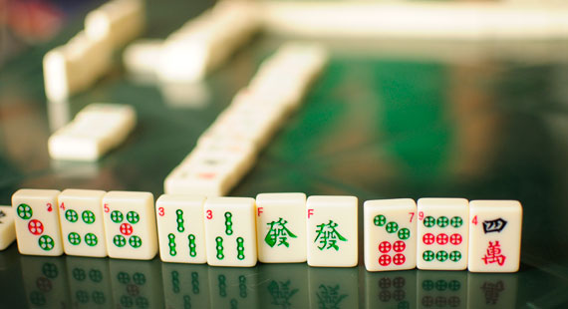
4. 当你受某一习惯捆绑时
When you are under bondage to a personal habit

Slide 16
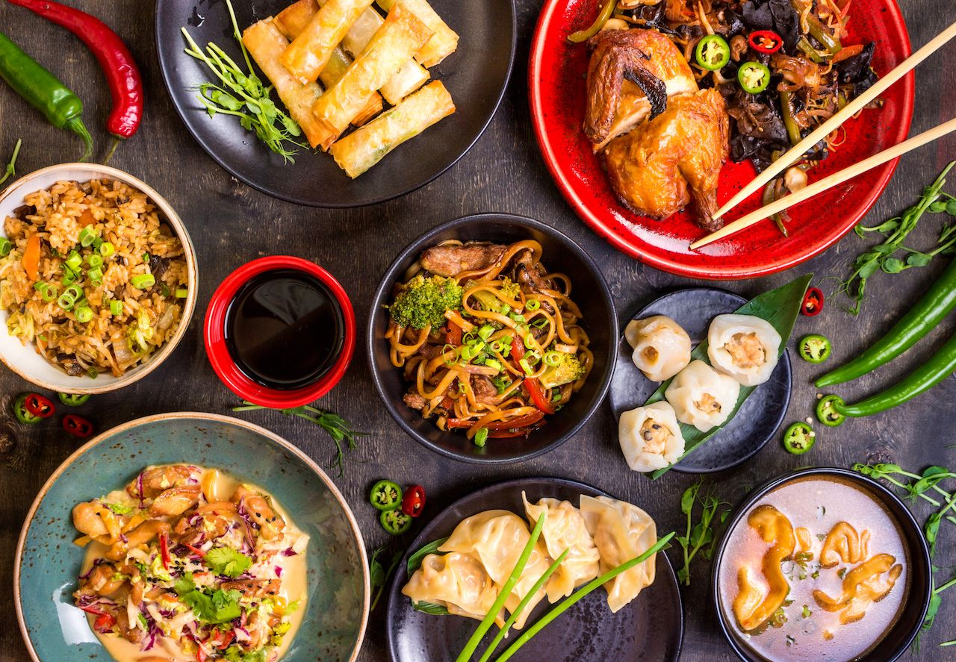
我该禁食什么？
“WHAT should I Fast?”

Slide 17
典型禁食 = (不吃食物)
Typical Fast = No Food

Slide 18
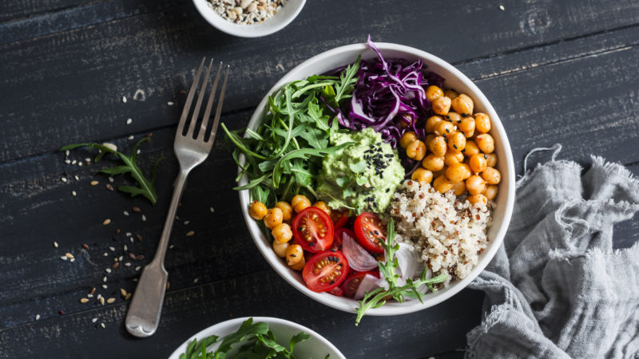
部分禁食 = (某些食物)
Partial Fast = Certain Foods

Slide 19
完全禁食 = (食物 & 水)
Total Fast = Food & Water

Slide 20
禁性 = (性活动)
Sexual Fast = No sexual activity （林前7:5）

Slide 21
或任何其它你决定禁的东西 （电视，花在娱乐和爱好上的时间, 乐趣,浪费时间的事等.）
Or anything else you decide you want to fast
(TV, spending on habits, hobbies, time wasters, etc.)

Slide 22
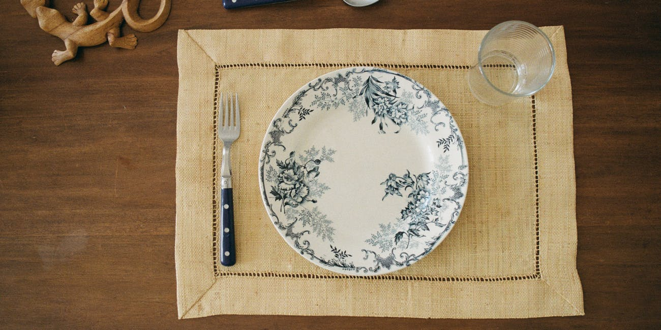
要禁食多长时间?
“How long do I Fast?”

Slide 23
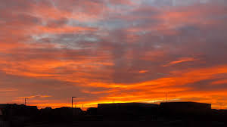
定一个时间.
定一时间 - 天数 - 白天 或夜晚 - 要实际
Set a time: Day(s); Sunup to sundown; Be realistic.

Slide 24
如何禁食？
“HOW do I Fast?”

Slide 25
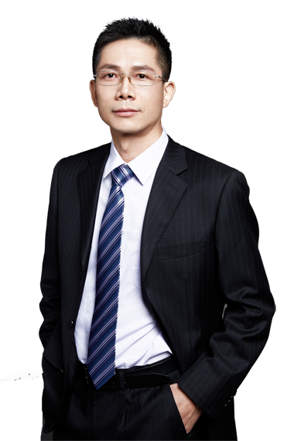
定一时间段
Set a Time Period
不吃食物 只喝水
Refrain from food but not water
花长时间祷告
Spend a lot of time in Prayer
端正与神的关系
Get right with God
阅读《圣经》
Read the Scriptures
祷告明确 而感恩
Pray Specifically & Thankfully
从易开始
Start slow

Slide 26
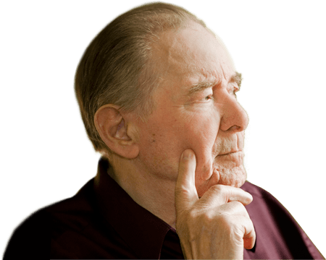
禁食有哪些危险？
“What are the DANGERS in Fasting?”

Slide 27
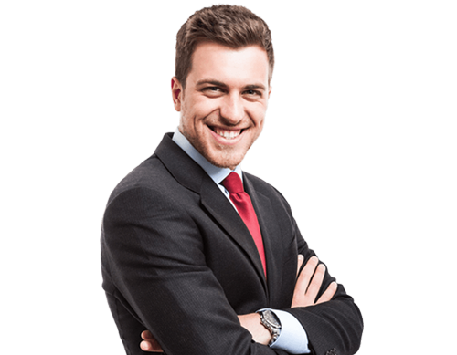
太长
律法主义
假冒为善
专心于事而不是神
Too Long
Legalism
Hypocrisy
Focusing on things
other than God

Slide 28
“你禁食的时候，要梳头洗脸， 不叫人看出你禁食来，只叫你暗中的父看见；你父在暗中察看，必然报答你。太6:17-18”
“But when you fast, comb your hair and wash your face. Then no one will notice that you are fasting, except your Father, who knows what you do in private. And your Father, who sees everything, will reward you.” (Matthew 6:17-18 NLT)

