Slide 1
路得记
1

Slide 3
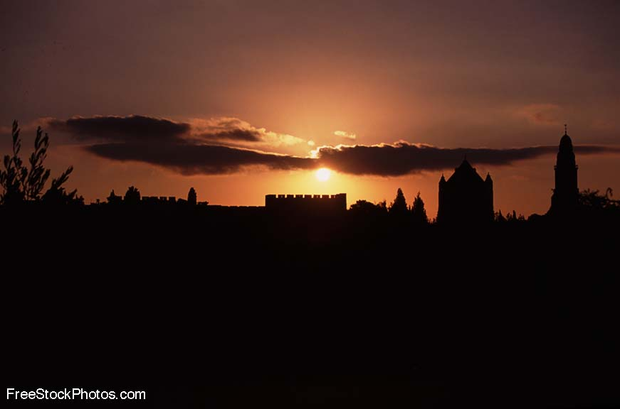
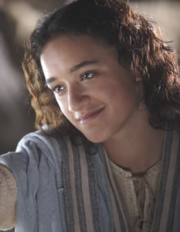
神看不见的手
《路得记》

Slide 4
日期 Date | 经文 Verses | 标题 Title
3月31 3/31 | 所有 ALL | 神看不见的手（导语） God’s Invisible Hand (Introduction)
4月7日 4/7 | 1:1-5 | 神看不见的手在患难中 God’s Invisible Hand in Suffering
4月14日 4/14 | 1:6-22 | 神看不见的手在各关系中 God’s Invisible Hand in Relationships
4月21日 4/20 | 2:1-23 | 神看不见的手在各天职中 God’s Invisible Hand in Vocations
4月28日 4/27 | 3:1-18 | 神看不见的手在婚姻中 God’s Invisible Hand in Marriage
5月5日 5/5 | 4:1-12 | 神看不见的手在救赎中 God’s Invisible Hand in Redemption
5月12日 5/12 | 4:13-22 | 神看不见的手在历史中 God’s Invisible Hand in History
神看不见的手

Slide 5
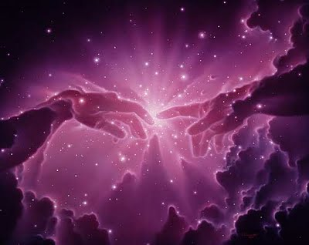
介绍 (Introduction)
神看不见的手 (God’s Invisible Hand)

Slide 6
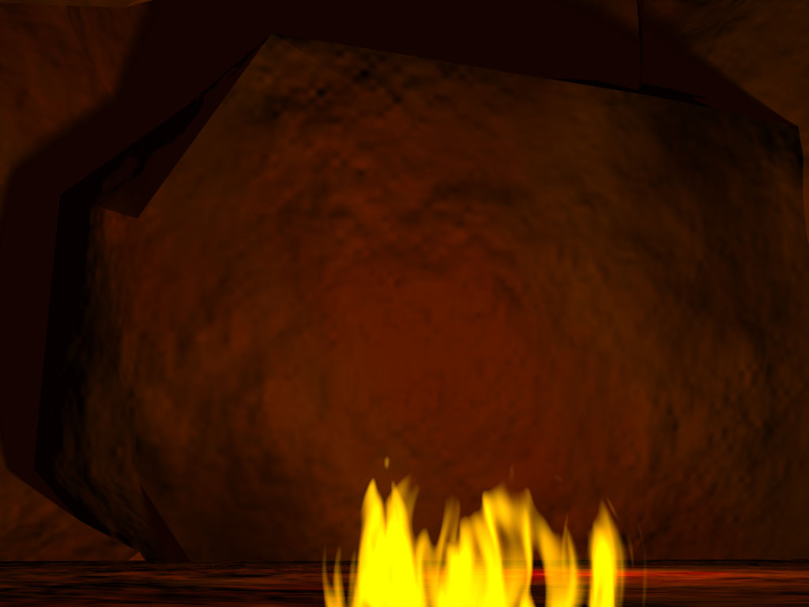
在《路得记》里, 神被提了23次,
他才是历史的真正英雄。
In Ruth, God is mentioned 23 times. He is the real hero of this story.
《路得记》集爱情故事，悲剧和神学于一体。
Ruth is a love story, a tragedy and a theology book all in one.
该书将会告诉我们神在历史,自然灾害, 每个国家, 甚至我们每个人的日常生活都有亲密的介入。
The Book will show us that God is intimately involved with history, natural disasters, every nation, and even each one of our own personal daily lives.
在我们阅读时，我们将清晰地看到神不能看见的手。（我们疑惑的事情为什么这么发生，过后就看到原来神有目的）。
As we read it, we will look specifically for God’s invisible hand (The times we wonder why things happen and later see that God has a purpose all along)

Slide 7
查经四步法 The 4 Steps of Bible Study
阅读 (READ)
应用 (APPLY)
观察 (OBSERVE)
解释 (INTERPRET)

Slide 8
查经四步法 The 4 Steps of Bible Study
阅读 (READ)
应用 (APPLY)
观察 (OBSERVE)
解释 (INTERPRET)
有多少人这周阅读了
《路得记》?
我们待会一起来
阅读《路得记》。

Slide 9
当士师秉政的时候，国中遭遇饥荒。在犹大的伯利恒，有一个人带着妻子和两个儿子往摩押地去寄居。这人名叫以利米勒，他的妻名叫拿俄米；他两个儿子，一个名叫玛伦，一个名叫基连，都是犹大伯利恒的以法他人。他们到了摩押地，就住在那里。
¹ In the days when the judges ruled, there was a famine in the land. So a man from Bethlehem in Judah, together with his wife and two sons, went to live for a while in the country of Moab. ² The man’s name
was Elimelek, his wife’s name was Naomi, and the names of his two sons were Mahlon and Kilion.
They were Ephrathites from Bethlehem, Judah. And they went to Moab and lived there.

Slide 10
后来拿俄米的丈夫以利米勒死了，剩下妇人和他两个儿子。这两个儿子娶了摩押女子为妻，一个名叫俄珥巴，一个名叫路得 ，在那里住了约有十年。玛伦和基连二人也死了，剩下拿俄米，没有丈夫，也没有儿子。
³ Now Elimelek, Naomi’s husband, died, and she was left with her two sons.
⁴ They married Moabite women, one named Orpah and the other Ruth.
After they had lived there about ten years, ⁵ both Mahlon and Kilion also died,
and Naomi was left without her two sons and her husband.

Slide 11
她就与两个儿妇起身，要从摩押地归回；因为她在摩押地听见耶和华眷顾自己的百姓，赐粮食与他们。于是她和两个儿妇起行离开所住的地方，要回犹大地去。
⁶ When Naomi heard in Moab that the LORD had come to the aid of his people by providing food for them, she and her daughters-in-law prepared to return home from there. ⁷ With her two daughters-in-law she left the place where she had been living and
set out on the road that would take them back to the land of Judah.

Slide 12
拿俄米对两个儿妇说: “你们各人回娘家去吧。愿耶和华恩待你们，像你们恩待已死的人与我一样!愿耶和华使你们各在新夫家中得 平安！”于是拿俄米与他们亲嘴。他们就放声而哭,说： “不然，我们必与你一同回你本国去。”
⁸ Then Naomi said to her two daughters-in-law, “Go back, each of you, to your mother’s home.
May the LORD show you kindness, as you have shown kindness to your dead husbands and to me.
⁹ May the LORD grant that each of you will find rest in the home of another husband.” Then she kissed them goodbye and they wept aloud ¹⁰ and said to her, “We will go back with you to your people.”

Slide 13
拿俄米说： “我女儿们哪，回去吧！为何要跟我去呢﹖我还能生子作你们的丈夫吗﹖我女儿们哪，回去吧！我年纪老迈，不能再有丈夫；
¹¹ But Naomi said, “Return home, my daughters. Why would you come with me? Am I going to have any more sons, who could become your husbands?
¹² Return home, my daughters; I am too old to have another husband.

Slide 14
即或说我还有指望，今夜有丈夫可以生子，你们岂能等着他们长大呢﹖你们岂能等着他们不嫁别人呢﹖我女儿们哪，不要这样。我为你们的缘故甚是愁苦，因为耶和华伸手攻击我。”
Even if I thought there was still hope for me—even if I had a husband tonight
and then gave birth to sons— ¹³ would you wait until they grew up?
Would you remain unmarried for them? No, my daughters. It is more bitter for me
than for you, because the LORD’s hand has turned against me!”

Slide 15
两个儿妇又放声而哭，俄珥巴与婆婆亲嘴而别，只是路得舍不得拿俄米。拿俄米说:“看哪，你嫂子已经回她本国和她所拜的神那里去了，你也跟着你嫂子回去吧！”
¹⁴ At this they wept aloud again. Then Orpah kissed her mother-in-law goodbye, but Ruth clung to her. ¹⁵ “Look,” said Naomi, “your sister-in-law is going back to her people and her gods. Go back with her.”

Slide 16
路得 说:“不要催我回去不跟随你。你往哪里去，我也往那里去；你在哪里住宿，我也在那里住宿；你的国就是我的国，你的神就是我的神。你在哪里死，我也在那里死，也葬在那里。除非死能使你我相离！不然，愿耶和华重重地降罚与我。”拿俄米见路得 定意要跟随自己去，就不再劝他了。
¹⁶ But Ruth replied, “Don’t urge me to leave you or to turn back from you. Where you go I will go,
and where you stay I will stay. Your people will be my people and your God my God.
¹⁷ Where you die I will die, and there I will be buried. May the LORD deal with me,
be it ever so severely, if even death separates you and me.”
⁸ When Naomi realized that Ruth was determined to go with her, she stopped urging her.

Slide 17
于是二人同行，来到伯利恒。他们到了伯利恒，合城的人就都惊讶。妇女们说：“这是拿俄米吗﹖”
¹⁹ So the two women went on until they came to Bethlehem.
When they arrived in Bethlehem, the whole town was stirred because
of them, and the women exclaimed, “Can this be Naomi?”

Slide 18
拿俄米对她们说：“不要叫我拿俄米（就是甜的意思），要叫我玛拉（就是苦的意思），因为全能者使我受了大苦。我满满地出去，耶和华使我空空地回来。耶和华降祸与我，全能者使我受苦。既是这样，你们为何还叫我拿俄米呢﹖”
²⁰ “Don’t call me Naomi,” she told them. “Call me Mara, because the Almighty has made my life very bitter. ²¹ I went away full, but the LORD has brought me back empty. Why call me Naomi? The LORD has afflicted me; the Almighty has brought misfortune upon me.”

Slide 19
拿俄米和她儿妇摩押女子路得 ，从摩押地回来到伯利恒，正是动手割大麦的时候。
²² So Naomi returned from Moab accompanied by Ruth the Moabite,
her daughter-in-law, arriving in Bethlehem as the barley
harvest was beginning.

Slide 20
拿俄米的丈夫以利米勒的亲族中， 有一个人名叫波阿斯，是个大财主。摩押女子路得 对拿俄米说：“容我往田间去，我蒙谁的恩，就在谁的身后拾取麦穗。”
¹ Now Naomi had a relative on her husband’s side, a man of standing from
the clan of Elimelek, whose name was Boaz. ² And Ruth the Moabite said
to Naomi, “Let me go to the fields and pick up the leftover grain behind
anyone in whose eyes I find favor.”

Slide 21
拿俄米说：“女儿啊，你只管去。”路得 就去了，来到田间，在收割的人身后拾取麦穗。他恰巧到了以利米勒本族的人波阿斯那块田里。
Naomi said to her, “Go ahead, my daughter.” ³ So she went out, entered a field and began to glean behind the harvesters. As it turned out, she was working in a field belonging to Boaz, who was from the clan of Elimelek.

Slide 22
波阿斯正从伯利恒来，对收割的人说：“愿耶和华与你们同在！”他们回答说：“愿耶和华赐福与你！”波阿斯问监管收割的仆人说：“那是谁家的女子﹖”
⁴ Just then Boaz arrived from Bethlehem and greeted the harvesters,
“The LORD be with you!” “The LORD bless you!” they answered. ⁵ Boaz asked
the overseer of his harvesters, “Who does that young woman belong to?”

Slide 23
监管收割的仆人回答说：“是那摩押女子，跟随拿俄米从摩押地回来的。 她说：‘请你容我跟着收割的人拾取打捆剩下的麦穗。’她从早晨直到如今，除了在屋子里坐一会儿，常在这里。”
⁶ The overseer replied, “She is the Moabite who came back from Moab with Naomi.
⁷ She said, ‘Please let me glean and gather among the sheaves behind the harvesters.
She came into the field and has remained here from morning till now,
except for a short rest in the shelter.”

Slide 24
波阿斯对路得 说：“女儿啊，听我说，不要往别人田里拾取麦穗，也不要离开这里，要常与我使女们在一处。 我的仆人在那块田收割，你就跟着他们去。我已经吩咐仆人不可欺负你；你若渴了，就可以到器皿那里喝仆人打来的水。”
⁸ So Boaz said to Ruth, “My daughter, listen to me. Don’t go and glean in another field and don’t go
away from here. Stay here with the women who work for me. ⁹ Watch the field where the men are harvesting, and follow along after the women. I have told the men not to lay a hand on you.
And whenever you are thirsty, go and get a drink from the water jars the men have filled.”

Slide 25
路得 就俯伏在地叩拜，对他说：“我既是外邦人，怎么蒙你的恩，这样顾恤我呢﹖ ” 波阿斯回答说：“自从你丈夫死后，凡你向婆婆所行的，并你离开父母和本地，到素不认识的民中，这些事人全都告诉我了。”
¹⁰ At this, she bowed down with her face to the ground. She asked him, “Why have I found such favor
in your eyes that you notice me—a foreigner?” ¹¹ Boaz replied, “I’ve been told all about what you
have done for your mother-in-law since the death of your husband—how you left your father and
mother and your homeland and came to live with a people you did not know before.

Slide 26
愿耶和华照你所行的赏赐你。你来投靠耶和华─以色列神的翅膀下，愿你满得他的赏赐。路得说：“我主啊，愿在你眼前蒙恩。我虽然不及你的一个使女，你还用慈爱的话安慰我的心。”
¹² May the LORD repay you for what you have done. May you be richly rewarded by the LORD, the God of Israel, under whose wings you have come to take refuge.” ¹³ “May I continue to
find favor in your eyes, my lord,” she said. “You have put me at ease by speaking kindly
to your servant—though I do not have the standing of one of your servants.”

Slide 27
到了吃饭的时候，波阿斯对路得 说：“你到这里来吃饼，将饼蘸在醋里。”路得 就在收割的人旁边坐下；他们把烘了的穗子递给她。她吃饱了，还有余剩的。
¹⁴ At mealtime Boaz said to her, “Come over here. Have some bread and dip it
in the wine vinegar.” When she sat down with the harvesters, he offered her
some roasted grain. She ate all she wanted and had some left over.

Slide 28
她起来又拾取麦穗，波阿斯吩咐仆人说：“她就是在捆中拾取麦穗，也可以容她，不可羞辱她；并要从捆里抽出些来，留在地下任她拾取，不可叱吓她。”
¹⁵ As she got up to glean, Boaz gave orders to his men, “Let her gather among
the sheaves and don’t reprimand her. ¹⁶ Even pull out some stalks for her
from the bundles and leave them for her to pick up, and don’t rebuke her.”

Slide 29
这样，路得 在田间拾取麦穗，直到晚上，将所拾取的打了，约有一伊法大麦。 她就把所拾取的带进城去给婆婆看，又把她吃饱了所剩的给了婆婆。
¹⁷ So Ruth gleaned in the field until evening. Then she threshed the barley she
had gathered, and it amounted to about an ephah.¹⁸ She carried it back to town,
and her mother-in-law saw how much she had gathered. Ruth also brought
out and gave her what she had left over after she had eaten enough.

Slide 30
婆婆问她说：“你今日在哪里拾取麦穗，在哪里作工呢﹖愿那顾恤你的得 福。”路得 就告诉婆婆说：“我今日在一个名叫波阿斯的人那里作工。”
¹⁹ Her mother-in-law asked her, “Where did you glean today? Where did you work? Blessed be the man who took notice of you!” Then Ruth told her mother-in-law
about the one at whose place she had been working.
“The name of the man I worked with today is Boaz,” she said.

Slide 31
拿俄米对儿妇说：“愿那人蒙耶和华赐福，因为他不断地恩待活人死人。”拿俄米又说：“那是我们本族的人，是一个至近的亲属。”摩押女子路得 说：“他对我说：你要紧随我的仆人拾取麦穗，直等他们收完了我的庄稼。”
²⁰ “The LORD bless him!” Naomi said to her daughter-in-law. “He has not stopped showing his kindness to the living and the dead.” She added, “That man is our close relative; he is one of our guardian-redeemers.^{” 21} Then Ruth the Moabite said,
“He even said to me, ‘Stay with my workers until they finish harvesting all my grain.

Slide 32
拿俄米对儿妇路得 说：“女儿啊，你跟着他的使女出去，不叫人遇见你在别人田间，这才为好。” 于是路得 与波阿斯的使女常在一处 拾取麦穗，直到收完了大麦和小麦。路得仍与婆婆同住。
²² Naomi said to Ruth her daughter-in-law, “It will be good for you, my daughter, to go with the women who work for him, because in someone else’s field you might be harmed.”
²³ So Ruth stayed close to the women of Boaz to glean until the barley and wheat harvests were finished. And she lived with her mother-in-law.

Slide 33
路得 的婆婆拿俄米对她说：“女儿啊，我不当为你找个安身之处，使你享福吗﹖ 你与波阿斯的使女常在一处，波阿斯不是我们的亲族吗﹖他今夜在场上簸大麦；你要沐浴抹膏，换上衣服，下到场上，却不要使那人认出你来。你等他吃喝完了，
¹ One day Ruth’s mother-in-law Naomi said to her, “My daughter, I must find a home for you,
where you will be well provided for. ² Now Boaz, with whose women you have worked, is a
relative of ours. Tonight he will be winnowing barley on the threshing floor. ³ Wash, put on perfume,
and get dressed in your best clothes. Then go down to the threshing floor, but don’t let him know
you are there until he has finished eating and drinking.

Slide 34
到他睡的时候，你看准他睡的地方，就进去掀开他脚上的被，躺卧在那里，他必告诉你所当作的事。” 路得 说：“凡你所吩咐的，我必遵行。”路得 就下到场上，照她婆婆所吩咐她的而行。
⁴ When he lies down, note the place where he is lying. Then go and uncover his feet
and lie down. He will tell you what to do.” ⁵ “I will do whatever you say,”
Ruth answered. ⁶ So she went down to the threshing floor and
did everything her mother-in-law told her to do.

Slide 35
波阿斯吃喝完了，心里欢畅，就去睡在麦堆旁边。路得 便悄悄地来掀开他脚上的被，躺卧在那里。 到了夜半，那人忽然惊醒，翻过身来，不料有女子躺在他的脚下。
⁷ When Boaz had finished eating and drinking and was in good spirits, he went over
to lie down at the far end of the grain pile. Ruth approached quietly, uncovered his feet and lay down. ⁸ In the middle of the night something startled the man;
he turned—and there was a woman lying at his feet!

Slide 36
他就说：“你是谁﹖”回答说：“我是你的婢女路得 。求你用你的衣襟遮盖我，因为你是我一个至近的亲属。”
⁹ “Who are you?” he asked. “I am your servant Ruth,” she said.
“Spread the corner of your garment over me, since you
are a guardian-redeemer of our family.”

Slide 37
波阿斯说：“女儿啊，愿你蒙耶和华赐福。你末后的恩比先前更大；因为少年人无论贫富，你都没有跟从。女儿啊，现在不要惧怕，凡你所说的，我必照着行；我本城的人都知道你是个贤德的女子。我实在是你一个至近的亲属，只是还有一个人比我更近。
¹⁰ “The LORD bless you, my daughter,” he replied. “This kindness is greater than that which you
showed earlier: You have not run after the younger men, whether rich or poor.
¹¹ And now, my daughter, don’t be afraid. I will do for you all you ask. All the people of my town
know that you are a woman of noble character. ¹² Although it is true that I am a guardian-redeemer
of our family, there is another who is more closely related than I.

Slide 38
你今夜在这里住宿，明早他若肯为你尽亲属的本分，就由他吧！倘若不肯，我指着永生的耶和华起誓，我必为你尽了本分，你只管躺到天亮。”路得 便在他脚下躺到天快亮，人彼此不能辨认的时候就起来了。波阿斯说：“不可使人知道有女子到场上来。”
¹³ Stay here for the night, and in the morning if he wants to do his duty as your guardian-redeemer, good; let him redeem you. But if he is not willing, as surely as the LORD lives I will do it.
Lie here until morning.” ¹⁴ So she lay at his feet until morning, but got up before anyone could be recognized; and he said, “No one must know that a woman came to the threshing floor.”

Slide 39
又对路得 说：“打开你所披的外衣。”她打开了，波阿斯就撮了六簸箕大麦，帮她扛在肩上，她便进城去了。路得 回到婆婆那里，婆婆说：“女儿啊，怎么样了﹖”
¹⁵ He also said, “Bring me the shawl you are wearing and hold it out.”
When she did so, he poured into it six measures of barley and placed the
bundle on her. Then he went back to town. ¹⁶ When Ruth came to her
mother-in-law, Naomi asked, “How did it go, my daughter?”

Slide 40
路得 就将那人向他所行的述说了一遍，又说：“那人给了我六簸箕大麦，对我说：你不可空手回去见 你的婆婆。”婆婆说：“女儿啊，你只管安坐等候，看这事怎样成就，因为那人今日不办成这事必不休息。”
Then she told her everything Boaz had done for her ¹⁷ and added, “He gave me these
six measures of barley, saying, ‘Don’t go back to your mother-in-law empty-handed.’”
¹⁸ Then Naomi said, “Wait, my daughter, until you find out what happens.
For the man will not rest until the matter is settled today.”

Slide 41
波阿斯到了城门，坐在那里，恰巧波阿斯所说的那至近的亲属经过。波阿斯说：“某人哪，你来坐在这里。”他就来坐下。 波阿斯又从本城的长老中拣选了十人，对他们说：“请你们坐在这里。”他们就都坐下。 波阿斯对那至近的亲属说：“从摩押地回来的拿俄米，现在要卖我们族兄以利米勒的那块地；
¹ Meanwhile Boaz went up to the town gate and sat down there just as the guardian-redeemer
he had mentioned came along. Boaz said, “Come over here, my friend, and sit down.”
So he went over and sat down. ² Boaz took ten of the elders of the town and said,
“Sit here,” and they did so. ³ Then he said to the guardian-redeemer, “Naomi, who has come back from Moab, is selling the piece of land that belonged to our relative Elimelek.

Slide 42
我想当赎那块地的是你，其次是我，以外再没有别人了。你可以在这里的人面前和我本国的长老面前说明，你若肯赎就赎，若不肯赎就告诉我。”那人回答说：“我肯赎。”
⁴ I thought I should bring the matter to your attention and suggest that you buy it in the presence of these seated here and in the presence of the elders of my people.
If you will redeem it, do so. But if you will not, tell me, so I will know. For no one has the right to do it except you, and I am next in line.” “I will redeem it,” he said.

Slide 43
波阿斯说：“你从拿俄米手中买这地的时候，也当娶（原文是买；10节同）死人的妻摩押女子路得 ，使死人在产业上存留他的名。” 那人说：“这样我就不能赎了，恐怕于我的产业有碍。你可以赎我所当赎的，我不能赎了。”
⁵ Then Boaz said, “On the day you buy the land from Naomi, you also acquire Ruth
the Moabite, the dead man’s widow, in order to maintain the name of the dead with
his property.” ⁶ At this, the guardian-redeemer said, “Then I cannot redeem it because
I might endanger my own estate. You redeem it yourself. I cannot do it.”

Slide 44
从前，在以色列中要定夺什么事，或赎回，或交易，这人就脱鞋给那人。以色列人都以此为证据。 那人对波阿斯说：“你自己买吧！”于是将鞋脱下来了。
⁷ (Now in earlier times in Israel, for the redemption and transfer of property to become final, one party took off his sandal and gave it to the other. This was the method of legalizing transactions in Israel.) ⁸ So the guardian-redeemer said to Boaz,
“Buy it yourself.” And he removed his sandal.

Slide 45
波阿斯对长老和众民说：“你们今日作见证，凡属以利米勒和基连、玛伦的，我都从拿俄米手中置买了； 又娶了玛伦的妻摩押女子路得 为妻，好在死人的产业上存留他的名，免得 他的名在本族本乡灭没。你们今日可以作见证。”
⁹ Then Boaz announced to the elders and all the people, “Today you are witnesses that I have bought
from Naomi all the property of Elimelek, Kilion and Mahlon. ¹⁰ I have also acquired Ruth the Moabite, Mahlon’s widow, as my wife, in order to maintain the name of the dead with his property, so that his
name will not disappear from among his family or from his hometown. Today you are witnesses!”

Slide 46
在城门坐着的众民和长老都说：“我们作见证。愿耶和华使进你家的这女子，像建立以色列家的拉结、利亚二人一样。又愿你在以法他得 亨通，在伯利恒得 名声。愿耶和华从这少年女子赐你后裔，使你的家像他玛从犹大所生法勒斯的家一般。”
¹¹ Then the elders and all the people at the gate said, “We are witnesses. May the LORD make the
woman who is coming into your home like Rachel and Leah, who together built up the family of Israel.
May you have standing in Ephrathah and be famous in Bethlehem. ¹² Through the offspring the LORD gives you by this young woman, may your family be like that of Perez, whom Tamar bore to Judah.”

Slide 47
于是，波阿斯娶了路得 为妻，与她同房。耶和华使她怀孕生了一个儿子。妇人们对拿俄米说：“耶和华是应当称颂的！因为今日没有撇下你使你无至近的亲属。愿这孩子在以色列中得 名声。他必提起你的精神，奉养你的老，因为是爱慕你的那儿妇所生的。有这儿妇比有七个儿子还好！”
¹³ So Boaz took Ruth and she became his wife. When he made love to her, the LORD enabled her to conceive, and she gave birth to a son. ¹⁴ The women said to Naomi: “Praise be to the LORD, who this
day has not left you without a guardian-redeemer. May he become famous throughout Israel!
¹⁵ He will renew your life and sustain you in your old age. For your daughter-in-law, who loves you
and who is better to you than seven sons, has given him birth.”

Slide 48
拿俄米就把孩子抱在怀中，作他的养母。 邻舍的妇人说：“拿俄米得 孩子了！”就给孩子起名叫俄备得 。这俄备得 是耶西的父，耶西是大卫的父。
¹⁶ Then Naomi took the child in her arms and cared for him. ¹⁷ The women living there said, “Naomi has a son!” And they named him Obed. He was the father of Jesse, the father of David.

Slide 49
法勒斯的后代记在下面：法勒斯生希斯仑； 希斯仑生兰；兰生亚米拿达； 亚米拿达生拿顺；拿顺生撒门；撒门生波阿斯；波阿斯生俄备得 ； 俄备得 生耶西；耶西生大卫。
¹⁸ This, then, is the family line of Perez: Perez was the father of Hezron,
¹⁹ Hezron the father of Ram, Ram the father of Amminadab, ²⁰ Amminadab the father of Nahshon,
Nahshon the father of Salmon, ²¹ Salmon the father of Boaz, Boaz the father of Obed,
²² Obed the father of Jesse, and Jesse the father of David.

Slide 50
查经四步法 The 4 Steps of Bible Study
阅读 (READ)
应用 (APPLY)
观察 (OBSERVE)
解释 (INTERPRET)

Slide 51
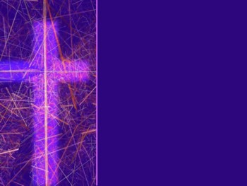
谁 (WHO)
什么 (WHAT)
何时 (WHEN)
哪里 (WHERE)
为何 (WHY)
如何 (HOW)

Slide 52
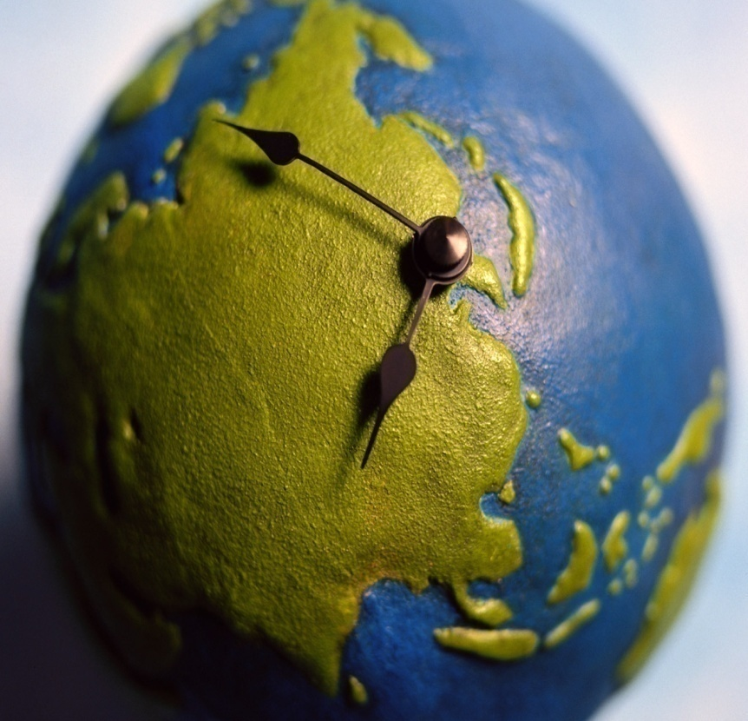
何时 - WHEN?

Slide 53
《路得记》发生在何时？
WHEN did the story of Ruth take place?
摩西时代
Moses
1500 B.C.
师士时代
Judges
1375 B.C.- 1050 B.C.
扫罗王时代
King Saul
1050 B.C.
《路得记》Book of Ruth

Slide 54
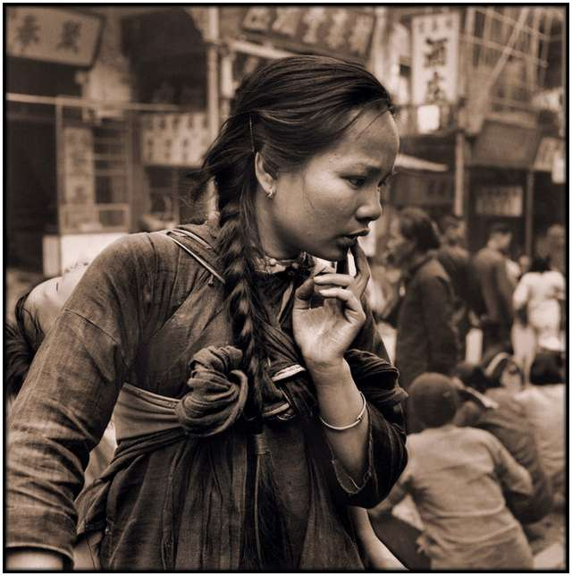
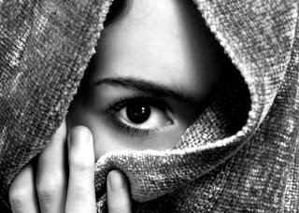
中国当时是什么朝代？
When in China’s timeline did Ruth live?
夏朝
Xia Dynasty (2070–1600 BC)
.
商朝 (殷代)
.
周朝
Zhou Dynasty (1046–256 BC)
Shang (Yin) Dynasty (1600-1046 BC)
.
《路得记》
Book of Ruth

Slide 55
何时: When?
这是以色列历史中最黑暗，最邪恶，最叛逆，最顽固和不幸的时期。
This is one of the most dark, one of the most wicked, rebellious, obstinate, unfortunate periods in all of Israel’s history.
以色列的罪恶循环(犯罪-毁灭-悔改-拯救者-赞美)
Israel’s Sin Cycle (Sin – Destruction – Repent – Deliverer – Praise)
“各人照自己的意思任意而行。”
“Everybody did what was right in their own eyes”
许多人认为该故事发生在师士睚珥秉政之时(士10)
Many think the story happened during the time of Judge Jair (Jud. 10)
发生在神惩罚以色列时（尤其针对伯利恒）。
During one of God’s punishments of Israel (specifically Bethlehem)

Slide 56
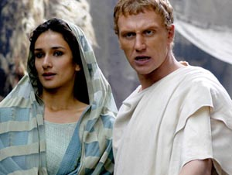
谁? - WHO?

Slide 57
在此系列里,我们将深入查考…
两以色列人 (拿俄米&以利米勒)
2 Israelites (Elimelek & Naomi)
两救赎者 （波阿斯& ???）
2 Redeemers (Boaz & ???)
两儿子 （玛伦&基连）
2 Sons (Mahlon & Kilion)
两阶层 （领导 & 工人）
2 Classes (Leaders & Workers)
两儿媳 （路得&俄珥巴）
2 Daughters (Ruth & Orpah)
两位神 （真神 &基抹神）
2 Gods (TRUE GOD & Chemosh)
两国 （以色列& 摩押）
2 Nations (Israelites & Moabites)
路得许多的后代…
And many descendants of Ruth…
During this series, we will take a deeper look at…

Slide 58
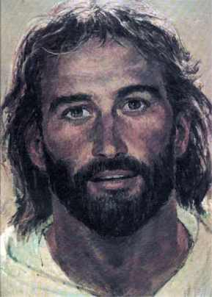
迟些我们将查考...
拉结
Rachael
利亚
Leah
大卫
David
耶西
Jesse
法勒斯
Perez
他玛
Tamar
犹大
Judah
希斯仑
Hezron
兰
Ram
亚米拿达
Aminadab
拿顺
Nahshon
撒门
Salmon
血统从路得一直延续到耶稣
And the ancestral
line from Ruth all
the way to Jesus
Later we will look at…

Slide 59
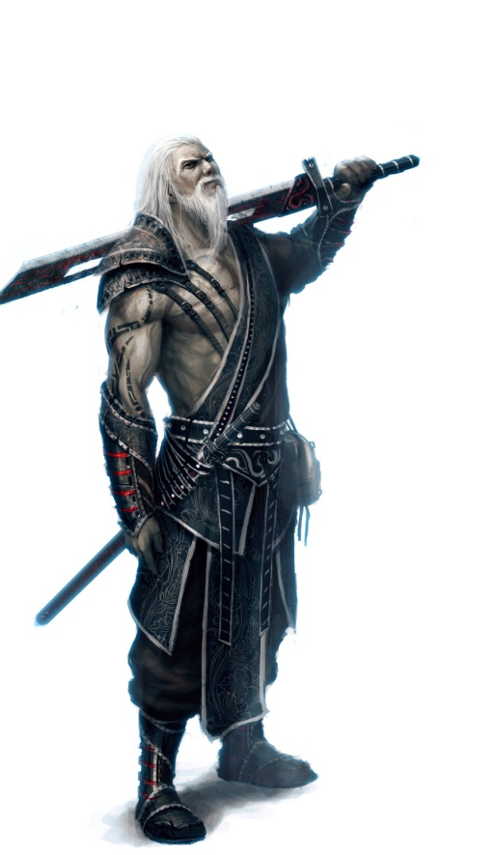
十三位师士: The 13 Judges
(1375 - 1050 B.C.)
俄陀聂: Othniel (3:7-11)
以笏: Ehud (3:12-30)
珊迦: Shamgar (3:31)
底波拉: Deborah (4:1-5:31)
基甸: Gideon (6:1-8:32)
亚比米勒: Abimelech (8:33-9:57)
陀拉: Tola (10:1-2)
睚珥: Jair (10:3-5)
耶弗他: Jephthah (10:6-12:7)
以比赞: Ibzan (12:8-10)
以伦: Elon (12:11-12)
押顿: Abdon (12:13-15)
参孙: Samson (13:1-16:31)

Slide 60
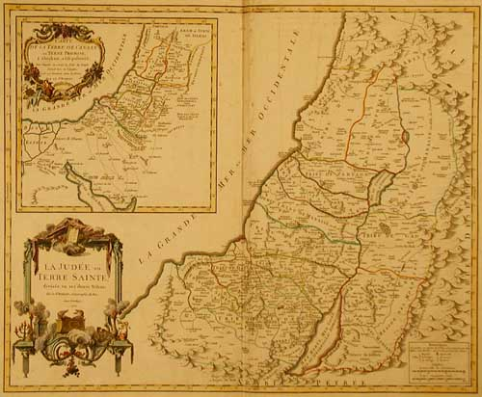
哪里
WHERE?

Slide 61
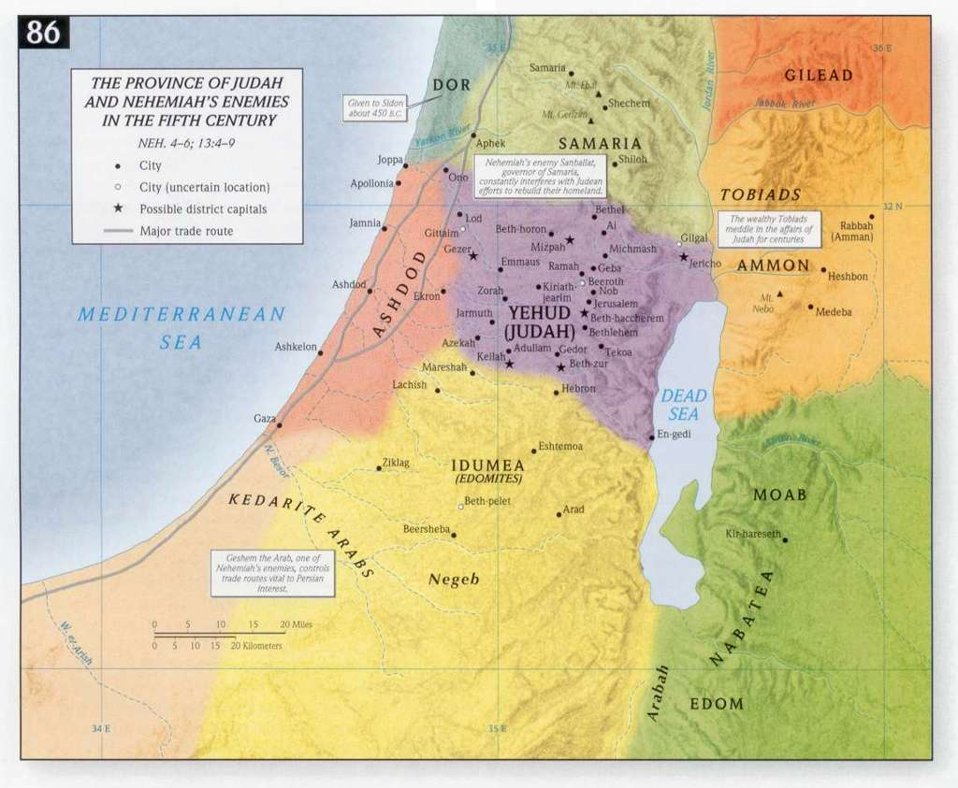
《路得记》发生在哪里？
WHERE did the story of Ruth take place?
以色列: 君王当政之前,约书亚征服之后
ISRAEL: Before kings; Following Joshua’s conquests;
伯利恒: “粮仓”(他们没有粮食)
申11:13-17(神对伯利恒说 “你们若听从诫命,我就赐福.若敬拜别神,我将降饥荒.”)
BETHLEHEM: “The House of Bread”
(they had no more bread)
Deut 11:13-17 (God said to Bethlehem “IF you obey, I will bless you. IF you worship other gods, I will bring famine.”)
路得记
The Book
of RUTH
以色列
ISRAEL
耶路撒冷 (Jerusalem)
伯利恒 (Bethlehem)
摩押 (Moab)
四个关键地方: 4 Key Places

Slide 62
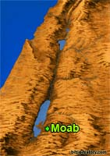
哪里 ? - WHERE?
摩押:坐落在地中海平面910米之上的高原
MOAB is located on a Plateau 3,000’ (910 m) above the level of the Mediterranean Sea
西=死海和约旦河
东=亚扪和阿拉伯沙漠
南=靠近以东
北=亚扪
West = Dead Sea & the Jordan River
East = Ammonites & Arabian desert
South = by Edomites
North = The Ammonites
寒冷; 多雨; 肥沃高原
Cool; much rain; fertile plateau
大概离伯利恒约96公里
About 60 miles (xx K) from Bethlehem

Slide 63
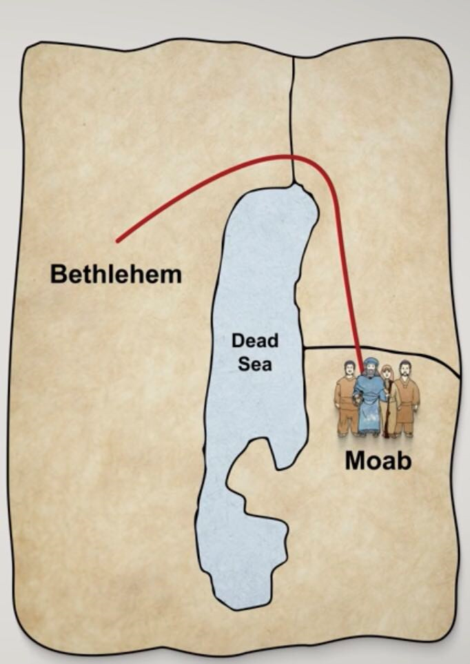
哪里 ? - WHERE?
以利米勒一家四口的
迁徙路线图。
从伯利恒到摩押，
以利米勒带领一家四口先往上向北绕过死海再往南到达摩押。
伯利恒
死
海
摩押

Slide 64
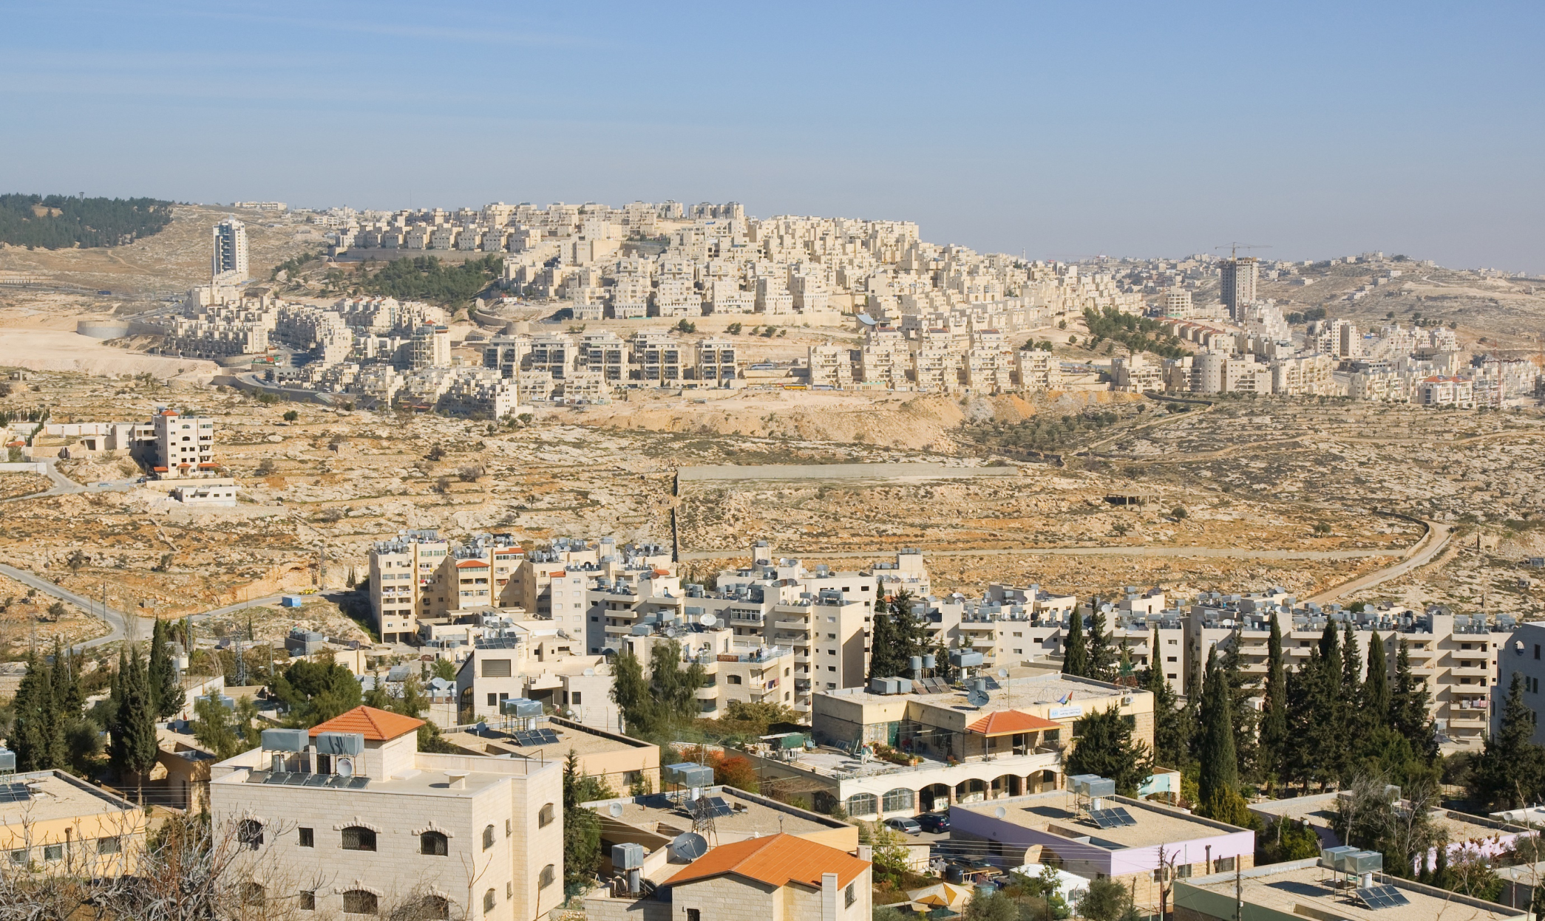
伯利恒的今天

Slide 65
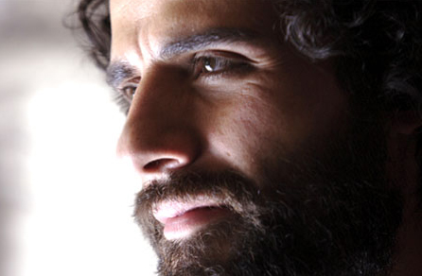
为何? - WHY?

Slide 66
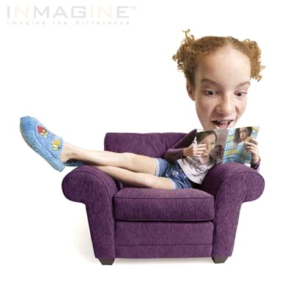
为何? - WHY?
路得的故事是真实的,甚至告诉我们一些耶稣的祖先。
The story of Ruth is a true event that tells us about some of Jesus’ ancestors.
该书告诉神的子民，
他主权之手一直在做工，虽然我们有时不理解为何事情会这样发生。
The book was also written to show God’s people that His sovereign hand is at work even when we cannot seem to understand why things are happening.

Slide 67
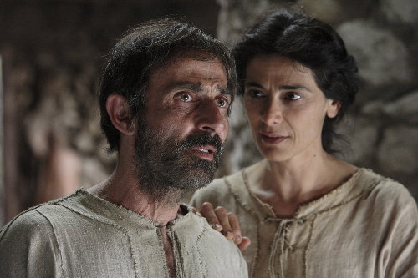
什么? - WHAT?

Slide 68
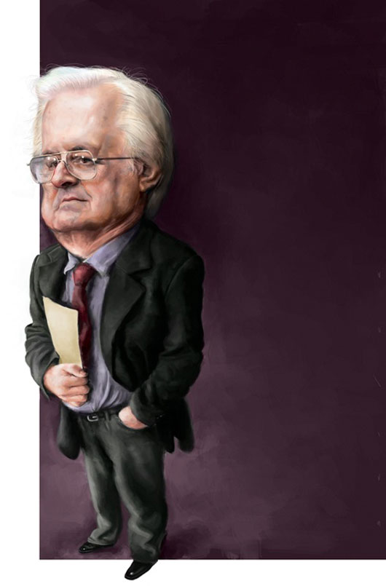
花絮- Trivia
在逾越节期间，犹太人会大声诵读《路得记》。
The Book of Ruth is read aloud by the Jews during Passover
该书53%内容是对话。
53% of the book is dialogue
《路得记》和《以斯帖记》是圣经中唯一以女人名字命名的两卷书。
Ruth and Esther are the only 2 books named after women.

Slide 69
查经四步法 The 4 Steps of Bible Study
阅读 (READ)
应用 (APPLY)
观察 (OBSERVE)
解释 (INTERPRET)

Slide 70
解释 (INTERPRET)
这书绝大部分内容都浅显易懂。
Most of this book is self-explanatory and easy to understand.
这是真实的故事,所提到的人名地名真实确凿。 It is a true story. All people and places mentioned are factual.
在查考过程中, 我将帮助你解释各种词语， 习语和神学暗示。
As we go through the book, I will help you interpret various words, phrases, and theological implications.
我将回答随时出现的问题。
I will try to answer the questions that will come up as we go.
首先，你需要明白一些关键词。
First, you need to understand some key words.

Slide 71
关键词
KEY WORDS

Slide 72
主权- SOVEREIGNTY
神统治和掌管。神无处不在。神是至高至大的权柄。没有什么超越神。神超越撒旦，鬼魔、生、死、天堂、地狱、飞鸟、鱼类和兽类。《箴言》说掷骰子下去，出来的数字都由神选择。他掌控万有，自造天地一直到你每天的决定，他都无所不知。
God rules and reigns. God is over all. God is the one who is the highest ultimate authority. There is no one beyond God. God is over Satan, demons, life, death, heaven, hell, the birds, the fish and the beasts. Proverbs says that even when a die is rolled, that the numbers that come up are chosen by God. He is in control of everything, from creation, all the way down to your every day decisions.
关键词- Key Words

Slide 73
主权- SOVEREIGNTY
但4:35: “世上所有的居民都算为虚无；在天上的万军和世上的居民中，他都凭自己的意旨行事。无人能拦住他手，或问他说，你作什么呢﹖”
Dan 4:35 “And all the inhabitants of the earth are reputed as nothing: and He does according to His will in the army of heaven, and among the inhabitants of the earth: and none can stay His hand, or say unto Him, What are you doing?”
西1:16: “因为万有都是靠他造的，无论是天上的，地上的；能看见的，不能看见的；或是有位的，主治的，执政的，掌权的；一概都是借着他造的，又是为他造的。”
Col 1:16 “For by Him were all things created, that are in heaven, and that are in earth, visible and invisible, whether they are thrones, or dominions, or principalities, or powers: all things were created BY HIM AND FOR HIM.”
经节- Verses

Slide 74
主权- SOVEREIGNTY
弗1:11: “我们也在他里面得（或作：成）了基业；这原是那位随己意行、作万事的，照着他旨意所预定的，”
Eph 1:11 “In whom also we have obtained an inheritance, being predestined according to the purpose of Him who works all things after the counsel of His own will:”
诗篇115:3: “然而，我们的神在天上，都随自己的意旨行事。”
Psalm 115:3 "But our God is in the heavens; He does whatever He pleases."
诗篇135:6: “耶和华在天上,在地下,在海中,在一切的深处,都随自己的意旨而行.”
Psalm 135:6 "Whatever the Lord pleases, He does, In heaven and in earth, in the seas and in all deeps."
经节- Verses

Slide 75
主权- SOVEREIGNTY
赛46:10: “我从起初指明末后的事，从古时言明未成的事，说：我的筹算必立定；凡我所喜悦的，我必成就。”
Isaiah 46:10 "Declaring the end from the beginning and from ancient times things which have not been done, saying, ‘My purpose will be established, and I will accomplish all My good pleasure’;"
罗9:22-23: “倘若神要显明他的忿怒，彰显他的权能，就多多忍耐宽容那可怒预备遭毁灭的器皿， 又要将他丰盛的荣耀彰显在那蒙怜悯早预备得荣耀的器皿上。”
Rom. 9:22-23 "What if God, although willing to demonstrate His wrath and to make His power known, endured with much patience vessels of wrath prepared for destruction? And He did so in order that He might make known the riches of His glory upon vessels of mercy, which He prepared beforehand for glory."
经节- Verses

Slide 76
护理- PROVIDENCE
神看不见的手介入地上的每个生命中。 神在历史中做工可以透过君王，王后， 统治者和列国得到确信和承认。他也在普通人的日常细节中做工，就像拿俄米， 路得和以利米勒以及…我们。神做工既体现在广大领域，也体现在我们的生活细节中。这就是他看不见手的护佑。
God’s Invisible hand is involved in the life of everyone on earth. The belief and acknowledgement that God is at work in human history through kings and queens, rulers and nations and also at work in the everyday details of normal people, like Naomi and Ruth and Elimelech...and us. God is at work in the large areas and the details of our life. That is His invisible hand of providence
关键词- Key Words

Slide 77
护理- PROVIDENCE
“说：耶和华─我们列祖的神啊，你不是天上的神吗﹖你不是万邦万国的主宰吗﹖在你手中有大能大力，无人能抵挡你。”（志下20:6）
“O LORD, God of our fathers, are you not the God who is in heaven? You rule over all the kingdoms of the nations. Power and might are in your hand, and no one can
withstand you.” (2 Chron. 20:6)
签放在怀里，定事由耶和华。（箴16:33）
The lot is cast into the lap, but its every decision is from the LORD. (Prov. 16:33)
希律和本丢彼拉多,外邦人和以色列民,果然在这城里聚集,要攻打你所膏的圣仆(仆：或作子)耶稣, 成就你手和你意旨所预定必有的事.(徒4:27-28)
Herod and Pontius Pilate met together with the Gentiles and the people of Israel in this city to conspire against your holy servant Jesus. They did what your power and will had decided beforehand should happen. (Acts 4:27b-28)
拿俄米
关键词- Verses

Slide 78
护理- PROVIDENCE
“你们如今要知道:我,惟有我是神:在我以外并无别神. 我使人死,我使人活;我损伤,我也医治,并无人能从我手中救出来.”(申32:39)
See now that I, even I, am he, and there is no god beside me; I kill and I make alive; I wound and I heal; and there is none that can deliver out of my hand. (Deut. 32:39)
举例：“约拿书4:6 耶和华神安排一棵蓖麻，使其发生高过约拿, 影儿遮盖他的头,救他脱离苦楚；约拿 因这棵蓖麻大大喜乐.” 神又安排一条虫子摧毁了那蓖麻。约拿通过这事学到了一个功课。
EXAMPLE: “Jonah 4:6 And the LORD God prepared a gourd, and made it to come up over Jonah, that it might be a shadow over his head, to deliver him from his grief. So Jonah was exceeding glad of the gourd.” Then God sent a worm to destroy the gourd. Jonah learned a lesson through the event.
经节- Verses

Slide 79
不变- IMMUTABILITY
神不能改变。他不会改变。他不需改变。他的一切都是完美的。他没有哪一天更好或更糟。神全知。他按他有的信息处理一切，而这是完整而不需改变的。既然他是无可改变的完美，他的决定也总是完美的。他完全信实稳定。神不改变他自己的性情。
God’s Inability to change. He cannot change. He doesn’t need to change. Everything about Him is perfect. He never had a day that was better or worse than another day. God has all knowledge. He deals with everything according to the information He has, which is complete and doesn’t change. Since He is unchangeably perfect, His decisions are always perfect. He is totally faithful and stable. God cannot change His own nature,

Slide 80
不变- IMMUTABILITY
“耶和华的筹算永远立定；他心中的思念万代常存.” 诗33:11
“But the plans of the Lord stand firm forever, the purposes of His heart through all generations.” Psalm 33:11
“因我─耶和华是不改变的.” 玛拉基书3:6
“I am the Lord, I change not." Malachi 3:6
“以色列的大能者必不致说谎,也不致后悔；因为他迥非世人,决不后悔.”（撒上15:29）
“And also the Glory of Israel will not lie or change His mind; for He is not a man that He should change His mind” (1 Samuel 15:29).
“耶稣基督，昨日、今日、一直到永远、是一样的.”（来13:8）
“Jesus Christ is the same yesterday and today, yes and forever” (Heb. 13:8).
经节- Verses

Slide 81
不变- IMMUTABILITY
“各样美善的恩赐和各样全备的赏赐都是从上头来的，从众光之父那里降下来的；在他并没有改变，也没有转动的影儿。”（雅各书1:17）
“Every good thing bestowed and every perfect gift is from above, coming down from the Father of lights, with whom there is no variation, or shifting shadow” (James 1:17).
“神非人，必不致说谎，也非人子，必不致后悔。他说话岂不照着行呢﹖他发言岂不要成就呢﹖” 民数记23:19
“God is not man, that he should lie, or a son of man, that he should change his mind. Has he said, and will he not do it? Or has he spoken, and will he not fulfill it? “ Num. 23:19
“耶和华啊,你的话安定在天,直到永远.”诗篇119:89
“O Lord, your instructions endure; they stand secure in heaven “Psalm 119:89
经节- Verses

Slide 82
普通启示: GENERAL REVELATION
神 “看得见之手”可以在神的创造之工，神迹和自然灾难中看到。
God’s ‘visible hand’ can be seen in God’s work of creation, miracles & natural disasters.
创造: 通过观看所有神所造，我们知道有一位造物主。我们会钦佩他的手工，感谢他的创造。
Creation: By looking at all that is created, we know there is a Creator. We can admire His handiwork and appreciate Him for what He has made.
神迹: 当人们看到红海开了,人们得医治，童女怀孕, 火焰从天而降，我们看见神能行一切。
Miracles: When people see the Red Sea part, people healed, a virgin birth, fire falling from heaven, etc. , we see that God can do whatever He pleases to do.
自然灾难: 圣经说每一风暴, 雷霆闪电, 雨点，飓风，火山，洪水，饥荒，海啸，地震等都是神的作为，而不是魔鬼的作为。
Natural Disasters: The Scriptures teach that every storm, lightning bolt, drop of rain, hurricane, volcano, flood, famine, tsunami, earthquake, etc are “acts of God’, not acts of the devil.

Slide 83
普通启示: GENERAL REVELATION
罗1:18-20: “原来，神的忿怒从天上显明在一切不虔不义的人身上，就是那些行不义阻挡真理的人。 神的事情，人所能知道的，原显明在人心里，因为神已经给他们显明。 自从造天地以来，神的永能和神性是明明可知的，虽是眼不能见，但借着所造之物就可以晓得，叫人无可推诿。”
Rom. 1:18-20, “For the wrath of God is revealed from heaven against all ungodliness and unrighteousness of men, who suppress the truth in unrighteousness, 19 because that which is known about God is evident within them; for God made it evident to them. 20 For since the creation of the world His invisible attributes, His eternal power and divine nature, have been clearly seen, being understood through what has been made, so that they are without excuse.”
经节- Verses

Slide 84
普通启示: GENERAL REVELATION
阿摩司3:6-7 :“城中若吹角,百姓岂不惊恐呢?灾祸若临到一城,岂非耶和华所降的吗? 主耶和华若不将奥秘指示他的仆人─众先知,就一无所行.”
Amos 3:6-7 "If a trumpet is blown in a city will not the people tremble? If a calamity occurs in a city has not the Lord done it?"
哀3:37-38 :”除非主命定,谁能说成就成呢? 祸福不都出于至高者的口吗?”
Lam. 3:37-38 "Who is there who speaks and it comes to pass, unless the Lord has commanded it? Is it not from the mouth of the Most High that both good and ill go forth?"
诗篇19:1 “诸天述说神的荣耀;穹苍传扬他的手段.”
Psalm 19:1 ”The heavens declare the glory of God;
the skies proclaim the work of his hands.”
经文- Verses

Slide 85
特殊启示: SPECIAL REVELATION
神通过圣经和蔼地向我们启示了很多关于他自己。他在数个国家里挑选了四十位不同职业的作者，以三种语言，花了1500年著述了一系列书信来启示我们有关他的性情，他的计划和我们对他的需要。尽管《圣经》并没有告诉我们所有一切，但却告诉了我们如何讨神喜悦及如何与他度永生的一切知识。
God has graciously revealed many things about Himself to us by giving us the written Word. He 40+ men from several nations, multiple occupations, three languages, and took over 1500 years to write the collection of books and letters that reveal to us His nature, His plan and our need for Him. Although the Bible does not tell us everything, it does tell us everything we need to know to please God and live eternally with Him.
关键词- Key Words

Slide 86
特殊启示: SPECIAL REVELATION
“圣经都是神所默示的（或作：凡神所默示的圣经），于教训、督责、使人归正、教导人学义都是有益的， 叫属神的人得以 完全，预备行各样的善事。”提后3:16-17
“All Scripture is God-breathed and is useful for teaching, rebuking, correcting and training in righteousness, so that the servant of God may be thoroughly equipped for every good work. “ 2 Timothy 3:16-17
“我们并有先知更确的预言，如同灯照在暗处。你们在这预言上留意，直等到天发亮，晨星在你们心里出现的时候，才是好的。 1: 20 第一要紧的，该知道经上所有的预言没有可随私意解说的； 1: 21 因为预言从来没有出于人意的，乃是人被圣灵感动，说出神的话来。”彼后1:19-21
“We also have the prophetic message as something completely reliable, and you will do well to pay attention to it, as to a light shining in a dark place, until the day dawns and the morning star rises in your hearts. Above all, you must understand that no prophecy of Scripture came about by the prophet’s own interpretation of things. For prophecy never had its origin in the human will, but prophets, though human, spoke from God as they were carried along by the Holy Spirit.”
2 Peter 1:19-21
经节- Verses

Slide 87
神的性情- GOD’S NATURE
神是圣洁的。神是完美的。神是美好的。神是与我们“分别开”和永不相同的。神行凡事都有意图。当他行创造，行赏赐、行惩罚，行毁灭，为了永恒的缘故，他每一刻行怜悯，发烈怒都是对的。每一个决定都是完美，正确和好的。
God is holy. God is perfect. God is good. God is ‘set apart’ and eternally different from us. Everything God does has a purpose. He is doing what is right when He creates, when He rewards, when He punishes, when He destroys, when He shows mercy, when He shows wrath and at every second for eternity, every decision is perfect, right and good.
申命记32:4“他是盘石，他的作为完全；他所行的无不公平，是诚实无伪的神，又公义，又正直。”
Deuteronomy 32:4 “He is the Rock, His works are perfect, and all His ways are just. A faithful God Who does no wrong, upright and just is He.”
关键词- Key Words

Slide 88
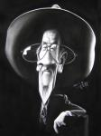
《路得记》中的六大关键词
神是主权至高的。他掌控万有。
God is Sovereign. He is in control of everything.
神在每个历史时期对每个人都有一个计划。
God has a plan for every person in every period of history.
神的性情乃为慈爱，良善和完美。
God’s nature is loving, good, and perfect.
神恒常不变。他不能改变。
God is immutable. He cannot change.
神行赏罚作为慈爱完美的一种表现。
God rewards and punishes as an act of loving perfection.
我能相信神永远会行对我最好的事。
I can trust God to always do what is best for me.
6 Key Lessons from the Book of Ruth

Slide 89
今日 问题- Today’s Question
如果神掌权，他为何允许人犯罪？他难道就不能毁灭邪恶，只允许他喜悦的事存在吗？若神是主权至高的，那不就意味着所有事（甚至邪恶）的发生都是神的意志吗？
If God is in control, why does He allow sin? Can’t He just destroy evil and allow only what pleases Him? If God is sovereign, doesn’t that mean that everything that happens (even evil) is God’s Will?”
EXAMPLE: 一名妇女被强奸。她对她的牧师说:“马克牧师，我被强奸了。我有一个问题要问你。”牧师说:“那是什么?”她说，“上帝为什么要强奸我?” 牧师说:“上帝不会强奸人。上帝是慈爱的父亲，祂不是强奸犯。上帝不会坐在天堂里宣布强奸、虐待儿童或杀害无辜者合法。神是至高的，是良善的。”她说，“如果上帝是至高无上的，那不就意味着发生的一切都是上帝的意志吗?”
“不。很多事都不是神的意志。我们管它们叫罪”
“No. There are many things that are not God’s Will. We call them sin.”

Slide 90
今日问题- Today’s Question
就如同我们在经里读到的那样，神会发怒。神会流泪。神谁忧伤。神会哀痛。耶稣也哭，流泪，这一切说明什么呢？不是万有都顺服神。悖逆，罪和邪恶都不是神要的。神是主权至高的，神也是良善的。神是光，在他毫无黑暗。黑暗，邪恶和罪不是来自神的个性。
As we read scripture, God gets angry. God weeps. God grieves. God mourns. Jesus cries, sheds tears, what does that indicate? Everything is not in obedience to God. There is rebellion, sin, evil, and that’s not what God wanted. God is sovereign, but God is good. God is light. In him there is no darkness at all. Darkness and evil and sin do not proceed from the character of God.
因为他是有主权的，他是良善的，他总是能最终让万事互相效力，成就他最后的救赎美意。
Because he is the sovereign and because he is good, God works out everything in the end for his ultimate redemptive good.

Slide 91
今日问题- Today’s Question
主权意味着神胜过罪。神胜过恶。神胜过我们，撒旦，鬼魔。最终，就如同罗马书8:28节说的：“神为了益处让万事互相效力。”
Sovereignty means that God is bigger than sin. God is bigger than evil. God is bigger than we are, and Satan, and demons, and that in the end, as Romans 8:28 says, “God works out all things for good.”
这并不意味着所有的事都是神的预旨，是他要的，或他的意志和愿望。但却意味着神足够伟大。即使罪，愚蠢和悖逆的存在，神也能让这些事为了益处互相效力。神不会浪费一滴眼泪。神不会浪费一次患难。神不会浪费一次疾苦，因为神不仅主权至高，他还是良善的神。
That doesn’t mean that all things are what God decreed, or wanted, or willed, or wished. But it does mean that God is big enough that even when there is sin, and folly, and rebellion, God is big enough to work it out for good, and he does. He works out all things for good. God wastes not one tear. God wastes not one suffering. God wastes not one hardship, because God is not just sovereign. God is good.

Slide 92
神的意志: God’s Will
神的定旨：神一说，事发生了。他说有，世界就有了。
GOD’S DECREED WILL: God speaks and it happens. He spoke and the world WAS.
神的许旨：神许可你做他宁愿你不做的事。神允许。 他选择不制止你。从长远看，这会成就他的旨意。
GOD’S PERMISSIVE WILL: God permits that which He does not prefer. God allows it. He chooses not to stop it. In the long term, it will result in His purpose being done.
神的令旨：神命令我们去做，并告诉我们反应的正面和负面后果。他预知了我们的反应。
GOD’S PERSCRIPTICE WILL: That which God commands us to do. He attaches positive and negative consequences to our responses. He foreknows our response.
中立：神既没命令也没禁止的事；中立（如网球）
ADIAPHORA: Those things God neither commands or forbids; neutral. (ie: tennis)
神能张开也能闭上你的眼。他能赐给你对某事的渴望也能挪走这渴望。神在创造天地之前就预知未来之事。
God can open your eyes or close them. He can give you a desire for something or remove your desire. God has knowledge of future events before He created the earth.

Slide 93
举例：约瑟的彩袍 EXAMPLE: Josephs coat of many colors
创45:3-8：约瑟又对他弟兄们说：“请你们近前来。”他们就近前来。他说：“我是你们的兄弟约瑟，就是你们所卖到埃及的。 现在，不要因为把我卖到这里自忧自恨。这是神差我在你们以先来，为要保全生命。 现在这地的饥荒已经二年了，还有五年不能耕种，不能收成。 神差我在你们以先来，为要给你们存留余种在世上，又要大施拯救，保全你们的生命。 这样看来，差我到这里来的不是你们，乃是神。他又使我如法老的父，作他全家的主，并埃及全地的宰相。”
Gen. 45:3-8 “Joseph said to his brothers, “I am Joseph! Is my father still living?” But his brothers were not able to answer him, because they were terrified at his presence. Then Joseph said to his brothers, “Come close to me.” When they had done so, he said, “I am your brother Joseph, the one you sold into Egypt! And now, do not be distressed and do not be angry with yourselves for selling me here, because it was to save lives that God sent me ahead of you. For two years now there has been famine in the land, and for the next five years there will be no plowing and reaping. But God sent me ahead of you to preserve for you a remnant on earth and to save your lives by a great deliverance. “So then, it was not you who sent me here, but God. He made me father to Pharaoh, lord of his entire household and ruler of all Egypt.”
50:19-20约瑟对他们说：“不要害怕，我岂能代替神呢﹖ 50: 20 从前你们的意思是要害我，但神的意思原是好的，要保全许多人的性命，成就今日的光景。”
50:19-20 ”But Joseph said to them, “Don’t be afraid. Am I in the place of God? You intended to harm me, but God intended it for good to accomplish what is now being done, the saving of many lives.”
彩袍
The COAT
深坑
The PIT
奴隶
The SLAVE
监狱
The PRISON
作梦
The DREAM
法老
The PHAROAH
饥荒
The FAMINE
食物
The FOOD
弥赛亚
The MESSIAH

Slide 94
查经四步法 The 4 Steps of Bible Study
阅读 (READ)
应用 (APPLY)
观察 (OBSERVE)
解释 (INTERPRET)

Slide 95
应用 - Applications
我相信神会行对我最好的事 。
I can trust God to do what is best for me.
我不能做任何事改变全能者的计划。
Nothing I do can change the plans of the Almighty.
神会使用我为他未来的旨意预备道路。
God will use me to prepare the way for His future purposes.
神甚至能使用我的不顺服来荣耀他自己。
God even uses my disobedience to bring glory to Himself.
神是圣洁，良善，仁爱，完美的…而且他爱我。
God is holy, good, loving, perfect…and HE LOVE ME.
我应该以尽心、尽性、尽力、尽意的爱回报他。
I should in return love Him with all my heart, soul, mind & strength.

Slide 96
在接下来的六周里我们将学习 In the next 6 weeks, we will look at…
* 神看不见的手在患难中
God’s Invisible Hand in Suffering
* 神看不见的手在各关系中
God’s Invisible Hand in Relationships
* 神看不见的手在各天职中
God’s Invisible Hand in Vocations
* 神看不见的手在婚姻中
God’s Invisible Hand in Marriage
* 神看不见的手在救赎中
God’s Invisible Hand in Redemption
* 神看不见的手在历史中
God’s Invisible Hand in History

