Slide 1

RUTH
2

Slide 2
日期 Date | 经文 Verses | 标题 Title
3月31 3/31 | 所有 ALL | 神看不见的手（导语） God’s Invisible Hand (Introduction)
4月7日 4/7 | 1:1-5 | 神看不见的手在患难中 God’s Invisible Hand in Suffering
4月14日 4/14 | 1:6-22 | 神看不见的手在各关系中 God’s Invisible Hand in Relationships
4月21日 4/20 | 2:1-23 | 神看不见的手在各天职中 God’s Invisible Hand in Vocations
4月28日 4/27 | 3:1-18 | 神看不见的手在婚姻中 God’s Invisible Hand in Marriage
5月5日 5/5 | 4:1-12 | 神看不见的手在救赎中 God’s Invisible Hand in Redemption
5月12日 5/12 | 4:13-22 | 神看不见的手在历史中 God’s Invisible Hand in History
神看不见的手

Slide 3
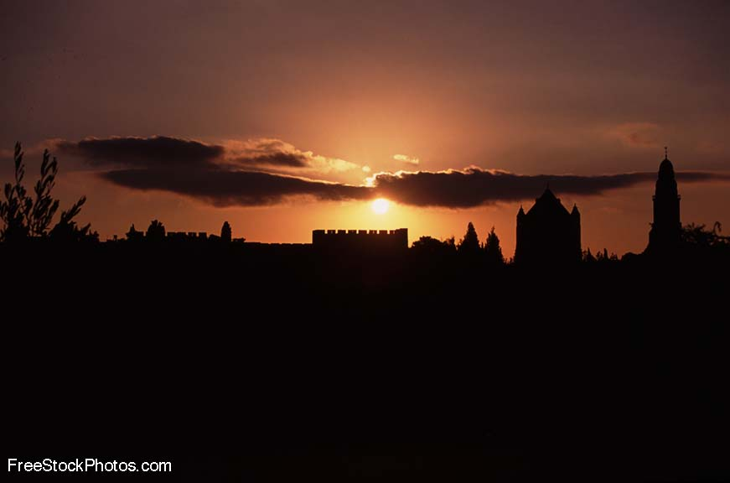
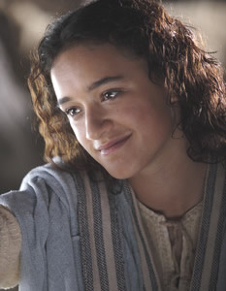
神看不见的手
《路得记》

Slide 4


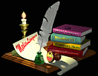

查经四步法
The 4 Steps of Bible Study
阅读 (READ)
应用 (APPLY)
观察 (OBSERVE)
解释 (INTERPRET)

Slide 5

查经四步法
The 4 Steps of Bible Study
阅读 (READ)
应用 (APPLY)
观察 (OBSERVE)
解释 (INTERPRET)
今天
路得记1:1-5
TODAY: Ruth 1:1-5

Slide 6

当士师秉政的时候，国中遭遇饥荒。在犹大伯利恒，有一个人带着妻子和两个儿子往摩押地去寄居。 这人名叫以利米勒，他的妻名叫拿俄米；他两个儿子，一个名叫玛伦，一个名叫基连，都是犹大伯利恒的以法他人。他们到了摩押地， 就住在那里。
¹ In the days when the judges ruled, there was a famine in the land. So a man from Bethlehem in Judah, together with his wife and two sons, went to live for a while in the country of Moab. ² The man’s name
was Elimelek, his wife’s name was Naomi, and the names of his two sons were Mahlon and Kilion.
They were Ephrathites from Bethlehem, Judah. And they went to Moab and lived there.

Slide 7
后来拿俄米的丈夫以利米勒死了，剩下妇人和他两个儿子。这两个儿子娶了摩押女子为妻，一个名叫俄珥巴，一个名叫路得 ，在那里住了约有十年。玛伦和基连二人也死了，剩下拿俄米，没有丈夫，也没有儿子。
³ Now Elimelek, Naomi’s husband, died, and she was left with her two sons.
⁴ They married Moabite women, one named Orpah and the other Ruth.
After they had lived there about ten years, ⁵ both Mahlon and Kilion also died,
and Naomi was left without her two sons and her husband.

Slide 8

查经四步法
The 4 Steps of Bible Study
阅读 (READ)
应用 (APPLY)
观察 (OBSERVE)
解释 (INTERPRET)

Slide 9
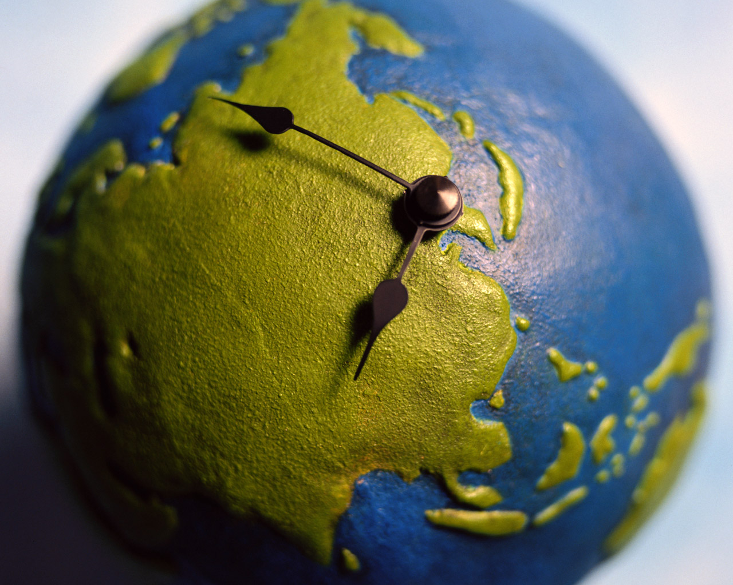
何时? - WHEN?

Slide 10
当士师秉政的时候，国中遭遇饥荒。在犹大伯利恒，有一个人带着妻子和两个儿子往摩押地去寄居。这人名叫以利米勒，他的妻名叫拿俄米；他两个儿子，一个名叫玛伦，一个名叫基连，都是犹大伯利恒的以法他人。他们到了摩押地，就住在那里。
¹ In the days when the judges ruled, there was a famine in the land. So a man from Bethlehem in Judah, together with his wife and two sons, went to live for a while in the country of Moab. ² The man’s name
was Elimelek, his wife’s name was Naomi, and the names of his two sons were Mahlon and Kilion.
They were Ephrathites from Bethlehem, Judah. And they went to Moab and lived there.

Slide 11
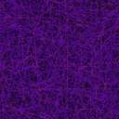
《路得记》发生在何时？
WHEN did the story of Ruth take place?
摩西时代
Moses
1500 B.C.
师士时代
Judges
1375 B.C.- 1050 B.C.
扫罗王时代
King Saul
1050 B.C.
《路得记》Book of Ruth

Slide 12
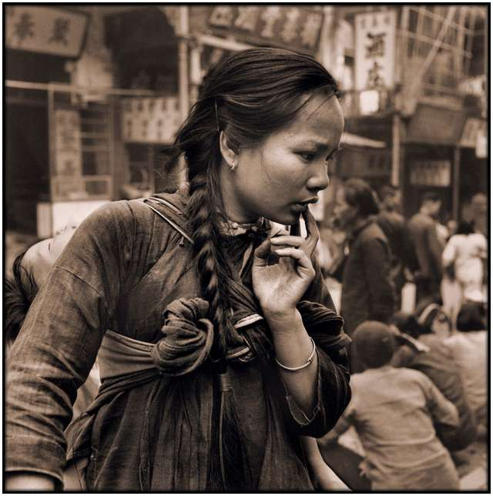
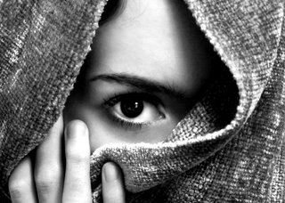
中国当时是什么朝代？
When in China’s timeline did Ruth live?
夏朝
Xia Dynasty (2070–1600 BC)
.
商朝 (殷代)
.
周朝
Zhou Dynasty (1046–256 BC)
Shang (Yin) Dynasty (1600-1046 BC)
.
《路得记》
Book of Ruth

Slide 13
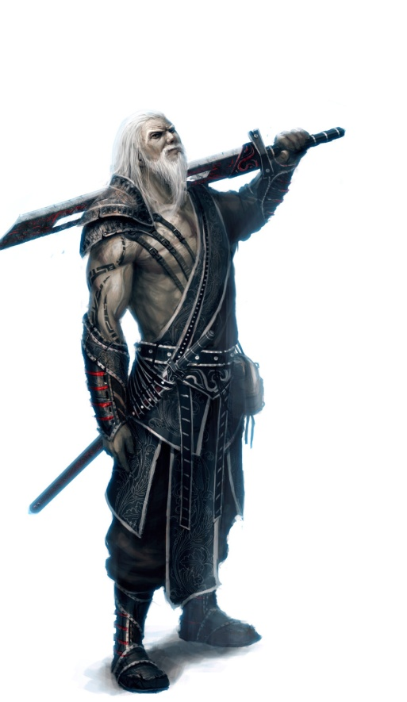
何时: When?
这是以色列历史中最黑暗，最邪恶,最叛逆,最顽固和不幸的时期. “各人照自己的意思任 意而行.”
  This is one of the most dark, one of the most wicked, rebellious, obstinate, unfortunate periods in all of Israel’s history. “Everybody did what was right in their own eyes”
许多人认为该故事发生在师士睚珥秉政之时(士10)
  Many think the story happened during the time of Judge Jair (Jud. 10)

Slide 14
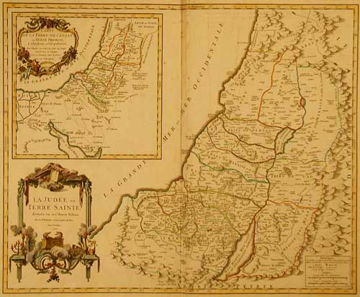

哪里
WHERE?

Slide 15
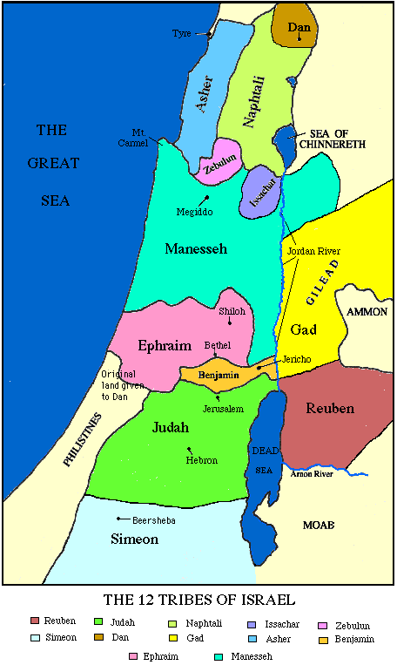
《路得记》发生在哪里？WHERE did the story of Ruth take place?
以色列: Israel
犹大: Judah
伯利恒: “粮仓” = 他们没有粮食(若敬拜别神,我将降饥荒.”) 后来，这城叫做 “大卫之城”。
同时也是耶稣的出生地。
  BETHLEHEM: “The House of Bread” (they had no more bread)
  Later it will be the capital, the City of David and the birthplace of Jesus
摩押:大概离伯利恒约96公里
  MOAB: 50-60 mi (96 K) from Bethlehem
寒冷; 多雨; 肥沃高原
  Cool; much rain; fertile plateau
以色列
ISRAEL
耶路撒冷 (Jerusalem)
伯利恒 (Bethlehem)
摩押 (Moab)
犹大: Judah
两个关键地方: Key Places

Slide 16
当士师秉政的时候，国中遭遇饥荒。在犹大伯利恒，有一个人带着妻子和两个儿子往摩押地去寄居。这人名叫以利米勒，他的妻名叫拿俄米；他两个儿子，一个名叫玛伦，一个名叫基连，都是犹大伯利恒的以法他人。他们到了摩押地，就住在那里。
¹ In the days when the judges ruled, there was a famine in the land. So a man from Bethlehem in Judah, together with his wife and two sons, went to live for a while in the country of Moab. ² The man’s name
was Elimelek, his wife’s name was Naomi, and the names of his two sons were Mahlon and Kilion.
They were Ephrathites from Bethlehem, Judah. And they went to Moab and lived there.

Slide 17
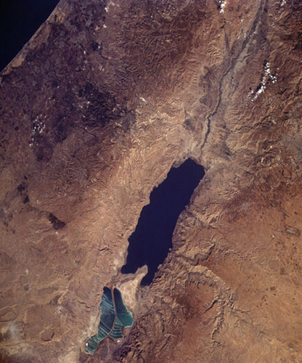
伯利恒 (Bethlehem)
死海: Dead Sea
摩押 (Moab)

Slide 18
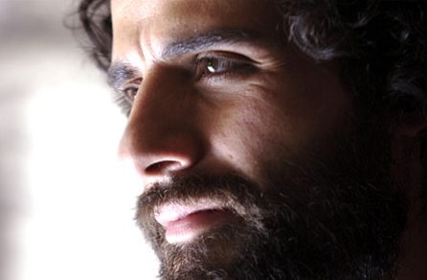
为何? - WHY?

Slide 19
当士师秉政的时候，国中遭遇饥荒。在犹大伯利恒，有一个人带着妻子和两个儿子往摩押地去寄居。这人名叫以利米勒，他的妻名叫拿俄米。他两个儿子，一个名叫玛伦，一个名叫基连，都是犹大伯利恒的以法他人。他们到了摩押地，就住在那里。
¹ In the days when the judges ruled, there was a famine in the land. So a man from Bethlehem in Judah, together with his wife and two sons, went to live for a while in the country of Moab. ² The man’s name
was Elimelek, his wife’s name was Naomi, and the names of his two sons were Mahlon and Kilion.
They were Ephrathites from Bethlehem, Judah. And they went to Moab and lived there.

Slide 20
为何? - WHY?
当时在伯利恒(甚至整个以色列)闹饥荒, 但邻近的摩押却没有。
  There was a famine in Bethlehem (and all of Israel) but not in Moab nearby.
这意味着神在惩罚以色列。
  This implies that God was punishing Israel.
(尤其针对伯利恒).
  (specifically Bethlehem)
申11:13-17(神对伯利恒说 “你们若听从诫命, 我就赐福.若敬拜别神,我将降饥荒.”)
  In Deut 11:13-17, God said to Bethlehem “IF you obey, I will bless you. IF you worship other gods, I will bring famine.”

Slide 21
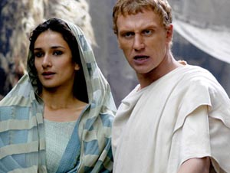
谁? - WHO?

Slide 22
后来拿俄米的丈夫以利米勒死了，剩下妇人和他两个儿子。这两个儿子娶了摩押女子为妻，一个名叫俄珥巴，一个名叫路得 ，在那里住了约有十年。玛伦和基连二人也死了，剩下拿俄米，没有丈夫，也没有儿子。
³ Now Elimelek, Naomi’s husband, died, and she was left with her two sons.
⁴ They married Moabite women, one named Orpah and the other Ruth.
After they had lived there about ten years, ⁵ both Mahlon and Kilion also died,
and Naomi was left without her two sons and her husband.

Slide 23

今天 (today)
两以色列人 (拿俄米&以利米勒) 2 Israelites (Elimelek & Naomi)
两儿子（玛伦&基连） 2 Sons (Mahlon & Kilion)
两儿媳 （路得&俄珥巴） 2 Daughters (Ruth & Orpah)
两国 （以色列& 摩押） 2 Nations (Israelites & Moabites)

Slide 24
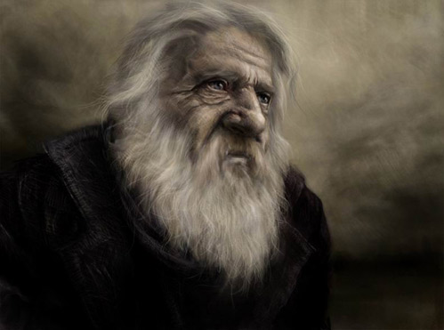
以利米勒
他的名字意思是“神是王”。
  His name means “My God is King”
拿俄米的丈夫, 基连和玛伦的父亲。
  Husband of Naomi; Father of Kilion and Mahlon
一个伯利恒的以法他人。
  An Ephrathite, from Bethlehem.
土地拥有者。犹太人社区的一部分。
  A land owner. Part of the Jewish community.
他对家庭的带领建立在恐惧而非对神的信赖上。
  Made his decisions for his family based on fear, not trust.
ELIMELEK

Slide 25
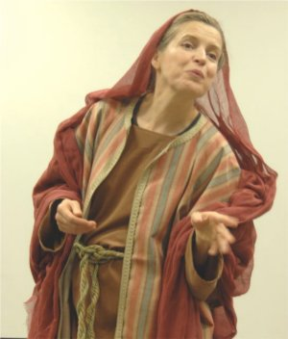
拿俄米
这个名字的意思是 “可爱的”或 “仁慈的”
  Name means “Pleasant” or “gracious”
以利米勒的妻子，玛伦和基连的母亲。
  Wife to Elimelek; mother to Mahlon & Kilion
不得不经历短期内接连埋葬三位亲人的痛苦。
  Had to suffer through 3 deaths and 3 funerals very close together
爱路得和俄珥巴，不断称她们为“女儿们”。
  Loved Ruth and Orpah. Kept calling them ‘daughters’.
希望她的名字改为玛拉（苦的意思）。
  Wanted her name changed to MARA (“bitter”)
后来,她照顾路得的儿子俄备得,视为己出. 家乡的人都说： “拿俄米得孩子了。”
  Later, she cared for Ruth’s son Obed as if her own; the women of the town say "Naomi has a son" (Ruth 4:17)
NAOMI

Slide 26
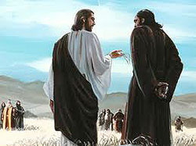
玛伦和基连
以利米勒和拿俄米的两儿子。
The 2 sons of Elimelech and Naomi
玛伦：娶了路得, 其名为“病了.”
  Mahlon: Married Ruth; His name means "sick“
基连: 娶了俄珥巴,其名为“虚弱”或“垂死”。
Kilion: Married Orpah; His name means "weakening" or “dying"
双双陨殁于搬去摩押十年后。
  Died 10 years after moving to Moab
传统认为他们都是中年时移民到摩押的。
  Tradition tells us they were middle age when they moved to Moab
MAHLON & KILION

Slide 27
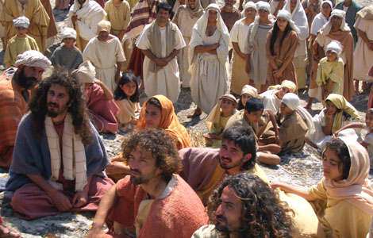
以法他人
伯利恒地区的居民。
雅各的妻子拉结葬于以法他。
先知弥迦预言以法他要出君王.(弥5:2)
很多牧羊人;看管祭牲羊。
伯利恒=农业和放牧业
以法他=伯利恒
EPHRATHITES

Slide 28
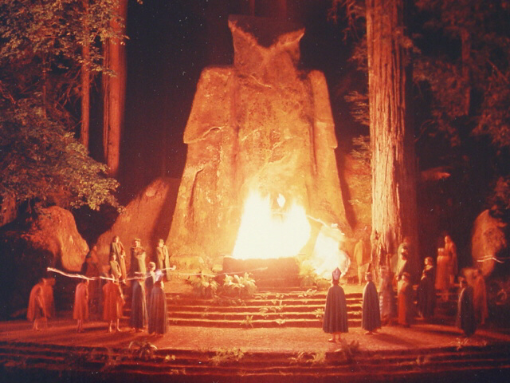
摩押人
根据创世记19:30-38记载,摩押人的祖先是罗得与他长女乱伦而生的后代。这两女在索多玛和蛾摩拉毁城时失去了未婚夫和母亲。她们决定通过与父亲乱伦的方式为父亲延续后代。长女把父亲灌醉后与之同房生了儿子叫摩押。小女儿也照着行，生了儿子叫便亚米，后来成为亚扪人的祖先。
      According to Genesis 19:30-38, the ancestor of the Moabites was Lot by incest with his oldest daughter. She and her sister, having lost their fiancés and their mother in the destruction of Sodom and Gomorrah, decided to continue their father's line through intercourse with their father. The elder got him drunk, had sex with him conceived Moab. The younger daughter did the same and conceived a son named Ben-Ammi, who became ancestor to the Ammonites
MOABITES

Slide 29
摩押人
摩押的意思是“我父的种子”。
      Moab means “seed of my father”
考古学： “米沙石碑”(又名 “摩押石碑”) 是一种黑色的石头,摩押统治者米沙在上面刻有题词,提到了“雅威”和“大卫之家”.
      Archeology: The Mesha Stele (a.k.a. "Moabite Stone") is a black stone bearing an inscription by the ruler Mesha of Moab. It mentions YHWH and ‘house of David’
      摩押人和亚扪人的男子禁止与以色列联姻，但是女子却没有限制，允许皈依。
      Only the men of Moab and Ammon were forbidden to marry into the Israelite nation, but the women were permitted to convert without restriction.
MOABITES

Slide 30
摩押人
      大部分摩押人都是多神崇拜。他们的主神叫 “基抹”。根据列王纪下记载，在危急时刻，他们会向基抹神献人祭。（王上11王下3）
      Most of the Moabites were polytheists. Their chief god was Chemosh. According to II Kings, at times of peril, human sacrifices were offered to him.(1 Ki .11; 2 Ki. 3)
民数记说他们劝诱以色列人加入他们的献祭。摩押人不被允许进入犹太帐幕敬拜耶和华神。
      The Book of Numbers says that they induced the Israelites to join in their human sacrifices. Moabites were not allowed to worship in the Jewish tabernacle.
MOABITES

Slide 31
摩押人
摩押石碑也提到了基抹所对应的女神“阿施塔-基抹”(在美国，复活节又叫Easter，就是从这个女神的名字“阿施塔”而来) The Moabite Stone also mentions a female counterpart of Chemosh, Ashtar-Chemosh, (In America, Resurrection Day is called Easter, after the goddess Ashtar)
所罗门在橄榄山上为基抹神建了一个寺庙(王上6:7,33)，直到约西亚改革(王下23:13). 所罗门这个出于政治目的的动作使得敬拜基抹神成为以色列宗教生活的一部分长达400年之久。
        Solomon built a sanctuary to Chemosh on the Mount of Olives (I Ki. 6:7, 33), which was maintained till the reform of Josiah (II Ki. 23:13). This movement by Solomon was a political one, but it made the worship of Chemosh a part of the religious life of Israel for nearly 400 years.
MOABITES

Slide 32
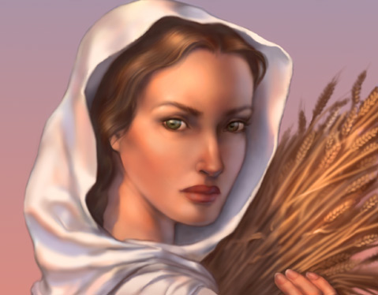
俄珥巴
一个摩押女子,成长于这种异教环境.
  A Moabite, Grew up in this pagan culture.
嫁给了基连。十年后守了寡。
  Married Kilion. Became a widow after 10 years.
她的名字是“长鬃毛”或“颈背”。
  Her name means “Mane” or ‘Back of the neck”
在路得和拿俄米返回伯利恒后选择留在了摩押地。
  Stayed in Moab when Naomi and Ruth went to Bethlehem
尽管圣经对她提到很少,但很久以前犹太文学中却说到了很多她的事。
  Though the Bible says little about her, Jewish writings from long ago say a lot.
ORPAH

Slide 33
根据犹太文学记载…
ACCORDING TO JEWISH LITERATURE…
在希伯来文学里，俄珥巴又叫哈拉法，生了四个非利士巨人，其中一个就是歌利亚。据说这四个儿子给了她四滴眼泪，就是在与她家婆分别时流下的四滴泪（巴比伦塔木德，索塔42b）
      In rabbinic literature, Orpah is called Harafa, the mother of four Philistine giants, one of whom was Goliath. These four sons were said to have been given her for the four tears which she shed at parting with her mother-in-law (Babylonian Talmud, Sotah 42b).
她母亲名她为哈拉法，意为“打谷”，她允许自己被众多男人“敲打”，如同打谷那样。（巴比伦塔木德，索塔42b ）
        Her other name Harafa means ‘threshing’; that she allowed herself to be 'threshed' by many men as one would thresh wheat . (Babylonian Talmud, Sotah 42b).
根据犹太传说，俄珥巴是路得的姐姐，同为摩押王一格龙的女儿。因她转离了家婆，她的名字改为“俄珥巴”。
According to Jewish legend, Orpah was a sister of Ruth, and both were daughters of the Moabite King Eglon. Her name was changed to "Orpah" because she turned her back on her mother-in-law.

Slide 34
路得
她的名字意为“朋友”
  Her name means “FRIEND”
她嫁给了玛伦，十年后守寡。
  Married Mahlon. Became a widow 10 years later.
传统认为，她嫁给波阿斯（80岁）时大概四十岁。
  Traditionally, she was around 40 when she married Boaz (age 80)
她转离摩押决定跟随拿俄米和 “拿俄米的神”。
  Turned her back on Moab to follow Naomi and Naomi’s God.
吃苦耐劳; 顺服拿俄米; 忠心; 值得信任。
  Hard worker; obedient to Naomi; bold; faithful; trusting.
大卫王的曾祖母。耶稣基督的祖先。
  Great grandmother of King David. Ancestor of Jesus Christ.
RUTH

Slide 35
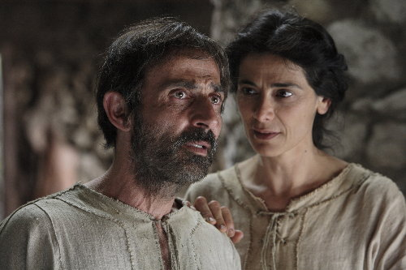
什么? - WHAT?

Slide 36
什么? - WHAT?
神的子民不该迁移到摩押。神的子民不该与摩押人居住。
  And so God’s people weren’t to move to Moab. God’s people were not to dwell with Moabites.
他们之所以迁往那里是因为不想死（饥荒）
  They went there because they did not want to die (of famine).
他们却死在了那里，而他们的朋友却都在伯利恒生 存下来了。
  They died there. Their friends were all still alive in Bethlehem.
拿俄米在未有任何孙子时就失去了丈夫和儿子们。 她身处异教之地，家人都死光了。
  Naomi buried her husband and then buried her only two sons before she even got grandchildren. She is in a foreign pagan land and her whole family is dead.

Slide 37

查经四步法
The 4 Steps of Bible Study
阅读 (READ)
应用 (APPLY)
观察 (OBSERVE)
解释 (INTERPRET)

Slide 38
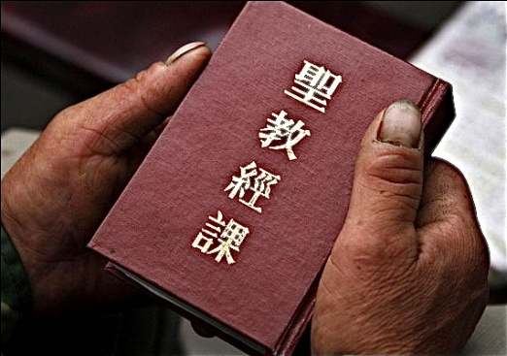
解释 (INTERPRET)
摩西从上帝那里写下律法,所有犹太人都知道.
  Moses had written the laws from God. All Jews knew them.
这次迁移是不顺服神不信靠神的表现。
  This move was an act of disobedience and a lack of trusting God.
神，在他的主权里，却使用这个事件为人类的救主——耶稣基督的到来预备道路。
  God, in His Sovereignty, used these events to prepare the way for the Savior of all mankind, Jesus Christ.
拿俄米知道死亡是从神而来（1:20）
  Naomi knew the deaths were from God (1:20)
无论何事何境神都在掌管。
  God is in control of every situation.

Slide 39

  上一周的提醒:
  三大关键词
  Reminder from last week: 3 KEY WORDS
主权- SOVEREIGNTY
护理- PROVIDENCE
不变- IMMUTABILITY

Slide 40
主权- SOVEREIGNTY
神统治和掌管。神无处不在。神是至高至大的权柄。没有什么超越神。神超越撒旦，鬼魔、生、死、天堂、地狱、飞鸟、鱼类和兽类。《箴言》说掷骰子下去，出来的数字都由神选择。他掌控万有，自造天地一直到你每天的决定，他都无所不知。
  God rules and reigns. God is over all. God is the one who is the highest ultimate authority. There is no one beyond God. God is over Satan, demons, life, death, heaven, hell, the birds, the fish and the beasts. Proverbs says that even when a die is rolled, that the numbers that come up are chosen by God. He is in control of everything, from creation, all the way down to your every day decisions.
关键词- Key Words

Slide 41
护理- PROVIDENCE
神看不见的手介入地上的每个生命中。 神在历史中做工可以透过君王，王后， 统治者和列国得到确信和承认。他也在普通人的日常细节中做工，就像拿俄米， 路得和以利米勒以及…我们。神做工既体现在广大领域，也体现在我们的生活细节中。这就是他看不见手的护佑。
  God’s Invisible hand is involved in the life of everyone on earth. The belief and acknowledgement that God is at work in human history through kings and queens, rulers and nations and also at work in the everyday details of normal people, like Naomi and Ruth and Elimelech...and us. God is at work in the large areas and the details of our life. That is His invisible hand of providence
关键词- Key Words

Slide 42
不变- IMMUTABILITY
神不能改变。他不会改变。他不需改变。他的一切都是完美的。他没有哪一天更好或更糟。神全知。他按他有的信息处理一切，而这是完整而不需改变的。既然他是无可改变的完美，他的决定也总是完美的。他完全信实稳定。神不改变他自己的性情。
  God’s Inability to change. He cannot change. He doesn’t need to change. Everything about Him is perfect. He never had a day that was better or worse than another day. God has all knowledge. He deals with everything according to the information He has, which is complete and doesn’t change. Since He is unchangeably perfect, His decisions are always perfect. He is totally faithful and stable. God cannot change His own nature,
关键词- Key Words

Slide 43

查经四步法
The 4 Steps of Bible Study
阅读 (READ)
应用 (APPLY)
观察 (OBSERVE)
解释 (INTERPRET)

Slide 44
应用- Applications
对于今天所有男人来说，以利米勒是一个负面的，做出愚蠢决定的男人的榜样。这种决定会拖累我们的妻儿。我们作为家庭的头，受神呼召带领家庭，让妻儿桌上有食物，头上有片瓦。满足妻儿的基本需求是神所托付的。
  Now, for all of us men, Elimelech serves for us as a negative, example of the foolish decisions that we men can make, that include our wives and our children. As the head of our household, called of God to lead our family; to put food on the table, roof over the head, to take care of the basic needs of the wife and children that God has entrusted to us.
他带领家人远离教会，团契和对真神的敬拜，去到一个无法敬拜真神的地方。他离弃了所有获得属灵食物的机会。
  He moves them away from church and fellowship, and worship of God to a place where they would be the only God following family in the place where there is not a place to worship. He forsakes all of the spiritual opportunity for food.

Slide 45
应用 - Applications
以利米勒为何要迁往摩押？这样他不至于死。那以利米勒在摩押怎么样了？死了。故事的教育意义：死亡掌握在神的手里，不是我们手里。
  Why did Elimelech move to Moab? So that he wouldn’t die. What did Elimelech do in Moab? Died. Moral of the story: Death is in God’s hands, not ours.
当你决定在哪里生活和养育你的孩子，你乃是在决定你全家将与什么人来往。你要考虑那里是否有一个好教会可让你全家敬拜真神。
  When you decide where you will live and raise your children, you are deciding who your family will fellowship with and if there is a good church for your family to worship the true God.

Slide 46
应用- Applications
  如果呆在那里，他们会与谁结婚？他们会嫁娶那个你放在他们面前的人。在决定离开他们敬拜神的地方时，他们同时也离开了团契和问责。
  If your children stay there, who they will marry? They will marry the people that you put in front of them. And in deciding to leave their place of worship of God, they also left fellowship and accountability.
就像很多男人那样，他只考虑财政上的代价，没有考虑属灵上的损失。结果，他的全家定居在摩押，成为那地或许是唯一一个真神的敬拜者。
  And like so many men do, he simply counted the financial costs, didn’t count the spiritual cost.
  As a result, relocated his whole family to Moab as were perhaps the only worshippers of God.

Slide 47
应用 - Applications
拿俄米的丈夫和儿子是如何死的？是神的审判和咒诅吗？或是所谓的自然过程和事件？圣经没有任何交代。这在我们的生活中很典型，是不是？事情就这样发生了，为什么？沉默。神不回答。圣经说隐藏的事是属于耶和华的,我们只看到一部分，也只知道一部分。我们知道需要知道的所有事。我们绝不可能知道想知道的所有事。我们必须靠信心而活，必须信任上帝。
  How did Naomi’s husband and sons die? Was it God’s judgment, God’s curse? Was it the so-called natural course of events? Scripture says nothing. This is so typical of our life, is it not? Something happens – why? Silence. God doesn’t answer. The Bible says that the secret things belong to the Lord, that we know in part, that we see in part. We know everything we need to know. We by no means know everything we want to know. We must live by faith, and we must trust God

Slide 48
应用 - Applications
摩押人不允许进入神的子民的会中敬拜神。这就好比你们教会中的某个年轻男子或女子嫁娶了某个非基督徒。他们不允许成为你教会的成员，也不能与你们一起敬拜和服事神。这很显然在家庭和抚养孩子上都会是问题。这些人与神远离，他们敬拜基抹神。他们娶的女子很可能敬拜的是另一个神。他们在生活和婚姻上不信靠神。他们的婚姻违背神的旨意，但他们觉得自己的理由足以使自己的决定合法化。
  The Moabites were not allowed to enter the corporate assembly of the worship of God’s people. This would be like one of you young men or women at your church marrying a person who wasn’t a follower of the true God; wasn’t allowed to become a member at your church; couldn’t join you in worship and service of God. This obviously creates problems in the home and the raising of children. These were people who were apart from God; they worshipped Chemosh. They’re marrying girls who, in all likelihood, worship another God. But they didn’t trust God for their life or for their spouses. They married against God’s will and felt their reasons were good enough to justify their decision.
尽管以利米勒和拿俄米不顺服，神却使用路得。
  God used Ruth despite the disobedience of Elimelek and Naomi, not because of it.

Slide 49

圣经在这方面是如何说的…
What does the Bible say about…
神看不见的手在患难中
God’s Invisible Hand in Suffering

Slide 50
神的主权超越撒旦有限的能力和权柄
1. 撒旦在圣经中被称为 “世界的王”（约12:31）或“这个世界的神”（林后4；4）或“空中掌权者”（弗2:2）
  Satan is sometimes called in the Bible “the ruler of this world” (Jn 12:31) or “the god of this world” (2 Cor. 4:4) or “the prince of the power of the air” (Eph. 2:2)
2. 神按自己的意愿选择和设立君王（但2:20;4:17）
  God chooses and sets up every king as HE wants (Dan. 2:20; 4:17)
3. 神让君王的心如陇沟里的水随意流转（箴21:1）
  God turns the king’s heart whichever way He wants. (Prov. 21:1)
4. 即使地上的君王在撒旦的影响或鬼魔的占有下想要摧毁神在地上的工作，神嗤笑并继续成就他的旨意。(诗2:2-4)
  Even when earthly kings under Satan’s influence and demonic possession try to destroy God’s works on earth, God laughs and accomplishes His will. (Ps. 2:2-4)
5. 诗33:10-11说: “耶和华的眼目看顾敬畏他的人和仰望他慈爱的人，要救他们的命脱离死亡，并使他们在饥荒中存活。”
  Ps. 33:10-11 says, “The Lord brings the counsel of the nations to nothing; he frustrates the plans of the peoples. The counsel of the Lord stands forever, the plans of his heart to all generations.”
God is sovereign over Satan’s limited power and authority.

Slide 51
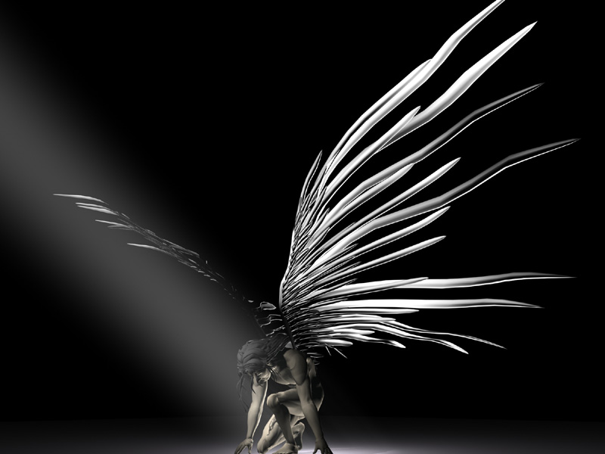
神的主权超越天使和鬼魔
1. 在马太福音八章，耶稣赶出了一大群害怕他的恶鬼。他们得求耶稣不把他们差往地狱。
  In Matthew 8, Jesus cast out a legion of demons who were terrified of Him. They had to ask Jesus’ permission to NOT be sent to Hell.
2. 马可福音1:27, “他吩咐污鬼，连污鬼也听从他。”
  Mark 1:27, “He commands even the unclean spirits, and they obey Him.”
God is sovereign over angels and demons.

Slide 52
马丁路德：坚固保障歌（三段）
群魔虽然环绕我身，
向我尽量施侵凌，
我不惧怕，因神有旨，
真理必使我得胜。
幽暗之君虽猛，不足令我心惊，
他怒我能容忍，日后胜负必分，
主言必使他败奔。
And though this world, with devils filled, should threaten to undo us,
we will not fear, for God hath willed - His truth to triumph through us.
The Prince of Darkness grim, we tremble not for him;
his rage we can endure, - for lo, his doom is sure; - one little word shall fell him.
Martin Luther: A Mighty Fortress is Our God (verse 3)

Slide 53
神的主权超越生死
1. 撒上2:6说耶和华使人死，也使人活；使人下阴间，也使人往上升。
  1 Samuel 2:6 says that the Lord brings both life and death; it is HE who kills and HE who brings back to life.
2. “你们如今要知道 :我 ,惟有我是神 .在我以外并 无别神 .我使人死 ,我使人活 .我损伤 ,我也医治 ， 并无人能从我手中救出来 .”(申命记32:39)
  “See now that I, even I, am He, and there is no god beside me; I kill and I make alive; I wound and I heal; and there is none that can deliver out of my hand” (Deuteronomy 32:39).
3. 神允许撒旦伤害约伯,但命令它保全约伯的性命。
  God allowed Satan to hurt Job but commanded his life be spared.
God is sovereign over life and death.

Slide 54
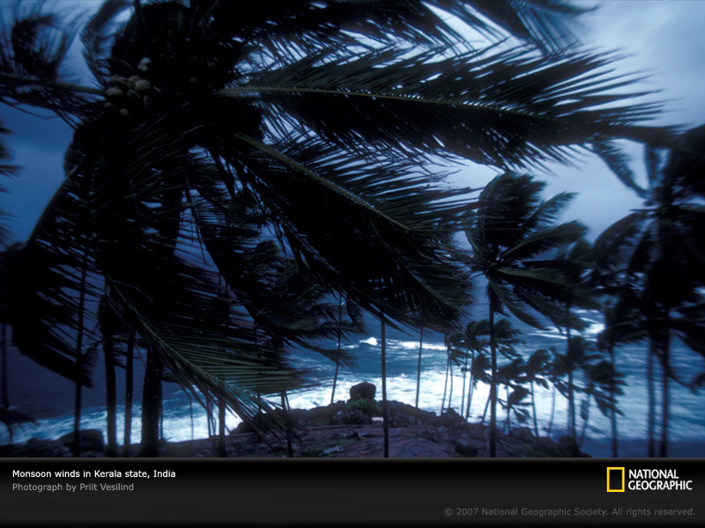
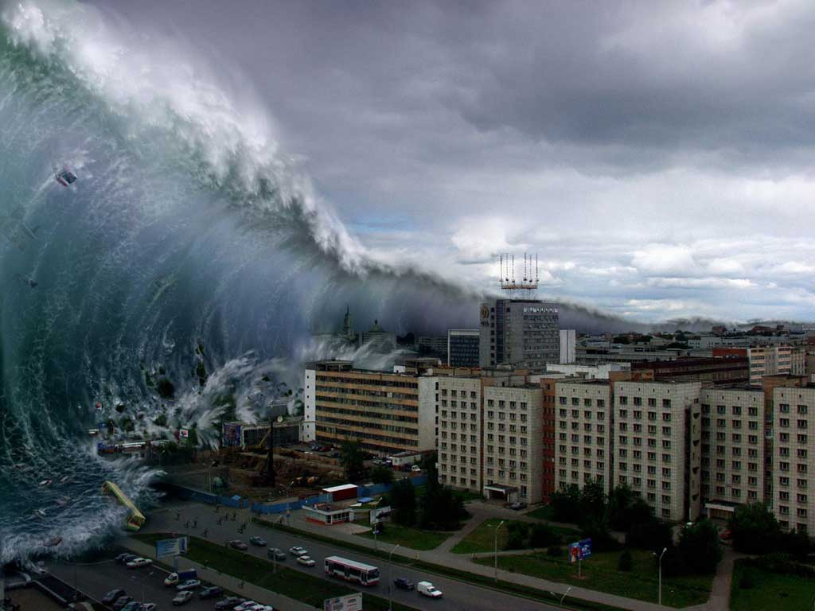
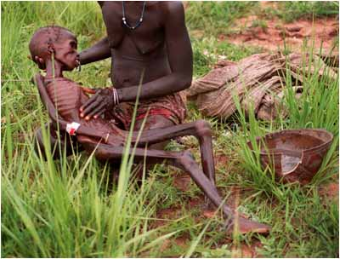
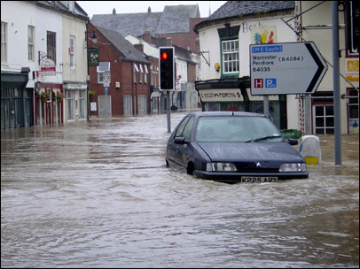
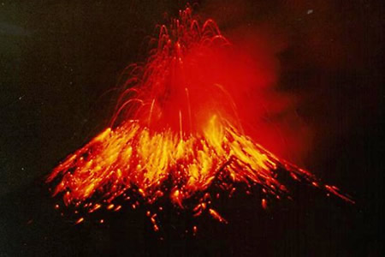
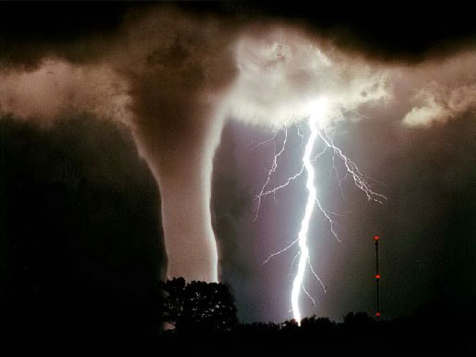
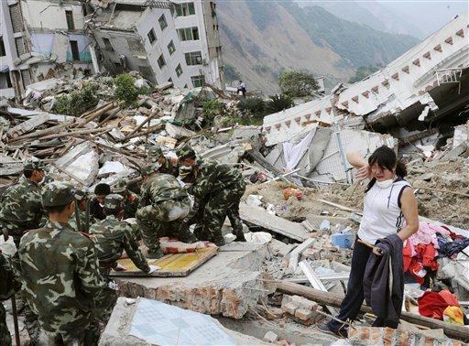
神，而不是撒旦，掌控自然
(GOD, NOT SATAN, CONTROLS NATURE)

Slide 55
神的主权超越疾病，残障和痛苦
1. 撒旦只能伤害约伯到神允许的程度。
  Satan could only hurt Job to the extent that God allowed him.
2. 当神的旨意是通过解救人出痛苦来荣耀他自己时， 撒旦和恶魔才能使疾病发生。
  Satan and demons can cause sickness when it is God’s purpose to glorify Himself through the deliverance from that pain.
3. 神在燃烧的荆棘中晓谕摩西: “谁造了人的口？谁使人口哑、 耳聋、目明、眼瞎呢？岂不是我耶和华吗？”（出埃及记4:11）
  God says to Moses at the burning bush, “Who has made man’s mouth? Who makes him mute, or deaf, or seeing, or blind? Is it not I, the Lord?” (Exodus 4:11)
4. 在林下12:7-9, 保罗反复求神挪去他“肉中的刺”，但神还是 保留了那根刺。因为神要在软弱 的人身上显出他自己的刚强。
  .In 2 Cor. 12:7-9, Paul says he repeatedly asked God to remove his ‘thorn in the flesh’ but God wanted the thorn to remain. God’s strength was evident in Paul’s weakness.
God is sovereign over sickness, disabilities and pain.

Slide 56
神的主权超越瘟疫
1.我们的神在天上，随自己的意旨行事（诗篇115:3）
2. 瘟疫在圣经中屡见不鲜。
3. 神曾主动降下瘟疫; 神也曾发命止住瘟疫。
5. 神预先定准我们的年限和所住的疆界（使徒行传17:26）
6.无论生死，我们都在神的慈爱中。
7.“谨慎地活，大胆地死”——郭牧师
God is sovereign over all animals, birds and fish.

Slide 57
神的主权超越动物，鱼类和鸟类
1. 在约伯记38-41中，神提醒约伯只有他控制地上， 空中和海里的动物。他控制它们的出生，它们的食物，它们的位置，它们的行为以及它们的死亡。
  In Job 38-41, God reminds Job that ONLY HE controls the animals on the land, air and sea. He controls their births, their feeding, their location, their actions, and their deaths.
2. 在千禧国度里，神将改变动物性情，让它们与人 和平相处。
  During the Millennial Kingdom, God will change the dispositions of the animals to get along with each other and with human beings. .
3. 在每个瘟疫中，神控制每只青蛙，每个苍蝇和蚊虫 （甚至那些在埃及发生的）
  The Lord controlled every frog, fly and gnat in every plague (even the ones in Egypt)
God is sovereign over all animals, birds and fish.

Slide 58
神的主权超越天堂和地狱
1. 路加福音12和马太福音10告诉我们不要惧怕撒旦， 它只能暂时伤害你的身体，却不能伤害你的灵魂，乃要惧怕神，因祂有能力决定你在地狱还是天堂度永生。
  Luke 12 and Matthew 10 tell us not to be afraid of Satan who is occasionally given power to hurt your body, but instead fear the One (God) who has the power to determine your eternal destiny in Heaven or Hell.
2. 耶稣创造了天堂和地狱. 他决定谁去哪儿。 （约翰福音第一章，罗马书2:6）
  Jesus created both Heaven and Hell. He determines who goes where. (Jn 1; Rom. 2:6)
3. 耶稣也为魔鬼和他的堕落天使创造了地狱。 世人因为跟随魔鬼和其天使也会进地狱。
  Jesus also created Hell for the devil and his angels. Men will share Hell because they follow the devil and his angels.
God is sovereign over Heaven and Hell

Slide 59
神的主权超越撒旦的试探
1. 林前10:13“你们所遇见的试探，无非是人所能受的。神是信实的，必不叫你们受试探过于所能受的。在受试探的时候，总要给你们开一条出路，叫你们能忍受得住。”
  1 Cor. 10:13, “There is no temptation that has overtaken you except that which is common to every man; but God is faithful. He will NOT ALLOW you to be tempted beyond what you are able to handle, but will with every temptation provide a way to escape that you may be able to handle it.”
2. 徒1:16说即使犹大的背叛也是籍大卫的口预定的。
  Acts 1:16 says that even Judas’ betrayal was preordained of God and spoken of by David.
3. 在路加福音22中，耶稣告诉彼得撒旦想控制他，但耶稣不允许。他祷告父神当彼得跌倒后能真正悔改。
  In Luke 22, Jesus tells Peter that Satan demanded to have him but Jesus won’t allow it. He prayed to the Father and Peter will indeed repent when he falls.
God is sovereign over Satan’s attempts to tempt us.

Slide 60
神的主权超越耶稣的痛苦忧伤
1. 在约翰福音10:18中耶稣说：“没有人夺我的命去，是我自己舍的。”
  Jn 10:18 Jesus said, “‘No one takes my life from me, but I lay it down of my own decision’
2. 彼得说耶稣是“按着神的定旨和先见被交与人.”（徒2:23）
  Peter said that Jesus was “delivered up according to the definite plan and foreknowledge of God” (Acts 2:23).
God is sovereign over Jesus’ pain and grief.

Slide 61
神是慈爱的。
他同时也是圣洁，良善，完美，怜悯和仁慈的。
他是审判者。
他展示他的忿怒，管教，怒气和权能。
但是在凡事上，神是主权至高的。
他的旨意定能成就。
God is loving.
He is also holy, good, perfect, compassionate, and kind.
He is a Judge.
He shows His wrath, his discipline, His anger, and His power.
But in everything, God is sovereign.
HIS PURPOSE WILL BE ACCOMPLISHED.

Slide 62
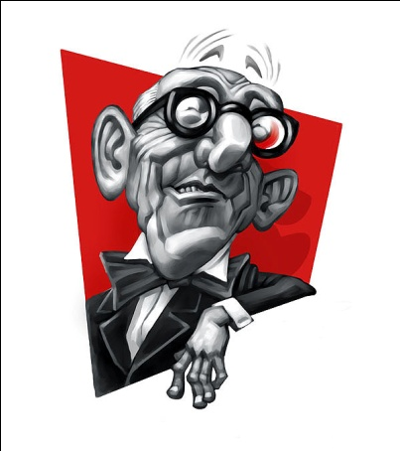
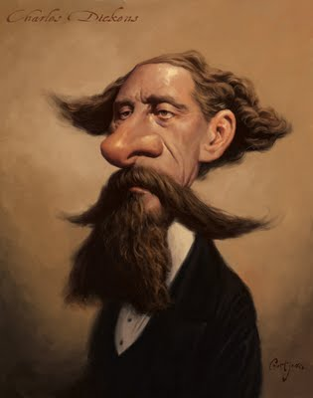
引述
“神在我们的欢愉中对我们低语，透过我们的良知向我们说话，但却在我们的痛苦中大声疾呼：痛苦原来是神的扬声器，为要唤醒充耳不闻的世界”——C.S.刘易斯
  ““God whispers to us in our pleasures, speaks to us in our conscience, but shouts in our pains: It is His megaphone to rouse a deaf world” –C.S. Lewis
“苦难比任何教育都有效。它教会我明白你以前的心是什么。我曾被弯曲和折断，然而，我希望是为了塑造更好的形状。”——查尔斯·狄更斯
  “Suffering has been stronger than all other teaching, and has taught me to understand what your heart used to be. I have been bent and broken, but - I hope - into a better shape.” –Charles Dickens
QUOTES

Slide 63
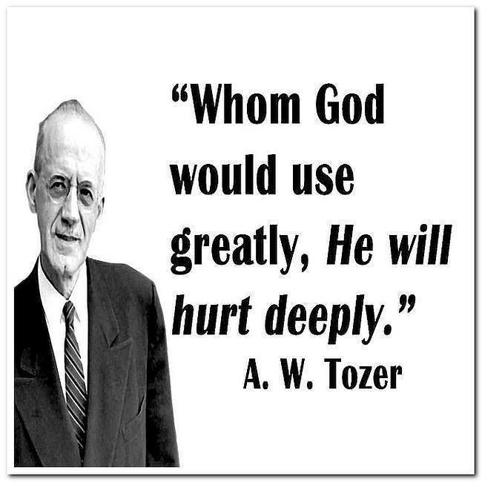
引述
“
上帝
要用其重，
必伤其深。
——陶恕
QUOTES

