Slide 1
RUTH
3

Slide 2
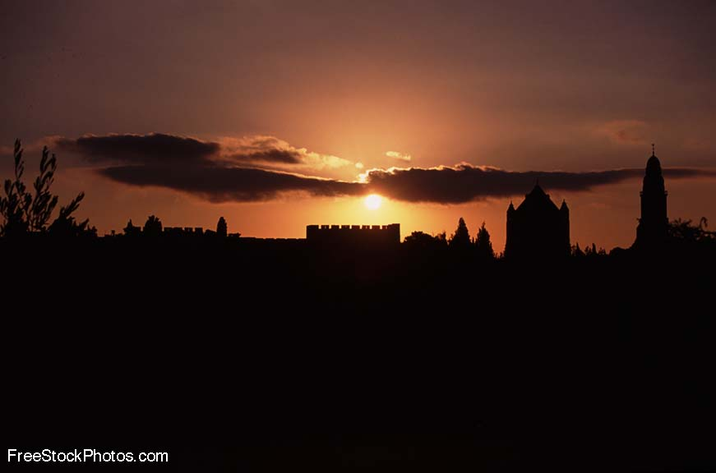
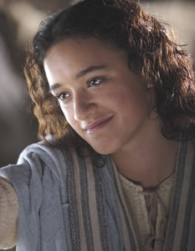
神看不见的手
《路得记》

Slide 3
日期 Date | 经文 Verses | 标题 Title
3月31 3/31 | 所有 ALL | 神看不见的手（导语） God’s Invisible Hand (Introduction)
4月7日 4/7 | 1:1-5 | 神看不见的手在患难中 God’s Invisible Hand in Suffering
4月14日 4/14 | 1:6-22 | 神看不见的手在各关系中 God’s Invisible Hand in Relationships
4月21日 4/20 | 2:1-23 | 神看不见的手在各天职中 God’s Invisible Hand in Vocations
4月28日 4/27 | 3:1-18 | 神看不见的手在婚姻中 God’s Invisible Hand in Marriage
5月5日 5/5 | 4:1-12 | 神看不见的手在救赎中 God’s Invisible Hand in Redemption
5月12日 5/12 | 4:13-22 | 神看不见的手在历史中 God’s Invisible Hand in History
神看不见的手

Slide 4
查经四步法 The 4 Steps of Bible Study
阅读 (READ)
应用 (APPLY)
观察 (OBSERVE)
解释 (INTERPRET)

Slide 5
查经四步法 The 4 Steps of Bible Study
阅读 (READ)
应用 (APPLY)
观察 (OBSERVE)
解释 (INTERPRET)

Slide 6
当士师秉政的时候，国中遭遇饥荒。在犹大、伯利恒，有一个人带着妻子和两个儿子往摩押地去寄居。这人名叫以利米勒，他的妻名叫拿俄米；他两个儿子，一个名叫玛伦，一个名叫基连，都是犹大伯利恒的以法他人。他们到了摩押地，就住在那里。
¹ In the days when the judges ruled, there was a famine in the land. So a man from Bethlehem in Judah, together with his wife and two sons, went to live for a while in the country of Moab. ² The man’s name
was Elimelek, his wife’s name was Naomi, and the names of his two sons were Mahlon and Kilion.
They were Ephrathites from Bethlehem, Judah. And they went to Moab and lived there.

Slide 7
后来拿俄米的丈夫以利米勒死了，剩下妇人和他两个儿子。这两个儿子娶了摩押女子为妻，一个名叫俄珥巴，一个名叫路得 ，在那里住了约有十年。玛伦和基连二人也死了，剩下拿俄米，没有丈夫，也没有儿子。
³ Now Elimelek, Naomi’s husband, died, and she was left with her two sons.
⁴ They married Moabite women, one named Orpah and the other Ruth.
After they had lived there about ten years, ⁵ both Mahlon and Kilion also died,
and Naomi was left without her two sons and her husband.

Slide 8
她就与两个儿妇起身，要从摩押地归回；因为她在摩押地听见耶和华眷顾自己的百姓，赐粮食与他们。于是她和两个儿妇起行离开所住的地方，要回犹大地去。
⁶ When Naomi heard in Moab that the LORD had come to the aid of his people by providing food for them, she and her daughters-in-law prepared to return home from there. ⁷ With her two daughters-in-law she left the place where she had been living and
set out on the road that would take them back to the land of Judah.

Slide 9
现在我们继续今天这堂课的故事…
And now we continue with the story for today’s lesson….

Slide 10
拿俄米对两个儿妇说: “你们各人回娘家去吧。愿耶和华恩待你们，像你们恩待已死的人与我一样!愿耶和华使你们各在新夫家中得 平安！”于是拿俄米与他们亲嘴。他们就放声而哭,说： “不然，我们必与你一同回你本国去。”
⁸ Then Naomi said to her two daughters-in-law, “Go back, each of you, to your mother’s home.
May the LORD show you kindness, as you have shown kindness to your dead husbands and to me.
⁹ May the LORD grant that each of you will find rest in the home of another husband.” Then she kissed them goodbye and they wept aloud ¹⁰ and said to her, “We will go back with you to your people.”

Slide 11
拿俄米说： “我女儿们哪，回去吧！为何要跟我去呢﹖我还能生子作你们的丈夫吗﹖我女儿们哪，回去吧！我年纪老迈，不能再有丈夫；
¹¹ But Naomi said, “Return home, my daughters. Why would you come with me? Am I going to have any more sons, who could become your husbands?
¹² Return home, my daughters; I am too old to have another husband.

Slide 12
即或说我还有指望，今夜有丈夫可以生子，你们岂能等着他们长大呢﹖你们岂能等着他们不嫁别人呢﹖我女儿们哪，不要这样。我为你们的缘故甚是愁苦，因为耶和华伸手攻击我。”
Even if I thought there was still hope for me—even if I had a husband tonight
and then gave birth to sons— ¹³ would you wait until they grew up?
Would you remain unmarried for them? No, my daughters. It is more bitter for me
than for you, because the LORD’s hand has turned against me!”

Slide 13
两个儿妇又放声而哭，俄珥巴与婆婆亲嘴而别，只是路得 舍不得 拿俄米。拿俄米说：“看哪，你嫂子已经回她本国和她所拜的神那里去了，你也跟着你嫂子回去吧！”
¹⁴ At this they wept aloud again. Then Orpah kissed her mother-in-law goodbye, but Ruth clung to her. ¹⁵ “Look,” said Naomi, “your sister-in-law is going back to her people and her gods. Go back with her.”

Slide 14
路得 说：“不要催我回去不跟随你。你往哪里去，我也往那里去；你在哪里住宿，我也在那里住宿；你的国就是我的国，你的神就是我的神。你在哪里死，我也在那里死，也葬在那里。除非死能使你我相离！不然，愿耶和华重重地降罚与我。”拿俄米见路得 定意要跟随自己去，就不再劝他了。
¹⁶ But Ruth replied, “Don’t urge me to leave you or to turn back from you. Where you go I will go,
and where you stay I will stay. Your people will be my people and your God my God.
¹⁷ Where you die I will die, and there I will be buried. May the LORD deal with me,
be it ever so severely, if even death separates you and me.”
⁸ When Naomi realized that Ruth was determined to go with her, she stopped urging her.

Slide 15
于是二人同行，来到伯利恒。他们到了伯利恒，合城的人就都惊讶。妇女们说：“这是拿俄米吗﹖”
¹⁹ So the two women went on until they came to Bethlehem.
When they arrived in Bethlehem, the whole town was stirred because
of them, and the women exclaimed, “Can this be Naomi?”

Slide 16
拿俄米对她们说：“不要叫我拿俄米（就是甜的意思），要叫我玛拉（就是苦的意思），因为全能者使我受了大苦。我满满地出去，耶和华使我空空地回来。耶和华降祸与我，全能者使我受苦。既是这样，你们为何还叫我拿俄米呢﹖”
²⁰ “Don’t call me Naomi,” she told them. “Call me Mara, because the Almighty has made my life very bitter. ²¹ I went away full, but the LORD has brought me back empty. Why call me Naomi? The LORD has afflicted me; the Almighty has brought misfortune upon me.”

Slide 17
拿俄米和她儿妇摩押女子路得 ，从摩押地回来到伯利恒，正是动手割大麦的时候。
²² So Naomi returned from Moab accompanied by Ruth the Moabite,
her daughter-in-law, arriving in Bethlehem as the barley
harvest was beginning.

Slide 18
查经四步法 The 4 Steps of Bible Study
阅读 (READ)
应用 (APPLY)
观察 (OBSERVE)
解释 (INTERPRET)

Slide 19
何时? - WHEN?

Slide 20
《路得记》发生在何时？
WHEN did the story of Ruth take place?
摩西时代
Moses
1500 B.C.
师士时代
Judges
1375 B.C.- 1050 B.C.
扫罗王时代
King Saul
1050 B.C.
《路得记》Book of Ruth

Slide 21
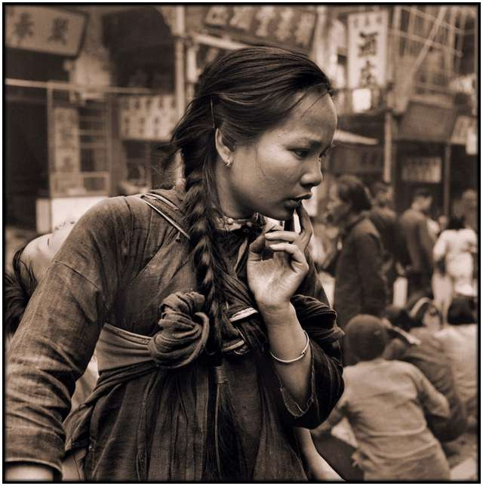
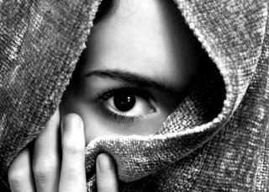
中国当时是什么朝代？
When in China’s timeline did Ruth live?
夏朝
Xia Dynasty (2070–1600 BC)
.
商朝 (殷代)
.
周朝
Zhou Dynasty (1046–256 BC)
Shang (Yin) Dynasty (1600-1046 BC)
.
《路得记》
Book of Ruth

Slide 22
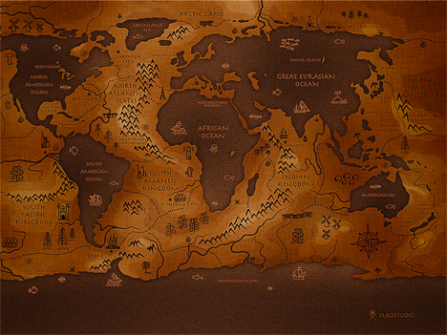
哪里
WHERE?

Slide 23
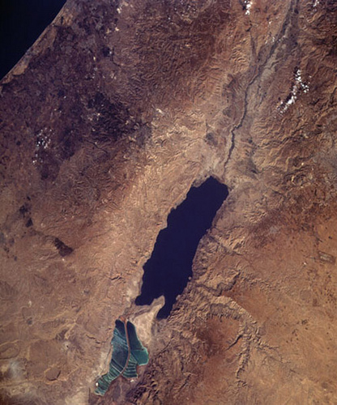
伯利恒 (Bethlehem)
死海: Dead Sea
摩押 (Moab)

Slide 24
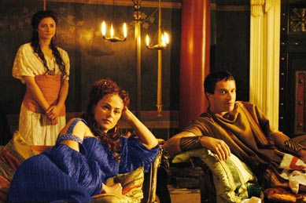
谁? - WHO?

Slide 25
让我们快速回顾上次的内容…
Let’s do a quick review from last week’s lesson…
两以色列人 (拿俄米&以利米勒) 2 Israelites (Elimelek & Naomi)
两儿子（玛伦&基连） 2 Sons (Mahlon & Kilion)
两儿媳 （路得&俄珥巴） 2 Daughters (Ruth & Orpah)
两国 （以色列& 摩押） 2 Nations (Israelites & Moabites)

Slide 26
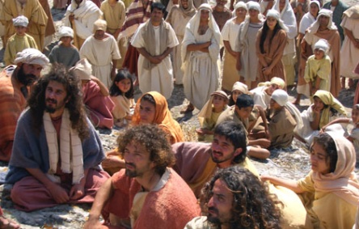
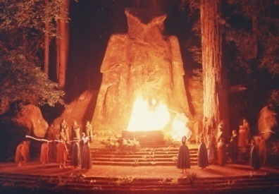
以法他人 (Ephratites)
事奉真神的犹太人，养殖羊群，种植庄稼。
Jews who served God, raised sheep and crops.
伯利恒地区的居民。信徒的紧密社区。
The Bethlehem region inhabitants. Close community of believers.
摩押人 (Moabites)
摩押的意思是“我父的种子”.
Moab means “seed of my father”
摩押人和亚扪人的男子禁止与以色列联姻，
但是女子却没有限制，允许皈依.
Only the men of Moab and Ammon were forbidden to marry into the Israelite
nation, but the women were permitted to convert without restriction. MOABITE LAW!
大部分摩押人都是多神崇拜。他们的主神叫 “基抹”。根据列王纪下记载，在危急时刻，他们会向基抹神献人祭
Most of the Moabites were polytheists. Their chief god was Chemosh. According to II Kings, at times of peril, human sacrifices were offered to him.(1 Ki .11; 2 Ki. 3)

Slide 27
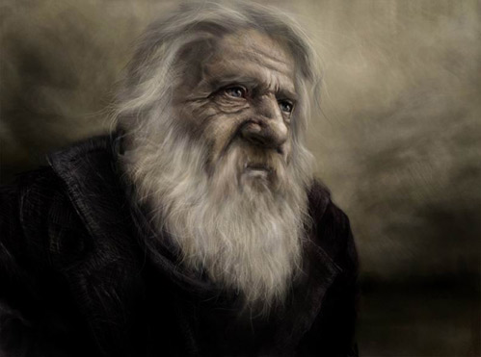
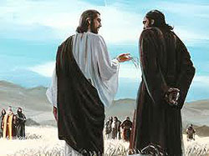
以利米勒 (Elimelek)
拿俄米的丈夫, 基连和玛伦的父亲。
Husband of Naomi; Father of Kilion and Mahlon
把家人带到摩押。他和其双子死于那地。
Brought his family to Moab. He and his sons died there.
玛伦和基连 (Kilion and Mahlon)
以利米勒和拿俄米的两儿子。
The 2 sons of Elimelech and Naomi
玛伦：娶了路得, 其名为“病了.”
Mahlon: Married Ruth; His name means "sick“
基连: 娶了俄珥巴,其名为“虚弱”或“垂死”。
Kilion: Married Orpah; His name means "weakening" or “dying"
双双陨殁于搬去摩押十年后。
Died 10 years after moving to Moab

Slide 28
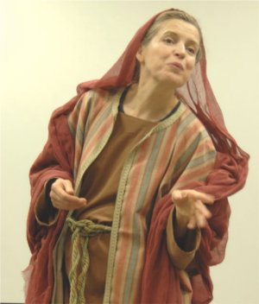
拿俄米 (Naomi)
这个名字的意思是 “可爱的”或 “仁慈的”
Name means “Pleasant” or “gracious”
以利米勒的妻子，玛伦和基连的母亲。
Wife to Elimelek; mother to Mahlon & Kilion
不得不经历短期内接连埋葬三位亲人的痛苦。
Had to suffer through 3 deaths and 3 funerals very close together
爱路得和俄珥巴，不断称她们为“女儿们”。
Loved Ruth and Orpah. Kept calling them ‘daughters’.
希望她的名字改为玛拉（苦的意思）。
Wanted her name changed to MARA (“bitter”)
为她的苦境责备神。
Blamed God for her troubles.
作为寡妇回到她的人民之中。没有家人照顾她。
Went back to her people as a widow. No family to care for her.
试图让她的儿媳们都留在摩押。
Tried to get her daughters to stay in Moab.

Slide 29
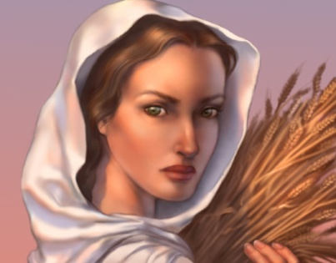
俄珥巴 (Orpah)
一个摩押女子,成长于这种异教环境.
A Moabite, Grew up in this pagan culture.
在路得和拿俄米返回伯利恒后选择留在了摩押地。
Stayed in Moab when Naomi and Ruth went to Bethlehem
回到自己的家人，朋友和众神那里！（15节）。
Returned to her family, her friends AND HER gods! (v.15)
路得 (Ruth)
她转离摩押决定跟随拿俄米和 “拿俄米的神”。
Turned her back on Moab to follow Naomi and Naomi’s God.
吃苦耐劳; 顺服拿俄米; 忠心; 值得信任。
Hard worker; obedient to Naomi; bold; faithful; trusting.
大卫王的曾祖母。耶稣基督的祖先。
Great grandmother of King David. Ancestor of Jesus Christ.

Slide 30
今天我们要将观察和释经结合起来，为要展示大家圣经学习中的“提问方法”。 Today we will combine our observation and interpretation time in order to show you the “QUESTIONING METHOD” of Bible Study.

Slide 31
查经四步法 The 4 Steps of Bible Study
阅读 (READ)
应用 (APPLY)
观察 (OBSERVE)
解释 (INTERPRET)

Slide 32
拿俄米对两个儿妇说: “你们各人回娘家去吧。愿耶和华恩待你们，像你们恩待已死的人与我一样!
拿俄米想让这两儿妇去哪里？
Where did Naomi try to send the girls?
为何拿俄米要差她们回去？
Why did Naomi try to send them back?
两女子如何对待拿俄米的？
How did the girls treat Naomi?
拿俄米给了这两女子什么祝福？
What blessing did Naomi give the girls?
⁸ Then Naomi said to her two daughters-in-law, “Go back, each of you, to your mother’s home. May the LORD show you kindness, as you have shown kindness to your dead husbands and to me.

Slide 33
愿耶和华使你们各在新夫家中得 平安！”于是拿俄米与他们亲嘴。他们就放声而哭,说： “不然，我们必与你一同回你本国去。”
谁赐给我们丈夫和妻子？
Who gives us husbands and wives?
为何她们都放声而哭？
Why did they cry loudly?
谁说要与她一起回去？路得？俄珥巴 ？
两人都？
Who said they would return with her? Ruth? Orpah? Both?
两女子知道以色列人会如何对待她们吗？
Did the girls know how the Israelites would treat them (Moabites)?
⁹ May the LORD grant that each of you will find rest in the home of another husband.” Then she kissed them goodbye and they wept aloud ¹⁰ and said to her, “We will go back with you to your people.”

Slide 34
拿俄米说: “我女儿们哪, 回去吧！ 为何要跟我去呢﹖我还能生子作你们的丈夫吗﹖我女儿们哪，回去吧！ 我年纪老迈， 不能再有丈夫；
拿俄米多少次劝她们回去？（三次）
How many times has Naomi told them to return now? (3)
两寡妇回去后，她们的生活将会是怎样的？
If the girls return home, what will their life be like?
为何拿俄米提到等她再有儿子？
Why did Naomi mention waiting for her to have more sons?
什么是“娶寡嫂制”？
What is a Levirate marriage?
¹¹ But Naomi said, “Return home, my daughters. Why would you come with me? Am I going to have any more sons, who could become your husbands?
¹² Return home, my daughters; I am too old to have another husband.

Slide 35
娶寡嫂制：是一种婚姻形式，亡故之人的兄弟有义务娶兄弟的遗孀，而寡妇也有义务嫁给亡夫的兄弟。这制度曾经，现在依然在世界很多地方施行。（申25:5）
Levirate marriage: is a type of marriage in which the brother of a deceased man is obligated to marry his brother's widow, and the widow is obligated to marry her deceased husband's brother. It was, and still is, practiced in many societies around the world.

Slide 36
中亚和匈奴：娶寡嫂制在中亚和匈奴的游牧民族里广为流行。中国历史学家司马迁（145-87 BC）证实一人亡故后，其亲戚，通常是兄弟娶其遗孀。东北部的匈奴人直到公元七世纪还在施行这种制度。当时妇女的社会地位较高，她们可以决定是否再嫁。她的新夫可能是其亡夫的兄弟或儿子（与另一妇人所生） ，这样她们最终可能嫁给了叔伯或继子。至于年龄则并不重要。
Central Asia and Xiongnu: Levirate marriages were widespread among Central Asian nomads. Chinese historian Sima Qian (145-87 BC) attested that after a man's death, one of his relatives, usually a brother, marries his widow. The Northeastern Huns until the 7th century BC . Women had a high social status and had a choice whether to remarry or not. Her new husband might be a brother or a son (by another woman) of her first husband, so she could end up marrying her brother-in-law or stepson; the difference in age did not matter.

Slide 37
即或说我 还有指望，今夜有丈 夫可以生子，你们岂能 等着他们 长大呢﹖
若路得和俄珥巴 当时为四十岁左右，如果拿俄米再嫁生子年长到足够娶妻，那么她们该多大年纪了？
If Ruth and Orpah were about 40 at this time, how old would they be when Naomi got married and had 2 sons old enough to marry?
姊妹们，若要你嫁给前夫的兄弟，你有什么感觉？
How would you women feel about marrying your husband’s brother or father?
弟兄们，若你的妻子嫁给你的兄弟，你有什么感觉？
How would you men feel about your wife marrying your brother or father?
Even if I thought there was still hope for me—even if I had a husband tonight and then gave birth to sons— ¹³ would you wait until they grew up?

Slide 38
你们岂能等着他们不嫁别人呢﹖我女儿们哪，不要这样。我为你们的缘故甚是愁苦，因为耶和华伸手攻击我。”
拿俄米责备谁带给她这忧伤？
Who does Naomi blame for this grief ?
该责备神还是拿俄米？
Is God to blame or Naomi?
拿俄米在对神苦毒的感情上诚实吗？
Was Naomi being honest about her bitter feelings toward God?
当不幸的事发生在我们身上时，如何才能不让苦毒抓住我们呢？
How can we stop bitterness from overtaking us when something bad happens in our life?
Would you remain unmarried for them? No, my daughters. It is more bitter for me than for you, because the LORD’s hand has turned against me!”

Slide 39
两个儿妇 又放声而哭，俄珥巴与婆婆亲嘴而别，只是路 得 舍不得 拿俄米。
为何说“这时”两儿妇又放声大哭？
Why does it say “AT THIS” this wept aloud again?
俄珥巴放弃了什么？
What was Orpah giving up?
路得放弃了什么？
What was Ruth giving up?
如何看出路得的信心很大？
How does this show the great faith of Ruth?
¹⁴ At this they wept aloud again. Then Orpah kissed her mother-in-law goodbye, but Ruth clung to her.

Slide 40
拿俄米说：“看哪，你嫂子已经回她本国和她所拜的神那里去了，你也跟着你嫂子回去吧！”
俄珥巴回到谁那里？
Who was Orpah returning to?
俄珥巴现在的宗教会是什么？
What would be Orpah’s religion now?
拿俄米有无邀请两儿妇敬拜真神？为什么没？
Did Naomi invite the girls to worship the True God? Why not?
为何拿俄米想独自回乡?
Why would Naomi want to return alone?
¹⁵ “Look,” said Naomi, “your sister-in-law is going back to her people and her gods. Go back with her.”

Slide 41
路得 说：“不要催我回去不跟随你。你往哪里去，我也往那里去；你在哪里住宿，我也在那里住宿；你的国就是我的国，你的神就是我的神。
路得接受了拿俄米哪六样东西？
What 6 things did Ruth accept of Naomi’s? (v.16-17)
为何路得迫不及待要敬拜拿俄米的神？
Why was Ruth anxious to worship Naomi’s God?
去到伯利恒后， 路得将会遇到什 么艰难？
What hardships would Ruth face by moving to Bethlehem?
¹⁶ But Ruth replied, “Don’t urge me to leave you or to turn back from you. Where you go I will go, and where you stay I will stay. Your people will be my people and your God my God.

Slide 42
你在哪里死，我也在那里死，也葬在那里。除非死能使你我相离！不然，愿耶和华重重地降罚与我。”拿俄米见路得 定意要跟随自己去，就不再劝他了。
拿俄米为何停止了与路得的争论？
Why did Naomi stop urging Ruth?
路得去以色列是“去看看的”吗？
Was Ruth just going to Israel to “check it out”?
¹⁷ Where you die I will die, and there I will be buried. May the LORD deal with me,
be it ever so severely, if even death separates you and me.”
⁸ When Naomi realized that Ruth was determined to go with her, she stopped urging her.

Slide 43
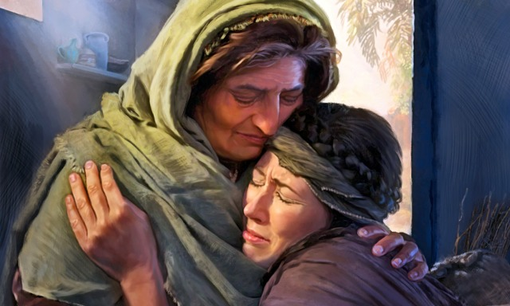
人间最美好的婆媳关系.

Slide 44
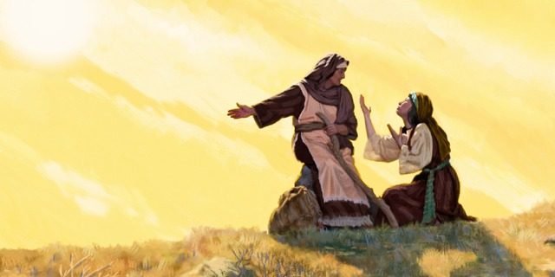
世间最忠诚的儿媳

Slide 45
于是二人同行，来到伯利恒。他们到了伯利恒,合城的人就都惊讶. 妇女们说:“这是拿俄米吗?”
这两妇女要旅行多远？路程多长？
How far did the women travel? How long?
为何合城的人都惊动了？
Why was the whole town stirred?
妇女们彼此问什么？
What did the women ask each other?
¹⁹ So the two women went on until they came to Bethlehem.
When they arrived in Bethlehem, the whole town was stirred because
of them, and the women exclaimed, “Can this be Naomi?”

Slide 46
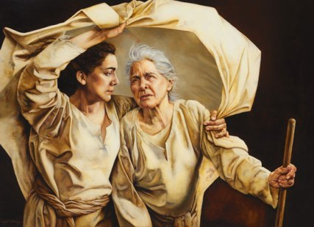
寡妇返乡

Slide 47
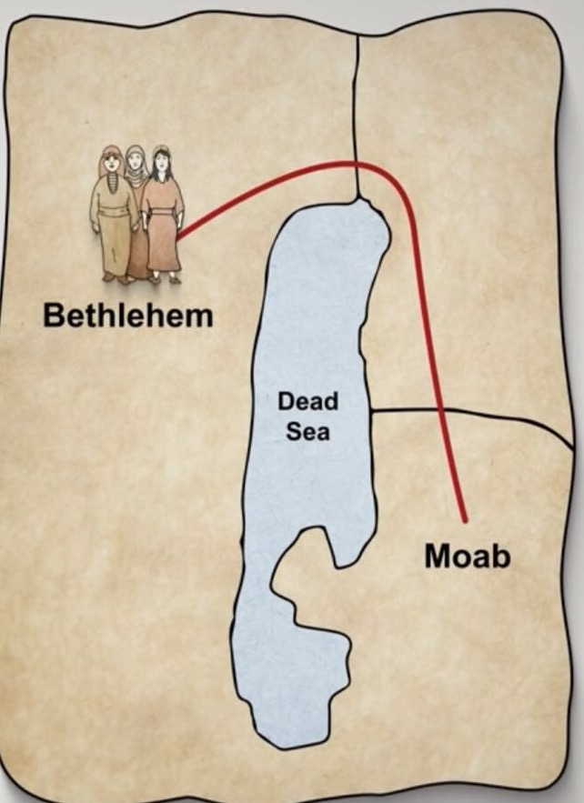
从摩押到伯利恒大约96公里，需要4天，旅程十分艰苦。她们需要向北走过死海边缘，由摩押山地一直下行至海平面以下400多米深的约旦河谷，然后攀登崎岖的荒漠，来到海拔800多米的伯利恒。
伯利恒
伯利恒
摩押地
摩押地
¹⁹ So the two women went on until they came to Bethlehem.
When they arrived in Bethlehem, the whole town was stirred because
of them, and the women exclaimed, “Can this be Naomi?”

Slide 48
拿俄米对她们说: “不要叫我拿俄米 (就是甜的意思), 要叫我玛拉 (就是苦的意思), 因为全能者使我受了大苦。
拿俄米的回答是什么意思？
What does the name Naomi mean?
为何她愿被称为“苦”?
Why did she want to be called Mara?
当她为自己的苦况责怨神时，她错在哪里？
In what way was Naomi wrong when she blamed God for a bitter life?
当她为自己的苦况责怨神时，她对在哪里？
In what way was Naomi right when she blamed God for her bitter life?
²⁰ “Don’t call me Naomi,” she told them. “Call me Mara, because the Almighty has made my life very bitter.

Slide 49
我满满地出去，耶和华使我空 空地回来。耶和华降祸与我，全能者使我受苦。既是这样， 你们为何还叫 我拿俄米呢﹖”
拿俄米出去时，什么是满的？回来时，什么是空的？
In what was did Naomi go away FULL and return EMPTY?
拿俄米多少次将她的苦难，不幸，痛苦和苦毒归于神？
How many times has Naomi credited GOD for her affliction, misfortune, pain and bitterness?
（五次）5
²¹ I went away full, but the LORD has brought me back empty.
Why call me Naomi? The LORD has afflicted me; the Almighty
has brought misfortune upon me.”

Slide 50
拿俄米和她儿妇摩押女子路得 ，从摩押地回来到伯利恒，正是动手割大麦的时候。
她们选择了一个什么季节 返乡？
What time of year did they travel?
你觉得她们为何选择这个 时间？
Why do you think they went back at this time?
以色列从神那里得了祝福和粮食后，有无对神保持忠心？
After receiving blessings and food from God, did the nation Israel stay faithful to Him?
没有。不久就敬拜摩押基抹神了。（士10）
No. They soon worshipped the Moabite god Chemosh. (Judges 10)
²² So Naomi returned from Moab accompanied by Ruth the Moabite,
her daughter-in-law, arriving in Bethlehem as the barley
harvest was beginning.

Slide 51
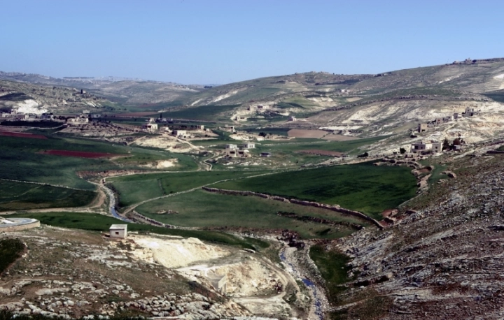
伯利恒（以法他），又称“粮仓”。位于耶路撒冷南方约8公里，希伯伦东北约22公里，海拔880米。城郊的土壤肥沃，出产丰富，是主耶稣出生的地方。

Slide 52
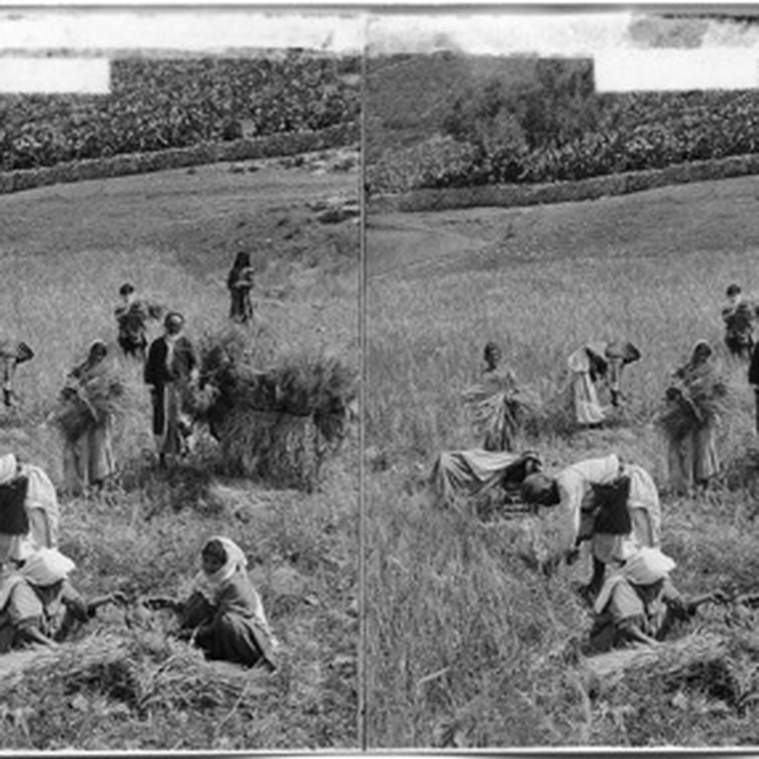
19世纪末，伯利恒的巴勒斯坦人在收割。

Slide 53
查经四步法 The 4 Steps of Bible Study
阅读 (READ)
应用 (APPLY)
观察 (OBSERVE)
解释 (INTERPRET)

Slide 54
Applications
如果当初是你自己首先不顺服神时，不要将你的麻烦怪到神身上。圣经说我们种什么就收什么。我们常常自己惹了麻烦却希望神来改变结果。
Don’t blame God for your troubles when YOU are the one who acted in disobedience in the first place. The Bible says we reap that which we sow. We cause the problem and want God to change the outcome.

Slide 55
Applications
当妇人们失去丈夫，看上去毫无指望时，拿俄米和路得奔向神和他的子民。俄珥巴 则奔向过去的家人，朋友和邪神。
When their husbands died and everything seemed hopeless, Naomi and Ruth ran to God and His people. Orpah ran back to her old family, friends and god.
当情况变得严峻时，你跑向哪里？ 那就是你的神。
Where do YOU run when things get tough? THAT is your god.

Slide 56
Applications
当你因某事心存苦毒或责怨神时，要诚实, 但要记住祂的主权, 相信祂,与祂交谈。阅读一些圣经里神如何奇迹般地将人的悲剧化腐朽为神奇转变为胜利的例子。
When you are bitter or blame God for an event in your life,
be honest about it. But remember His sovereignty. Trust Him.
Talk with Him. Read Biblical examples of those for whom God
has turned their tragedies into triumphs.

Slide 57
我们晓得万事都互相效力，叫爱神的人得益处，就是按他旨意被召的人。 罗8:28
所有的事物都互相效力（好的和坏的）
ALL THINGS WORK TOGETHER (the good and the bad)
为了爱神的人，就是按他旨意蒙召的人的益处。
For Good for those who LOVE GOD and are THOSE HE HAS CALLED
都是为了要成就神的旨意。
It is all to accomplish HIS PURPOSE
“All things work out for the good of those who love God and
are the called according to His purpose.” Romans 8:28

Slide 58
圣经是怎么说的…
What does the Bible say about…
圣经说了很多关于婚姻的事。我们将在两周后再查这个主题。同时，圣经也谈到了不少我们与朋友，约会，与其他信徒，以及与非基督徒的关系。今天，我们就来看看这些关系。
The Bible has a lot to say about marriage relationships. We will look at those verses in 2 weeks. But the Bible also talks a lot about the time we spend with friends, dating, going to church and being with non-Christians. Today, we will look at these.
神看不见的手在各关系中
God’s Invisible Hand in Relationships

Slide 59
神对你的友谊设立了界线…
“有福的人：不从恶人的计谋，不站罪人的道路，不坐好讥笑的人的座位。” 诗篇1:1
“Blessed is the one who does not walk in step with the wicked or stand in the way that sinners take or sit in the company of mockers.” Psalm 1:1
“你们不要自欺，滥交是败坏善行”. 林前15:33
“Do not be deceived: “Bad company ruins good morals.” 1 Cor. 15:33
“与智慧人同性的必得智慧；和愚昧人做伴的必受亏损.”箴13:20
Whoever walks with the wise becomes wise, but the companion of fools will suffer harm.” Prov. 13:20
很多其它经文。
Many more
God has set boundaries for your friendships…

Slide 60
神也为你的约会设立了界线…
约会的目的是为了找到终生伴侣。
Dating is for the purpose of finding a life partner.
“你们和不信的原不相配，不要同负一轭。义和不义有什么相交呢？光明和黑暗有什么相通呢？基督与彼列有什么相和呢？信主的和不信主的有什么相干呢？神的殿和偶像有什么相同呢？因为我们是永生神的殿…你们务要从他们中间出来，与他们分别。”林后6:14-17
“Do not be unequally yoked with unbelievers. For what partnership has righteousness with lawlessness? Or what fellowship has light with darkness? What accord has Christ with Belial? Or what portion does a believer share with an unbeliever? What agreement has the temple of God with idols? For we are the temple of the living God; …Therefore go out from their midst, and be separate from them, says the Lord.” 2 Cor 6:14-17
“耶路撒冷的众女子啊，我指着羚羊或田野的母鹿嘱咐你们，不要惊动，不要叫醒我所亲爱的，等他自己情愿。”歌2:7
“I adjure you, O daughters of Jerusalem…that you not stir up or awaken love until it pleases.” Song of Songs 2:7
“你不会在鸡群里找到你的狮子。”
“You won’t find your lion by looking in the chicken house”
God has set boundaries for your dating…

Slide 61
神指示我们与其他信徒经常交往
“你们不要停止聚会，好像那停止惯了的人，倒要彼此劝勉。既知道那日子临近，就更当如此”来10:25
“Let us not give up meeting together, as some are in the habit of doing, but let us encourage one another—and all the more as you see the Day approaching.” Heb. 10:25
眼不能对手说: “我用不着你;”头也不能对脚说: “我用不着你.”不但如此身上肢体,人以为软弱的, 更是不可少的。身上肢体，我们看为不体面的，越发给它加上体面。你们就是基督的身子，并且各自作肢体。林前12:23, 27
“The eye cannot say to the hand, "I don't need you!" And the head cannot say to the feet, "I don't need you!" On the contrary, those parts of the body that seem to be weaker are indispensable, and the parts that we think are less honorable we treat with special honor. Now you are the body of Christ, and each one of you is a part of it.” 1 Cor. 12:23,27
God directs us to have regular fellowship with other Christians.

Slide 62
神指示我们要爱非信徒并与他们分享福音
“不可行恶人的路，不要走坏人的道。要躲避，不可经过，要转身而去。”（箴4:14-15）
"Do not enter the path of the wicked, and do not walk in the way of evil. Avoid it, do not travel on it; turn away from it and pass on." (Prov. 4:14-15)
“你不可能同时踏上两条绝然不同的道路。你要么离开你的道路，转离你的目标加入别人，要么你的朋友转离他们的道路加入你。当你目标明确地前行时，你就能在熟人中分辨谁是朋友，谁是障碍。”——杰巴良博士
“You cannot walk on two different paths at the same time. Either you will leave yours to walk away from your goal, or your friends will leave theirs to join you. When you walk with purpose, you see which of your acquaintances are friends and which are obstacles.” –Dr. Jay BarLeon
God directs us to love and share the Gospel with non-Christians.

Slide 63
神指示我们要爱非基督徒并与他们分享福音
耶稣花时间与妓女，税吏和最糟糕的罪人在一起，为要拯救他们出罪恶。如果他们拒绝他的好意，他继续前行。
Jesus spent his time with the prostitutes, tax collectors, and worst sinners for the sole purpose of delivering them from their sin. If they rejected His offer, He moved on.
爱人就包括与他们诚实相待。若为了维持友谊而容忍罪恶只能使他们的灵魂永远落在地狱。
Loving people includes being honest with them. Tolerating evil for the sake of friendship only secures their eternity in Hell.
爱每个人。与人分享福音。但要花时间与那些跟你同道并能帮助你亲近神的人在一起，而不是远离他们。
Love everyone. Share the Gospel with everyone. But spend your time with those who are on your path and will help you draw closer to God, not farther away from Him.
God directs us to love and share the Gospel with non-Christians.

