Slide 1
RUTH
4

Slide 2
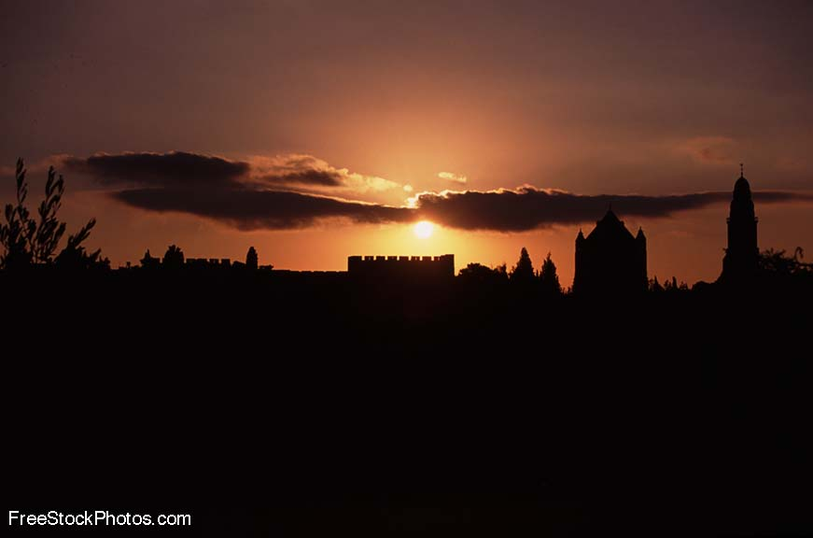
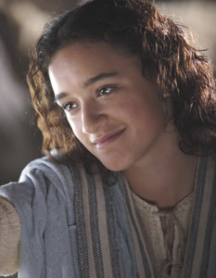
神看不见的手
《路得记》

Slide 3
日期 Date | 经文 Verses | 标题 Title
3月31 3/31 | 所有 ALL | 神看不见的手（导语） God’s Invisible Hand (Introduction)
4月7日 4/7 | 1:1-5 | 神看不见的手在患难中 God’s Invisible Hand in Suffering
4月14日 4/14 | 1:6-22 | 神看不见的手在各关系中 God’s Invisible Hand in Relationships
4月21日 4/20 | 2:1-23 | 神看不见的手在各天职中 God’s Invisible Hand in Vocations
4月28日 4/27 | 3:1-18 | 神看不见的手在婚姻中 God’s Invisible Hand in Marriage
5月5日 5/5 | 4:1-12 | 神看不见的手在救赎中 God’s Invisible Hand in Redemption
5月12日 5/12 | 4:13-22 | 神看不见的手在历史中 God’s Invisible Hand in History
神看不见的手

Slide 4
查经四步法 The 4 Steps of Bible Study
阅读 第二章 (READ Ch. 2)
应用 (APPLY)
观察 (OBSERVE)
解释 (INTERPRET)

Slide 5
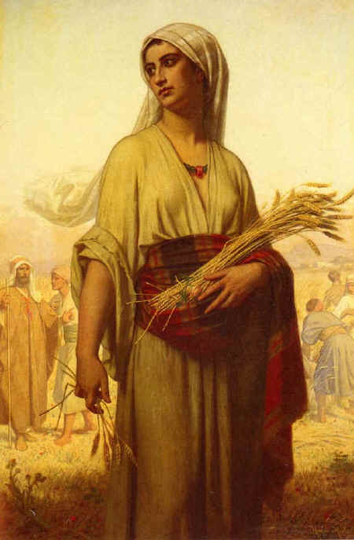
让我们快速回顾上次的内容…
Let’s do a quick review from last week’s lesson…
在犹大闹饥荒。
There is a famine in Israel
以利米勒带领家人到摩押
Elimelek brought his family to Moab
他和二子死于摩押
He and his sons died in Moab
拿俄米和路得返回伯利恒
Naomi and Ruth return to Bethlehem
拿俄米变得苦毒;路得事奉真神。
Naomi gets bitter; Ruth serves God

Slide 6
拿俄米的丈夫以利米勒的亲族中， 有一个人名叫波阿斯，是个大财主。摩押女子路得 对拿俄米说：“容我往田间去，我蒙谁的恩， 就在谁的身后拾取麦穗。”
¹ Now Naomi had a relative on her husband’s side, a man of standing from
the clan of Elimelek, whose name was Boaz. ² And Ruth the Moabite said
to Naomi, “Let me go to the fields and pick up the leftover grain behind
anyone in whose eyes I find favor.”

Slide 7
拿俄米说:“女儿啊，你只管去.” 路得 就去了，来到田间，在收割的人身后拾取麦穗。他恰巧到了以利米勒本族的人波阿斯那块田里。
Naomi said to her, “Go ahead, my daughter.” ³ So she went out, entered a field and began to glean behind the harvesters. As it turned out, she was working in a field belonging to Boaz, who was from the clan of Elimelek.

Slide 8
波阿斯正从伯利恒来， 对收割的人说：“愿耶和华与 你们同在！”他们回答说： “愿耶和华赐福与你！” 波阿斯问监管收割的仆人说： “那是谁家的女子﹖”
⁴ Just then Boaz arrived from Bethlehem and greeted the harvesters,
“The LORD be with you!” “The LORD bless you!” they answered. ⁵ Boaz asked
the overseer of his harvesters, “Who does that young woman belong to?”

Slide 9
监管收割的仆人回答说： “是那摩押女子，跟随拿俄米从摩押地回来的。 她说:‘请你容我跟着收割的人拾取打捆剩下的麦穗.’她从早晨直到如今，除了在屋子里坐一会儿，常在这里。”
⁶ The overseer replied, “She is the Moabite who came back from Moab with Naomi.
⁷ She said, ‘Please let me glean and gather among the sheaves behind the harvesters.
She came into the field and has remained here from morning till now,
except for a short rest in the shelter.”

Slide 10
波阿斯对路得 说：“女儿啊，听我说，不要往别人田里拾取麦穗，也不要离开这里，要常与我使女们在一处。 我的仆人在那块田收割，你就跟着他们去。我已经吩咐仆人不可欺负你；你若渴了，就可以到器皿那里喝仆人打来的水。”
⁸ So Boaz said to Ruth, “My daughter, listen to me. Don’t go and glean in another field and don’t go
away from here. Stay here with the women who work for me. ⁹ Watch the field where the men are harvesting, and follow along after the women. I have told the men not to lay a hand on you.
And whenever you are thirsty, go and get a drink from the water jars the men have filled.”

Slide 11
路得 就俯伏在地叩拜，对他说：“我既是外邦人，怎么蒙你的恩，这样顾恤我呢﹖ ” 波阿斯回答说：“自从你丈夫死后，凡你向婆婆所行的，并你离开父母和本地， 到素不认识的民中，这些事人全都告诉我了。”
¹⁰ At this, she bowed down with her face to the ground. She asked him, “Why have I found such favor
in your eyes that you notice me—a foreigner?” ¹¹ Boaz replied, “I’ve been told all about what you
have done for your mother-in-law since the death of your husband—how you left your father and
mother and your homeland and came to live with a people you did not know before.

Slide 12
愿耶和华照你所行的赏赐你。 你来投靠耶和华─以色列神的翅膀下, 愿你满得 他的赏赐。 路得 说：“我主啊，愿在你眼前蒙恩。 我虽然不及你的一个使女， 你还用慈爱的话安慰我的心。”
¹² May the LORD repay you for what you have done. May you be richly rewarded by the LORD, the God of Israel, under whose wings you have come to take refuge.” ¹³ “May I continue to
find favor in your eyes, my lord,” she said. “You have put me at ease by speaking kindly
to your servant—though I do not have the standing of one of your servants.”

Slide 13
到了吃饭的时候，波阿斯对路得 说: “你到这里来吃饼，将饼蘸在醋里。”路得 就在收割的人旁边坐下；他们把烘了的穗子递给她。她吃饱了，还有余剩的。
¹⁴ At mealtime Boaz said to her, “Come over here. Have some bread and dip it
in the wine vinegar.” When she sat down with the harvesters, he offered her
some roasted grain. She ate all she wanted and had some left over.

Slide 14
她起来又拾取麦穗，波阿斯吩咐仆人说:“她就是在捆中拾取麦穗,也可以容她,不可羞辱她;并要从捆里抽出些来,留在地下任她拾取，不可叱吓她。”
¹⁵ As she got up to glean, Boaz gave orders to his men, “Let her gather among
the sheaves and don’t reprimand her. ¹⁶ Even pull out some stalks for her
from the bundles and leave them for her to pick up, and don’t rebuke her.”

Slide 15
这样，路得 在田间拾取麦穗， 直到晚上，将所拾取的打了， 约有一伊法大麦。 她就把所 拾取的带进城去给婆婆看， 又把她吃饱了所剩的给了婆婆。
¹⁷ So Ruth gleaned in the field until evening. Then she threshed the barley she
had gathered, and it amounted to about an ephah.¹⁸ She carried it back to town,
and her mother-in-law saw how much she had gathered. Ruth also brought
out and gave her what she had left over after she had eaten enough.

Slide 16
婆婆问她说：“你今日在哪里拾取麦穗，在哪里作工呢﹖愿那顾恤你的得 福。”路得 就告诉婆婆说：“我今日在一个名叫波阿斯的人那里作工。”
¹⁹ Her mother-in-law asked her, “Where did you glean today? Where did you work? Blessed be the man who took notice of you!” Then Ruth told her mother-in-law
about the one at whose place she had been working.
“The name of the man I worked with today is Boaz,” she said.

Slide 17
拿俄米对儿妇说：“愿那人蒙耶和华赐福，因为他不断地恩待活人死人。”拿俄米又说：“那是我们本族的人，是一个至近的亲属。” 摩押女子路得 说：“他对我说：你要紧随我的仆人拾取麦穗， 直等他们收完了我的庄稼。”
²⁰ “The LORD bless him!” Naomi said to her daughter-in-law. “He has not stopped showing his kindness to the living and the dead.” She added, “That man is our close relative; he is one of our guardian-redeemers.^{” 21} Then Ruth the Moabite said,
“He even said to me, ‘Stay with my workers until they finish harvesting all my grain.

Slide 18
拿俄米对儿妇路得 说：“女儿啊，你跟着他的使女出去，不叫人遇见你在别人田间，这才为好。” 于是路得 与波阿斯的使女常在一处 拾取麦穗，直到收完了大麦和小麦。路得仍与婆婆同住。
²² Naomi said to Ruth her daughter-in-law, “It will be good for you, my daughter, to go with the women who work for him, because in someone else’s field you might be harmed.”
²³ So Ruth stayed close to the women of Boaz to glean until the barley and wheat harvests were finished. And she lived with her mother-in-law.

Slide 19
查经四步法 The 4 Steps of Bible Study
阅读 (READ)
应用 (APPLY)
观察 (OBSERVE)
解释 (INTERPRET)

Slide 20
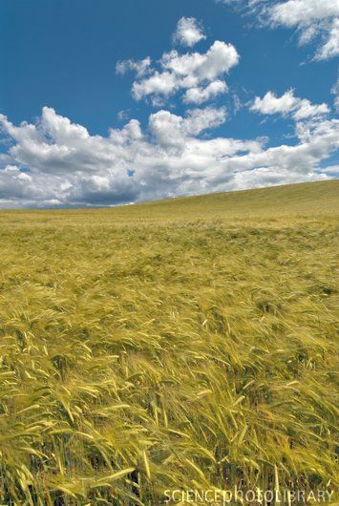
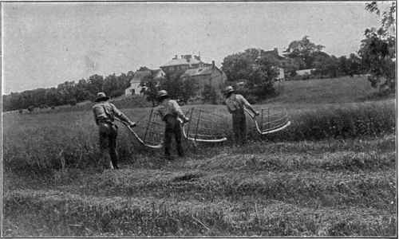
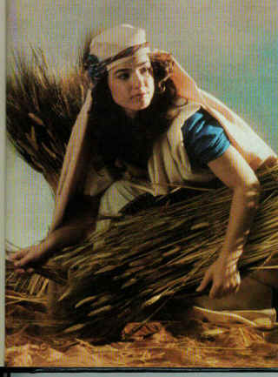
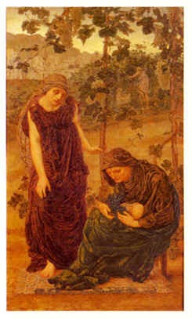
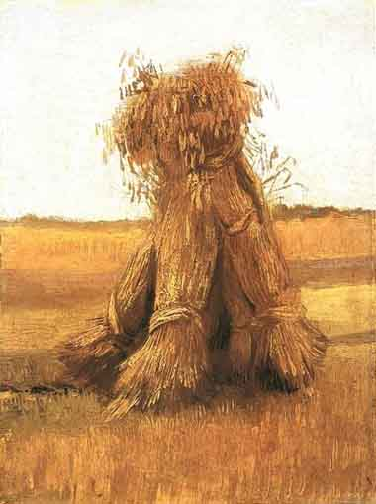
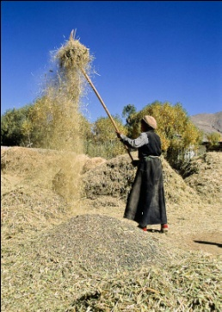
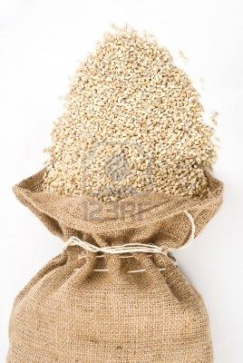
收割大麦 (Harvesting the Barley)
工头选择当天在哪块地收割
The foreman chooses the field for the day
收割工割下大麦
The harvesters cut the barley
妇女将割下的大麦打捆
The women gather the barley into bundles
外邦人和乞丐拾起剩余的麦穗
The foreigners and beggars pick up extra
大麦干后放进仓里。
The barley is dried and put in a barn
让谷粒与谷壳分离
The grain is separated from the chaff
大麦便装袋出售
The barley is bagged up and sold

Slide 21
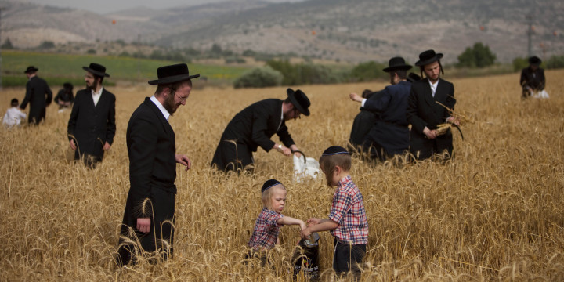
正统犹太人正在用镰刀割小麦，准备七七节（或五旬节）庆典。这一天他们要在会堂诵读妥拉中有关十诫的经文，并诵读路得记。

Slide 22
这章出现了新的人物…
New people introduced in this chapter…

Slide 23
工头 (Foreman)
给工人分工
Assigns the workers to their fields
直接向地主汇报
Reports directly to the landowner
收割工 (Men Harvesters)
负责割下谷物留在地里
Cut the grain and leave it in the field
都是男人
Always men.
女工 (Women Workers)
跟在收割工之后
Followed the harvesters
将割下的庄稼打捆
Gathered the barley into sheaves

Slide 24
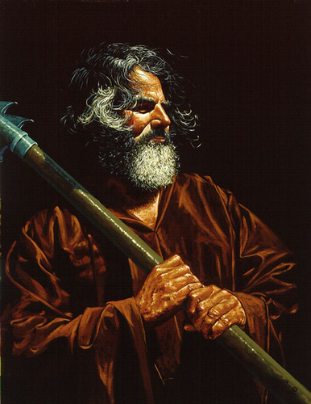
波阿斯 (Boaz)
以利米勒的侄子（据犹太人传统）
Distant relative of Elimelek
伯利恒一位富庶的地主
Wealthy land owner in Bethlehem
其名意为 “他的力量”或 “他带着力量来”
Name means "strength is in him" or "he comes in strength"
比路得年纪大很多。
Much older than Ruth (History say he was 80 and Ruth was 40 when they married)
圣殿里前两根柱子中的一个以波阿斯命名
One of the 2 front columns on the temple was named after Boaz
在1950年代早期，“一个波阿斯”指的是富有的私人农场主或地主。
In the early 1950s, the term "a Boaz" referred to a rich private farmer or landowner.

Slide 25
从亚伯拉罕到波阿斯 (Abraham to Boaz)
亚伯拉罕- Abraham
Father of Israel
以撒- Isaac
以实玛利 - Ishmael
Israel/Arab
雅各 - Jacob
以扫- Esau
Tricky & Hairy
十一个儿子- 11 more sons
犹大 - Judah
Joseph’s eldest brother
法勒斯- Perez
谢拉 – Zereh
From daughter in law
希斯仑 - Hezron
Grandson of Judah
亚兰 - Ram
Left Egypt with Moses
亚米拿达- Amminadab
Born during 40 years in dessert. Aaron’s father in law
拿顺- Nashon
Chief of the tribe of Judah
撒门 - Salmon
喇合 - Rahab
Mom was a godly ex-hooker
波阿斯BOAZ
married Ruth

Slide 26
今天我们要将观察和释经结合起来，为要展示大家圣经学习中的“提问方法”。 Today we will combine our observation and interpretation time in order to show you the “QUESTIONING METHOD” of Bible Study.

Slide 27
查经四步法 The 4 Steps of Bible Study
阅读 (READ)
应用 (APPLY)
观察 (OBSERVE)
解释 (INTERPRET)

Slide 28
拿俄米的丈 夫以利米勒 的亲族中, 有一个人 名叫波阿斯, 是个大财主。
什么是有“有名望的人”？不止是有钱人。
What is a “man of standing”? More than just a ‘rich man’.
我们说波阿斯这名是什么意思来着？
What did we say the name BOAZ meant?
¹ Now Naomi had a relative on her husband’s side, a man of standing from
the clan of Elimelek, whose name was Boaz.

Slide 29
摩押女子路得 对拿俄米说: “容我往田间 去,我蒙谁的 恩,就在谁的 身后拾取麦穗.”
路得出去做工是谁的主意？
Whose idea was it for Ruth to go to work?
为何路得认为在某个不认识的人的地里拾麦穗是OK的？
Why did Ruth think it was OK to pick up grain in the fields of someone she didn’t even know?
犹太律法禁止收割者倒回去拾起遗落的麦穗。要留给外邦人和穷人。
Jewish law forbid the harvesters to go back and pick up leftovers. They were for foreigners and poor people.
² And Ruth the Moabite said to Naomi, “Let me go to the fields and pick up
the leftover grain behind anyone in whose eyes I find favor.”

Slide 30
拿俄米说: “女儿啊,你只 管去.” 路得 就 去了，来到田间,在收割的人身 后拾取麦穗.他 恰巧到了以利 米勒本族的人 波阿斯那块田里。
为何路得出去做工先问是否允许？
Why did Ruth ask permission to go to work?
路得做的是什么工？
What kind of work did Ruth do?
那块地属于谁的？
Who did the field belong to?
“恰巧”…这句话如何说到神的护理？
“As it turned out”… How does this phrase speak about the providence of God?
Naomi said to her, “Go ahead, my daughter.” ³ So she went out, entered a field and began to glean behind the harvesters. As it turned out, she was working in a field belonging to Boaz, who was from the clan of Elimelek.

Slide 31
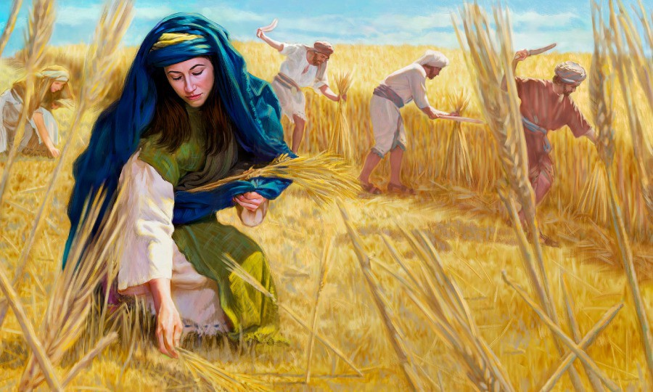
摩押女子路得在波阿斯的麦田里拾麦穗

Slide 32
波阿斯正从伯利恒来, 对收割的人说：“愿耶和华与 你们同在!” 他们回答说: “愿耶和华赐福与你!”
为何这里说波阿斯从伯利恒来？难道他们不都是在伯利恒吗？
Why does it say that Boaz came FROM Bethlehem? Weren’t they also in Bethlehem?
敬虔的犹太人常见的问候语是什么？
What was the common greeting and response of the godly Jew?
⁴ Just then Boaz arrived from Bethlehem and greeted the harvesters,
“The LORD be with you!” “The LORD bless you!” they answered.

Slide 33
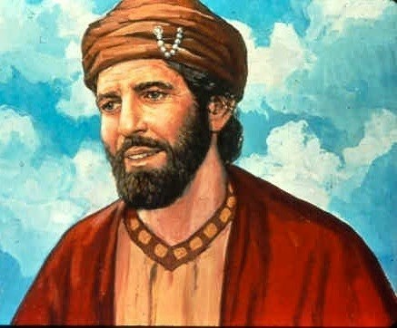
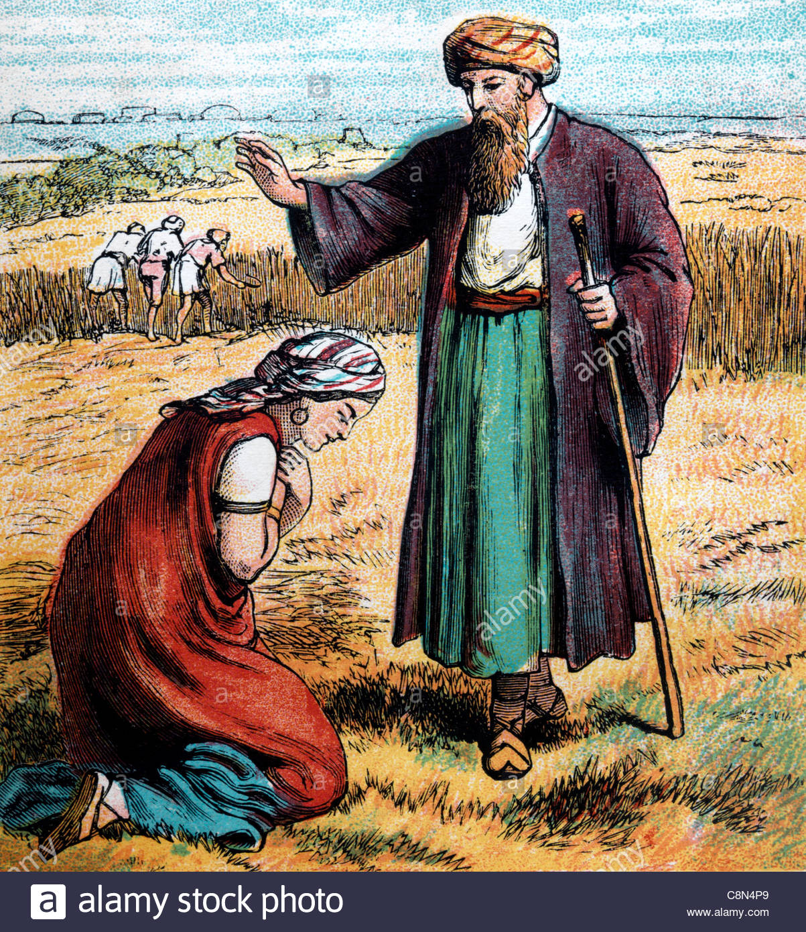
波阿斯

Slide 34
波阿斯问监管 收割的仆人说: “那是谁家 的女子﹖”
波阿斯问监工什么问题？
What did Boaz ask the overseer?
为什么？
Why?
你认为波阿斯为何会注意到路得？
Why do you think Boaz noticed Ruth?
⁵ Boaz asked the overseer of his harvesters,
“Who does that young woman belong to?”

Slide 35
监管收割的仆人回答说:“是那摩押女子，跟随拿俄米从摩押地回来的。她说:‘请你容我跟着收割的人拾取打捆剩下的麦穗.’
路得在开始拾麦穗之前有无获得监工的许可？
Did Ruth ask permission from the overseer before beginning to glean?
为什么监工两次提到路得的摩押身份？
Why does the Overseer mention Ruth was a Moabite twice?
为什么监工提到了拿俄米？
Why does the overseer mention Naomi?
⁶ The overseer replied, “She is the Moabite who came back from Moab with Naomi. ⁷ She said, ‘Please let me glean and gather among the sheaves behind the harvesters.

Slide 36
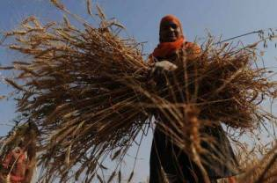
她从早晨 直到如今， 除了在屋子 里坐一会儿， 常在这里。”
这句话告诉了我们有关路得的什么？
What does this verse tell us about Ruth?
She came into the field and has remained here from morning till now,
except for a short rest in the shelter.”

Slide 37
波阿斯对路 得 说:“女儿啊，听我说，不要 往别人田里拾取麦穗，也不要离开这里，要常与我使女们在一处。
波阿斯与路得交谈会冒什么风险？为什么？
What risk was Boaz taking by even talking to Ruth? Why?
为何称她为“女儿啊”？
Why did he call her ‘my daughter’?
他告诉路得要与谁在一起？
Who did he tell Ruth to stay with?
为何他希望她留在他地里？
Why did he want her to stay in his field?
⁸ So Boaz said to Ruth, “My daughter, listen to me. Don’t go and glean in another field and don’t go away from here. Stay here with the women who work for me.

Slide 38
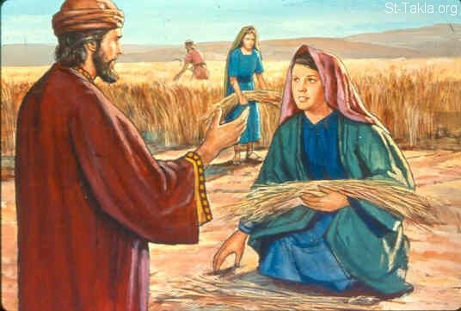
路得遇见波阿斯

Slide 39
我的仆人在那块田收割，你就跟着他们去。我已经吩咐仆人不可欺负你；你若渴了，就可以到器皿那里喝仆人打来的水。”
为何他吩咐工人不能碰她？为何他们会‘碰’她？
Why did he have to tell the men not to touch Ruth? Why would they ‘touch’ her?
为什么从男人的水罐里喝水被视为一种尊荣？
Why was it considered to be an honor to drink from the men’s water jars?
这节经文告诉我们波阿斯什么？
What does this verse show us about Boaz?
⁹ Watch the field where the men are harvesting, and follow along after the women. I have told the men not to lay a hand on you. And whenever you are thirsty, go and get a drink from the water jars the men have filled.”

Slide 40
路得 就俯伏 在地叩拜， 对他说: “我既是外 邦人,怎么蒙 你的恩，这样顾恤我呢?”
为何她要俯伏在地？
Why did she bow with her face to the ground?
她问波阿斯什么？
What did she ask Boaz?
为什么波阿斯与她说话都让她感到惊讶？
Why did it surprise her when Boaz talked to her?
她是否知道波阿斯乃一亲戚？
Did she know Boaz was related yet?
¹⁰ At this, she bowed down with her face to the ground. She asked him,
“Why have I found such favor in your eyes that you notice me—a foreigner?”

Slide 41
波阿斯回答说：“自从你丈夫死后，凡你向婆婆所行的，并你离开父母和本地， 到素不认识的民中，这些事人全都告诉我了。”
波阿斯是如何知道路得的经历的？
How did Boaz know what Ruth had done?
路得离开谁后来到伯利恒？
Who did Ruth leave to come to Bethlehem?
¹¹ Boaz replied, “I’ve been told all about what you have done for your mother-in-law since the death of your husband—how you left your father and mother and your homeland and came to live with a people you did not know before.

Slide 42
愿耶和华照你 所行的赏赐你。 你来投靠耶和 华─以色列神 的翅膀下, 愿你满得 他的赏赐。
为何他祈求神赏赐路得？
Why did he ask God to repay Ruth?
神真有翅膀吗？
Does God really have wings?
投靠在神的翅膀下是何意思？
What does it mean to be under God’s wings?
为何波阿斯称神为“以色列神”？
Why does Boaz call God “the God of Israel’?
¹² May the LORD repay you for what you have done. May you be richly rewarded by the LORD, the God of Israel, under whose wings you have come to take refuge.”

Slide 43
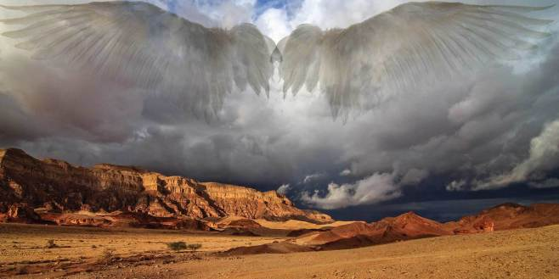
愿你投在耶和华，以色列神的翅膀下

Slide 44
路得 说： “我主啊，愿在你眼前蒙恩. 我虽然不及你 的一个使女， 你还用慈爱的 话安慰我的心.”
“蒙恩”这词是什么意思？
What does the word ‘favor’ mean?
为何波阿斯的这番话让路得心安？
Why did Boaz’s speech put Ruth at ease?
为何路得的地位甚至比仆人还要低？
Why was Ruth’s position even lower than that of a servant?
¹³ “May I continue to find favor in your eyes, my lord,” she said.
“You have put me at ease by speaking kindly to your servant—
though I do not have the standing of one of your servants.”

Slide 45
到了吃饭的时候，波阿斯对路得 说: “你到这里来吃饼,将饼蘸在醋里.” 路得 就在收割的人旁边坐下；他们把烘了的穗子递给她.她吃饱了,还有余剩的.
波阿斯第二次与她说话是什么时候？
When did Boaz talk to her next?
他们午饭都吃了什么？
What did they have for dinner?
路得吃饭时与谁坐在一起？
Who was Ruth sitting with to eat?
她吃饱了吗？为何这点很重要？
Did she get enough to eat? Why is this important?
¹⁴ At mealtime Boaz said to her, “Come over here. Have some bread and dip it in the wine vinegar.” When she sat down with the harvesters, he offered her some roasted grain. She ate all she wanted and had some left over.

Slide 46
她起来又拾取麦穗，波阿斯吩咐仆人说:“她就是在捆中拾取麦穗,也可以容她,不可羞辱她;并要从捆里抽出些来,留在地下任她拾取，不可叱吓她。”
为何波阿斯要吩咐他的工人不要训斥和羞辱路得？
Why did Boaz have to tell the men not to reprimand or humiliate Ruth?
为何他吩咐工人从捆里再抽出些大麦留给路得？
Why did he tell them to pull some barley out that had already been sheaved?
路得熟悉自己的工作吗？
Did Ruth know what she was doing?
申命记24:19 “你在田间收割庄稼，若忘下一捆，不可回去再取，要留给寄居的与孤儿寡妇。这样，耶和华─你神必在你手里所办的一切事上赐福与你。”
Deuteronomy 24:19 “When you are harvesting in your field and you overlook a sheaf, do not go back to get it. Leave it for the alien, the fatherless and the widow, so that the LORD your God may bless you in all the work of your hands.”
¹⁵ As she got up to glean, Boaz gave orders to his men, “Let her gather among the sheaves and don’t reprimand her. ¹⁶ Even pull out some stalks for her from the bundles and leave them for her to pick up, and don’t rebuke her.”

Slide 47
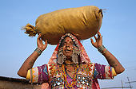
这样,路得 在田间拾取 麦穗, 直到晚 上,将所拾取 的打了,约有 一伊法大麦.
路得那天工作了多长时间？
How long did Ruth work that day?
她是如何打谷的？
How did she thresh the barley?
一伊法大麦相当于多少？
What does an ephah of barley amount to?
一个希伯来计量单位=相当于22升或5加仑。
A Hebrew unit of dry measure = about one bushel (22 liters / 5 gallons).
¹⁷ So Ruth gleaned in the field until evening. Then she threshed the barley she had gathered, and it amounted to about an ephah.

Slide 48
她就把所 拾取的带进 城去给婆婆看, 又把她吃饱 了所剩的给 了婆婆.
她扛着这大麦回家要走多远？
How far did she have to carry the barley?
路得还给了拿俄米什么？
What else did Ruth give Naomi?
18 She carried it back to town, and her mother-in-law saw how much she had gathered. Ruth also brought out and gave her what she had left over after she had eaten enough.

Slide 49
婆婆问她说：“你今日在 哪里拾取麦穗，在哪里作工呢﹖ 愿那顾恤你 的得 福.”
为何拿俄米问她在哪里拾麦穗？
Why did Naomi ask her where she had gleaned and worked?
拿俄米为何怀疑男人会注意到路得？
Why did Naomi suspect that a man had taken notice of Ruth?
¹⁹ Her mother-in-law asked her, “Where did you glean today?
Where did you work? Blessed be the man who took notice of you!”

Slide 50
路得 就告诉婆婆说: “我今日在一 个名叫波阿斯 的人那里作工.”
你认为路得将告诉拿俄米有关波阿斯什么？
What do you think Ruth told Naomi about Boaz?
她如何知道波阿斯的名字？
How did she know his name was Boaz?
她知道波阿斯是一位亲戚吗？
Did she know yet that he was related?
Then Ruth told her mother-in-law about the one at whose place she had been working. “The name of the man I worked with today is Boaz,” she said.

Slide 51
拿俄米对儿 妇说:“愿那人 蒙耶和华赐福, 因为他不断地 恩待活人死人.”
拿俄米现在对神的看法与前面有什么区别？
How is Naomi’s opinion of God different here than it was just a few verses ago?
她前面光提到神惩罚的性情，现在她谈到神的慈爱。
She was just speaking of God’s punishing nature and now she speaks of His kindness.
神如何向活人显示慈爱？
How has God shown kindness to the living?
神如何向死人显示慈爱？
How has God shown kindness to the dead?
²⁰ “The LORD bless him!” Naomi said to her daughter-in-law.
“He has not stopped showing His kindness to the living and the dead.”

Slide 52
拿俄米又说: “那是我们本族的人，是一个至近的亲属.” 摩押女子路得说:“他对我说;你要紧随我的仆人拾取麦穗,直等他们收完了我的庄稼.’
什么是监护救赎者？
What is a guardian-redeemer?
为何作者提醒我们路得是摩押人，尽管她已经皈依了犹太教？
Why does the author remind us here that Ruth is a Moabitess even though she has converted to Judaism?
She added, “That man is our close relative; he is one of our guardian-redeemers.”
²¹ Then Ruth the Moabite said, “He even said to me, ‘Stay with my workers until they
finish harvesting all my grain.

Slide 53
拿俄米对儿 妇路得 说: “女 儿啊,你跟着他 的使女出去, 不叫人遇见你 在别人田间, 这才为好.”
为何路得最好呆在波阿斯的地里？
Why was it good for Ruth to stay in Boaz’s field?
她可能遭受到什么危害？
How could she have been harmed?
²² Naomi said to Ruth her daughter-in-law, “It will be good for you, my daughter, to go with the women who work for him, because in someone else’s field you might be harmed.”

Slide 54
于是路得 与波 阿斯的使女常 在一处 拾取麦穗, 直到收完了大麦和小麦。 路得仍与婆婆 同住。
路得与波阿斯的女工在一起工作了多长时间？
How long did Ruth work with Boaz’s women?
两个收割季节（大麦小麦）
持续七个星期，一直到五旬节。
2 Harvests (Barley AND wheat)
路得与谁住在一起？
Who did Ruth live with?
²³ So Ruth stayed close to the women of Boaz to glean until the barley and
wheat harvests were finished. And she lived with her mother-in-law.

Slide 55
查经四步法 The 4 Steps of Bible Study
阅读 (READ)
应用 (APPLY)
观察 (OBSERVE)
解释 (INTERPRET)

Slide 56
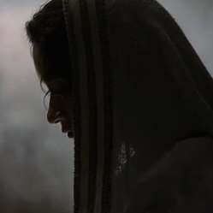
什么 - Applications
让我们来看看今天的课程该如何应用在老板，员工和求职者身上。然后，我们将查考一些有关工作的圣经指南。
Let’s see some practical applications for the boss, the employee, and the job seeker. Then we will look at some Biblical guidelines for working.

Slide 57
给老板的忠告
老板波阿斯如何向工人打招呼？他们如何回应他？
How does the boss Boaz greet his workers? How do they respond to him?
波阿斯对他的女工尊重爱护有加，不允许男雇员骚扰她们。
Boaz treats his female workers with respect and doesn’t allow his other men employees to harass them.
他与雇员一起分享，并确保他们吃够吃饱。
He shares with his employees and he makes sure they have enough.
“你们作主人（老板）的，待仆人也是一理，不要威吓他们。因为知道，他们和你们同有一位主在天上；他并不偏待人。”弗6:9
“Masters (bosses) treat your slaves in the same way. Don’t threaten them; remember, you both have the same Master in heaven, and he has no favorites.” (Eph. 6:9)
Advice for the boss

Slide 58
给雇员的忠告
波阿斯注意到工作努力的人
Bosses notice hard workers.
路得对于所得的一切心存感恩。
Ruth was grateful for everything given to her.
路得只在公休的时候休息
Ruth didn’t rest except for her breaks
你要通过工作荣耀神
You are honoring God by working.
路得对这个国家，人民和工作都不熟悉，但她并没有使用这些作为不工作的借口。
She was unfamiliar with the country, the people, and the work but she didn’t use that as an excuse NOT to work.
Advice for the employee

Slide 59
给求职者的忠告
神将路得带到他希望的地方。
God led Ruth to the place He wanted her.
她进去的时候并不知道这是个完美的地方。她尽她所能，别人也注意到了她的努力。
She didn’t know it was the perfect place when she took the job. She just did her best and was noticed for doing so.
尽管她是工价最低廉的员工，然而她还留下足够食物与拿俄米分享。
Even though she was the lowest paid of the employees, she saved enough to share with Naomi.
寻求神的旨意，而不是你自己。
Seek God’s will, not your own.
不要在选择工作的时候只考虑金钱！
DO NOT MAKE JOB DECISIONS BASED ONLY ON MONEY!
Advice for the job seeker

Slide 60
如何知道神对我生命的旨意？
神的训导旨意：他命令了我们但不强迫我们去做。
Preceptive Will of God: That which He commands but will not force us to do.
神的主权旨意：神按他的旨意而行，无人能拦阻。
Sovereign Will of God: God will do what He wants. No one can stop Him.
神的隐藏旨意: “隐秘的事是属耶和华─我们神的；惟有明显的事是永远属我们和我们子孙的，好叫我们遵行这律法上的一切话。”申29:29
Hidden will of God: “The secret things belong to the LORD our God, but the things revealed belong to us and to our children forever, that we may follow all the words of this law.” Deut. 29:29
神的启示旨意：在圣经中已启示的。学习神已经启示了内容，他会一步步启示他完美旨意。
Revealed will of God: Revealed in the Scripture. Study what God HAS revealed and He will reveal His perfect will one step at a time.
How do I know God’s will for my life?

Slide 61
我们需要问的问题
根据神的话，他允许我做这份工还是禁止？
Does God allow this job or is it forbidden in His Word?
这份工对于人类益处有何贡献？
How does this job contribute to the common good of mankind?
我是否真有能力做这份工？（罗12:3）
Do I honestly have the ability to do this job? (Rom. 12:3)
我是否真想做这份工？
Do I really want to do this job?
其他人是否认为我擅长这类工作？
Do others think I am good at this type of job?
我如何在眼前这份工作上每天荣耀神？(林前10:31) “所以,你们或吃或喝,无论作什么,都要为荣耀神而行。”
How can I honor God daily at the job I have now? (1 Cor. 10:31) “So whether you eat or drink or whatever you do, do it all for the glory of God.”
Questions we need to ask.

Slide 62
兴趣
Interest
能力
Ability
成功
Success

Slide 63
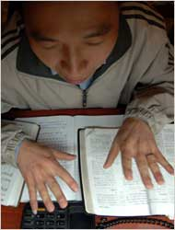
圣经是如何说到工作的？
挣钱的基本方式就是工作。不要试图做最少的工作却要挣最多的钱。不要将休息看得比工作重。工作是我们受造的目的，是我们荣耀神的方式。当你竭尽全力将工作做得最出色时，上帝便从中得荣耀。
The primary way to earn money is to work for it. Don’t try to get as much as possible by doing as little as possible. Don’t value rest more than work. WORK is what we were created to do as a means of carrying out the real goal of bringing glory to God? God receives glory as you do the best you can at the job you have.
What the Bible says about working

