Slide 1
RUTH
5

Slide 2
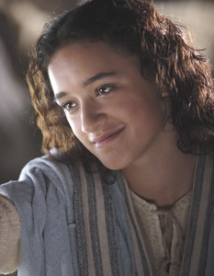
神看不见的手
《路得记》

Slide 3
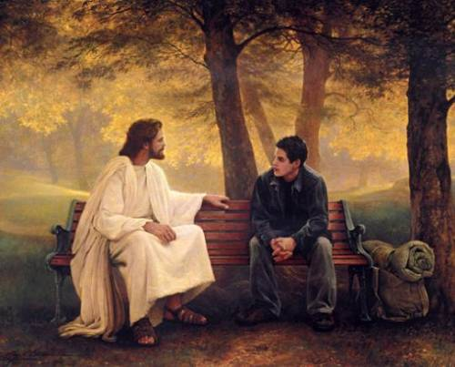
上周: 神看不见的手在职业中
Last week: God’s Invisible Hand in Vocations
神与你随地随在！
God is with you Everywhere!

Slide 4
日期 Date | 经文 Verses | 标题 Title
3月31 3/31 | 所有 ALL | 神看不见的手（导语） God’s Invisible Hand (Introduction)
4月7日 4/7 | 1:1-5 | 神看不见的手在患难中 God’s Invisible Hand in Suffering
4月14日 4/14 | 1:6-22 | 神看不见的手在各关系中 God’s Invisible Hand in Relationships
4月21日 4/20 | 2:1-23 | 神看不见的手在各天职中 God’s Invisible Hand in Vocations
4月28日 4/27 | 3:1-18 | 神看不见的手在婚姻中 God’s Invisible Hand in Marriage
5月5日 5/5 | 4:1-12 | 神看不见的手在救赎中 God’s Invisible Hand in Redemption
5月12日 5/12 | 4:13-22 | 神看不见的手在历史中 God’s Invisible Hand in History
神看不见的手

Slide 5
查经四步法 The 4 Steps of Bible Study
阅读 第三章 (READ Ch. 3)
应用 (APPLY)
观察 (OBSERVE)
解释 (INTERPRET)

Slide 6
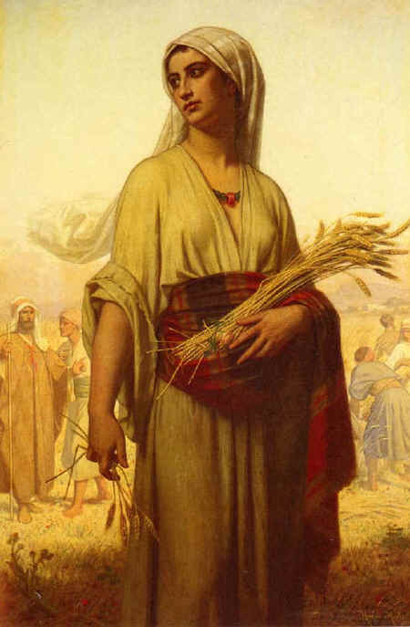
让我们快速回顾上次的内容…
Let’s do a quick review from last week’s lesson…
在犹大闹饥荒。
There is a famine in Israel
以利米勒带领家人到摩押
Elimelek brought his family to Moab
他和二子死于摩押
He and his sons died in Moab
拿俄米和路得返回伯利恒
Naomi and Ruth return to Bethlehem
拿俄米变得苦毒;路得事奉真神。
Naomi gets bitter; Ruth serves God

Slide 7
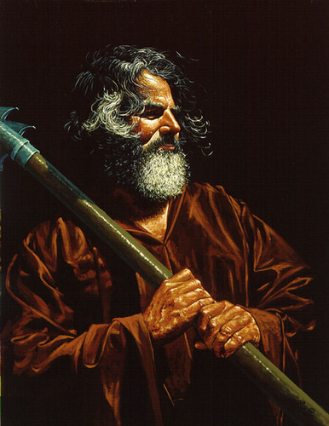
路得到地里干活
Ruth goes to work in the fields
神带她去到波阿斯的地里
God leads her to Boaz’ field
波阿斯是一亲戚,恩慈待她。
Boaz is a distant relative and treats her kindly.
波阿斯让路得只在他地里工作。
Boaz tells Ruth to only work in his fields.
拿俄米和路得看到神不可见的手在做工。
Naomi and Ruth see God’s invisible hand at work.
收割的季节快要结束了
The harvest season is coming to an end.
拿俄米有了一个计划。
Naomi has a plan.

Slide 8
路得 的婆婆拿俄米对她说：“女儿啊，我不当为你找个安身之处，使你享福吗﹖ 你与波阿斯的使女常在一处，波阿斯不是我们的亲族吗﹖他今夜在场上簸大麦；你要沐浴抹膏，换上衣服，下到场上，却不要使那人认出你来。你等他吃喝完了，
¹ One day Ruth’s mother-in-law Naomi said to her, “My daughter, I must find a home for you,
where you will be well provided for. ² Now Boaz, with whose women you have worked, is a
relative of ours. Tonight he will be winnowing barley on the threshing floor. ³ Wash, put on perfume,
and get dressed in your best clothes. Then go down to the threshing floor, but don’t let him know
you are there until he has finished eating and drinking.

Slide 9
到他睡的时候，你看准他睡的地方，就进去掀开他脚上的被，躺卧在那里，他必告诉你所当作的事。” 路得 说：“凡你所吩咐的，我必遵行。”路得 就下到场上，照她婆婆所吩咐她的而行。
⁴ When he lies down, note the place where he is lying. Then go and uncover his feet
and lie down. He will tell you what to do.” ⁵ “I will do whatever you say,”
Ruth answered. ⁶ So she went down to the threshing floor and
did everything her mother-in-law told her to do.

Slide 10
波阿斯吃喝完了，心里欢畅，就去睡在麦堆旁边。路得 便悄悄地来掀开他脚上的被，躺卧在那里。 到了夜半，那人忽然惊醒，翻过身来，不料有女子躺在他的脚下。
⁷ When Boaz had finished eating and drinking and was in good spirits, he went over
to lie down at the far end of the grain pile. Ruth approached quietly, uncovered his feet and lay down. ⁸ In the middle of the night something startled the man;
he turned—and there was a woman lying at his feet!

Slide 11
他就说：“你是谁﹖”回答说：“我是你的婢女路得 。求你用你的衣襟遮盖我，因为你是我一个至近的亲属。”
⁹ “Who are you?” he asked. “I am your servant Ruth,” she said.
“Spread the corner of your garment over me, since you
are a guardian-redeemer of our family.”

Slide 12
波阿斯说：“女儿啊，愿你蒙耶和华赐福。你末后的恩比先前更大；因为少年人无论贫富，你都没有跟从。女儿啊，现在不要惧怕，凡你所说的，我必照着行；我本城的人都知道你是个贤德的女子。我实在是你一个至近的亲属，只是还有一个人比我更近。
¹⁰ “The LORD bless you, my daughter,” he replied. “This kindness is greater than that which you
showed earlier: You have not run after the younger men, whether rich or poor.
¹¹ And now, my daughter, don’t be afraid. I will do for you all you ask. All the people of my town
know that you are a woman of noble character. ¹² Although it is true that I am a guardian-redeemer
of our family, there is another who is more closely related than I.

Slide 13
你今夜在这里住宿，明早他若肯为你尽亲属的本分，就由他吧！倘若不肯，我指着永生的耶和华起誓，我必为你尽了本分，你只管躺到天亮。”路得 便在他脚下躺到天快亮，人彼此不能辨认的时候就起来了。波阿斯说：“不可使人知道有女子到场上来。”
¹³ Stay here for the night, and in the morning if he wants to do his duty as your guardian-redeemer, good; let him redeem you. But if he is not willing, as surely as the LORD lives I will do it.
Lie here until morning.” ¹⁴ So she lay at his feet until morning, but got up before anyone could be recognized; and he said, “No one must know that a woman came to the threshing floor.”

Slide 14
又对路得 说：“打开你所披的外衣。”她打开了，波阿斯就撮了六簸箕大麦，帮她扛在肩上，她便进城去了。路得 回到婆婆那里，婆婆说：“女儿啊，怎么样了﹖”
¹⁵ He also said, “Bring me the shawl you are wearing and hold it out.”
When she did so, he poured into it six measures of barley and placed the
bundle on her. Then he went back to town. ¹⁶ When Ruth came to her
mother-in-law, Naomi asked, “How did it go, my daughter?”

Slide 15
路得 就将那人向他所行的述说了一遍，又说：“那人给了我六簸箕大麦，对我说：你不可空手回去见 你的婆婆。”婆婆说：“女儿啊，你只管安坐等候，看这事怎样成就，因为那人今日不办成这事必不休息。”
Then she told her everything Boaz had done for her ¹⁷ and added, “He gave me these
six measures of barley, saying, ‘Don’t go back to your mother-in-law empty-handed.’”
¹⁸ Then Naomi said, “Wait, my daughter, until you find out what happens.
For the man will not rest until the matter is settled today.”

Slide 16
查经四步法 The 4 Steps of Bible Study
阅读 (READ)
应用 (APPLY)
观察 (OBSERVE)
解释 (INTERPRET)

Slide 17
今天我们要将观察和释经结合起来，为要展示大家圣经学习中的“提问方法”。 Today we will combine our observation and interpretation time in order to show you the “QUESTIONING METHOD” of Bible Study.

Slide 18
路得 的婆婆拿俄米对她说：“女儿啊，我不当为你找个安身之处，使你享福吗﹖
为什么给儿媳找新夫是拿俄米的工作？
Why was it Naomi’s job to find a husband for her daughter-in-law?
拿俄米是否也在给自己找后路？
Was Naomi also looking after herself?
¹ One day Ruth’s mother-in-law Naomi said to her, “My daughter, I must find a
home for you, where you will be well provided for.

Slide 19
犹太文化认为：一个男人如果在世时没有留下后裔就死了，这人就等于没有在世上存在过。 因此，根据犹太传统，寡妇拿俄米有义务传承她夫家的名号和产业。既然自己已年级老迈，她唯一能的做就是为路得寻夫，通过路得将以利米勒家的产业赎出来，让父家的名号能继续遗传下去。同时，让路得能有个好归宿。

Slide 20
你与波阿斯的使女常在一处，波阿斯不是我们的亲族吗﹖
为什么拿俄米提到波阿斯是一位亲属？
Why does Naomi mention Boaz is a relative?
谁首先提到波阿斯是可能的丈夫人选？（波阿斯？拿俄米？路得？）
Who first mentions Boaz as a possible husband? (Boaz? Naomi? Ruth?)
2. Now Boaz, with whose women you have worked, is a relative of ours.

Slide 21
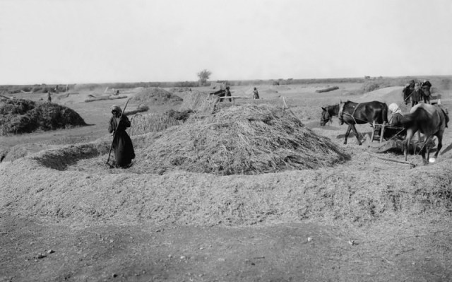
19世纪末，巴勒斯坦的农夫在打谷场上打麦子，他们用
牲畜拖着碌碡碾压麦子，把麦粒和糠秕脱离。

Slide 22
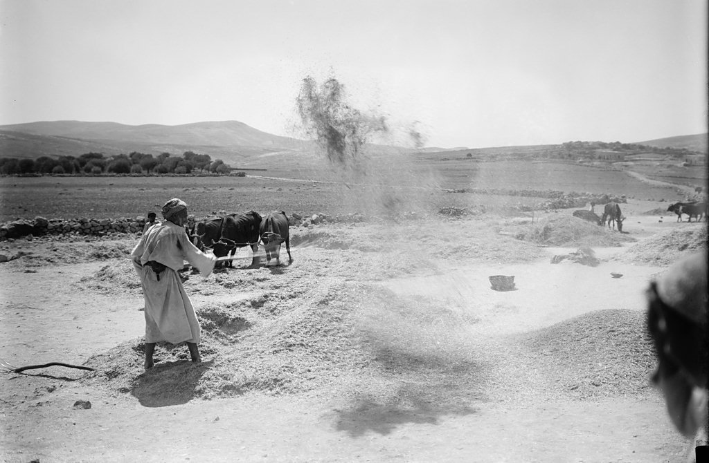
19世纪末，巴勒斯坦的农夫在打谷场上扬场。农夫利用碌碡把麦粒和糠秕分开后，再用木叉把麦粒和脱离的糠秕一起扬在空中，风把比较轻的糠秕吹到远处，而比较重的麦粒则落在近处，这样可以把麦粒和糠秕分开。

Slide 23
他今夜在场上簸大麦；你要沐浴抹膏，换上衣服，下到场上，却不要使那人认出你来。你等他吃喝完了，
什么是簸大麦？
What is winnowing barley?
拿俄米指导路得做了哪三件事让她变得更有吸引力（结束寡妇身份，迈向新生活）？
What 3 things did Naomi instruct Ruth to do to make herself more attractive ?
拿俄米是问路得还是吩咐路得？
Did Naomi ask Ruth or tell her?
为什么 拿俄米选择这个时机让路得去夜访麦场？
Why was Ruth to wait for Boaz to finish before letting Boaz know she was there?
Tonight he will be winnowing barley on the threshing floor. ³ Wash, put on perfume,
and get dressed in your best clothes. Then go down to the threshing floor, but don’t
let him know you are there until he has finished eating and drinking.

Slide 24
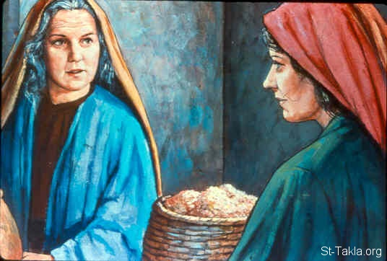
拿俄米指示路得如何行

Slide 25
路得 说： “凡你所吩咐的，我必遵行。” 路得 就下到场上，照她婆婆所吩咐她的而行。
为何路得在这件事上完全遵从婆婆？
Why was Ruth obedient to her mother-in-law in this matter?
这个故事是否意味着每个婆婆都有权利控制儿媳的生活？
Does this story give every mother-in-law the right to control her daughter-in-law ‘s life?
⁵ “I will do whatever you say,” Ruth answered. ⁶ So she went down to the threshing
floor and did everything her mother-in-law told her to do.

Slide 26
到他睡的时候，你看准他睡的 地方，就进去掀开他脚上的被，躺卧在那里， 他必告诉你所 当作的事。”
为何路得需要知道波阿斯在哪里躺下？
Why did Ruth need to see where Boaz laid down?
路得掀开他脚下的被子有什么重要意义？
What is the significance of Ruth uncovering Boaz’ feet?
为何这一步需要路得的信心？
Why was this a step of faith for Ruth?
⁴ When he lies down, note the place where he is lying. Then go and uncover
his feet and lie down. He will tell you what to do.”

Slide 27
波阿斯吃喝 完了,心里欢畅，就去 睡在麦 堆旁边。
波阿斯去睡觉时心情如何？为什么？
What was Boaz’ mood when he went to bed? Why?
为什么作者要提到（英文圣经提到）波阿斯在麦堆最远的那端躺下？
Why does the author mention that Boaz laid down at the far end of the pile?
⁷ When Boaz had finished eating and drinking and was in good spirits,
he went over to lie down at the far end of the grain pile.

Slide 28
路得 便悄悄地来掀开他脚上的被，躺卧在那里。 到了夜半，那人忽然惊醒，翻过身来，不料有女子躺在他的脚下。
为何路得悄悄靠近呢？
Why did Ruth approach quietly?
你认为波阿斯发现一个女人在他脚下时有什么想法？
What do you think Boaz thought when he discovered a woman at his feet?
你认为当波阿斯看见她躺在脚下时，路得有什么感觉？
How do you think Ruth felt when Boaz saw her laying at his feet?
Ruth approached quietly, uncovered his feet and lay down. ⁸ In the middle of the night something startled the man; he turned—and there was a woman lying at his feet!

Slide 29
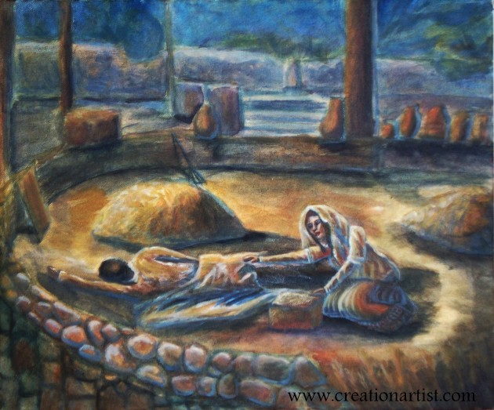
路得向波阿斯求婚

Slide 30
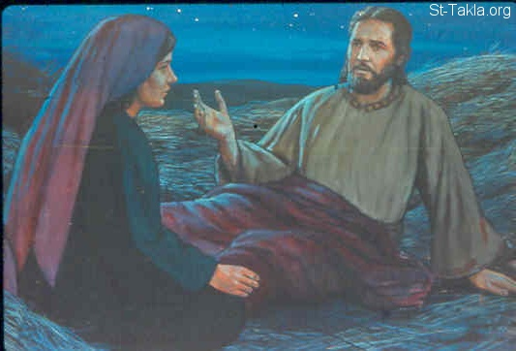
路得夜访打麦场

Slide 31
他就说：“你是谁﹖”回答说：“我是你的婢女路得 。求你用你的衣襟遮盖我，因为你是我一个至近的亲属。”
为何他问她是谁？他不是已经认识她好几个月了么？
Why did he ask who she was? Didn’t he already know her for several months?
为何路得要求波阿斯用衣服盖她？
Why did she ask Boaz to put his garment over her?
什么是“监护救赎者（至近的亲属）”？
What is a guardian-redeemer?
⁹ “Who are you?” he asked. “I am your servant Ruth,” she said. “Spread the corner
of your garment over me, since you are a guardian-redeemer of our family.”

Slide 32
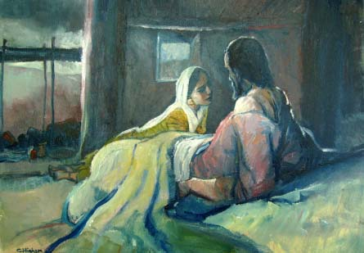
观点一: View #1
Naomi is asking Ruth to make herself sexually desirable to Boaz
Naomi assumed that a drunk Boaz could not resist sex with Ruth
Boaz would then marry Ruth out of guilt or pregnancy
Ruth was willing to have sex with Boaz to get a rich husband
“spread your cloak over me” means “uncover your genitals and come have sex with me”
She left before dawn to hide their sexual affair
Boaz told Ruth to spend the night, have sex, but tell no one
Boaz gave Ruth grain as payment for her sexual services

Slide 33
观点二: View #2
以西结书16:8 “我又从你身旁经过，见你已经到了谈情说爱的时候，我就用我的衣襟搭在你身上，遮盖你赤裸的身体；我又向你起誓，与你立约，于是你就属于我了。这是主耶和华的宣告。”
Ezekiel 16:8 " And when I passed by again, I saw that you were old enough for love. So I wrapped my cloak around you to cover your nakedness and declared my marriage vows. I made a covenant with you, says the Sovereign Lord, and you became mine.”
Naomi told Ruth to look good instead of covered with dirt from work
Ruth was willing to marry Boaz, provide for Naomi, perpetuate her husbands name by giving him a son, keep the inheritance in the family
Ruth identifies herself as a relative and reminds Boaz of his responsibility as a guardian-redeemer. (v.9)
Boaz gives her the Lord’s blessing (v.10), not a sexual reply
“Spread your garment” means “"I would like to be the one to whom you pledge your faithfulness and with whom you make a marriage covenant."” (Ez. 16:8)
路得记2:12 “愿耶和华照你所行的赏赐你。你来投靠耶和华─以色列神的翅膀下，愿你满得 他的赏赐。” 衣襟和翅膀相同的字根。
Ruth 2:12" "The Lord recompense you for what you have done, and a full reward be given you by the Lord, the God of Israel, under those wings you have come to take refuge."
The word for ‘garment’ is the same word in Hebrew for ‘wings’. Ruth was reminding Boaz of his blessing on her earlier in Ruth 2:12.
Boaz mentions that Ruth’s reputation is high even among the Jews (v.11).
Boaz was willing to forfeit Ruth to obey Jewish laws (a closer redeemer). Why would he break the laws regarding sex?

Slide 34
波阿斯说：“女儿啊，愿你蒙耶和华赐福。你末后的恩比先前更大；因为少年人无论贫富，你都没有跟从。
为何他称她为女儿？
Why does he call her daughter?
路得先前展示了什么恩情？
What kindness had Ruth shown earlier?
路得选择了波阿斯而没选择谁？
Who had Ruth chosen Boaz over?
他们的年龄差有多大？
What was their age difference?
¹⁰ “The LORD bless you, my daughter,” he replied. “This kindness is greater than that which you showed earlier: You have not run after the younger men, whether rich or poor.

Slide 35
女儿啊，现在不要惧怕，凡你所说的，我必照着行；我本城的人都知道你是个贤德的女子。
路得向波阿斯求什么？
What was Ruth asking Boaz to do?
路得的名声怎么样？
What was Ruth’s reputation?
来到麦场可能会怎样损害路得和波阿斯的声誉？
How did coming to the threshing floor jeopardize Ruth & Boaz’ reputations?
¹¹ And now, my daughter, don’t be afraid. I will do for you all you ask. All the
people of my town know that you are a woman of noble character.

Slide 36
我实在是你一 个至近的亲属，只是还有一个 人比我更近。
为什么波阿斯提到另一个亲属？
Why does Boaz mention another family member?
当路得从波阿斯嘴里听到这个时，路得会有什么感觉？
How do you think Ruth felt when she heard this from Boaz?
¹² Although it is true that I am a guardian-redeemer of our family, there is
another who is more closely related than I.

Slide 37
你今夜在这里住宿，明早他若肯为你尽亲属的本分，就由他吧！倘若不肯，我指着永生的耶和华起誓，我必为你尽了本分，你只管躺到天亮。”
为何他再次要求她躺到天亮才走？
Why does he tell her twice to stay until morning?
波阿斯对另一个救赎者的态度是什么？
What was Boaz’ attitude regarding the other redeemer?
如何体现出波阿斯敬畏上帝？
¹³ Stay here for the night, and in the morning if he wants to do his duty as your
guardian-redeemer, good; let him redeem you. But if he is not willing, as surely
as the LORD lives I will do it. Lie here until morning.”

Slide 38
路得只是希望波阿斯娶她那么简单吗？
路得希望波阿斯成为她的“监护救赎人”，将她夫家的产业赎买下来，并生子将夫家名号传下去。意味着波阿斯要作出很大的牺牲。
¹³ Stay here for the night, and in the morning if he wants to do his duty as your
guardian-redeemer, good; let him redeem you. But if he is not willing, as surely
as the LORD lives I will do it. Lie here until morning.”

Slide 39
路得 便在他脚下躺到天快亮，人彼此不能辨认的时候就起来了。波阿斯说：“不可使人知道有女子到场上来。”
为什么不让人知道一个女子来到麦场很重要？
Why was it important that no one know a woman came to the threshing floor?
¹⁴ So she lay at his feet until morning, but got up before anyone could be recognized;
and he said, “No one must know that a woman came to the threshing floor.”

Slide 40
又对路得 说：“打开你所披的外衣。”她打开了，波阿斯就撮了六簸箕大麦，帮她扛在肩上，他便进城去了。
波阿斯给了路得什么礼物？
What gift did Boaz give Ruth?
波阿斯进程去办事起得有多早？
How early did Boaz go to the town to take care of the situation?
¹⁵ He also said, “Bring me the shawl you are wearing and hold it out.”
When she did so, he poured into it six measures of barley and placed the bundle on her. Then he went back to town.

Slide 41
路得 回到婆婆那里，婆婆说：“女儿啊， 怎么样了﹖”
路得去了麦场的这一夜，拿俄米可能在想些什么？
What might have been going through Naomi’s mind when Ruth was gone all night?
¹⁶ When Ruth came to her mother-in-law, Naomi asked, “How did it go, my daughter?”

Slide 42
路得 就将那人向他所行的述说了一遍，又说：“那人给了我六簸箕大麦，对我说：你不可空手回去见 你的婆婆。”
为什么波阿斯也给拿俄米一份礼物？
Why did Boaz give a gift to Naomi also?
Then she told her everything Boaz had done for her ¹⁷ and added, “He gave me these
six measures of barley, saying, ‘Don’t go back to your mother-in-law empty-handed.’”

Slide 43
婆婆说：“女儿啊，你只管安坐等候，看这事怎样成就，因为那人今日不办成这事必不休息。”
路得和拿俄米要等多久才知道结果？
How long would Ruth and Naomi have to wait before finding out the results?
这个谈判要冒什么风险？
What was at stake in the negotiations?
¹⁸ Then Naomi said, “Wait, my daughter, until you find out what happens.
For the man will not rest until the matter is settled today.”

Slide 44
查经四步法 The 4 Steps of Bible Study
阅读 (READ)
应用 (APPLY)
观察 (OBSERVE)
解释 (INTERPRET)

Slide 45
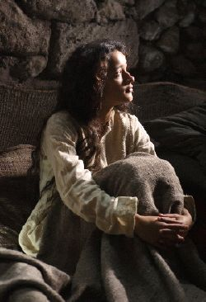
什么 - Applications
圣经里对于任何有意成为配偶或寻找配偶的人都给予了很多劝告和指引。问题不是我们不知道圣经对婚姻有何要求，而是我们不愿意遵从圣经的要求。
The Bible is full of advice and instructions for anyone desiring to become or find a godly spouse. The problem is not that we do not know what the Bible says about marriage, it is that we do not obey what the Bible says.

Slide 46
针对父母的应用
为什么父母都想给女儿找个夫家？
Why do parents want to find a husband for their daughters?
父母在给儿女找配偶时应扮演什么角色？
What role should parents play in finding a spouse for their child?
父母在给儿女找配偶时不应扮演什么角色？
What role should parents NOT play in finding a spouse for their child?
父母应在儿女的配偶身上寻找什么？
What should a parent look for in a spouse for their children?
为什么说父母为了让子女在某个年龄前结婚而不惜牺牲掉这些品质是很危险的？
Why is it dangerous for a parent to sacrifice these qualities just to get their children married by a certain age?
Application Questions for Parents

Slide 47
针对单身者的应用
为什么单身女子总是在鸡舍里找狮子？
Why do single women look for a lion in the chicken house?
为什么你要与某个你明知道神不允许的人约会？
Why do you date someone you KNOW isn’t approved of for you by God?
到哪里去找一个能让你更亲近神的人？
Where can you find the person who will draw you closer to God?
宁愿单身好，还是嫁错人好？
Is it better to stay single or to marry the wrong person?
如何知道他或她是不是正确人选？
How do you know if she or he is the right person?
成为正确的人更重要还是找到正确的人更重要？
Is it more important to find the right person or become the right person?
Application Questions to Single People

Slide 48
神已经开了一条路。在这条路上神希望赐给你所有的美好事物。如果你为了眼前的快乐而选择另一条路，你可能会丧失神为你预备的最好的事物。
God has set a path. On that path are all the wonderful things He wants for you. If you choose another path, you may forfeit the best things for those things that you find temporarily pleasing.

Slide 49
针对已婚人士的应用
不要问：“我是否嫁/娶对了人？”
乃要问：“我如何在这个婚姻里更蒙神的祝福？”
DON’T ASK: “Did I marry the right person?”
DO ASK: “How can I receive God’s blessing on this marriage?”
不要问：“我如何才能改善我的配偶？”
乃要问：“我如何才能成为更好的配偶？”
DON’T ASK: “How can I make my spouse a better person for me?”
DO ASK: “How can I become a better person for my spouse?”
不要问：“我如何才能避免离婚？”
乃要问：“我如何让婚姻变得不可思议得好？”
DON’T ASK: “How can I avoid a divorce?”
DO ASK: “How can I make my marriage incredible?”
Application Questions to Married People

Slide 50
圣经如何论述婚姻的？
What the Bible says about marriage

Slide 51
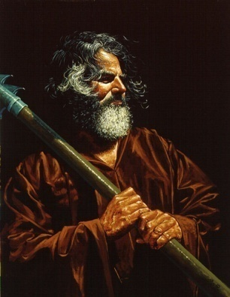
圣经对丈夫有什么说的？
男人要离开父母家将妻子放在父母之首.(太19:4-6)
A man is to leave his father and mother and put his wife first. (Matt. 19:4-6)
丈夫要爱妻子如同基督爱教会(弗5:25)
Husbands are to love their wives as Christ loves His church (Eph 5:25)
丈夫要供应家庭的需要. (提前5:8)
Husbands are to provide for the needs of their family (1 Tim 5:8)
丈夫在思想和行为上都要保持忠诚(箴5:15-19)
Husbands are to remain faithful in thought and deed (Pov. 5:15-19)
r
丈夫要满足妻子的性需求（林前7）
Husbands are to meet their wives sexual desires (1 Cor 7)
What the Bible says to the husband

Slide 52
圣经对妻子怎么说的？
弗5:22-23 “你们作妻子的，当顺服自己的丈夫，如同顺服主。 因为丈夫是妻子的头，如同基督是教会的头；他又是教会全体的救主。”
Eph. 5:22-23 “Wives, submit to your husbands as to the Lord. For the husband is the head of the wife as Christ is the head of the church, his body, of which he is the Savior.”
妻子要满足丈夫的性需求（林前7）
Wives are to meet their husbands sexual desires (1 Cor 7)
对神和丈夫都要忠心。将神放在首位。
Be faithful to God and your husband. Put God first.
建立一个你丈夫非常愿意回来的家室。
Create a home your husband will want to come home to.
What the Bible says to the wife

Slide 53
圣经对渴望婚姻的人如何说的
神赐给你配偶是好事. (箴18:22)
It is a good thing if God gives you a spouse (Prov. 18:22)
神若赐给你单身的能力也是好事。 (林前7:1-16)
It is a good thing if God gives you the ability to stay single (1 Cor 7:1-16)
宁愿结婚也不要一生受情欲试探 (林前7:1-16)
It is better to get married that to live a life a lust (1 Cor 7:1-16)
神会为了他的荣耀让这一切互相效力.(罗8:28)
God will work it all out for His greatest glory (Rom 8:28)
集中注意力以耶和华为乐，他会赐你所求的。 (诗37:4-5)
Focus on what God wants and He will give you your desires (Psalm 37:4-5)
What the Bible says to those desiring marriage

Slide 54
圣经对渴望婚姻的人如何说的
不与非基督徒有任何连结(婚姻或约会)(林后6:14-18)
你们和不信的原不相配,不要同负一轭. 义和不义有什么相交呢? 光明和黑暗有什么相通呢?基督和彼列(彼列就是撒但的别名)有什么相和呢? 信主的和不信主的有什么相干呢? 神的殿和偶像有什么相同呢? 因为我们是永生神的殿,就如神曾说:我要在他们中间居住,在他们中间来往;我要作他们的神;他们要作我的子民.又说:你们务要从他们中间出来,与他们分别;不要沾不洁净的物,我就收纳你们. 我要作你们的父;你们要作我的儿女. 这是全能的主说的。
Do not make any bonds (marriage or dating) with non-Christians (2 Cor 6:14-18)
“Do not be mismatched with unbelievers. For what partnership is there between righteousness and lawlessness? Or what fellowship is there between light and darkness? What agreement does Christ have with the devil? Or what does a believer share with an unbeliever? What agreement has the temple of God with idols? For we are the temple of the living God; as God said, "I will live in them and walk among them, and I will be their God, and they shall be my people. Therefore come out from them, and be separate from them, says the Lord, and touch nothing unclean; then I will welcome you, and I will be your father, and you shall be my sons and daughters, says the Lord Almighty."

Slide 55
箴言中的好妻子
tries to be her husband’s best friend (2:17)
is a blessing to her husband (18:22)
is prudent & discerning (19:14)
is a gift from the Lord (19:14)
builds up her household (9:1; 14:1)
is the crown of her husband (12:4)
is concerned with inward beauty (11:16, 22; 31:30)
delights in meeting her husband’s sexual needs (5:9-23)
努力成为丈夫的好友
是丈夫的祝福
审慎而有洞察力的
是从神而来的赏赐
建立自己的家室
是丈夫的冠冕
注重内在美丽
乐意满足丈夫的性需求
The Good Wife (in Proverbs)

Slide 56
箴言中的愚昧妻子
Nags, nags, nags, nags (19:13; 21:9; 25:24)
shames her husband by her behavior (12:4)
lacks discretion (11:22)
is lazy (19:14-15)
is difficult to stop from her bad ways (27:15-16)
tears down her household (14:1)
is overly concerned with her outward appearance (11:22; 31:30)
唠叨,唠叨,唠叨,唠叨
行为让丈夫蒙羞
缺乏深思熟虑
懒惰
很难停止坏的行为
拆毁家室
过分注重外表
The Foolish Wife (in Proverbs)

Slide 57
箴言中的智慧丈夫
Knows his wife is a gift from God (18:22; 19:13, 14; 31:10)
Has a healthy sex life with his wife (5:15-19)
Is faithful to his wife (5:15-19)
Is always happy with his wife’s love (5:19)
Doesn’t desert his family (27:8)
Is his wife’s best friend (2:17)
Rewards his wife for her hard work (31:27-28)
Praises his wife regularly (31:28-31)
Leaves his family an inheritance (13:22)
Trusts his wife as a partner (31:11)
认识到妻子是从神而来的赏赐。
与妻子保持健康的性生活
对妻子忠诚
对妻子的爱总是恋慕
不会抛弃家庭
成为妻子的好友
回报妻子的辛勤劳动
经常赞美自己的妻子
给家人留下遗产
信靠妻子如同伴侣
The Wise Husband (in Proverbs)

