Slide 1
RUTH
6

Slide 2
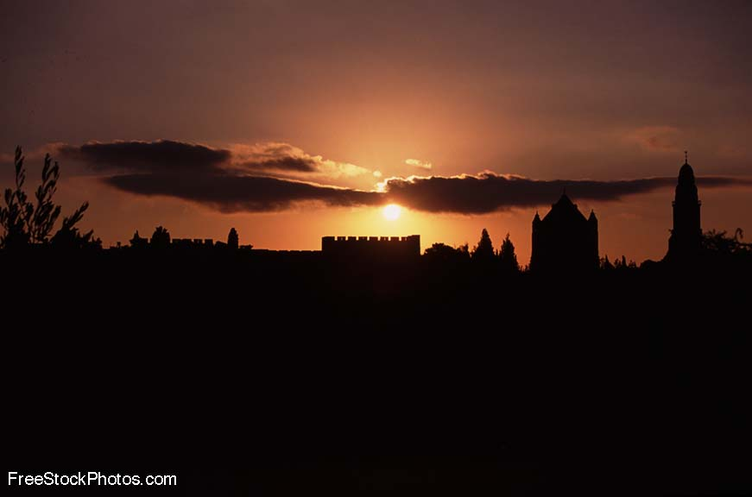
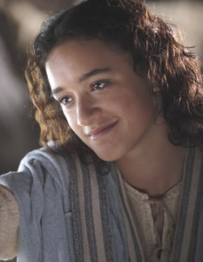
神看不见的手
《路得记》

Slide 3
日期 Date | 经文 Verses | 标题 Title
3月31 3/31 | 所有 ALL | 神看不见的手（导语） God’s Invisible Hand (Introduction)
4月7日 4/7 | 1:1-5 | 神看不见的手在患难中 God’s Invisible Hand in Suffering
4月14日 4/14 | 1:6-22 | 神看不见的手在各关系中 God’s Invisible Hand in Relationships
4月21日 4/20 | 2:1-23 | 神看不见的手在各天职中 God’s Invisible Hand in Vocations
4月28日 4/27 | 3:1-18 | 神看不见的手在婚姻中 God’s Invisible Hand in Marriage
5月5日 5/5 | 4:1-12 | 神看不见的手在救赎中 God’s Invisible Hand in Redemption
5月12日 5/12 | 4:13-22 | 神看不见的手在历史中 God’s Invisible Hand in History
神看不见的手

Slide 4
查经四步法 The 4 Steps of Bible Study
阅读 (READ)
应用 (APPLY)
观察 (OBSERVE)
解释 (INTERPRET)

Slide 5
查经四步法 The 4 Steps of Bible Study
阅读 第四章 (READ Ch. 4:1-12)
应用 (APPLY)
观察 (OBSERVE)
解释 (INTERPRET)

Slide 6
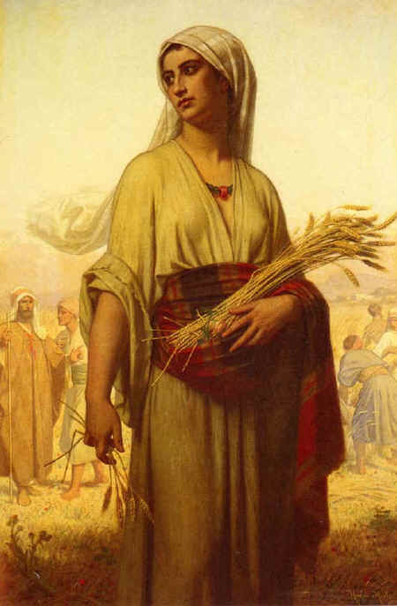
让我们快速回顾一下…
Let’s do a quick review…
在犹大闹饥荒。
There is a famine in Israel
以利米勒带领家人到摩押
Elimelek brought his family to Moab
他和二子死于摩押
He and his sons died in Moab
拿俄米和路得返回伯利恒
Naomi and Ruth return to Bethlehem
拿俄米变得苦毒;路得事奉真神。
Naomi gets bitter; Ruth serves God

Slide 7
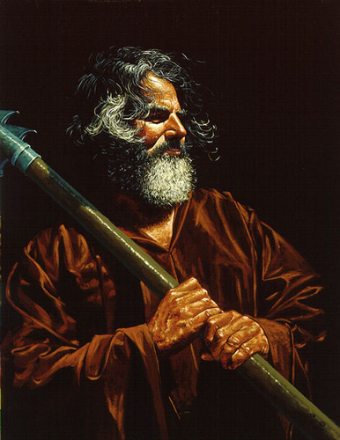
路得到地里干活
Ruth goes to work in the fields
神带她去到波阿斯的地里
God leads her to Boaz’ field
波阿斯是一远房亲戚,恩慈待她。
Boaz is a distant relative and treats her kindly.
波阿斯让路得只在他地里工作。
Boaz tells Ruth to only work in his fields.
拿俄米和路得看到神不可见的手在做工。
Naomi and Ruth see God’s invisible hand at work.
收割的季节快要结束了
The harvest season is coming to an end.
拿俄米有了一个计划。
Naomi has a plan.

Slide 8
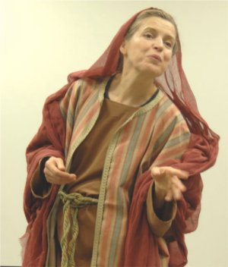
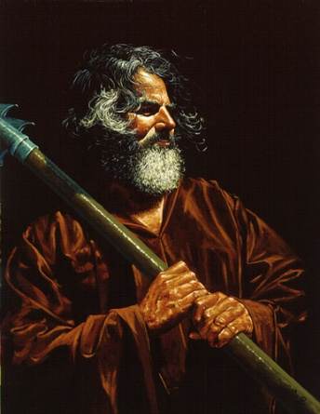
路得沐浴更衣梳妆打扮
Ruth bathes, puts on perfume and her best dress
她去到大麦打场的地方
She goes to the place where the men are winnowing barley
她梳妆打扮后，夜访打麦场。
When Boaz is asleep, she lays at his feet
他醒来后，她向他亮出身份。
He awakes and she reveals who she is
路得请求波阿斯向她求婚。
Ruth asks Boaz to propose to her
波阿斯愿意娶路得并照顾拿俄米。
Boaz is willing to marry Ruth and care for Naomi
但他必须与另一个更近的亲属交谈。
But first he must speak to a man who has first rights to Ruth

Slide 9
波阿斯到了城门，坐在那里，恰巧波阿斯所说的那至近的亲属经过。波阿斯说：“某人哪，你来坐在这里。”他就来坐下。 波阿斯又从本城的长老中拣选了十人，对他们说：“请你们坐在这里。”他们就都坐下。 波阿斯对那至近的亲属说：“从摩押地回来的拿俄米，现在要卖我们族兄以利米勒的那块地；
¹ Meanwhile Boaz went up to the town gate and sat down there just as the guardian-redeemer
he had mentioned came along. Boaz said, “Come over here, my friend, and sit down.”
So he went over and sat down. ² Boaz took ten of the elders of the town and said,
“Sit here,” and they did so. ³ Then he said to the guardian-redeemer, “Naomi, who has come back from Moab, is selling the piece of land that belonged to our relative Elimelek.

Slide 10
我想当赎那块地的是你，其次是我，以外再没有别人了。你可以在这里的人面前和我本国的长老面前说明，你若肯赎就赎，若不肯赎就告诉我。”那人回答说：“我肯赎。”
⁴ I thought I should bring the matter to your attention and suggest that you buy it in the presence of these seated here and in the presence of the elders of my people.
If you will redeem it, do so. But if you will not, tell me, so I will know. For no one has the right to do it except you, and I am next in line.” “I will redeem it,” he said.

Slide 11
波阿斯说：“你从拿俄米手中买这地的时候，也当娶（原文是买；10节同）死人的妻摩押女子路得 ，使死人在产业上存留他的名。” 那人说：“这样我就不能赎了，恐怕于我的产业有碍。你可以赎我所当赎的，我不能赎了。”
⁵ Then Boaz said, “On the day you buy the land from Naomi, you also acquire Ruth
the Moabite, the dead man’s widow, in order to maintain the name of the dead with
his property.” ⁶ At this, the guardian-redeemer said, “Then I cannot redeem it because
I might endanger my own estate. You redeem it yourself. I cannot do it.”

Slide 12
从前，在以色列中要定夺什么事，或赎回，或交易，这人就脱鞋给那人。以色列人都以此为证据。 那人对波阿斯说：“你自己买吧！”于是将鞋脱下来了。
⁷ (Now in earlier times in Israel, for the redemption and transfer of property to become final, one party took off his sandal and gave it to the other. This was the method of legalizing transactions in Israel.) ⁸ So the guardian-redeemer said to Boaz,
“Buy it yourself.” And he removed his sandal.

Slide 13
波阿斯对长老和众民说：“你们今日作见证，凡属以利米勒和基连、玛伦的，我都从拿俄米手中置买了； 又娶了玛伦的妻摩押女子路得 为妻，好在死人的产业上存留他的名，免得 他的名在本族本乡灭没。你们今日可以作见证。”
⁹ Then Boaz announced to the elders and all the people, “Today you are witnesses that I have bought
from Naomi all the property of Elimelek, Kilion and Mahlon. ¹⁰ I have also acquired Ruth the Moabite, Mahlon’s widow, as my wife, in order to maintain the name of the dead with his property, so that his
name will not disappear from among his family or from his hometown. Today you are witnesses!”

Slide 14
在城门坐着的众民和长老都说：“我们作见证。愿耶和华使进你家的这女子，像建立以色列家的拉结、利亚二人一样。又愿你在以法他得 亨通，在伯利恒得 名声。愿耶和华从这少年女子赐你后裔，使你的家像他玛从犹大所生法勒斯的家一般。”
¹¹ Then the elders and all the people at the gate said, “We are witnesses. May the LORD make the
woman who is coming into your home like Rachel and Leah, who together built up the family of Israel.
May you have standing in Ephrathah and be famous in Bethlehem. ¹² Through the offspring the LORD gives you by this young woman, may your family be like that of Perez, whom Tamar bore to Judah.”

Slide 15
查经四步法 The 4 Steps of Bible Study
阅读 (READ)
应用 (APPLY)
观察 (OBSERVE)
解释 (INTERPRET)

Slide 16
今天我们要将观察和释经结合起来，为要展示大家圣经学习中的“提问方法”。 Today we will combine our observation and interpretation time in order to show you the “QUESTIONING METHOD” of Bible Study.

Slide 17
波阿斯到了城门,坐在那里,恰巧波阿斯所说的那至近的亲属经过.波阿斯说: “某人哪,你来坐在这里.” 他就来坐下.
为何波阿斯去到城门口？
Why did Boaz go to the town gate?
谁是那监护救赎者？
Who was the guardian-redeemer?
波阿斯如何招呼他？
How did Boaz greet the man?
为何他希望那人坐在城门？
Why did he want the man to sit at the gate?
¹ Meanwhile Boaz went up to the town gate and sat down there just as the guardian-redeemer he had mentioned came along. Boaz said, “Come over here, my friend, and sit down.” So he went over and sat down.

Slide 18
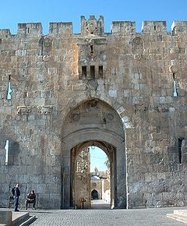
圣经里“城门口”的意义：
“城门口”是古代以色列城邑里公众集会、买卖交易、审判案件、宣布公告的地方。这十位长老是证人。
圣经中首次提到城门口是在创19:1。当时罗得坐在索多玛和蛾摩拉城门口，向两位来访的天使打招呼。
摩西律法规定，悖逆不孝的儿子要由父母带到城门口，由长老主持对质并审判，严重者会被石刑处死。申21:18-21
波阿斯来到伯利恒城门口来处理一桩非常郑重的事务：在长老们的见证下，宣布自己作为路得亲属救赎者的身份，处理涉及迎娶路得的法律事宜。

Slide 19
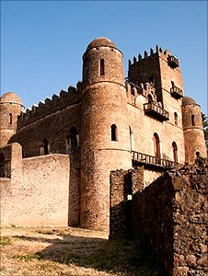
圣经里“城门口”的意义
以色列军队在前方征战非利士时，大祭司以利曾在城门口中等候有关约柜和他儿子的战报。
当大卫王统治以色列的时候，他站在军队面前，在城门口下达命令(撒下18:1-5)
城门在其他古代文化中也很重要。以斯帖记2章5-8节说:王的臣仆中有几个人在城门口商议谋害王。被末底改听到了。
控制了敌人的城门口，就等于控制了整个城市。参孙将非利士人的城门拆下并背走了是对敌人大羞辱。

Slide 20
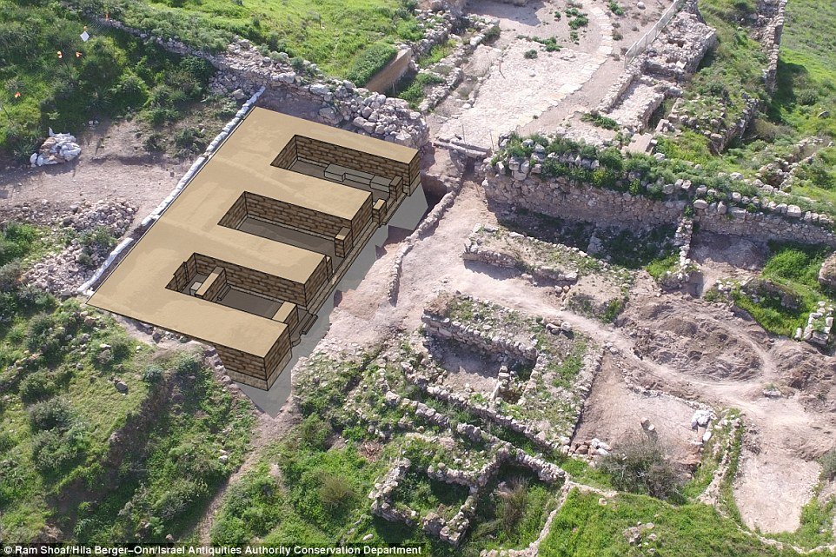
旧约时期常见的城门口
拉吉（Lachish）城门口的遗址及复原示意图。从城门进来，两侧各有3个房间，平时作为交易、诉讼、公告的公共设施，战时作为防御工事。基色、米吉多、夏琐、撒玛利亚和但的遗址都有相同的城门结构。。

Slide 21
波阿斯又从本城的长老中拣选了十人，对他们说：“请你们坐在这里。”他们就都坐下。 波阿斯对那至近的亲属说：“从摩押地回来的拿俄米，现在要卖我们族兄以利米勒的那块地；
为何波阿斯召集了十位长老？
Why did Boaz gather 10 of the town elders?
为何波阿斯重点放在买卖土地上而不是娶路得这事？
Why did Boaz focus on the sale of the land instead of the marriage to Ruth?
² Boaz took ten of the elders of the town and said, “Sit here,” and they did so.
³ Then he said to the guardian-redeemer, “Naomi, who has come back from Moab,
is selling the piece of land that belonged to our relative Elimelek.

Slide 22
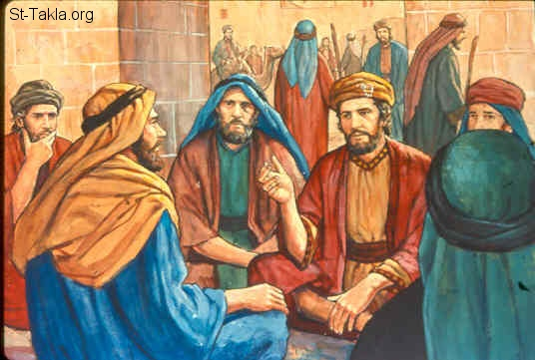
波阿斯在伯利恒城门口
波阿斯一大早来到城门口等候无名氏的出现，按照律法的办事，在众长老的见证下，与这位更近的亲属商讨对路得的救赎的事宜。

Slide 23
我想当赎那 块地的是你, 其次是我, 以外再没 有别人了。
波阿斯是建议那人要赎那地呢还是说服他不赎？
Did Boaz suggest that the man buy the property or try to talk him out of it?
波阿斯难道不能买下那地，娶回路得而不告诉那人吗？
Couldn’t Boaz have just bought the land, married Ruth and never told the other man?
多少人见证了那桩交易？
How many people were witnessing the transaction?
⁴ I thought I should bring the matter to your attention and suggest that you buy it in the presence of these seated here and in the presence of the elders of my people.

Slide 24
你可以在这里的人面前和我本国的长老面前说明,你若肯赎就赎,若不肯赎就告诉我.” 那人回答说:“我肯赎.”
波阿斯有无向那人施压以便他尽快做出决定？
Does Boaz seem to be pressing the man for a decision to be made immediately?
那人想赎那块地吗？
Did the man want to buy the property?
波阿斯暂时还没有告诉那人什么信息？
What had Boaz NOT told him yet?
If you will redeem it, do so. But if you will not, tell me, so I will know. For no one has the right to do it except you, and I am next in line.” “I will redeem it,” he said.

Slide 25
波阿斯说: “你从拿俄米手中买这地的时候,也当娶(原文是买;10节同)死人的妻摩押女子路得 ,使死人在产业上存留他的名.”
为什么他向那人提醒路得的摩押和寡妇身份？
Why do you think he reminds the man that Ruth is a Moabitess and a widow?
那人若娶了路得，他将承担什么责任？
If the man marries Ruth, what will be his new responsibilities?
⁵ Then Boaz said, “On the day you buy the land from Naomi,
you also acquire Ruth the Moabite, the dead man’s widow,
in order to maintain the name of the dead with his property.”

Slide 26
那人说: “这样我就不能赎了, 恐怕于我的产 业有碍。你可以赎我所当赎的,我不能赎了。”
为何那人不愿赎那地了？
Why did the man refuse to buy the land?
娶路得会怎样危害这人的产业？
How would marrying Ruth endanger the man’s own estate?
⁶ At this, the guardian-redeemer said, “Then I cannot redeem it because
I might endanger my own estate. You redeem it yourself. I cannot do it.”

Slide 27
从前，在以色列中要定夺什么事,或赎回,或交易,这人就脱鞋给那人。以色列人都以此为证据.
那时在以色列交易的最后要做什么？
What was the final part of the legal transaction in Israel at that time?
为什么他们选择以这种方式定夺事情？那时一双鞋对男人有多么重要？
Why do you think they chose this method of legalizing a transaction? How important were a man’s sandals to him in those days?
⁷ (Now in earlier times in Israel, for the redemption and transfer of property
to become final, one party took off his sandal and gave it to the other.
This was the method of legalizing transactions in Israel.)

Slide 28
“脱鞋之家”
申命记255-10：
“兄弟妻子就不可出去嫁给陌生人。她丈夫的兄弟应当尽兄弟的本分，娶她为妻，与她同房。妇人生的长子要归在已故兄弟的名下，免得他的名在以色列中涂去了。那人。若不情愿娶他兄弟的妻子，他兄弟的妻子就要上到城门长老那里，说: ‘我丈夫的兄弟拒绝在以色列中为他的兄弟留名，不愿意为我尽兄弟的本分。’ 本城的长老就要召那人来，跟他谈话。若他坚持说：‘我不情愿娶她。’ 9他兄弟的妻子就要在长老眼前来到那人跟前，脱下他脚上的鞋，吐唾沫在他脸上，回应说：‘凡不为兄弟建立家室的都要这样待他。’在以色列中，他要以‘脱鞋之家’闻名。”

Slide 29
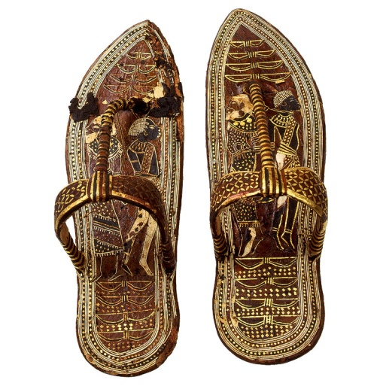
古代以色列男人的鞋子
《塔木德》(公元200 - 500年)(安息日129a) 宣称：“一个人应卖掉他房子的顶梁来买双鞋子”，如照字面理解，这无疑强调了在圣地穿鞋的重要性。精通犹太律法的学者永远不会穿着破旧的鞋子出门。后来，卡巴拉派学者认为身体是“灵魂的鞋子”，在物质世界的旅程中保护它。

Slide 30
无名氏——不愿尽义务的亲属
犹太传统认为这个无名氏可能是拿俄米的丈夫的弟兄，是比波阿斯更近的亲属，有优先的权利赎回拿俄米的土地。
他只愿意买土地，不愿娶路得。
因为路得是外邦女子，又是寡妇，若他娶过来，路得所生的长子要归在以利米勒的名下，将来分家产时，大半要归给路得的子孙，他的子孙反而没份，因此他马上拒绝赎回路得，而将鞋子脱下交给波阿斯。
这位脱鞋之家放弃权利，是因拒绝路得而放弃买地。波阿斯本来不要买地，因为他已是大地主，却因为爱路得的缘故，他买赎了那块地。

Slide 31
无名氏亲属 VS 波阿斯
一个视路得为敝屣。
只愿买田地不愿娶路得。
成为“脱鞋之家”。
一个只看眼前的利益和属世的得失。
一个寂寂无名。
一个视路得为珍宝。
为了路得而愿赎田地。
成为弥赛亚祖先。
一个看见属天的祝福和上帝的旨意。
一个名入圣经。

Slide 32
那人对波阿斯说: “你自己买吧!” 于是将鞋 脱下来了.
你认为波阿斯这时心情怎么样？
How do you think Boaz felt at this moment?
⁸ So the guardian-redeemer said to Boaz, “Buy it yourself.” And he removed his sandal.

Slide 33
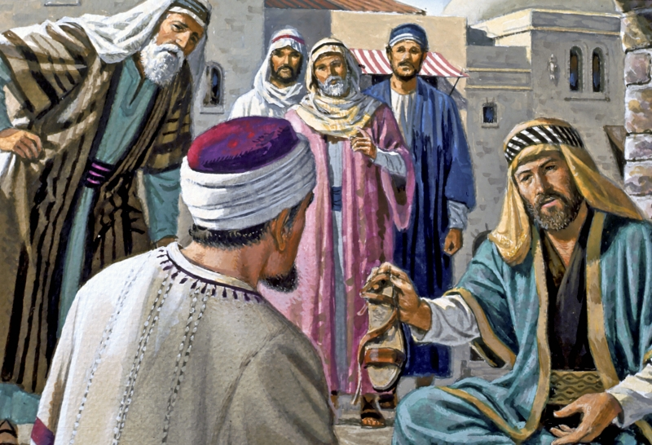
波阿斯让无名氏脱鞋为凭放弃至近亲属权利

Slide 34
波阿斯对长老和众民说:“你们今日作 见证,凡属以 利米勒和基连、 玛伦的,我都从拿俄米手中置买了;
为何波阿斯向长老和众民宣布这事的结果？
Why did Boaz make the announcement to the elders and all the people?
这块地属于谁的？
波阿斯说他从谁哪里买下？
Who did the property belong to?
Who did Boaz say he bought it from?
⁹ Then Boaz announced to the elders and all the people, “Today you are witnesses
that I have bought from Naomi all the property of Elimelek, Kilion and Mahlon.

Slide 35
又娶了玛伦的妻摩押女子路得 为妻，好在死人的产业上存留他的名，免得 他的名在本族本乡灭没。你们今日可以作见证。”
波阿斯还宣布了什么？
What else did Boaz announce?
波阿斯告诉证人他将为路得做什么？
What did Boaz tell the witnesses he would do for Ruth?
若波阿斯不娶路得，以利米勒的家族会发生什么？
What would happen to Elimelek’s family name had Boaz not married Ruth?
他们的孩子将承继以利米勒的姓还是波阿斯的姓？
Would their children have Elimelek’s family name or Boaz’ family name?
¹⁰ I have also acquired Ruth the Moabite, Mahlon’s widow, as my wife, in order to maintain the name of the dead with his property, so that his name will not disappear from among his family or from his hometown. Today you are witnesses!”

Slide 36
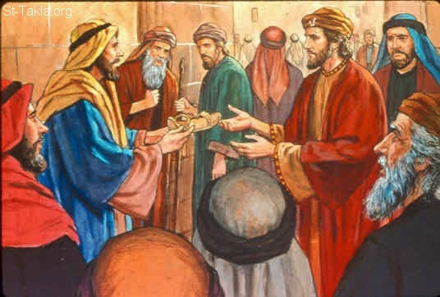
众人见证了波阿斯获得救赎亲属的权利

Slide 37
在城门坐着的众民和长老都说：“我们作见证。愿耶和华使进 你家的这女子，像建立以色列家的拉结、利亚 二人一样。
人们将路得和拿俄米与谁相比？
Who did the people compare Ruth and Naomi to?
拉结和利亚有着怎样的历史重要性？
What was the historical significance of Rachel and Leah?
¹¹ Then the elders and all the people at the gate said, “We are witnesses.
May the LORD make the woman who is coming into your home like
Rachel and Leah, who together built up the family of Israel.

Slide 38
拉结和利亚（雅各之妻）创: 29,30
为了要娶拉结，雅各打了七年工。但是拉结的父亲拉班却偷偷地将大女儿利亚给了雅各。他只好再打工七年，才娶了拉结。
Jacob worked 7 years in order to marry Rachel. Her father Laban sent his older daughter Leah into Jacob’s honeymoon bed. He married both but had to work 7 more years.
她们姊妹俩生下十二个儿子，组成以色列民的祖先。
Between them, they had 12 sons who became the nation Israel.
尽管雅各爱的是拉结，但是神却选择利亚作耶稣肉身的祖先。
Although Jacob loved Rachel, it was Leah that God used as an ancestor of Jesus
下周我们再详细讲这个。
More on this next week
Rachel and Leah (Jacob’s wives) Gen. xxxx

Slide 39
又愿你在以法他得 亨通,在伯利恒得 名声.愿耶和华从这少年女子赐你后裔,使你的家像他玛从犹大所生法勒斯的家一般.”
他们祈求神赐波阿斯什么？
What did they pray God would give Boaz?
谁是法勒斯？他玛？犹大？
Who was Perez? Tamar? Judah?
May you have standing in Ephrathah and be famous in Bethlehem.
¹² Through the offspring the LORD gives you by this young woman,
may your family be like that of Perez, whom Tamar bore to Judah.”

Slide 40
法勒斯 (从他玛和犹大出) 创.38
犹大（雅各十二之子中的长子）因为他玛嫁给他前面的两儿子都死了，不让她嫁给他的三儿子。
Judah (the eldest of Jacob’s 12 sons) refused to let Tamar marry his 3rd son since the first 2 of his sons she married died.
他玛便化妆成一个妓女，与犹大同房，生下双子。
Tamar disguised herself as a prostitute, slept with Judah, and bore his twin sons
法勒斯的出生很有争议。他的孪生兄弟先伸出手，声明头生权，被推回去后，法勒斯才出生。谁将继承产业？
Perez’ birth was controversial. His twin stuck his arm out, was declared the firstborn, pulled it back in and Perez was first born. Who gets the inheritance?
波阿斯和他的观众都是法勒斯的后代。
Boaz and the Bethlehem men he is speaking to are descendants of Perez.
所罗巴伯(以色列民流放巴比伦时的领袖)也是法勒斯的后代(太1:12-16), 大卫和耶稣也是。
Zerubbabel (leader of the Israelite exiles during the Babylonian Captivity) was also one of Perez’ descendants. (Matt. 1:12-16) as were David & Jesus.
Perez (Born to Tamar and Judah) Gen. 38

Slide 41
查经四步法 The 4 Steps of Bible Study
阅读 (READ)
应用 (APPLY)
观察 (OBSERVE)
解释 (INTERPRET)

Slide 42
有关应用的问题
在哪方面波阿斯让我们想起救赎主耶稣？
In what way does Boaz remind us of Jesus the Redeemer?
在哪方面路得让我们想起自己？
In what way does Ruth remind us of ourselves?
波阿斯是不得不救赎路得和拿俄米呢， 还是他自己的选择？
Did Boaz have to redeem Ruth and Naomi or was it his own choice?
路得和拿俄米对波阿斯的救赎之爱应怎样回应？
What should be Ruth and Naomi’s response to Boaz’ redeeming love?
波阿斯的行动有哪些益处？
What were the benefits of Boaz’ actions?
神对我们的救赎之爱有哪些益处？
What are the benefits of God’s redeeming love to us?
Application Questions

Slide 43
圣经如何说的？
What the Bible says

Slide 44
约3:16 “神爱世人，甚至将他的独生子 赐给他们，叫一切信他的，不至灭亡， 反得永生。”
John 3:16 “For God loved the world so much that he gave his one and only Son, so that everyone who believes in him will not perish but have eternal life.”
神爱你吗？有多爱？
Does God love you? How much?
“因为世人都犯了罪，亏缺了神的荣耀。”罗3:23
“For everyone has sinned; we all fall short of God’s glorious standard.” (Rom. 3:23)
在神与我们之间隔着什么？
What stands between us and God?

Slide 45
就如经上所记：没有义人，连一个也没有。 没有明白的；没有寻求神的; 都是偏离正路， 一同变为无用。没有行善的，连一个也没有。(罗3:10-12)
“As the Scriptures say, “No one is righteous—not even one. No one is truly wise; no one is seeking God. All have turned away; all have become useless. No one does good, not a single one.” (Rom. 3:10-12)
我们当中有寻求神的吗？还是神向我们启示他自己？
Do any of us look for God or does God reveal Himself to us?
因为罪的工价乃是死；惟有神的恩赐，在我们的主基督耶稣里，乃是永生。（罗6:23）
“For the wages of sin is death, but the free gift of God is eternal life through Christ Jesus our Lord.” (Rom. 6:23)
我们若下地狱，是活该吗？
If we go to Hell, do we deserve it?

Slide 46
因为你归耶和华─你神为圣洁的民；耶和华─你神从地上的万民中拣选你，特作自己的子民。耶和华专爱你们，拣选你们，并非因你们的人数多于别民，原来你们的人数在万民中是最少的。
Deu7:6-7
神有义务拯救任何人吗？
Is God obligated to save ANYONE?
就如神从创 立世界以前，在基督里拣选了我们，使我们在他面前成为圣洁，无有瑕疵;又因爱我们，就按着自己意旨所喜悦的，预定我们借着耶稣基督得儿子的名分, 使他荣耀的恩典得着称赞;这恩典是他在爱子里所赐给我们的。Eph. 1:4-6
神为何要拯救哪怕一个人？
Why would God even save one person?

Slide 47
惟有基督在我们还作罪人的时候为我们死， 神的爱就在此向我们显明了。
Rom 5.8 “But God demonstrates his own love for us in this: While we were still sinners, Christ died for us. “
耶稣救赎我们要花什么代价？
What did it cost for Jesus to redeem us?
亲爱的弟兄阿，神既是这样爱我们，我们也当彼此相爱。 从来没有人见过神，我们若彼此相爱，神就住在我们里面，爱他的心在我们里面得以完全了。
John 14:12 ‘Very truly I tell you, whoever believes in me will do the works I have been doing, and they will do even greater things than these, because I am going to the Father. “
我们因有什么反应？
What should be our response?

Slide 48
耶稣又说：所以我对你们说过，若不是蒙我父的恩赐，没有人能到我这里来。约6:65
“No one can come to Me, unless the Father who sent Me draws him; and I will raise him up on the last day. For this reason I have said to you, that no one can come to Me, unless it has been granted him from the Father” (John 6:65).
在我们的救恩中谁是发起人？
Who is the Initiator in our salvation?
外邦人听见这话，就欢喜了，赞美神的道；凡预定得永生的人都信了。徒13:48
“And when the Gentiles heard this, they began rejoicing and glorifying the word of the Lord; and as many as had been appointed to eternal life believed “ (Acts 13:48).
每个人都信了吗？谁信了？
Did everyone believe? Who did believe?

Slide 49
他便救了我们；并不是因我们自己所行的义， 乃是照他的怜悯，借着重生的洗和圣灵的更新。 多3:5
“He saved us, not on the basis of deeds which we have done in righteousness, but according to His mercy, by the washing of regeneration and renewing by the Holy Spirit” (Titus 3:5).
什么是神救恩的基础？
What is the basis upon which God bestows salvation?
仰望为我们信心创 始成终的耶稣。他因那摆在前面的喜乐，就轻看羞辱，忍受了十字架的苦难，便坐在神宝座的右边。来12:2
“Fixing our eyes on Jesus, the author and perfecter of faith, who for the joy set before Him endured the cross, despising the shame, and has sat down at the right hand of the throne of God” (Hebrews 12:2).
为什么耶稣被称为信心的创始成终者？
Why is Jesus called the AUTHOR and PERFECTOR (lit: “COMPLETER”) of faith?

Slide 50
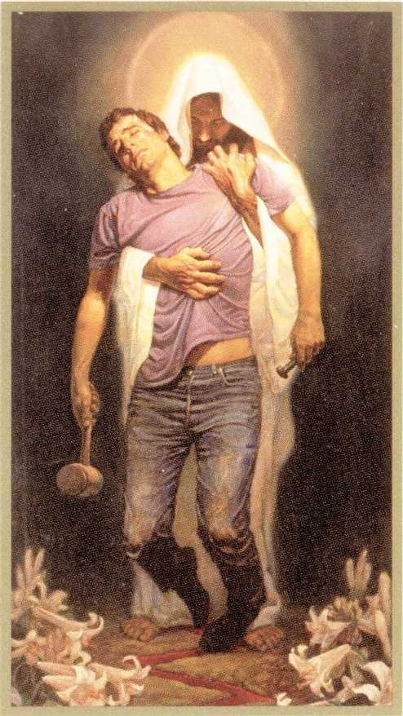
什么 - Applications
波阿斯选择救赎路得出于同情而不是义务。他赎了她，娶了她，供应她，让她的姓可以承继下去。同样，耶稣选择救赎我们是出于爱，而不是义务，用他的鲜血买赎我们，让我们作他的新娘，把他的名字给我们，让我们有永生。
Boaz chose to redeem Ruth out of compassion, not obligation. He bought her, married her, provided for her and kept her name alive. In the same way, Jesus chose to redeem us out of love, not obligation, bought us with His blood, took us as His Bride, and gives us His Name so that we can live forever.

Slide 51
神在我们救恩中的角色(God’s Role in Your Salvation)
神拣选我们，在世界未造之前。
GOD chose you before the world was created
神被你弃绝，当你选择罪而不是他的爱时。
GOD was rejected by you as you chose sin over His love
神差他的儿子偿付你罪的代价。
GOD sent His Son to pay the penalty for your sins
神将你吸转过来，因为爱你。
GOD drew you back to Himself by loving you
神赐给你信心相信耶稣，并赐你悔改认罪的心。
GOD gave you the faith to believe in Jesus and a heart to repent of your sins
神远在你选择他之前就选择了你。
GOD chose you long before you ever chose Him.
神让你做他儿女，充满你，保护你，爱你。
GOD adopted you, fills you, secures you, defends you and loves you.

Slide 52
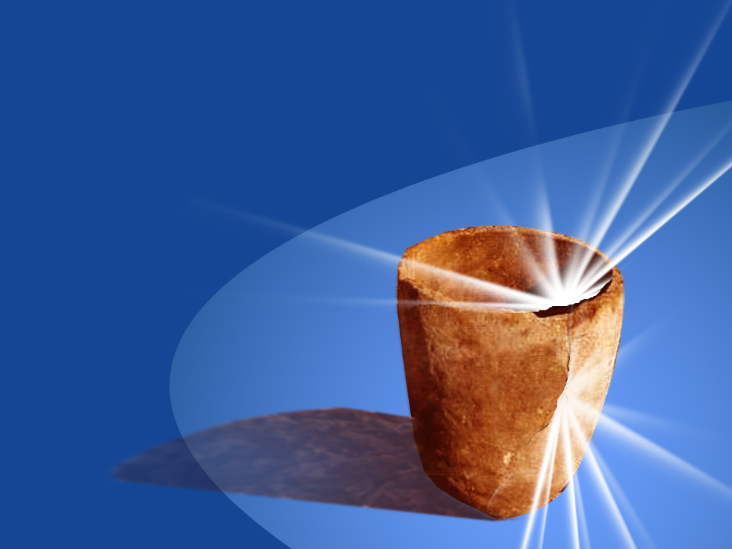
神是陶匠我们是泥！罗9
HE is the POTTER, We are the CLAY!
(Romans 9)

Slide 53
他是陶匠我们是泥(罗马书9)
神选择我们不在乎我们未来的行为。
God chooses us prior to birth regardless of future actions
神选择我们完全基于他自己的意愿。
God chooses us based on nothing but His own desires
人不喜欢听到神拣选的真理。
Men do not like to hear the truth about God’s choosing.
如果你告诉真相，人会说神不公平。
If you tell the truth, men will claim that God is unfair.
神是主权至高的。神是爱。神是怜悯。
God is sovereign. God is loving. He is merciful.
He is the Potter, we are the Clay (Romans 9)

Slide 54
主权- SOVEREIGNTY
神统治和掌管。神无处不在。神是至高至大的权柄。没有什么超越神。神超越撒旦，鬼魔、生、死、天堂、地狱、飞鸟、鱼类和兽类。他掌控万有，自造天地一直到你每天的决定，他都无所不知。甚至你的救恩，信心，悔改和永生都是从神而来的恩典，而不是你的善行和智力的结果。
God rules and reigns. God is over all. God is the one who is the highest ultimate authority. There is no one beyond God. God is over Satan, demons, life, death, heaven, hell, the birds, the fish and the beasts. He is in control of everything, from creation, all the way down to your every day decisions. Even your salvation, faith, repentance, and eternal life are gifts of grace from God, not of your own works or intelligence.

Slide 55
主权- SOVEREIGNTY
但4:35: “世上所有的居民都算为虚无；在天上的万军和世上的居民中，他都凭自己的意旨行事。无人能拦住他手，或问他说，你作什么呢﹖”
Dan 4:35 “And all the inhabitants of the earth are reputed as nothing: and He does according to His will in the army of heaven, and among the inhabitants of the earth: and none can stay His hand, or say unto Him, What are you doing?”
西1:16: “因为万有都是靠他造的，无论是天上的，地上的；能看见的，不能看见的；或是有位的，主治的，执政的，掌权的；一概都是借着他造的，又是为他造的。”
Col 1:16 “For by Him were all things created, that are in heaven, and that are in earth, visible and invisible, whether they are thrones, or dominions, or principalities, or powers: all things were created BY HIM AND FOR HIM.”

Slide 56
主权- SOVEREIGNTY
弗1:11: “我们也在他里面得（或作：成）了基业；这原是那位随己意行、作万事的，照着他旨意所预定的，”
Eph 1:11 “In whom also we have obtained an inheritance, being predestined according to the purpose of Him who works all things after the counsel of His own will:”
诗篇115:3: “然而，我们的神在天上，都随自己的意旨行事。”
Psalm 115:3 "But our God is in the heavens; He does whatever He pleases."
诗篇135:6: “耶和华在天上,在地下,在海中,在一切的深处,都随自己的意旨而行.”
Psalm 135:6 "Whatever the Lord pleases, He does, In heaven and in earth, in the seas and in all deeps."

Slide 57
主权- SOVEREIGNTY
赛46:10: “我从起初指明末后的事，从古时言明未成的事，说：我的筹算必立定；凡我所喜悦的，我必成就。”
Isaiah 46:10 "Declaring the end from the beginning and from ancient times things which have not been done, saying, ‘My purpose will be established, and I will accomplish all My good pleasure’;"
罗9:22-23: “倘若神要显明他的忿怒，彰显他的权能，就多多忍耐宽容那可怒预备遭毁灭的器皿， 又要将他丰盛的荣耀彰显在那蒙怜悯早预备得荣耀的器皿上。”
Rom. 9:22-23 "What if God, although willing to demonstrate His wrath and to make His power known, endured with much patience vessels of wrath prepared for destruction? And He did so in order that He might make known the riches of His glory upon vessels of mercy, which He prepared beforehand for glory."

Slide 58
“如果你在神恩典的赏赐上增加任何东西，你就是在否认神的恩典。如果你加入自由 意志，好行为，人的选择或人的责任，你 都给‘恩典’这个词注入了水分。很多基 督徒出于善意，试图为神的行为辩护，加 入了人的主权选择以达成平衡，却不知因 此抢夺了神在救恩中的主权。神不需要你 为他辩护。他出于对自己儿女强烈的爱， 而随自己的喜悦和旨意而行。”——杰巴良
“If you add anything to God’s gift of grace then you are denying that it is indeed grace. If you add free will, good works, human choice or human responsibility, then you have diluted the very word ‘grace’. Many well-meaning Christians, in an attempt to defend God’s actions, add man’s sovereign choice to the equation and thus end up robbing God of His sovereignty in the act of salvation. God does not need for you to defend Him. He does what He wants for His own purposes and out of a deep love for His children.” ^{Dr. Jay BarLeon}

Slide 59
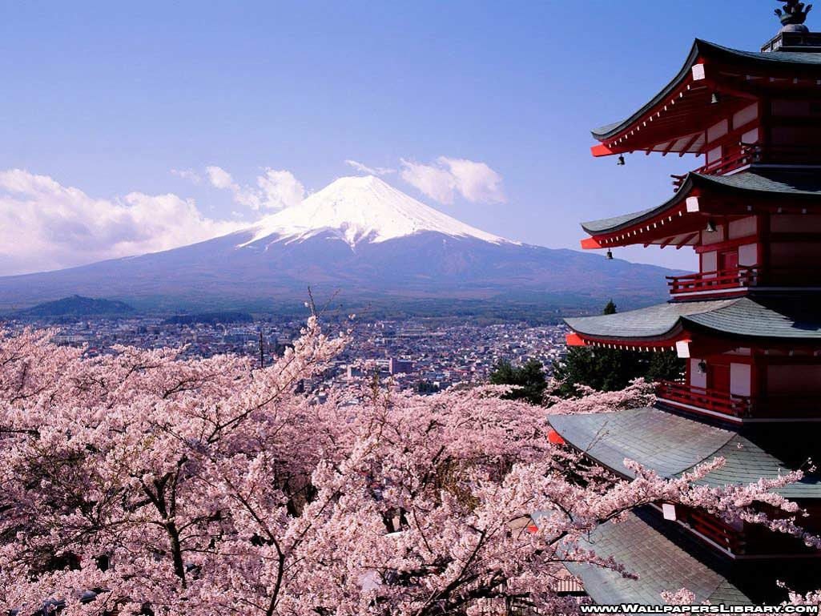
下一课:神看不见的手在历史中
God’s Invisible Hand in History

