Slide 1
RUTH
7

Slide 2
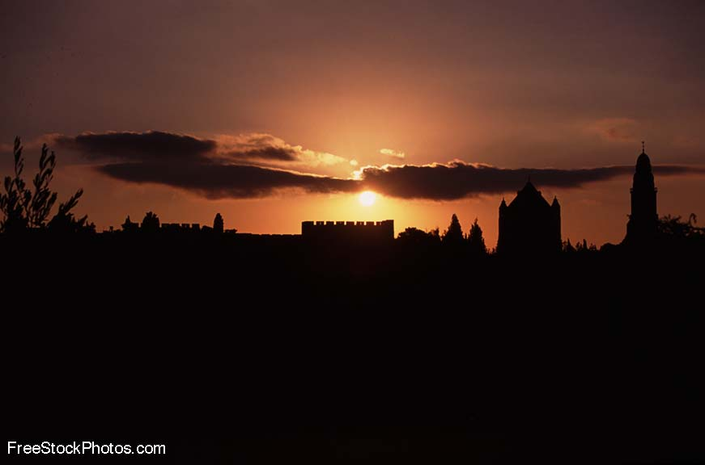
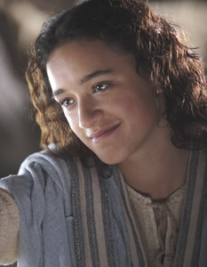
神看不见的手
《路得记》

Slide 3
日期 Date | 经文 Verses | 标题 Title
3月31 3/31 | 所有 ALL | 神看不见的手（导语） God’s Invisible Hand (Introduction)
4月7日 4/7 | 1:1-5 | 神看不见的手在患难中 God’s Invisible Hand in Suffering
4月14日 4/14 | 1:6-22 | 神看不见的手在各关系中 God’s Invisible Hand in Relationships
4月21日 4/20 | 2:1-23 | 神看不见的手在各天职中 God’s Invisible Hand in Vocations
4月28日 4/27 | 3:1-18 | 神看不见的手在婚姻中 God’s Invisible Hand in Marriage
5月5日 5/5 | 4:1-12 | 神看不见的手在救赎中 God’s Invisible Hand in Redemption
5月12日 5/12 | 4:13-22 | 神看不见的手在历史中 God’s Invisible Hand in History
神看不见的手

Slide 4
查经四步法 The 4 Steps of Bible Study
阅读 (READ)
应用 (APPLY)
观察 (OBSERVE)
解释 (INTERPRET)

Slide 5
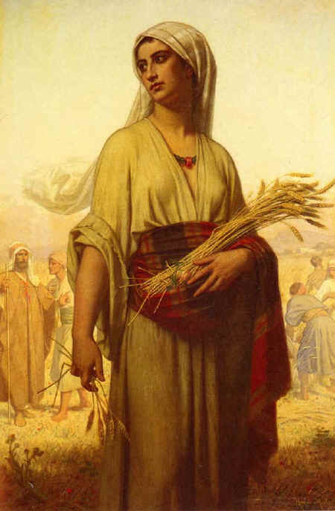
让我们快速回顾一下…
Let’s do a quick review…
在犹大闹饥荒。
There is a famine in Israel
以利米勒带领家人到摩押
Elimelek brought his family to Moab
他和二子死于摩押
He and his sons died in Moab
拿俄米和路得返回伯利恒
Naomi and Ruth return to Bethlehem
拿俄米变得苦毒;路得事奉真神。
Naomi gets bitter; Ruth serves God

Slide 6
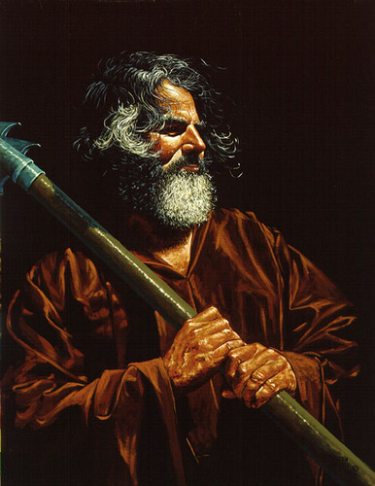
路得到地里干活
Ruth goes to work in the fields
神带她去到波阿斯的地里
God leads her to Boaz’ field
波阿斯是一远房亲戚,恩慈待她。
Boaz is a distant relative and treats her kindly.
波阿斯让路得只在他地里工作。
Boaz tells Ruth to only work in his fields.
拿俄米和路得看到神不可见的手在做工。
Naomi and Ruth see God’s invisible hand at work.
收割的季节快要结束了
The harvest season is coming to an end.
拿俄米有了一个计划。
Naomi has a plan.

Slide 7
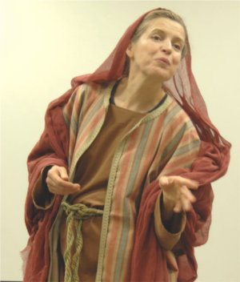
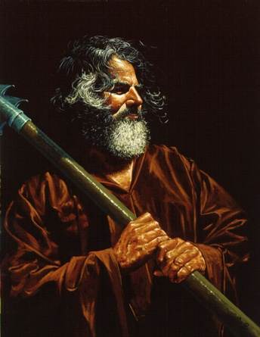
路得沐浴更衣梳妆打扮
Ruth bathes, puts on perfume and her best dress
她去到大麦打场的地方
She goes to the place where the men are winnowing barley
她趁波阿斯熟睡时，躺在他脚下。
When Boaz is asleep, she lays at his feet
他醒来后，她向他亮出身份。
He awakes and she reveals who she is
路得请求波阿斯向她求婚。
Ruth asks Boaz to propose to her
波阿斯愿意娶路得并照顾拿俄米。
Boaz is willing to marry Ruth and care for Naomi
但他必须与另一个更近的亲属交谈。
But first he must speak to a man who has first rights to Ruth

Slide 8
波阿斯通知那人土地买卖的事。
Boaz informs the man of the sale of the property
那人想买那块地。
The man decides to buy the land
波阿斯提醒他娶路得的责任。
Boaz reminds him of his responsibility to marry Ruth
那人决定不买那块地了。
The man declines to buy the property
波阿斯买了那地并宣布要娶路得。
Boaz buys the property and announces his engagement to Ruth
一个合法协议以换鞋的方式定下来了。
A legal contract is made and a sandal exchanged
城里的长老和乡亲见证了这个协议。
The elders and townspeople witness the contract

Slide 9
查经四步法 The 4 Steps of Bible Study
阅读 第四章 (READ Ch. 4:13-22)
应用 (APPLY)
观察 (OBSERVE)
解释 (INTERPRET)

Slide 10
这样，波阿斯便娶了路得为妻，与她同房。耶和华使她怀孕生了一个儿子。 14妇女们对拿俄米说：“耶和华当受称颂！因为今日祂赐给你一位至亲，使你后继有人，愿这孩子在以色列得享盛名！
¹³ So Boaz took Ruth and she became his wife. When he made love to her, the LORD enabled her to conceive, and she gave birth to a son. ¹⁴ The women said to Naomi:
“Praise be to the LORD, who this day has not left you without a guardian-redeemer.

Slide 11
15他必让你的生命重新得力，奉养你，使你安度晚年，因为他是爱你的儿媳妇所生的。有这儿媳妇比有七个儿子还要好！”
May he become famous throughout Israel!
¹⁵ He will renew your life and sustain you in your old age. For your daughter-in-law, who loves you and who is better to you than seven sons, has given him birth.”

Slide 12
16拿俄米接过婴孩抱在怀中，照顾他。 17邻居的妇女们喊着说：“拿俄米有孩子了！”她们给孩子取名叫俄备得，这俄备得就是耶西的父亲，耶西是大卫的父亲。
¹⁶ Then Naomi took the child in her arms and cared for him.
¹⁷ The women living there said, “Naomi has a son!” And they named him Obed.
He was the father of Jesse, the father of David.

Slide 13
法勒斯的后代记在下面：法勒斯生希斯仑； 希斯仑生兰；兰生亚米拿达； 亚米拿达生拿顺；拿顺生撒门；撒门生波阿斯；波阿斯生俄备得 ； 俄备得 生耶西；耶西生大卫。（圣经当代译本修订本）
¹⁸ This, then, is the family line of Perez: Perez was the father of Hezron, ¹⁹ the father of Ram, the father of Amminadab, ²⁰ the father of Nashon, the father of Salmon, ²¹ the father of Boaz, the father of Obed, ²² the father of Jesse, the father of David. “

Slide 14
查经四步法 The 4 Steps of Bible Study
阅读 (READ)
应用 (APPLY)
观察 (OBSERVE)
解释 (INTERPRET)

Slide 15
于是，波阿斯娶了路得 为妻，与她同房。耶和华使她怀孕生了一个儿子.
为何这里说：“耶和华使她怀孕”？你认为这涉及的是波阿斯的年纪吗？
Why does it say “the Lord enabled her to conceive”? Do you think it is referring to Boaz’ age?
为什么路得的头胎是个儿子很重要？
Why was it important for Ruth to have a son first?
谁决定这个孩子的性别？
Who decides if the child is a boy or a girl?
¹³ So Boaz took Ruth and she became his wife. When he made love to her,
the LORD enabled her to conceive, and she gave birth to a son.

Slide 16
妇女们对拿俄米说：“耶和华当受称颂！因为今日祂赐给你一位至亲，使你后继有人，愿这孩子在以色列得享盛名！
为何村里的女人都很高兴？
Why were the village women so happy?
她们是叫她玛拉(苦毒)还是拿俄米(甜美)？
Do they call her Mara (bitter) or Naomi (pleasant)?
她们为俄备得祷告什么？
What was their prayer for Obed?
这个祷告以什么方式得回应了？
In what way was the prayer answered?
¹⁴ The women said to Naomi: “Praise be to the LORD, who this day has not left you without a guardian-redeemer. May he become famous throughout Israel!

Slide 17
15他必让你的生命重新得力，奉养你，使你安度晚年，因为他是爱你的儿媳妇所生的。有这儿媳妇比有七个儿子还要好！”
一个孙子如何“更新她的生命”？
How will a grandchild “renew her life”?
俄备得将如何奉养拿俄米？
How will Obed sustain Naomi?
妇人们说 “路得比七个儿子还好”是什么意思？
What did the women mean by “Ruth is better than 7 sons”?
¹⁵ He will renew your life and sustain you in your old age. For your daughter-in-law, who and who is better to you than seven sons, has given him birth.”

Slide 18
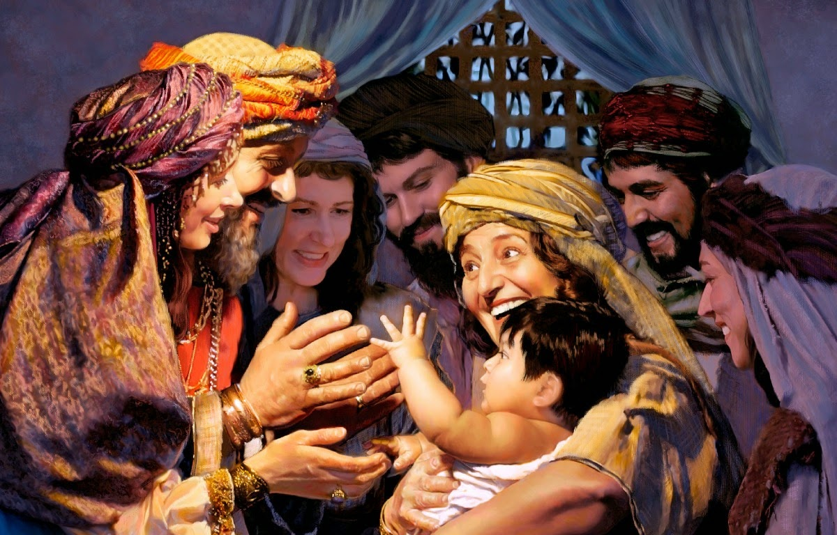
拿俄米的后代从路得而来

Slide 19
拿俄米就把孩子抱在怀中，作他的养母。 邻舍的妇人说：“拿俄米得 孩子了！”就给孩子起名叫俄备得 。这俄备得 是耶西的父，耶西是大卫的父。
谁是俄备得第一个看顾者？
Who was the primary caretaker for Obed?
为何她们说: “拿俄米得孩子了”？
Why did they say, “Naomi has a son”?
为何她们给他取名俄备得（意思是‘侍奉’）？
Why did they name their son Obed (which means ‘serving’)?
¹⁶ Then Naomi took the child in her arms and cared for him. ¹⁷ The women living there said, “Naomi has a son!” And they named him Obed. He was the father of Jesse, the father of David.

Slide 20
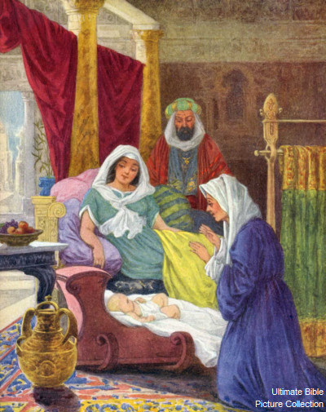
上帝对敬畏祂之人的抬举和祝福
谁像耶和华我们的神呢？他坐在至高之处，
⁶ 自己谦卑，观看天上地下的事。 ⁷ 他从灰尘里抬举贫寒人，从粪堆中提拔穷乏人， ⁸ 使他们与王子同坐，就是与本国的王子同坐。 ⁹ 他使不能生育的妇人安居家中，为多子的乐母。你们要赞美耶和华！
诗篇113:5-9

Slide 21
法勒斯的后代记在下面：法勒斯生希斯仑； 希斯仑生兰；兰生亚米拿达； 亚米拿达生拿顺；拿顺生撒门；撒门生波阿斯；波阿斯生俄备得 ； 俄备得 生耶西；耶西生大卫。
俄备得与大卫王有什么关系？
What relationship was Obed to King David?
¹⁸ This, then, is the family line of Perez: Perez was the father of Hezron, ¹⁹ Hezron the father
of Ram, Ram the father of Amminadab, ²⁰ Amminadab the father of Nahshon, Nahshon the
father of Salmon, ²¹ Salmon the father of Boaz, Boaz the father of Obed, ²² Obed the father
of Jesse, and Jesse the father of David.

Slide 22
出
埃
及
王国
时代
寄居埃及
士师时代
430年
(出12:40)
450年
(徒13:20)
犹
大
40年
法
勒
斯
希
斯
仑
兰
亚
米
拿
达
拿
顺
撒
门
可能省略多代
他
玛
波
阿
斯
喇
合
俄
备
得
耶
西
大
卫
犹大支派的首领，
大祭司亚伦的大舅子
(民1:7;2:3;出6:23)
路
得

Slide 23
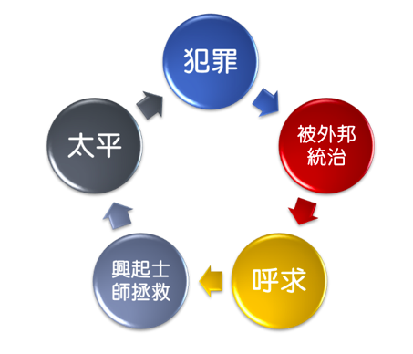
师士时代如果没有上帝，生命就是不断的循环往复，无法突破，没有出路。
路得
大卫
所罗门
耶稣
路得贤德、敬畏上帝，她便开启了皇家血脉，进入线性的历史，一路传承，直到永恒。

Slide 24
查经四步法 The 4 Steps of Bible Study
阅读 (READ)
应用 (APPLY)
观察 (OBSERVE)
解释 (INTERPRET)

Slide 25
神的主权超越历史
但4:35: “世上所有的居民都算为虚无；在天上的万军和世上的居民中，他都凭自己的意旨行事。无人能拦住他手，或问他说，你作什么呢﹖”
Dan 4:35 “And all the inhabitants of the earth are reputed as nothing: and He does according to His will in the army of heaven, and among the inhabitants of the earth: and none can stay His hand, or say unto Him, What are you doing?”
诗篇115:3: “然而，我们的神在天上， 都随自己的意旨行事。”
Psalm 115:3 "But our God is in the heavens; He does whatever He pleases."
诗篇135:6: “耶和华在天上,在地下,在海中,在一切的深处,都随自己的意旨而行.”
Ps 135:6 "Whatever the Lord pleases, He does, In heaven and in earth, in the seas and in all deeps."
GOD IS SOVEREIGN OVER HISTORY

Slide 26
护理- PROVIDENCE
神看不见的手介入地上的每个生命中。 神在历史中做工可以透过君王，王后， 统治者和列国得到确信和承认。他也在普通人的日常细节中做工，就像拿俄米， 路得和以利米勒以及…我们。神做工既体现在广大领域，也体现在我们的生活细节中。这就是他看不见手的护佑。
God’s Invisible hand is involved in the life of everyone on earth. The belief and acknowledgement that God is at work in human history through kings and queens, rulers and nations and also at work in the everyday details of normal people, like Naomi and Ruth and Elimelech...and us. God is at work in the large areas and the details of our life. That is His invisible hand of providence

Slide 27
护理- PROVIDENCE
“说：耶和华─我们列祖的神啊，你不是天上的神吗﹖你不是万邦万国的主宰吗﹖在你手中有大能大力，无人能抵挡你。”（志下20:6）
“O LORD, God of our fathers, are you not the God who is in heaven? You rule over all the kingdoms of the nations. Power and might are in your hand, and no one can
withstand you.” (2 Chron. 20:6)
签放在怀里，定事由耶和华。（箴16:33）
The lot is cast into the lap, but its every decision is from the LORD. (Prov. 16:33)
希律和本丢彼拉多,外邦人和以色列民,果然在这城里聚集,要攻打你所膏的圣仆(仆：或作子)耶稣, 成就你手和你意旨所预定必有的事.(徒4:27-28)
Herod and Pontius Pilate met together with the Gentiles and the people of Israel in this city to conspire against your holy servant Jesus. They did what your power and will had decided beforehand should happen. (Acts 4:27b-28)

Slide 28
护理- PROVIDENCE
“你们如今要知道:我,惟有我是神:在我以外并无别神. 我使人死,我使人活;我损伤,我也医治,并无人能从我手中救出来.”(申32:39)
See now that I, even I, am he, and there is no god beside me; I kill and I make alive; I wound and I heal; and there is none that can deliver out of my hand. (Deut. 32:39)
举例:“约拿书4:6 耶和华神安排一棵蓖麻，使其发生高过约拿, 影儿遮盖他的头,救他脱离苦楚；约拿 因这棵蓖麻大大喜乐.” 神又安排一条虫子摧毁了那蓖麻。约拿通过这事学到了一个功课。
EXAMPLE: “Jonah 4:6 And the LORD God prepared a gourd, and made it to come up over Jonah, that it might be a shadow over his head, to deliver him from his grief. So Jonah was exceeding glad of the gourd.” Then God sent a worm to destroy the gourd. Jonah learned a lesson through the event.

Slide 29
耶稣基督的祖先
The Ancestry of Jesus Christ
亚当-
亚伯兰
Adam - Abram
波阿斯-
耶稣
Boaz - Jesus
亚伯兰-
波阿斯
Abram - Boaz

Slide 30
亚当到亚伯兰 (Adam to Abram)
亚当
ADAM
赛特
SETH
以挪士
ENOSH
该南
KENAN
玛勒列
MAHALALEL
雅列
JARED
以诺
ENOCH
玛土撒拉
METHUSELAH
拉麦
LAMECH
挪亚
NOAH
闪
SHEM
亚法撒
ARPHAXAD
该南
CAINAN
沙拉
SHELAH
希伯
EBER
法勒
PELEG
拉吴
REU
西鹿
SERUG
他拉
TERAH
亚伯兰
ABRAM

Slide 31
从亚伯拉罕到波阿斯 (Abraham to Boaz)
亚伯拉罕- Abraham
犹大 Judah
法勒斯 Perez
希斯仑 Hezron
亚兰 Ram
亚米拿达- Amminadab
拿顺 Nashon
撒门 Salmon
波阿斯BOAZ
以撒 Isaac
雅各 Jacob

Slide 32
波阿斯(Boaz)
从波阿斯到耶稣 (Boaz to Jesus)
俄备得
OBED
耶西
JESSIE
大卫
DAVID
所罗门
SOLOMON
罗波安
REHOBOAM
亚比雅
ABIJAH
亚撒
ASA
约沙法
JEHOSHAPHAT
约兰
JEHORAM
乌西亚
UZZIAH
约坦
JOTHAM
亚哈斯
AHAZ
希西家
HEZEKIAH
玛拿西
MANASSEH
亚们
AMON
约西亚
JOSIAH
耶哥尼雅
JECONIAH
撒拉铁
SHEALTIEL
所罗巴伯
ZERUBBABEL
亚比玉
ABIUD
以利亚敬
ELIAKIM
亚所
AZOR
撒督
ZADOK
亚金
AKIM
以律
ELIUD
以利亚撒
ELIAZAR
马但
MATTHAN
雅各
JACOB
约瑟
JOSEPH
耶稣
JESUS

Slide 33
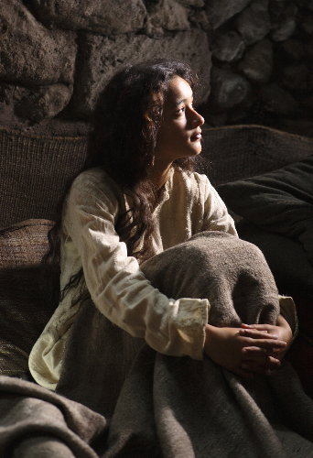
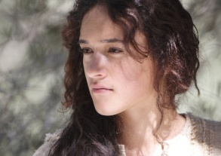
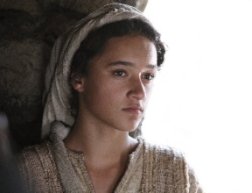
耶稣家谱列出的五个女人
The 5 Women listed in Jesus’ Genealogy
他玛（骗取家公怀孕）
Tamar (Deceived father-in-law into sex)
喇合（邪恶之地的前妓女）
Rahab (Ex-prostitute from evil culture)
路得（摩押人,敬拜基抹的邪恶之族）
Ruth (Moabite; evil culture worshipped Chemosh)
拔示巴（与大卫王通奸）
Bathsheba (Adultery with King David)
马利亚（纯洁，少女）
Mary (Pure, pre-teenage girl)

Slide 34
耶稣家谱的事实 Facts about Jesus’ Genealogy
马利亚和约瑟都是大卫王的后代。
Mary and Joseph were both descendants of King David
这就是为何他们在伯利恒并应验了预言。
That is why they were in Bethlehem and fulfilled prophecy
福音书列出耶稣家谱使犹太人相信耶 稣是弥赛亚。
The Gospels list Jesus’ genealogy to assure Jews He is the Messiah
“谁生谁”也可指“谁之孙”或 “谁之后代”的意思
“Son of” can also mean “grandson of” or “descendant of”
耶稣没有妻子和孩子。
Jesus had NO wives or children.

Slide 35
查经四步法 The 4 Steps of Bible Study
阅读 (READ)
应用 (APPLY)
观察 (OBSERVE)
解释 (INTERPRET)

Slide 36
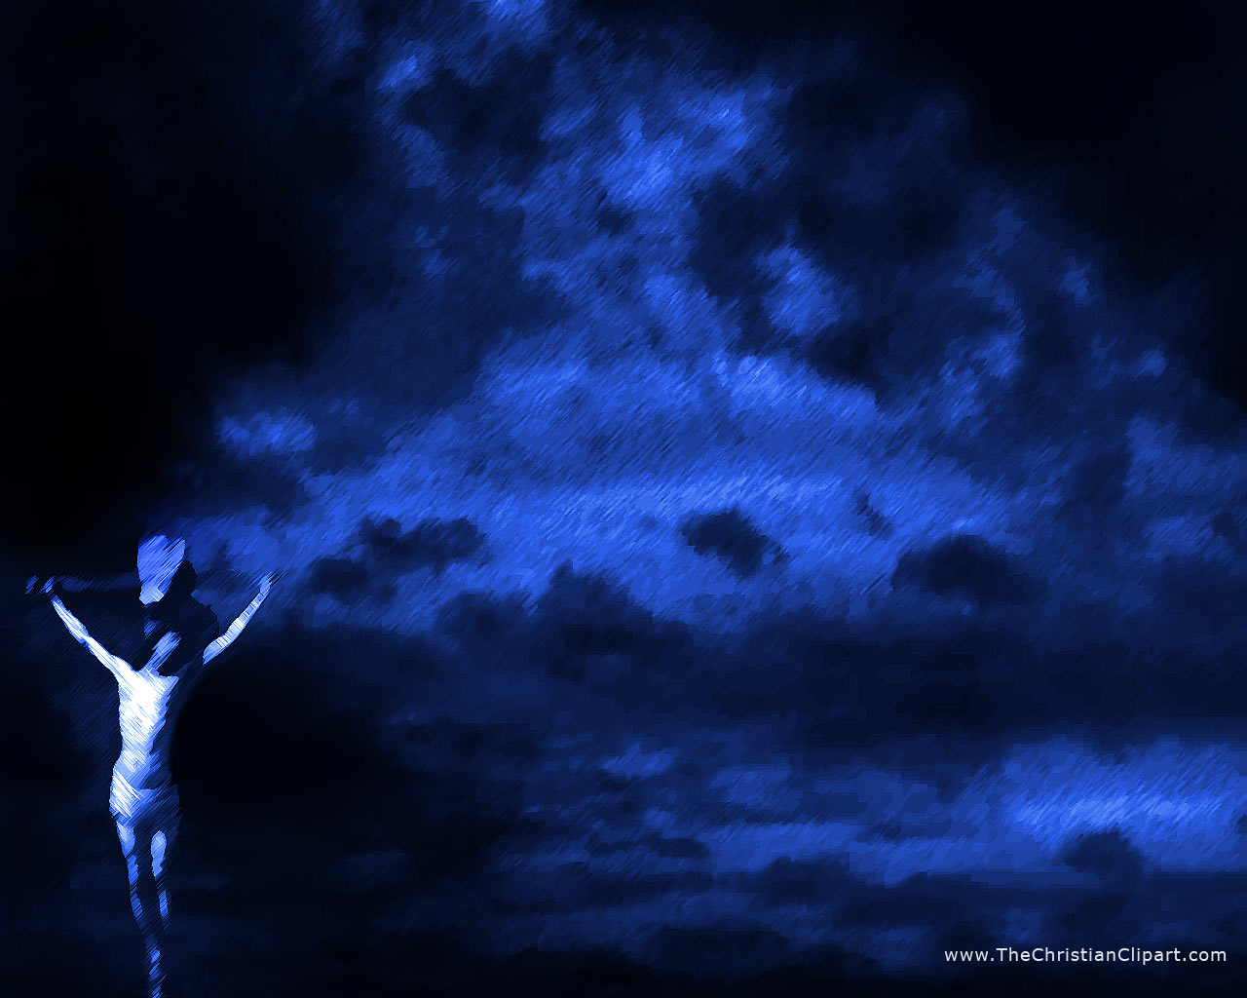
耶稣的祖先有祭司，君王，战士
和圣民。
Jesus had some ancestors that were priests, kings, warriors and holy people.
耶稣的祖先也有曾是妓女，杀人犯、拜偶像的、撒谎的、骗子、一夫多妻者、醉汉、乱伦者、 邪恶的、亵渎者、不敬虔者、窃贼、和愚昧者。
Jesus also had ancestors that were prostitutes, murderers, idolaters, liars, deceivers, polygamists, drunkards, incestual, rapists, evil, blasphemers, ungodly, perverted, thieves, and just stupid.

Slide 37
耶稣可以选择和使用任何人！
JESUS CAN CHOSE AND USE ANYONE HE WANTS TO!!!
神可以拯救最烂的罪人。
God can save even the worst of sinners.
你的过去一团糟,并不意味着你的未来也必如此。
Just because your past is filthy, does NOT mean your future has to be.
给后代留下属灵遗产,让他们感到骄傲而不是羞耻。
Leave a LEGACY for your descendants to be proud of, not ashamed of.
无人好到不需依靠耶稣得救
也无人坏到耶稣无法拯救。

Slide 38
应用 - Applications
我相信神会行对我最有益的事 。
I can trust God to do what is best for me.
我不能做任何事改变全能者的计划。
Nothing I do can change the plans of the Almighty.
神会使用我为祂未来的旨意预备道路。
God will use me to prepare the way for His future purposes.
神甚至能使用我的不顺服来荣耀他自己。
God even uses my disobedience to bring glory to Himself.
神是圣洁，良善，仁爱，完美的…而且祂爱我。
God is holy, good, loving, perfect…and HE LOVE ME.
我应该以尽心、尽性、尽力、尽意的爱回报祂。
I should in return love Him with all my heart, soul, mind & strength.

Slide 39
谢谢你与我们一起学习
“神看不见之手”
系列（路得记）。
愿神看不见的手
一生一世引领你。
Thank you for studying “God’s Invisible Hand” (the Book of Ruth) with us. May God’s invisible hand guide you all the days of your life.

