Slide 1
金钱
Today: MONEY & Offering

Slide 2
圣经主题强化课程
INTENSIVE BIBLE TRAINING PROGRAM

Slide 3
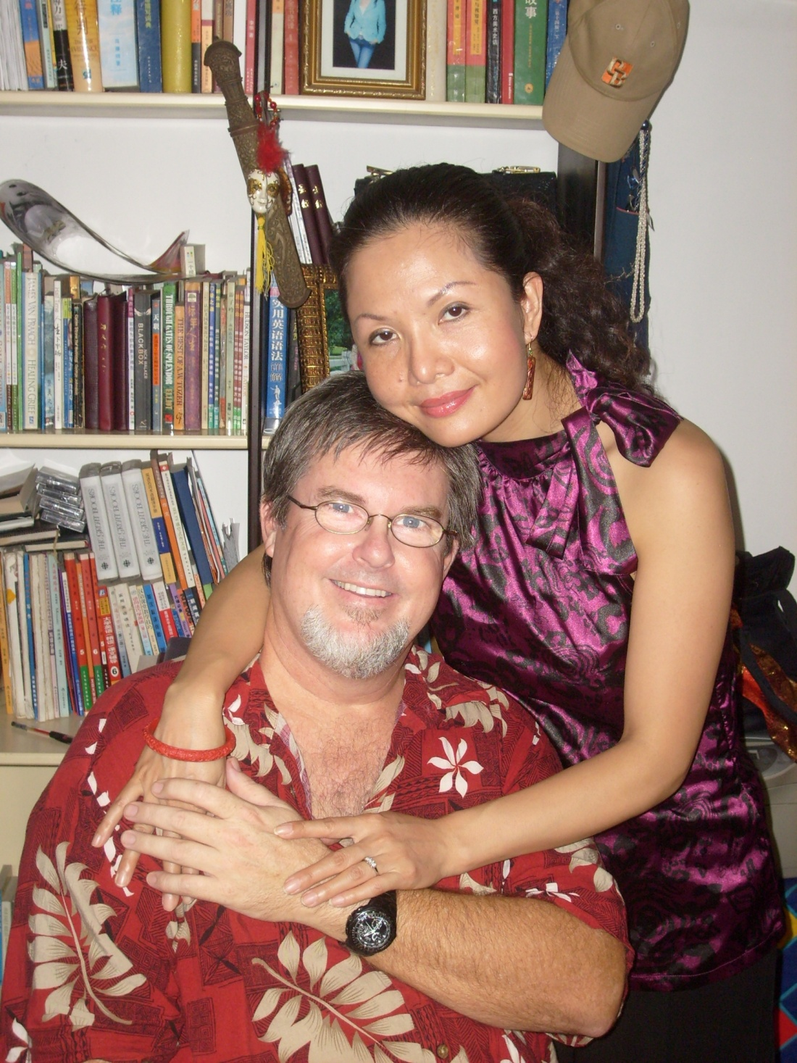
Teachers:
Dr. Jay
Barleon
&
Suran

Slide 4
前言
金钱. 小小第一张纸能驱使人去行疯狂之事. 人们不惜拼上性命得到它. 这张纸既不能吃也不能穿，但为何如此多人的生命与之纠缠在一起？答案在于它的价值。人愿意为他们重视的任何事物献上性命. 父母都愿意为孩子舍命. 很多人为保护自己所爱的国家献身. 圣经提到金钱的次数甚至多余天堂和地狱加起来的总和. 神知道除非我们学会将神看得高于那张小小的，肮脏的, 叫做 “金钱”的纸，我们毫无机会与神一起度永生. 只有我们学会真正将神的价值看得高于钱财, 我们才能开始体验神赐予的圣灵充满美好生活. 让我们一起查考神在圣经中为我们定下的对待金钱的态度和行为的重要原则。
Money. Little slips of colored paper that drives people to do crazy things. People alter their lives to get more of it. You can’t eat it or wear it. So why do so many people’s lives evolve around money? The answer is in what it is worth. People will dedicate their lives to anything they value. Any parent would sacrifice their life for their child. Many brave people have died defending the countries they love and value. The Bible speaks more about money than about Heaven and Hell put together. God knows that unless we can learn to value Him above these little pieces of dirty colored paper we call ‘money’ we have little chance of ever spending eternity with Him. Only when we learn to truly value God above money can we even begin to experience the wonderful Spirit-filled life that He has provided for us. Let’s look at some important principles God has laid down in the Bible regarding our attitudes and actions towards money.
INTRODUCTION

Slide 5
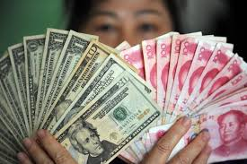
金钱是个属灵问题…
你的财宝在哪里，你的心也在哪里。
-太6:21
圣经中提到有关金钱财富方面的教导，新旧约加起来的经文有800处之多；
新约中耶稣的教导中有四分之一是关于金钱方面的。
MONEY IS A SPIRITUAL ISSUE…

Slide 6
金钱是个属灵问题…
太6:24-34 “一个人不能侍奉两个主. 不是恶这个爱那个,就是重这个轻那个。你们不能又侍奉神,又侍奉玛门. 所以我告诉你们:不要为生命忧虑,吃什么,喝什么,为身体忧虑穿什么.
MONEY IS A SPIRITUAL ISSUE…

Slide 7
金钱是个属灵问题…
所以, 不要忧虑说: ‘吃什么? 喝什么? 穿什么? 这都是外邦人所求的。你们需用的这一切东西，你们的天父是知道的。你们要先求他的国和他的义, 这些东西都要加给你们了。所以不要为明天忧虑, 因为明天自有明天的忧虑; 一天的难处一天当就够了。”
So don’t worry about these things, saying, ‘What will we eat? What will we drink? What will we wear?’ These things dominate the thoughts of unbelievers, but your heavenly Father already knows all your needs. Seek the Kingdom of God above all else, and live righteously, and he will give you everything you need. So don’t worry about tomorrow, for tomorrow will bring its own worries. Today’s trouble is enough for today.” - Matthew 6:24-34
MONEY IS A SPIRITUAL ISSUE…

Slide 8
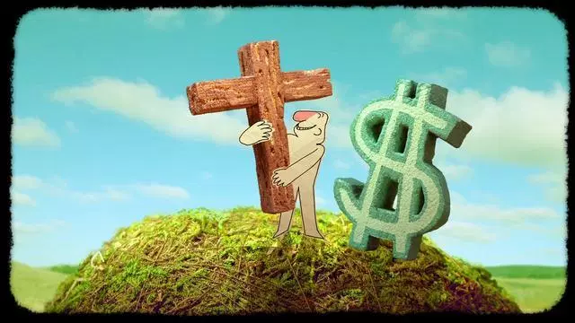
金钱是个属灵问题…
我们是在追求赐供应的神，还是在追求神赐的供应？
这是个关乎敬拜对象的问题——我们狂热追求什么，什么就成为我们的神。
MONEY IS A SPIRITUAL ISSUE…

Slide 9
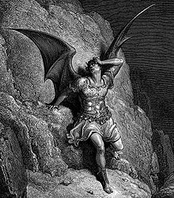
撒旦的谎言
上帝希望所有的基督徒都健康富有。
God wants all Christians to be healthy and wealthy
只要奉耶稣的名祷告求什么上帝都会给。
God will give you all you ask for if you pray in Jesus Name
金钱是幸福之源。
Money brings happiness
财富丰足是罪。
It’s a sin to have much money
如果你很富有, 一定是
来自神的祝福.
If you have much money, it is always because God has blessed you
SATAN’S LIES

Slide 10
成功神学和贫穷神学
成功神学：认为富有的基督徒比贫穷者更公义，因为财富是神赐福的标志。
贫穷神学：认为贫穷者要比富有者更公义，因为主耶稣就是贫穷的。
TO FIND THE HEART, FOLLOW THE MONEY

Slide 11
成功神学和贫穷神学
圣经中四种财富管家
公义的富人：上帝，亚伯拉罕,以撒，雅各，约瑟，约伯，亚利马太的约瑟，吕底亚，多加。
公义的穷人：路得和拿俄米，耶稣基督，只有两个小钱的寡妇，马其顿教会，保罗。
不义的富人：拉班，以扫，拿八，哈曼，富有的财主，耶洗别。
不义的穷人：游手好闲者，懒虫，愚拙的人，箴言中反复警告的类型。
TO FIND THE HEART, FOLLOW THE MONEY

Slide 12
圣经是怎么说的？
WHAT DOES THE BIBLE SAY?

Slide 13
顺着金钱就能找到人的心
“不要为自己积攒财宝在地上,地上有虫子咬,能锈坏,也有贼挖窟窿来偷.只要积攒财宝在天上,天上没有虫子咬,不能锈坏,也没有贼挖窟窿来偷。因为你的财宝在那里,你的心也在那里。一个人不能侍奉两个主。不是恶这个爱那个,就是重这个轻那个.你们不能又侍奉神,又侍奉玛门。”
“Do not store up for yourselves treasures on earth, where moths and rust destroy, and where thieves break in and steal. But store up for yourselves treasures in heaven, where moths and rust do not destroy, and where thieves do not break in and steal. For where your treasure is, there your heart will be also. …No one can serve two masters. Either you will HATE the one and LOVE the other, or you will be DEVOTED to the one and DESPISE the other. You cannot serve both God and money. “Matt 6:19-21,24
TO FIND THE HEART, FOLLOW THE MONEY

Slide 14
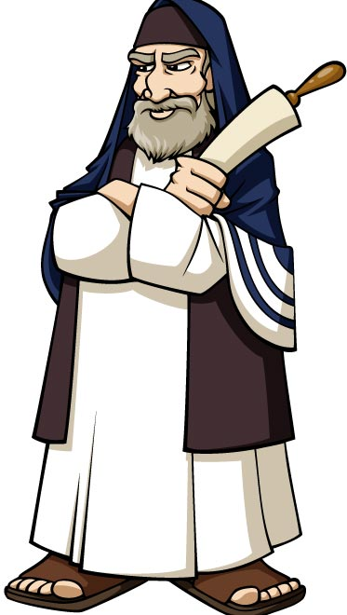
路加福音16:10-15
…法利赛人是贪爱钱财的，他们听见这一切话，就嗤笑耶稣。耶稣对他们说：“你们是在人面前自称为义的，你们的心，神却知道；因为人所尊贵的，是神看为可憎恶的。”
“…The Pharisees (religious people) who loved money, heard all this and were sneering at Jesus. He said to them, “You are the ones who justify yourselves in the eyes of others, but God knows your hearts. What people value highly is detestable in God’s sight. “
Luke 16:10-15

Slide 15
无论贫富,上帝要的是敬虔和知足
上帝关注的不是你富有，还是贫穷，而在于你是公义，还是不义。
“ 多给谁，就向谁多取；多托谁，就向谁多要 ”-路12:48
成为富人并不是罪,但是强烈希望致富则是罪。
敬虔的基督徒使用财富来服事神，不敬虔的人将敬虔作为得利的门道。提后6:5-6
没有人比耶稣基督拥有更多财富，但是在人世间传道时，他无家可归。
TO FIND THE HEART, FOLLOW THE MONEY

Slide 16
满足的关键
2. 腓4:11-13 “我并不是因缺乏说这话，我无论在什么景况，都可以知足，这是我已经学会了。我知道怎样处卑贱，也知道怎样处丰富，或饱足、或饥饿、或有余、或缺乏，随事随在，我都得了秘诀。我靠着那加给我力量的，凡事都能作。”
Phil. 4:11-13 “I am not saying this because I am in need, for I have learned to be content whatever the circumstances. I know what it is to be in need, and I know what it is to have plenty. I have learned the secret of being content in any and every situation, whether well fed or hungry, whether living in plenty or in want. I can do all this through him who gives me strength.”
THE CONTENTMENT KEY

Slide 17
满足的关键
提前6:6-11 “然而,敬虔加上知足的心便是大利了, 因为我们没有带什么到世上来,也不能带什么去,只要有衣有食,就当知足.但那些想发财的人,就陷在迷惑、落在网罗和许多无知有害的私欲里,叫人沉在败坏和灭亡中.贪财是万恶之根.有人贪恋钱财,就被引诱离了真道,用许多愁苦把自己刺透了.”
1 Tim 6:6-10 “But godliness with contentment is great gain. For we brought nothing into the world, and we can take nothing out of it. But if we have food and clothing, we will be content with that. Those who want to get rich fall into temptation and a trap and into many foolish and harmful desires that plunge people into ruin and destruction. For the love of money is a root of all kinds of evil. Some people, eager for money, have wandered from the faith and pierced themselves with many griefs.”
THE CONTENTMENT KEY

Slide 18
如何正确理解满足
X满足的迷思:
再有一点点就满足了。
满足必须从学习和操练中得来。
满足= 我能对付, 并非我喜爱。
满足并不限制和排除内在驱动。
腓4:11-13; 代上4:9-10,
THE CONTENTMENT KEY

Slide 19
上帝希望你养家糊口
提前5:8 “人若不看顾亲属，就是背了真道，比不信的人还不好。不看顾自己家里的人，更是如此。”
1 Tim. 5:8 “If anyone does not provide for the needs of his own, and especially those of his family, he has denied the faith and is worse than a nonbeliever.”
帖后3:10 “若有人不肯作工, 就不可吃饭. ”
2 Thess. 3:10 “If a man will not work, he should not eat.”
GOD’S DESIGN IS TO WORK FOR YOUR NEEDS

Slide 20
箴言6:6-11
“懒惰人哪，你去察看蚂蚁的动作，就可得智慧。蚂蚁没有元帅，没有官长，没有君王，尚且在夏天预备食物，在收割时聚敛粮食。懒惰人哪，你要睡到几时呢?你何时睡醒呢?再睡片时，打盹片时，抱着手躺卧片时，你的贪穷就必如强盗速来，你的缺乏仿佛拿兵器的人来到。”
“Go look at the ant, you sluggards! Observe what she does and become wise! They have no chief, no officers and no rulers to tell them what to do. And yet they work hard in the right seasons, planting, harvesting, and preparing the food they will need later. How long will you keep lying down, you sluggard? When are you going to get up and quit sleeping? ‘I just want a little more sleep’, you say! ‘Just a nap.’ ‘Just let me fold my hands and rest a while longer.’ Before you know it, you will be as poor as a homeless person, and your needs will be the same as if you were robbed by an armed thief!”
Proverbs 6:6-11

Slide 21
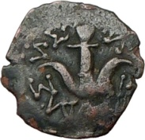
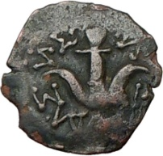
神喜爱牺牲式的礼物
路21:1-4 “耶稣抬头观看.见财主把捐项投在库里。又见一个穷寡妇.投了两个小钱。就说: ‘我实在告诉你们. 这穷寡妇,所投的比众人还多,因为众人都是自己有余,拿出来投在捐项里;但这个寡妇是自己不足,把他一切养生的都投上了.”
^{Luke 23:1-4 “}As Jesus looked up, he saw the rich putting their gifts into the temple treasury.
He also saw a poor widow put in two very small copper coins. “Truly I tell you,” he said,
“this poor widow has put in more than all the others. All these people gave their gifts
out of their wealth; but she out of her poverty put in all she had to live on.”
GOD LOVES THE SACRIFICIAL GIFT

Slide 22
马其顿人的榜样
林后8:1-8 “弟兄们,我把神赐给马其顿众教会的恩告诉你们,就是他们在患难中受大试炼的时候,仍有满足的快乐; 在极穷之间,还格外显出他们乐捐的厚恩. 我可以证明:他们是按着力量,而且也过了力量,自己甘心乐意的捐助,再三的求我们,准他们在这供给圣徒的恩情上有分。并且他们所作的,不但照我们所想望的,更照神的旨意,先把自己献给主,又归附了我们。因此我劝提多,既然在你们中间开办这慈惠的事,就当办成了。你们既然在信心、口才、知识、热心和待我们的爱心上,都格外显出满足来，就当在这慈惠的事上也格外显出满足来. 我说这话,不是吩咐你们,乃是藉着别人的热心试验你们爱心的实在。”
2 Cor. 8:1-8 ”And now, brothers and sisters, we want you to know about the grace that God has given the Macedonian churches. In the midst of a very severe trial, their overflowing joy and their extreme poverty welled up in rich generosity. For I testify that they gave as much as they were able, and even beyond their ability. Entirely on their own, they urgently pleaded with us for the privilege of sharing in this service to the Lord’s people. And they exceeded our expectations: They gave themselves first of all to the Lord, and then by the will of God also to us. So we urged Titus, just as he had earlier made a beginning, to bring also to completion this act of grace on your part. But since you excel in everything—in faith, in speech, in knowledge, in complete earnestness and in the love we have kindled in you—see that you also excel in this grace of giving. I am not commanding you, but I want to test the sincerity of your love by comparing it with the earnestness of others. “
MACCEDONIAN EXAMPLE

Slide 23
奉献的态度
林后9:6-8 “少种的少收，多种的多收, 这话是真的。各人要随本心所酌定的, 不要作难，不要勉强,因为捐得乐意的人,是神所喜爱的。神能将各样的恩惠多多地加给你们，使你们凡事常常充足，能行各样的善事。”
2 Cor. 9:6-8b “Remember this: Whoever sows sparingly will also reap sparingly, and whoever sows generously will also reap generously. Each of you should give what you have decided in your heart to give, not reluctantly or under compulsion, for God loves a cheerful giver. And God is able to bless you abundantly, so that in all things at all times, having all that you need, you will abound in every good work. “
THE ATTITUDE OF GIVING

Slide 24
加增对神的感恩
林后9:6-11-15 “叫你们凡事富足,可以多多施舍,就藉著我们使感谢归于神. 因为办这供给的事,不但补圣徒的缺乏,而且叫许多人越发感谢神. 他们从这供给的事上得了凭据,知道你们承认基督,顺服他的福音,多多地捐钱给他们和众人,便将荣耀归与神. 他们也因神极大的恩赐显在你们心里,就切切地想念你们,为你们祈祷. 感谢神,因他有说不尽的恩赐.”
2 Cor. 9:6-11-15 “You will be enriched in every way so that you can be generous on every occasion, and through us your generosity will result in thanksgiving to God. This service that you perform is not only supplying the needs of the Lord’s people but is also overflowing in many expressions of thanks to God. Because of the service by which you have proved yourselves, others will praise God for the obedience that accompanies your confession of the gospel of Christ, and for your generosity in sharing with them and with everyone else. And in their prayers for you their hearts will go out to you, because of the surpassing grace God has given you. Thanks be to God for his indescribable gift!”
INCREASES THANKSGIVING TO GOD

Slide 25
神的态度
雅2:5 “我亲爱的弟兄们，请听！神岂不是拣选了世上的贫穷人，叫他们在信上富足，并承受他所应许给那些爱他之人的国吗？”
雅5:1-5 “嗐！你们这些富足人哪,应当哭泣,号啕,因为将有苦难临到你们身上. 你们的财物坏了,衣服也被虫子咬了. 你们的金银都长了锈;那锈要证明你们的不是,又要吃你们的肉,如同火烧。你们在这末世只知积攒钱财. 工人给你们收割庄稼,你们亏欠他们的工钱;这工钱有声音呼叫，并且那收割之人的冤声已经入了万军之主的耳了. 你们在世上享美福,好宴乐,当宰杀的日子竟娇养你们的心。.”
.”

Slide 26
《箴言》的忠告
你的所是比你的所有更重要
箴30:7-9 “我求你两件事,在我未死之先,不要不赐给我:求你使虚假和谎言远离我;使我也不贫穷也不富足,赐给我需用的饮食. 恐怕我饱足不认你,说: ‘耶和华是谁呢?’ 又恐怕我贫穷就偷窃,以致亵渎我神的名.”
WHO YOU ARE IS MORE IMPORTANT THAN WHAT YOU HAVE
Prov. 30:7-9 “Give me, Lord, neither poverty nor riches. Feed me with my portion of food. If I were too full I might deny You and say, ‘Who is the Lord?’ If I were too needy I might steal and profane the name of my God.”
ADVICE FROM PROVERBS

Slide 27
《箴言》的忠告
那些扶贫助困者
THOSE WHO HELP THE POOR
那些不帮助穷困者
THOSE WHODO NOT HELP THE POOR
喜乐
Is happy (14:21; 22:9)
将不会忍饥挨饿
Will not go hungry (28:27)
他们的需要将会满足
Will have their needs met (28:27)
他们乃是在给予神
Is giving to God (19:17)
向穷人表达爱
Shows love for the poor (29:7)
神会偿还你
Will be repaid by God (22:2-23)
他的呼吁不蒙应允
His pleas will be ignored (21:13)
被多人咒诅
Will be cursed by many (28:27)
弃绝神的创造
Rejects God’s creation (22:2; 29:13)
辱没神自己
Reproaches God Himself (14:31)
必以贫穷告终
Will end up in poverty (22:16)
必将被神审判
Will be punished by God (22:23)
ADVICE FROM PROVERBS

