Slide 1
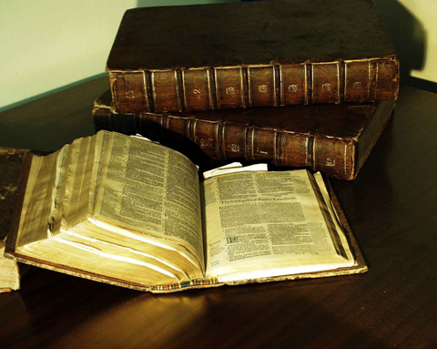
《圣经》如何形成？
ow We Got the ible

Slide 2
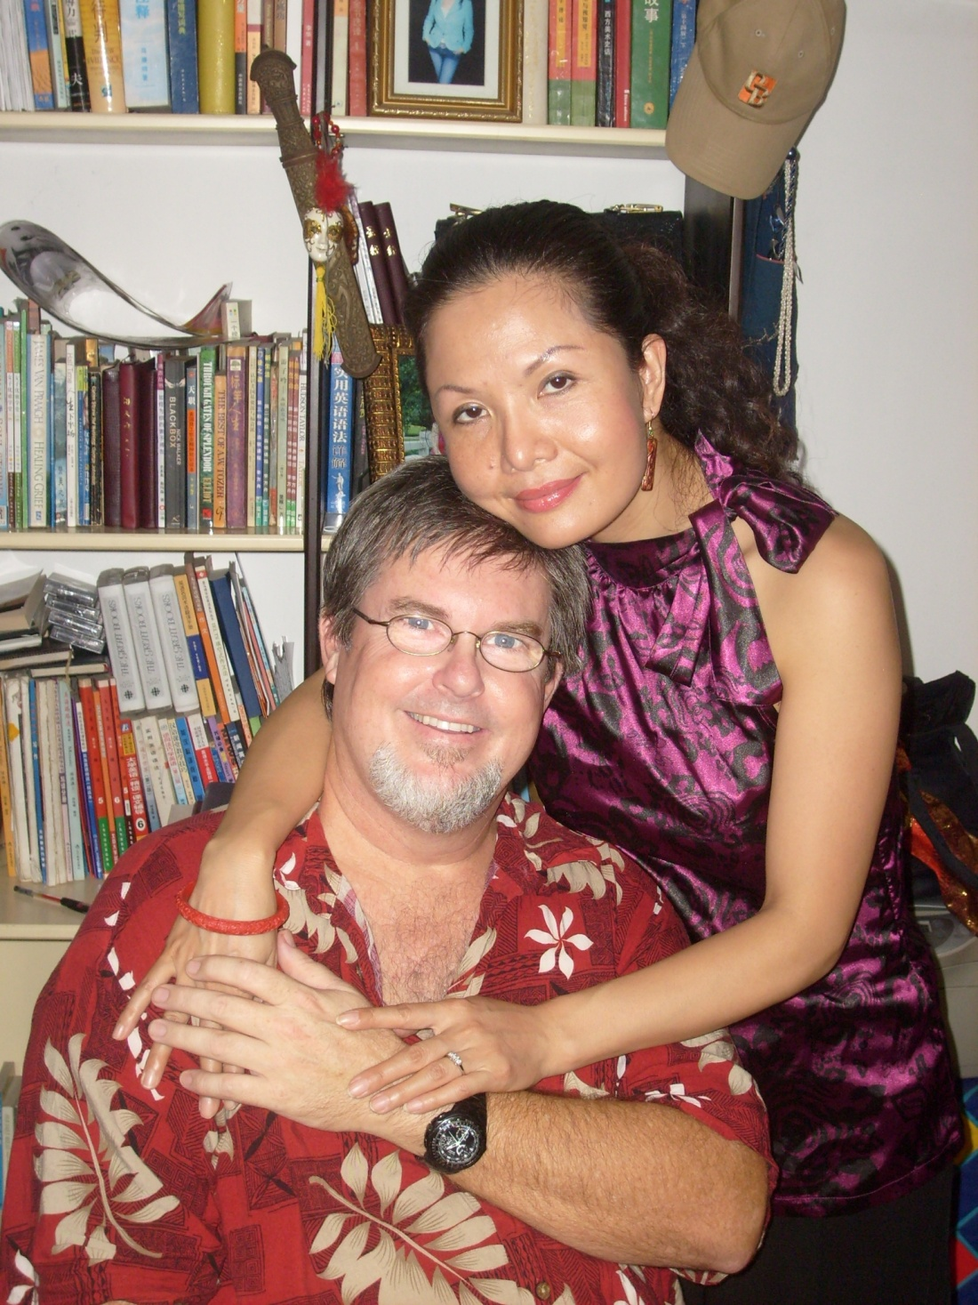
Teachers:
Dr. Jay Barleon
&Suran

Slide 3
圣经 The Bible

Slide 4
旧约
Old Testament
新约
New Testament
400 年沉默期 (400 Silent Years)

Slide 5
旧约
新约
Old Testament New Testament

Slide 6
* 有66卷书组成
Made up of 66 different books.
* 写作跨度一千五百年
Written over a span of 1,500 years
* 超过四十位作者
Written by more than 40 men
* 作者身份行业众多(君王,乡民,哲学家, 渔夫,诗人,学者,农夫).
From many walks of life (kings, peasants, philosophers, fishermen, poets, scholars, farmers)
* 写于不同地方(旷野,地窖,皇宫).
• in different places (wilderness, dungeon, palaces)

Slide 7
* 写于不同的时期(战争时期, 和平时期，奴隶时期, 等).
• At different times and moods (times of war, peace, slavery, etc)
* 不同的心情(极大的喜乐,绝望等.)
In different moods (tremendous joy, despair, etc)
* 跨越三大洲(亚洲,非洲,欧洲)
• On three continents (Asia, Africa, and Europe)
* 三种语言(希伯来,亚兰,希腊语).
• In three languages (Hebrew, Aramaic, and Greek)
* 然而却是完美统一毫无矛盾错误.
• YET IN PERFECT UNITY WITHOUT CONTRADICTION OR ERROR

Slide 8
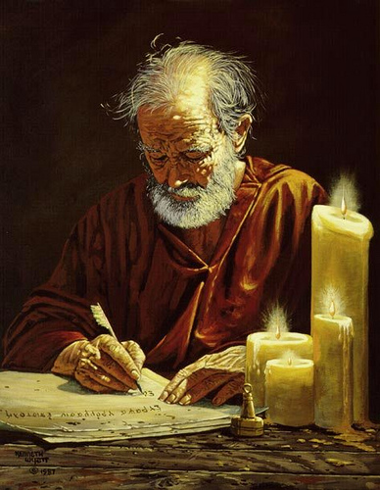
神是 《圣经》 的作者
God is the Author of the Bible
一位作者, 多位
抄录员
One Author, Many Scribes!

Slide 9
旧约(石头， 粘土，皮革)
O.T. (stone, clay, leather)
复制在皮革, 纸卷轴上.
Copied on leather & paper scrolls
牛皮纸 （上等动物皮）
Vellum (fine animal skin)
新约 西奈古抄本 （纸莎草）
N.T. (papyrus)
印刷机： 纸张
Printing Press: paper
纸张；互联网；有声圣经
Paper; Internet; Audio
1500 BC 500 BC AD 1 AD 500 AD 1000 AD 1500 AD 1900 AD 2000
1500 BC 500 BC AD1 AD 500 AD 1000 AD 1500 AD 1900 AD 2000

Slide 10
什么是正典？ What is the Canon?
希腊文: 一把量尺
Greek: κανών – A Measuring stick; ruler.
被接受为 “神的道” 的书单. 这些著作确定了基督信仰的教义,实践和敬拜
(The list of books that are accepted as the Word of God. Those writings that determine Christian doctrine, practice, and worship)

Slide 11
旧约正典
Old Testament Canon

Slide 12
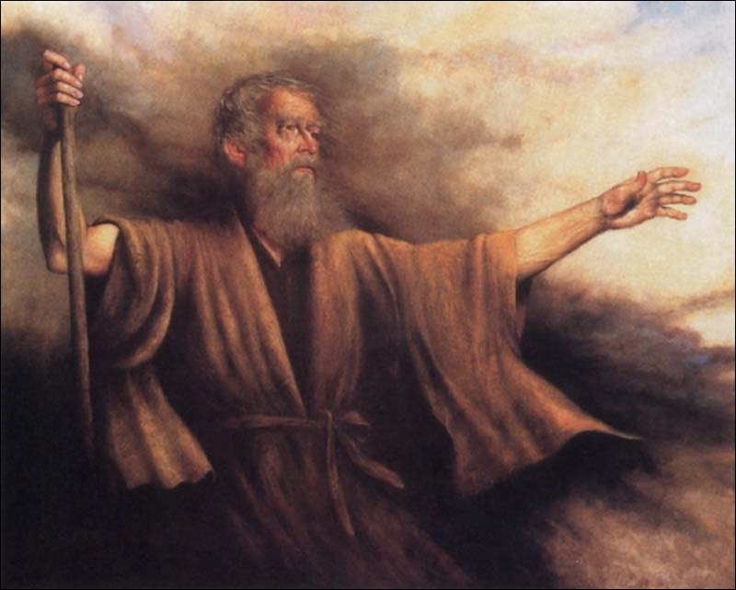
旧约中的圣徒记录了
神多年来的工作和信息。
神晓谕摩西写下来。
前五本书由此写成。
（称为“托拉”或
“摩西五经”）
君王、牧者、领袖、
先知继续
在神的指示下进行写作。
The Old Testament saints record God’s work and message throughout the years. God tells Moses to write them in a book.
The first 5 books are written.
(called the Torah & Pentateuch)
Kings, shepherds, leaders, & prophets, continue to write as God directs them.
1500 BC 500 BC AD 1 AD 500 AD 1000 AD 1500 AD 1900 AD 2000
1500 BC 500 BC AD1 AD 500 AD 1000 AD 1500 AD 1900 AD 2000
1500 BC 500 BC AD1 AD 500 AD 1000 AD 1500 AD 1900 AD 2000

Slide 13
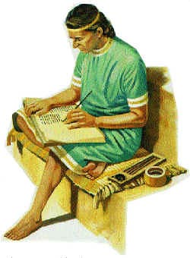
大概在公元前450年，
以斯拉,
这个祭司和文士
收集和整理
希伯来圣经书卷。
塔纳赫/旧约
About 450 B.C., Ezra, the priest and scribe collects and arranges the books of the Hebrew Bible.
Tanakh / Old Testament
1500 BC 500 BC AD 1 AD 500 AD 1000 AD 1500 AD 1900 AD 2000
1500 BC 500 BC AD1 AD 500 AD 1000 AD 1500 AD 1900 AD 2000
1500 BC 500 BC AD1 AD 500 AD 1000 AD 1500 AD 1900 AD 2000

Slide 14
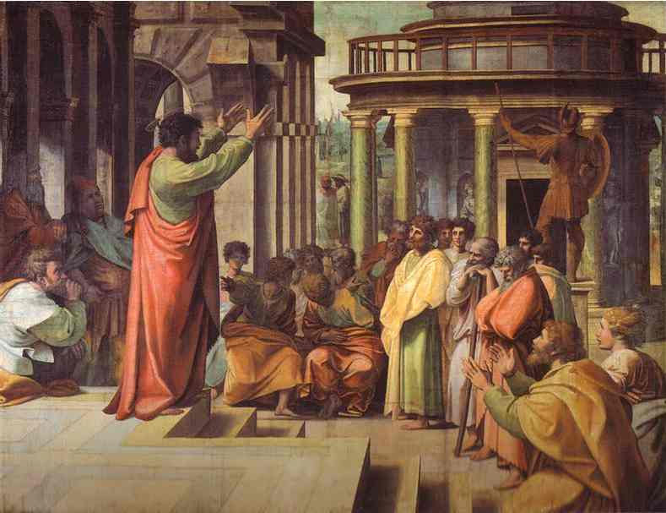
公元前250-100年间
《七十士译本》形成。
这个《旧约圣经》
的希腊文译本在埃
及亚历山大港由
七十二位犹太
学者译成。
250 – 100 B.C.
The Septuagint (LXX)
The Greek translation of the Old Testament is translated by 70-72 Jewish scholars in Alexandria, Egypt.
1500 BC 500 BC AD 1 AD 500 AD 1000 AD 1500 AD 1900 AD 2000
1500 BC 500 BC AD1 AD 500 AD 1000 AD 1500 AD 1900 AD 2000
1500 BC 500 BC AD1 AD 500 AD 1000 AD 1500 AD 1900 AD 2000

Slide 15
《七十士译本》影响
当时亚历山大帝国通行的文字
语言为希腊文,译成的希腊文
旧约经典就成了犹太人通用
的“正典”。
耶稣在世时所引用的旧约圣经
就是七十士希腊文译本。
今天基督教所用的新约圣经中所
引用的旧约,也是出自该译本。
250 – 100 B.C.
The Septuagint (LXX)
The Greek translation of the Old Testament is translated by 70-72 Jewish scholars in Alexandria, Egypt.
1500 BC 500 BC AD 1 AD 500 AD 1000 AD 1500 AD 1900 AD 2000
1500 BC 500 BC AD1 AD 500 AD 1000 AD 1500 AD 1900 AD 2000
1500 BC 500 BC AD1 AD 500 AD 1000 AD 1500 AD 1900 AD 2000

Slide 16
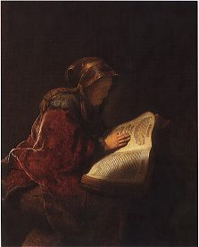
公元前200年，
46卷书按门类进行
了整理：历史，
诗歌和预言类。
9卷有争议的书卷在
公元 90年被犹太
长老删除，
剩下39卷书。
200 B.C., 46 books are arranged into categories: Historical, Poetic & Prophetic. Nine disputed books are removed in 90 A.D. by Jewish elders leaving 39 O.T. Books.
1500 BC 500 BC AD 1 AD 500 AD 1000 AD 1500 AD 1900 AD 2000
1500 BC 500 BC AD1 AD 500 AD 1000 AD 1500 AD 1900 AD 2000
1500 BC 500 BC AD1 AD 500 AD 1000 AD 1500 AD 1900 AD 2000

Slide 17
在耶稣的年代，旧约被称为
《塔納赫》 : The TANAKH
a.k.a. The Masoretic Text or the Miqra)
The TORAH (托拉)
a.k.a. Teachings; Pentateuch; 5 Books of Moses
(摩西五经)
NEVI’IM (尼威姆)
a.k.a. the Prophets (先知书)
KETUVIM (克丢威姆)
a.k.a. The Writings (诗篇等)

Slide 18
耶稣对他们说: “这就是我从前与你们同在之时所告诉你们的话,说摩西的律法,先知的书,和诗篇上所记的,凡指着我的话,都必须应验.” -路24:44
He said to them, "This is what I told you while I was still with you: Everything must be fulfilled that is written about me in the Law of Moses (torah), the Prophets (nevi’im) and the Psalms (ketuvim)." -Luke 24:44

Slide 19
塔纳赫(TheTANAKH)
律法书TORAH
先知书NEVI’IM
诗篇KETUVIM
Bereshith – Genesis创
Shemot - Exodus 出
Vayikra – Leviticus利
Bamidbar – Numbers 民Devarim – Deuteronomy申
Y‘hoshua – Joshua书
Shophtim - Judges 士
Sh‘muel – Samuel撒 (I & II) M’lakhim – Kings王 (I & II)
Y‘shayahu – Isaiah赛
Yir‘mi’yahu – Jeremiah耶
Y‘khezqel – Ezekiel结
Hoshea – Hosea何
Yo‘el - Joel / Amos - Amos 摩Ovadyah – Obadiah俄
Yonah – Jonah 拿
/ Mikhah – Micah弥
Nakhum – Nahum鸿
Havakuk – Habakkuk哈
Ts‘phanyah – Zephaniah 番
Khagai - Haggai 该
Z'kharyah - Zechariah 亚
Mal‘akhi – Malachi玛
Sifrei Emet / Books of Truth
Tehillim - Psalms 诗
Mishlei – Proverbs箴
Iyov - Job 伯
Five Megilot /Five Scrolls:
Shir Hashirim - Song of Songs雅 Rut – Ruth得
Eikhah - Lamentations 哀
Kohelet - Ecclesiastes 传
Esther - Esther 斯
The rest of the "Writings":
Dani‘el- Daniel 但
Ezra Ezra 拉
Nechemia - Nehemiah 尼
Divrei Hayamim –Chronicles 代 1 & 2

Slide 20
新约正典
New Testament Canon

Slide 21
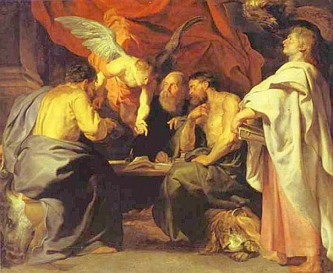
承认正典的阶段
The Stages of Canonization

Slide 22
“承认正典”的定义
Definition of Canonization
承认正典: 一个确定哪些书籍可合法地形成一本圣经的过程。决定入典的书籍必须是由圣灵通过目击见证人或与目击见证人交谈过之人的手写成的。
Canonization: The process of formulating the ONE BIBLE by means of determining which books are legitimately written by the Holy Spirit through eye-witnesses or those who have spoken to eye witnesses.

Slide 23
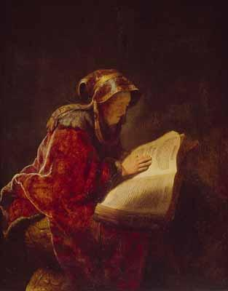
承认正典的阶段
Stages of Canonization
写作—书或信写于神选择的作者之手
Composition – Books and letters are written by God’s chosen authors
2. 公众—著作广泛被阅和流传
Community –The writings are read and circulated
3. 编辑— 著作收集装订成册
Compilation– The writings are collected and bound
4. 承认正典—稍后承认著作的权威
Canonization–Authority is given to the writings later

Slide 24
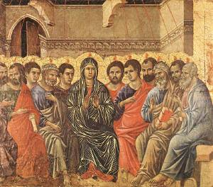
1. 圣灵引导使徒话语
“只等真理的圣灵来了,他要引导你们明白（原文作进入）一切的真理;因为他不是凭自己说的,乃是把他所听见的都说出来,并要把将来的事告诉你们.” 约16:13
However, when He, the Spirit of truth, has come, He will guide you into all truth; for He will not speak on His own authority, but whatever He hears He will speak; and He will tell you things to come. (John 16:13 NKJV)
Holy Spirit Led the Apostle’s Words

Slide 25
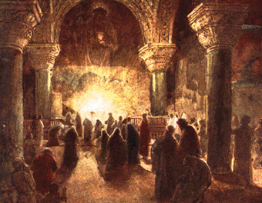
2. 著作被阅和流传
“你们念了这书信,便交给老底嘉的教会,叫他们也念;你们也要念从老底嘉来的书信.” 歌罗西书4:16
Now when this epistle is read among you, see that it is read also in the church of the Laodiceans, and that you likewise read the epistle from Laodicea. Colossians 4:16 NKJV
Writings Read & Circulated

Slide 26
3. 书信收集装订成册
教会制作信件副本,然后再继续传阅书信,最后,每个教会都有大多数被承认信件的副本。
Churches would make copies for themselves and pass the letters along. Over time, each church had copies of most of the accepted letters.
Letters Collected & Bound

Slide 27
4. 稍后赋予书信权威
承认正典时认可已被接受的书卷
Canonization approved books already accepted
承认正典时认可已被用于敬拜的书卷
Canonization approved books already used in worship
承认正典时认可已知的合法有效的书卷
Canonization approved books already known to be valid
Authority Given to Books Later

Slide 28
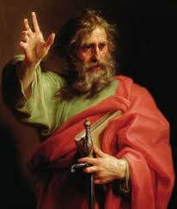
使徒时期：
使徒们凭圣灵里的记忆
将昔日主耶稣教导他们
的教训再教导信徒。
那时信仰靠使徒们口述
传递,史称
“口述福音时期”
Apostle’s Era
Before the NT was written.
It was a period of apostles’ Oral Histories
1500 BC 500 BC AD 1 AD 500 AD 1000 AD 1500 AD 1900 AD 2000
1500 BC 500 BC AD1 AD 500 AD 1000 AD 1500 AD 1900 AD 2000
1500 BC 500 BC AD1 AD 500 AD 1000 AD 1500 AD 1900 AD 2000

Slide 29
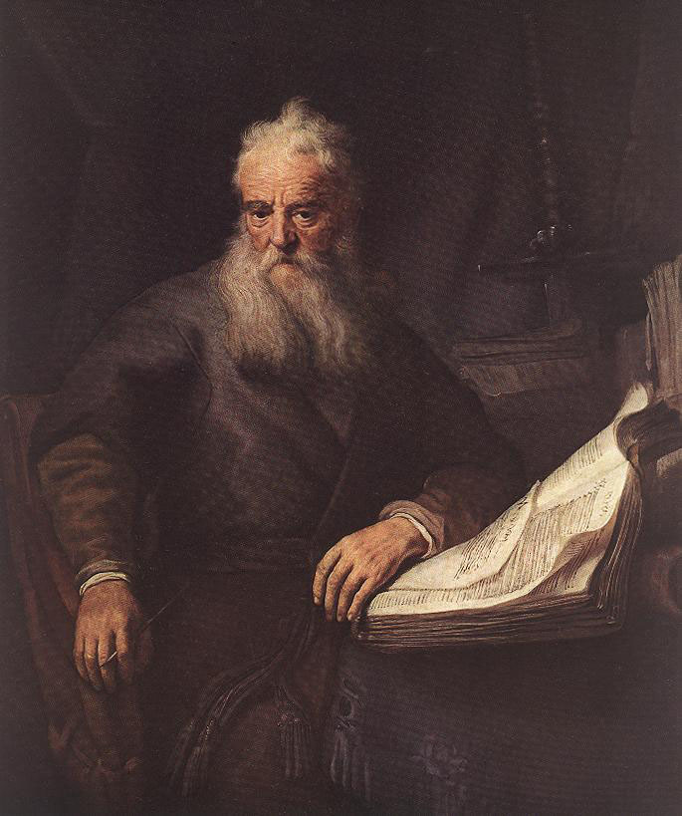
公元35-95年.
新约书信
写成并
传阅。
35 – 95 A.D. New Testament books and letters are written and circulated.
1500 BC 500 BC AD 1 AD 500 AD 1000 AD 1500 AD 1900 AD 2000
1500 BC 500 BC AD1 AD 500 AD 1000 AD 1500 AD 1900 AD 2000
1500 BC 500 BC AD1 AD 500 AD 1000 AD 1500 AD 1900 AD 2000

Slide 30
35 – 95 A.D. New Testament books and letters are written and circulated.
第一世纪初，四福音及保罗的书信，特别受到重视。教会扩展到了外邦，第二代的教牧人员多属使徒的门生，他们遇到问题，就会请教使徒，这样就进入
“书信时期”。
1500 BC 500 BC AD 1 AD 500 AD 1000 AD 1500 AD 1900 AD 2000
1500 BC 500 BC AD1 AD 500 AD 1000 AD 1500 AD 1900 AD 2000
1500 BC 500 BC AD1 AD 500 AD 1000 AD 1500 AD 1900 AD 2000

Slide 31
新约在流传中形成正典
关键词：使徒，目击证人
新约不是由后来者随意定为正典,而是：
新约书信在著述时，就立刻在各教会进入了传阅，而当时的目击证人都还在世。
在这个传阅过程中,正典
已经在逐渐形成。
记住上面这两点！！
Writings Read & Circulated

Slide 32
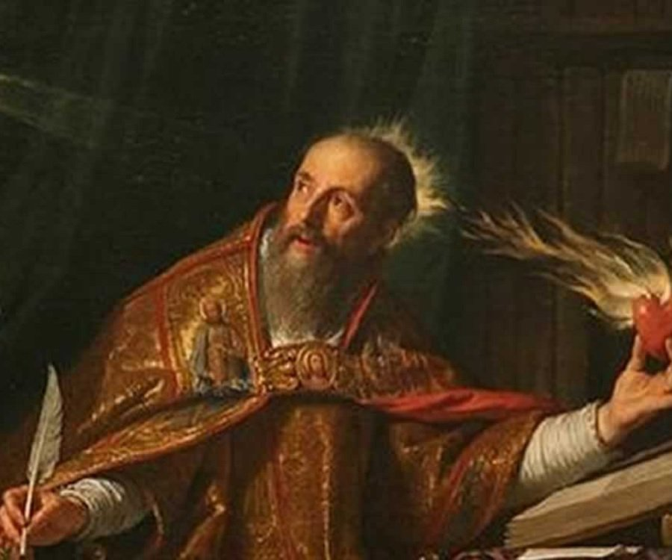
101 – 300 A.D. New Testament books and letters are written and circulated.
公元二—三世纪
当新约“正典”尚未形成之前，不同地区教会渐渐成为地域性“教区”，其“教区”牧者就是教会历史上具有权威的主教，史称“教父”。
当正典尚未确立之前，正典书卷的内容及书名，早已出现在一些教父的著作中。那时虽无确立为正典，但基督徒早就将四福音和使徒们的著作，作为信仰的根据，崇拜诵读，信仰生活的典范，视为“正典”的地位。
1500 BC 500 BC AD 1 AD 500 AD 1000 AD 1500 AD 1900 AD 2000
1500 BC 500 BC AD1 AD 500 AD 1000 AD 1500 AD 1900 AD 2000
1500 BC 500 BC AD1 AD 500 AD 1000 AD 1500 AD 1900 AD 2000

Slide 33
新约在流传中形成正典
第三-第四世纪初，新约正典的目录在大公教会及教会牧者(特土良160-220，俄利根185-254等)中,早已存在共识(圣灵的同感);后来通过的正典27卷只是日后的确认和宣布。
书目可以分成三组:
第一组：4福音和使徒行传。
第二组：保罗13封书信（希伯来人书除外）第三组：雅各书，彼得前后书，约翰1,2,3书犹大书（称为普通书信）。启示录是三世纪后才被纳入正典；希伯来书到迦太基会议才被纳入。
Writings Read & Circulated

Slide 34
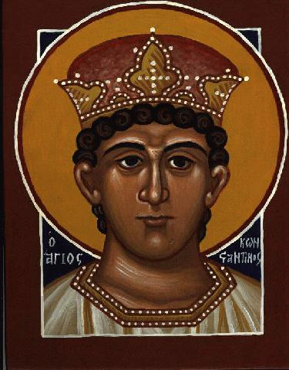
康斯坦丁大帝
将基督教
合法化后，
新约书信
在罗马帝
国范围内
被大量收集和传阅。
The N.T. letters are collected and circulated throughout the Roman Empire by Constantine who legalizes Christianity.
1500 BC 500 BC AD 1 AD 500 AD 1000 AD 1500 AD 1900 AD 2000
1500 BC 500 BC AD1 AD 500 AD 1000 AD 1500 AD 1900 AD 2000
1500 BC 500 BC AD1 AD 500 AD 1000 AD 1500 AD 1900 AD 2000

Slide 35
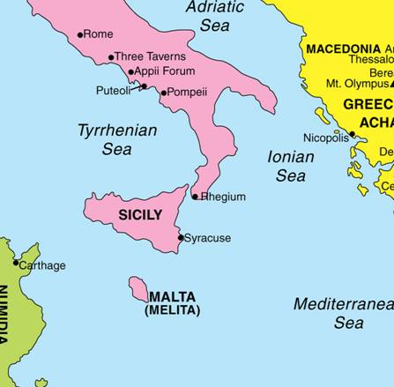
公元397年
迦太基大会，
承认经过
三个世纪
基督徒
使用的新约
圣经被正式
确认为正典。
The 27 books of the N.T. were formally confirmed as canonical by the Synod of Carthage in AD 397, recognizing 3 centuries of use by followers of Christ.
迦太基
Carthage
1500 BC 500 BC AD 1 AD 500 AD 1000 AD 1500 AD 1900 AD 2000
1500 BC 500 BC AD1 AD 500 AD 1000 AD 1500 AD 1900 AD 2000
1500 BC 500 BC AD1 AD 500 AD 1000 AD 1500 AD 1900 AD 2000

Slide 36
教父们考核正典的条件
“古，真，正”三字诀
古：初期使徒教会所接受遵行的书信；
在第一世纪公开传读过。
真：确认为出自使徒手笔的书函。
教父们认为这一点是最高的权威。
正：教训，教义，思想，道德等是否正派，
一致，符合作为信徒信仰生活的准则
1500 BC 500 BC AD 1 AD 500 AD 1000 AD 1500 AD 1900 AD 2000
1500 BC 500 BC AD1 AD 500 AD 1000 AD 1500 AD 1900 AD 2000
1500 BC 500 BC AD1 AD 500 AD 1000 AD 1500 AD 1900 AD 2000

Slide 37
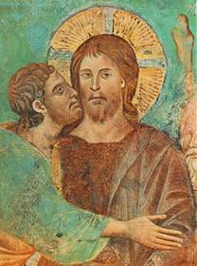
为何教会需要一个封闭的正典？
(Why did the church need a closed cannon?)
信徒在基要教义上不断争议
(Believers were arguing over basic doctrines)
很多异端邪说进入教会
(Many heresies came into the church)
很多假书信进入教会
(Many false letters came into the church)
人们需要知道该相信哪封书信
(People needed to know which letters to believe)
犹大福音
Gospel of Judas

Slide 38
正典形成的本质
这些大会只是“确认” 及“宣布”了基督教群体对于新约正典的共识 (在圣灵引导下产生的)，而并不是“决定”哪些书卷是新约正典.
正典的形成，虽在形式上，是透过教会召开的大会所制定;然而从本质上来说,这个正典形成的过程,乃是圣灵透过对众教会的神圣引导而完成的过程，并不是某个“会议” 或“个人”所制定而成的事件。

