Slide 1
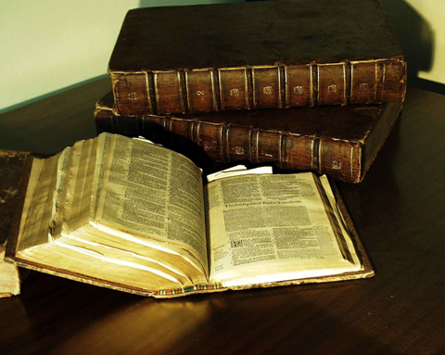
《圣经》如何形成？
ow We Got the ible

Slide 2
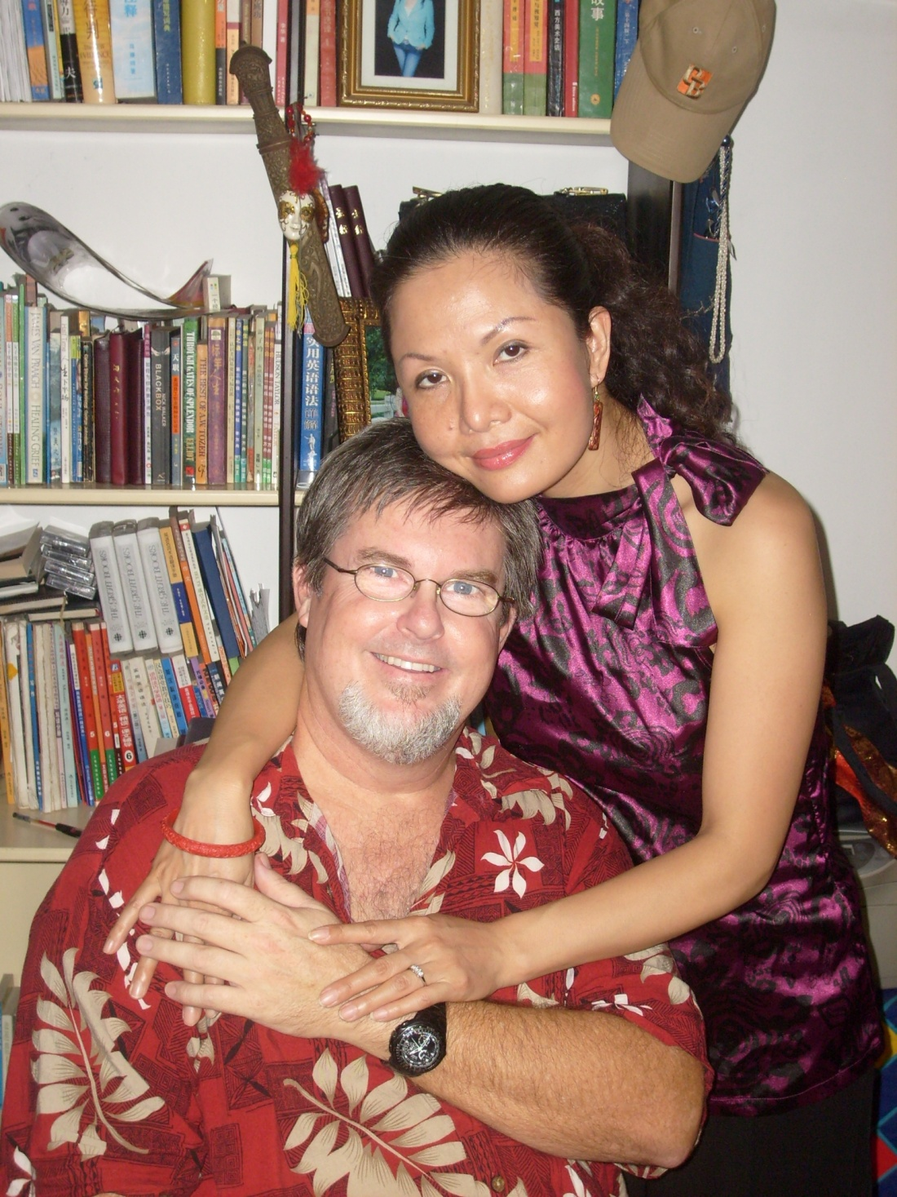
Teachers:
Dr. Jay Barleon
&Suran

Slide 3
圣经 The Bible

Slide 4
旧约
Old Testament
新约
New Testament
400 年沉默期 (400 Silent Years)

Slide 5
旧约
新约
Old Testament New Testament

Slide 6
* 有66卷书组成
Made up of 66 different books.
* 写作跨度一千五百年
Written over a span of 1,500 years
* 超过四十位作者
Written by more than 40 men
* 作者身份行业众多(君王,乡民,哲学家, 渔夫,诗人,学者,农夫).
From many walks of life (kings, peasants, philosophers, fishermen, poets, scholars, farmers)
* 写于不同地方(旷野,地窖,皇宫).
• in different places (wilderness, dungeon, palaces)

Slide 7
* 写于不同的时期(战争时期, 和平时期，奴隶时期, 等).
• At different times and moods (times of war, peace, slavery, etc)
* 不同的心情(极大的喜乐,绝望等.)
In different moods (tremendous joy, despair, etc)
* 跨越三大洲(亚洲,非洲,欧洲)
• On three continents (Asia, Africa, and Europe)
* 三种语言(希伯来,亚兰,希腊语).
• In three languages (Hebrew, Aramaic, and Greek)
* 然而却是完美统一毫无矛盾错误.
• YET IN PERFECT UNITY WITHOUT CONTRADICTION OR ERROR

Slide 8
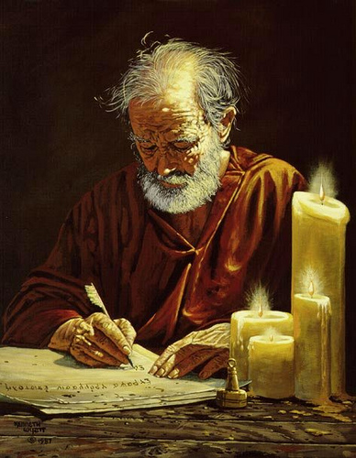
神是 《圣经》 的作者
God is the Author of the Bible
一位作者, 多位
抄录员
One Author, Many Scribes!

Slide 9
旧约(石头， 粘土，皮革)
O.T. (stone, clay, leather)
复制在皮革, 纸卷轴上.
Copied on leather & paper scrolls
牛皮纸 （上等动物皮）
Vellum (fine animal skin)
新约 （纸莎草）
N.T. (papyrus)
印刷机： 纸张
Printing Press: paper
纸张；互联网；有声圣经
Paper; Internet; Audio
1500 BC 500 BC AD 1 AD 500 AD 1000 AD 1500 AD 1900 AD 2000
1500 BC 500 BC AD1 AD 500 AD 1000 AD 1500 AD 1900 AD 2000

Slide 10
圣经译本
如何形成？
ow We Got the ible

Slide 11
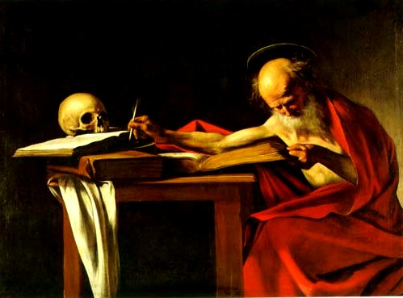
哲罗姆将《圣经》
翻译成拉丁文。
花了他25年时间
（410-435A.D）.
这个版本叫
《拉丁文标准译本》
被教会使用作为
基本圣经长达
多个世纪。
Jerome translates the Scriptures into Latin. It takes him 25 years to complete (410-435 A.D.). This version called the Latin Vulgate was used as the basic Bible for many centuries by the church.
1500 BC 500 BC AD 1 AD 500 AD 1000 AD 1500 AD 1900 AD 2000
1500 BC 500 BC AD1 AD 500 AD 1000 AD 1500 AD 1900 AD 2000
1500 BC 500 BC AD1 AD 500 AD 1000 AD 1500 AD 1900 AD 2000

Slide 12
日耳曼语言大迁徙
（公元378-600）
导致除了拉丁语外的
新语言的出现。
因此也出现对英语
《圣经》的需求。
Germanic migrations (AD 378-600) cause new languages, other than Latin, to emerge. Thus the need for a bible in English.
1500 BC 500 BC AD 1 AD 500 AD 1000 AD 1500 AD 1900 AD 2000
1500 BC 500 BC AD1 AD 500 AD 1000 AD 1500 AD 1900 AD 2000
1500 BC 500 BC AD1 AD 500 AD 1000 AD 1500 AD 1900 AD 2000

Slide 13
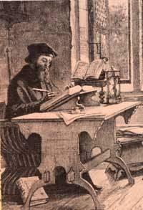
The first English Bible was translated from Latin in AD 1382 by Oxford Scholar and priest named John Wycliffe. It was copied by hand!
第一本英文圣经
由牛津学者和神父
约翰·威克里夫
于公元1382
从拉丁文翻译而来.
这本圣经
完全为手抄本.
1500 BC 500 BC AD 1 AD 500 AD 1000 AD 1500 AD 1900 AD 2000
1500 BC 500 BC AD1 AD 500 AD 1000 AD 1500 AD 1900 AD 2000
1500 BC 500 BC AD1 AD 500 AD 1000 AD 1500 AD 1900 AD 2000

Slide 14
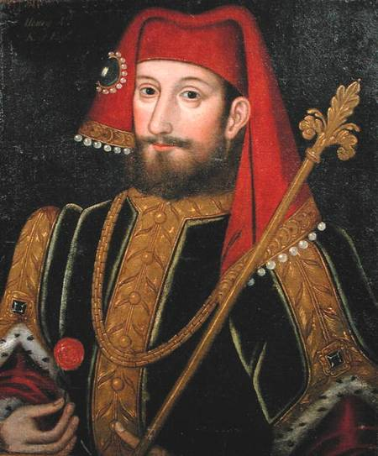
In 1408, in England under King Henry IV, it becomes illegal to translate or read the Bible in common English without the permission of a Bishop.
公元1408年,
在英国国王
亨利四世的统治下,
没有主教的允许,
用大众英语翻译
和阅读圣经
是违法的。
1500 BC 500 BC AD 1 AD 500 AD 1000 AD 1500 AD 1900 AD 2000
1500 BC 500 BC AD1 AD 500 AD 1000 AD 1500 AD 1900 AD 2000
1500 BC 500 BC AD1 AD 500 AD 1000 AD 1500 AD 1900 AD 2000

Slide 15
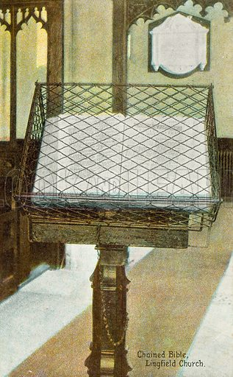
In 1408, in England under King Henry IV, it becomes illegal to translate or read the Bible in common English without the permission of a Bishop.
1500 BC 500 BC AD 1 AD 500 AD 1000 AD 1500 AD 1900 AD 2000
1500 BC 500 BC AD1 AD 500 AD 1000 AD 1500 AD 1900 AD 2000
1500 BC 500 BC AD1 AD 500 AD 1000 AD 1500 AD 1900 AD 2000

Slide 16
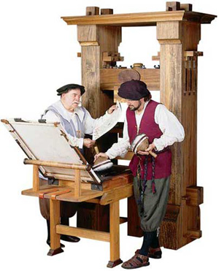
Before the printing press is invented, the Bible was copied by hand. Around 1455, Johannes Gutenberg popularized the “movable type” and printed the first Bible in Mainz, Germany.
在印刷机发明之前，
《圣经》复制完全靠手抄.
大概在公元1455年，
约翰·古腾堡
普及了 “活字印刷”,
并在德国的
美因茨印刷了
第一本《圣经》.
1500 BC 500 BC AD 1 AD 500 AD 1000 AD 1500 AD 1900 AD 2000
1500 BC 500 BC AD1 AD 500 AD 1000 AD 1500 AD 1900 AD 2000
1500 BC 500 BC AD1 AD 500 AD 1000 AD 1500 AD 1900 AD 2000

Slide 17
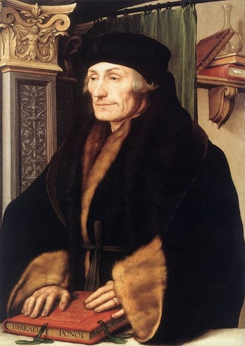
In 1516, Erasmus
(priest & Greek scholar) publishes a more accurate Greek translation and another translation in the common Latin of the people. (textus receptus)
公元1516年,
伊拉斯谟
（神父和希腊学者）
发行了一个更
加准确的
希腊语版本和一个
大众拉丁语版本.
（《希腊文新约标准文本 》）
1500 BC 500 BC AD 1 AD 500 AD 1000 AD 1500 AD 1900 AD 2000
1500 BC 500 BC AD1 AD 500 AD 1000 AD 1500 AD 1900 AD 2000
1500 BC 500 BC AD1 AD 500 AD 1000 AD 1500 AD 1900 AD 2000

Slide 18
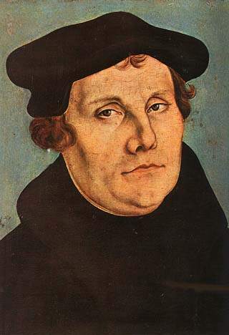
In 1522, Martin Luther translates the N.T. from Greek into German for the common man to read.
The Pope brands him a heretic
for doing so.
公元1522年，
马丁·路德
将《新约》
从希腊文译成德文,
适合普罗大众阅读.
教皇因此给他扣上
“异端者”的帽子.
1500 BC 500 BC AD 1 AD 500 AD 1000 AD 1500 AD 1900 AD 2000
1500 BC 500 BC AD1 AD 500 AD 1000 AD 1500 AD 1900 AD 2000
1500 BC 500 BC AD1 AD 500 AD 1000 AD 1500 AD 1900 AD 2000

Slide 19
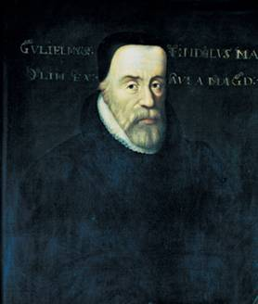
William Tyndale
(Father of the English Bible)
1st N.T. printed from Greek into English (A.D. 1525).
Burned at the stake for printing the Bible!
威廉·廷德尔
（英文圣经之父）
于公元1525年
第一次印刷了英文
《圣经》.
他为此
被烧死在火刑柱上.
1500 BC 500 BC AD 1 AD 500 AD 1000 AD 1500 AD 1900 AD 2000
1500 BC 500 BC AD1 AD 500 AD 1000 AD 1500 AD 1900 AD 2000
1500 BC 500 BC AD1 AD 500 AD 1000 AD 1500 AD 1900 AD 2000

Slide 20
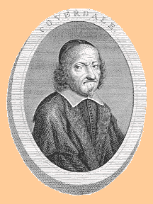
The Coverdale Bible translated by Miles Coverdale (AD 1535) and dedicated to Anne Boleyn, one of King Henry VIII’s wives.
This is the 1st complete Bible to be printed in English!
科弗代尔《圣经》
第一本完整的
英文圣经。
由迈尔斯·科弗代尔
于公元1535年
翻译完成献给王后-
亨利八世的妻子
安妮·波利尼
1500 BC 500 BC AD 1 AD 500 AD 1000 AD 1500 AD 1900 AD 2000
1500 BC 500 BC AD1 AD 500 AD 1000 AD 1500 AD 1900 AD 2000
1500 BC 500 BC AD1 AD 500 AD 1000 AD 1500 AD 1900 AD 2000

Slide 21
As persecution came from Catholicism under “Bloody Mary” exiles from England fled to Geneva, Switzerland. In AD 1560, they printed The Geneva Bible
在“血腥玛丽”
继承王位后，
从天主教
而来的逼迫使得
很多宗教改革领袖
从英国逃亡日内瓦。
在公元1560年，
他们印刷了
《日内瓦圣经》
1500 BC 500 BC AD 1 AD 500 AD 1000 AD 1500 AD 1900 AD 2000
1500 BC 500 BC AD1 AD 500 AD 1000 AD 1500 AD 1900 AD 2000
1500 BC 500 BC AD1 AD 500 AD 1000 AD 1500 AD 1900 AD 2000

Slide 22
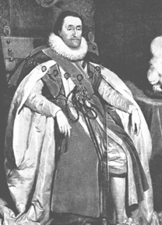
King James I commissions 54 scholars to undertake a new Bible translation. For 6 years, 6 teams of scholars using the Textus Receptus, Bishops Bible, & Tyndale’s Bible, complete the King James Version in AD 1611.
英王詹姆士一世
授权54位学者从事
一项新的圣经翻译任务.
经过六年时间,
六队学者使用
《希腊文新约标准文本 》,
《主教圣经》和
《廷德尔圣经》,
最后与公元1611年,
形成了今天的
《英皇钦定本》
1500 BC 500 BC AD 1 AD 500 AD 1000 AD 1500 AD 1900 AD 2000
1500 BC 500 BC AD1 AD 500 AD 1000 AD 1500 AD 1900 AD 2000
1500 BC 500 BC AD1 AD 500 AD 1000 AD 1500 AD 1900 AD 2000

Slide 23
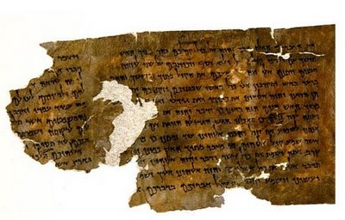
Older manuscripts discovered! Between 1629 and 1947, several of the earliest known copies of the Bible are found! These are used in future translations of the Bible.
早期手稿被发现!
在1629年和1947年间,
好几个早期
著名的圣经
手稿被发现!
这些手稿都在未来
圣经的翻译中
被使用。
1500 BC 500 BC AD 1 AD 500 AD 1000 AD 1500 AD 1900 AD 2000
1500 BC 500 BC AD1 AD 500 AD 1000 AD 1500 AD 1900 AD 2000
1500 BC 500 BC AD1 AD 500 AD 1000 AD 1500 AD 1900 AD 2000

Slide 24
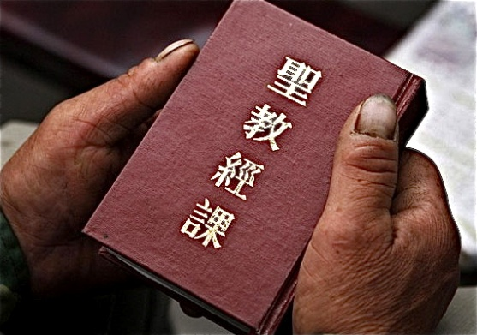
The Chinese Union Bible
was translated by a panel from many different Protestant Denominations using the English Revised Version. The oldest manuscripts were used for crosschecking. Translation began in 1890. Completed in 1919.
中文圣经和合本
是由一个委员会集体
翻译而成.该委员会由不同
宗派传教士差会组成,以
当年流行最广泛的
英王钦定本为母本,
辅之以
希伯来文和希腊文。
翻译工作从1890年开始，
1919年完成。
1500 BC 500 BC AD 1 AD 500 AD 1000 AD 1500 AD 1900 AD 2000
1500 BC 500 BC AD1 AD 500 AD 1000 AD 1500 AD 1900 AD 2000
1500 BC 500 BC AD1 AD 500 AD 1000 AD 1500 AD 1900 AD 2000

Slide 25
清末1890年西方来华宣教士，在沪召开宣教士大会，通过了一项重要议案，由各差会教士中，推选出有翻译圣经能力者，共同翻译一本白话文圣经。这译本必须文笔通畅，忠于原文，并为各教派共同认可。
大会选出翻译委员会的会长：狄考文(CW Mareer) ，委员四人: 富善(C. Goodrich),鲍康宁(FW Baller), 鹿依士(Spencer Lewis), 文书田(George Stephen Owen)以及他们的中国助手。
由于译者来自不同宗派，所以译本便称为《官话圣经和合本》。
1500 BC 500 BC AD 1 AD 500 AD 1000 AD 1500 AD 1900 AD 2000
1500 BC 500 BC AD1 AD 500 AD 1000 AD 1500 AD 1900 AD 2000
1500 BC 500 BC AD1 AD 500 AD 1000 AD 1500 AD 1900 AD 2000

Slide 26
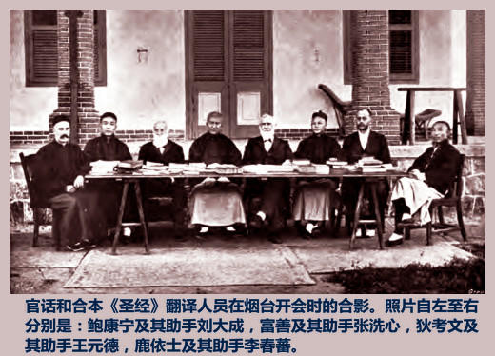
当年的翻译委员会成员及其中国助手
1500 BC 500 BC AD 1 AD 500 AD 1000 AD 1500 AD 1900 AD 2000
1500 BC 500 BC AD1 AD 500 AD 1000 AD 1500 AD 1900 AD 2000
1500 BC 500 BC AD1 AD 500 AD 1000 AD 1500 AD 1900 AD 2000

Slide 27
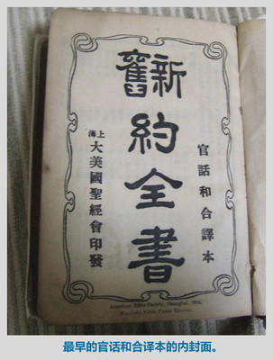
和合本诞生一百年
1919—2019
《和合本圣经》是汉语世界最通用的圣经译本,自从一九一九年出版以来一直是中国最为权威，最受欢迎，使用最为广泛的译本，百年来影响无数的中国人。这是神给中国人的极大恩典！
1500 BC 500 BC AD 1 AD 500 AD 1000 AD 1500 AD 1900 AD 2000
1500 BC 500 BC AD1 AD 500 AD 1000 AD 1500 AD 1900 AD 2000
1500 BC 500 BC AD1 AD 500 AD 1000 AD 1500 AD 1900 AD 2000

Slide 28
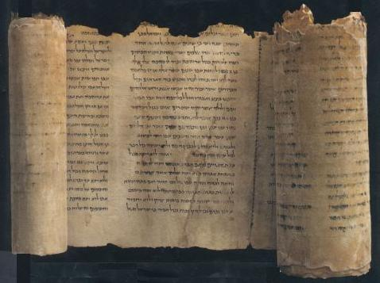
1947, Dead Sea Scrolls are found in a cave by a shepherd boy. They are the oldest known copies of parts of the O.T. They were made between 100 BC & 100 AD.
1947年，死海古卷
由一个牧童在一
个洞里发现。
它们是最
古老的旧约手稿。
形成于大概
在公元前100年到
公元后100年间。
1500 BC 500 BC AD 1 AD 500 AD 1000 AD 1500 AD 1900 AD 2000
1500 BC 500 BC AD1 AD 500 AD 1000 AD 1500 AD 1900 AD 2000
1500 BC 500 BC AD1 AD 500 AD 1000 AD 1500 AD 1900 AD 2000

Slide 29
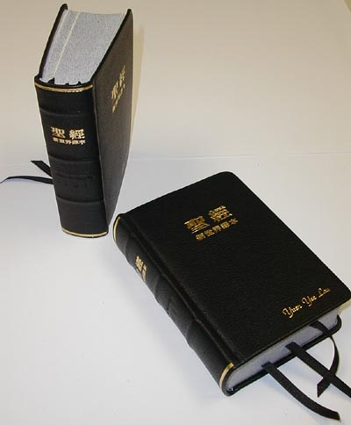
Between 1885 and today, Bible have been translated into over
30 different English versions . The Bible can now be read in nearly 3000 languages!
从1885年至今，
出现了超过30
个不同的英文
《圣经》译本。
《圣经》已经被翻
译成将近
三千种语言！
1500 BC 500 BC AD 1 AD 500 AD 1000 AD 1500 AD 1900 AD 2000
1500 BC 500 BC AD1 AD 500 AD 1000 AD 1500 AD 1900 AD 2000
1500 BC 500 BC AD1 AD 500 AD 1000 AD 1500 AD 1900 AD 2000

Slide 30
现今已有58亿人使用《圣经》
目前活跃使用的语言约有七千种, 其中已经翻译了三千种语言的圣经。
尚有十三亿人无其母语完整版圣经。
目标: 到2025年, 将完成每一种语言的圣经翻译。
——威克里夫圣经翻译全球联盟
1500 BC 500 BC AD 1 AD 500 AD 1000 AD 1500 AD 1900 AD 2000
1500 BC 500 BC AD1 AD 500 AD 1000 AD 1500 AD 1900 AD 2000
1500 BC 500 BC AD1 AD 500 AD 1000 AD 1500 AD 1900 AD 2000

Slide 31
截止2017年底，最大的网络圣经“You Version
《圣经》”的手机APP下载量是三亿次。
1500 BC 500 BC AD 1 AD 500 AD 1000 AD 1500 AD 1900 AD 2000
1500 BC 500 BC AD1 AD 500 AD 1000 AD 1500 AD 1900 AD 2000
1500 BC 500 BC AD1 AD 500 AD 1000 AD 1500 AD 1900 AD 2000

Slide 32
How often do you read yours?
你多经常
阅读你的
《圣经》
?
1500 BC 500 BC AD 1 AD 500 AD 1000 AD 1500 AD 1900 AD 2000
1500 BC 500 BC AD1 AD 500 AD 1000 AD 1500 AD 1900 AD 2000
1500 BC 500 BC AD1 AD 500 AD 1000 AD 1500 AD 1900 AD 2000

Slide 33
如果原版圣经是没有划分的,那他们是如何给神的话划分章节的?
How did the Bible get divided into CHAPTERS & VERSES if the divisions weren’t in the original?

Slide 34
塔什:Tatian
哲罗姆: Jerome
卡罗: Caro
(第二世纪)
组成一本和谐的福音书
( 四福音合参本).
(公元347-420年)
将《马太福音》分成“长章” 和“短章”.
(公元1240年)
现代的分章由卡罗完成.
(并行程第一本词汇索引)
(2nd century)
Produced a harmony of the Gospels
(the Diatessaron).
(347-420 A.D)
Divided the book of Matthew into "breves"
(long chapters) and "capitula" (short chapters)
(1240 A.D.)
Modern chapter divisions by Hugo de Sancto Caro.
(also the 1st concordance)
斯蒂芬: Stephens
公元1551年罗伯特·斯蒂芬将圣经分节。
(1551) verses inserted by Robert Stephens

Slide 35
章节的划分，段落，章标题，中心参考都是 人加上去的，而不是原文有的。
The chapter and verse divisions, the paragraphs, the chapter headings, the center references are of human and not divine origin.
这些划分有助于学习圣经。
They can be beneficial as aids to study.
它们不是启示内容的一部分。
They are not part of the inspired text.
有些章节的划分并不很恰当， 较新的译本将 合并经节。
Some chapter divisions do not fit well so newer translations will blend verses.
我们应感恩，因着他们付出劳动划分章节， 让我们可以轻松地找到经文的位置。
We should be grateful for the labor of those who arranged chapter and verse divisions which enable us to locate passages with ease.

Slide 36
结束
(THE END)
1500 BC 500 BC AD 1 AD 500 AD 1000 AD 1500 AD 1900 AD 2000
1500 BC 500 BC AD1 AD 500 AD 1000 AD 1500 AD 1900 AD 2000

