Slide 1
耶稣所传 的福音

Slide 2
本课内容 (TODAY)
耶稣传福音 JESUS PROCLAIMS THE GOSPEL
耶稣阐明福音 JESUS ILLUSTRATES THE GOSPEL
耶稣解释福音 JESUS EXPLAINS THE GOSPEL
使徒所传的福音 THE GOSPEL ACCORDING TO THE APOSTLES
教会历史所传的福音 THE GOSPEL ACCORDING TO CHURCH HISTORY
常见的问题 COMMONLY ASKED QUESTIONS

Slide 3
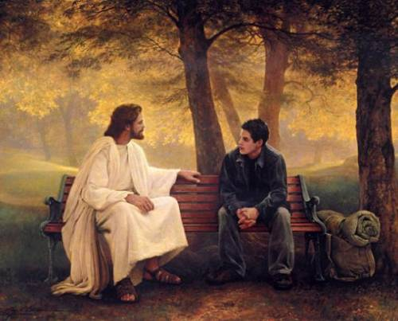
耶稣传福音
JESUS PROCLAIMS THE GOSPEL

Slide 4
耶稣传福音
税吏马太 MATTHEW /TAX COLLECTOR
那瞎子 THE BLIND MAN
年轻的财主 RICH YOUNG RULER
加略人犹大 JUDAS ISCARIOT
撒该 ZACCHAEUS
JESUS PROCLAIMS THE GOSPEL

Slide 5
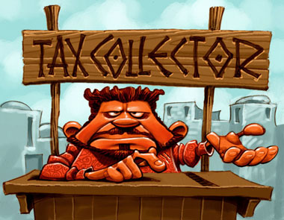
税吏
TAX COLLECTOR

Slide 6
路5:27-32 “这事以后,耶稣出去,看见一个税吏,名叫利未,坐在税关上,就对他说:“你跟从我来!”他就撇下所有的,起来,跟从了耶稣. 利未在自己家里为耶稣大摆筵席,有许多税吏和别人与他们一同坐席.法利赛人和文士就向耶稣的门徒发怨言说:“你们为甚么和税吏并罪人一同吃喝呢?” 耶稣对他们说:“无病的人用不著医生,有病的人才用得著;我来本不是召义人悔改,乃是召罪人悔改.”
Luke 5:27-32 “After this, Jesus went out and saw a tax collector by the name of Levi sitting at his tax booth. “Follow me,” Jesus said to him, and Levi got up, left everything and followed him. Then Levi held a great banquet for Jesus at his house, and a large crowd of tax collectors and others were eating with them. But the Pharisees and the teachers of the law who belonged to their sect complained to his disciples, “Why do you eat and drink with tax collectors and sinners?” Jesus answered them, “It is not the healthy who need a doctor, but the sick. I have not come to call the righteous, but sinners to repentance.”

Slide 7
耶稣呼召我们跟随他
耶稣去到罪人那里。
Jesus went to the sinner
耶稣的命令简短，但却改变人生… “跟随我! ”
Jesus’ command was short but life-changing…”FOLLOW ME!”
利未撇下一切跟随了耶稣。
Levi left EVERYTHING to follow Jesus
利未(马太) 希望他的朋友也见耶稣。
Levi (Matthew) wanted his friends to meet Jesus also
法利赛人根据他们的宗教规条论断耶稣。
The Pharisees judged Jesus by their religious rules
耶稣拒绝了自义者，接受了悔改者。
Jesus rejected the self-righteous and accepted those who repented
耶稣的呼召是悔改。
Jesus’ call was to REPENTANCE
Jesus Calls Us to Follow Him

Slide 8
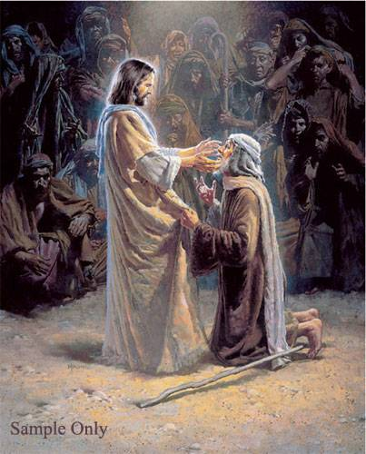
约9
耶稣让 瞎子看见
John 9
JESUS OPENS
BLIND EYES

Slide 9
耶稣医治了一个盲人(约9章)
耶稣医治了一个盲人并说: “我是世界的光”。
Jesus healed a blind man saying, “I am the Light of the World”
法利赛人责备耶稣在安息日医治病人。
The Pharisees rebuked Jesus for healing on the Sabbath
那个盲人和其父母受审问到底耶稣是谁
The man and his parents were interrogated about who Jesus was
当耶稣听说法利赛人将那盲人丢出来后便去找他.
Jesus went to find the man when He heard the Pharisees had thrown him out
那人相信耶稣, 称他为主，并敬拜他。
The man believed Jesus , called Him LORD, and worshipped Him
耶稣对法利赛人说他们依旧是瞎眼的。
Jesus told the Pharisees that they were still blind
若耶稣已开了你的眼, 称他为主并敬拜他。
IF JESUS HAS OPENED YOUR EYES, CALL HIM LORD AND WORSHIP HIM
Jesus Heals a Blind man (John 9)

Slide 10
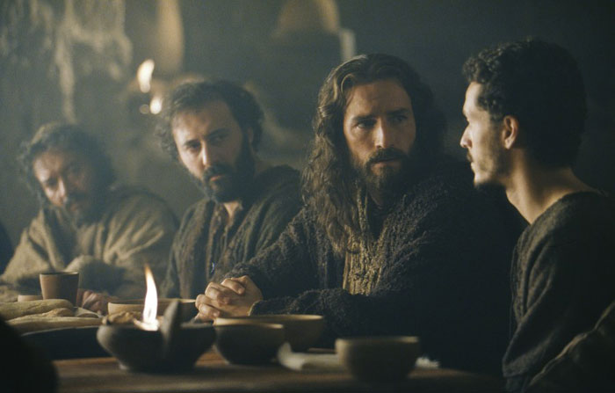
太19:16-26
耶稣挑战一个心切的慕道者
Matthew 19:16-26
JESUS CHALLENGES
AN EAGER SEEKER

Slide 11
太19: 16-26 “有一个人来见耶稣说:
“夫子,我该做甚么善事才能得永生?” 耶稣对他说:“你为甚么以善事问我呢?只有一位是善的.你若要进入永生,就当遵守诫命.” 他说:“甚么诫命?”耶稣说:“就是‘不可杀人,不可奸淫,不可偷盗，不可作假见证,当孝敬父母,又当爱人如己.’” 那少年人说: “这一切我都遵守了,还缺少甚么呢?”
Matt. 19:16-26 “Just then a man came up to Jesus and asked, “Teacher, what good thing must I do to get eternal life?” “Why do you ask me about what is good?” Jesus replied. “There is only One who is good. If you want to enter life, keep the commandments.” “Which ones?” he inquired. Jesus replied, “‘You shall not murder, you shall not commit adultery, you shall not steal, you shall not give false testimony, honor your father and mother,’ and ‘love your neighbor as yourself.’” “All these I have kept,” the young man said. “What do I still lack?”

Slide 12
耶稣说:“你若愿意作完全人,可去变卖你所有的,分给穷人,就必有财宝在天上;你还要来跟从我.” 那少年人听见这话,就忧忧愁愁地走了,因为他的产业很多. 耶稣对门徒说:“我实在告诉你们:财主进天国是难的. 我又告诉你们:骆驼穿过针的眼,比财主进神的国还容易呢!” 门徒听见这话,就希奇得很,说: “这样谁能得救呢?” 耶稣看著他们说:“在人这是不能的,在神凡事都能!”
Jesus answered, “If you want to be perfect, go, sell your possessions and give to the poor, and you will have treasure in heaven. Then come, follow me.” When the young man heard this, he went away sad, because he had great wealth. Then Jesus said to his disciples, “Truly I tell you, it is hard for someone who is rich to enter the kingdom of heaven. Again I tell you, it is easier for a camel to go through the eye of a needle than for someone who is rich to enter the kingdom of God.” When the disciples heard this, they were greatly astonished and asked, “Who then can be saved?” Jesus looked at them and said, “With man this is impossible, but with God all things are possible.”

Slide 13
年轻的财主
他动机正确 HE HAD THE RIGHT MOTIVES
他态度正确 HE HAD THE RIGHT ATTITUDE
他找对了人 HE CAME TO THE RIGHT PERSON
他问对了问题 HE ASKED THE RIGHT QUESTION
THE RICH YOUNG RULER

Slide 14
年轻的财主
他动机正确 HE HAD THE RIGHT MOTIVES
他态度正确 HE HAD THE RIGHT ATTITUDE
他找对了人 HE CAME TO THE RIGHT PERSON
他问对了问题 HE ASKED THE RIGHT QUESTION
被拒
THE RICH YOUNG RULER

Slide 15
年轻的财主
他动机正确 HE HAD THE RIGHT MOTIVES
他态度正确 HE HAD THE RIGHT ATTITUDE
他找对了人 HE CAME TO THE RIGHT PERSON
他问对了问题 HE ASKED THE RIGHT QUESTION
被拒
心怀骄傲
FILLED WITH PRIDE
不承认自己的罪
DID NOT CONFESS HIS GUILT
不愿委身于基督
WOULD NOT SUBMIT TO CHRIST
THE RICH YOUNG RULER

Slide 16
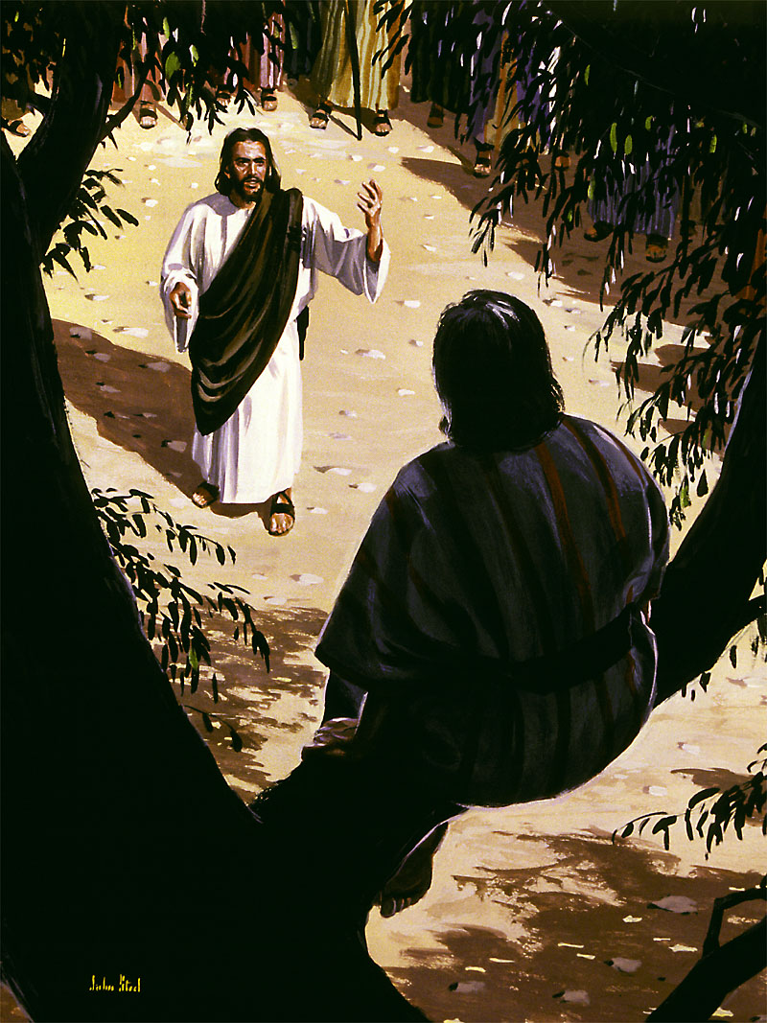
路19:1-10
耶稣寻找和拯救 失丧者
LUKE 19:1-10
JESUS SEEKS AND SAVES THE LOST

Slide 17
路19:1-10 “耶稣进了耶利哥,正经过的时候,有一个人名叫撒该,作税吏长,是个财主.他要看看耶稣是怎样的人;只因人多,他的身量又矮,所以不得看见,就跑到前头,爬上桑树,要看耶稣，因为耶稣必从那里经过. 耶稣到了那里,抬头一看,对他说:” 撒该,快下来!今天我必住在你家里.”
Luke 19:1-10 “ Jesus entered Jericho and was passing through. A man was there by the name of Zacchaeus; he was a chief tax collector and was wealthy. He wanted to see who Jesus was, but because he was short he could not see over the crowd. So he ran ahead and climbed a sycamore-fig tree to see him, since Jesus was coming that way. When Jesus reached the spot, he looked up and said to him, “Zacchaeus, come down immediately. I must stay at your house today.”

Slide 18
他就急忙下来,欢欢喜喜地接待耶稣.
众人看见,都私下议论说:“他竟到罪
人家里去住宿.” 撒该站著对主说:
“主啊,我把所有的一半给穷人;我若讹诈了谁,就还他四倍.” 耶稣说: “今天救恩到了这家,因为他也是亚伯拉罕的子孙.人子来,为要寻找,拯救失丧的人.”
So he came down at once and welcomed him gladly. All the people saw this and began to mutter, “He has gone to be the guest of a sinner.” But Zacchaeus stood up and said to the Lord, “Look, Lord! Here and now I give half of my possessions to the poor, and if I have cheated anybody out of anything, I will pay back four times the amount.” Jesus said to him, “Today salvation has come to this house, because this man, too, is a son of Abraham. For the Son of Man came to seek and to save the lost.”

Slide 19
撒该的故事
撒该去到能看见耶稣的地方.
Zacchaeus went where he could see Jesus
耶稣对撒该说: “我今晚要住在你家里.”
Jesus called out to Zacchaeus and said, I must stay at your house today”
撒该称耶稣为 “主” 且行为立即翻转。
Zacchaeus calls Jesus “LORD” and immediately reverses his actions
这就是我们所说的悔改.
This is what we call REPENTANCE
耶稣宣布撒该 “得救了”。
Jesus declared Zacchaeus “SAVED”
耶稣说他来是寻拯救失丧的人.
Jesus said HE CAME TO SEEK AND SAVE THE LOST
没有人 “寻求” (罗3) …耶稣才是 “寻找者”.
No man is a “seeker” (Rom. 3)… Jesus is the “Seeker”
Zacchaeus

Slide 20
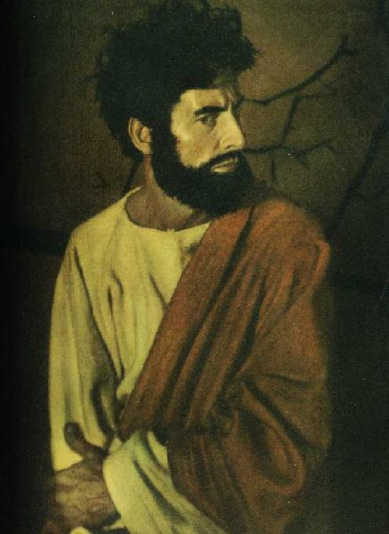
加略人犹大:
耶稣谴责
心硬者
JUDAS ISCARIOT:
JESUS CONDEMNS
THE HARDENED HEART

Slide 21
加略人犹大
知道并相信有关耶稣的事实 KNEW AND BELIEVED THE FACTS ABOUT JESUS
与耶稣和其跟随者生活过 LIVED WITH JESUS AND HIS FOLLOWERS
传道和行神迹者 EVANGELIST AND MIRACLEWORKER
倍受信任的群体领袖(管钱财) TRUSTED LEADER (TREASURER) OF THE GROUP
JUDAS ISCARIOT

Slide 22
加略人犹大
知道并相信有关耶稣的事实 KNEW AND BELIEVED THE FACTS ABOUT JESUS
与耶稣和其跟随者生活过 LIVED WITH JESUS AND HIS FOLLOWERS
传道和行神迹者 EVANGELIST AND MIRACLEWORKER
倍受信任的群体领袖(管钱财) TRUSTED LEADER (TREASURER) OF THE GROUP
被拒
JUDAS ISCARIOT

Slide 23
加略人犹大
知道并相信有关耶稣的事实 KNEW AND BELIEVED THE FACTS ABOUT JESUS
与耶稣和其跟随者生活过 LIVED WITH JESUS AND HIS FOLLOWERS
传道和行神迹者 EVANGELIST AND MIRACLEWORKER
倍受信任的群体领袖(管钱财) TRUSTED LEADER (TREASURER) OF THE GROUP
被拒
钱财-权利-职位
MONEY – POWER - POSITION
假忠诚- 欺骗性
FALSE LOYALTY - DECEPTIVE
想要弥赛亚但不想要主.
WANTED A MESSIAH BUT NOT A LORD
JUDAS ISCARIOT

Slide 24
太7:21-23 “凡称呼我 ‘主啊,主啊’的人，不能都进天国;惟独遵行我天父旨意的人,才能进去. 当那日,必有许多人对我说:‘主啊,主啊,我们不是奉你的名传道,奉你的名赶鬼，奉你的名行许多异能吗?’我就明明地告诉他们说: ‘我从来不认识你们,你们这些作恶的人,离开我去吧!’”
Matt. 7:21-23 “Not everyone who says to me, ‘Lord, Lord,’ will enter the kingdom of heaven, but only the one who does the will of my Father who is in heaven. Many will say to me on that day, ‘Lord, Lord, did we not prophesy in your name and in your name drive out demons and in your name perform many miracles?’ Then I will tell them plainly, ‘I never knew you. Away from me, you evildoers!’ “

Slide 25
“救恩的大奇迹不是我们接受基督,而是基督接受了我们!”
得救
SAVED
谦卑下来
HUMBLE YOURSELF
知道事实
KNOW FACTS
悔改罪
REPENT OF SIN
委身于他
SUBMIT TO HIM
相信
BELIEVE IN FAITH
“The great miracle of redemption is not that we accept Christ, but that He accepts us!”

Slide 26
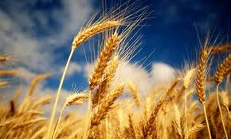
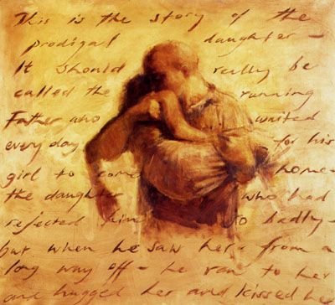
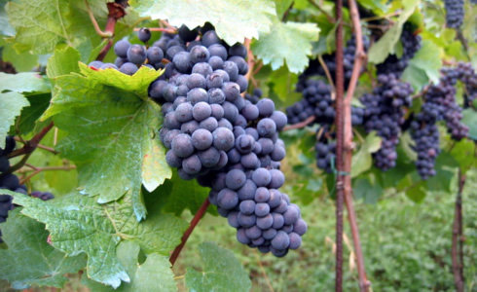
耶稣用以阐明福音的比喻
Jesus’ Parables Illustrate His Gospel

Slide 27
四种土壤的比喻
PARABLE OF THE SOILS

Slide 28
土 SOIL | 心 HEART | 迹象 SIGNS | 根 ROOTS
硬 HARD | 毫无反应 UNRESPONSIVE | 无 NONE | 无 NO
浅 SHALLOW | 肤浅的 SUPERFICIAL | 塑料果实 PLASTIC FRUIT | 无 NO
杂草丛生 WEEDY | 世俗的 WORLDLY | 塑料果实 PLASTIC FRUIT | 无 NO
好土 GOOD | 善于接受 RECEPTIVE | 结果 FRUIT | 有 YES

Slide 29
易信
主义
EASY BELIEVISM
主权
救恩
LORDSHIP
土 SOIL | 心 HEART | 迹象 SIGNS | 根 ROOTS
硬 HARD | 毫无反应 UNRESPONSIVE | 无 NONE | 无 NO
浅 SHALLOW | 肤浅的 SUPERFICIAL | 塑料果实 PLASTIC FRUIT | 无 NO
杂草丛生 WEEDY | 世俗的 WORLDLY | 塑料果实 PLASTIC FRUIT | 无 NO
好土 GOOD | 善于接受 RECEPTIVE | 结果 FRUIT | 有 YES

Slide 30
错误
WRONG
易信
主义
EASY BELIEVISM
主权
救恩
LORDSHIP
正确
RIGHT
土 SOIL | 心 HEART | 迹象 SIGNS | 根 ROOTS
硬 HARD | 毫无反应 UNRESPONSIVE | 无 NONE | 无 NO
浅 SHALLOW | 肤浅的 SUPERFICIAL | 塑料果实 PLASTIC FRUIT | 无 NO
杂草丛生 WEEDY | 世俗的 WORLDLY | 塑料果实 PLASTIC FRUIT | 无 NO
好土 GOOD | 善于接受 RECEPTIVE | 结果 FRUIT | 有 YES

Slide 31
错误
WRONG
易信
主义
EASY BELIEVISM
主权
救恩
LORDSHIP
正确
RIGHT
土 SOIL | 心 HEART | 迹象 SIGNS | 根 ROOTS
硬 HARD | 毫无反应 UNRESPONSIVE | 无 NONE | 无 NO
浅 SHALLOW | 肤浅的 SUPERFICIAL | 塑料果实 PLASTIC FRUIT | 无 NO
杂草丛生 WEEDY | 世俗的 WORLDLY | 塑料果实 PLASTIC FRUIT | 无 NO
好土 GOOD | 善于接受 RECEPTIVE | 结果 FRUIT | 有 YES
未得救
UNSAVED
未得救
UNSAVED
倒退
BACKSLIDDEN
未得救
UNSAVED
倒退
BACKSLIDDEN
未得救
UNSAVED
得救
SAVED
得救
SAVED

Slide 32
错误
WRONG
易信
主义
EASY BELIEVISM
主权
救恩
LORDSHIP
正确
RIGHT
土 SOIL | 心 HEART | 迹象 SIGNS | 根 ROOTS
硬 HARD | 毫无反应 UNRESPONSIVE | 无 NONE | 无 NO
浅 SHALLOW | 肤浅的 SUPERFICIAL | 塑料果实 PLASTIC FRUIT | 无 NO
杂草丛生 WEEDY | 世俗的 WORLDLY | 塑料果实 PLASTIC FRUIT | 无 NO
好土 GOOD | 善于接受 RECEPTIVE | 结果 FRUIT | 有 YES
未得救
UNSAVED
未得救
UNSAVED
倒退
BACKSLIDDEN
未得救
UNSAVED
倒退
BACKSLIDDEN
未得救
UNSAVED
得救
SAVED
得救
SAVED

Slide 33
麦子和稗子的比喻
PARABLE OF THE WHEAT & TARES

Slide 34
麦子和稗子
播麦者 (SOWER of WHEAT)
耶稣: JESUS
神的道: WORD of GOD
播稗者 (SOWER of TARES)
撒旦: SATAN
谎言: LIES
混合的土壤 (MIXED SOILS)
得救的: SAVED
未得救的: UNSAVED
The Wheat and the Tares

Slide 35
神国宝藏的比喻
PARABLE OF THE KINGDOM TREASURE

Slide 36
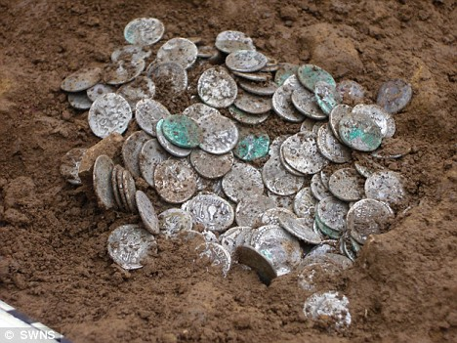
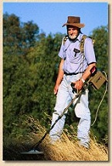
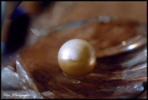
神国宝藏的比喻: The Treasure of the Kingdom
找到 FOUND
买了 BOUGHT
卖掉 SOLD
此屋出售
HOUSE
FOR SALE
找到 FOUND
买了BOUGHT

Slide 37
葡萄园工人的比喻（太20）
PARABLE OF THE WORKERS (Matt 20)

Slide 38
工人的工价不均
1. 主权至高的神主动发起救恩
1. God sovereignly initiates salvation
2. 神设立救恩的条件
2. God established the terms of salvation
3. 神不断呼召人得救
3. God continues to call people to be saved
4. 所有得救的都愿意服事祂
4. All redeemed are willing to work for Him
5. 神施怜悯给贫穷者
5. God shows compassion to the needy
6. 神持守祂永恒赏赐的应许
6. God keeps His promise of eternal reward
7. 神所赐的超出我们应得的
7. God gives us more than we deserve
Workmen Paid Unequal Wages

Slide 39
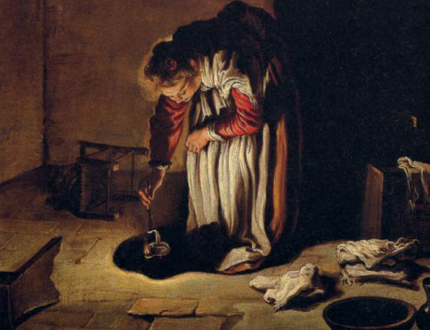
失落钱币的比喻
PARABLE OF THE LOST COIN

Slide 40
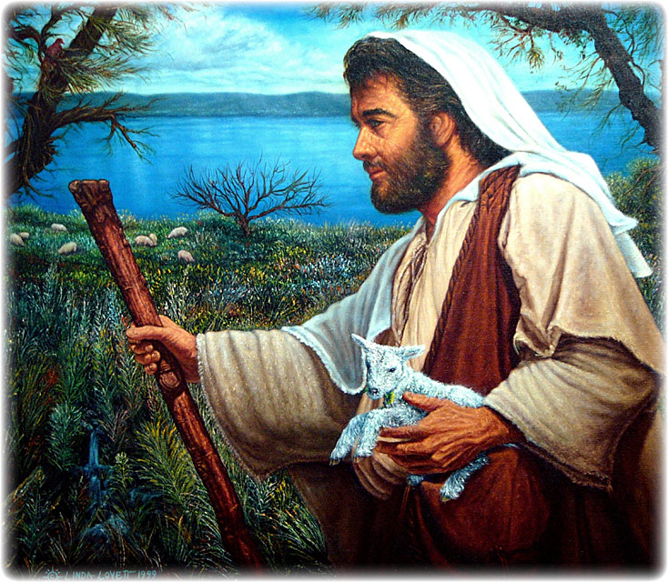
失落羊只的比喻
PARABLE OF THE LOST SHEEP

Slide 41
浪子回头的比喻
PARABLE OF THE LOST SON

Slide 42
失去& 找回 : LOST & FOUND
羊: SHEEP
钱币: COIN
儿子: SON
找到: FOUND
找到: FOUND
找到: FOUND
欢喜: REJOICED
欢喜: REJOICED
欢喜: REJOICED
承认自己的罪: RECOGNIZED HIS SINFULNESS
谦卑自己: HUMBLED HIMSELF
向他的父亲 认罪: CONFESSED TO HIS FATHER
向父亲委身: SUBMITTED TO HIS FATHER
获得奖赏: REWARDED

Slide 43
葡萄树和枝子的比喻
PARABLE OF THE VINE & BRANCHES

Slide 44
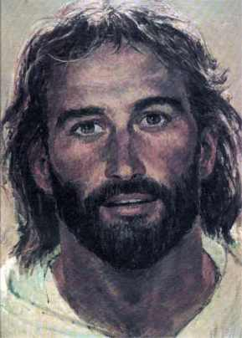
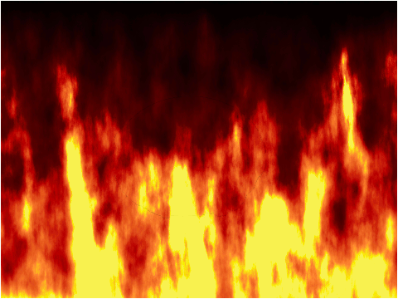

Slide 45
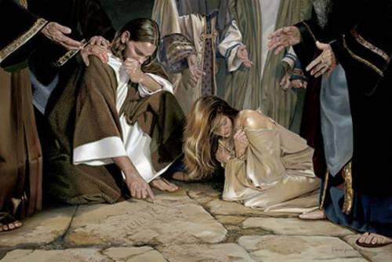
耶稣解释他的福音
Jesus Explains His Gospel

Slide 47
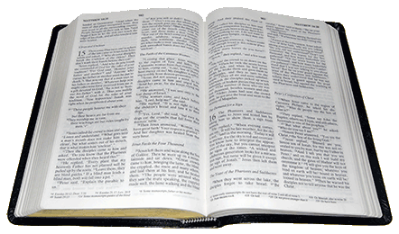
呼召悔改
福音
GOSPEL
地狱: HELL
The Call to Repentance

Slide 48
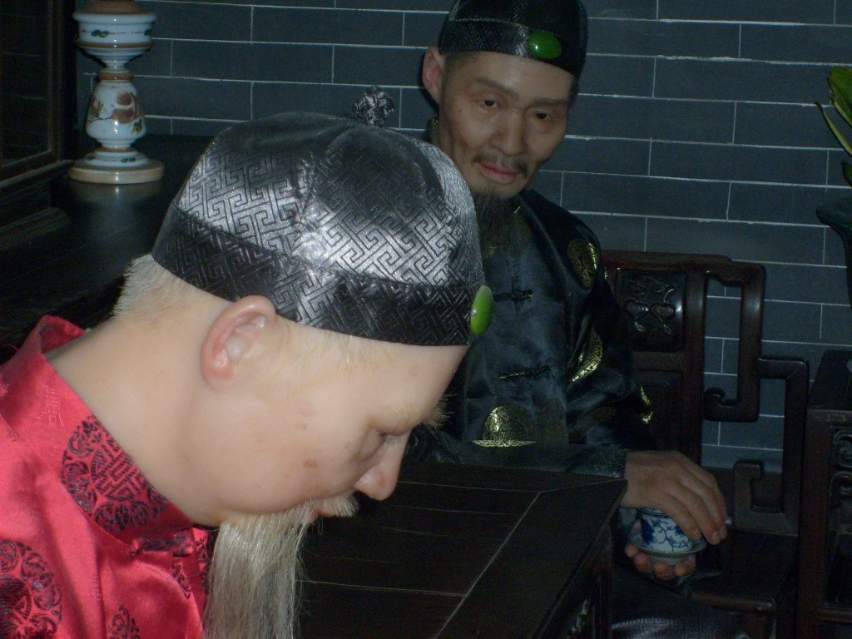
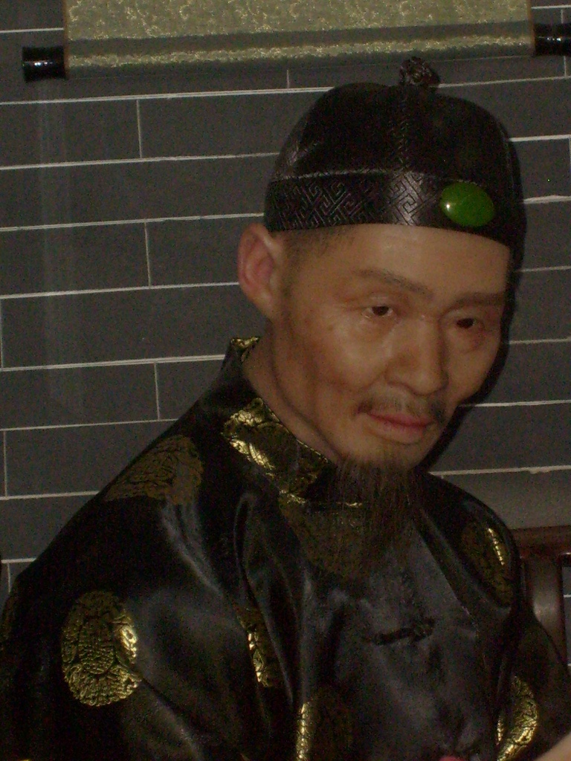
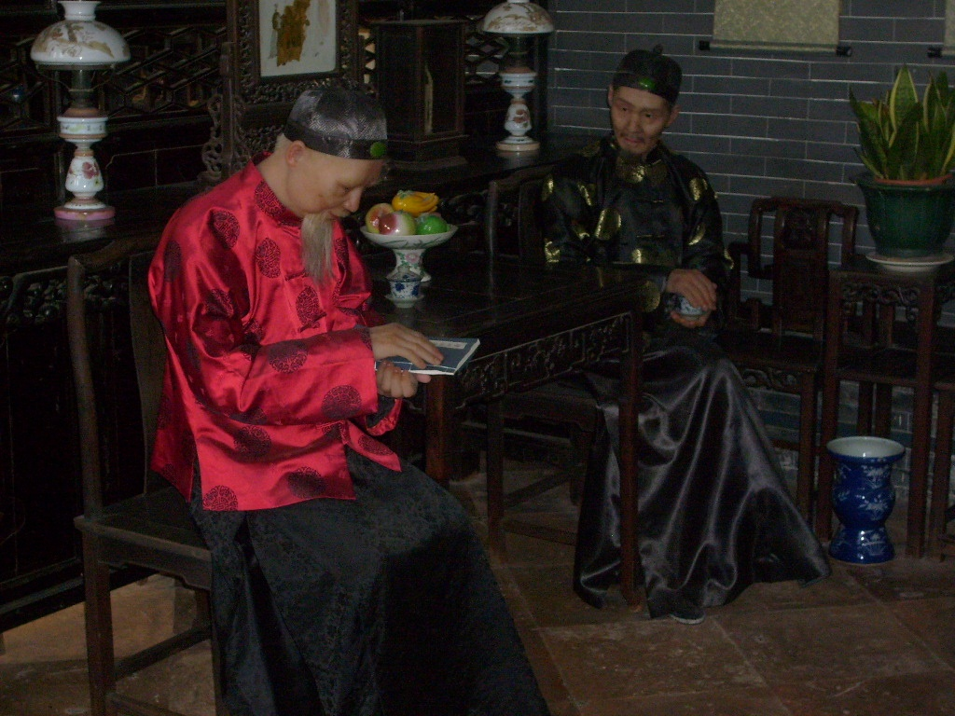
信心若没有行为就是死的
FAITH WITHOUT WORKS IS A DEAD FAITH

Slide 49
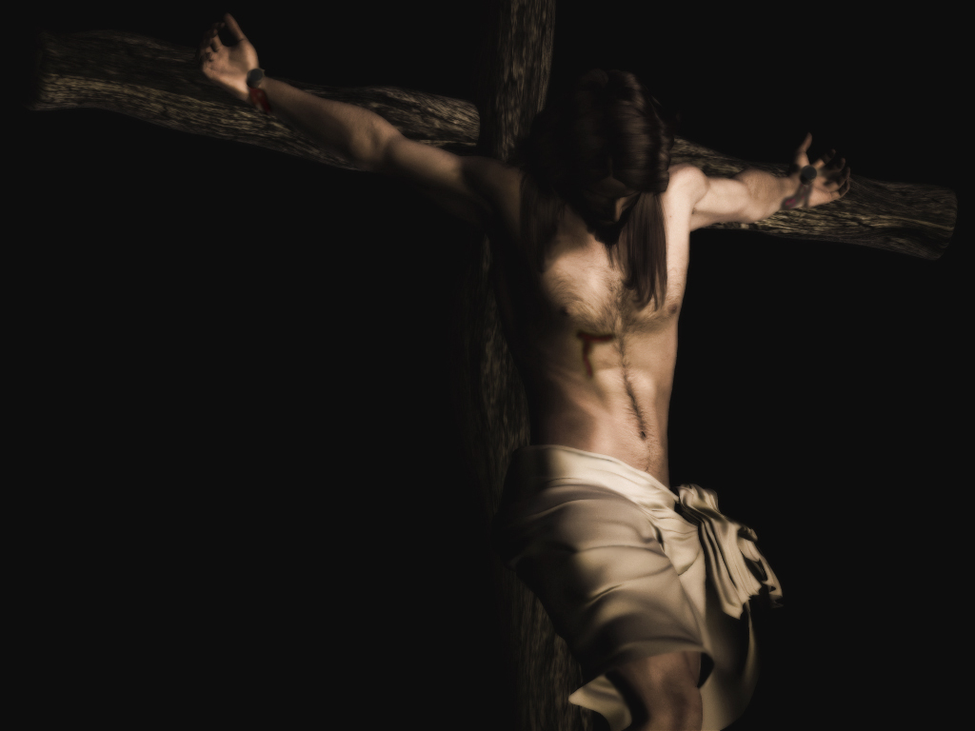
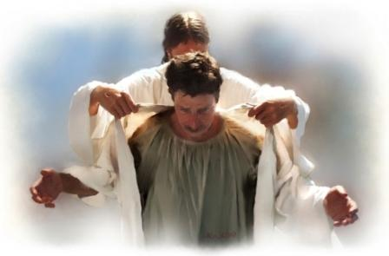
伟大的交换（林后5:12）
我的罪归到他身上
MY SIN WAS PLACED ON HIM
他的义披在我身上
HIS RIGHTEOUSNESS WAS PLACED ON ME
The Double Imputation

Slide 50
得救的路
地狱
HELL
天
堂
HEAVEN
宽
WIDE
窄
NARROW
很多
MANY
很少
FEW
The Way of Salvation

Slide 51
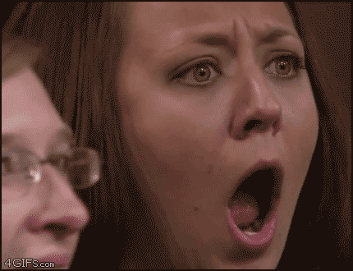
但我叫你
为主呀！
BUT I CALLED
YOU LORD!
我去了教会!
I WENT TO CHURCH!
我奉你的名行了神迹！
I DID MIRACLES IN YOUR NAME!
我从不认识你…你这些作恶的人.
I NEVER KNEW YOU… WORKER OF INIQUITY
我说了方言！
I SPOKE IN TONGUES!
你欠我!
YOU OWE ME!
我奉你的
名赶鬼了！
I CAST OUT DEMONS IN YOUR NAME!
我唱了各
种赞美诗！
I SANG ALL THE PRAISE SONGS!
我做了十
一奉献！
I GAVE MY TITHE!

Slide 52
但我叫你
为主呀！
BUT I CALLED
YOU LORD!
我去了教会!
I WENT TO CHURCH!
我奉你的名行了神迹！
I DID MIRACLES IN YOUR NAME!
我从不认识你…你们这些作恶的人.
I NEVER KNEW YOU… WORKER OF INIQUITY
我说了方言！
I SPOKE IN TONGUES!
你欠我!
YOU OWE ME!
我奉你的
名赶鬼了！
I CAST OUT DEMONS IN YOUR NAME!
我唱了各
种赞美诗！
I SANG ALL THE PRAISE SONGS!
我做了十
一奉献！
I GAVE MY TITHE!

Slide 53
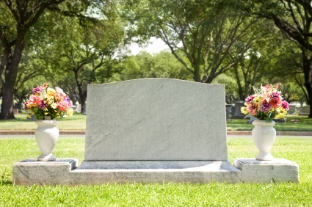
作门徒的代价
每日 向自己死
Died to Self
-Daily- -
The Cost of Discipleship

