Slide 1
耶稣基督所传 的福音

Slide 2
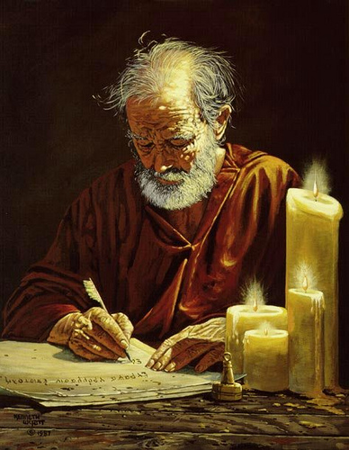
使徒所传的福音
The Gospel According to the Apostles

Slide 3
有人开始教导说耶稣的福音只适用于他当时针对的人群,说使徒后来给教会的福音信息不同. 真相是使徒约翰,保罗,犹大,彼得,犹大和《希伯来书》的作者所传的信息与耶稣的所传是相同的福音:论及救恩和呼召跟随耶稣时都要承认他是主和救主.
People have begun to teach that Jesus’ Gospel was only applicable to the crowd He spoke to, and that the apostles had a different message for the church age. The truth is that the message taught by John, Paul, Jude, Peter, James, and the writer of the Book of Hebrews was the same message that Jesus brought regarding salvation and the call to follow Jesus as both Lord and Savior.

Slide 4
保罗 (罗6:1-2)
“这样,怎么说呢？我们可以仍在罪中,叫恩典显多吗?
断乎不可！
我们在罪上死
了的人岂可仍
在罪中活著呢?”
PAUL (Rom.6:1-2)
“What shall we say, then? Shall we go on sinning so that grace may increase? By no means! We are those who have died to sin; how can we live in it any longer?”

Slide 5
保罗
(提多书2:11-12)
“因为神救众人的
恩典已经显明出来,教训我们除去不敬虔的心和世俗的情欲,在今世自守,公义,敬虔度日.”
PAUL (Titus 2:11-12)
“For the grace of God has appeared that offers salvation to all people. It teaches us to say “No” to ungodliness and worldly passions, and to live self-controlled, upright and godly lives in this present age,”

Slide 6
保罗
(加5:19-21)
“情欲的事都是显而易见的,就如奸淫,污秽,邪荡, 拜偶像,邪术,仇恨,争竞,忌恨,恼怒,结党,纷争,异端, 嫉妒(注:有古卷在此有 “凶杀”二字),醉酒,荒宴等类. 我从前告诉你们,现在又告诉你们,行这样事的人必不能承受神的国。”
PAUL (Gal. 5:19-21)
“The acts of the flesh are obvious: sexual immorality, impurity and debauchery; ²⁰ idolatry and witchcraft; hatred, discord, jealousy, fits of rage, selfish ambition, dissensions, factions and envy; drunkenness, orgies, and the like. I warn you, as I did before, that those who live like this will not inherit the kingdom of God,”

Slide 7
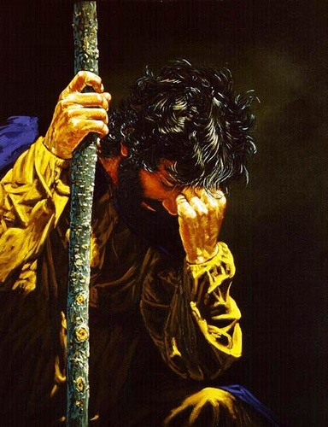
犹大
（犹大书11-12）
“他们有祸了! 因为走了该隐的道路,又为利往巴兰的错谬里直奔,并在可拉的背叛中灭亡了.这样的人在你们的爱席上与你们同吃的时候,正是礁石(注:或作 “玷污”)他们作牧人,只知喂养自己,无所惧怕;”
JUDE (v.11-12)
“Woe to them! They have taken the way of Cain; they have rushed for profit into Balaam’s error; they have been destroyed in Korah’s rebellion. These people are blemishes at your love feasts, eating with you without the slightest qualm—shepherds who feed only themselves,”

Slide 8
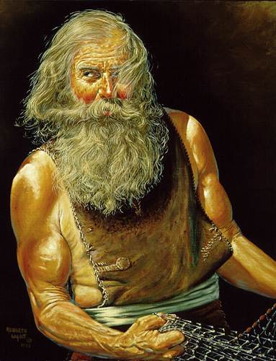
彼得
（徒2:36）
“故此,以色列全家当确实地知道,你们钉在十字架上的这位耶稣,神已经立他为主,为基督了.”
PETER (Acts 2:36)
“Therefore let all Israel be assured of this: God has made this Jesus, whom you crucified, BOTH LORD AND MESSIAH.”

Slide 9
彼得
（彼后1:3）
“神的神能已将一切关乎生命和虔敬的事赐给我们，皆因我们认识那用自己荣耀和美德召我们的主.”
PETER (2 Peter 1:3)
“His divine power has given us everything we need for a godly life through our knowledge of him who called us by his own glory and goodness”

Slide 10
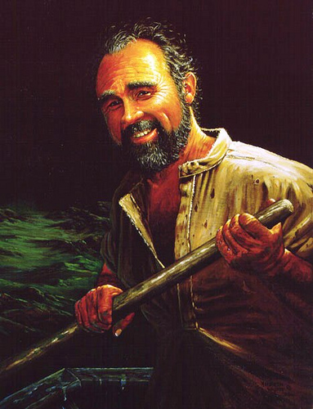
雅各
（2:17,20）
“这样,信心若没有行为就是死的….虚浮的人哪,你愿意知道没有行为的信心是死的吗?”
JAMES (2:17,20)
“In the same way, faith
by itself, if it is not accompanied by action, is dead…You foolish person, do you want evidence that faith without deeds is useless?”

Slide 11
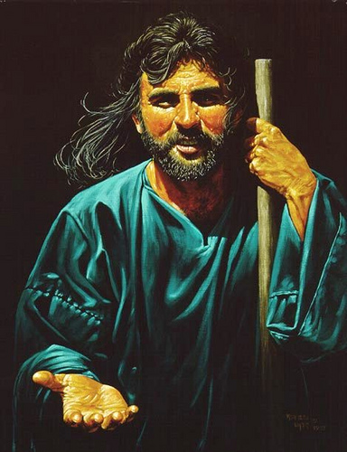
约翰
（约一1:6）
“我们若说是与神相交,却仍在黑暗里行,就是说谎话,不行真理了. ”
JOHN (1 JOHN 1:6)
“If we claim to have fellowship with him and yet walk in the darkness, we lie and do not live out the truth.”

Slide 12
约翰
（约一2:15）
“不要爱世界和世界上的事.人若爱世界,爱父的心就不在他里面了.”
（世界的观念和价值体系）
JOHN (1 JOHN 2:15)
“Do not love the world or anything in the world. If anyone loves the world, love for the Father is not in them.”

Slide 13
约翰 (约一3:6-10 )
“凡住在他里面的,就不犯罪;凡犯罪的,是未曾看见他,也未曾认识他. 小子们哪,不要被人诱惑. 行义的才是义人,正如主是义的一样.犯罪的是属魔鬼,因为魔鬼从起初就犯罪。神的儿子显现出来,为要除灭魔鬼的作为. 凡从神生的,就不犯罪,因神的道存在他心里;他也不能犯罪,因为他是由神生的. 从此就显出谁是神的儿女,谁是魔鬼的儿女.凡不行义的就不属神，不爱弟兄的也是如此. ”
JOHN
(1 JOHN 3:6-10)
“No one who lives in
him keeps on sinning.
No one who continues
to sin has either seen him or known him. Dear children, do not let anyone lead you astray. The one who does what is right is righteous, just as he is righteous. The one who does what is sinful is of the devil, because the devil has been sinning from the beginning. The reason the Son of God appeared was to destroy the devil’s work. No one who is born of God will continue to sin, because God’s seed remains in them; they cannot go on sinning, because they have been born of God. This is how we know who the children of God are and who the children of the devil are: Anyone who does not do what is right is not God’s child, nor is anyone who does not love their brother and sister. “

Slide 14
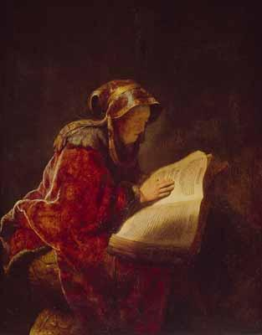
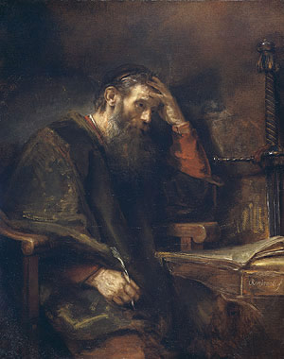
教会历史所传的福音
The Gospel According to Historic Christianity

Slide 15
有人试图将“主权救恩”描绘成新的教义.甚至有人将之定性为异端. 真实情况是教会历史上一直教导这个福音.“轻易恩典”的神学才是“另一个福音”呢.我们在早期教会的著作, 教父, 宗教改革家,各种信经,教义问答,清教徒们的具有重大历史意义著作里,以及学者们,诸如爱德华兹,司布真,慈运理,怀特菲尔德,马太·亨利,沃菲尔德,特里,品克,陶泽,艾恩赛德,瓦因等无数人的著作里可以看到。
Some try to portray ‘Lordship Salvation’ as a new doctrine. There are those who even call it a heresy. The truth is that it is the same Gospel taught throughout the history of the church. Easy Grace theology is ‘another gospel’. This is seen in the earliest known church writings, early church fathers, Reformers, and other Confessions, Catechisms, historic protestant writings of the Puritans, and scholars Edwards, Spurgeon, Zwingly, Whitefield, Matthew Henry, Warfield, Torrey, Pink, Tozer, Ironside, Vine and countless others.

Slide 16
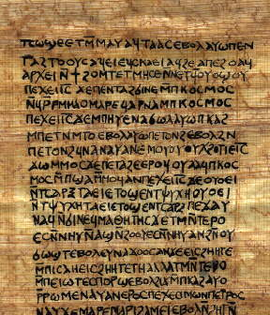
十二使徒遗训
(最早的教会文献之一)
“任何一个教导真理但却不能践行所教真理的先知都是假先知.”
THE DIDACHE
(One of the earliest
church documents)
“Every prophet who teaches the truth but fails to practice what he preaches is a false prophet”

Slide 17
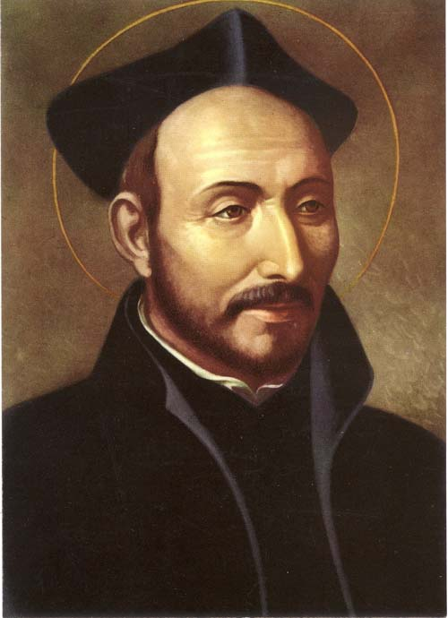
伊格那修
(二世纪安提阿主教)
“重要的不是短暂的认信行为，而是坚持不懈地以信心为动机. ”
IGNATIUS
(Bishop of Antioch
2nd cent.)
“What matters is not a momentary act of professing but being persistently motivated by faith.”

Slide 18
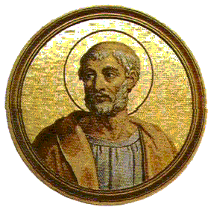
克莱门特
(公元100年)
“让我们不光称他为主,因为这救不了我们…既这样,弟兄们,让我们透过行为承认他…这个世界和将要来的世界(天堂)是两个仇敌。这个世界意味着奸淫,腐败,贪婪和欺骗，另一个则全然没有这些。我们不能与两者都为友，要得到其一，必放弃另一个。”
Clement (A.D. 100)
“Let us not merely call Him Lord, for that will not save us….Thus brothers, let us acknowledge Him by our actions…This world and the world to come are two enemies. This one means adultery, corruption, avarice, and deceit, while the other gives them up. We cannot, then, be friends with both. To get the one, we must give up the other up.”

Slide 19
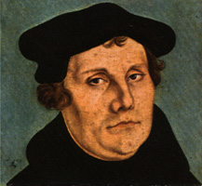
马丁路德
(公元1523年)
“我们教导对基督的信心时,也教导了善行。 因为你们是凭信心持有基督,在基督里你们称义。从今开始努力行善,爱神爱人,呼唤神,向祂感恩，赞美祂,向祂认罪…这些实在是从信心里流淌出来的善行.”
Martin Luther (1523)
“When we have taught faith in Christ, we have also taught good works. Because you have laid hold on Christ by faith, through whom you are made righteous, begin now to do good works. Love God, and your neighbor, call upon God, give thanks to Him, praise Him, confess to Him. ..These are good works indeed which flow out of this faith.”

Slide 20
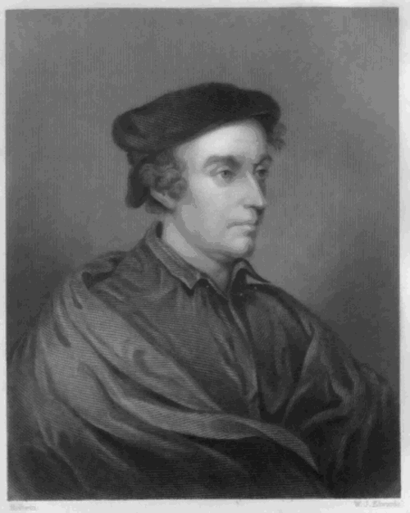
菲利普· 梅来克森
（路德的伙伴和改革战友）
“一个人没有归信是很明显的。他们的心继续犯罪,与良心作对.他们没有渴望和接受罪得赦免的真信心.圣灵不会居住在对神毫无畏惧,持续违抗蔑视神的人的心里.”
PHILIP MELANCHTHON
(Luther’s companion
and fellow Reformer)
“It must be obvious that if conversion to God does not happen, and the heart continues to sin against conscience, that there is no true faith that desires and receives forgiveness of sins. The Holy Spirit is not in a heart in which there is no fear of God, but instead a continuing defiance.”

Slide 21
比利时信条
（公元1561年）
“我们相信此真信心既由听神的话以及圣灵的工作而来,就重生我们,使我们成为新人,使我们过一种新的生活，释放我们脱离一切罪的捆绑.”
BELGIC CONFESSION
(A.D. 1561)
“We believe that this true faith, being wrought in man by the hearing of the Word of God and the operation of the Holy Ghost, doth regenerate and make him a new man, causing him to live a new life, and freeing him from the bondage of sin.””

Slide 22
海德堡要理问答
(公元1563年)
“那么是否这(因信称义)的教义让人变得草率和不敬吗?...不!那些靠信心被根植在基督里的人不结出感恩的果子是不可能的.”
HEIDELBERG CATECHISM
(A.D. 1563)
“But does this doctrine (justification by faith)
make men careless and profane?...No! For it is impossible that those who are implanted into Christ by true faith, should not bring forth fruits of thankfulness”

Slide 23
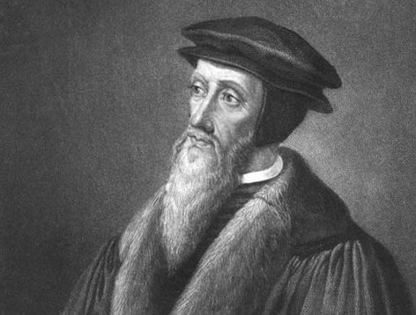
约翰加尔文
“我们不敢设想一个没有善行的信心,或者没有善行的称义…你要在基督里称义吗?你必须先拥有基督。但是你若不参与他的成圣,你就不能拥有他,因为基督是不能切分的…”
JOHN CALVIN
“We dream NOT of a faith which is devoid of good works ,nor of a justification which can exist without them…Would ye then obtain justification in Christ? You must previously possess Christ. But you cannot possess Him without being made a partaker of His sanctification; for Christ cannot be divided…”

Slide 24
以下人也教导了同样的信息
所有的宗教改革家
威斯敏斯特信仰告白
清教徒
马太亨利
乔治·怀特菲尔德
约拿单·爱德华兹
查尔斯·司布真
B. B 沃菲尔德
R.A. 特里
A.W 陶泽
H. A. 品克
J.I. 巴刻
R.C 司布尔
约翰·派博
麦约翰
艾约翰
ASLO TAUGHT BY
ALL REFORMERS
WESTMINSTER CONFESSION OF FAITH
the PURITANS
MATTHEW HENRY
GEORGE WHITFIELD
JONATHON EDWARDS
CHARLES SPURGEON
B.B. WARFIELD
R.A. TORREY
A.W. TOZER
H.A. IRONSIDE
A.W. PINK
J.I. PACKER
R.C. SPROUL
JOHN PIPER
JOHN MACARTHUR
JOHNNIE ACHORD
And YOU?
你呢？

Slide 25
常见问题
Common Questions

Slide 26
常见问题
我们如何领人归主并给他们立刻的确信？
How can we lead people to Christ and offer them immediate assurance?
Common Questions

Slide 27
常见问题
你不能!
这是圣灵的工作,不是你的!
You can’t. That’s the job of the Holy Spirit, Not You!
林后13:5: “你们总要自己省察有信心没有,也要自己试验.岂不知,你们若不是可弃绝的,就有耶稣基督在你们心里吗?”
2 Cor. 13:5 “Examine yourselves as to whether you are in the faith. Test yourselves. Do you not know yourselves, that Jesus Christ is in you?; unless indeed you are disqualified.”
Common Questions

Slide 28
常见问题
如何知道某人的罪是暂时的还是他们根本未得救？
How do I know if someone’s sin is temporary or if they are unsaved?
Common Questions

Slide 29
常见问题
判断你自己,而不是判断他人。
Judge yourself, not others.
犯罪后心里沉重忧伤，还是找各种借口？
Is the heart troubled or does it make excuses?
罗7:告诉我们保罗希望停止犯罪。
Rom. 7: Paul’s desire to stop sinning
Common Questions

Slide 30
常见问题
如果我在罪中挣扎,应怀疑自己是否得救了吗？
Should I doubt my salvation if I struggle with sin in my life?
Common Questions

Slide 31
常见问题
如果你内心激烈斗争,这是好迹象。
If you are struggling, that Is a good sign
问自己我最强烈的愿望是希望取悦神，还是取悦肉体？是否为罪忧伤痛悔，因为伤了神的心？
We usually struggle until we release control to the Holy Spirit
Common Questions

Slide 32
常见问题
如何区分倒退的基督徒和非基督徒?
How can I tell a backslidden Christian from a non-Christian?
Common Questions

Slide 33
常见问题
这不是你的工作。That’s not your job
倒退的基督徒没有出现在圣经里。
Backslidden Christian is NOT in the Bible;
约一3章谈到了那些
持续活在罪里的人(没有得救的迹象)
1 John 3 addresses those who LIVE IN CONTINUAL SIN
Common Questions

Slide 34
常见问题
有没有所谓的属肉体的基督徒？
Is there such thing as a carnal Christian?
Common Questions

Slide 35
常见问题
林前3:3: “你们仍是属肉体的,因为在你们中间有嫉妒,纷争,这岂不是属乎肉体,照著世人的样子行吗？”
1 Cor. 3:3 “For ye are yet carnal: for whereas there is among you envying, and strife, and divisions, are ye not carnal, and walk as men?”
将经文放在上下文里去理解！
LEAVE THE VERSE IN CONTEXT!
Common Questions

Slide 36
常见问题
弟兄们,我从前对你们说话,不能把你们当作属灵的,只得把你们当作属肉体,在基督里为婴孩的.我是用奶喂你们,没有用饭喂你们. 那时你们不能吃,就是如今还是不能.你们仍是属肉体的,因为在你们中间有嫉妒,纷争,这岂不是属乎肉体,照著世人的样子行吗？有说:“我是属保罗的.”有说:“我是属亚波罗的.”这岂不是你们和世人一样吗？
^{(V.1-4)} And I, brethren, could not speak unto you as unto spiritual, but as unto carnal, even as unto babes in Christ. ²I have fed you with milk, and not with meat: for hither to ye were not able to bear it, neither yet now are ye able. ³For ye are yet carnal: for whereas there is among you envying, and strife, and divisions, are ye not carnal, and walk as men? ⁴For while one saith, I am of Paul; and another, I am of Apollos; are ye not carnal?”
Common Questions

Slide 37
常见问题
这是些正在成长的基督徒…成长很慢;
而不是活在邪恶之中。(属灵婴孩)
These are Christians who are growing…but too slow; NOT living evil lives. (Babes)
保罗一直在灵里喂养他们 (我喂养了你们)。
Paul has been feeding them spiritually (I have fed you)
他们被称为 “属肉体的”,因为他们根据自己与属灵领袖的关系来划分,导致纷争(我属保罗,我属阿波罗, 等).
They are called “carnal” because they are dividing and causing strife over their desire
to be associated with godly people (I am of Paul, I am of Apollos, etc)
他们还是彼此相交的 (你们中间)。
They are still in fellowship (among you)
Common Questions

Slide 38
常见问题
难道我们不可以避免这种争议,保持教会的合一吗？
Shouldn’t we avoid this controversy in order to keep unity in the church?
Common Questions

Slide 39
保罗会如何回答这个问题？
HOW WOULD PAUL ANSWER THAT QUESTION?
加1:8-10 “但无论是我们,是天上来的使者,
若传福音给你们,与我们所传给你们的不同,他就应当被咒诅.我们已经说了,现在又说:
若有人传福音给你们,与你们所领受的不同,他就应当被咒诅!我现在是要得人的心呢?
还是要得神的心呢?我岂是讨人的喜欢吗?
若仍旧讨人的喜欢,我就不是基督的仆人了.”
GAL. 1:8-10 “But even if we or an angel from heaven should preach a gospel other than the one we preached to you, let them be under God’s curse! As we have already said, so now I say again: If anybody is preaching to you a gospel other than what you accepted, let them be under God’s curse! Am I now trying to win the approval of human beings, or of God? Or am I trying to please people? If I were still trying to please people, I would not be a servant of Christ. “

Slide 40
常见问题
那我是基督徒吗?
SO AM I A CHRISTIAN?
只有你自己可以回答这个问题。
ONLY YOU CAN ANSWER THAT QUESTION
Common Questions

Slide 41
救恩的四个要素
相信: BELIEVE
承认: CONFESS
悔改: REPENT
接受: RECEIVE
Common Questions

Slide 42
真正得救的信心的标志
约翰一书中有一系列我们可以用于省察自己信心的标准。当我们看这些时，要记得没有人能在所有时候完美地通过所有检测，但是它们揭示了一个我们在恩典中成长的生活的一致性趋势。

Slide 43
真正得救的信心的标志
你有没有与基督及被其救赎的人们相交？ （约翰一书1:3）
人们会说你在光明中行，还是在黑暗里行？ （约翰一书1:6-7）
你承认并坦白你的罪吗？（约翰一书1:8）
你遵守主道吗？（约翰一书2:3-5）
你的生活表明你爱神而不是爱世界吗？ （约翰一书2:15）
你生活的特征是行公义吗？（约翰一书2:29）

Slide 44
真正得救的信心的标志
7. 你努力保持生活圣洁吗？（约翰一书3:3）
8. 你看到罪在你的生活中越来越少吗？
（约翰一书3:5-6）[注：这不是指完全无罪，而是作为一种生活方式，不持续活在罪里]
9. 你表现出爱其他基督徒弟兄吗？（约翰一书3:14）
10. 你的爱，是“在行为和诚实上”，而不只是“在言语和舌头上”吗？（约翰一书3:18-19）
11. 你有坦然无惧的良心吗？（约翰一书3:21）
12. 你在基督徒道路上有胜了世界的经历吗？（约翰一书5:4）

