Slide 1
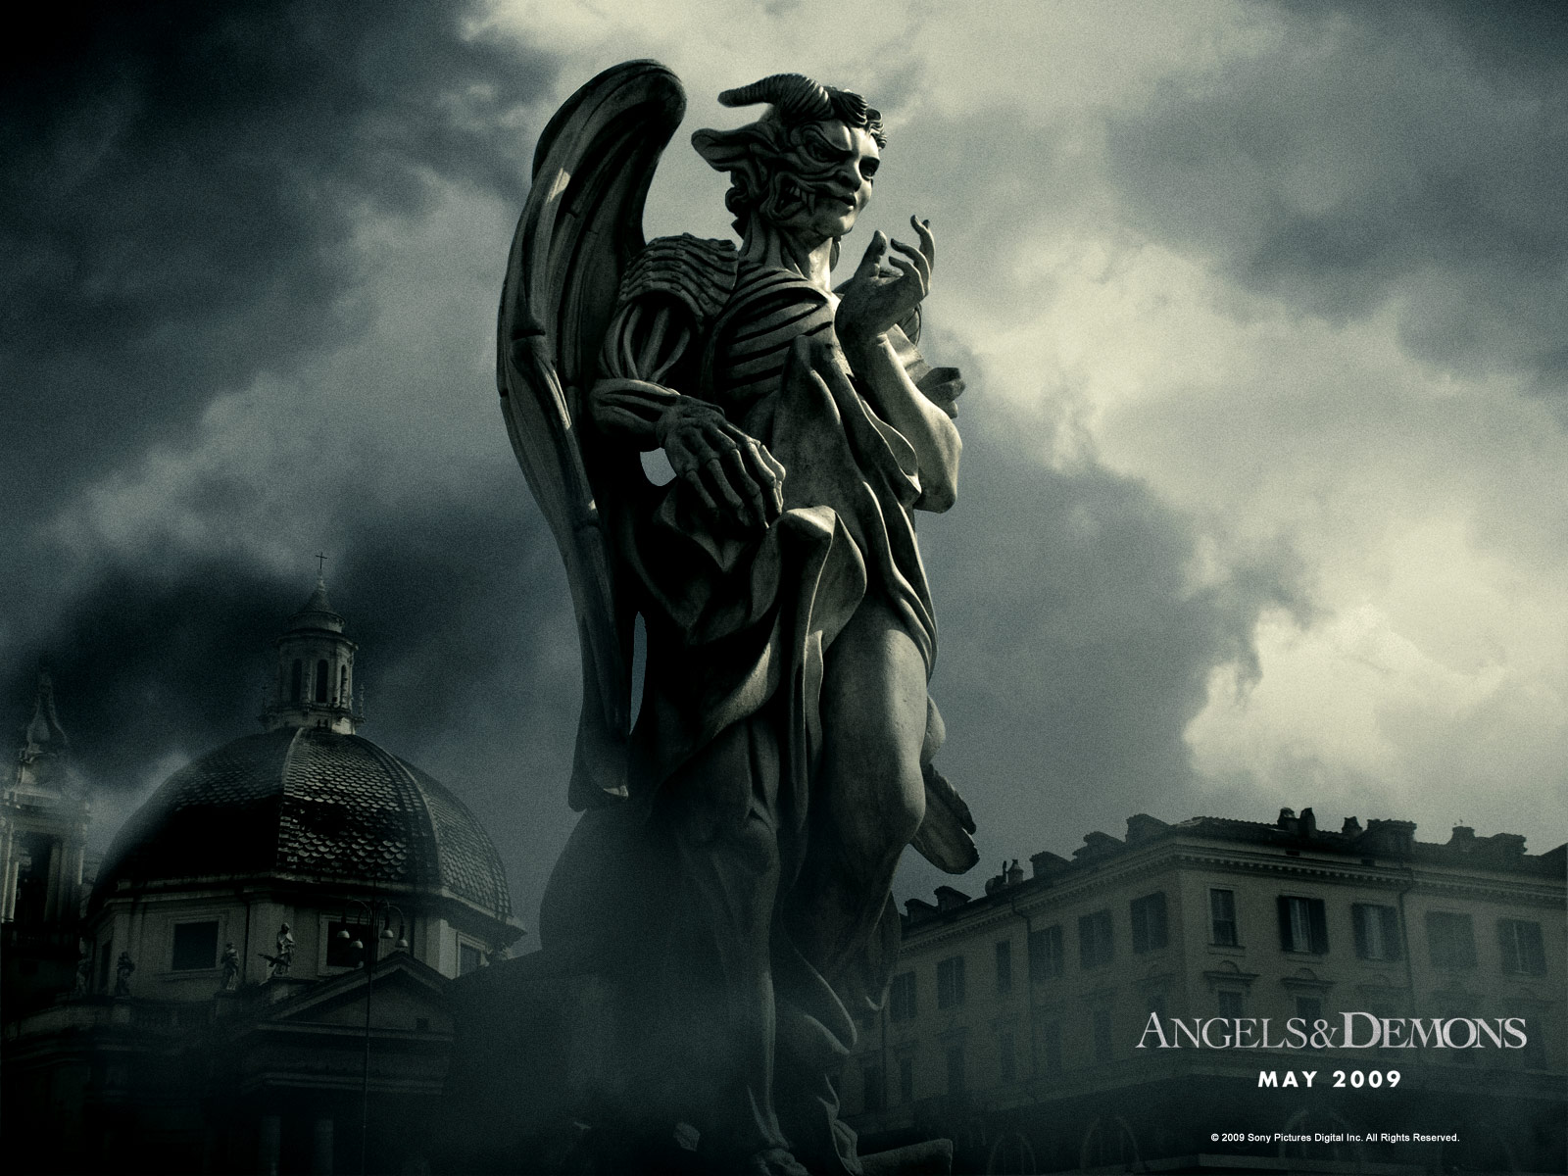
鬼魔
DEMONS

Slide 2
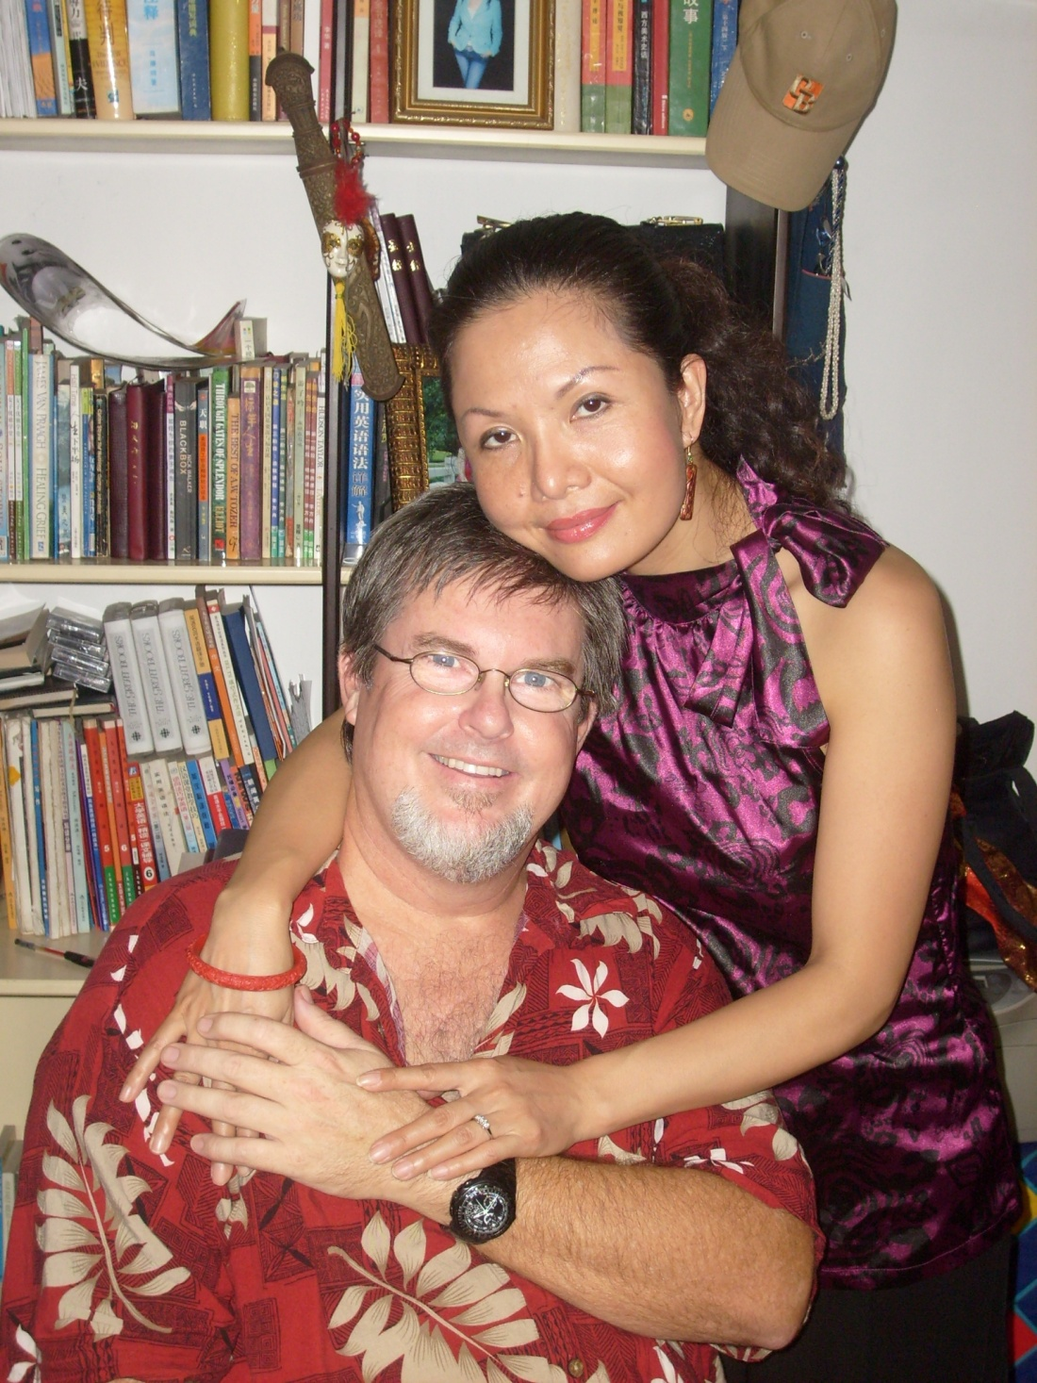
Teachers:
Dr. Johnnie Achord
&
Shulan
Achord

Slide 3
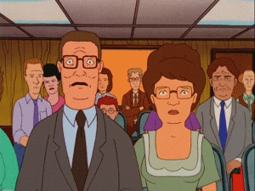
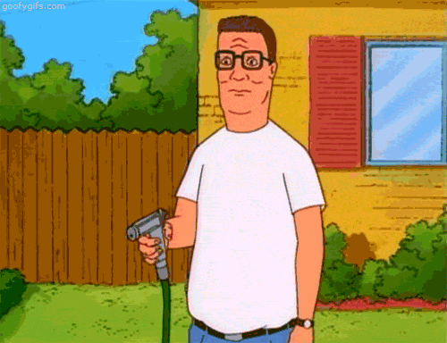
今日基督徒中的两个极端
鬼魔无处不在
鬼魔无处可寻
DEMONS ARE EVERYWHERE
DEMONS ARE NOWHERE
2 EXTREEMS AMONG TODAYS CHRISTIANS

Slide 4
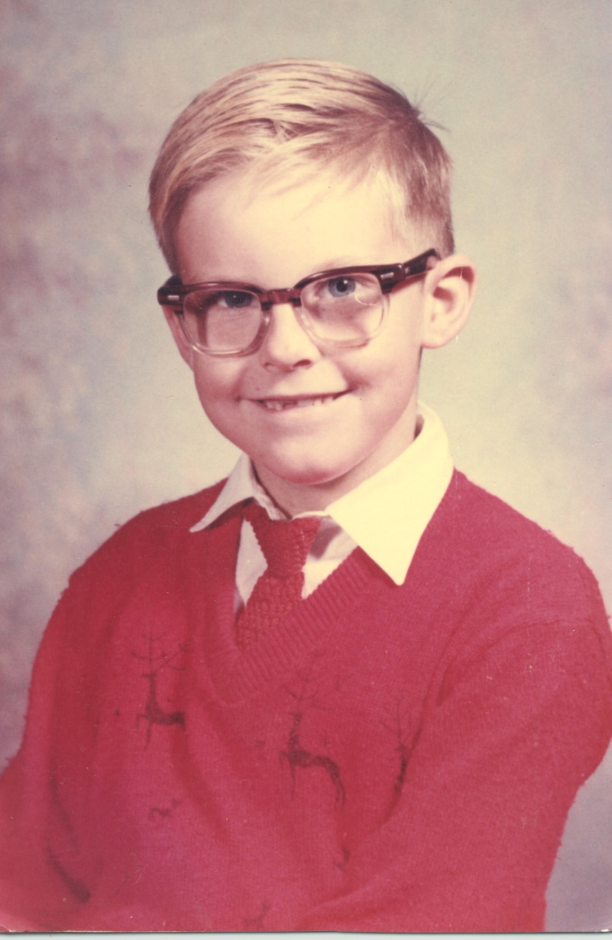
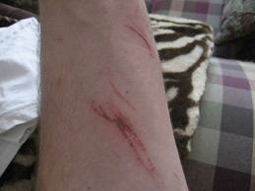
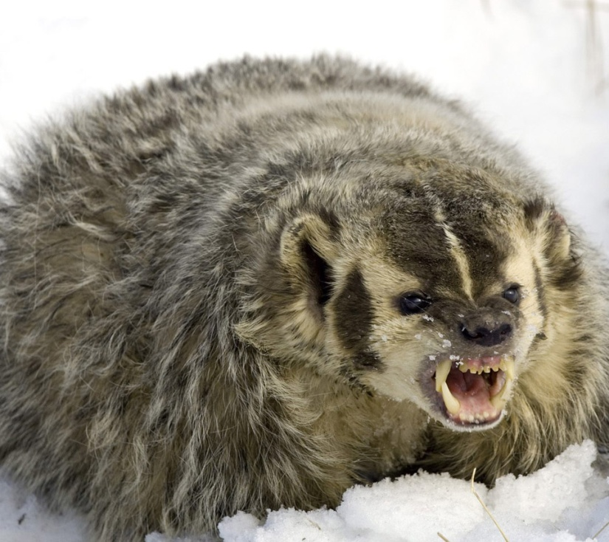

Slide 5
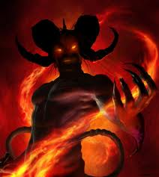
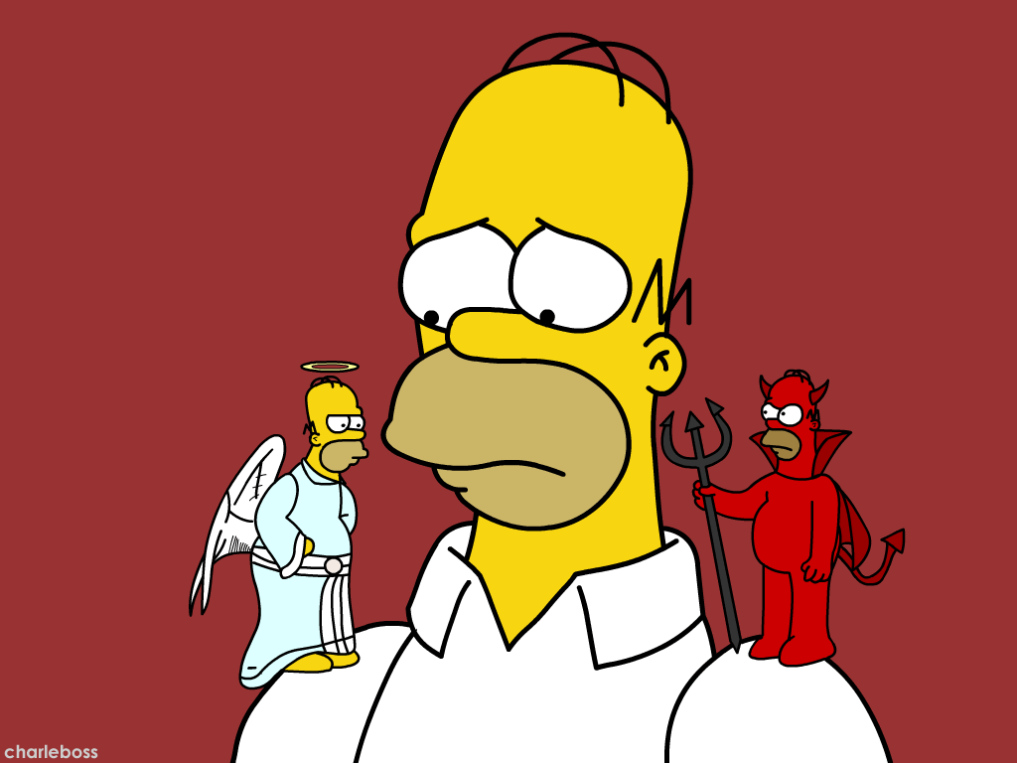
关于鬼魔有哪些常见的误区? What are some common misconceptions about DEMONS?

Slide 6
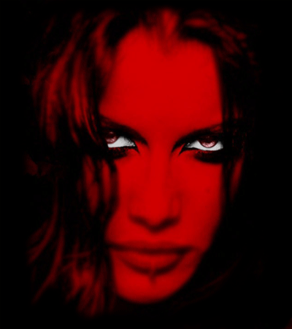
误区
“撒旦头长犄角，身穿红睡衣.” “Satan has horns and red pajamas”
“撒旦住在地狱里.” “Satan lives in Hell”
“撒旦每天攻击我们.” “Satan attacks us daily”
“撒旦导致一切疾病和自然灾害.” “Satan causes all sickness natural disasters”
Misconceptions

Slide 7
误区
“坏人死后就变成鬼魔。” “Bad people become demons when they die”
“基督徒不受鬼魔影响.” “Christians are free from demonic influence”
“邪灵的所有攻击都容易识别.” “All demonic attack is easy to identify”
“鬼魔是些荒诞不经的怪物.” “Demons are grotesque monsters”
Misconceptions

Slide 8
误区
“我们凭话语就可捆绑撒旦.” “We can bind Satan with our words”
“耶稣和撒旦是兄弟.”(摩门教) “Jesus and Satan are brothers” (Mormons)
“试探均从魔鬼而来.” “Every temptation comes from the devil”
“只有真先知能行神迹.” “Only true prophets can do miracles”
Misconceptions

Slide 9
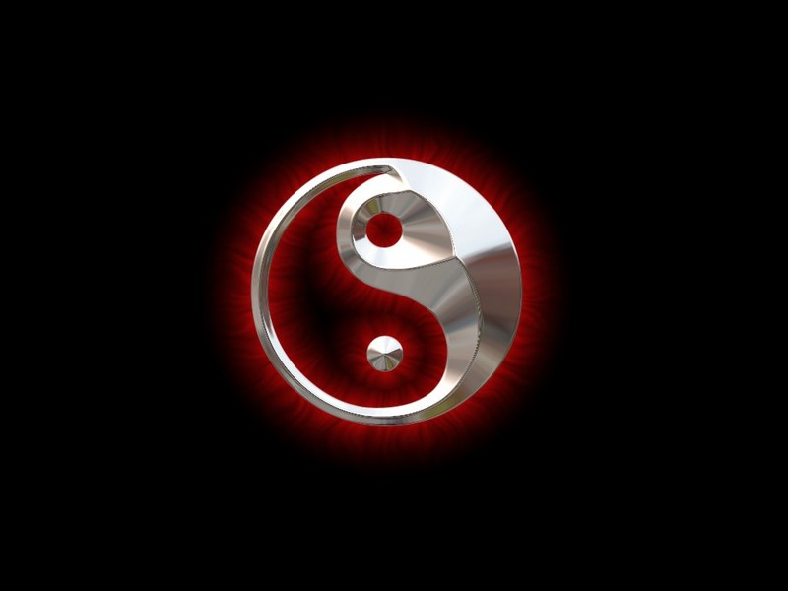
二元论:
上帝和撒旦是反向相等的力量=
错误！
上帝只有敌人,没有对手。
DUALISM: GOD and Satan are equal opposites = WRONG!

Slide 10
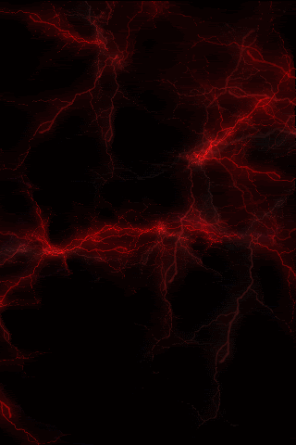
《圣经》是如何说的？
BUT WHAT DOES THE BIBLE SAY?

Slide 11
关于鬼魔的诸多
问题…
16 Questions about DEMONS

Slide 12
圣经中有两组天使：正义天使和堕落天使。然而，起初所有的天使都是正义的， 在天上敬拜服事神。
In the Bible, there are 2 groups of angels: the righteous angels and the fallen angels. Originally, ALL angels were righteous. They ALL worshipped and served God in heaven.

Slide 13
鬼魔是什么?
由神创造的如同天使般的不可见的灵体。
Invisible spirit beings created as angels by God
路西弗(撒旦)原是一个很有权柄的天使长。
Lucifer (Satan) was an archangel with authority
路西弗企图像神那般接受敬拜. (结28; 赛14)
Lucifer wanted to be worshipped as a god (Ez. 28; Is. 14)
神因牠的骄傲将之逐出天堂来到地上。
God cast him from heaven to earth for his pride
在这次叛乱中, 有三分之一的天使跟随了撒旦。
1/3 of the innumerable angels followed Satan in his rebellion against God
这些堕落的天使, 我们称之为“鬼魔”。
These fallen angels are the ones we call DEMONS
WHAT ARE DEMONS?

Slide 14
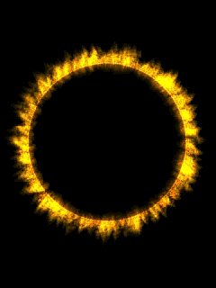
鬼魔是何时被造的?
在天地被造以先。
Before the earth was created
约伯记38:4-7告诉我们神创造地球时,天使在一旁高声欢呼。
Job 38:4-7 tells us that the angels shouted for joy as they watched God create the earth
WHEN WERE DEMONS CREATED?

Slide 15
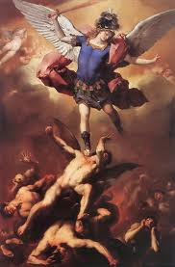
鬼魔何时堕落的?
在六天创造完毕后, 神说一切甚好(创1:31).
After Day 6…God said ALL He made was very good (Gen. 1:31)
在创世记三章前…撒旦在园子里试探夏娃。
Before Gen 3… Satan tempts Eve in the garden
创世记第一章和第三章之间相隔了很多年。
There are many years between Gen. 1 and 3
WHEN DID THE DEMONS FALL?

Slide 16
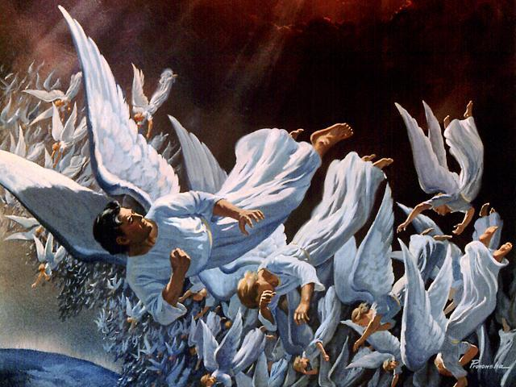
先看看撒旦从哪里来？
Question: Where did Satan come from?

Slide 17
堕落前的撒旦:以西结书28:12-17 (Satan BEFORE the Fall: Ezekiel 28:12-17)
完美的样板 (Example of Perfection)
充满智慧 (Full of Wisdom)
一个卫士 (A Guardian)
所行的无可指责 (Blameless in his ways)
完全的美丽 (Perfect in Beauty)
天生的音乐才能 (Music in his nature)

Slide 18
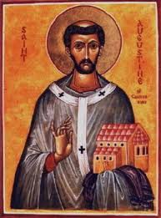
骄傲的罪
“骄傲是罪之母,能孕育出所有其它的罪.”
—圣奥古斯丁
“Pride is the mother of all sin and she is pregnant with all of the other sins.” St. Augustine
THE SIN OF PRIDE

Slide 19
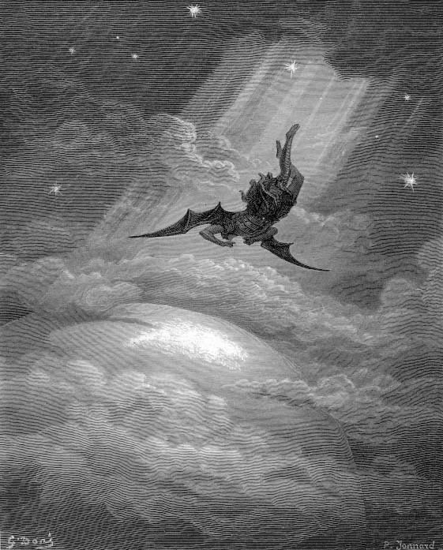
堕落后的撒旦 (Satan AFTER the Fall)

Slide 20
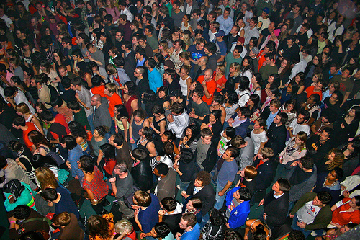
林后11:14-15“这也不足为怪，因为连撒但也装作光明的天使。所以他的差役，若装作仁义的差役，也不算希奇。 他们的结局必然照着他们的行为。”
2 Corinthians 11:14-15 “And no wonder, for even Satan disguises
himself as an angel of light. So it is no surprise if his servants,
also, disguise themselves as servants of righteousness.”

Slide 21
现在，卢西弗叫作“撒旦”，率领剩余的鬼魔 每天悖逆神的旨意，想方设法赢得更多的跟随者。牠知道所有的人都会跟着牠入火湖，除非他们 成为耶稣的跟随者。
For now, Lucifer, now called Satan, leads the remaining demons in a daily rebellion against the plan of God, trying to gain as many followers as possible. He knows that all men will follow him into the Lake of Fire unless they become followers of Jesus.

Slide 22
撒旦有哪些名字？
Question: What are some of Satan’s names?
撒旦 (SATAN)
太4:10 (Mt. 4:10)
卢西弗 (LUCIFER)
赛14:12 (Is. 14:12)
魔鬼 (The DEVIL)
来2:14 (Heb. 2:14)
别西卜 (BEELZEBUB)
太12:24 (Mt. 12:24)
彼列 (BELIAL)
林后6:14 (2 Cor. 6:14)

Slide 23
问题：撒旦有哪些头衔？
Question: What are some of Satan’s titles?
鬼魔之王
(prince of demons)
古龙/蛇
(dragon/serpent)
这个世代的神
(god of this age)
试探者
(the tempter)
空中掌权者的
(ruler of the kingdom of the air)
控告信徒者
(accuser of believers)
这个世界的王
(prince of this world)
仇敌
(the enemy)
那恶者
(the evil one)
吼叫的狮子
(a roaring lion)
光明天使
(angel of light)

Slide 24
天使长卢西弗率众天使背叛神，企图篡夺神的宝座。神让所有的天使作出选择：是跟随卢西弗还是神。以便将那些骄傲和悖逆的天使隔离开。
One mighty archangel named Lucifer led a rebellion against God in an attempt to take over the throne. God allowed these angels to choose sides between Lucifer and Jesus in order to separate those angels whose hearts were filled with pride and rebellion.

Slide 25
三分之一跟随卢西弗的天使被驱逐出了天庭，现在叫做“堕落天使”或“鬼魔”。它们的结局已定。其中一些已经被捆锁起来等候审判，其余的在地上。白色大宝座审判后，所有的鬼魔都会被永久扔进火湖。
About one third (1/3) of the angels sided with Lucifer and were cast out of Heaven. They are now called “fallen angels” or “demons”. Their future is already sealed. Some of them have already been chained up and are held in judgment. The rest are on earth. Following the Great White Throne Judgment, all of the demons will be throne in the Lake of Fire for eternity.

Slide 26
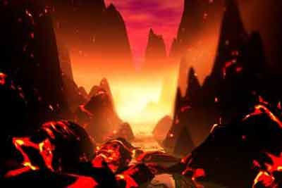
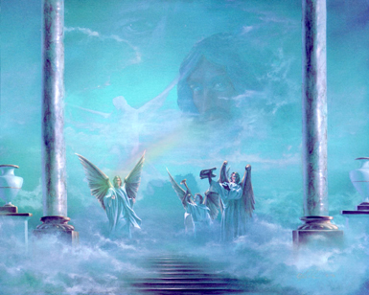

Slide 27
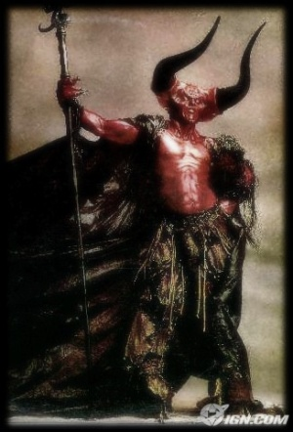
鬼魔都长什么样?
鬼魔不是…
DEMONS ARE NOT…
* 不是面目可憎的 长着翅膀,四蹄, 犄角和獠牙的怪物。
NOT Ugly monsters with wings, hooves, horns and fangs
* 也并非穿红睡衣,手拿铁叉。
NOT dressed in red pajamas with a pitchfork
WHAT DO DEMONS LOOK LIKE?

Slide 28
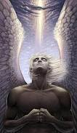
鬼魔都长什么样?
鬼魔是
DEMONS ARE
模仿光明的天使
Imitating Angels of light
“这也不足为怪,因为连撒但也装作光明的天使.”
林后 11:14 (2 Cor)
他们装作敬虔的牧师,并行神迹异能, 却教导假教义.
They appear as godly preachers and miracle workers teaching false doctrines
WHAT DO DEMONS LOOK LIKE?

Slide 29
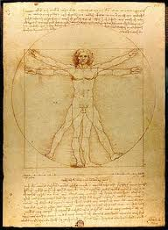
鬼魔是男的,女的,亦或无性别
《圣经》中所涉及的鬼 魔都以男性出现。
All Biblical references and appearances are MALE
《圣经》从未说他们无 性别。
The Bible never says they are without gender
ARE DEMONS MALE OR FEMALE OR NEITHER?

Slide 30
鬼魔繁殖吗?
天上的天使不嫁不娶不繁殖(太22:30).
The angels in Heaven do not marry or reproduce (Matt 22:30).
堕落天使却与地上的女人结合并繁殖后代.(创6)
The fallen angels both married earthly women and produced offspring. (Gen. 6)
它们的后代被称为 巨人,并拥有远超普通人的能力.
Their offspring are called Nephilim and have abilities beyond normal men
此事促使神给人类120年时间悔改,然后以洪水灭世。
That prompted God to give men 120 more years and then destroy the earth in a great flood.
DO DEMONS REPRODUCE?

Slide 31
撒旦和鬼魔能无所不知吗?
撒旦和鬼魔并非无所不知. 然而它们拥有几千年的热切观察及经验。 他们也不能读懂你的心事。
Satan and demons are not Omniscient. But they have thousands of years of keen observation and experience behind them. They cannot read your mind either.
撒旦和鬼魔并非无所不能. 它们只拥有神给它们的能力。
Satan and demons are not Omnipotent. They have only power God gives them.
DO SATAN OR DEMONS KNOW EVERYTHING?

Slide 32
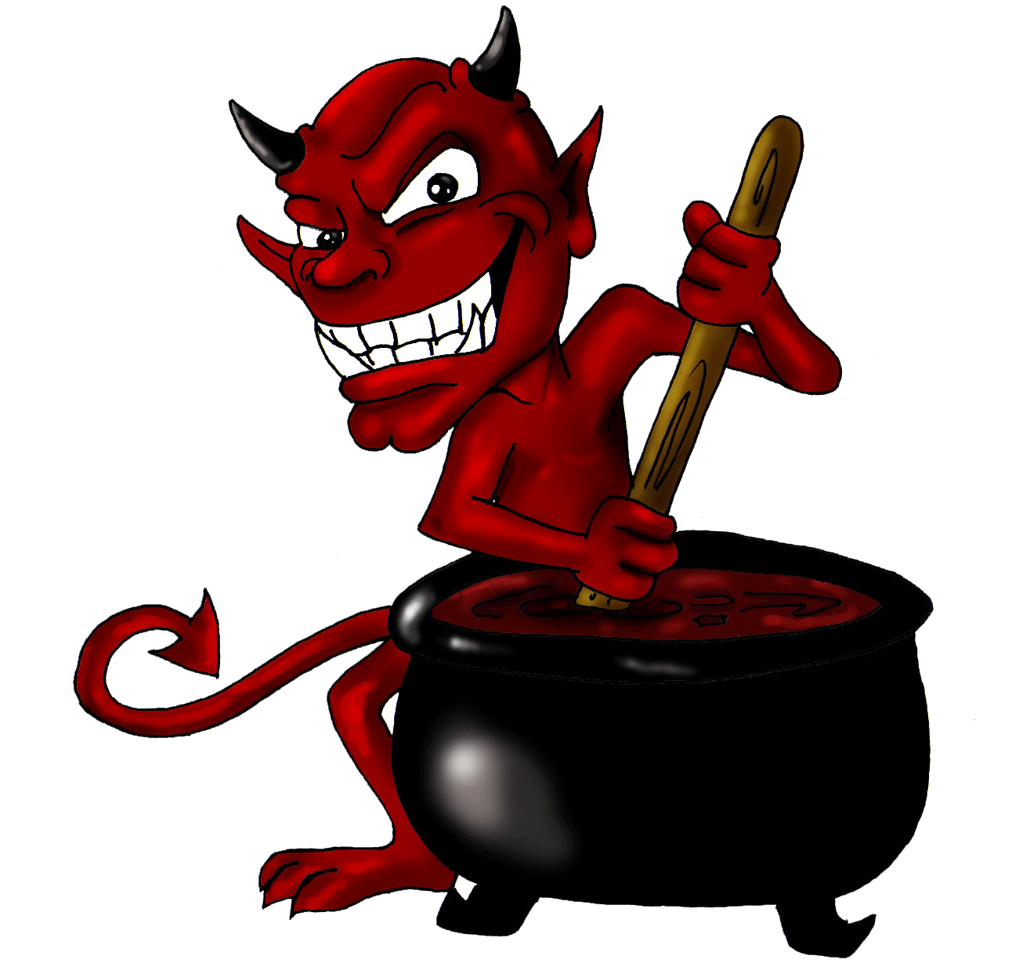
撒旦和鬼魔无所不在吗?
撒旦和鬼魔并非无所不在。它们只能一时在一地.
Satan and demons are not Omnipresent. They can be only one place at a time.
撒旦可能与你本人从未有任何相干。
Satan may never have ANYTHING to do with you personally
鬼魔却会向你发动战争。
Demons will war against you though.
撒旦遍游全地寻找可伤害的人(彼前5:8) 然后日日夜夜到神的宝座前控告基督徒。
Satan roams the earth seeking for people to harm (1 Pet. 5:8) and then goes to HEAVEN before God’s throne every day and night accusing Christians.
正是在类似的会面中,神让撒旦去试验约伯。
It was during one of these sessions that God asked Satan to examine Job.
ARE SATAN OR DEMONS EVERYWHERE?

Slide 33
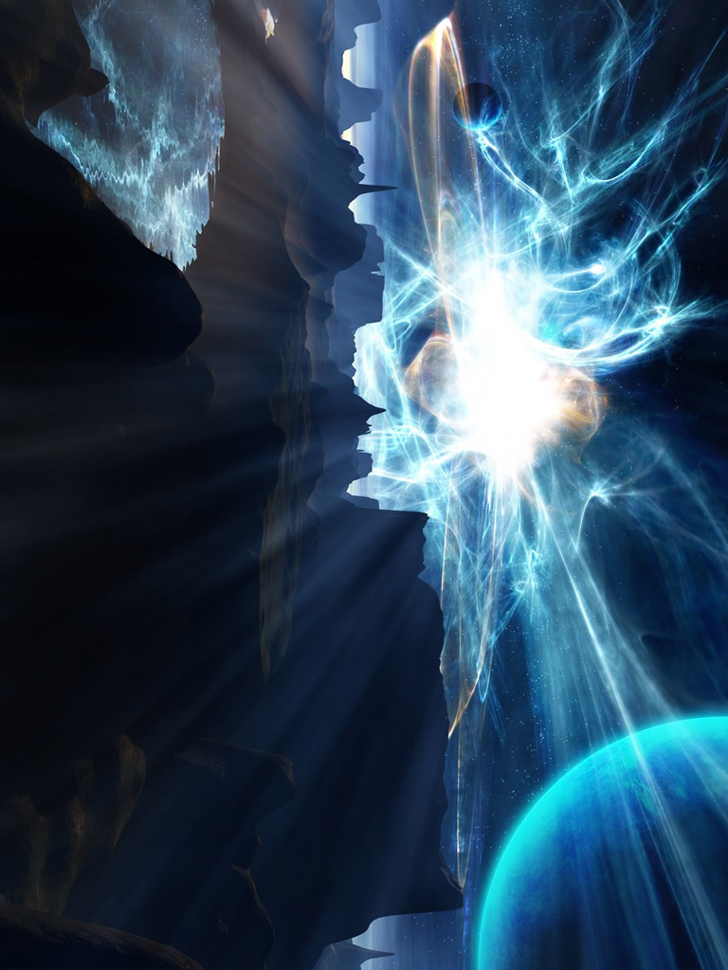
撒旦和鬼魔从来就存在吗?
撒旦和鬼魔并非永恒。 它们也是在某个时间被造。
Satan and demons are not Eternal.
They were created at a point in time.
撒旦和鬼魔并非神祗， 乃要屈服于神并祂的管治。
Satan and demons are not gods, but are subject to God and His rules.
撒旦并不拥有至高主权. 牠只能行神允许的事情。
Satan is not sovereign. He can only do whatever God allows him to do.
HAVE SATAN OR DEMONS ALWAYS EXISTED?

Slide 34
撒旦或鬼魔均超有大能吗?
撒旦并非导致每个疾病和每场灾难。
Satan is not behind every sickness and disaster.
神声称每一个波浪, 雨水,冰雹, 地震, 火山, 洪水, 海啸等都是祂手所做的.（约伯记37,38章）
GOD claims credit for every wave, rain, hail, earthquake, volcano, flood, tsunami, etc. (Job 37,38)
神说惟有祂决定 谁会眼瞎, 腿瘸,或生病.(出4:11)
GOD says that HE ONLY determines who will be blind, lame or sick. (Ex4:11)
神说惟有祂能力决定人的生死。(太10:28)
God says that HE ONLY has the power of life and death. (Matt. 10:28)
我们给了撒旦太多的能力并将神做的工归到它头上
We give Satan far too much power and credit for works of God.
ARE SATAN OR DEMONS ALL POWERFUL?

Slide 35
撒旦和鬼魔住在地狱吗?
撒旦甚至还尚未见过地狱。
Satan has never seen Hell.
撒旦和所有鬼魔有一天将会被扔进火湖（启20:10）
Satan and all demons will someday be cast into the Lake of Fire (Rev.20:10)
有些鬼魔已经受捆锁直到审判之日 （犹6）
Some demons have been chained until judgment day (Jude 6)
DO SATAN AND DEMONS LIVE IN HELL?

Slide 36
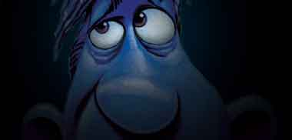
有人祷告求神“捆绑撒旦”
是什么意思？
What do people mean when they ask God to ‘bind Satan’?

Slide 37
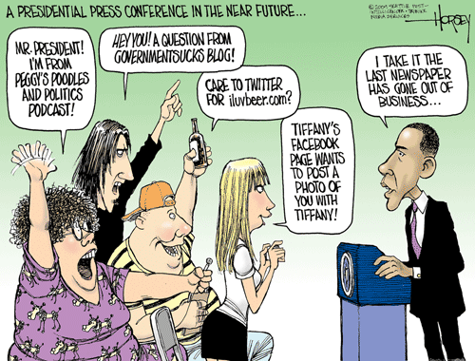
How long does Satan stay bound for?
Do you take turns binding him to keep him bound longer?
撒旦能被捆绑多久？你们是轮流捆绑他，这样他被俘的时间就长点吗？
How could he attack you anyway if someone else had him bound?
若其他人已经把他捆绑了， 他如何还能攻击你呢？
我奉耶稣的名捆绑你的提问！
I bind your questions in the Name of Jesus!
若撒旦不是无所不在的，他如何听到你要捆绑他呢？
How does Satan hear you bind him if he’s not omnipresent?
Wouldn’t he come back mad once he got free?
他被释放后会不会发怒呀？

Slide 38
撒旦唯一被捆绑会发生在千禧年间。 并且需要一个大能的天使才能捆绑他。
The only time Satan will be bound is during the 1,000 Millennium.
It will take a strong angel to do that.
“他捉住那龙，就是古蛇，又叫魔鬼，也叫撒旦，把它捆绑一千年，扔在无底坑里，将无底坑关闭，用印封上，使它不得再迷惑列国。等到哪一千年完了，以后必须暂时释放它。” （启示录20:2-3）
"He seized the dragon, that ancient serpent, who is the devil, or Satan, and bound him for a thousand years. He threw him into the Abyss, and locked and sealed it over him, to keep him from deceiving the nations anymore until the thousand years were ended. After that, he must be set free for a short time." [Revelation 20:2-3]

Slide 39
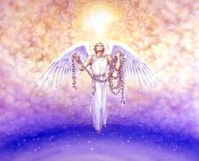
撒旦唯一被捆绑会发生在千禧年间。 并且需要一个大能的天使才能捆绑他。
The only time Satan will be bound is during the 1,000 Millennium.
It will take a strong angel to do that.
“他捉住那龙，就是古蛇，又叫魔鬼，也叫撒旦，把它捆绑一千年，扔在无底坑里，将无底坑关闭，用印封上，使它不得再迷惑列国。等到哪一千年完了，以后必须暂时释放它。” （启示录20:2-3）
"He seized the dragon, that ancient serpent, who is the devil, or Satan, and bound him for a thousand years. He threw him into the Abyss, and locked and sealed it over him, to keep him from deceiving the nations anymore until the thousand years were ended. After that, he must be set free for a short time." [Revelation 20:2-3]

Slide 40
犹大在他的书信里警告，末世时，假教师会出现并声称他们（和我们）有胜过魔鬼的能力…
Jude warned in his epistle that in the end times, false teachers would come, teaching that they (and we) have power over demonic forces…
“这些作梦的人也像他们污秽身体，轻慢主治的，毁谤在尊位的。天使长米迦勒为摩西的尸首与魔鬼争辩的时候，尚且不敢用毁谤的话罪责他，只说: ‘主责备你吧!’ 但这些人毁谤他们所不知道的。他们本性所知道的事与那没有灵性的畜类一样，在这事上竟败坏了自己。他们有祸了！”（犹8-10）
“ In the very same way, these dreamers pollute their own bodies, reject authority and slander celestial beings. But even the archangel Michael, when he was disputing with the devil about the body of Moses, did not dare to bring a slanderous accusation against him, but said, "The Lord rebuke you!" Yet these men speak abusively against whatever they do not understand; and what things they do understand by instinct, like unreasoning animals —these are the very things that destroy them. WOE TO THEM!“ (Jude 8-10)

Slide 41
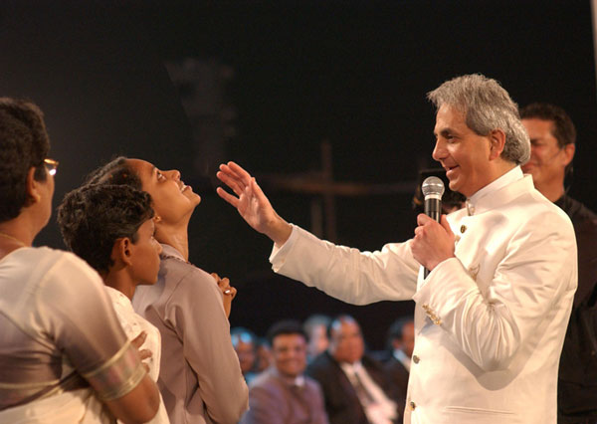
犹大在他的书信里警告，末世时，假教师会出现并声称他们（和我们）有胜过魔鬼的能力…
Jude warned in his epistle that in the end times, false teachers would come, teaching that they (and we) have power over demonic forces…
“这些作梦的人也像他们污秽身体，轻慢主治的，毁谤在尊位的。天使长米迦勒为摩西的尸首与魔鬼争辩的时候，尚且不敢用毁谤的话罪责他，只说: ‘主责备你吧!’ 但这些人毁谤他们所不知道的。他们本性所知道的事与那没有灵性的畜类一样，在这事上竟败坏了自己。他们有祸了！”（犹8-10）
“ In the very same way, these dreamers pollute their own bodies, reject authority and slander celestial beings. But even the archangel Michael, when he was disputing with the devil about the body of Moses, did not dare to bring a slanderous accusation against him, but said, "The Lord rebuke you!" Yet these men speak abusively against whatever they do not understand; and what things they do understand by instinct, like unreasoning animals —these are the very things that destroy them. WOE TO THEM!“ (Jude 8-10)

Slide 42
堕落天使能得救吗?
不能.如同神在创造之前就已经拣选了祂的儿女(弗1:4-5)。祂同时也称那些没有堕落天使为 “蒙拣选的天使”(提前5:21), 在创造之前就被神拣选了。
No. Just as God chose His children before He created them (Eph. 1:4-5), He also calls the angels who did not fall “elect angels” (1 Tim. 5:21) chosen before He created them.
堕落天使已经被定罪了, 将会在白色大宝座的审判之后，投入火湖里遭受永远的刑罚。
Fallen angels have already been condemned and will suffer their punishment in the Lake of Fire following the Great White Throne Judgment.
CAN FALLEN ANGELS BE SAVED?

Slide 43
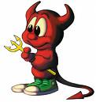
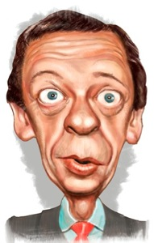
基督徒会被鬼附吗？
Can a Christian
be demon possessed?

Slide 44
圣经并没有明确说明基督徒是否会被鬼附。
The Bible does not explicitly state whether a Christian can be possessed by a demon.

Slide 45
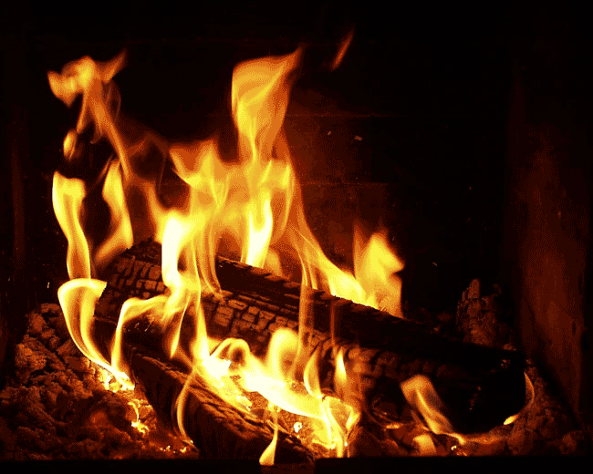
有人说既然基督徒有圣灵内住，似乎不可能圣灵会允许邪灵附身在他内住的这人身上。但…圣灵无处不在，所以凡有邪灵的地方，圣灵也在。
Some would say that since a Christian is indwelt by the Holy Spirit it would seem unlikely that the Holy Spirit would allow a demon to possess the same person He is indwelling. BUT…The Holy Spirit is EVERYWHERE and therefore indwells
EVERYWHERE demons dwell.

Slide 46
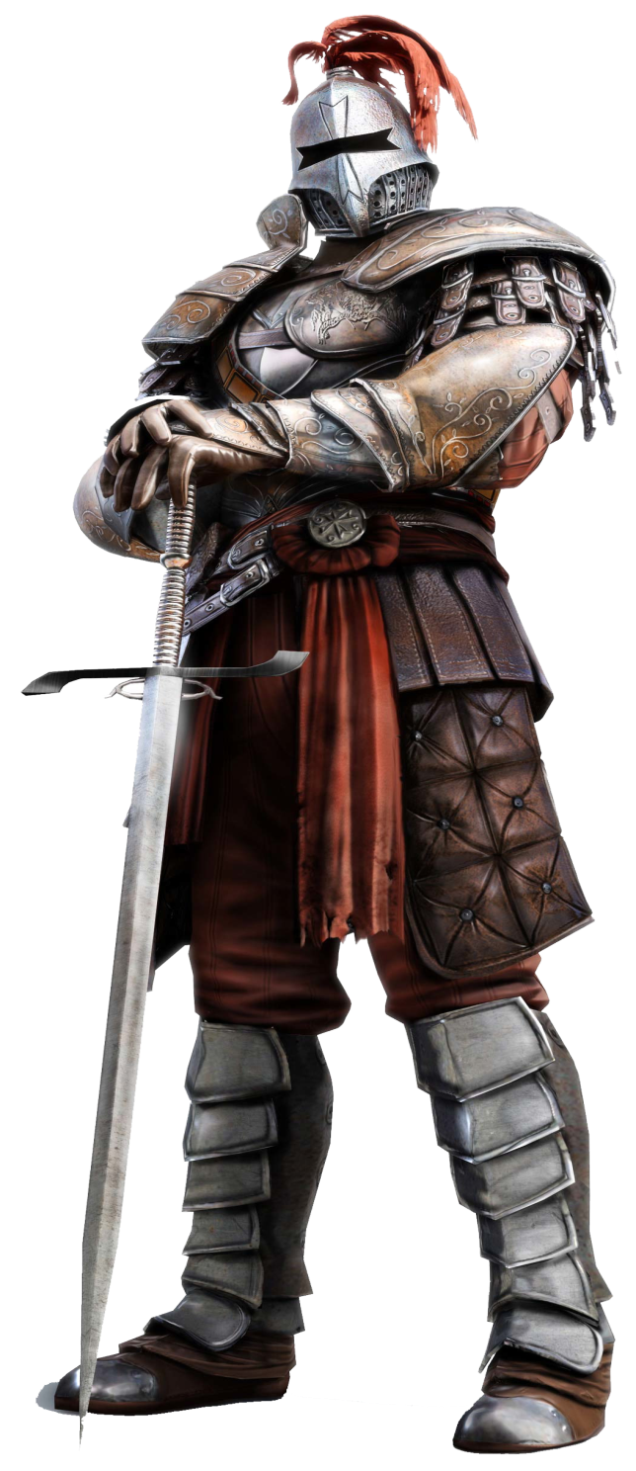
注意到在新约所有关于属灵争战的经文里，从未告诉我们要给信徒赶鬼。信徒被
告知要抵抗魔鬼但没有告知要赶鬼出来。
Notice that in all the N.T. passages dealing with spiritual warfare,
we are never told to cast a demon out of a believer.
Believers are told to resist the devil never instructed to cast him out.

Slide 47
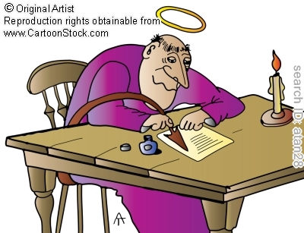
有人相信基督徒可能被鬼压迫,但不会被附身。区别是….
Some believe Christians can be oppressed,
but not possessed. The difference is…

Slide 48
邪灵附身包括鬼魔对某人的思想/行为有直接的控制。
（路4:33-35;8:27-33;太17:14-18）
Demon possession involves a demon having direct control over the thoughts and/or actions of a person
(Luke 4:33-35; 8:27-33; Matt. 17:14-18).
邪灵压迫或影响包括一个或多个鬼魔在属灵上攻击一个人，怂恿他或她做出罪恶的行为。
(彼前5:8-9;雅4:7)
Demon oppression or influence involves a demon or demons attacking a person spiritually and/or encouraging him/her into sinful behavior
(1 Peter 5:8-9; James 4:7).

Slide 49
问题变成:一个基督徒是否可能允许自己的意念和行为被鬼魔控制呢？
The question becomes: Is it possible for a Christian to yield
control of his thoughts or actions to a demon?

Slide 50
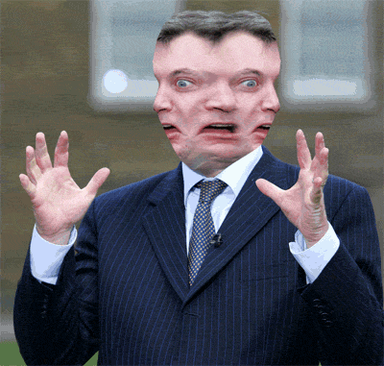
为何了解鬼魔很重要?
他们与你的生命
密切相关。
They are involved with your life
为了更成功地赢
得对它们的战斗。
To fight against them successfully
《圣经》吩咐我们
预备与它们争战。
The Bible commands you to be prepared to fight them
WHY IS IT IMPORTANT TO KNOW ABOUT DEMONS?

Slide 51
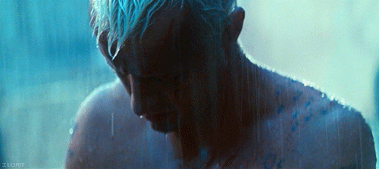
如何才能战胜它们?
下周，我们将回答这个问题。
After a short break, we will answer this question!
HOW CAN I DEFEAT THEM?

