Slide 1
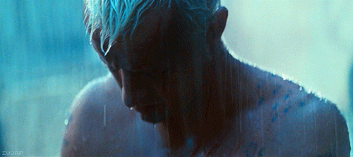
如何才能战胜鬼魔?
HOW CAN I DEFEAT THEM?

Slide 2
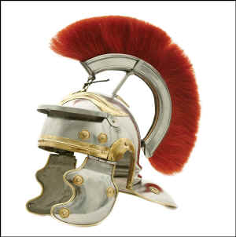
如何才能战胜鬼魔?
先知道三重罪之源
(世界-肉体-魔鬼).
KNOW the 3-FOLD SOURCE of SIN
(The WORLD – The FLESH – The DEVIL)
2. 知道如何披戴属灵盔甲
(弗6:10-18).
KNOW how to put on your SPIRITUAL ARMOR
(Eph. 6:10-18)
HOW CAN I DEFEAT THEM?

Slide 3
1. 知道三重罪之源
世界
(The WORLD)
肉体
(The FLESH)
魔鬼
(The DEVIL)
肉体的情欲
Lust of the Flesh
眼目的情欲
Lust of the Eyes
今生的骄傲
Pride of Life
新的父
New Father
新的意愿
New Desires
新的生活
New Life
超自然属鬼魔行为
SUPERNATURAL DEMONIC ACTIVITY
自然的属鬼魔行为
NATURAL DEMONIC ACTIVITY
1. Know the 3 FOLD SOURCE OF SIN

Slide 4
世界
肉体的情欲 Lust of the Flesh
眼目的情欲
Lust of the Eyes
今生的骄傲Pride of Life
THE WORLD

Slide 5
世界
“不要爱世界和世界上的事. 人若爱世界,爱父的心就不在他里面了. 因为凡世界上的事,就像肉体的情欲,眼目的情欲,并今生的骄傲,都不是从父来的,乃是从世界来的. 这世界和其上的情欲都要过去,惟独遵行神旨意的,是永远常存。”
约一2:15-17
1 John 2:15-17 ”Do not love the world or anything in the world. If anyone loves the world, love for the Father is not in them. For everything in the world—the lust of the flesh, the lust of the eyes, and the pride of life—comes not from the Father but from the world. The world and its desires pass away, but whoever does the will of God lives forever.”
THE WORLD

Slide 6
世界
来自世界的关于金钱， 权利,道德,宗教等的观念。
The world’s views on money, power, moral issues, religion, etc.
罗12:2: “不要效法这个世界,只要心意更新而变化,叫你们察验何为神的善良、纯全、可喜悦的旨意。”
Rom. 12:2 “Do not conform to the pattern of this world, but be transformed by the renewing of your mind. Then you will be able to test and approve what God’s will is—his good, pleasing and perfect will.”
THE WORLD

Slide 7
*肉体的情欲
我们罪恶的欲望;对神的内在抵抗
Our sinful desires; internal resistance to God
加5:16: “我说：你们当顺著圣灵而 行,就不放纵肉体的情欲了.”
Gal. 5:16 “So I say, walk by the Spirit, and you will not gratify the desires of the flesh.”
林前10:13: “你们所遇见的试探，无非是人所能受的。神是信实的，必不叫你们受试探过于所能受的。在受试探的时候，总要给你们开一条出路，叫你们能忍受得住。”
1 Cor. 10:13 “No temptation has overtaken you except what is common to mankind. And God is faithful; He will not let you be tempted beyond what you can bear. But when you are tempted, He will also provide a way out so that you can endure it.”
THE LUST OF THE FLESH

Slide 8
*眼目的情欲
贪欲，贪婪，垂涎 Lust, Greed, Coveting
太5:28 “只是我告诉你们：凡看见妇女就动 淫念的，这人心里已经与她犯奸淫了。 ”
Matt. 5:28 "but I say to you that everyone who looks at a woman with lust for her has already committed adultery with her in his heart."
《十诫》告诫我们不要贪恋他人的东西。
The 10th Commandment tells us not to covet those things belonging to others.
提前6:9-10 “但那些想要发财的人，就陷在迷惑、落在网罗和许多无知有害的私欲里，叫人沉在败坏和灭亡中。 6:10 贪财是万恶之根！有人贪恋钱财，就被引诱离了真道，用许多愁苦把自己刺透了。 ”
1 Tim 6:9-10 “Those who want to get rich fall into temptation and a trap and into many foolish and harmful desires that plunge people into ruin and destruction. For the love of money is a root of all kinds of evil. Some people, eager for money, have wandered from the faith and pierced themselves with many griefs.”
THE LUST OF THE EYES

Slide 9
*今生的骄傲
撒旦起初的罪。
The original sin of Satan
常伪装成“自尊” 。
Often disguised as ‘self esteem’
“骄傲在败坏以先;狂心在跌倒之前。 ”(箴16:18)
"Pride goes before destruction, and an haughty spirit before a fall" (Prov. 16:18)
雅4:6 &箴3:34均说到 “神抵挡骄傲的人,赐福给谦卑的人。”
James 4:6 & Prov. 3:34 both say, “God resists the proud but gives grace to the humble.”
PRIDE OF LIFE

Slide 10
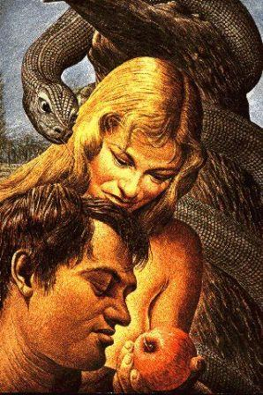
举例：撒旦诱惑夏娃
肉体的情欲
“好作食物”
Lust of the Flesh: “good for food”
眼目的情欲
“悦人眼目”
Lust of the Eyes: “pleasant to the eyes”
今生的骄傲
“吃了能使你像神”
Pride of Life: “It will make you like God”
EXAMPLE: SATAN TEMPTS EVE

Slide 11
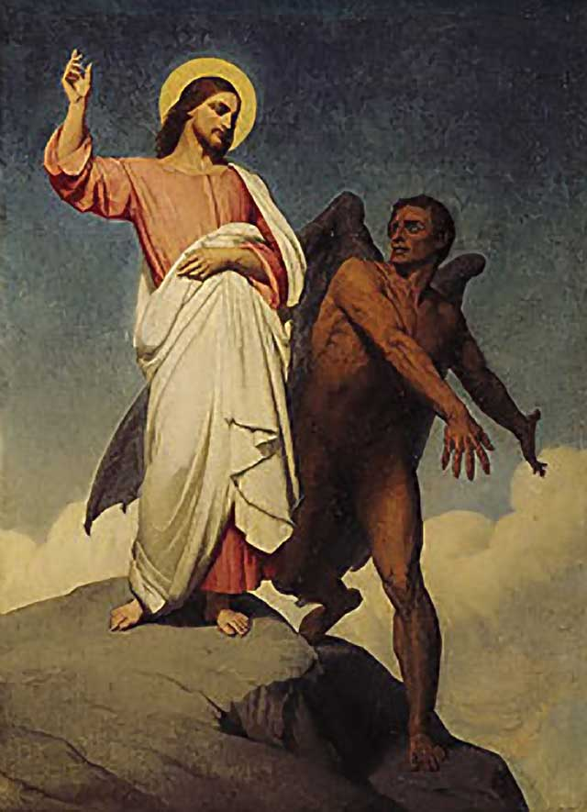
举例：撒旦试探耶稣
肉体的情欲
“将石头变成食物”
Lust of the Flesh: “Turn these stones into bread”
眼目的情欲
“我给你万国和万国的荣华”
Lust of the Eyes: “I will give you all of these kingdoms”
今生的骄傲
“跳下去证明你是神”
Pride of Life: “Cast yourself down and prove who you are”
EXAMPLE: SATAN TEMPTS JESUS

Slide 12
1. 知道三重罪之源
世界
(The WORLD)
肉体
(The FLESH)
魔鬼
(The DEVIL)
肉体的情欲
Lust of the Flesh
眼目的情欲
Lust of the Eyes
今生的骄傲
Pride of Life
新的父？
New Father?
新的意愿？
New Desires?
新的生活？
New Life?
超自然属鬼魔行为
SUPERNATURAL DEMONIC ACTIVITY
自然的属鬼魔行为
NATURAL DEMONIC ACTIVITY
1. Know the 3 FOLD SOURCE OF SIN

Slide 13
肉体
非基督徒 Non-Christian
父: 魔鬼 Father: the Devil
属世界的欲望 Worldly Desires
基督徒 Christian
新的父：神 New Father: GOD
新的欲望 NEW Desires
旧的生命 Old Life
新的生命 NEW LIFE
THE FLESH

Slide 14
肉体:新的父
神了收养你, 撒旦不再是你的父。
God adopts you. Satan is no longer your father.
约一3:10: “从此就显出谁是神的儿女，谁是魔鬼的儿女。凡不行义的就不属神，不爱弟兄的也是如此。”
1 John 3:10 “This is how we know who the children of God are and who the children of the devil are: Anyone who does not do what is right is not God’s child, nor is anyone who does not love their brother and sister. “
THE FLESH: NEW FATHER

Slide 15
肉体：新的意愿
你的肉体渴慕罪, 但你最大的愿望还是想顺服神。
Your flesh will desire sin, but your greatest desire will be to obey God.
罗7:21-25: “我觉得有个律，就是我愿意为善的时候，便有恶与我同在. 因为按著我里面的意思，我是喜欢神的律; 但我觉得肢体中另有个律和我心中的律交战,把我掳去,叫我附从那肢体中犯罪的律. 我真是苦啊！谁能救我脱离这取死的身体呢？ 感谢神！靠著我们的主耶稣基督就能脱离了。这样看来,我以内心顺服神的律，我肉体却顺服罪的律了。”
Rom 7:21-25 “ So I find this law at work: Although I want to do good, evil is right there with me. For in my inner being I delight in God’s law; but I see another law at work in me, waging war against the law of my mind and making me a prisoner of the law of sin at work within me. What a wretched man I am! Who will rescue me from this body that is subject to death? Thanks be to God, who delivers me through Jesus Christ our Lord! So then, I myself in my mind am a slave to God’s law, but in my sinful nature a slave to the law of sin.”
THE FLESH: NEW DESIRES

Slide 16
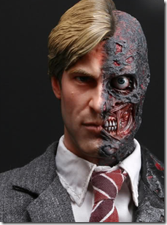
肉体:新的生命
向罪而死 &
向基督而活
Dead to sin & Alive to Christ
林后5:17 “若有人在基督里,他就是新造的人,旧事已过,都变成新的了.”
2 Cor. 5:17 “This means that anyone who belongs to Christ has become a new person. The old life is gone; a new life has begun!
THE FLESH: NEW LIFE

Slide 17
1. 知道三重罪之源
世界
(The WORLD)
肉体
(The FLESH)
魔鬼
(The DEVIL)
肉体的情欲
Lust of the Flesh
眼目的情欲
Lust of the Eyes
今生的骄傲
Pride of Life
新的父？
New Father?
新的意愿？
New Desires?
新的生活？
New Life?
超自然属鬼魔行为
SUPERNATURAL DEMONIC ACTIVITY
自然的属鬼魔行为
NATURAL DEMONIC ACTIVITY
1. Know the 3 FOLD SOURCE OF SIN

Slide 18
魔鬼（鬼魔）
超自然的属鬼魔行为
SUPERNATURAL DEMONIC ACTIVITY
自然的属鬼魔行为
NATURAL DEMONIC ACTIVITY
THE DEVIL (DEMONS)

Slide 19
魔鬼（鬼魔）
超自然的属鬼魔行为
SUPERNATURAL DEMONIC ACTIVITY
自然的属鬼魔行为
NATURAL DEMONIC ACTIVITY
THE DEVIL (DEMONS)

Slide 20
超自然的属鬼魔行为
鬼魔是拥有超自然能力的超自然存在. 它们模仿真正的奇迹, 由此招来很多跟随者. 他们以为找到了耶稣。
Demons are supernatural beings with supernatural abilities to imitate true miracles thereby gathering followers who think they are finding Jesus.
耶稣很清楚地说过将会有很多人称祂为 “主”, 行神迹并奉祂的名赶鬼, 但耶稣对他们说: “我从来就不认识你.” , 然后将他们逐到黑暗中(太7).
Jesus made it clear that there will be those who call Him “LORD” , do miracles and even cast out demons in His Name but He will say to them “I NEVER KNEW YOU” and cast them into outer darkness. (Matt. 7)
SUPERNATURAL DEMONIC ACTIVITY

Slide 21
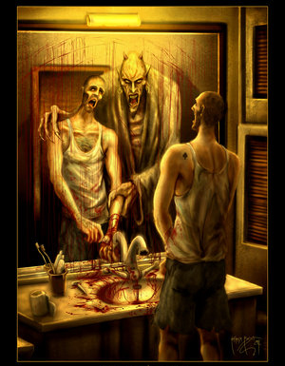
举例
鬼魔能够进入并控制人类.
DEMONS CAN ENTER AND CONTROL HUMAN BEINGS
EXAMPLE

Slide 22
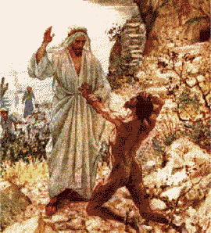
举例
鬼魔可以很强大: 格拉森的那个被鬼附的人能挣脱锁链并且没人能捆绑他. (路8:29)
DEMONS CAN BE STRONG: The demon possessed man at Gadara broke chains and could not be bound (Luke8:29)
EXAMPLE

Slide 23
举例
鬼魔和撒旦可能在肉体上攻击人,使人生病或夺去他们所有的一切. 前提是神为了自己的荣耀允许其发生。
DEMOS and SATAN can physically attack someone, make someone sick or take everything they have ONLY IF GIVEN PERMISSION BY GOD FOR HIS GLORY.
不是所有的疾病都与撒旦有关！ 神选择谁会眼瞎,耳聋, 瘸腿或疾病. 只有神能决定每个人何时离世。
NOT ALL SICKNESS IS SATAN! God chooses who will be blind, deaf, lame or sick. ONLY GOD CAN CHOOSE THE TIME OF A MAN’S DEATH.
EXAMPLE

Slide 24
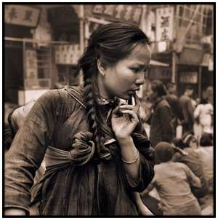
举例
鬼魔知道你的过去和你的祖先。 因为它们过去也在场。
DEMONS HAVE KNOWLEDGE of your past and your ancestors past. They were there.
EXAMPLE

Slide 25
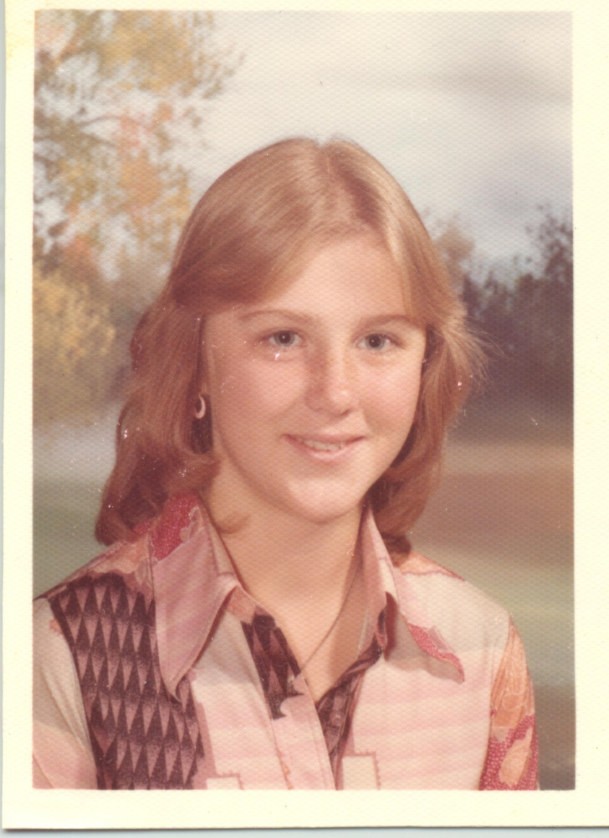
举例:
EXAMPLE: Last youth group

Slide 26
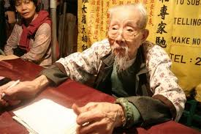
举例
鬼魔能给算命先生该说的话 并传给你，然后特意安排一些环境让你对算命先生深信不疑。
DEMONS CAN give
a fortune teller
words to tell you
and then arrange
Circumstances
make you trust
the fortune teller.
EXAMPLE

Slide 27
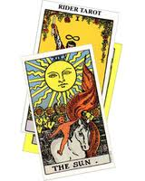
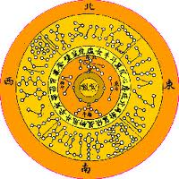
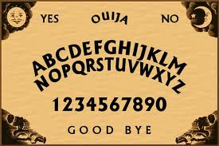
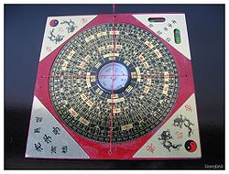
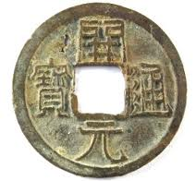
举例
鬼魔使用一些诸如扶乩板 , 塔罗牌, 通灵会, 占星术,算命者, 假先知, 假教师, 邪教, 名流, 偶像, 传统等工具来引人入圈套，让人深信他们拥有能力, 知识和真理。
Demons use tools such as Ouija Boards, Tarot Cards, Séances, Astrology, Fortune Tellers, False Prophets, False Teachers, Cults, Celebrities, Idols, Traditions, etc. to entrap people into believing they have power, knowledge and truth.
EXAMPLE

Slide 28
魔鬼(鬼魔)
自然的属鬼魔行为
NATURAL DEMONIC ACTIVITY
SUPERNATURAL DEMONIC ACTIVITY
超自然的属鬼魔行为
THE DEVIL (DEMONS)

Slide 29
自然的属鬼魔行为
《圣经》说明了鬼魔在诸多方面介入我们的生活，并试图让我们遵从它们而非顺服神。
The Bible explains MANY ways in which demons become involved in our everyday lives trying to get us to obey them rather than God.
NATURAL DEMONIC ACTIVITY

Slide 30
举例: 假教师是属鬼魔的
林后11:13-15a : “那等人是假使徒，行事诡诈，装作基督使徒的模样。 这也不足为怪，因为连撒但也装作光明的天使。所以，他的差役若装作仁义的差役，也不算希奇。他们的结局必然照著他们的行为.”
2 Cor. 11:13-15a “For such people are false apostles, deceitful workers, masquerading as apostles of Christ. And no wonder, for Satan himself masquerades as an angel of light. It is not surprising, then, if his servants also masquerade as servants of righteousness.”
EXAMPLE: FALSE TEACHERS ARE DEMONIC

Slide 31
与非基督徒约会是属鬼魔的
林后6:14-16a : “你们和不信的原不相配，不要同负一轭. 义和不义有甚么相交呢？光明和黑暗有甚么相通呢？基督和彼列（注：“彼列”就是撒但的别名）有甚么相和呢？信主的和不信主的有甚么相干呢？ 神的殿和偶像有甚么相同呢？”
2 Cor. 6:14-16a ”Do not be yoked together with unbelievers. For what do righteousness and wickedness have in common? Or what fellowship can light have with darkness? What harmony is there between Christ and the devil? Or what does a believer have in common with an unbeliever? What agreement is there between the temple of God and idols?
DATING NON-CHRISTIANS IS DEMONIC

Slide 32
举例: 以己愿行神的旨意=骄傲
撒上15:23 : “悖逆的罪与行邪术的罪相等；顽梗的罪与拜虚神和偶像的罪相同。你既厌弃耶和华的命令，耶和华也厌弃你作王。 ” 1 Sam. 15:23 “For rebellion is like the sin of witchcraft, and arrogance like the evil of idolatry. Because you have rejected the word of the LORD, he has rejected you as king.”
EXAMPLE: DOING GOD’S WILL YOUR OWN WAY = PRIDE

Slide 33
不正确表达愤怒是属鬼魔的
弗4:26-27: “生气却不要犯罪，不可含怒到日落; 也不可给魔鬼留地步。”
Eph 4:25 “In your anger do not sin”. Do not let the sun go down while you are still angry, and do not give the devil a foothold.”
WRONG EXPRESSION OF ANGER IS DEMONIC

Slide 34
好管闲事的女人是属鬼魔的
提前5:11-15: “至于年轻的寡妇,就可以辞她,因为她们的情欲发动,违背基督的时候,就想要嫁人. 她们被定罪,是因废弃了当初所许的愿,并且她们又习惯懒惰,挨家闲游:不但是懒惰,又说长道短，好管闲事,说些不当说的话。所以我愿意年轻的寡妇嫁人,生养儿女,治理家务,不给敌人辱骂的把柄,因为已经有转去随从撒但的。”
1 Tim 5:11-15 “ Besides, they get into the habit of being idle and going about from house to house. And not only do they become idlers, but also busybodies who talk nonsense, saying things they ought not to. So I counsel younger widows to marry, to have children, to manage their homes and to give the enemy no opportunity for slander. Some have in fact already turned away to follow Satan.”
WOMEN BUSYBODIES ARE DEMONIC

Slide 35
撒谎是属鬼魔的
约8:44: “你们是出于你们的父魔鬼，你们父的私欲，你们偏要行。他从起初是杀人的，不守真理，因他心里没有真理；他说谎是出于自己，因他本来是说谎的，
也是说谎之人的父。”
John 8:44 “You belong to your father, the devil, and you want to carry out your father’s desires. He was a murderer from the beginning, not holding to the truth, for there is no truth in him. When he lies, he speaks his native language, for he is a liar and the father of lies.”
LYING IS DEMONIC

Slide 36
弃绝福音是属鬼魔的
可4:15 : “那撒在路旁的，就是人听了道，撒但立刻来，把撒在他心里的道夺了去；”
Mark 4:15 “Some people are like seed along the path, where the word is sown. As soon as they hear it, Satan comes and takes away the word that was sown in them.”
REJECTING THE GOSPEL IS DEMONIC

Slide 37
宗教式的自高自大是属鬼魔的
提前3:6: “初入教的不可作监督，恐怕他自高自大，就落在魔鬼所受的刑罚里。”
1 Timothy 3:6 “An elder must not be a recent convert, or he may become conceited and fall under the same judgment as the devil.”
RELIGIOUS CONCEIT IS DEMONIC

Slide 38
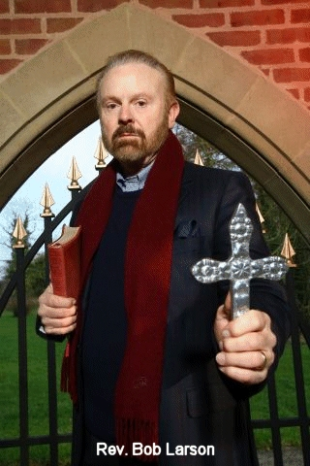
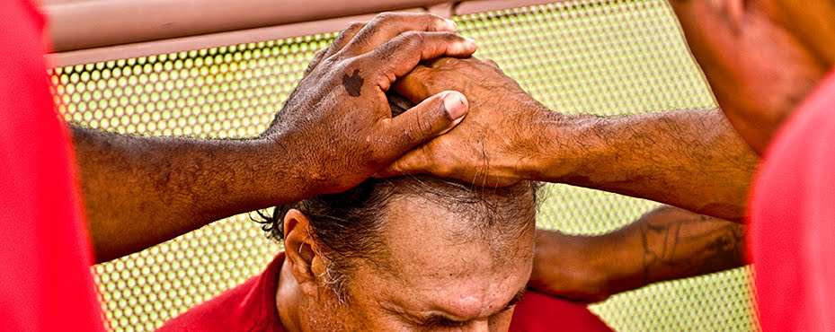
有些声称能驱魔的传道人非常骄傲。
这是属鬼魔的。
Some preachers who claim to cast out demons are very proud. This is DEMONIC.

Slide 39
制造假信者是属鬼魔的
太13: 他回答说:“那撒好种的就是人子,田地就是世界，好种就是天国之子;稗子就是那恶者之子,撒稗子的仇敌就是魔鬼” (37-38）
Matt. 13:all ”He answered, “The one who sowed the good seed is the Son of Man. The field is the world, and the good seed stands for the people of the kingdom. The weeds are the people of the evil one, and the enemy who sows them is the devil.: (v.37-38)
CREATING FALSE CONVERTS IS DEMONIC

Slide 40
罗马书1: 这些也是属鬼魔的…
苦毒
BITTERNESS
婚前性行为
PREMARITAL SEX
传闲话
GOSSIP
仇恨
HATRED
复仇
VENGEANCE
毁谤
SLANDER
拜偶像
IDOLATRY
骄傲
PRIDE
情欲
LUST
同性恋
HOMOSEXUALITRY
奸淫
ADULTRY
嫉妒
ENVY
自夸
BRAGGING
无怜悯
WITHOUT MERCY
孩子悖逆父母
KIDS DISOBEY PARENTS
将父母至于配偶之上
PARENTS ABOVE SPOUCE
贪婪& 垂涎
GREED & COVETING
等等
Etc.
ROMANS 1: ALSO DEMONIC…

Slide 41
所有的罪均属鬼魔
约一3:8 “犯罪的是属魔鬼,因为魔鬼从起初就犯罪. 神的儿子显现出来,为要除灭魔鬼的作为. ”
1 John 3:8 “The one who does what is sinful is of the devil, because the devil has been sinning from the beginning. The reason the Son of God appeared was to destroy the devil’s work.”
ALL SIN IS DEMONIC

Slide 42
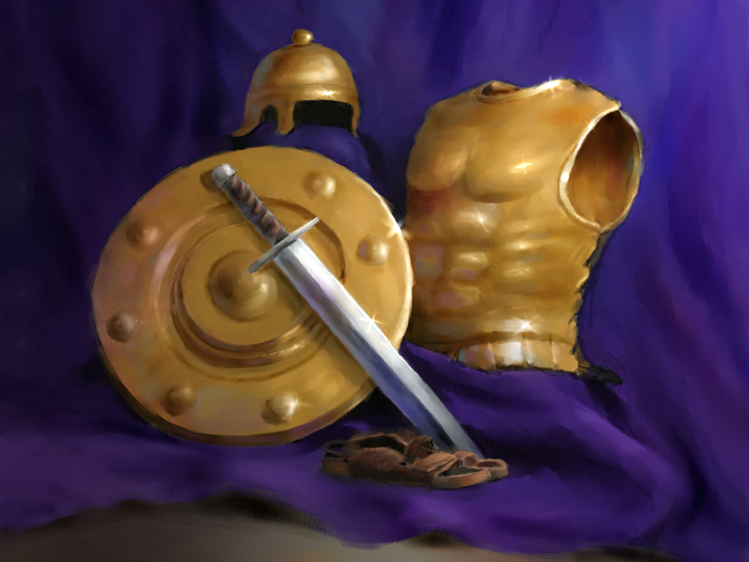
2. 神的盔甲
2. The Armor of God

Slide 43
“我还有末了的话：你们要靠著主，倚赖他的大能大力，作刚强的人。 要穿戴 神所赐的全副军装，就能抵挡魔鬼的诡计。 因我们并不是与属血气的争战，乃是与那些执政的、掌权的、管辖这幽暗世界的，以及天空属灵气的恶魔争战。
”Finally, be strong in the Lord and in his mighty power. Put on the full armor of God, so that you can take your stand against the devil’s schemes. For our struggle is not against flesh and blood, but against the rulers, against the authorities, against the powers of this dark world and against the spiritual forces of evil in the heavenly realms.

Slide 44
所以，要拿起 神所赐的全副军装，好在磨难的日子抵挡仇敌，并且成就了一切，还能站立得住。所以要站稳了，用真理当作带子束腰，用公义当作护心镜遮胸，又用平安的福音当作预备走路的鞋穿在脚上。 此外，又拿著信德当作藤牌，可以灭尽那恶者一切的火箭。 并戴上救恩的头盔，拿著圣灵的宝剑，就是 神的道。 靠著圣灵，随时多方祷告祈求，并要在此警醒不倦，为众圣徒祈求，”（弗6:10-18）
Therefore put on the full armor of God, so that when the day of evil comes, you may be able to stand your ground, and after you have done everything, to stand. Stand firm then, with the belt of truth buckled around your waist, with the breastplate of righteousness in place, and with your feet fitted with the readiness that comes from the gospel of peace. In addition to all this, take up the shield of faith, with which you can extinguish all the flaming arrows of the evil one. Take the helmet of salvation and the sword of the Spirit, which is the word of God. And pray in the Spirit on all occasions with all kinds of prayers and requests. With this in mind, be alert and always keep on praying for all the Lord’s people.” (EPH. 6:10-18)

Slide 45
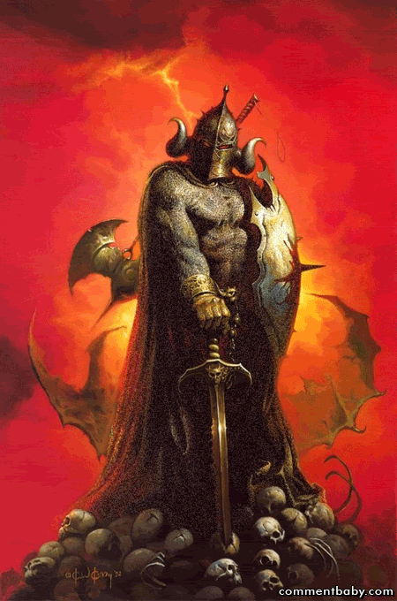
要知道你在与谁争战
“我还有末了的话：你们要靠著主,倚赖他的大能大力,作刚强的人. 要穿戴,神所赐的全副军装,就能抵挡魔鬼的诡计.因我们并不是与属血气的争战,乃是与那些执政的,掌权的,管辖这幽暗世界的,以及天空属灵气的恶魔争战.”
”Finally, be strong in the Lord and in his mighty power. Put on the full armor of God, so that you can take your stand against the devil’s schemes. For our struggle is not against flesh and blood, but against the rulers, against the authorities, against the powers of this dark world and against the spiritual forces of evil in the heavenly realms.”
KNOW WHO YOU ARE FIGHTING

Slide 46
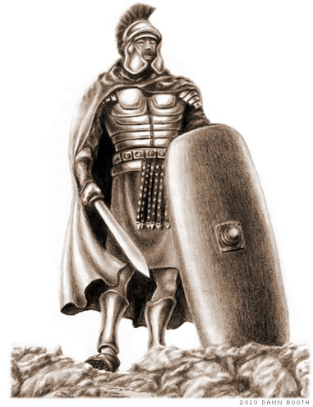
你必须穿戴齐全盔甲
“所以,要拿起神所赐的全副军装,好在磨难的日子抵挡仇敌,并且成就了一切,还能站立得住.”
“Therefore put on the full armor of God, so that when
the day of evil comes, you may be able to stand your
ground, and after you have done everything, to stand.
Stand firm then…”
YOU MUST PUT ON ALL THE ARMOR

Slide 47
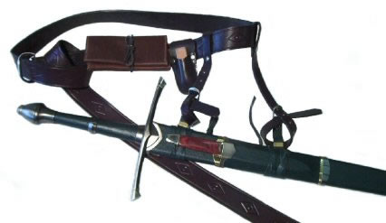
明白并相信真理
“所以要站稳了,用真理当作带子束腰.”
“with the belt of truth buckled around your waist”
KNOW AND BELIEVE THE TRUTH

Slide 48
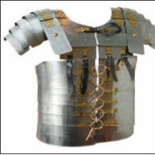
行你知道是正确的事
“用公义当作护心镜遮胸.”
“with the breastplate of righteousness in place”
DO WHAT YOU KNOW IS RIGHT

Slide 49
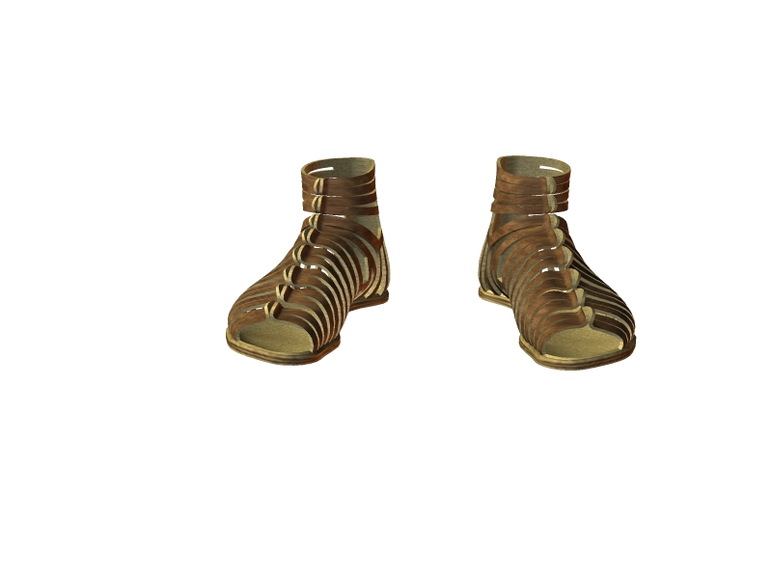
预备好传福音
“又用平安的福音当作预备走路的鞋穿在脚上.”
“and with your feet fitted with the readiness that comes from the gospel of peace.”
READY TO SHARE THE GOSPEL

Slide 50
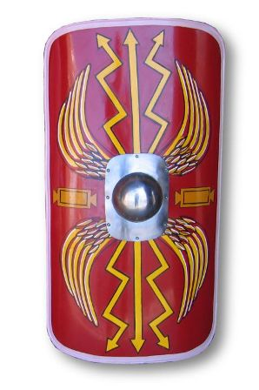
信靠神
“此外,又拿著信德当作藤牌,可以灭尽那恶者一切的火箭。”
“In addition to all this, take up the shield of faith, with which you can extinguish all the flaming arrows of the evil one.”
TRUST GOD

Slide 51
你得救了吗？
带上救恩的头盔
Take the helmet of salvation
ARE YOU SAVED?

Slide 52
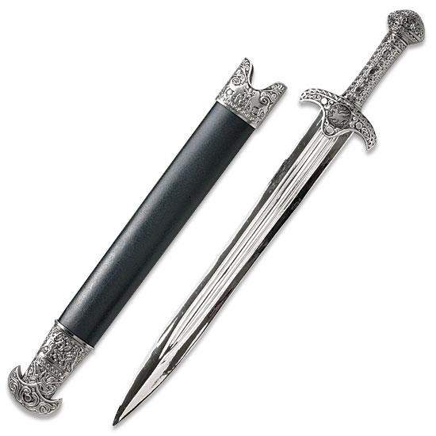
熟悉神的宝剑
“拿著圣灵的宝剑,就是神的道.”
“and the sword of the Spirit, which is the word of God.”
撒旦知道经文但扭曲，滥用或错误引用。
Satan knows Scriptures but he twists, abuses and misquotes them
耶稣每次受试探都引用圣经经文。
Each time Jesus was tempted, He quoted the Scriptures.
假教师最擅长对经文进行断章取义。
False teachers are masters of taking Scriptures out of their context.
熟悉圣经却不遵从，毫无意义。
Knowing the Scriptures means nothing if you don’t obey them.
KNOW GOD’S WORDS

Slide 53
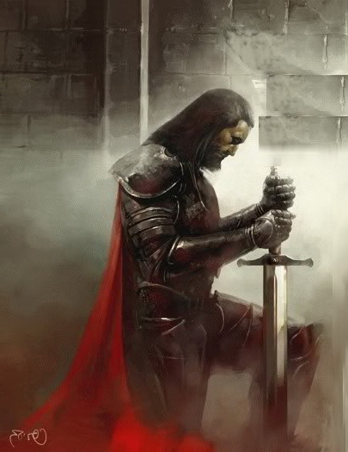
持续不断的祷告
“靠著圣灵，随时多方祷告祈求.”
“And pray in the Spirit on all occasions with all kinds of prayers and requests”
CONSTANT PRAYER

Slide 54
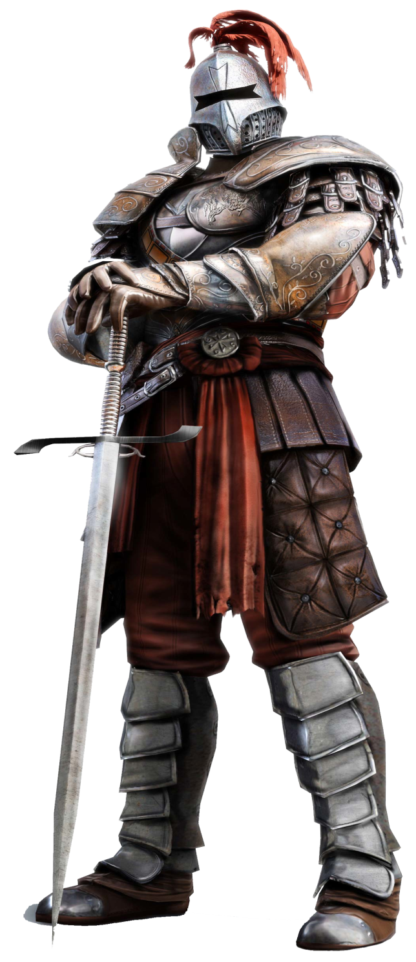
保持警醒
“并要在此警醒不倦，为众圣徒祈求。”
“With this in mind, be alert and always keep on praying for all the Lord’s people.”
STAY ALERT

