Slide 1
Adopting a Lean Culture
Lean Solutions
wwww.leansolutions.us
Bob Francis

Slide 2
Adopting a Lean culture
90% of all Lean Programs Fail!
Notes:
What % of Lean Implementations fail? 90%
By fail I mean don’t become part of the culture. Culture change is tough.

Slide 3
Adopting a Lean culture
“If it wasn’t for the people …………Kaizen would be easy!” Not So Famous Lean Sensei
“It’s ALL about the people!”
Clue Salesman
Notes:
Many years ago my Japanese sensei, told me….. “If it wasn’t for the people… Kaizen would be easy.
The people are the Culture.

Slide 4
5 Keys to success
WASTE
L
E
A
D
S
Notes:
Focus on Leading by example, Eliminating waste, Adding value, Developing people and Solving problems.
“The goal is not to implement “Lean”, but to make Lean part of our culture”.
If you’re doing these things hour by hour, week by week and month by month…..you’ve successfully adopted Lean as part of your culture. You’re one of the 10%!

Slide 5
Leading by Example
President
Board of
Directors
VP’s
GM’s
Managers
L
E
A
D
S
Notes:
You need Lean experience on your Board, you need an advocate. Your CEO, President, VP of Operations and Plant Manager should have experience implementing Lean or be open to change. They have to be willing to ”Take a leap of faith.”

Slide 6
Leadership’s Role
Executives
Managers
Site Leads
Cell Leads
Leads
Strategic Planning
Continuous Improvement
Daily Management
L
E
A
D
S
Notes:
Managers run the business with existing processes and systems, Leaders improve the business.
This is how they need to use their time.

Slide 7
Eliminate Waste & Add Value
Customer
Value Added
Direct Labor
Technical Support
Supervisors
Non Value Added
Managers
Vice Presidents
CEO/President
L
E
A
D
S
Notes:
We need to support the people adding Value. Servant Leadership is a critical part of Lean. Nothing changes until Leader behavior changes.

Slide 8
Add Value
Customers
Quality
Delivery
Price
Product performance
Product Support
Relationship
New Products
Shareholders
Revenue
Earnings Per Share
Gross Margin
Operating Expense
Return on Assets
Market Share
L
E
A
D
S
Notes:
What is Value and Who defines it? Customers are our primary focus, but we also have any obligation to Shareholders.

Slide 9
Develop People / Solve Problems
Processes
People
Vision/Mission
Strategy
Policy Deployment
Standard Work
Operational Excellence
Lead by Example
Eliminate Waste
Add Value
Develop People
Solve Problems
6S – TPM – Daily Management
L
E
A
D
S
Notes:
To Develop People and Solve Problems, we need a strong foundation of 5S-TPM-Standard Work in place.
First we need our Vison, Mission and Strategy defined. Next we must have Strategy Deployment, Daily Management and Operational Excellence processes in place.
No layoff policy as the result of Kaizen activity.

Slide 10
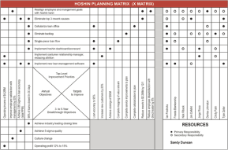
Policy Deployment
X-Matrix
Bowling Chart
A3
Notes:
Most companies have a Vision, Mission and Strategy defined. The next step is how do we execute that strategy.
Strategy Deployment is a tool to execute your strategy. It defines what we focus on and holds us accountable.
It ensures everyone in the company is aligned with our objectives from top to bottom.

Slide 11
Lean Daily Management
Visual Controls
Leader Standard Work
Daily Accountability
Notes:
Daily Management is made up of three components, Visual Controls, Leader Standard Work and Daily Accountability.

Slide 12
Visual Controls
Identify Performance Gaps
Solve
Problems
Prioritize Reasons
Notes:
Key Performance Indicators for Safety, Quality, Delivery and Costs, that support our strategy, are tracked.
We identify Gaps, Prioritize Reasons and Solve Problems. If we achieve our targets, we achieve or Strategy.

Slide 13
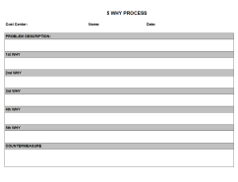
Problem Solving
5 Whys A3 8D
Notes:
Solving problems is made easy with standardized forms like 5 Whys, A3 and 8D.
These forms are really a tools for teaching people how to solve problems.

Slide 14
Leader Standard Work
Team Lead | Cell Lead | Plant Lead
Lead Shift Start Up meeting | Lead Team Lead meeting | Lead Cell Lead meeting
Confirm workers are following their Standard Work | Confirm Team Leads are following their Standard Work | Confirm Cell Leads are following Standard Work
Start and end shift tasks | Shift start and staffing | Weekly Gemba Walk with each Cell Lead
Review yesterday’s performance | Review yesterday’s performance | Review yesterday’s performance
Review/Assign improvement tasks | Review/Assign improvement tasks | Review/Assign improvement tasks
Document root cause and countermeasure input for misses
Document Cell performance
Notes:
Leaders follow a layered audit process holding everyone accountable.

Slide 15
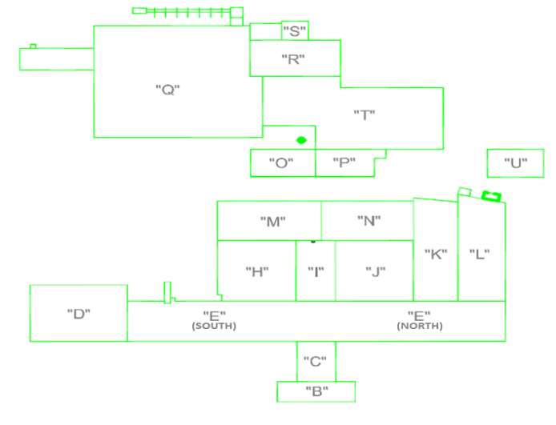
Daily Accountability
2
3
4
Process Line Mgr. 3
Schedule
1. 410 Assy 3:00
2. 420 Assy 3:15
3. 430 Assy 3:30
4. 440 Assy 3:45
1
4
2
1
3
Process Line Mgr. 1
Schedule
1. 101 1:00
2. 102 1:10
3. 103 1:30
4. 104 1:45
5. 105 1:55
6. 106 2:05
7. 107 2:10
8. 108 2:20
9. 109 2:25
Process Line Mgr. 2
Schedule
310 8:15
320 8:25
3. 330 8:35
4. 340 8:45
2
3
.
9
1
4
5
6
7
8
Front Offices
Executives
Conf. Rooms
Notes:
Each Manager does a Daily Gemba Walk to review the Management Boards with the teams.
The team consists of the CC, TL, Mfg. Eng., Quality and Purchasing

Slide 16
Organizational Structure
Value Stream A
Purchasing
Machining
Mfg. Eng.
Quality
Assy
IT
Finance
HR
Sales Marketing
OpEx
Notes:
Organizing around Product Value Streams will provide the structure and dedicated resources to focus on the customer.
Value Stream Managers will manage the whole Value Stream.

Slide 17
Lean Expertise
Kaizen Promotion Office (KPO)
Leader (Experienced, High Level, TPS trained)
Staffing (External experts and internal change agents)
High Potentials rotate through
Lean Consultant
TPS trained, hands on, holds CEO accountable
Participation on Kaizen Teams
Everyone from CEO to front line workers
L
E
A
D
S
Notes:
You’ll need to create a KPO and partner with a Lean Consultant. The CEO should do the initial Lean training with assistance, then the KPO and Consultants.

Slide 18
Cost Accounting
Standard Cost Accounting
Required by GAAP (External reporting)
Drives wrong “Lean” decisions
Throughput Accounting (Lean Accounting)
Used for Internal Reporting
Drives right “Lean” decisions
No allocation of overheads
Notes:
The biggest roadblock is the allocation of overhead or “Absorption”. Both can be used simultaneously

Slide 19
Incentives
Profit Sharing
Quarterly
Earnings
% Salary or Base Wages
Bonus Plan
Working Capital Turns
Earnings
Strategic Objectives
Notes:
Everyone needs to share in the benefits. Annual profit sharing is too long for making course corrections.
Turns is the best Lean metric to drive the right behavior and is a key to high earnings.

Slide 20
Increasing your chance of success
Daily Mgt
Policy Deployment
Lean Leadership
CEO/President/Board/VP’s
Accountability
$
100%
90%
80%
70%
50%
Notes:
In summary….to increase your chance of success you need to have Lean Leadership, Strategy Deployment, Daily Management, Accountability and Incentives.

Slide 21
What can your culture absorb?
3P, VSM, Problem Solving
Policy Deployment, Std Work
6S , TPM, Daily Management
Set Up Reduction
6
Sigma
Pull Systems
Notes:
What can your culture absorb. Start from where you are and put some of these concepts in place.

Slide 22
Take action!
What does a person in a Lean Culture do every day? He or She….. Leads by example Eliminates Waste Adds Value Develops People Solves Problems
Notes:
What do you do when no one is looking?
Do you Lead by Example, Eliminate Waste, Add Value, Develop People and Solve Problems. Then you’re one of the 10%!
It’s all about transforming people.

Slide 23
Required Reading
Notes:
If you’re serious about adopting Lean…you need to read these books.

Slide 24
Questions

