Slide 1
We will begin the PBN Webinar shortly.
Please mute your mic and type your full name in the chat box for roll call.

Slide 2
Utah State Instructional Materials Access Center U.S.I.M.A.C 2019 Preferred Braille Network Webinar (P.B.N.)
Armando Venegas, USIMAC Director

Slide 3
USIMAC - Overview
NIMAS…NIMAC…USIMAC
Founded January 2009
Our Vision: To provide accessible educational materials to ALL print disabled students within a timely manner.
Timely Manner = The same time as non-print disabled peers

Slide 4
USIMAC – Production Team
Current Staff:
Director
Executive Assistant
2 Customer Service Reps
6 Braille Transcriber/Editors
4 Proofreaders
5 Proofreader Aides
4 Alternate Format Techs
3 Tactile Graphics Specialist
1 Distribution/ Inventory Specialist

Slide 5
USIMAC – How to become a PBN
Email your Statement of Qualification (letter of interest) and a copy of your certificate to pbn@usdb.org.
Complete the USIMAC PBN test and return to pbn@usdb.org
You must receive a score of 90% or higher.

Slide 6
USIMAC – How to become a PBN
DO NOT SEND DOCUMENTS UNTIL WE REQUEST THEM
Current Resume
Signed PBN Price List Form
Tax ID or SS#:
Copy of your Driver’s License front & back
Copy of your SS Card front & back
EFT form/Direct Deposit & Canceled Check or Bank Statement
A State of Utah vendor ID will be issued upon completion of the above steps.

Slide 7
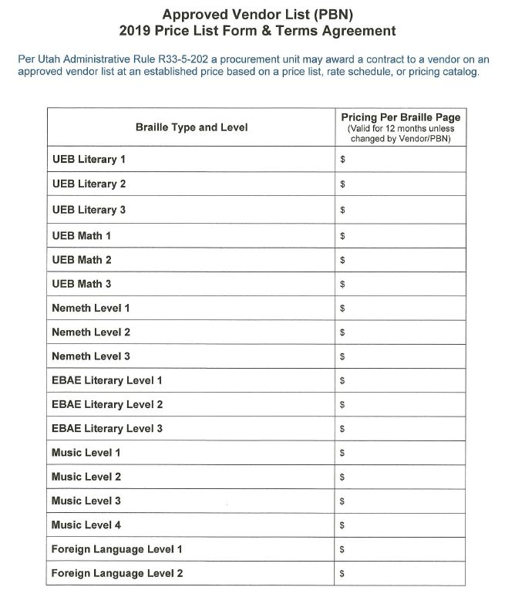
Pricelist Form

Slide 8
USIMAC – Awarding/Accepting Work
Example email:
The following project is available for transcription from USIMAC. Please accept or decline this offer within 24 hours to pbn@usdb.org. The deadline for this project is Partial every 14 days with the entire project completed within 126 days after receipt of GAE/purchase order. (**Please note you can submit an invoice every 2 weeks that will be processed for payment) Per agency guidelines (updated 1/31/19 and attached), this project must be sent to us as a .b2k, .abt (NEM & EBAE formats only), .dxb or .brf files. or as requested by the editor and always cc your editor and pbn@usdb.org
**Please note: during the bidding process, you may suggest an alternate deadline (within reason) if you feel that our deadline is an unreasonable timeline for this project. However, once an offer is accepted & approved the deadline cannot be adjusted.**
As a reminder, all projects must be submitted with no more than 45 errors per Braille volume. If our proofreaders reach 46 errors in one volume they will stop proofreading and return the volume to you for review.
Once you receive correction notes from the editor, you have 5 business days to fix any errors and resubmit the volume. Please make sure you are consistently returning your first submission and corrections on time to avoid delays with receiving additional projects or being placed on probation.
Project Details:
**SPECIAL REQUIREMENT: Submittal of Complete Volumes, partial pages, chapters, units, or sections, (Follow the order of text starting with chapter 8 going forward.) every 14 days after receipt of GAE/purchase order, with the entire project completed within 126 days after receipt of GAE/purchase order. (Front Matter, End Matter, and Ch. 8-24 ONLY)
UEB Literary Level 3
871 Estimated Print Pages, 3,920 Estimated Braille Pages (High Estimate)
SO 11508, ISBN: 9780030994562, American anthem, Modern American history (Grade 9-12)
(Front Matter, End Matter, and Ch. 8-24 ONLY)

Slide 9
USIMAC – Awarding/Accepting Work
Example email:
“State Purchasing has been notified of your acceptance of the project below. The next step in our process would be an e-mail notification from us which typically happens 5-7 business days from the date you accept (During the Holidays in Nov. Dec. & Jan. this date is extended to 7-10 business days). Any work completed prior to receiving the APPROVED purchase order will not be compensated for in the event that the project is canceled, or not approved. If you don't receive an e-mail within the time frame noted above, your welcome to e-mail us to follow up.

Slide 10
USIMAC – Approved GAE/ PO Email
Example email:
The State of Utah has approved your bid for:
SO 10542, ISBN: 9780133338720, My Perspectives English Language Arts, c2017 (Unit 3-5 & Back Matter ONLY)
Purchase Order GAE 068 (attached)
Date Approved: December 26, 2018
The project is DUE on or before Wednesday, March 7, 2019. Partial every 14 days
You have been assigned to work with Laurie MacKenzie lauriem@usdb.org as your editor. For all questions or communication with your editor, please email pbn@usdb.org and CC the editor.
Please reply to this email and CC your editor within 24 business hours to confirm receipt of your PO/GAE and acknowledgment of your deadline.
**ALL COMMUNICATION MUST BE SENT VIA EMAIL TO PBN@USDB.ORG AND CC THE EDITOR ASSIGNED TO THIS PROJECT.
Also attached are the Agency Guidelines for USIMAC Braille Projects, State of Utah Terms and Conditions, Approved GAE/PO

Slide 11
USIMAC – Project Process
All correspondence with your Editor must be via email to pbn@usdb.org and cc’d to your Editor.
Upon receipt of your GAE/ purchase order, confirm with your Editor and pbn@usdb.org within 24 hours (this is a requirement)
Your Editor can answer questions regarding the transcription part of the project.
Any payment or contract questions including deadlines, please email pbn@usdb.org

Slide 12
Project refusal
If you refuse a project, or fail to respond to a project request for two projects in a row, you will be skipped on the next project. If you refuse three consecutive projects, you will be put on probation for 3 months.
Note: If you refuse two projects and then accept the next, the violation will be reset.
If you are put on probation twice within a calendar year, USIMAC will remove you from our PBN Approved Vendor list permanently.
Penalties will be assessed on a case-by-case review basis in accordance with this document and with the State of Utah Purchase Order Terms and Conditions for Services pursuant to this purchase order.

Slide 13
USIMAC – Agency Guidelines
Please read through the agency guidelines carefully! As we have updated about 40% of the Language and or requirements
Do not leave extra space, dead space, or unnecessary blank spaces for the graphics.
Use USIMAC formatted Title page
A copy will be placed on the website under the “Preferred Braille Network” tab

Slide 14
USIMAC – Title Page/Proofreading
Please include a completed title page with each volume. (see agency guidelines number 11 a-d)
Proofreader’s name must be included on the title page.
Please transcribe the printing history information on the versa page.

Slide 15
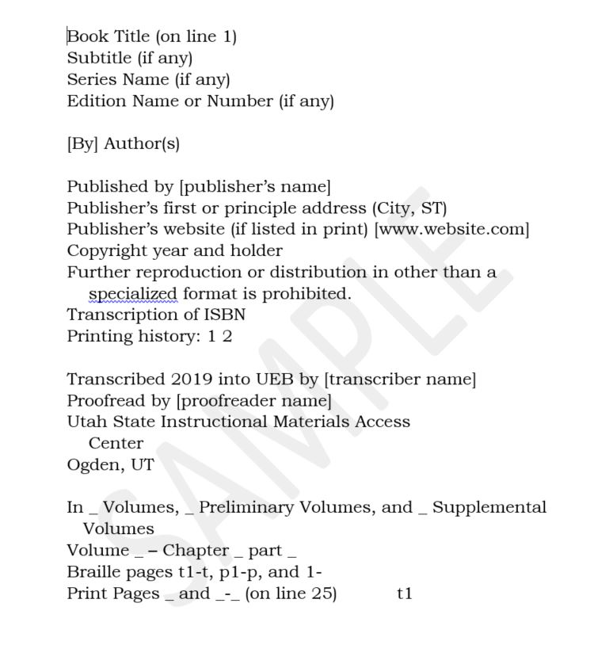

Slide 16
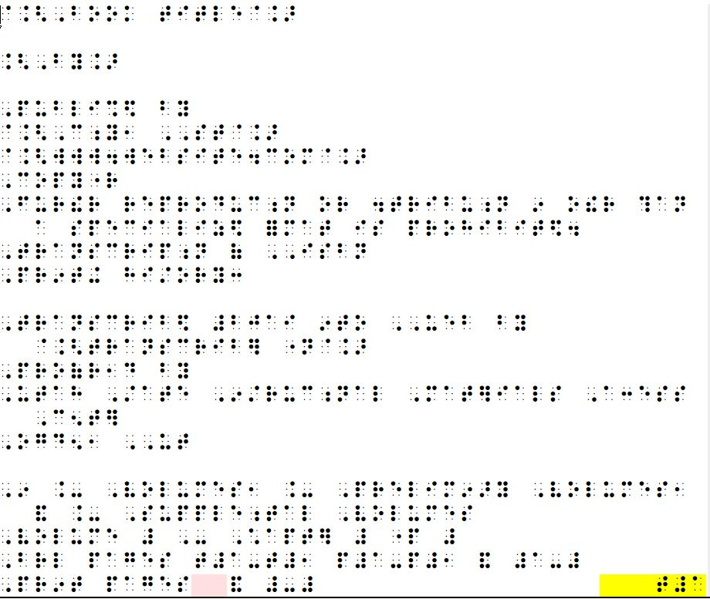

Slide 17
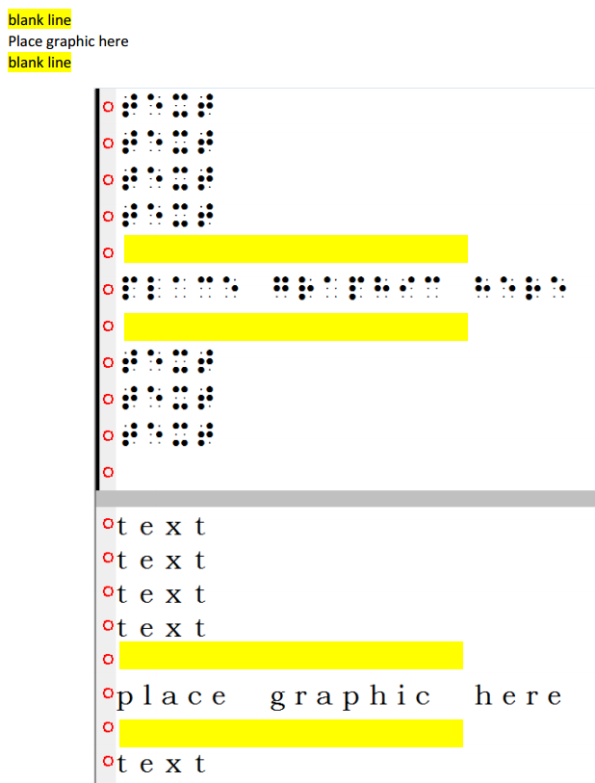
See Graphic _ on TG print page _
Previously Read Place Graphic Here
See Graphic _ on TG print page _
Transcribe ALL text including text around and inside of graphics.

Slide 18
Laurie MacKenzie

Slide 19
USIMAC – Invoicing/ Receiving Payment
Email all completed information to pbn@usdb.org
You have the option to submit an invoice for completed braille pages every 2 weeks or at the end of the project.
Include the following on your invoice:
Number of volumes
Page count per volume
GAE/PO #
SO #
You will receive a confirmation email similar to this example:
You are authorized for payment of 312 braille pages for a total of $374.40
Volume 1 96 Braille Pages $115.20
Volume 2 87 Braille Pages $104.40
Volume 3 129 Braille Pages $154.80

Slide 20
Contract Violation
What is considered a violation?
Missing a submission deadline by 24 hours
Not responding within 24 hours of receipt of GAE/PO
Submitting the wrong format, not adhering to Agency Guidelines and/or Contract Requirements
Not following through with corrections within five business days after proofreading notes are received
Submitting a volume with more than 45 errors for levels 1 and 2, and 75 errors for level 3 and above including Foreign Language level 2

Slide 21
Penalties for Violations
1st Violation: Warning
2nd Violation will result in a 10% deduction in final payment
3rd Violation will result in a contract cancellation for any current projects and subsequent probation period of three months. You will have twenty-four hours to submit the work you have completed. You will be paid for that piece only, (minus the 10% deduction from your second violation) and you will begin your probation period.
If you are put on probation twice within a calendar year, we will remove you from our PBN list permanently.

Slide 22
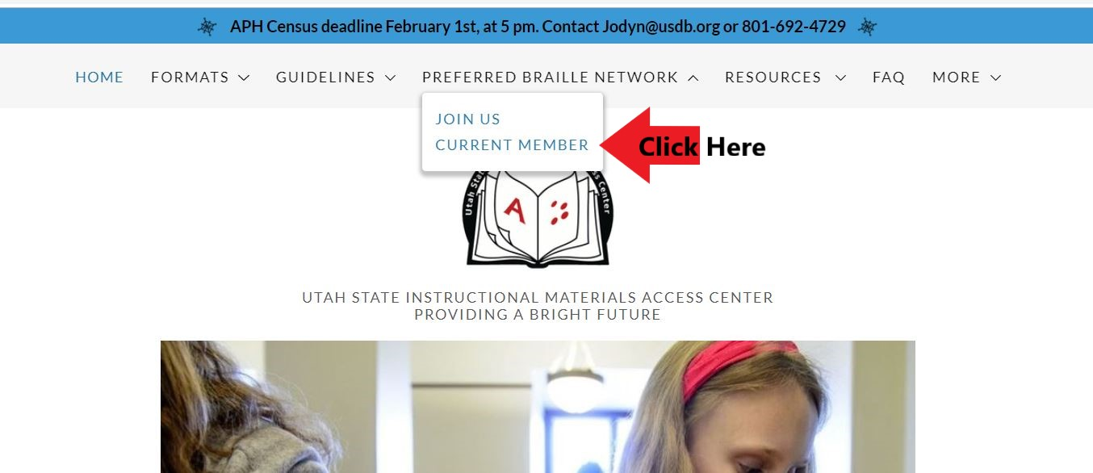
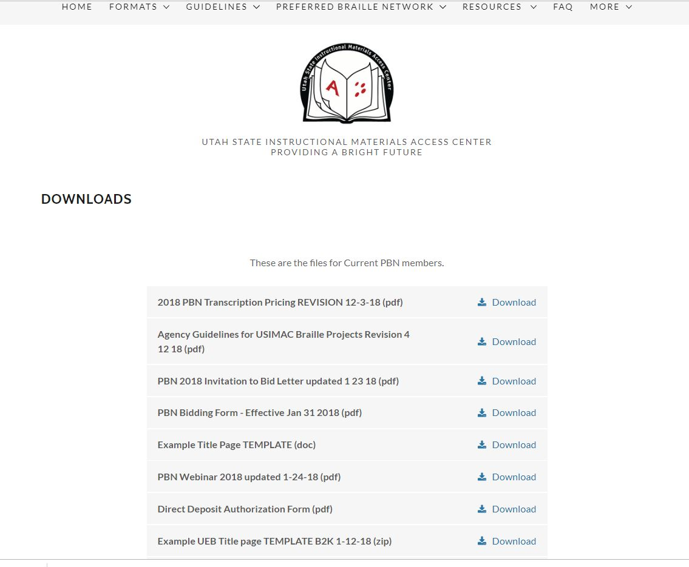
New Website

Slide 23
Contacts / Questions
Contacts
New & Existing Contracts / Vendors
Mandy Kay: pbn@usdb.org
Invoices
Cassidy McFarland: pbn@usdb.org
Website
www.usimac.org

