Slide 1
WGI WorlD Championships
Hernando Indoor Percussion
Dayton, OH – April 9-12, 2025

Slide 2
Travel info
Bus and Luggage
We are taking a school bus like last year. Space is extremely limited
We will have a luggage van
1 suitcase per person. Carry-on bags should be small
Hotel: Hampton Inn & Suites Springboro/Dayton South
25 Greenwood Ln, Springboro, OH 45066
Located a little closer to Dayton
Surrounded by restaurants (Chipotle, Waffle House, fast food, Etc.)
Plenty of hotels nearby to stay close to the students
Map

Slide 3
Overview map of Dayton and cincinnati
View Here

Slide 4
Performance Venues

Slide 5
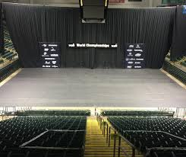
Wright State University Nutter Center
PSO Prelims Performance Venue
3640 Colonel Glenn Hwy, Dayton, OH 45324
Video Walk-Through
Thursday, April 10, 2025
Morning/Afternoon
Break
Afternoon/Evening
Map

Slide 6
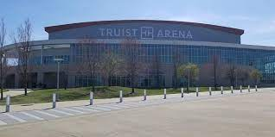
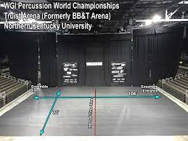
Truist Arena At Northern Kentucky University
PSO Semi-Finals Performance Venue
500 Louie B. Nunn Dr, Highland Heights, KY 41099
Video Walk-Through
Friday, April 11, 2025
Morning
Break
Afternoon/Evening
Map

Slide 7
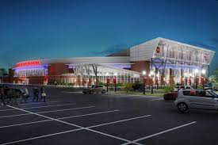
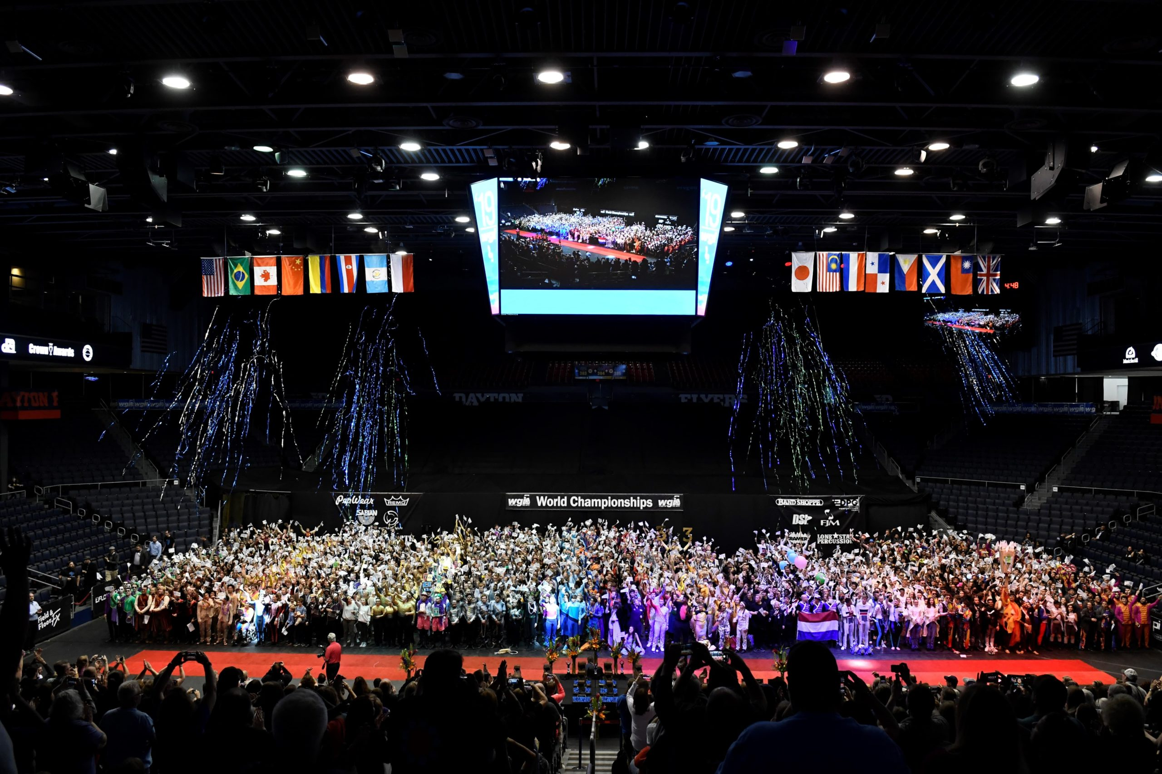
University of Dayton Arena
PSO Finals Performance Venue
1801 S. Edwin C. Moses Blvd, Dayton, OH 45417
Video Fly-Over
FACING THE BEAST
Saturday, April 12, 2025
Morning
Map

Slide 8
Schedules and Itinerary

Slide 9
Performance Schedules
Prelims performance times are randomly assigned
Groups are placed into several rounds (10-12 groups each)
57 groups as of now
Morning-Afternoon / Break for Concert Class / Afternoon-Evening
Semis performance times are based on Prelims
Groups perform in 2 rounds
24 groups advance to Semis
Morning-Afternoon
Finals performance times are based on Semis
Groups perform in 1 round
15 groups advance to Finals
Morning
Look HERE for future changes and details

Slide 10
2025 Wgi WorlD Championships Rough Draft Itinerary

Slide 11
Group needs
The Ways You Can Help!

Slide 12
Donations
Chips
Cookies
Grab-N-Go Breakfast Items
We might have to leave before hotel breakfast is open
Gatorade
Bottled Water
Might need weather-related items (hot hands if it is cold)

Slide 13
Needs from family/friends
Assist moving equipment if needed
Assist feeding students if needed
Other unexpected help as needed
Please be flexible
Most aspects of our schedule are out of our control
We will communicate every way that we can
Slack (for students)
Website
Band App

Slide 14
How to prepare

Slide 15
Packing
Some items will be loaded on the truck, some in the van, and some in carry-on bags (space is super limited)
The truck will not go with us to every location, and we won’t always have time to get in the van. Please make sure you have the correct items on the bus with you in your carry-on.
Please make sure you check the daily schedule to know what to pack and where to put it for each day
Be prepared to be flexible. Plans will change. We will give as many details as we can when we have them.

Slide 16
What to pack
Carry-On Items:
Snacks
Drinks (Screw-top lids)
Practice clothes for Nashville
Performance clothes and a change of clothes on show days
Phone charger
Money for meals and merch
Pillow / Blanket
In the Van:
One medium suitcase per person
Clothes to start the day
Toiletries
Anything else you usually need for hotel stays
****DON’T BRING ANYTHING AGAINST SCHOOL REGULATIONS****

