Slide 1
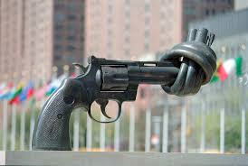
Mountain Spirit MCC
Sunday Service
September 14, 2025

Slide 2
  Prelude
  I Arise Today (St. Patrick’s Breastplate)
  Shaun Davey

Slide 3
Protocol Honoring Home
We bless these mountains in which we gather, and all the animals, plants, and elements for whom this is home;
We bless all who have walked this land and called this place home long before us;
We bless and honor Congregation Beth Israel for sharing their home with us;
And we pray that we will be a blessing in this place.
May peace be among us. Amen.

Slide 4
Invocation
Rev. Pressley S. And Mountain Spirit Community
Let us invite Spirit into our gathering in the ways we are most needing Spirit this morning.
Come Holy Spirit.
Come any way you want.
Just come. Amen

Slide 5
  Focus Scripture: John 14:23-27
  Reflection - Rev. Pressley S
Jesus [said to the disciples], “Anyone who loves me will obey my teaching. My Parent will love them, and we will come to them and make our home with them. Anyone who does not love me will not obey my teaching. These words you hear are not my own; they belong to the Parent who sent me.
“All this I have spoken while still with you. But the Advocate, the Holy Spirit, whom the Parent will send in my name, will teach you all things and will remind you of everything I have said to you. Peace I leave with you; my peace I give you. I do not give to you as the world gives. Do not let your hearts be troubled and do not be afraid.”

Slide 6
Community Prayers: Praying our Questions
Our Mother who lives within us, we celebrate your many names.
Your wisdom come, your will be done, unfolding from the depths within us.
Each day you give us all that we need.
You remind us of our strengths, and we embrace them.
You support us in our power, and we act with courage.
For you are the dwelling place within us,
the empowerment around us,
and the celebration among us, now and forevermore. Amen

Slide 7
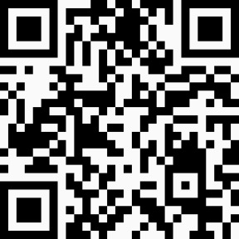
  Offertory
  Down By the Riverside
  Grandpa Elliot and International Artists

Slide 8
Communion
C: God is with you. All: And also with you
C: Let us open our hearts. All: We open them to God
C: Let us give God thanks and praise
All: It is a good and joyful thing to do
(Sanctus) All: Holy, Holy, Holy One, God of Power and Might, Heaven and Earth are full of your glory. Hosanna in the highest! Blessed is the one who comes in the name of the Creator. Hosanna in the highest!

Slide 9
Offering and Announcements
Book Group - Taking a break this week.
Founding Committee - Wednesday, 7pm ZOOM info ID: 641 953 6878. Passcode: 96778
Flamy Grant Concert, this Friday, 7pm, Land of Sky UCC
ReSister Drag Queen Bingo, this Saturday, 6pm Haywood Famous, WAVL. Want to help? Contact Rev. Dr. Lea Brown
Blue Ridge Pride, Saturday, Sept. 27th. Wear your MSMCC hat and network!
Hurricane Helen Anniversary Service, Sunday, Sept. 28th
Next week, we will be back to worshiping at the Congregational Beth Israel Synagogue, 229 Murdock Ave., Asheville, NC
Mountain Spirit Yowlers will reconvene to rehearse for our Dolly Parton Inspired Service, beginning Sunday, October 5th. Potluck at Pressley’s house.

Slide 10
Parting Song
Deep Peace - A Gaelic Blessing

Slide 11
Benediction
Rev. Pressley Sutherland
All: Go out with peace. Go out with kindness. Go out with Love,
One: In the name of the Creator, Christ, Comforter, and All that are Wise and Good.
All: Amén/Amen

