Slide 1




FARNBOROUGH
JUNIORS AFC
WELCOME TO
YOUR CLUB…
Information Guide

Slide 2
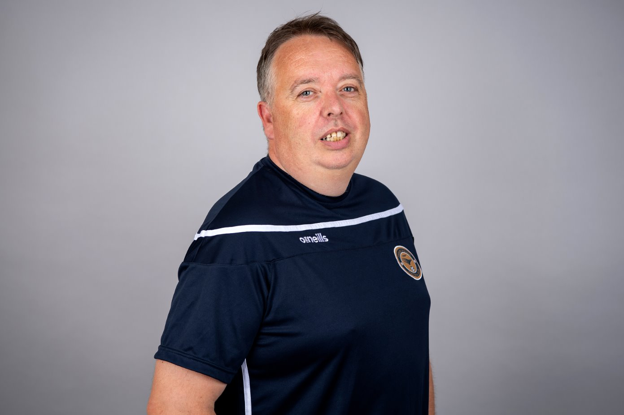
FROM THE CHAIRMAN…
A big thank you to all the parents and children that have decided to join Farnborough Junior Academy FC this season. Without you, we would not have a club and this great family.
This is our welcome pack to let you know who we are and what we are about.
As a club we are treating everyone as our family and friends, we currently work with Academy and First Teams to bring us all together as one club.
We endeavour to help your child on their journey through football, not just making them a better players but helping make friends and long-lasting skills for the life.
Our Mission Statement
we have:
The passion to learn,
The courage to fail,
The strength to keep going.
Michael Davies
Farnborough Junior AFC
Chairman

Slide 3
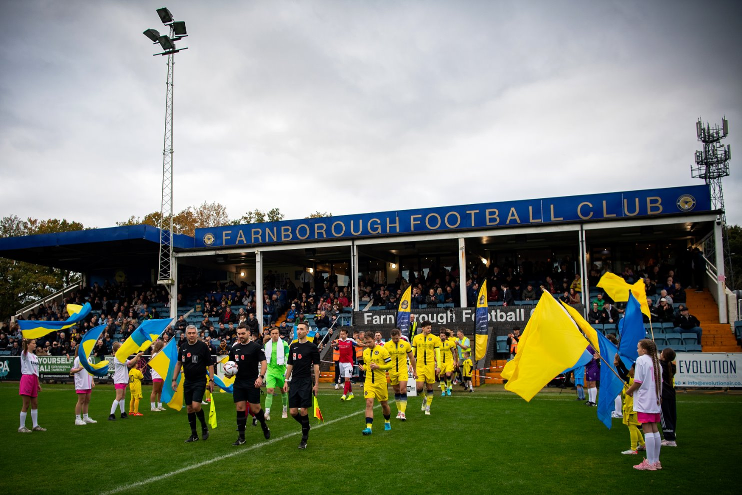
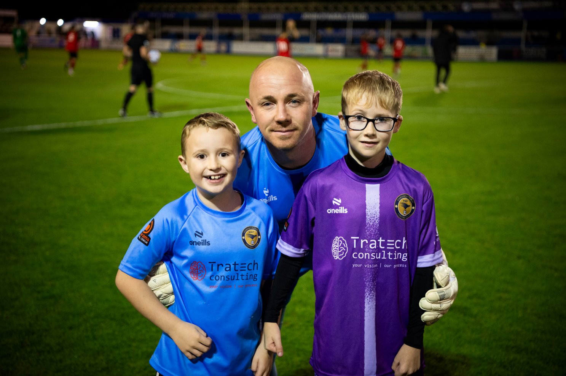
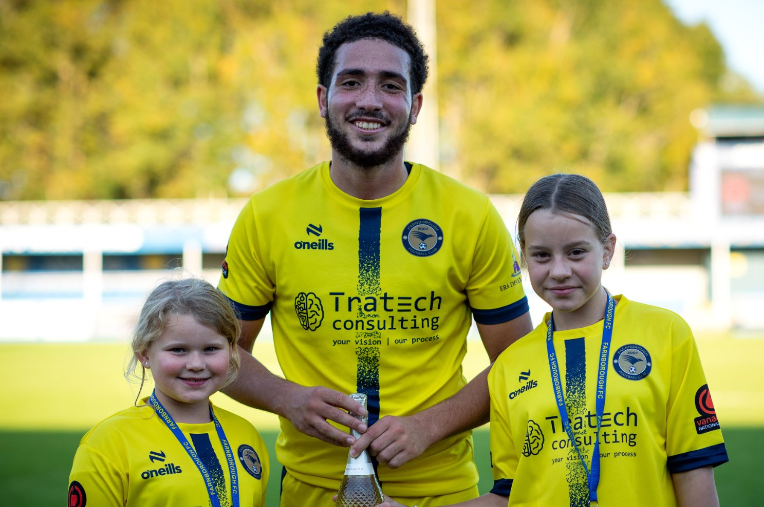
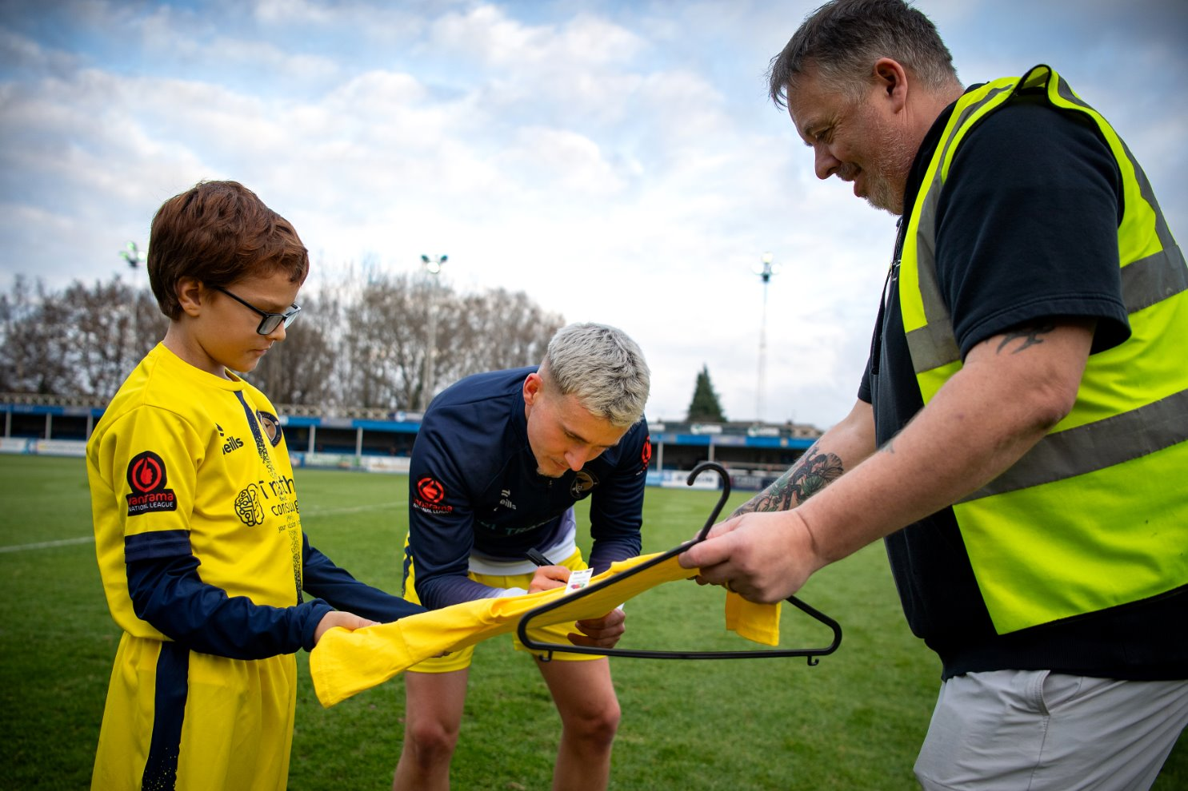

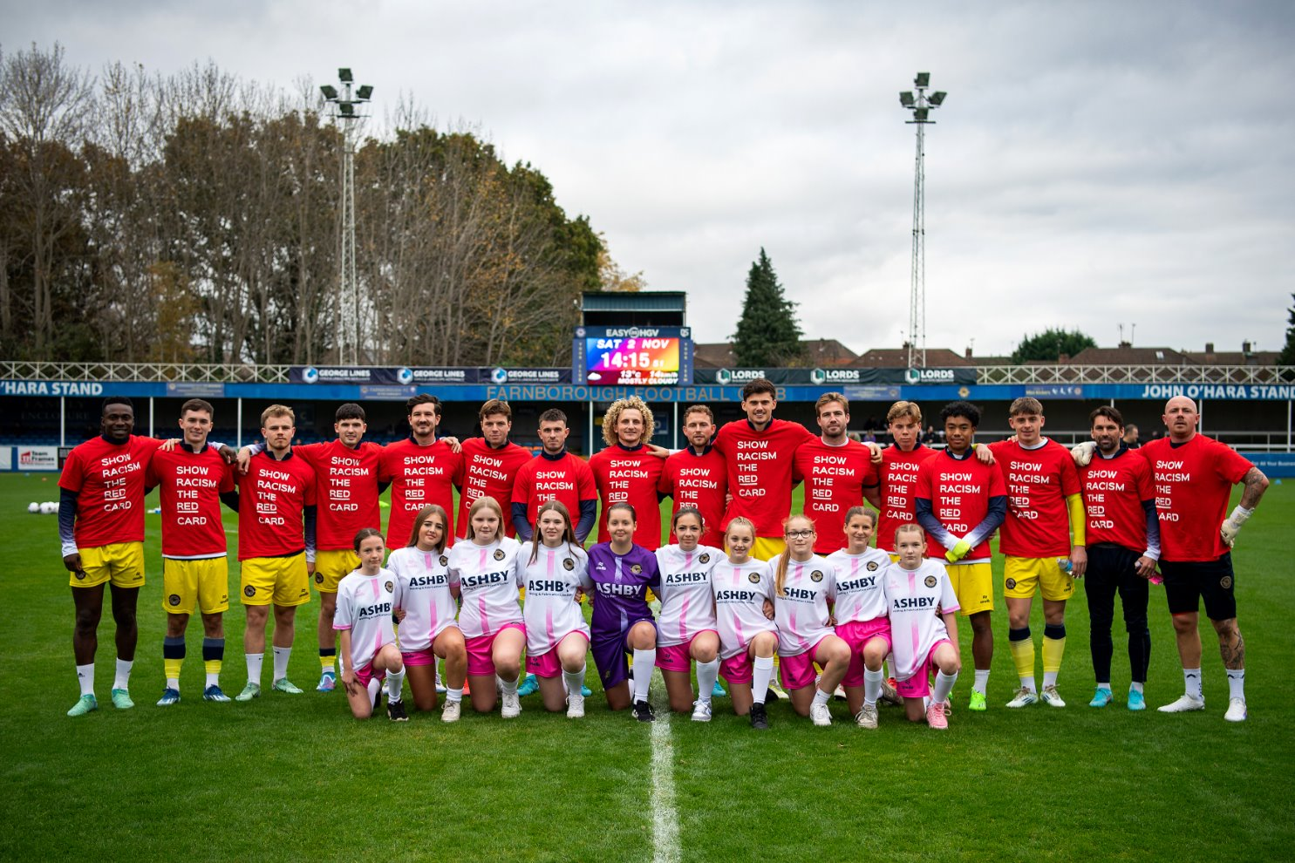
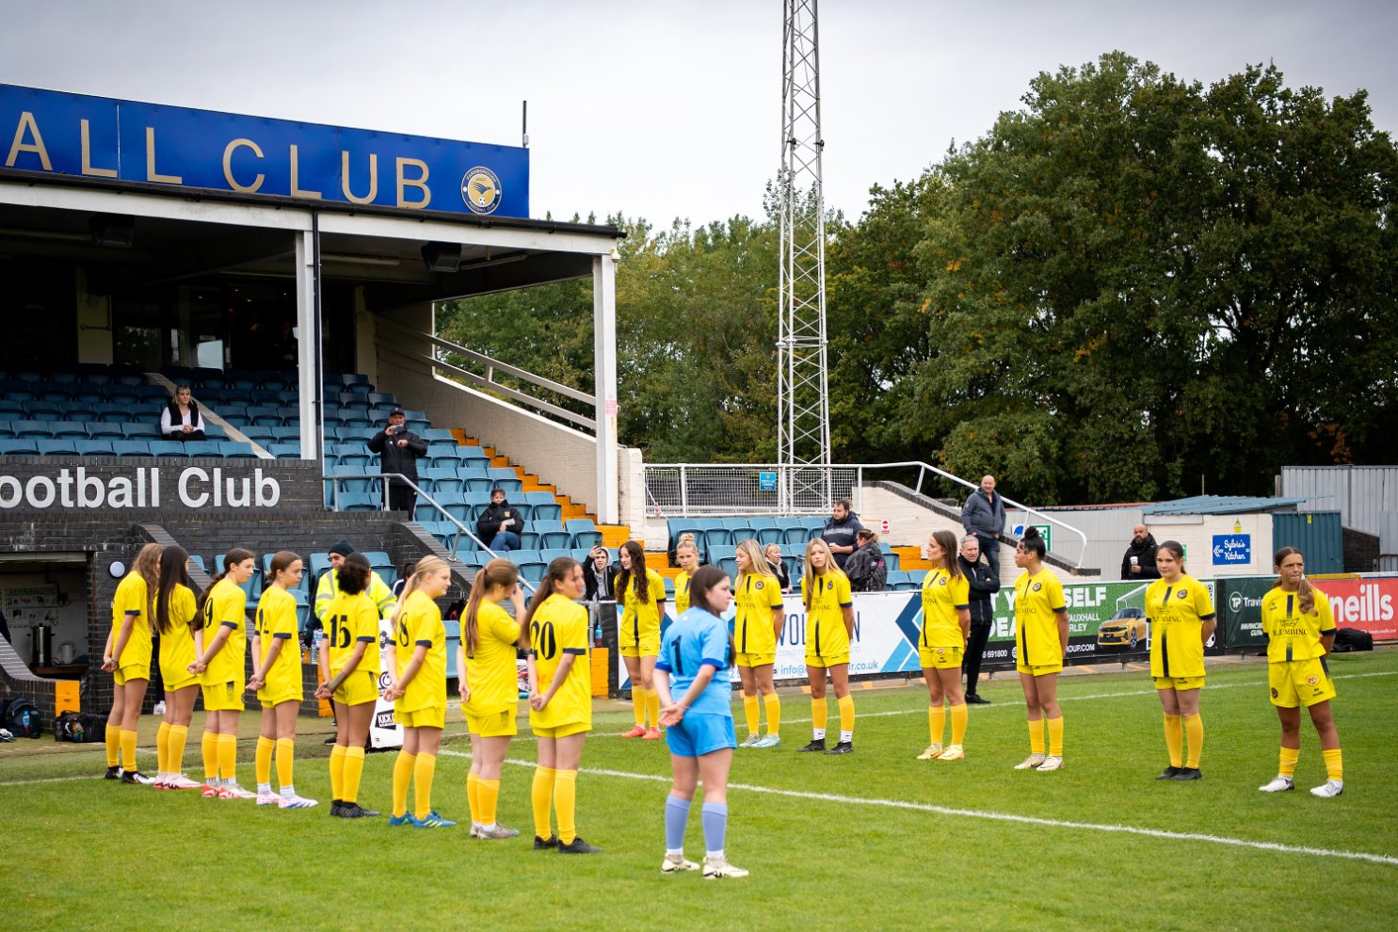
WE ARE ONE – FARNBOROUGH FC

Slide 4
Our Committee Members
Farnborough JFA
Chair:- Michael Davies
Vice-Chair:- James Elliott
Secretary:- Kieran Davies
Treasurer:- Tom Howell
Treasurer assistant:-Munir Chohan
Child Welfare Officer:-Charlotte Quinn
Football Development Officer:-James Quinn
Social Media:-
Hampshire FA contacts.
Hampshire FA Child Welfare Officer:
Shantell.Woodward@HampshireFA.com

Slide 5
Our coaches
U8 Matt Cutler
U9 Matt Rose
U9 Max Houghton
U11 Eddie Chishamba
U11 Luke Wheeler
U11 James Quinn
U12 Bobby Sellars
U12 Kevin Mulvey
U13 Girls Lisa McCarthy
U13 James Elliott
U14 Dean Wilcox
U15 Girls Mike Jones
U15 John Stokes
U16 Kieran Davies
U18 Girls Leighann May

Slide 6
What we offer you.
Safe place to play football
All coaches DBS Checked.
All qualified First Aiders.
A Gift Bag
Discount To Farnborough Home Games.
Winter Training
Opportunities to meet the first team players
A chance to become a mascot for a game
Presentation day
A first team member to your team ambassador.

Slide 7
Home Venues

Slide 8
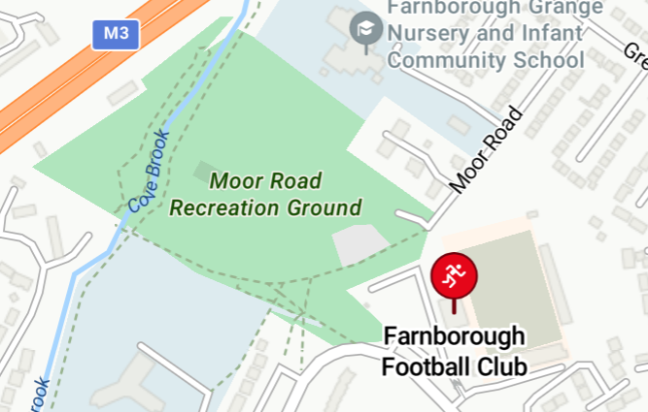
5 aside Pitch :-
Venue
Moor Rd,
Farnborough
GU14 8UD
Map

Slide 9
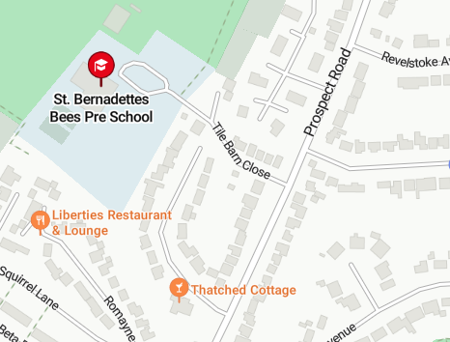
7 Aside Pitch :
Venue
St Bernadette's Catholic Primary School Tile barn Close Cove Farnborough
Hampshire GU14 8LS

Slide 10
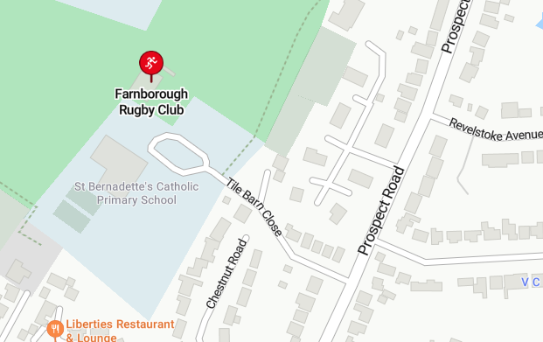
9 Aside Pitch :-
Venue
Farnborough Rufc,
Tile barn Close,
Farnborough
Hampshire
GU14 8LS

Slide 11
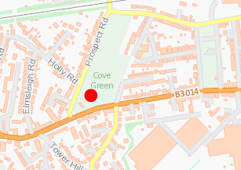
11 aside Pitch :-Venue Address (mixed)
Venue
Prospect Road Farnborough GU14 OEE
Map

Slide 12
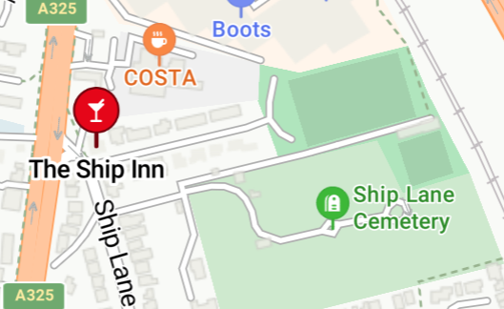
11 aside pitch :-Venue Address (Girls)
Venue
Ship Lane,
Farnborough
GU14 8BE
Map

Slide 13
INVESTMENT IN THE CLUB
Where our money has been spent to support the club
Each weekend of football, on average, we have six games at home. We must pay for the referees and the pitches.
Winter training across various venues.
Training equipment for all teams (footballs, cones, etc.) for the club this season.
New team kits every two years.
Courses for new managers, such as First Aid, England Playmaker courses, DBS checks, and Safeguarding, have been provided to ensure all your children are safe under our coaches.
Development in FA training courses for the coaches.

Slide 14
Club Charters
Code of Conducts

Slide 15
FARNBOROUGH JUNIORS COACHES
On and off the field, I will:
• Show respect to others involved in the game including match officials, opposition players,
coaches, managers, officials and spectators
• Adhere to the laws and spirit of the game
• Promote Fair Play and high standards of behaviour
• Always respect the match official’s decision
• Never enter the field of play without the referee’s permission
• Never engage in public criticism of the match officials
• Never engage in, or tolerate, offensive, insulting or abusive language or behaviour.
When working with players, I will:
• Place the well-being, safety and enjoyment of each player above everything, including winning
• Explain exactly what I expect of players and what they can expect from me
• Ensure all parents/carers of all players under the age of 18 understand these expectations
• Never engage in or tolerate any form of bullying
• Develop mutual trust and respect with every player to build their self-esteem
• Encourage each player to accept responsibility for their own behaviour and performance
• Ensure all activities I organise are appropriate for the players’ ability level, age and maturity
• Ensure all players receive fair game time
The

Slide 16
FARNBOROUGH JUNIORS PARENTS
As part of being a parent of our club we have high standards that we expect from everyone
• Have fun; it's what we're all here for!
• Always respect the Referee and coaches and encourage players to do the same
• Stay behind the respect barrier and within the Designated Spectators' Area (where provided)
• When players make mistakes, offer them encouragement to try again next time
• Never engage in, or tolerate offensive, insulting, or abusive language or behaviour
• Please don’t coach the players, you will have no idea what instructions the coach has given them, and you will only send mixed messages, if you want to be the coach we are always interested in volunteers being involved.
• No smoking or vaping anywhere near our pitches
• Praise your children for something they have done during the game, don’t highlight any negatives, they may be acutely aware of the penalty they gave away and, in some cases, may be blissfully unaware, highlight the positives and make them buzz for next week.
• Please do not confront the manager or coaches about their methods, if you have an issue with anything about coaching then please contact the club head coach who can direct you to the correct person that can help you. If the manager simply quits because of you, then there will be no team. Every coach has access to mentoring if they require it.
• Please note that that the supplied kit belongs to the club and gets changed every two years, it is your responsibility to return the kit to the coach at the end of every season.
• The club have the right to terminate any registration due to lack of payment of player subscription fees in the agreed timelines
The

Slide 17
FARNBOROUGH JUNIORS PLAYERS
As a player, you have a big part to play. That’s why The FA is asking every player to follow a Respect Code of Conduct.
When playing football, I will:
• Always play to the best of my ability
• Play fairly – I won’t cheat, complain or waste time
• Respect my team-mates, the other team, the referee or my coach/manager
• Play by the rules, as directed by the referee
• Shake hands with the other team and referee at the end of the game
• Listen and respond to what my coach/ team manager tells me
• Talk to someone I trust or the club welfare officer if I’m unhappy about anything at my club.
• Look to develop myself and my teammates providing advice and help when they need it
• I will be receptive to feedback and understand that I need this to improve
• I will be positive and not criticise or belittle my teammates when they make a mistake
• I will always promote positivity
.
Any bullying issues or behaviour that causes a negative impact on the team will be taken seriously and
may result in your removal from a team if proven.
The

Slide 18
COMPLAINTS PROCEDURE
Purpose: Farnborough JFA are committed in making sure that all involved with the club put players safety and enjoyment above all other aspects of the game and will hold all club officials and players to the same high standard as required by the FA. We will take all complaints seriously and as such will investigate any issues or concerns raised by players, coaches, parents, league officials or members of the public. The expected behaviors are set out in the Code of Conduct for player/coaches, club officials/ spectators.
Scope: Any person or persons involved with coaching, playing, spectating at either a training session or matchday activities which involve a Farnborough JFA team, whether that is in the regular league season with development league or competitive environment such as league, cup or tournament.
This complaints policy covers any area of concern in which the safety of a player is the to be put first and foremost with all decisions that club officials make within their team setting. Depending on the severity of your concerns then you should contact the responsible person in the club, that would be the team coach, child welfare officer, club secretary, club chairman, Hampshire CWO.
If you have any concerns where a child is being harmed, either physically or mentally this needs to be reported directly to the club CWO immediately, if they are unavailable then the Hampshire CWO would be the next step, contact details are at the end of this document.
The

Slide 19
COMPLAINTS PROCEDURE
If your concern is around training schedule or matchday activities, then we ask that you first approach your team coach to discuss and come to a resolution. If this has been attempted and the concern is still ongoing and not resolved then this is to be escalated through the CWO in the first instance, if they are unavailable then the club secretary. This must be in writing detailing the reasons behind your concern, who is involved within the complaint and any dates that were involved.
The outcomes that could result from an investigation could be, but not limited to
Suspensions from training and match day activities
Ban from training and match day activities
Removing coaches from team activities
Holding players registration if monies owed to the club is not played
The club will hold a three-strike rule for minor breach of code of conducts set out for players, coaches, spectators
2-week matchday suspension
6-week matchday suspension
Ban from any further matchday to training activities
The club hold the right to miss out a step should they feel the breach of conduct is serious enough to do so.
Hampshire FA Child Welfare Officer
The

Slide 20
COMPLAINTS PROCEDURE
The outcomes that could result from an investigation could be, but not limited to
Suspensions from training and match day activities
Ban from training and match day activities
Removing coaches from team activities
Holding players registration if monies owed to the club is not played
The club will hold a three-strike rule for minor breach of code of conducts set out for players, coaches, spectators
2-week matchday suspension
6-week matchday suspension
Ban from any further matchday to training activities
The club hold the right to miss out a step should they feel the breach of conduct is serious enough to do so.
Hampshire FA Child Welfare Officer:
The

Slide 21



JOIN OUR TEAM
Are You Looking to Get Involved with Farnborough Juniors? We Need Your Help!
Farnborough Juniors is always looking for enthusiastic volunteers who want to contribute to the growth and success of our club. Whether you have some time to spare or specific skills to offer, we would love for you to join our team and help us create a positive impact on the club and the community.
We are currently looking for volunteers to assist
We understand that people have different skills, so whether you’re a social media pro or just starting out in football, we welcome all skill levels. Your contribution, no matter how big or small, will make a huge difference to the club.
If you're interested in volunteering or would like more information, please reach out to us today! Join us in supporting the growth of Farnborough Juniors – we look forward to having you on board!
E-Mail - JuniorAcademy@farnboroughfc.co.uk

Slide 22










THANK YOU TO OUR FARNBOROUGH JUNIOR ACADEMY SPONSORS.
CLICK ON OUR SPONSOR LOGO TO VISIT THEIR WEBSITE

Slide 23
SPONSORSHIP PACKAGES
Front of away shirt:
£500 for 10 Kits
£650 for 13 Kits
£750 for 16 Kits
This will be the mid grey kit with their company logo on the front of the shirts for the specific team they have sponsored.
Will have a link and logo on our main sponsor page to their own website.
Logo to be included in all social media posts going forward.
Free entry to a home game for two people.
Sleeve of kit: £300
This will be the main kit with their company logo on the specific team they have sponsored.
We have a link and logo on our main sponsor page to their own website.
Logo to be included in all social media posts going forward.
Free entry to a home game for two people.

Slide 24
SPONSORSHIP PACKAGES
Training tops:
£500 for 10 Kits
£650 for 13 Kits
£750 for 16 Kits
Logo on specific training wear for their team, this can be designed, and colours can be chosen.
By the sponsor as this is not specific to match days, but a good opportunity to get notice on them training fields.
We have a link and logo on our main sponsor page to their own website.
Logo to be included in all social media posts going forward.
Jackets: To be quote depending on squad size and size of jackets
Logo on jackets for their team, this can be designed, and colours can be chosen.
By the sponsor as this is not specific to match days kit but a good opportunity to get notice on them training fields.
We have a link and logo on our main sponsor page to their own website.
Logo to be included in all social media posts going forward.
Other sponsorships are available on request or speak to your team's coach.

