Slide 1
Interland test you are not allowed to do in the Interland test
visit Interland website
use Interland products
view your Interland files
do web searches on google, bing, duckduckgo, or yahoo
watch interland videos
next
view Interland notes
listen to Interland audio
read Interland book

Slide 2
what is the strongest password?
letsplay
LeTspLay
LeT$pL@y!4

Slide 3
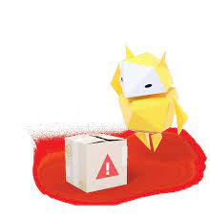
incorrect try again
back

Slide 4
correct
next

Slide 5
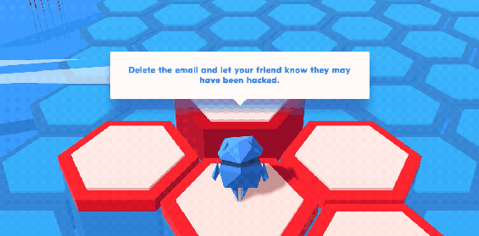
you got an hilarious email that is a scam
Delete and forget it
Forward it to your friends
Avoid clicking links and mark as ''spam''

Slide 6
incorrect try again
back

Slide 7
correct
next

Slide 8
what to do when bullied?
make fun of the bully
send negative vibes
block and report

Slide 9
incorrect try again
back

Slide 10
correct
next

Slide 11
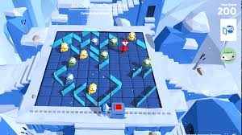
which mailbox do you put your address in?
public
friends
parents

Slide 12
incorrect
back

Slide 13
correct
next

Slide 14
should you steal bullying information?
yes
no

Slide 15
incorrect
next

Slide 16
correct
next

Slide 17
Congratulations you finished the test and you are internet awesome

