Slide 1

Wiltshire Walking Football League (WWFL)
Match Day Guidelines

Slide 2
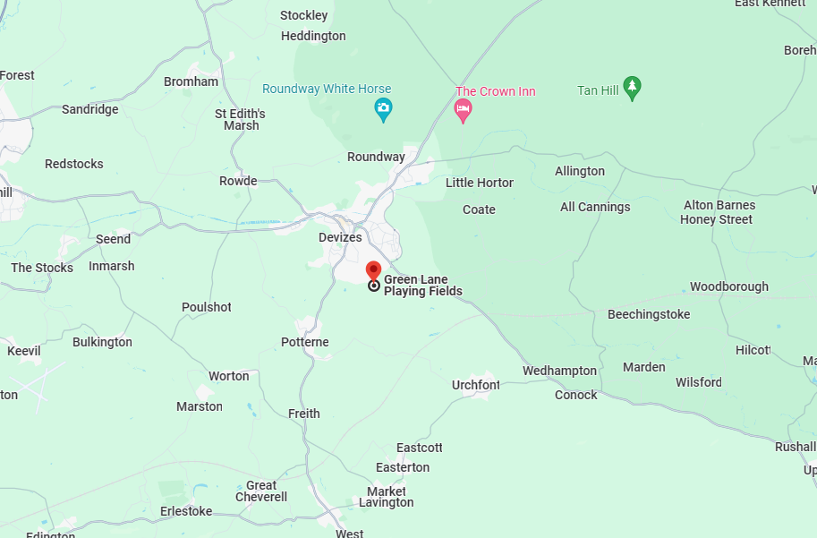
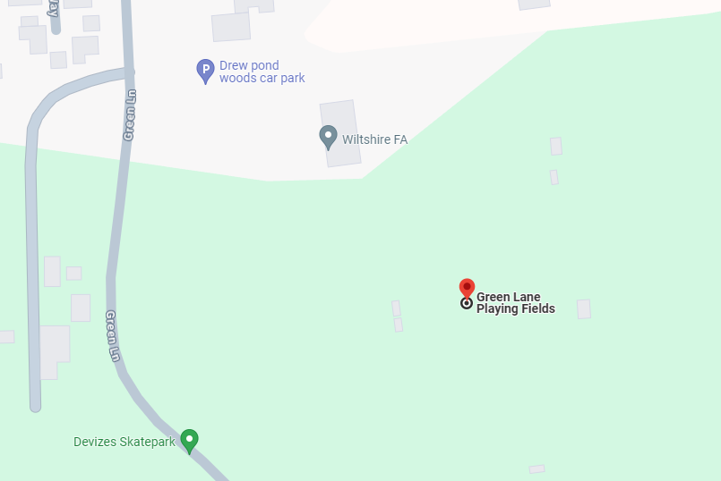
Venue (1) Wiltshire FA, Green Lane Playing Fields, Green Lane, Devizes, SN10 5EP(Wilts County FA Head Quarters)
Click on the below link for directions to the venue
Wiltshire FA - Google Maps

Slide 3
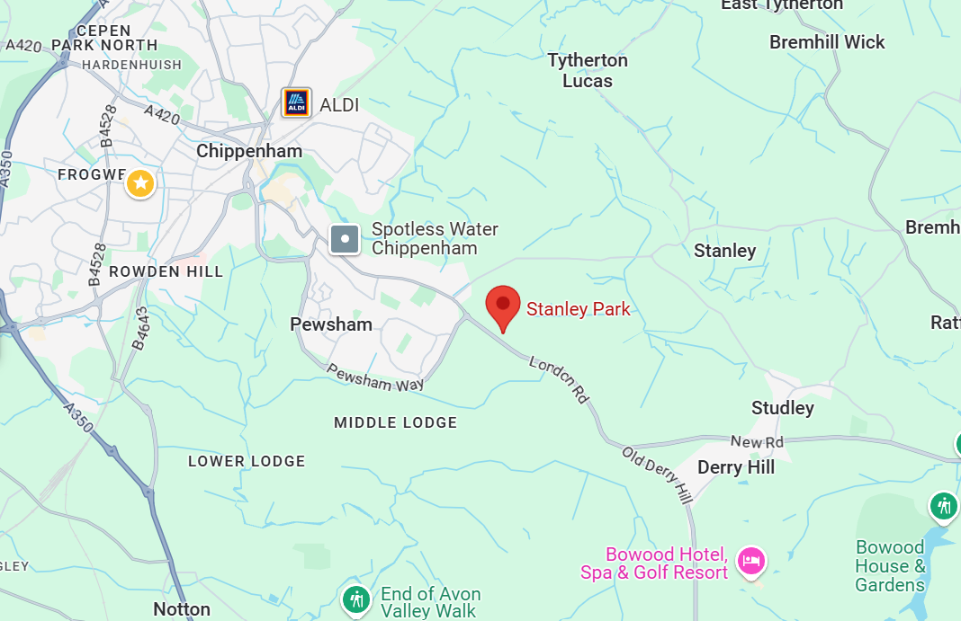
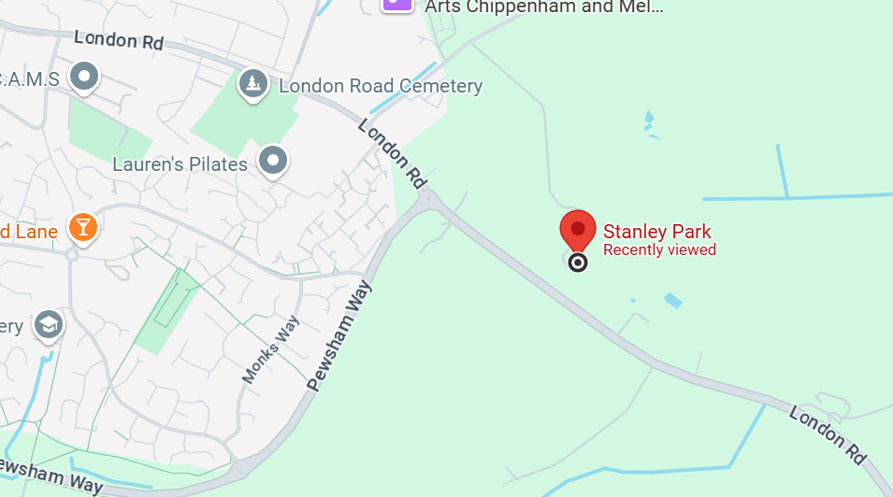
Venue (2) Stanley Park, Stanley Ln, Chippenham SN15 3RW
Click on the below link for directions to the venue
Google Maps
Opposite Abbeyfield Secondary School

Slide 4
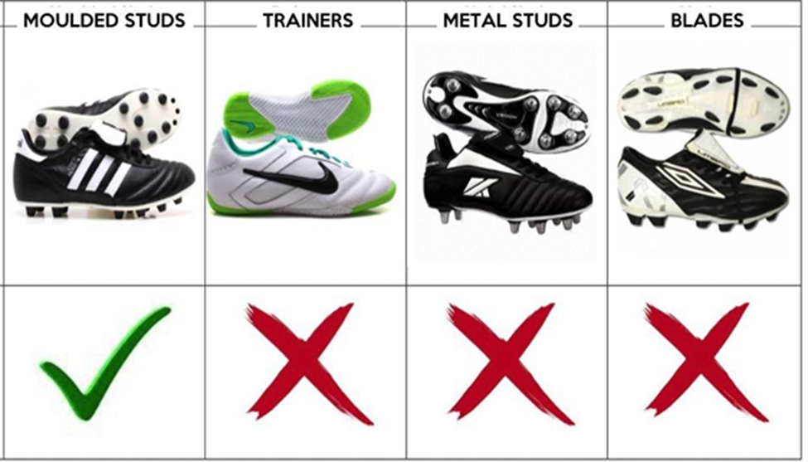
Footwear
Only plastic studded boots are allowed on the 3G pitch No metal studs. Blades, dimpled or flat soled shoes should not be used.
Players without the correct footwear will NOT be allowed to play

Slide 5
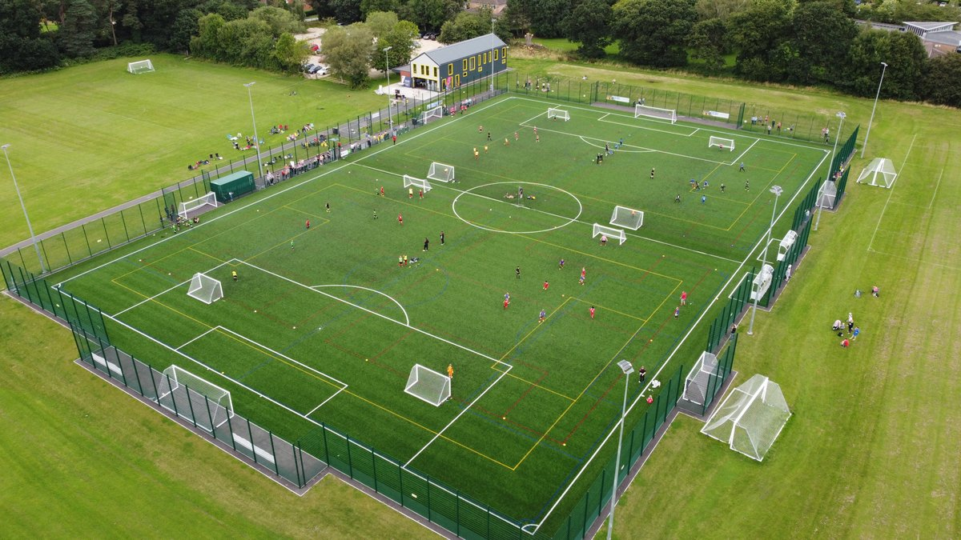
Pitch Plan (Same layout for both venues)
A
B
D
C
The pitches outer boundary is marked in RED

Slide 6
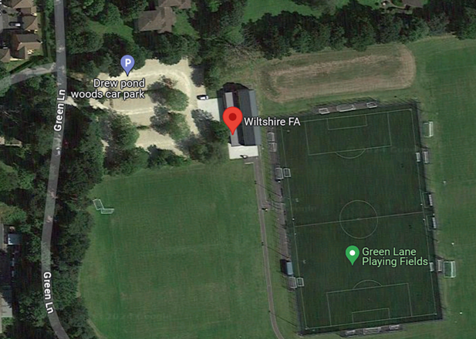
Player /Team Manager guidance
3a. Match Day ready – Player guidance:
on site parking is limited to approx. 100 cars, which may not always be enough on event days, so car sharing is advised.
arrive at the venue no more than 45 mins before a match and only go to the 3G pitch 15 mins prior to KO
come ready to play in full kit [Changing rooms may be available]
do not congregate on the patio area – Meet teammates on the warm-up area
3b Match Day ready – Manager
Complete, and hand to the match day event manager, the club/team register [A squad list will be provided, for you to indicate players taking part)

Slide 7
Laws of the Game (LotG)
Key Points for players:
Full adherence to the FA Laws of the Game (Feb 2025 version) and venue/competition specific rules (inc wearing of correct footwear for the 3G pitch, wearing of shin guards)
Adhere to the Principles of Walking Football. Whilst this is a competitive event, it is expected that all players will observe full FA RESPECT objectives and ensure FAIR PLAY

Slide 8
FUNDAMENTAL COMPETITION RULES
KICK-OFF’s / CHOICE OF ENDS
A Toss of the coin, by the Ref, will firstly decide who kicks off. The non kicking off team can choice which end they prefer
MATCH SCORES:
Upon completion of each game, a representative of BOTH team MUST deliver, to the control tent, the score of the match
HIGH BALL
A high ball free kick will be given if the ball is ABOVE the height of the goal cross bar GOALKEEPER
Deflections/saves (by the GK) resulting in the ball going directly over the goal-line (even above ‘high ball law’) is then a corner to the attacking team. When a save is made, and the ball enters the field of play above height restriction, a kick in (at the side of the pitch) will be awarded to the attacking team
CARDS
A BLUE card will result in a player ‘sin binned’ for FIVE minutes (with no replacement player allowed on in their place)
A RED card will result in the player not being allowed to take any further part in the event

Slide 9
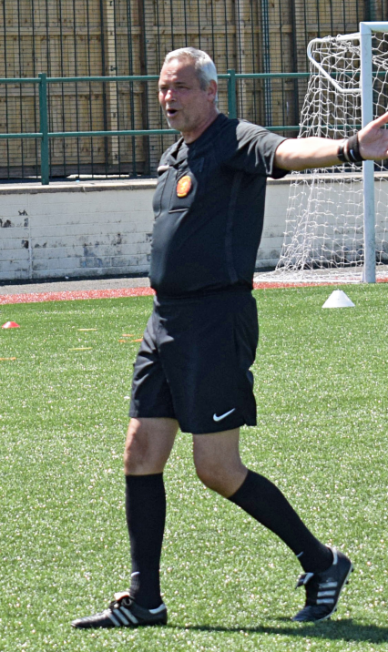
The REFEREES will ensure that….
Full compliance of the FA Laws of the Game for Walking Football (FA Version Feb 2025)
All players are wearing shin guards, and the correct footwear is worn (if not, then that player is not to take part in the game)
Cards will be shown for foul & abusive language/dissent of decisions
Principles of Walking Football are adhered to (next slides provide guidance)

Slide 10
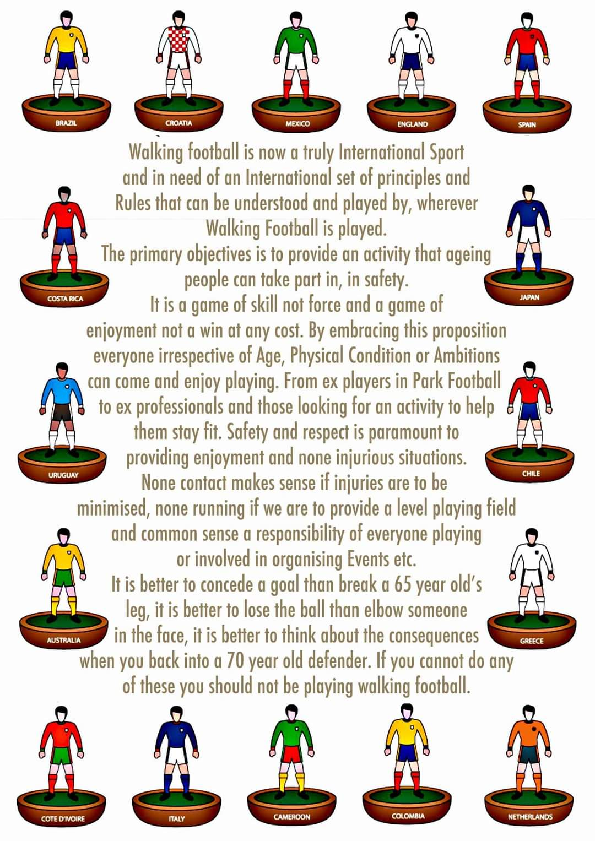
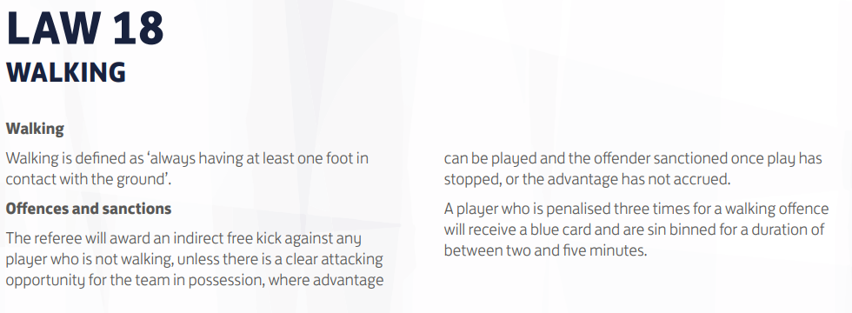
Walking Football

Slide 11

Walking Football Principle #1

Slide 12
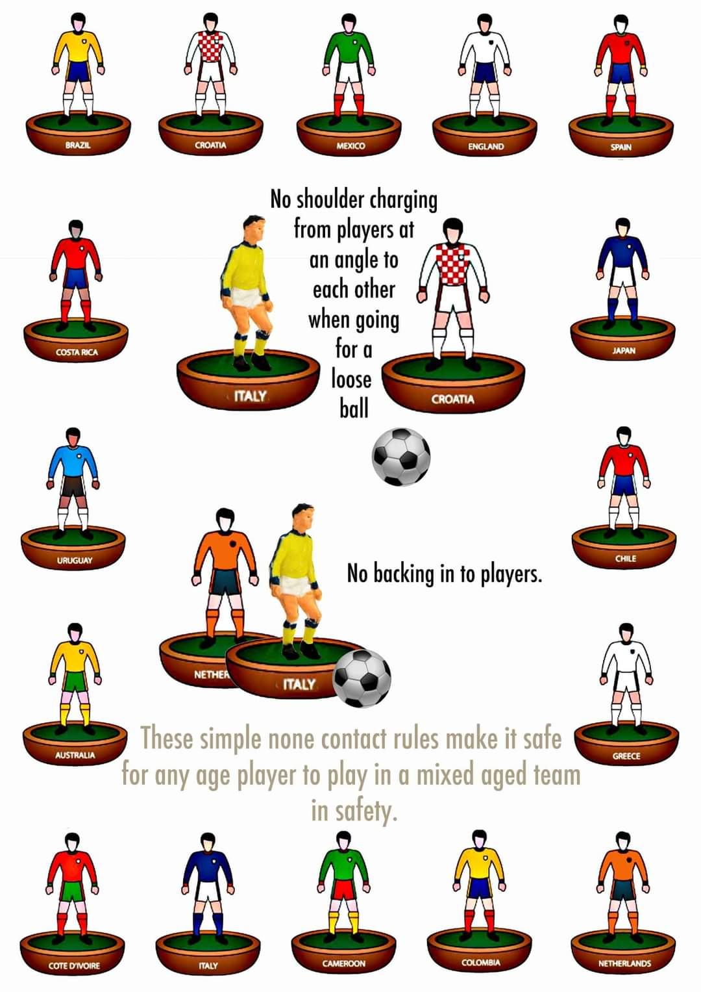
Walking Football Principle #2

Slide 13
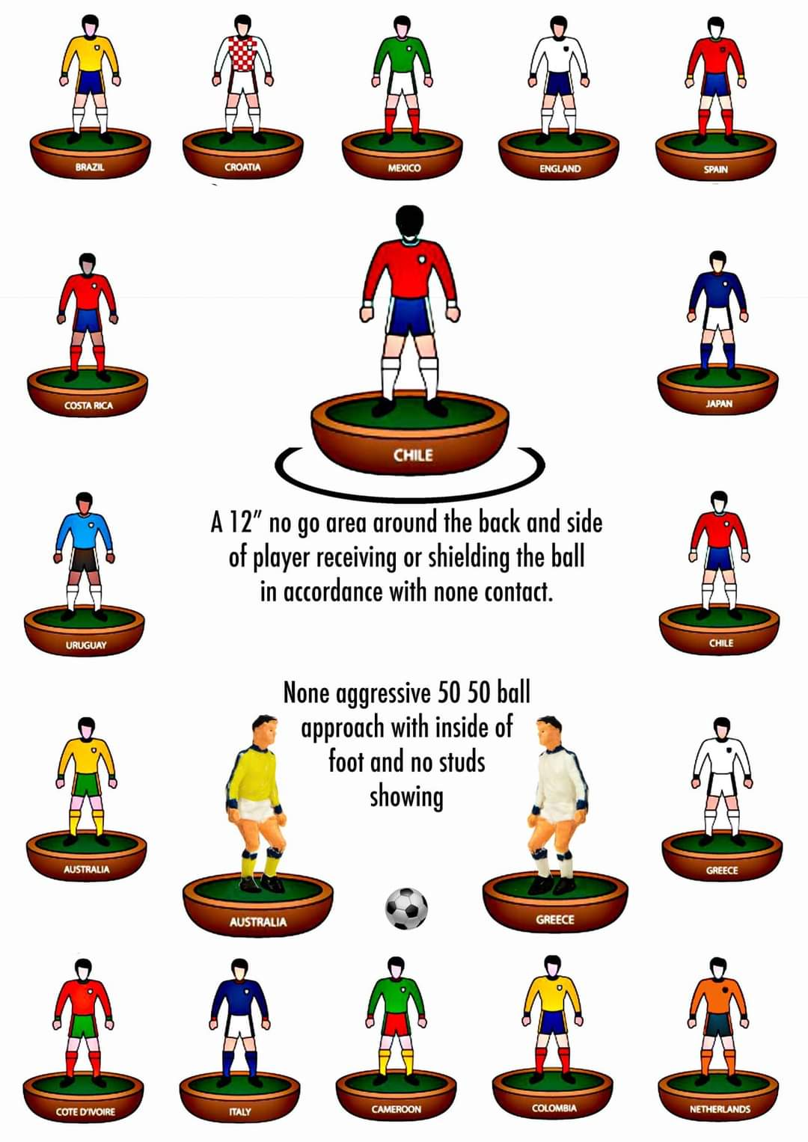
Walking Football Principle #3

