Slide 1
The Gospel
“Good News”
according to John

Slide 2
Joh 16:1 "These things I have spoken to you, that you should not be made to stumble.
2 "They will put you out of the synagogues; yes, the time is coming that whoever kills you will think that he offers God service.
3 "And these things they will do to you because they have not known the Father nor Me. (NKJV)
Joh 16:1 ESTAS cosas os he hablado, para que no os escandalicéis.
2 Os echarán de los sinagogas; y aun viene la hora, cuando cualquiera que os matare, pensará que hace servició á Dios.
3 Y estas cosas os harán, porque no conocen al Padre ni á mí.
kills G615 – apokteino = to destroy, slay, put to death,

Slide 3
In the 21st century, roughly 100,000 to 160,000 Christians were killed each year
(Gordon-Conwell Resources and World Christian Database, respectively)
Roughly 1,093,000 Christians were martyred, worldwide, between 2000 and 2010
(World Christian Database)

Slide 4
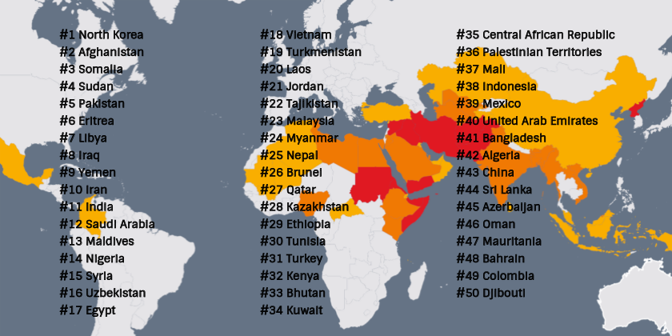

Slide 5
Rep. Chris Smith, R-N.J., has championed this cause in the House, holding special hearings and pleading for Nigeria’s (#14) Country of Particular Concern designation. In July, Smith submitted into the Congressional Record a letter from religious freedom experts urging Nigeria’s designation—reminding the world that Nigeria is the deadliest country for Christians, responsible for more than 69% of faith-based killings globally. In just one decade, over 145 Catholic priests were abducted, and 11 were murdered.

Slide 6
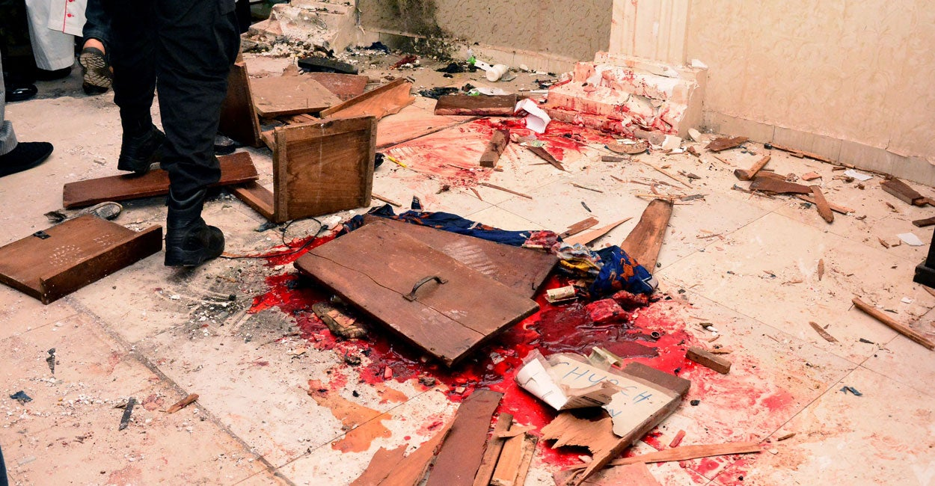
Christian Persecution in Nigeria Demands American Response
Andrea Picciotti-Bayer | September 18, 2025

Slide 7
(ZENIT News / Washington, 09.06.2025)
From the quiet suburbs of the United States to the contested streets of Jerusalem and the cathedrals of Europe, a troubling pattern is emerging: attacks against Christian communities and their sacred spaces are not only rising, but in some places multiplying at an alarming pace.
A recent report by the Family Research Council, released on August 11, documented 1,384 hostile incidents against Christian churches in the United States between 2018 and 2024. What began with fewer than 100 incidents annually ballooned after the 2022 leak of the Supreme Court’s Dobbs decision, which overturned Roe v. Wade. That year alone, 198 attacks were reported. By 2023, the number had nearly doubled again, reaching 485 cases before settling slightly lower at 415 in 2024.
A Global Surge in Anti-Christian Hostility Raises Alarms Across Churches | ZENIT - English
ISIS orders killing of Christians worldwide Sep 2025

Slide 8
Joh 16:4 "But these things I have told you, that when the time comes, you may remember that I told you of them. And these things I did not say to you at the beginning, because I was with you.
5 "But now I go away to Him who sent Me, and none of you asks Me, 'Where are You going?'
6 "But because I have said these things to you, sorrow has filled your heart.
Joh 16:4 Mas os he dicho esto, para que cuando aquella hora viniere, os acordeis que yo os lo había dicho. Esto empero no os lo dije al principio, porque yo estaba con vosotros.
5 Mas ahora voy al que me envió; y ninguno de vosotros me pregunta: ¿Adónde vas?
6 Antes, porque os he hablado estas cosas, tristeza ha henchido vuestro corazón.

Slide 9
Joh 16:7 "Nevertheless I tell you the truth. It is to your advantage that I go away; for if I do not go away, the Helper will not come to you; but if I depart, I will send Him to you.
8 "And when He has come, He will convict the world of sin, and of righteousness, and of judgment:
9 "of sin, because they do not believe in Me;
10 "of righteousness, because I go to My Father and you see Me no more;
11 "of judgment, because the ruler of this world is judged.
Joh 16:7 Empero yo os digo la verdad: Os es necesario que yo vaya: porque si yo no fuese, el Consolador no vendría á vosotros; mas si yo fuere, os le enviaré.
8 Y cuando él viniere redargüirá al mundo de pecado, y de justicia, y de juicio:
9 De pecado ciertamente, por cuanto no creen en mí;
10 Y de justicia, por cuanto voy al Padre, y no me veréis más;
11 Y de juicio, por cuanto el príncipe de este mundo es juzgado.
(ruler G758 – archon = chief, prince)

Slide 10
Joh 16:12 "I still have many things to say to you, but you cannot bear them now.
13 "However, when He, the Spirit of truth, has come, He will guide you into all truth; for He will not speak on His own authority, but whatever He hears He will speak; and He will tell you things to come.
14 "He will glorify Me, for He will take of what is Mine and declare it to you.
15 "All things that the Father has are Mine. Therefore, I said that He will take of Mine and declare it to you.
Joh 16:12 Aun tengo muchas cosas que deciros, mas ahora no las podéis llevar.
13 Pero cuando viniere aquel Espíritu de verdad, él os guiará á toda verdad; porque no hablará de sí mismo, sino que hablará todo lo que oyere, y os hará saber las cosas que han de venir.
14 El me glorificará: porque tomará de lo mío, y os lo hará saber.
15 Todo lo que tiene el Padre, mío es: por eso dije que tomará de lo mío, y os lo hará saber.

Slide 11
X

Slide 13
Belize 2025

Slide 14
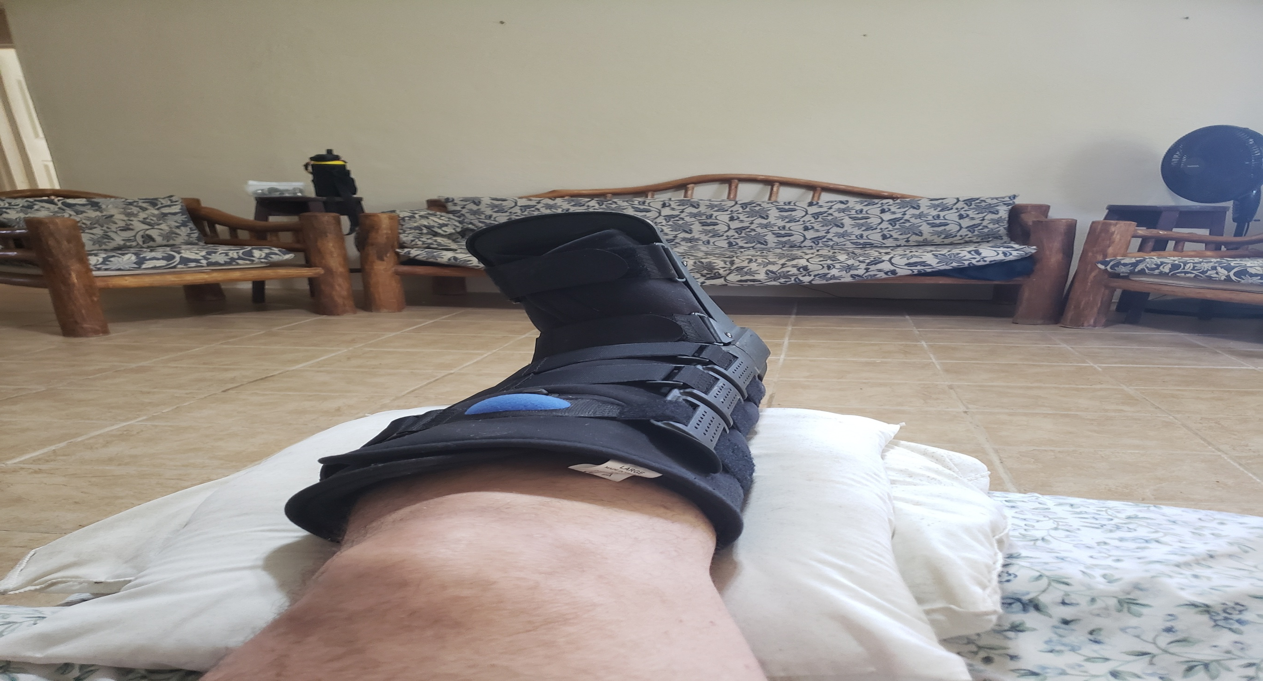
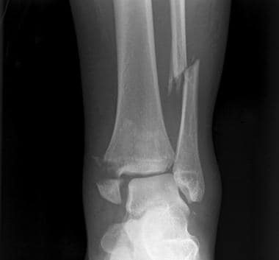

Slide 15
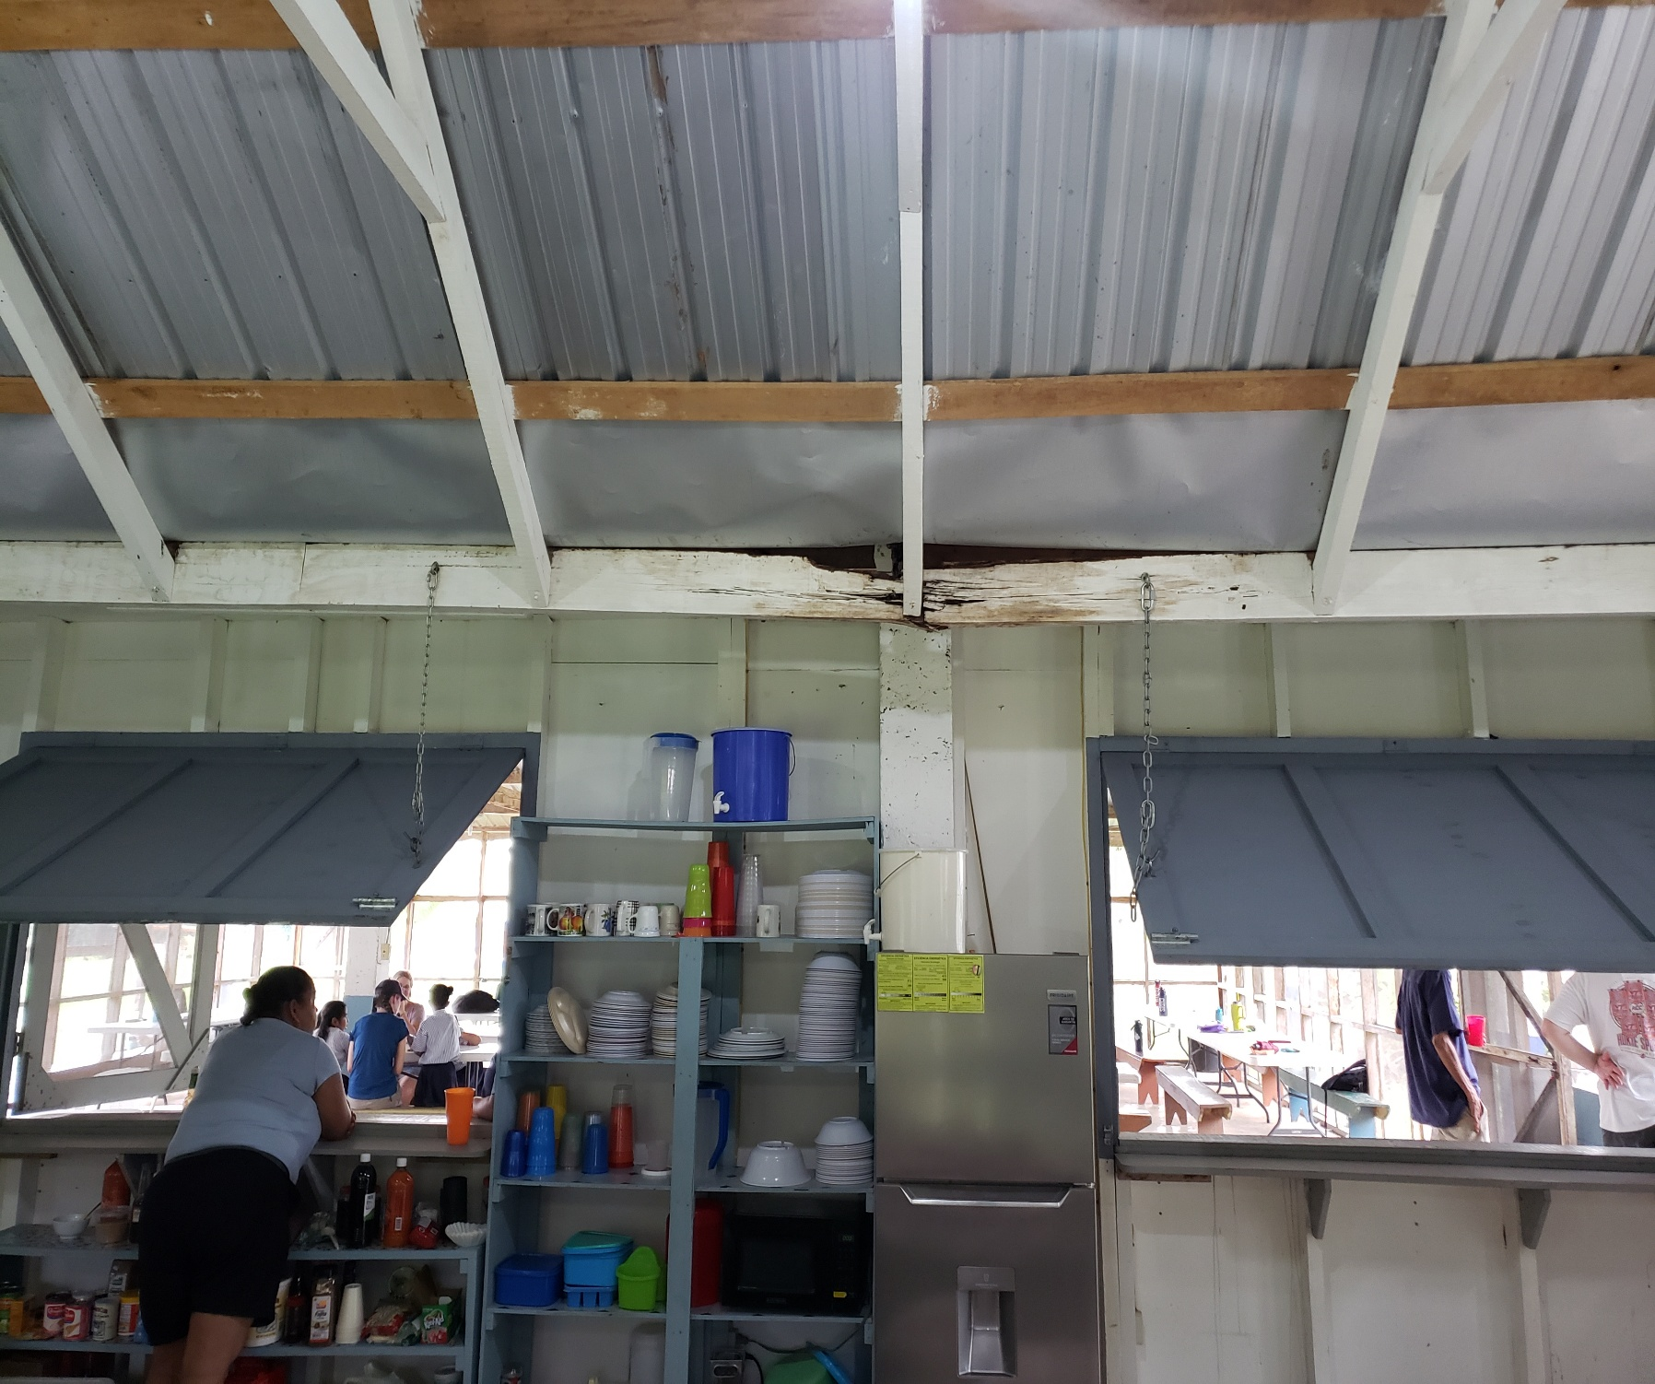
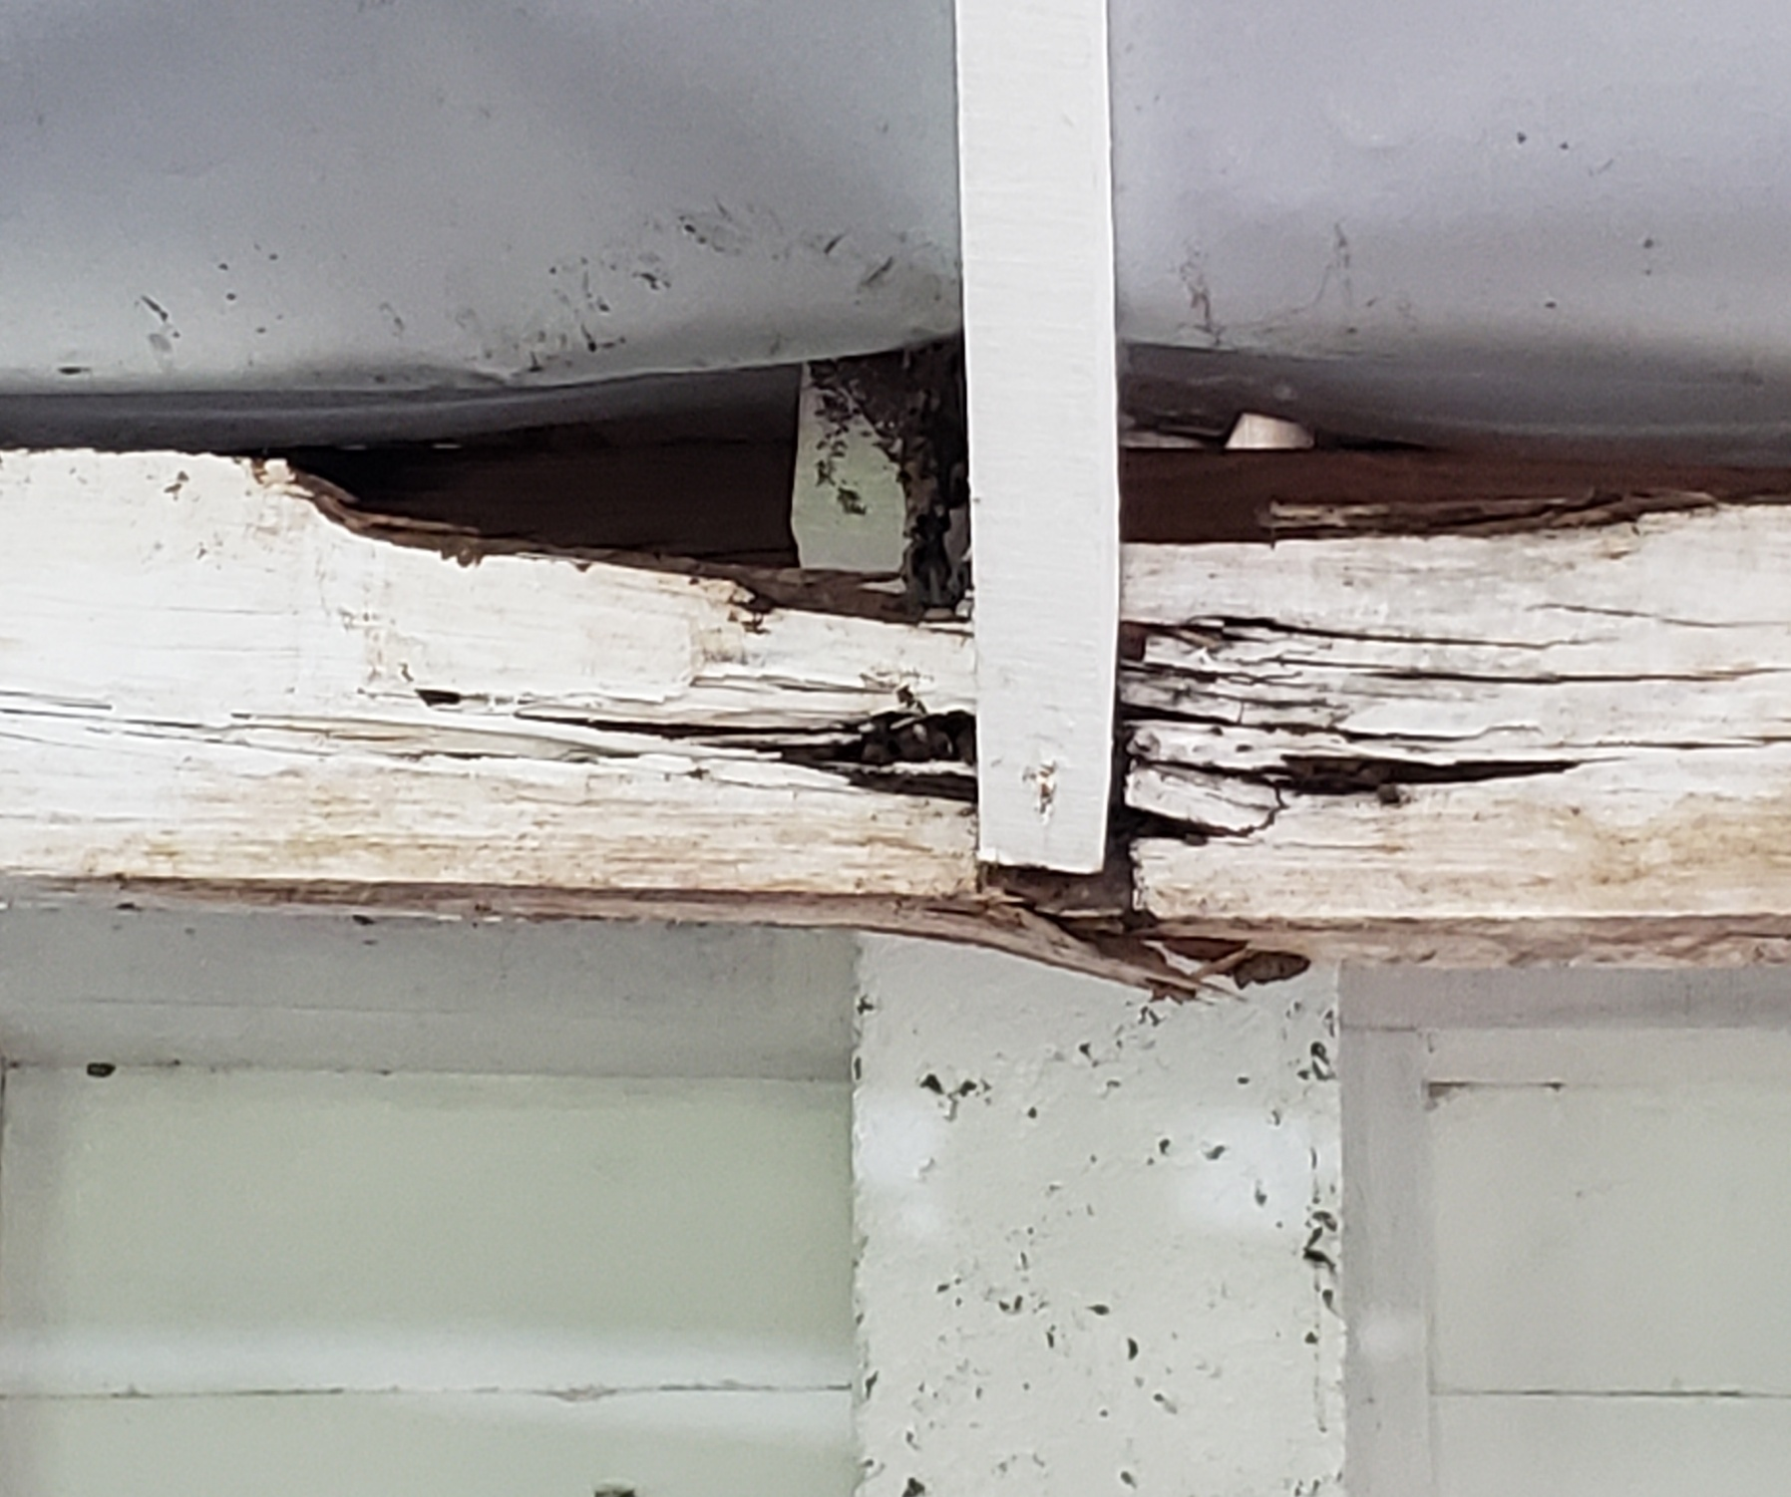
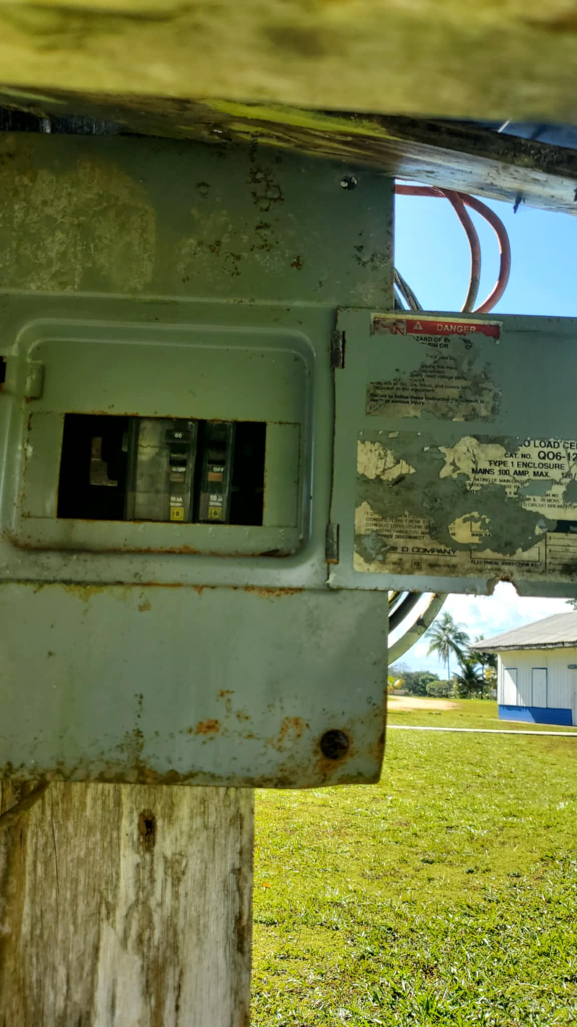

Slide 16
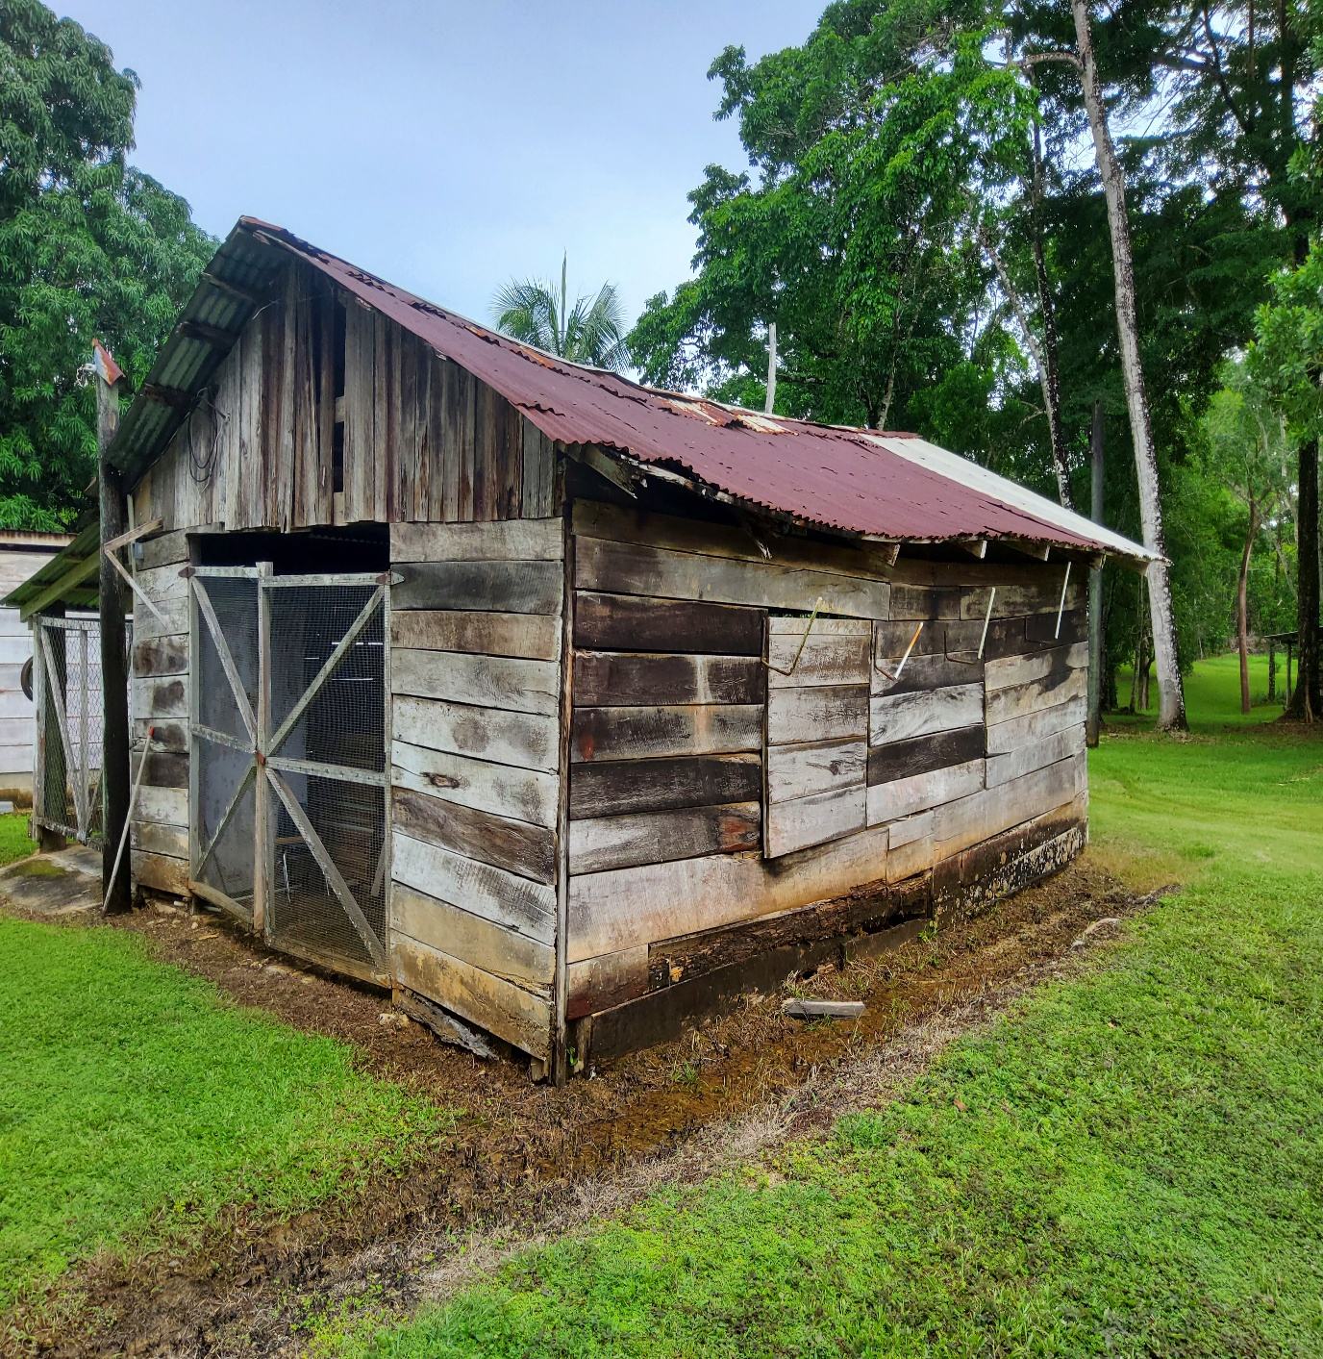
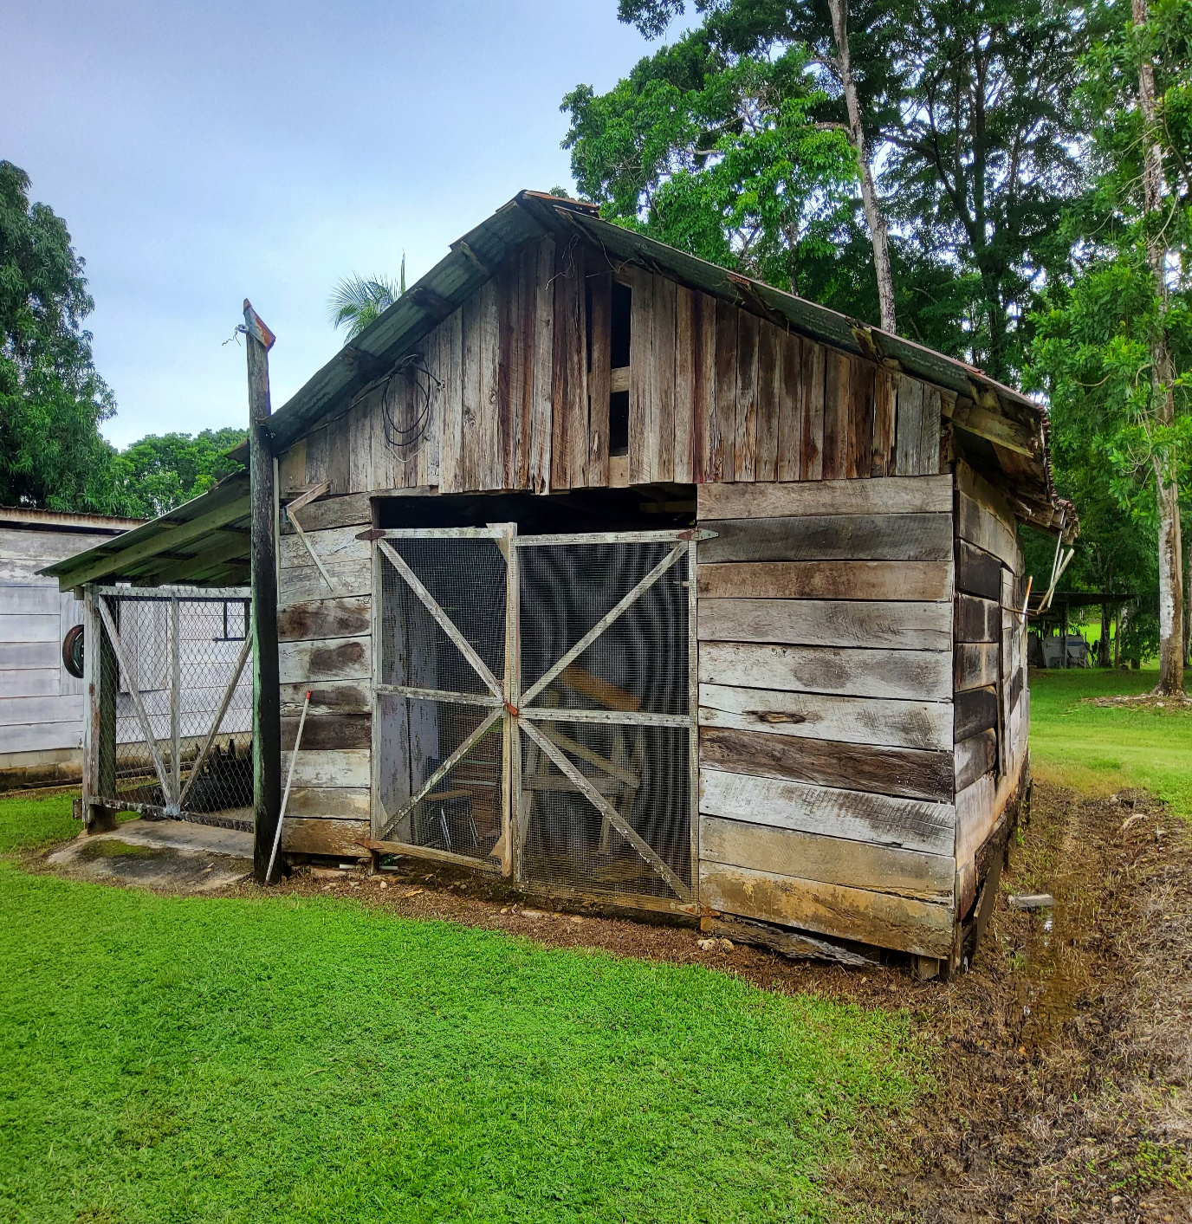
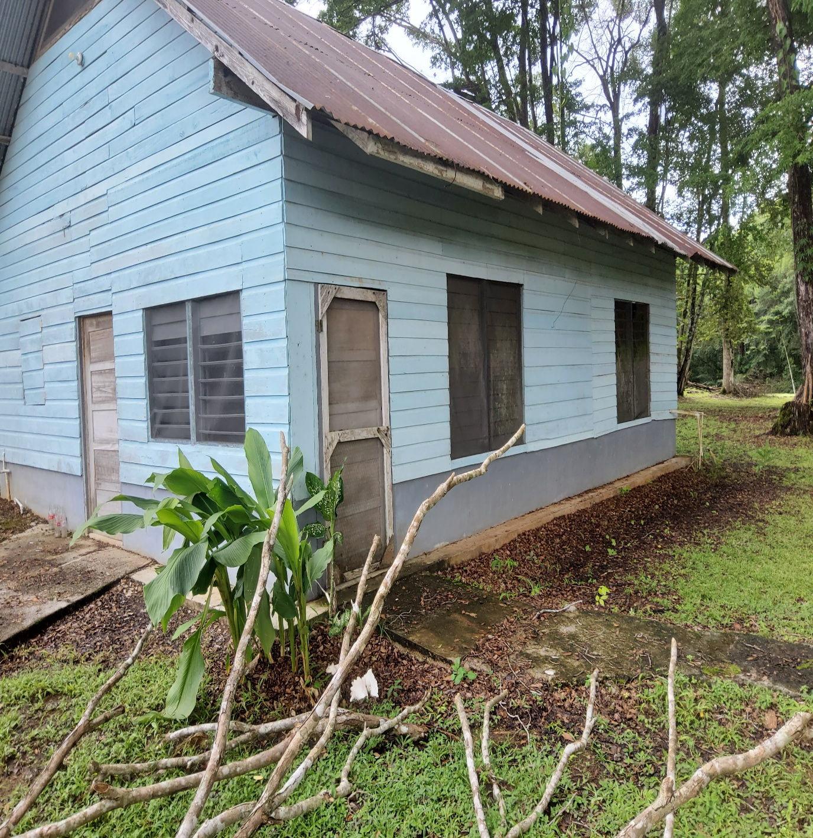
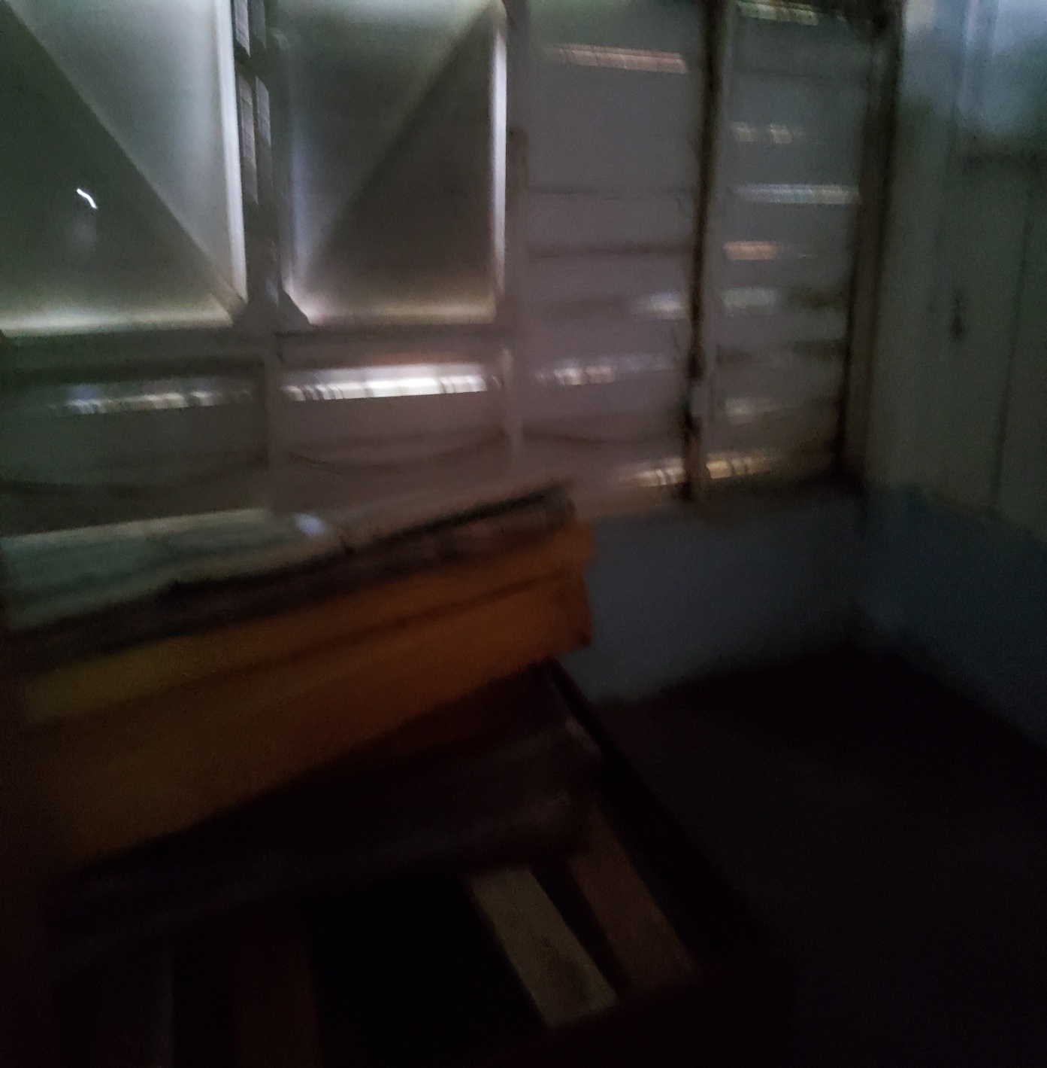

Slide 17
Ezr 7:10 For Ezra had prepared his heart
to seek the Law of Jehovah,
and to do it,
and to teach statutes and judgments in Israel.
Ezr 7:10 Porque Esdras había preparado su corazón para inquirir la ley de Jehová,
y para
hacer y enseñar á Israel mandamientos y juicios.
2Ti 2:2 And the things that you have heard
from me among many witnesses,
commit the same to faithful men
who will be able to teach others also.
2Ti 2:2 Y lo que has oído
de mí entre muchos testigos,
esto encarga á los hombres fieles que serán idóneos para enseñar también á otros.

Slide 18
Belize 2024
(Part 1)

Slide 19
Joh 4:34 Then Jesus explained: “My nourishment comes from doing the will of God, who sent me, and from finishing his work.
35 You know the saying, ‘Four months between planting and harvest.’ But I say, wake up and look around.
The fields are already ripe for harvest.
36 The harvesters are paid good wages, and the fruit they harvest is people brought to eternal life. What joy awaits both the planter and the harvester alike!
37 You know the saying, ‘One plants and another harvests.’ And it’s true.
38 I sent you to harvest where you didn’t plant;
others had already done the work,
and now you will get to gather the harvest.”
Joh 4:34 Jesús les dijo: --Mi comida es que yo haga la voluntad del que me envió y que acabe su obra.
35 ¿No decís vosotros: "Todavía faltan cuatro meses para que llegue la siega"? He aquí os digo: ¡Alzad vuestros ojos y mirad los campos, que ya están blancos para la siega!
36 El que siega recibe salario y recoge fruto para vida eterna, para que el que siembra y el que siega se gocen juntos.
37 Porque en esto es verdadero el dicho: "Uno es el que siembra, y otro es el que siega."
38 Yo os he enviado a segar lo que vosotros no habéis labrado. Otros han labrado, y vosotros habéis entrado en sus labores.

Slide 20
Ez 7:6 this Ezra went up from Babylon. And he was a ready scribe in the Law of Moses, which Jehovah, the God of Israel had given. And the king granted him all he asked, according to the hand of Jehovah his God on him.
7 And there went up some of the sons of Israel, and of the priests, and the Levites, and the singers, and the gatekeepers, and the temple slaves, to Jerusalem in the seventh year of Artaxerxes the king.
8 And he came to Jerusalem in the fifth month, in the seventh year of the king.
9 For on the first of the first month he began to go up from Babylon, and on the first of the fifth month he came to Jerusalem, according to the good hand of his God on him.
10 For Ezra had prepared his heart to seek the Law of Jehovah,
and to do it, and to teach statutes and judgments in Israel.
Ez 7:6 este Esdras, quien era escriba versado en la ley de Moisés, que Jehovah Dios había dado, subió de Babilonia. El rey le concedió todo lo que pidió, pues la mano de Jehovah su Dios estaba con él.
7 En el séptimo año del rey Artajerjes, también subieron a Jerusalén algunos de los hijos de Israel y algunos de los sacerdotes, levitas, cantores, porteros y servidores del templo.
8 Llegó a Jerusalén en el mes quinto del séptimo año del rey.
9 El primer día del mes primero había iniciado el viaje de retorno de Babilonia, y el primer día del mes quinto llegó a Jerusalén, pues la bondadosa mano de su Dios estaba con él.
10 Porque Esdras había preparado su corazón para escudriñar la ley de Jehovah y para cumplirla, a fin de enseñar a Israel los estatutos y los decretos.

Slide 21
2Ti 2:15 Study earnestly
to present yourself approved to God,
a workman that does not need to be ashamed, rightly dividing the Word of Truth.
2Ti 2:15 Procura con diligencia
presentarte a Dios aprobado, como obrero que no tiene de qué avergonzarse,
que maneja con precisión la palabra de verdad.
G4704 study earnestly - spoo-dad'-zo = to use speed, i.e. to make effort, be prompt or earnest:--do (give) diligence, be diligent (forward), endeavour, labour, study.
G3718 rightly dividing - or-thot-om-eh’-o = to make a straight cut, i.e. (figuratively) to dissect, (expound) correctly (the divine message)

Slide 22
Belize 2024
(Part 2)

Slide 23
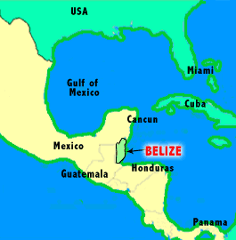

Slide 24


Zelda
Toledo Christian Academy (TCA)
Belize 2024
TCA Teachers

Slide 25
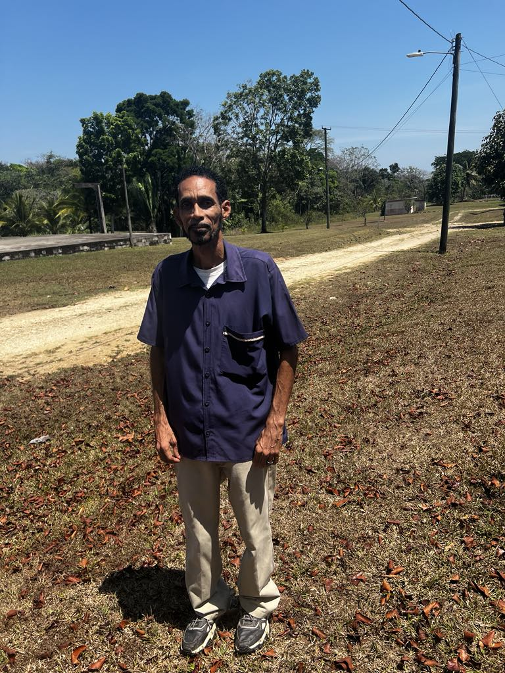
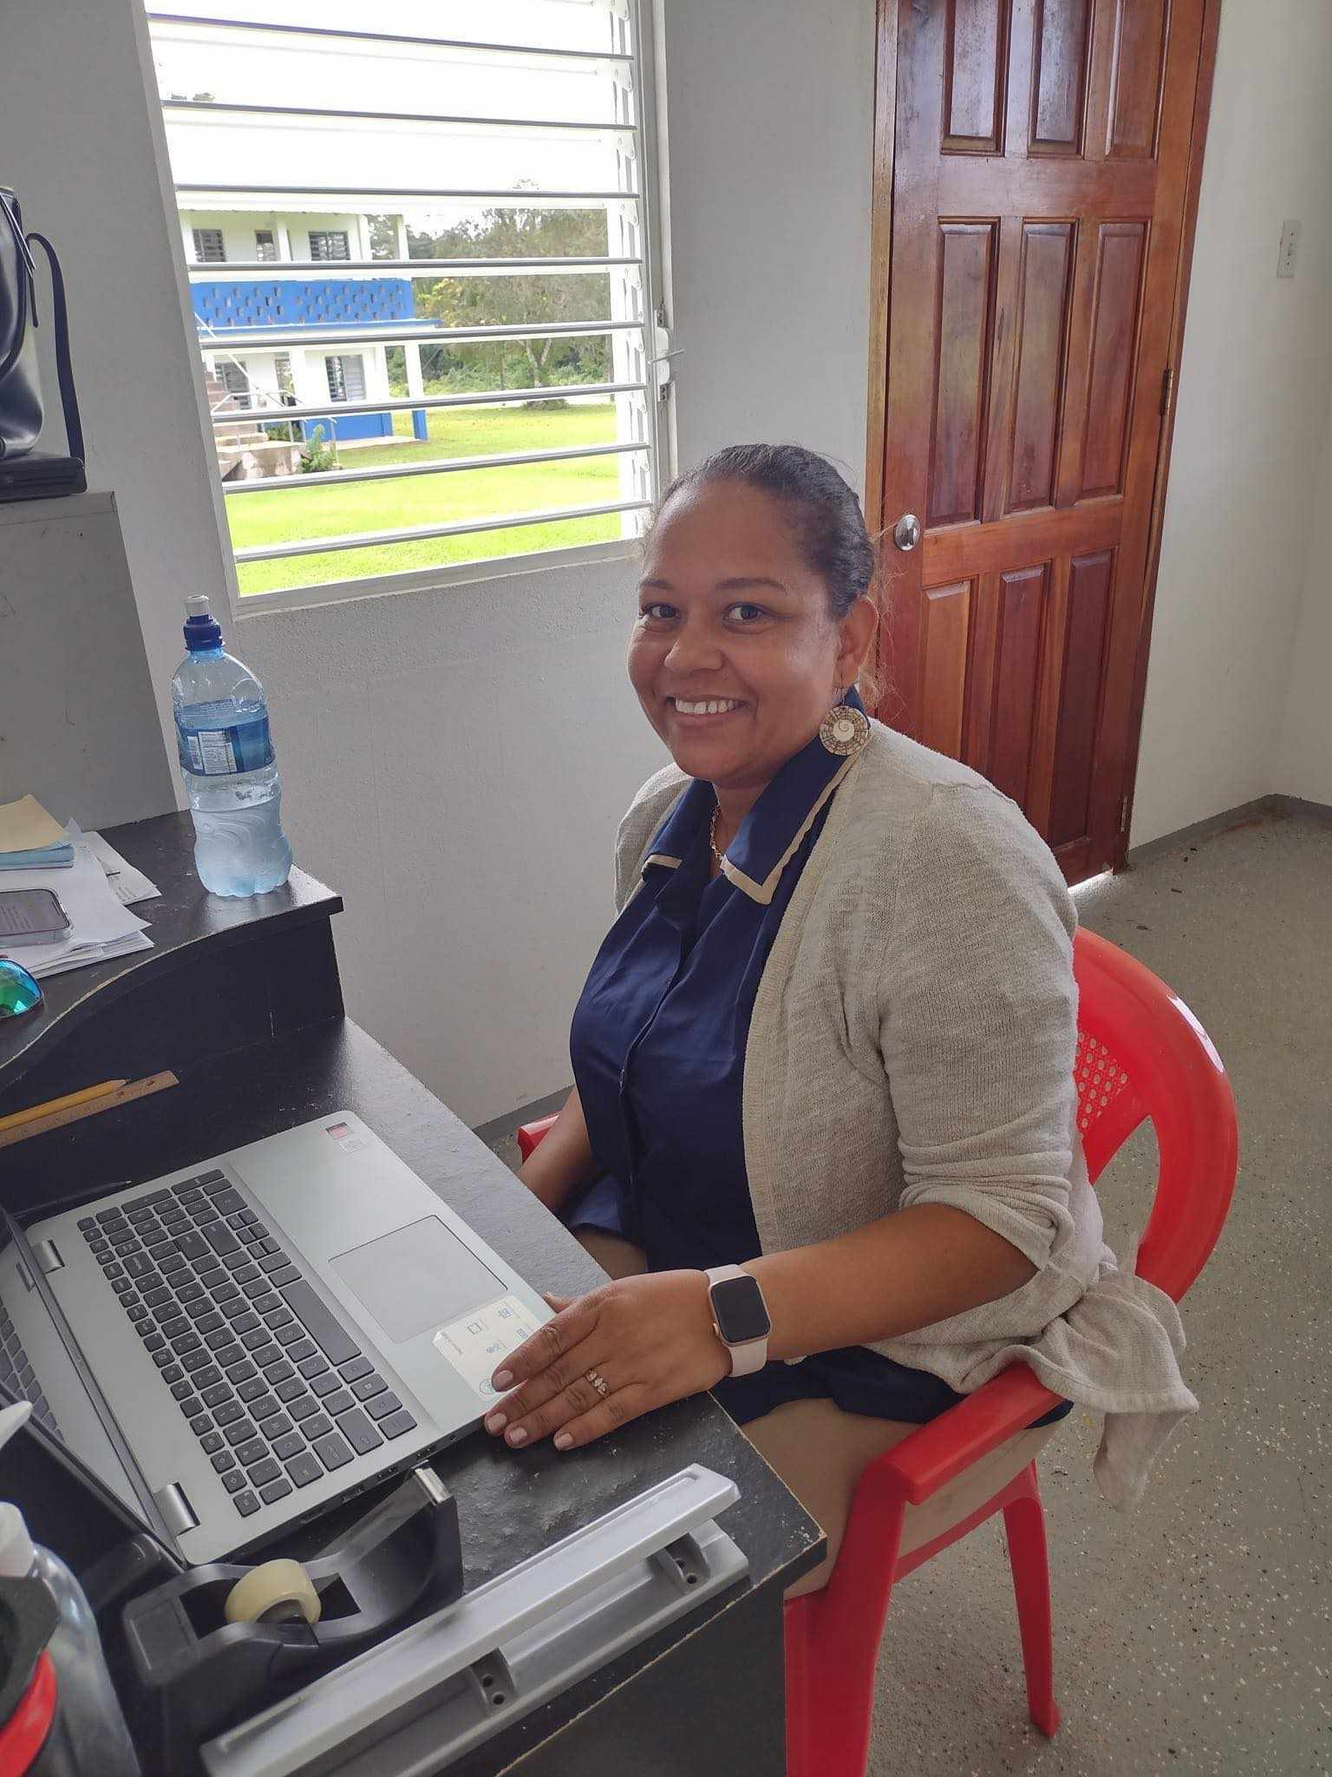
TCA Principle
Charlie Fisher
TCA Administrator
Zelda Tanner

Slide 26
Amargosa
Christian Fellowship
1986-1998
Santa Rosa 1998
Belize TCA
1999-2004
CCM
2004-?
CCM
Trav n Liz
2012-2014
ST Teams

Slide 27
Calvary Chapel Mesquite
2024
Santa Rosa 2024
Belize TCA
2024 - ?
BLC
2024 - ?
CCM
Missions
2024 - ?

Slide 28
Toledo Christian Academy (TCA) Emery Grove - Toledo District
Servant Leadership Ministries Belmopan - Cayo District
Mennonite Fellowship Spanish Lookout - Cayo District
Lighthouse Christian Radio Ambergros Caye Belize District
??? Ministries Orange Walk - Corrozal District

Slide 29
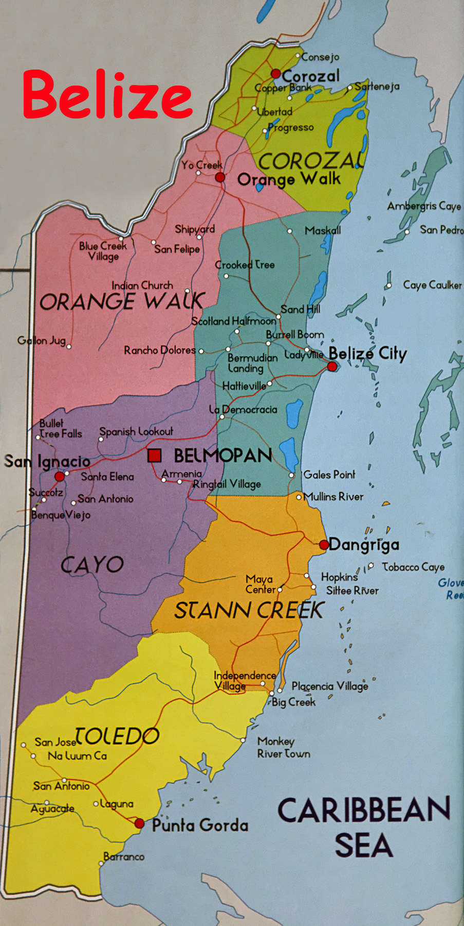
Belize
Central America
Corozal
N
Spanish Lookout
W
San Pedro
E
Punta Gorda
S

Slide 30
Emery Grove
Toledo District

Slide 31
Toledo Christian Academy (TCA)

Slide 32
Zelda
Toledo Christian Academy (TCA)
Belize 2024
TCA Teachers

Slide 33
TCA Principle
Charlie Fisher
TCA Administrator
Zelda Tanner

Slide 34
Belize Life Center
(BLC)

Slide 35

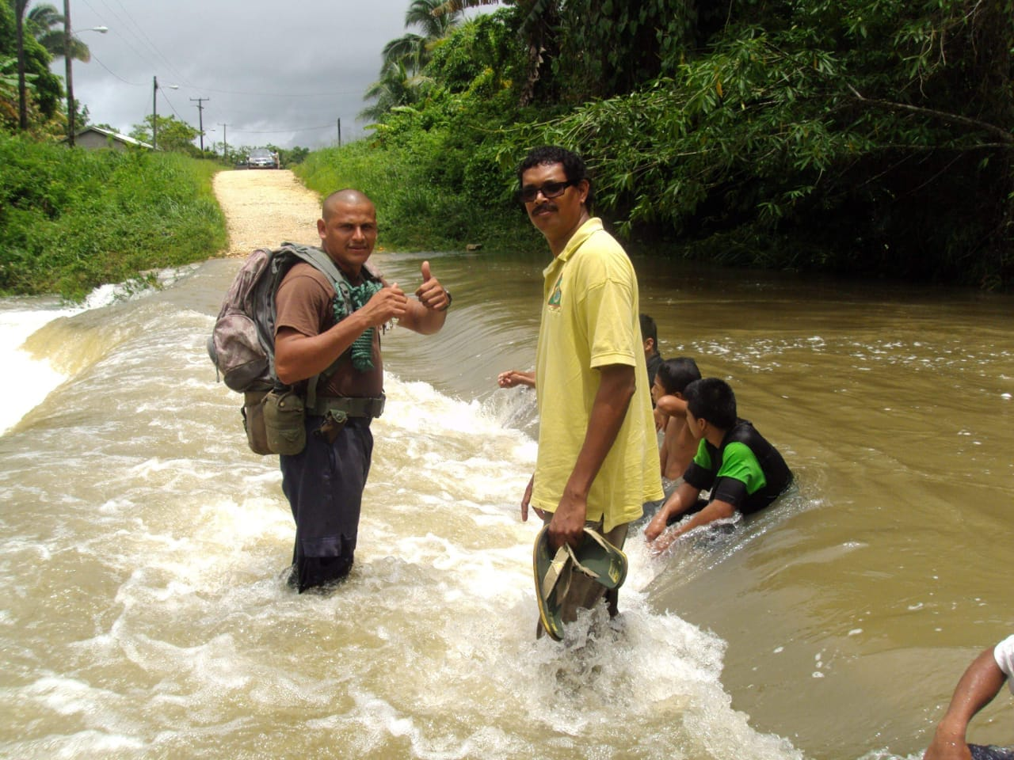
BLC Pastor
Evans and Bonsha Mangar
BLC Leader
Kenton Parham

Slide 36
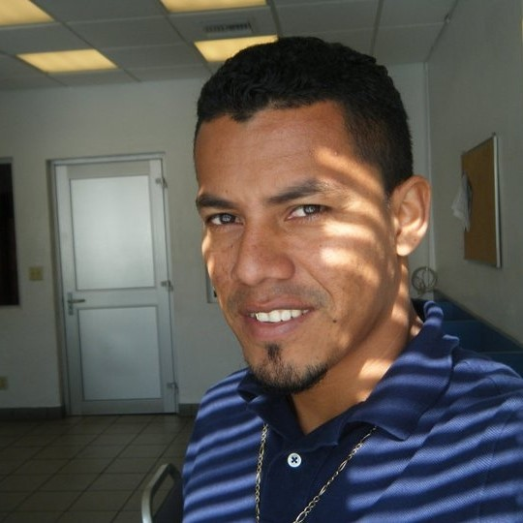
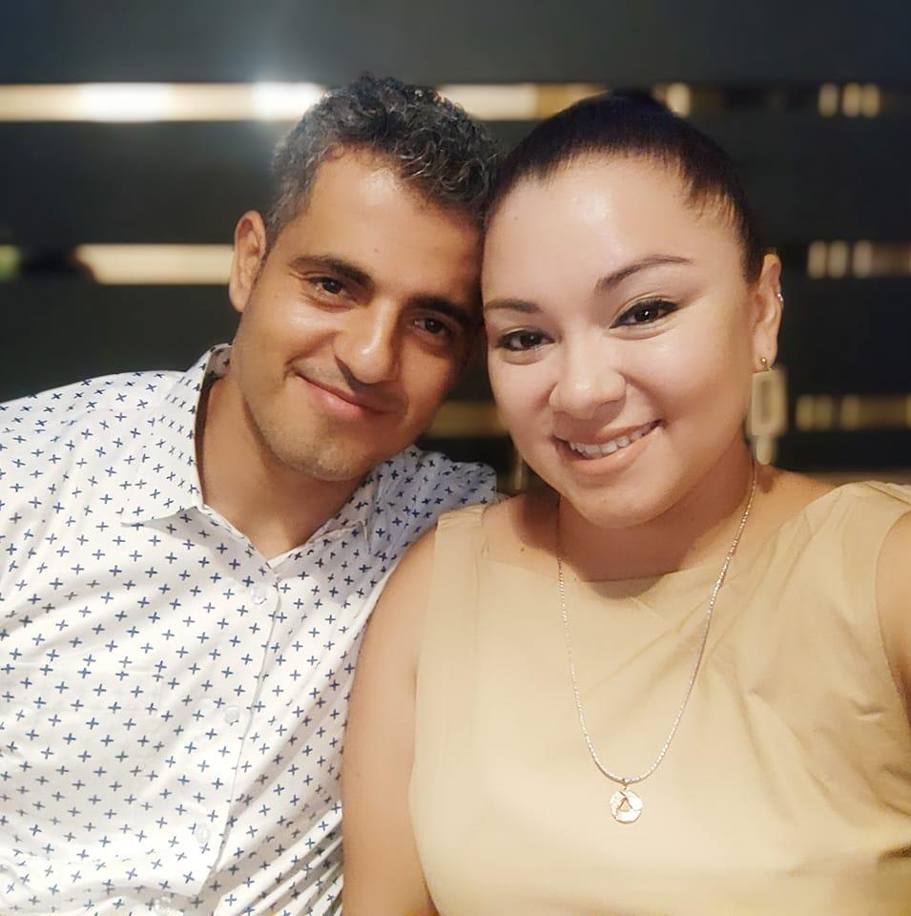
Abdon (James) Sanchez
San Pedro Town
Terrence & Andera Punjabi
FMI - Mapusa, India

Slide 37
Ambergris Caye
San Pedro Town

Slide 38
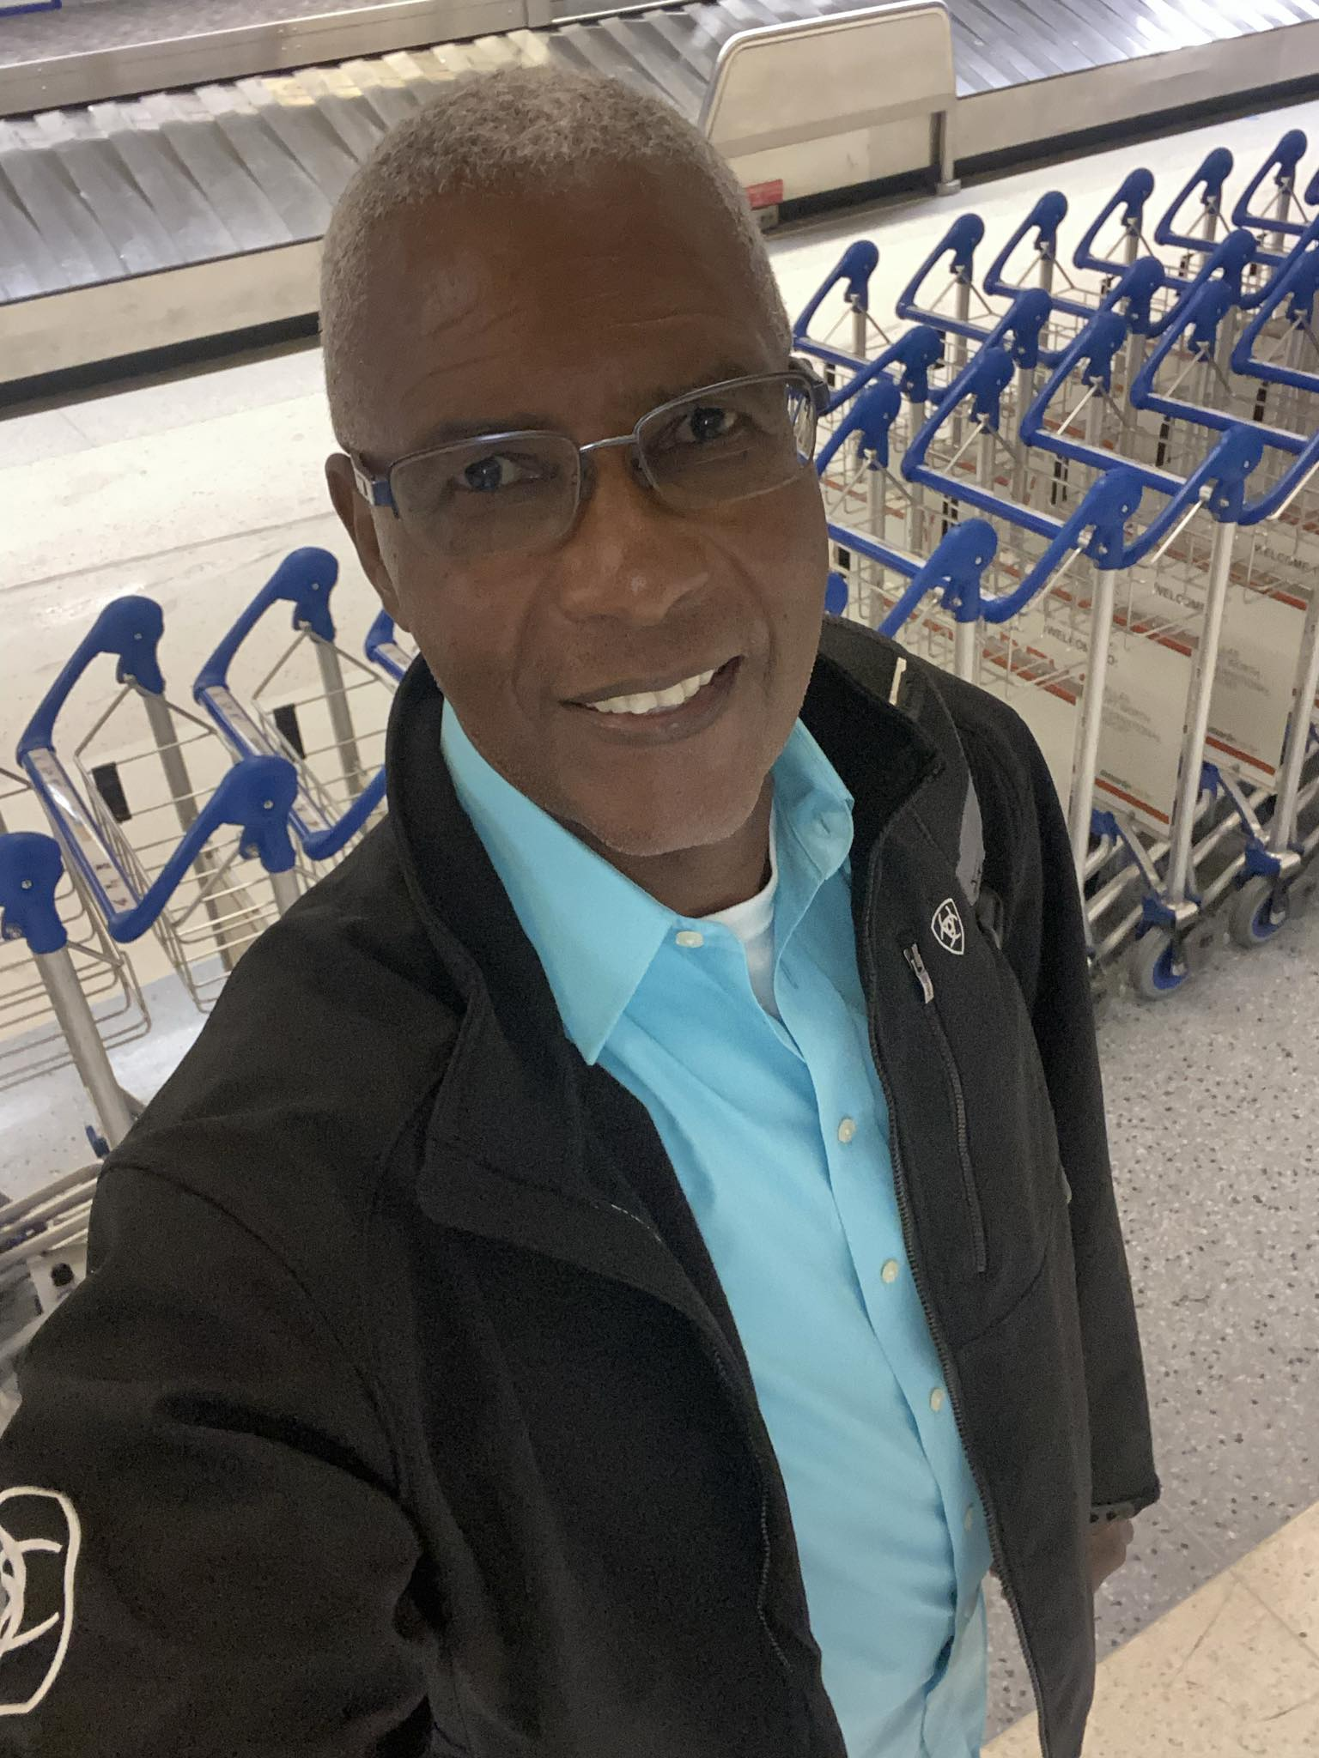
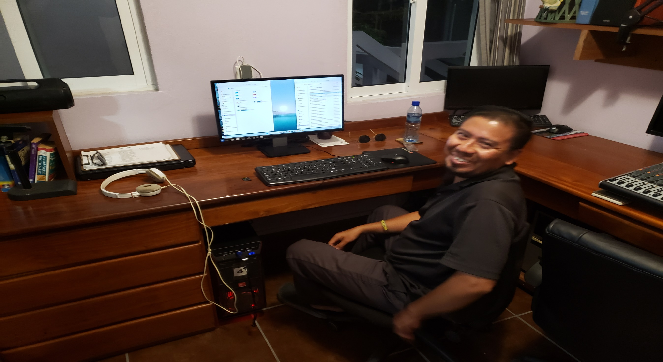
Lighthouse Christian Radio – director
Clive Welsh
Lighthouse Christian Radio – programmer
Elmer Montero

Slide 39
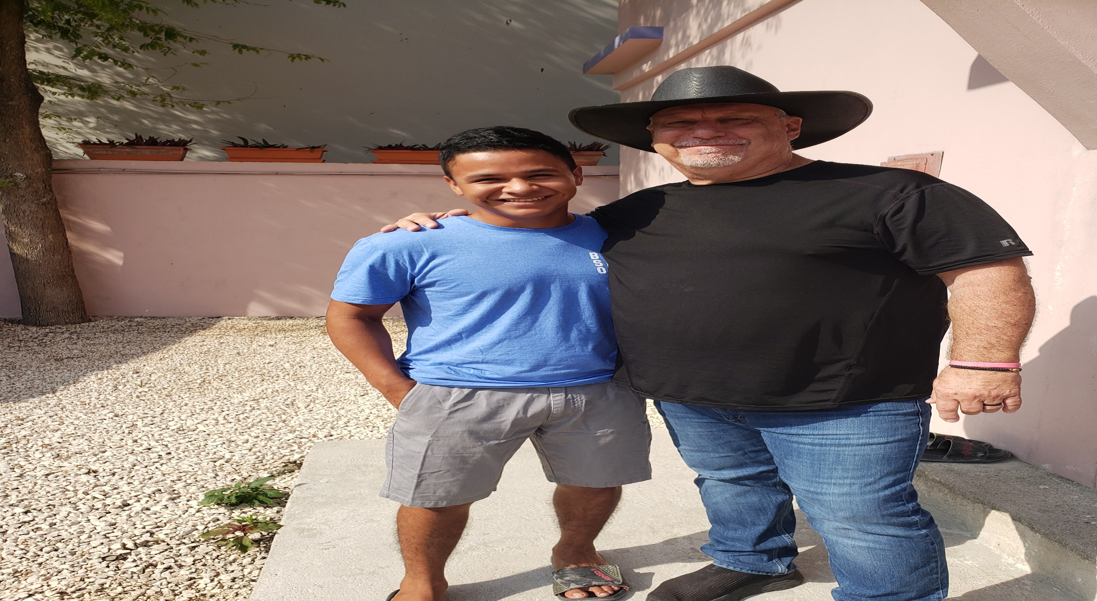
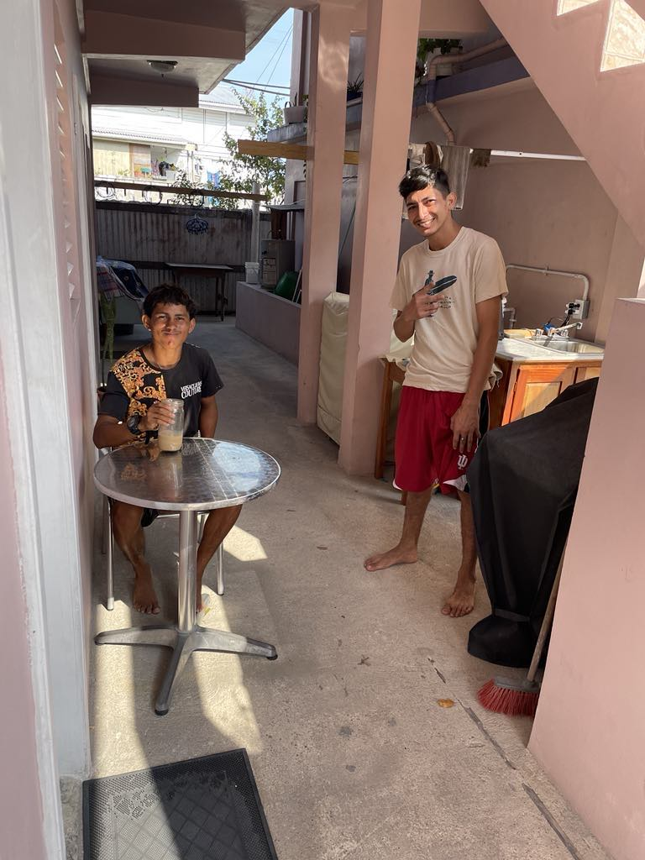
LCR Discipleship Program Leader
Wil Almazan
LCR Discipleship Program
Carlos & Jaime

Slide 40
Belize probable future ministry
*Spanish Lookout Mennonite community Cayo District (western most district)
Corozal Corozal District (northern most district)
Southern Toledo Technical Institute Toledo District

Slide 41
Mt 28:18 Jesús se acercó a ellos y les habló diciendo: "Toda autoridad me ha sido dada en el cielo y en la tierra.
19 Por tanto, id y haced discípulos a todas las naciones, bautizándoles en el nombre del Padre, del Hijo y del Espíritu Santo,
20 y enseñándoles que guarden todas las cosas que os he mandado. Y he aquí, yo estoy con vosotros todos los días, hasta el fin del mundo."
Mt 28:18 And Jesus came and spoke to them, saying, All authority is given to Me in Heaven and in earth.
19 Therefore go and teach all nations, baptizing them in the name of the Father and of the Son and of the Holy Spirit,
20 teaching them to observe all things, whatever I commanded you. And behold,
I am with you all the days
until the end of the world.

Slide 42
The Gospel
“Good News”
according to John

Slide 43
Jn 1:43 The next day Jesus decided to go to Galilee. He found Philip and said to him, “Come, follow me.”
44 Philip was from Bethsaida, Andrew and Peter’s hometown.
45 Philip went to look for Nathanael and told him, “We have found the very person Moses and the prophets wrote about! His name is Jesus, the son of Joseph from Nazareth.”
46 “Nazareth!” exclaimed Nathanael. “Can anything good come from Nazareth?” “Come and see for yourself,” Philip replied.
Jn 1:43 Al día siguiente, Jesús quiso salir para Galilea y encontró a Felipe. Y Jesús le dijo: --Sígueme.
44 Felipe era de Betsaida, la ciudad de Andrés y de Pedro.
45 Felipe encontró a Natanael y le dijo: --Hemos encontrado a aquel de quien Moisés escribió en la Ley, y también los Profetas: a Jesús de Nazaret, el hijo de José.
46 Y le dijo Natanael: --¿De Nazaret puede haber algo de bueno? Le dijo Felipe: --Ven y ve.
(Yeshuah =
Yah saves, delivers, rescues)

Slide 44
Jn 1:47 As they approached, Jesus said, “Now here is a genuine son of Israel—a man of complete integrity.”
48 “How do you know about me?” Nathanael asked. Jesus replied, “I could see you under the fig tree before Philip found you.”
49 Then Nathanael exclaimed, “Rabbi, you are the Son of God—the King of Israel!”
Jn 1:47 Jesús vio que Natanael venía hacia él y dijo de él: --¡He aquí un verdadero israelita, en quien no hay engaño!
48 Le dijo Natanael: --¿De dónde me conoces? Respondió Jesús y le dijo: --Antes que Felipe te llamara, cuando estabas debajo de la higuera, te vi.
49 Le respondió Natanael: --Rabí, ¡tú eres el Hijo de Dios! ¡Tú eres el rey de Israel!
(Messiah)

Slide 45
Jn 1:50 Jesus answered and said to him,
"Because I said to you,
'I saw you under the fig tree,' do you believe? You will see greater things than these."
51 And He said to him,
"Most assuredly, I say to you,
hereafter you shall see heaven open,
and the angels of God ascending and descending upon the Son of Man.“ (NKJV)
Jn 1:50 Respondió Jesús y le dijo: --¿
Crees porque te dije:
"Te vi debajo de la higuera"? ¡Cosas mayores que éstas verás!
51 Y les dijo:
--De cierto,
de cierto os digo que veréis el cielo abierto y a los ángeles de Dios que suben y descienden
sobre el Hijo del Hombre.
-Ge 28:12-

Slide 46
Heaven above
present
future
present
future
past
ΑΩ
ta
Jn 1:1 In the beginning was the Word,
and the Word was with God,
and the Word was God.
2 He was in the beginning with God.
(Re 1:8, 22:13)
Jn 1:1 En el principio era el Verbo,
y el Verbo era con Dios,
y el Verbo era Dios.
2 El era en el principio con Dios.
(Re 1:8, 22:13)
את
Earth below

Slide 47
7 6 5 4 3 2 1
1:1 בְּרֵאשִׁית בָּרָא אֱלֹהִים הַשָּׁמַיִם וְ הָאָֽרֶץ׃
אֵת
ְאֵת
ha eretz ha shamayim Elohim bara bereshit
v et
et
the earth and the heavens God created in beginning
3 words
3 words
As Creator, He is before the creation of the heavens and the earth
As Savior, He is the way between the heavens and the earth
4 = grace
6 = man

Slide 48
Jn 1:50 Jesus asked him, “Do you believe this just because I told you I had seen you under the fig tree? You will see greater things than this.”
51 Then he said, “I tell you the truth, you will all see heaven open and the angels of God going up and down on the Son of Man, the one who is the stairway between heaven and earth.” (NLT)
Jn 1:50 Respondió Jesús y le dijo: --¿Crees porque te dije: "Te vi debajo de la higuera"? ¡Cosas mayores que éstas verás!
51 Y les dijo: --De cierto, de cierto os digo que veréis el cielo abierto y a los ángeles de Dios que suben y descienden sobre el Hijo del Hombre.

Slide 49
Jn 1:51 Then he said,
“I tell you the truth,
you will all see heaven open
and the angels of God going up and down
on the Son of Man,
the one who is the stairway
between heaven and earth.” (NLT)
Jn 1:51 Y les dijo:
--De cierto,
de cierto os digo que veréis el cielo abierto y a los ángeles de Dios que suben y descienden
sobre el Hijo del Hombre.

Slide 50

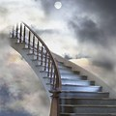

Ge 28:12-15 “Jacob’s ladder”

Slide 51
He is Risen!!!

Slide 52
1Co 15:12 But if Christ is proclaimed, that He was raised from the dead, how do some among you say that there is no resurrection of the dead?
13 But if there is no resurrection of the dead, neither has Christ been raised.
14 And if Christ has not been raised,
then our proclamation is worthless,
and your faith is also worthless.
1Co 15:12 Ahora bien, si Cristo es predicado como que ha resucitado de entre los muertos, ¿cómo es que algunos entre vosotros dicen que no hay resurrección de muertos?
13 Porque si no hay resurrección de muertos, tampoco Cristo ha resucitado.
14 Y si Cristo no ha resucitado, vana es nuestra predicación; vana también es vuestra fe.

Slide 53
1Co 15:15 Y aun somos hallados falsos testigos de Dios, porque hemos atestiguado de Dios que resucitó a Cristo, al cual no resucitó, si se toma por sentado que los muertos no resucitan.
16 Porque si los muertos no resucitan, tampoco Cristo ha resucitado;
17 y si Cristo no ha resucitado, vuestra fe es inútil; todavía estáis en vuestros pecados.
18 En tal caso, también los que han dormido en Cristo han perecido.
19 ¡Si sólo en esta vida hemos tenido esperanza en Cristo, somos los más miserables de todos los hombres!
1Co 15:15 And we are also found to be false witnesses of God, because we testified of God that He raised Christ; whom He did not raise if the dead are not raised.
16 For if the dead are not raised, then Christ is not raised.
17 And if Christ is not raised, your faith is foolish; you are yet in your sins.
18 Then also those that fell asleep in Christ were lost.
19 If in this life only we have hope in Christ,
we are of all men most miserable.

Slide 54
1Co 15:20 But now Christ has risen from the dead and has become the FIRSTFRUIT of those who slept.
21 For since death is through man, the resurrection of the dead also is through a Man.
22 For as in Adam all die, even so in Christ all will be made alive.
23 But each in his own order: Christ the first-fruit, and afterward they who are Christ's at His coming;
1Co 15:20 Pero ahora, Cristo sí ha resucitado de entre los muertos, como primicias de los que durmieron.
21 Puesto que la muerte entró por medio de un hombre, también por medio de un hombre ha venido la resurrección de los muertos.
22 Porque así como en Adán todos mueren, así también en Cristo todos serán vivificados.
23 Pero cada uno en su orden: Cristo, las primicias; luego los que son de Cristo, en su venida.

Slide 55
Lv 23:2 Speak to the sons of Israel and say to them, The feasts of Jehovah,
which you shall proclaim, holy convocations,
even these are My appointed feasts.
Lv 23:2 "Habla a los hijos de Israel y diles que las fiestas solemnes de Jehovah,
mis fiestas solemnes que proclamaréis como asambleas sagradas, son éstas:
PASSOVER
Unleavened
Bread
FIRSTFRUITS
PENTECOST
*
Jesus crucified on
PASSOVER
Jesus buried on
UNLEAVENED
BREAD
Jesus resurrected on
FIRSTFRUITS
Jesus initiate
His Church on
PENTECOST

Slide 56
“the GREAT COMISSION”

Slide 57
Mt 28:18 And Jesus came and spoke to them, saying, all authority is given to Me in Heaven and in earth.
19 Therefore go and teach all nations, baptizing them in the name of the Father and of the Son and of the Holy Spirit,
20 teaching them to observe all things, whatever I commanded you. And behold, I am with you all the days until the end of the world.
Mt 28:18 Jesús se acercó a ellos y les habló diciendo: "Toda autoridad me ha sido dada en el cielo y en la tierra.
19 Por tanto, id y haced discípulos a todas las naciones, bautizándoles en el nombre del Padre, del Hijo y del Espíritu Santo,
20 y enseñándoles que guarden todas las cosas que os he mandado. Y he aquí, yo estoy con vosotros todos los días, hasta el fin del mundo."

Slide 58
Ac 1:4 And having met with them,
He commanded them
not to depart from Jerusalem,
but to await the promise of the Father
which you heard from Me.
Ac 1:4 Y estando juntos,
les mandó que no se fuesen de Jerusalén,
sino que esperasen el cumplimiento
de la promesa del Padre,
"de la cual me oísteis hablar;

Slide 59
Ac 1:8 But you shall receive power,
the Holy Spirit coming upon you.
And you shall be witnesses to Me
both in Jerusalem
and in all Judea,
and in Samaria,
and to the end of the earth.
Ac 1:8 Pero recibiréis poder cuando
el Espíritu Santo haya venido sobre vosotros,
y me seréis testigos
en Jerusalén,
en toda Judea,
en Samaria
y hasta lo último de la tierra.

