Slide 1

We are PowerCem Technologies

Slide 2
Philosophy
South Emsall Sewage Treatment Works Wetland
To significantly reduce the carbon footprint of the construction
To preserve virgin aggregate resources
To avoid the use of a manufactured membrane
To create a strong, durable facility that can be maintained simply and safely throughout its intended design life
To use materials that can be fully recycled at end of life of the facility, with zero waste

Slide 3
The Project
South Emsall Sewage Treatment Works Wetland
5 wetland cells covering around 25,300 m²
Provision of storage capacity for storm overflows
Removal by plants of chemicals such as phosphates not addressed by the STW
Accommodates flow of 440l/s

Slide 4
Methodology
South Emsall Sewage Treatment Works Wetland
Soils laboratory tested to prove strength and impermeability, benchmarked against puddle clay
Designed for balanced cut/fill – no spoil to landfill
Bulk earthworks carried out to create cell plateaus
Base of cells stabilised in-situ with RoadCem and OPC to a depth of 250mm
Topsoil stabilised ex-situ, placed in 250mm layers and compacted to form the embankments
Embankments formed oversize and trimmed to shape after 1 week
Cell 1 full hydraulic test at capacity plus 25% safety margin

Slide 5
Carbon Footprint
South Emsall Sewage Treatment Works Wetland
Original design – all topsoil to landfill and import equal volume of clay
Estimated 3,000 HGV movements, requiring a 650m long temporary haul road, 2 bridges over the beck and a highway standard junction
Stabilising site won material reduced HGV movements to delivery of RoadCem and cement and plant
The haul road, would have been waste on removal, no longer required
Omission of manufactured liner further reduced carbon footprint
Based on other projects estimated 80% reduction in carbon footprint

Slide 6
Technology
South Emsall Sewage Treatment Works Wetland
Cement and lime stabilisation ‘glue’ the particles together, resulting in a brittle material with little tensile strength
RoadCem significantly enhances the stabilisation process by wrapping the particles in a needle like matrix
The resultant material has good tensile strength, a high modulus of elasticity and low permeability
Large areas can be stabilised with low voids and excellent crack control, such that movement joints are not required
Greater proportion of the cement is included in the hydration process which improves the durability of the stabilised material and reduces cement requirement
Contaminants are locked into the microstructure, no leaching of contaminants
RoadCem can be used with soils which are not suitable for lime, or cement stabilisation such as soils with high organic content and clays with high sulphate content and high-volume change potential

Slide 7
Design and Verification
South Emsall Sewage Treatment Works Wetland
The final layout of the cells and the cut/fill model were carried out by Civil Engineers from Rodgers Leask Ltd
The soil sampling, laboratory testing, geotechnical design and site monitoring and verification were carried out by Geotechnical Engineers from Rodgers Leask Ltd

Slide 8
Maintenance and End of Life
South Emsall Sewage Treatment Works Wetland
The stabilised material forming the bases and embankments of the cells enables mechanical plant to enter the cells throughout the lifetime of the facility for maintenance without damaging the integrity or the water retaining properties
Use of a liner would have made maintenance far more difficult
When the cells are eventually decommissioned the stabilised soil can be recycled, either as a growing medium, or as an aggregate for use elsewhere

Slide 9
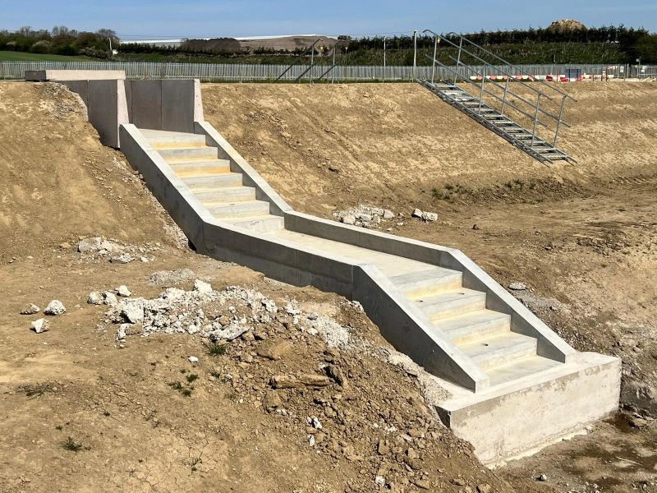
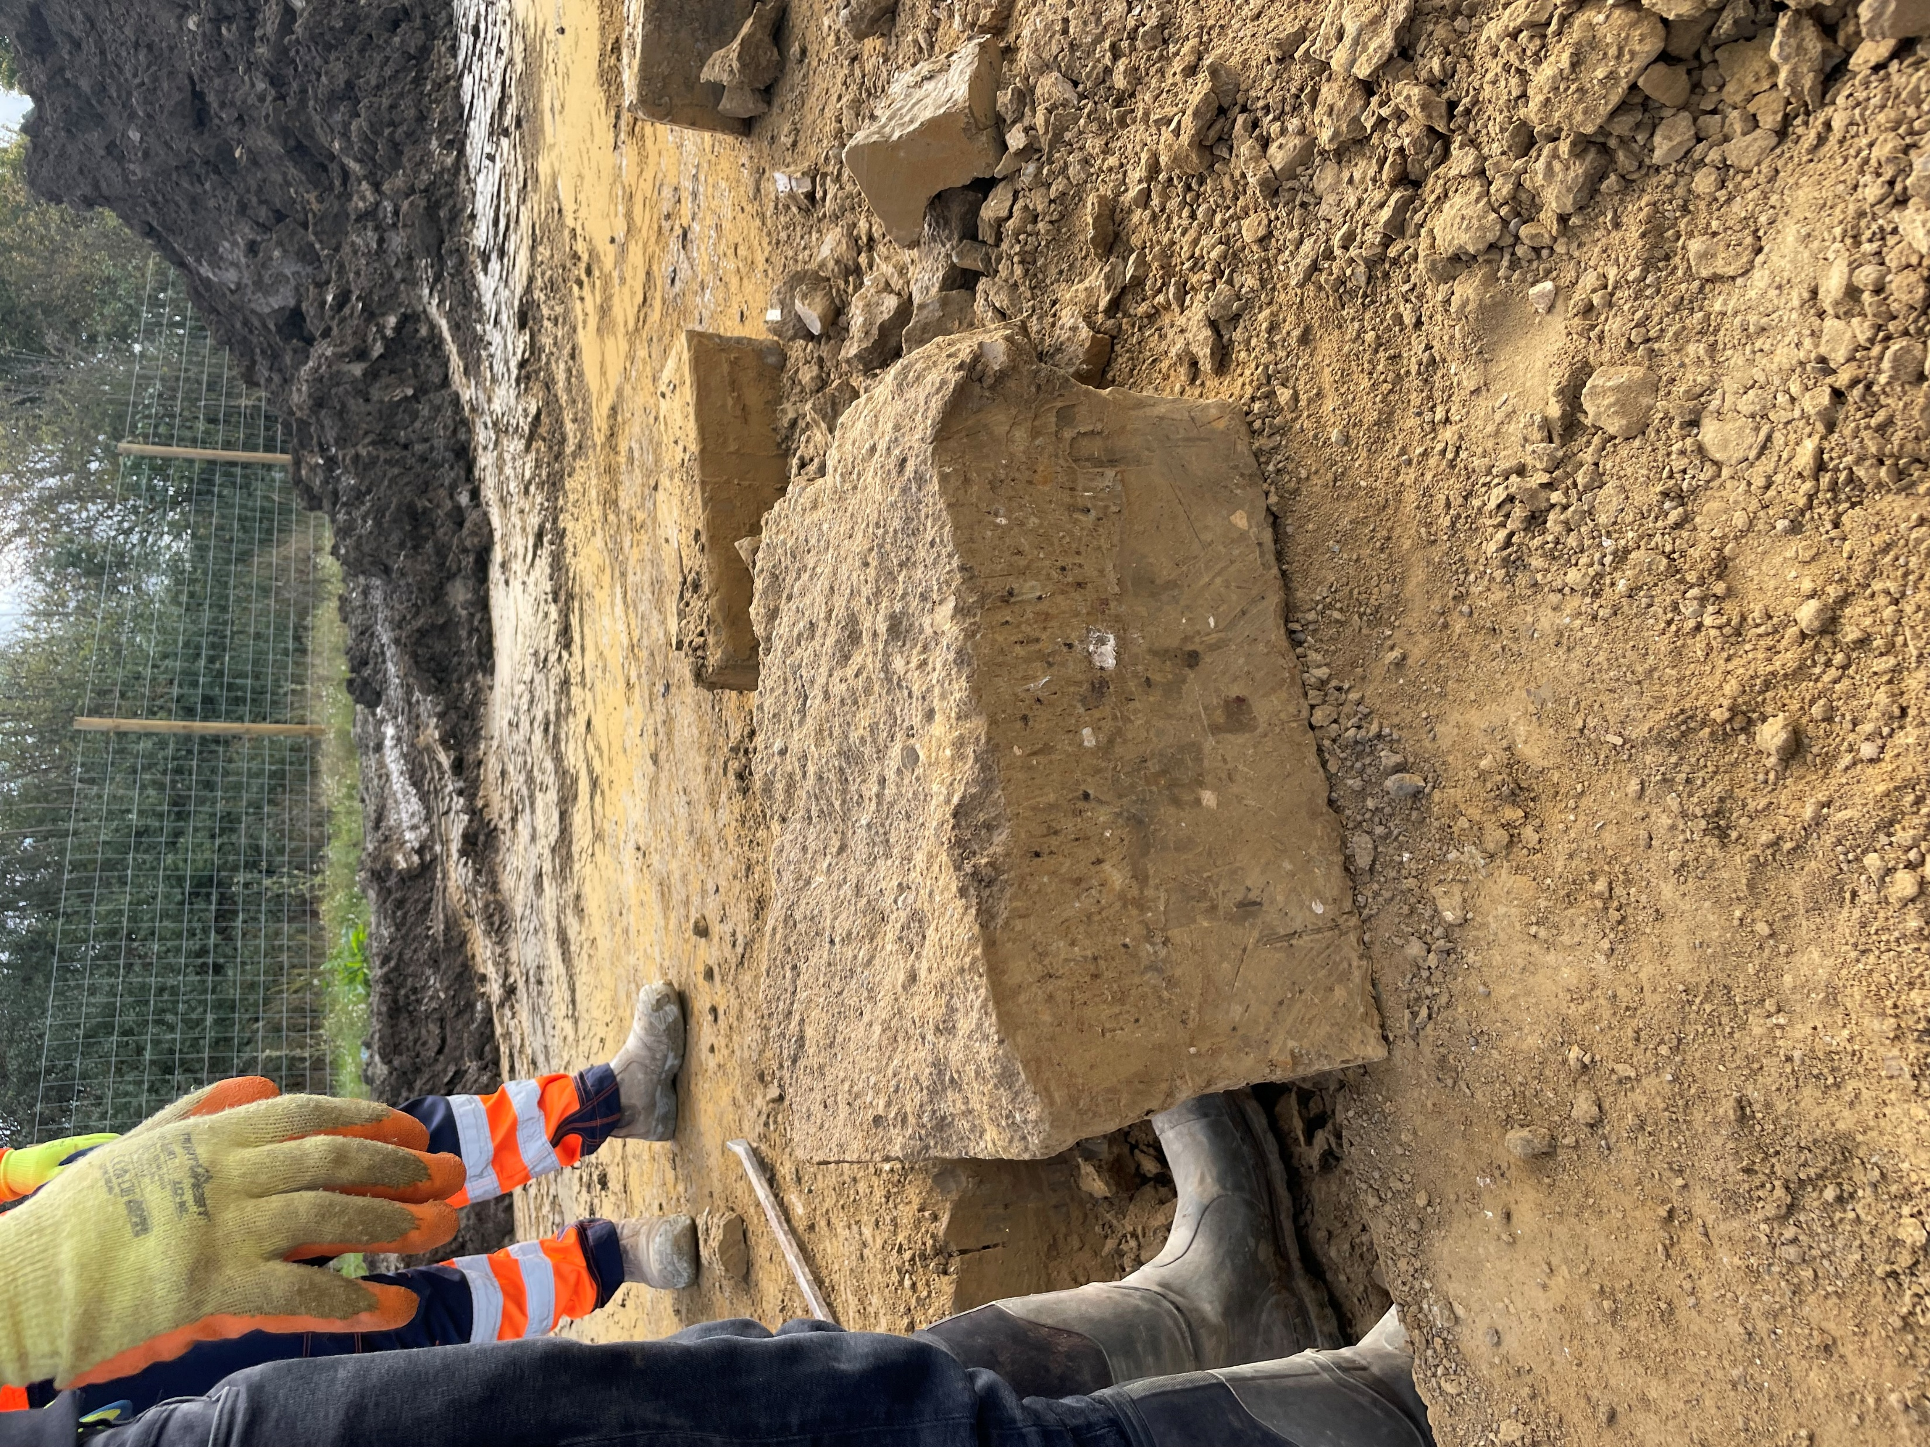
The high ductlity of RoadCem bound soil alows the material to be worked with drills and saws to enable the precast cascades to be retro fitted and simple bonded in to place, without loosing any integrity. Or creating cracks or breakaway.
South Emsall Sewage Treatment Works Wetland

Slide 10
Testimonial
Scott Arbuthnott
Water Industry Project Manager
Eric Wright Water Ltd 💡 Turning a design risk into client value.
At South Elmsall WwTW, early ground investigation flagged that the existing topsoil was too nutrient-rich for the wetland planting—meaning 13,000m³ would need to be exported, and clay imported to build the wetland base.
Rather than accept that, I got in touch with PowerCem Technologies, to explore stabilisation of the site-won soils. Working with DNS (Midlands) Ltd, we delivered the first UK use of cement-stabilised topsoil for water-retaining embankments.
This isn’t innovation for the sake of it. It’s a solution that:
✅ Saved over 33,000m³ of material movement
✅ Removed the need for a plastic liner and clay import
✅ Descoped a 500m haul road
✅ Reduced carbon, improved access, and cut risk
All of this was delivered by Eric Wright Water Ltd using the value engineering mechanism within the contract—something we’ve done across multiple AMP7 projects to give Yorkshire Water a better product at a better price.
It’s a great example of how delivery teams can take ownership of the detail and bring forward practical improvements that benefit the programme, the environment, and the end user.
One thing that’s worth highlighting when comparing with traditional clay lagoon builds is the impact of weather on programme. DNS (Midlands) Ltd constructed this wetland through winter 2024 with minimal weather downtime—something that really helped us stay on track while other sites were feeling the effects of a very wet winter season.
Another example of the practical benefits this approach can bring.

Slide 11
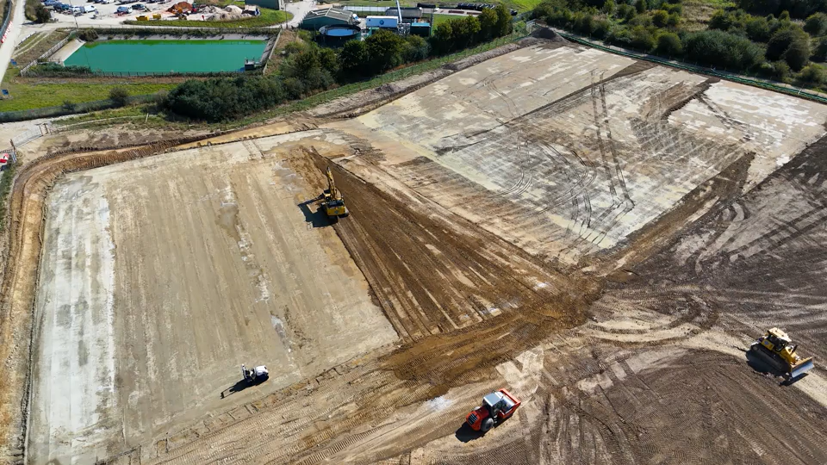
Video
South Emsall Sewage Treatment Works Wetland

