Slide 1
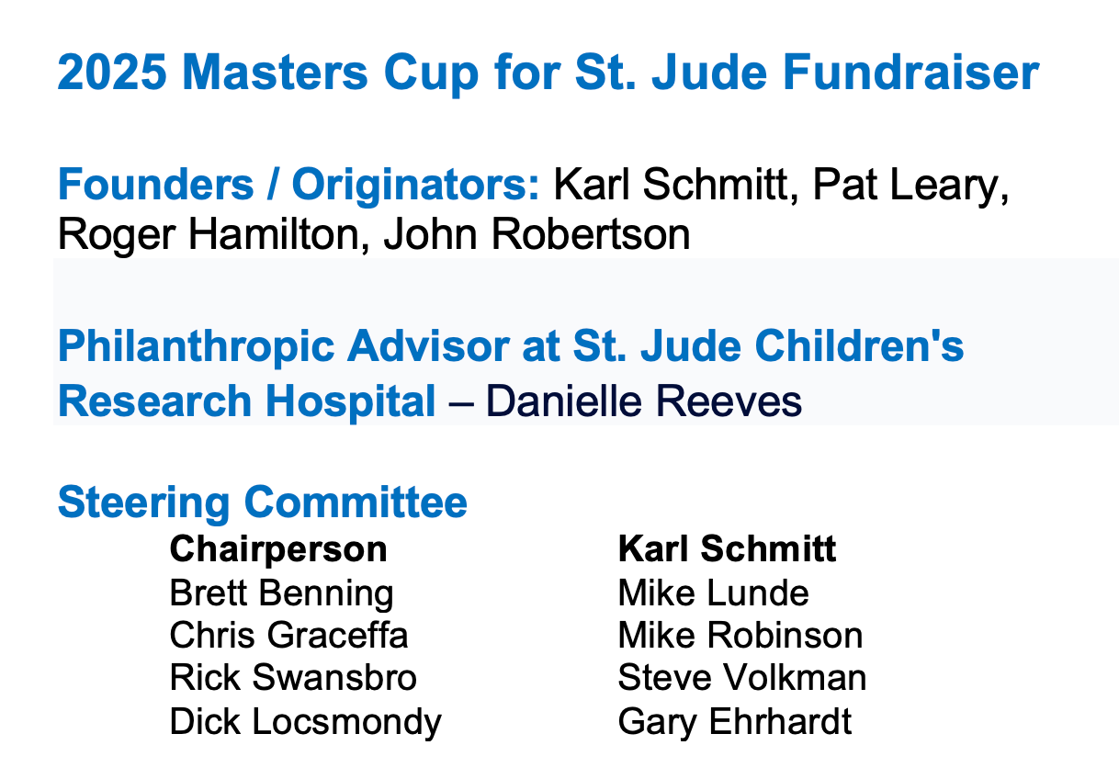

Slide 2
Masters Cup (Handicap) – Past Winners
2025 (?) 2024 – Dave Kohl
2023 – Bud Hewitt 2022 – Garret Anderson
2021 – Gary Randles 2020 - <Covid>
2019 – Dan Seller 2018 - <Weather>
2017 – Jeff Markley 2016 - <Weather>
2015 – Roger Johnson 2014 – Ron Hook
2013 – Roger (OB) Hamilton 2012 – Roger Hamilton
2011 – Milt Wengert 2010 – Bill Brandenberg
2009 – Milt Wengert 2008 – Dan (Dano) Anderson
2007 – Roger (OB) Hamilton 2006 – David (Bobes) Johnson
2005 – Dan Berry

Slide 3
Green Jacket – Past Winners (Scratch)
2025 (?) 2024 – Bobby VanSistine
2023 – Bud Hewitt 2022 – John Robertson
2021 - Grant Romaine 2020 - <Covid>
2019 – Jade Mosher 2018 – Gayle Poloni
2017 – Grant Romaine 2016 - <Weather>
2015 – Ron Hook 2014 - Roger Johnson
2013 – Roger Johnson 2012 – Roger Johnson
2011 – Roger Johnson 2010 – Roger Johnson
2009 – Chad Miller 2008 – Brian (Cuz) Silvers
2007 – John Robertson 2006 – John Robertson
2005 – John Robertson

Slide 4
MC4SJ – 20th Donor Recognition
Rockford Park District & Aldeen GC
RMLR Enterprises Ltd.
Forest Hills Country Club
Mauh-Nah-Tee-See Country Club
Rockford Country Club
Steve & Cole Bamburger
Dave Mays
Dick & Mary Ann Locsmondy

Slide 5
MC4SJ – 20th Donor Recognition
Prairie View Golf Club
Aldeen Golf Club
Francesco’s Risturante
Abbey Springs Golf
Pat Leary
Karl & Cyndi Schmitt
Newburg Village Golf Course
Swan Hill Golf Club

Slide 6
MC4SJ – 20th Donor Recognition
Trulli Audio
Timber Pointe Golf Club
Beth Anderson

Slide 7
Volunteers
Rudy’s Cigars
Cyndi Schmitt
Steve Volkman
Mary Ann Locsmondy
Kathleen Saros
Beth Anderson
Rick Swansbro
Marty Bieschke

Slide 8
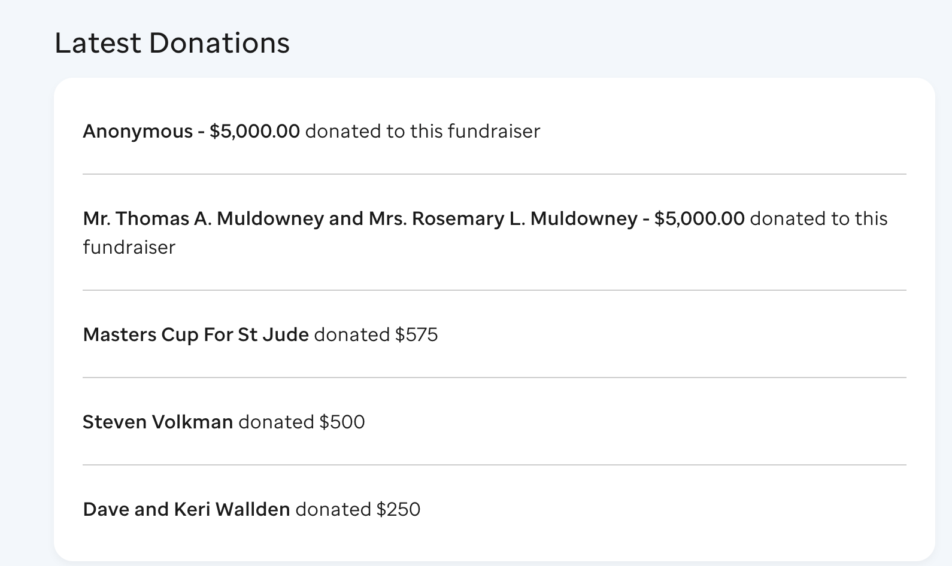
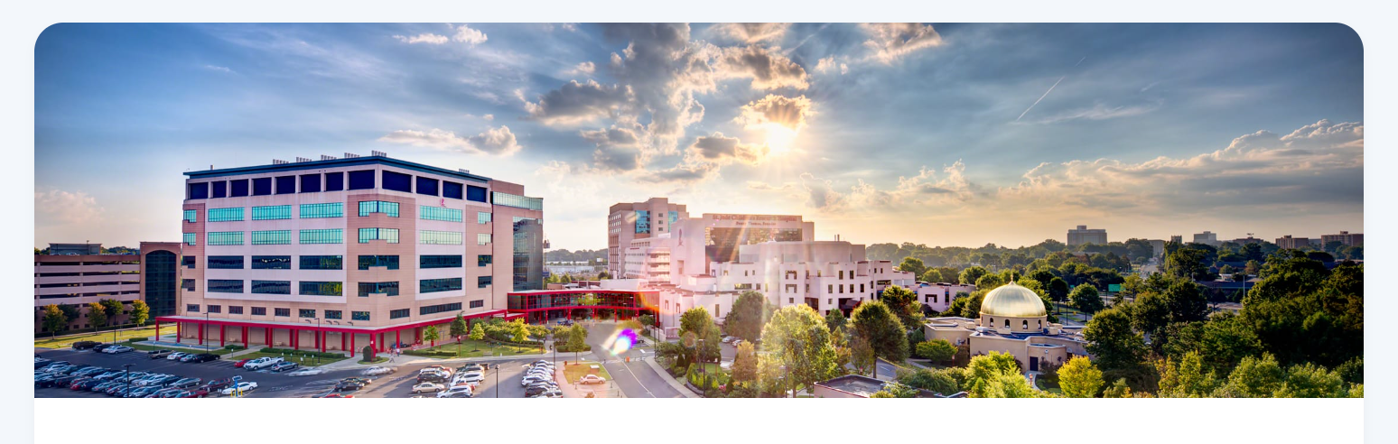
Direct Donors to Masters Cup for St Jude

Slide 9

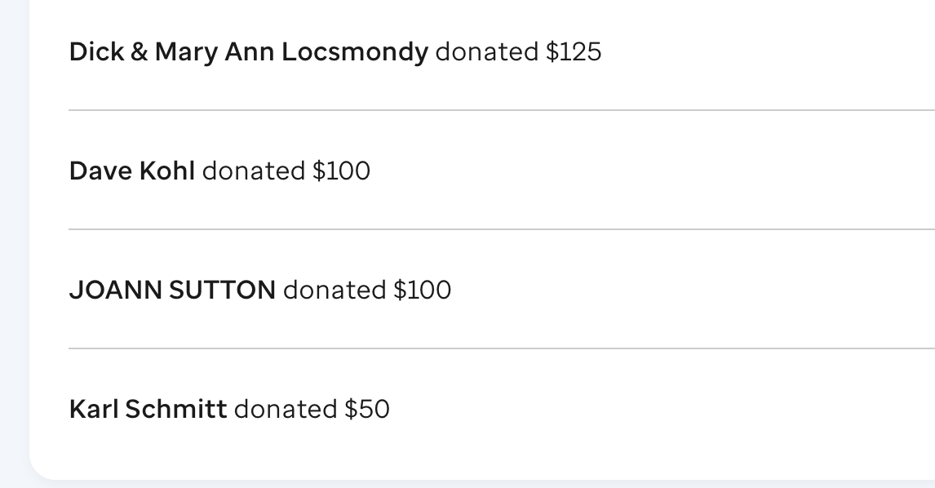
Direct Donors to Masters Cup for St Jude

Slide 10




Hole Sponsors
THIS DOESN’T HAPPEN WITHOUT YOU!

Slide 11




Hole Sponsors
THIS DOESN’T HAPPEN WITHOUT YOU!

Slide 12




Hole Sponsors
THIS DOESN’T HAPPEN WITHOUT YOU!

Slide 13




Hole Sponsors
THIS DOESN’T HAPPEN WITHOUT YOU!

Slide 14




Hole Sponsors
THIS DOESN’T HAPPEN WITHOUT YOU!

Slide 15




Hole Sponsors
THIS DOESN’T HAPPEN WITHOUT YOU!

Slide 16




Hole Sponsors
THIS DOESN’T HAPPEN WITHOUT YOU!

Slide 17




Hole Sponsors
THIS DOESN’T HAPPEN WITHOUT YOU!

Slide 18




Hole Sponsors
THIS DOESN’T HAPPEN WITHOUT YOU!

Slide 19




Hole Sponsors
THIS DOESN’T HAPPEN WITHOUT YOU!

Slide 20

THIS DOESN’T HAPPEN WITHOUT YOU!

