Slide 1


JJanuary 11, 2016
Summary
The Five Stage CCS Process
Session 8 – Resource 3

Slide 2
JJanuary 11, 2016
A More Complete Understanding of Optimal Care and Support
Optimal Care and Support = Competence x Mindful/Conscious Compassion
“We don’t have to feel it to be it”

Slide 3

Optimal Care and Support
10
Fully
Integrated
Biomedical,
Behavioural
and Medical
Best Practices
Optimal Care and Support
(Competent, Calm and Caring)
Competent Best Practices
Cold
Competence
Compromised
4 Outs
Burn-out
Tune-out
Freak-out
Space-out
Caring Incompetence
Incomplete
Support
Practices
0
Unconscious
Semi Conscious
Fully Conscious/Mindful
10
Conscious and therefore Calm and Caring

Slide 4
JJanuary 11, 2016
We Don’t Have to Feel It to Be It
“I have supported a man for several years. He is a very unlikeable, demeaning and unappreciative person. Honestly, I could not stand him. I tried to like him but he was so mean and self centred. I talked to myself every day, reminding myself that it is his disabilities that are causing his negative behaviour, but still I couldn’t stand him. Then during my CCS training I learnt that liking is not a necessary part of being a compassionate supporter.
Liking is not the same as being competent and conscious. Liking is a feeling that may or may not happen in support relationships. Compassionate care is the ‘by product’ of being competent with best practices and being more conscious/mindful and skillfully ahh-llowing of internal/subjective B-FIT resistance.
When I learnt this and just started to apply my B-FIT Mindfulness skill while supporting this man, everything started to change. I lost my negativity toward him. He is even it seems, becoming a bit more likeable.”
A Supporter

Slide 5

Making Optimal Care and Support Happen
Part 5
CARING &
COMPETENT SERVICES
Part 4
CONSCIOUSLY CONNECT
Part 3
CLARIFY AND CHOOSE
Part 2
CALM
Part 1
CATCH
Ben’s story

Slide 6
Making Optimal Care and Support Happen
I pay attention to what I am doing
I am aware that I’m doing it
I am aware of what B-FIT is doing
CATCH
“I catch myself being here, now, present”

Slide 7
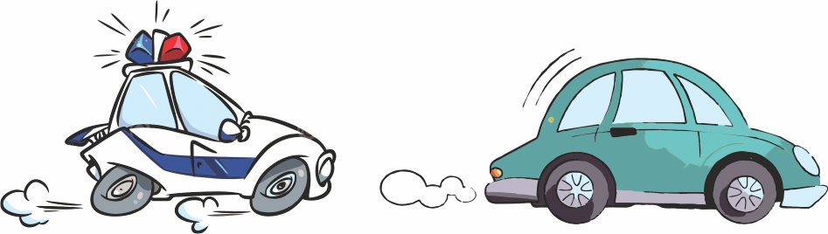
JJanuary 11, 2016
Catching Is…
e.g.
How aware you are when you are driving with a police car behind you?
Right Now – become Aware that you are reading this i.e. Catch

Slide 8
Making Optimal Care and Support Happen
CALM
“Being aware and ahh-llowing of B-FIT,
I calm myself and therefore calm others”.
CATCH
“I catch myself being here, now, present”

Slide 9

JJanuary 11, 2016
To be calm is to subjectively (internally) experience body sensations, feelings and thoughts with no/low resistance, as you work mindfully and passionately to solve problems or threats happening in your external world.
Calm Is…

Slide 10
JJanuary 11, 2016
Self Calming Strategies
Basic B-FIT Stress Rehearsal
Full Field Focus
B-FIT Compassion Practice
Self Bilateral, Biomeridian Awareness Based Calming, e.g. hands, butterfly hug, mindful movement/walks

Slide 11
Making Optimal Care and Support Happen
CLARIFY AND CHOOSE
“I objectively clarify my and their emotional state and the needs of the situation and then choose what actions to take.”
CALM
“Being aware and ahh-llowing of B-FIT,
I calm myself and therefore calm others”.
CATCH
“I catch myself being here, now, present”

Slide 12

JJanuary 11, 2016
To clarify and choose is…
together with catch and calm, remain aware of mine and others’ Feelings and Filters that are influencing the situation and then to objectively make informed choices.

Slide 13
Making Optimal Care and Support Happen
CONSCIOUSLY CONNECT
“I intend and become non-judgmental and unconditionally connected—regardless of how I feel”
CLARIFY AND CHOOSE
“I objectively clarify my and their emotional state and the needs of the situation and then choose what actions to take.”
CALM
“Being aware and ahh-llowing of B-FIT,
I calm myself and therefore calm others”.
CATCH
“I catch myself being here, now, present”

Slide 14

JJanuary 11, 2016
When we Mindfully Consciously Connect to another person, we move beyond our separate identity and roles to a place of shared unity and stillness – us-ness. This guides our every action, not against anything but in harmony with it. From this place of balance and no subjective resistance, we know and can therefore positively facilitate what must be done to keep others motivated, safe, respected, and still deeply connected with us.
ME
US
YOU

Slide 15
CARE AND SUPPORT
IS OPTIMAL
Making Optimal Care and Support Happen
(Competence x Consciousness)
CONSCIOUSLY CONNECT
“I intend and become non-judgmental and unconditionally connected—regardless of how I feel”
CLARIFY AND CHOOSE
“I objectively clarify my and their emotional state and the needs of the situation and then choose what actions to take.”
“My mindful, compassionate actions are useful, truthful, timely and kind”
CALM
“Being aware and ahh-llowing of B-FIT,
I calm myself and therefore calm others”.
CATCH
“I catch myself being here, now, present”

Slide 16

JJanuary 11, 2016
Compassion appears as selfless service, yet in mindful care and support we do not serve the other; we serve “us”. Compassion’s communion brings us together in a whole. It does not see the world’s pain and sorrow as other, it is shared, and it is ours. When we allow our shared vulnerability and humanness, our compassion is as natural as our breath and without hesitation we act to help.
Thich Nhat Hanh

Slide 17
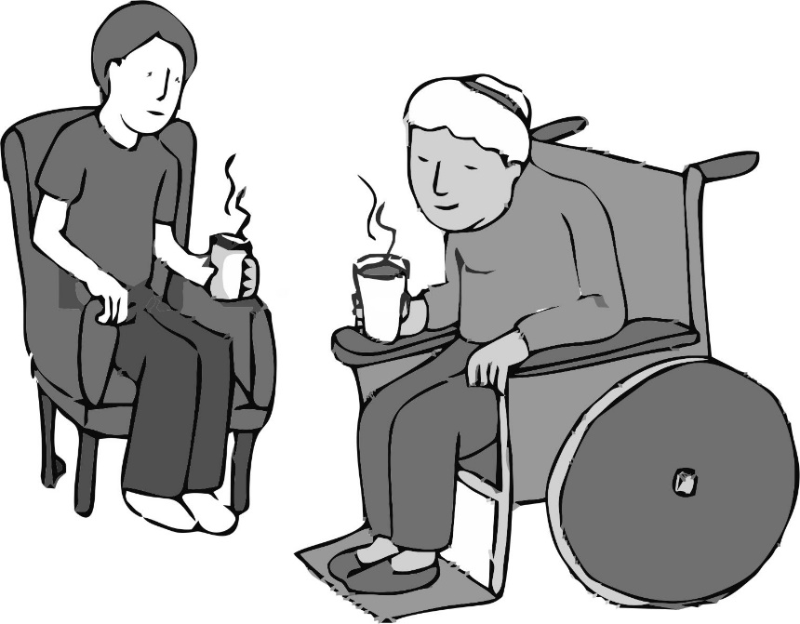
JJanuary 11, 2016
I listen to this person with dementia as she shares her most important story with me for the fifth time this morning. I listen and respond as excitedly as I did the first time she shared it with me. I know that my words in this moment are almost insignificant compared to my intention to just be present, Here-Now, for her.

Slide 18
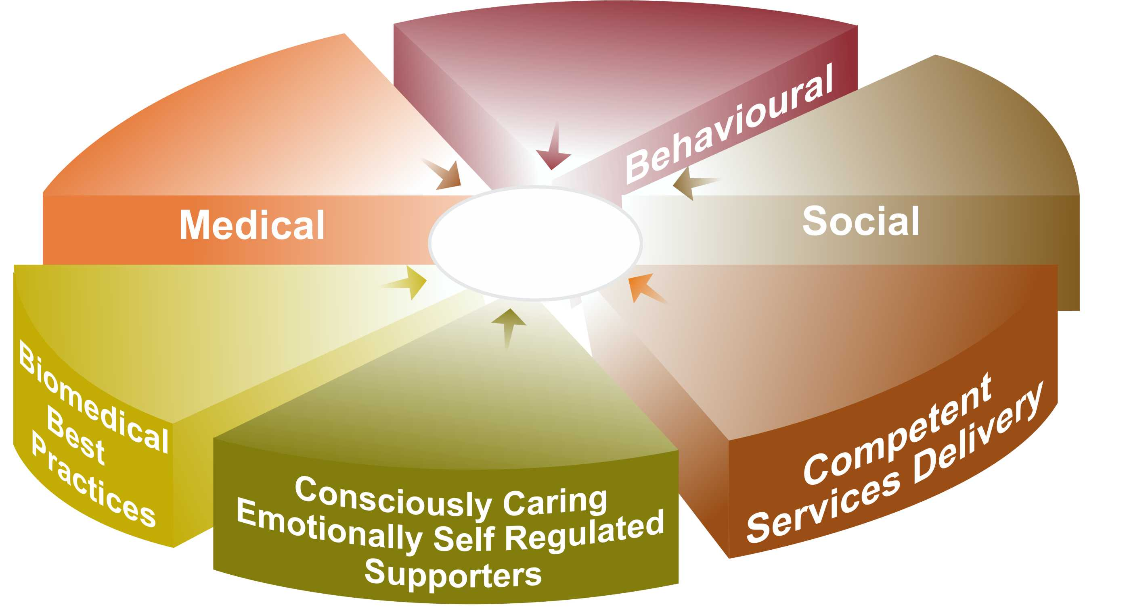
Evidence Based CCS Components for
Well-being and the Prevention and
De-escalation of Challenging Behaviours*
Crisis Interventions and
Learned Life Skills
e.g. ABA, IBI
Adequate Access to
Services to meet Physical,
Dental, Neurological and Mental
Health Services Needs
Socially Valued Roles,
Relationships and Meaningful
Life Experiences
Optimal
Well-being
Adequate Access to Services
to Meet Biomedical, Body,
Bowel, Brain,
Being, etc. Needs
‘How-Tos’ that Meet and
Exceed Professional Standards
e.g. 5 C’s Process
Mindful, Emotionally
Self Regulated and Unconditionally
Caring Supporters
* CCS reduces challenging behaviours by 50%-75% compared to MCCSS current ‘must use’ crisis protocols alone.

Slide 19
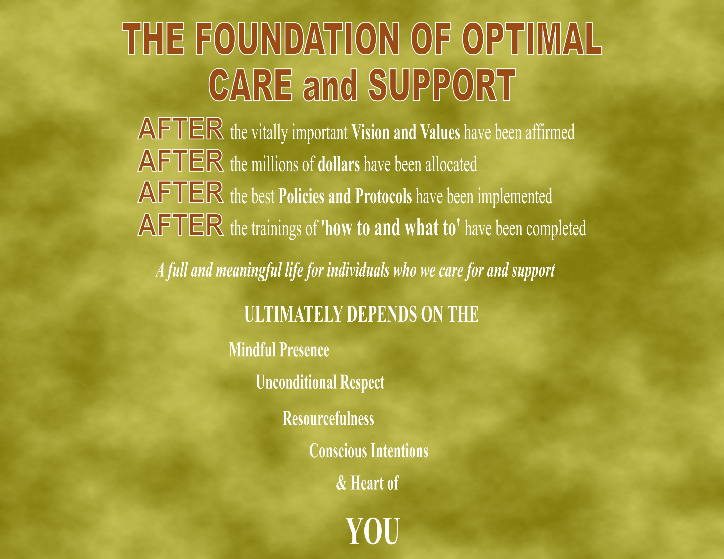

Slide 20

Our life’s most urgent and persistent question must be; what will I do for others today?
Adapted from Martin Luther King Jr.

Slide 21
JJanuary 11, 2016
My plan to be a more complete supporter
and more fully human
I will…
Continue:
Stop:
Start:

