Slide 1

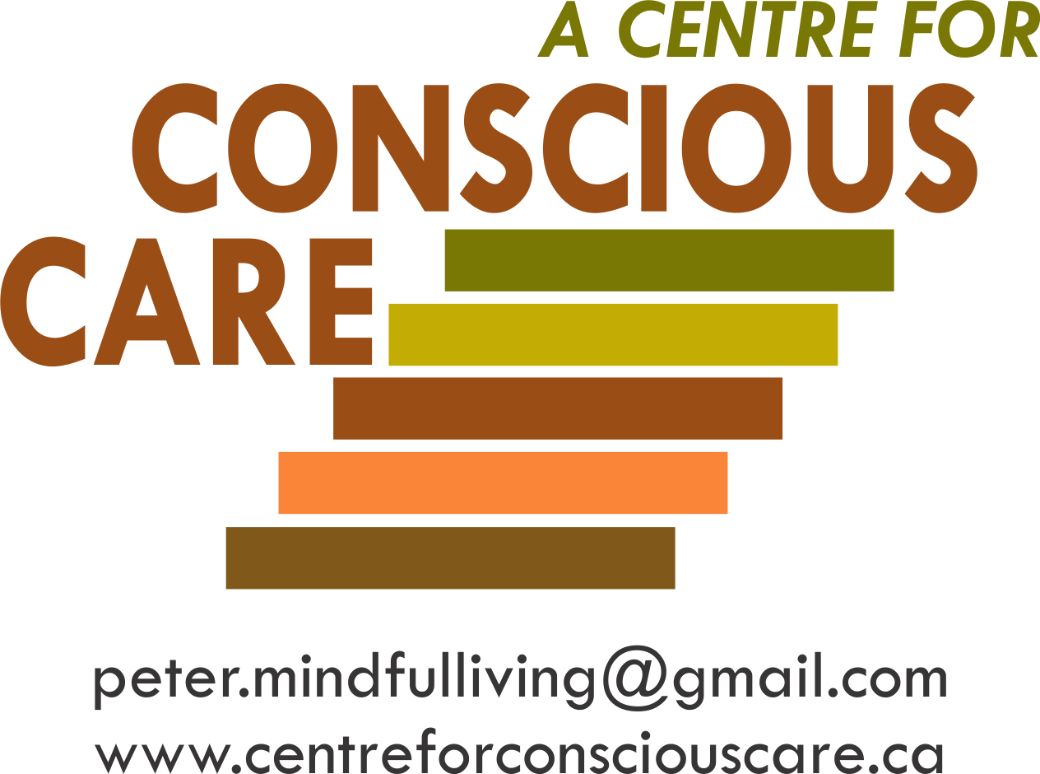
Brain Development, Coherence Balancing and Inflammation Regulation
Session VI – Resource 1

Slide 2
“The idea that the brain can change (heal) its own structure and function through thought and activity is, I believe, the most important discovery of the brain since we sketched out its basic anatomy and the workings of its basic components, the neuron.”
Norman Doidge
The Brain That Changes Itself

Slide 3
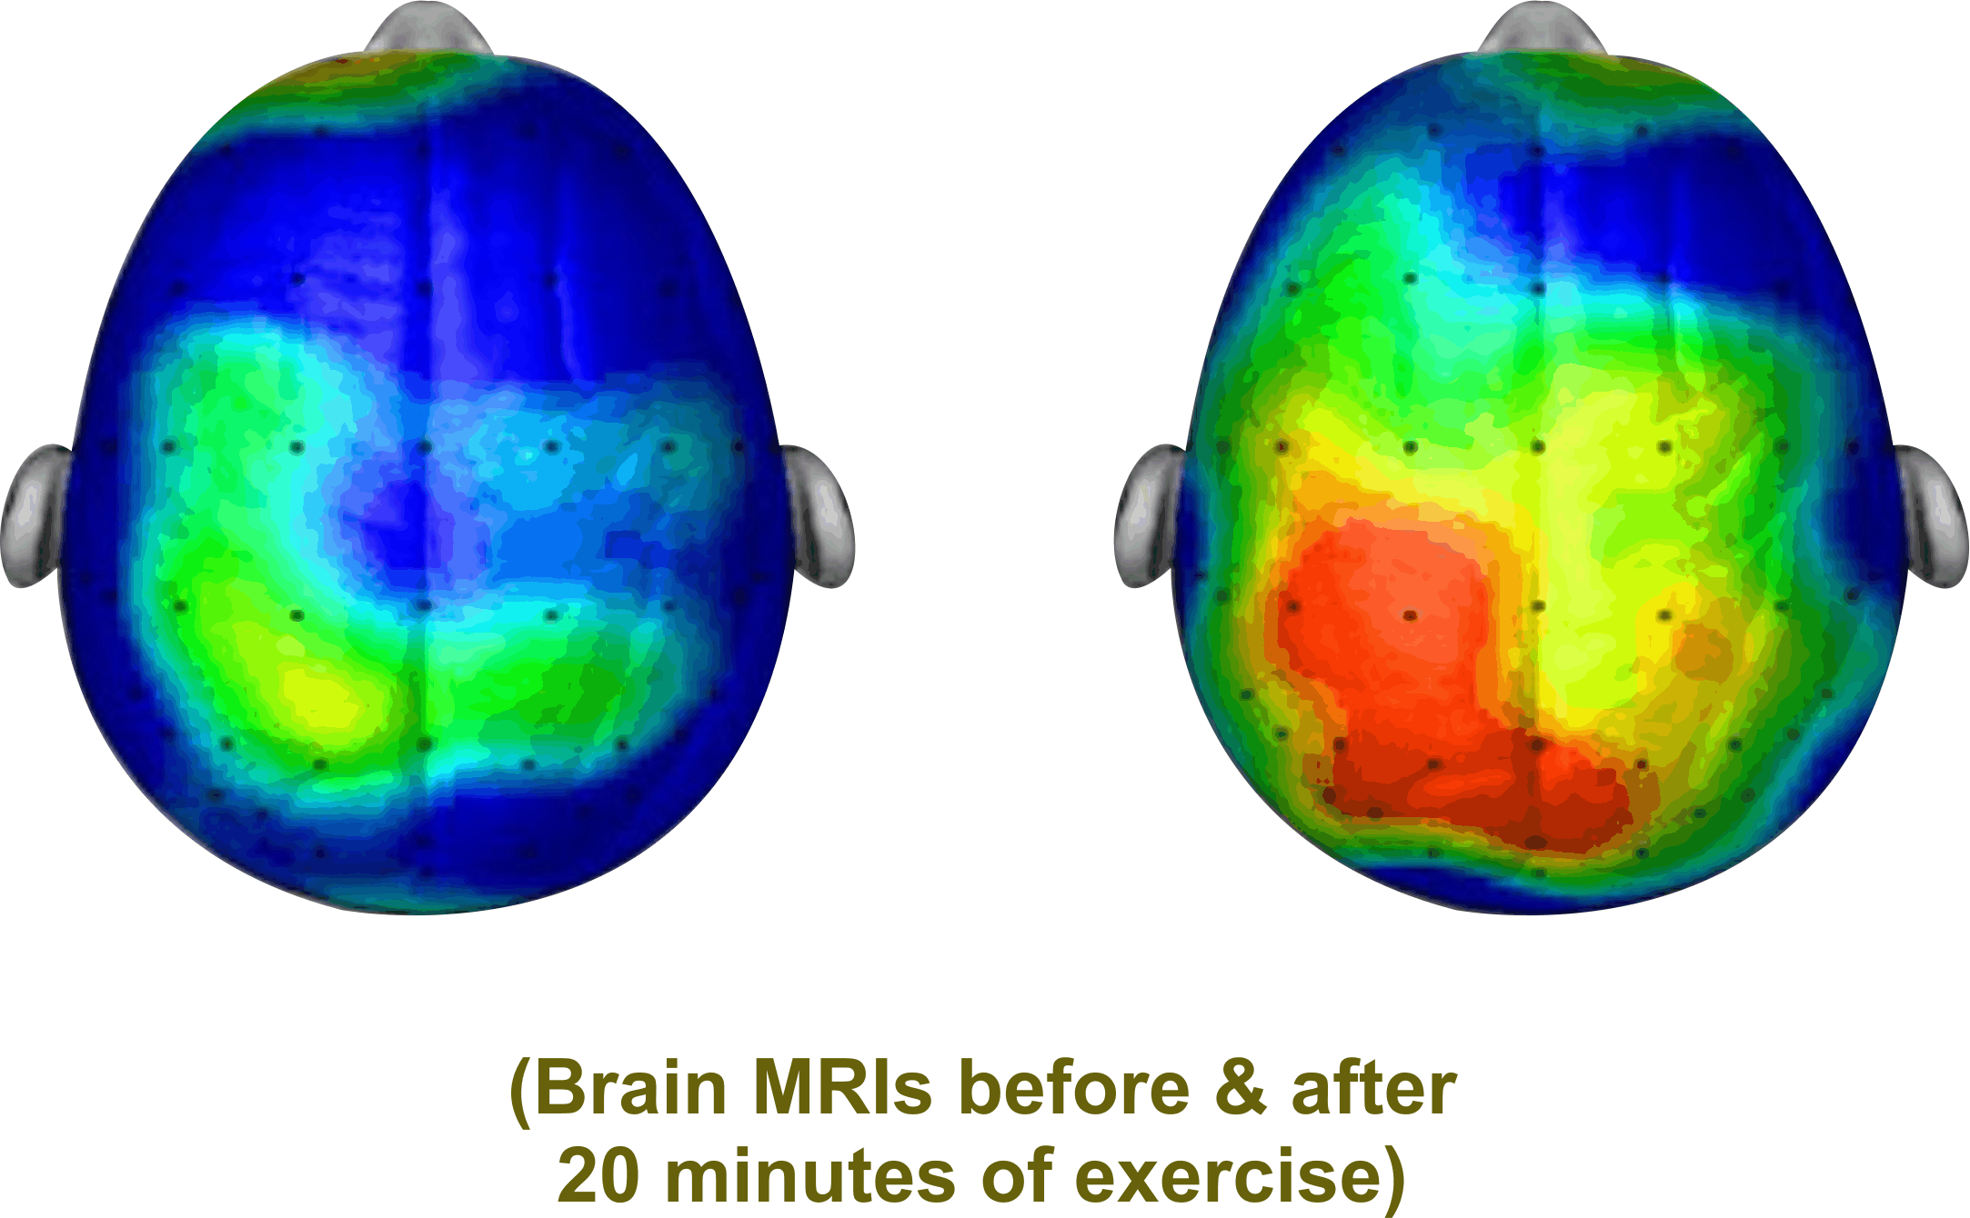
Brain Coherence
i.e. Many Parts of the Brain ‘Talking’ to Each Other
“Like you, I need to be able to understand and process information”. This requires optimal Brain Functioning e.g.
        neurogenesis (new neurons)
        neuroplasticity (more complete neuro networks)
        neurostimulation (brain firing)
        neurochemicals production (endorphins, dopamine, serotonin, oxytocin)
Ratey, J. & Hagerman, E. (2013). Spark: the revolutionary new science of exercise and the brain. Little, Brown Spark.
Notes:
Explain that neurogenesis, neuroplasticity, neuro-stimulation and neurochemical production are not well explored when provided optimal supports for people who have a disability.
When activities are in engaged that stimulate the above considerations, improve levels of anxiety and agitation can occur leading to improved quality of life.
A neurotypical/non-neurodivergent brain runs at 25 Hz of energy for processing
A neurodivergent brain runs at 17Hz much like how we feel when we first open our eyes after sleeping.
Often people will aggress to raise the level of brain energy or, they can activate the cerebellum through activities of bouncing and balancing.
Reference work of John Ratey, SPARK that speaks to exercise and revving up the brain to increase coherence.

Slide 4
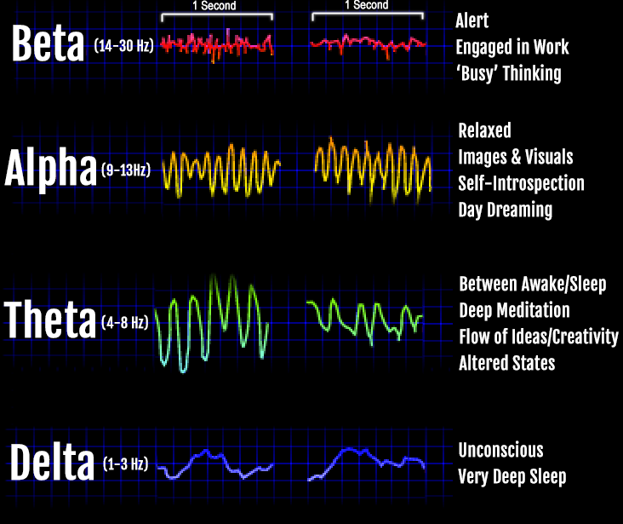
Brain Coherence Balancing & Inflammation Regulation
ASD Neurological Abnormalities
Left Right
Wang, J., et al. (2013). Resting state EEG abnormalities in autism spectrum disorders. Journal of neurodevelopmental disorders, 5, 1-14.
Notes:
Illustrates the inconsistent brain patterns in someone who has autism demonstrating low level of brain coherence.

Slide 5
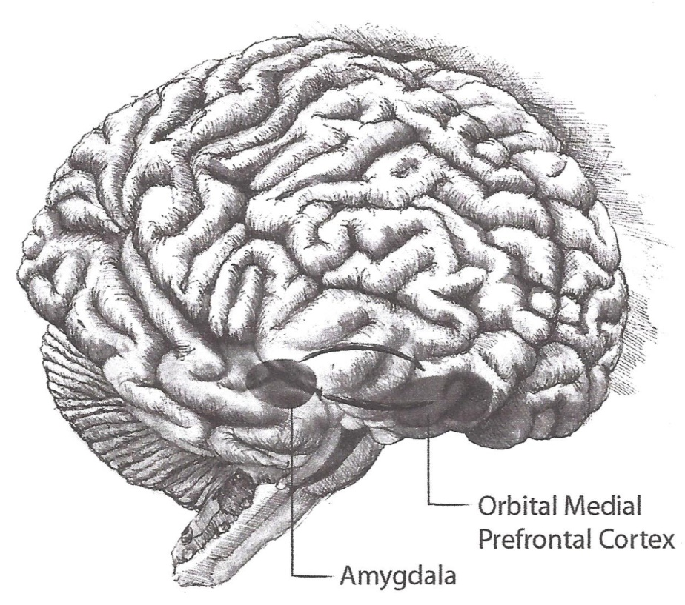
A Main CCS Focus
Mindful Neurodevelopment for Supporters and People They Support
Notes:
Review that an area of main focus of CCS is to develop the mindful neurodevelopment for both supporters and people who have autism or other intellectual/developmental disabilities.
Focus on the development of areas of the brain including the medial prefrontal cortex as it relates to the amygdala.

Slide 6
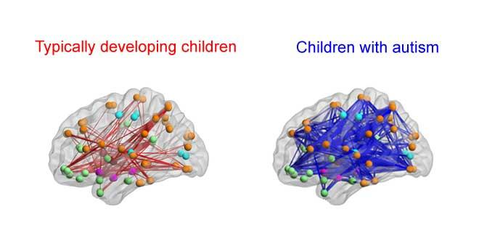
JJanuary 11, 2016
Potential for Well-being for People with Developmental Disabilities
Neuroscience is generally in agreement that for most people with developmental disabilities, reduced brain information transfer that contributes to deficits in executive function, understanding what others are thinking and some lack of empathy, in great part are a consequence of local over-connectivity and long-range under-connectivity.
Notes:
Explain that research is demonstrating that neurodivergent brains or the brains of those who have a developmental disability may have areas of the brain which are over-connected or areas of under connectivity.

Slide 7
However:
Neuroscience also near unanimously concurs that neurogenesis, neuroelectric stimulation, neurochemicals production, and neuroplasticity are, with appropriate training and conditioning, not only possible but highly predictable to measurably enhance cognition, empathy and emotional self regulation.
References:
Doidge, N. (2016). The brain's way of healing: Remarkable discoveries and recoveries from the frontiers of neuroplasticity. Penguin Life.
Eagleman, D. (2017). The Brain: The story of you. Vintage.
Siegel, D. J. (2007). The Mindful Brain: Reflection and attunement in the cultivation of well being. WW Norton & Company.
Notes:
No evidence to suggest that Brain and GI of people with developmental disabilities, yet there is evidence that they can grow with CCS type interventions.

Slide 8
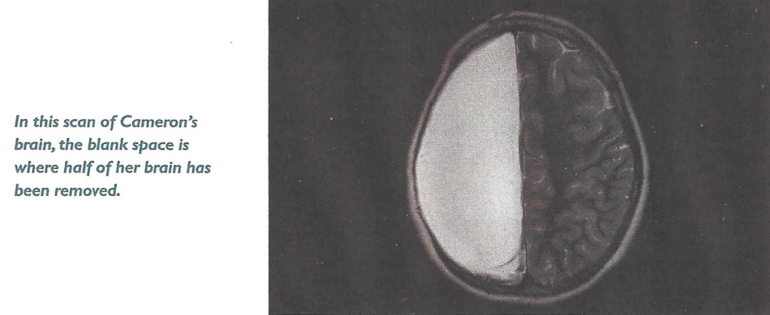
JJanuary 11, 2016
Could This Indicate Potential for Well-being?
In 2007, Neurosurgeons removed half of Cameron Mott’s Brain
The Results:
Aside from some weakening on one side of her body, she is indistinguishable from her classmates. She is a good student and participates in sports.
Eagleman, D. (2017). The Brain: the story of you. Vintage.
Notes:
At the age of four, Cameron began to have violent seizures. The seizures were aggressive: Cameron would suddenly drop to the floor, requiring her to wear a helmet all the time. She was quickly diagnosed with a rare and debilitating disease call Rasmussen’s Encephalitis.
Her neurologist knew that this form of epilepsy would lead to paralysis and eventually to death – and so they proposed a drastic surgery. In 2007, in an operation that took almost 12 hours, a team of neurosurgeons removed an entire half of Cameron’s brain.
What would be the long-term effects of removing half her brain? As it turns out, the consequences were surprisingly slight. Cameron is weak on one side of her body, but otherwise
she’s essentially indistinguishable from other children in her class. She has no problems, understanding language, music, math, stories. She’s good in school and she participates in sports.
How could this be possible? It’s not that one half of Cameron’s brain was simply not needed; instead, the remaining half of Cameron’s brain dynamically rewired to take over the missing functions, essentially cramming all the operations into half the brain space. Cameron’s recovery, and thousands of other examples, underscore a remarkable ability of the brain: it rewires itself to adjust to the inputs, outputs, and tasks at hand.

Slide 9
JJanuary 11, 2016
Neuroscience and Gastrointestinal (GI) Research Conclusions
Hundreds of Studies Indicate:
No evidence to suggest that the Brain and GI of people with developmental disabilities cannot heal, grow and develop.
Evidence that the Brain and GI can heal, grow and
develop with appropriate (CCS type) training and conditions.
(Reference previous Bibliography)
Notes:
No evidence to suggest that Brain and GI of people with developmental disabilities, yet there is evidence that they can grow with CCS type interventions.

Slide 10
Maladaptive Behaviours
Related to Brain Balancing
In trying to satisfy their need for brain central coherence, individuals experiencing problems associated with brain balancing may behave in reactionary and cognitively unintended ways.
They may:
become angry. Anger stimulates the brain to focus and in so doing organizes the individual’s thoughts, and therefore offers the individual relative calm. For everyone, anger is a much less painful emotion than fear.

Slide 11
obsess and become compulsive. These behaviours organize the individual’s thoughts, create focus and therefore calm the individual;
blame and even hit others. This is one way that the individual can self-medicate with anger. These behaviours are magnified by a supporter’s mindless fear and unknowing powerful communication of that fear.

Slide 12
Brain Facts to Enhance Brain Coherence and Functioning and Reduce Challenging Behaviours
The proven potential for brain development and enhanced functioning is sadly, possibly the least appreciated and understood fact regarding needs in supporting individuals with ASD/DD to be all that they can be.

Slide 13
Through proven training and maintenance of a healthy brain (e.g. inflammation prevention) enhanced brain functioning is possible as a result of development in the following area:
Neurochemicals Production e.g. endorphins, oxytocin, neurotransmitters like dopamine (pleasure) and serotonin and GABA (calming).
Ratey, J. J., & Manning, R. (2014). Go wild: Free your body and mind from the afflictions of civilization. Hachette UK.
Notes:
Review that brain functioning can possibly be enhanced by developing:
Neurochemical Production

Slide 14
Neurogenesis i.e. promotion of the growth of new neuron cells
Ahlskog, J. E., et al. (2011). Physical exercise as a preventive or disease-modifying treatment of
dementia and brain aging. Mayo Clinic proceedings, 86(9), 876–884.
Siegel, D. J. (2007). The Mindful Brain: Reflection and attunement in the cultivation of wellbeing. WW Norton & Company.
Neuroplasticity i.e. the reformation of neuron networks to take on new and extra ‘tasks’
Doidge, N. (2007). The Brain That Changes Itself: Stories of personal triumph from the frontiers of brain science. Penguin Life.
Doidge, N. (2016). The brain's way of healing: Remarkable discoveries and recoveries from the frontiers of neuroplasticity. Penguin Life.
Notes:
Neurogenesis
Neuroplasticity

Slide 15
Neurostimulation
Promoting Motor Function by Exercising the Brain
    Perrey, S. (2013). Promoting motor function by exercising the brain. Brain sciences, 3(1), 101-122.
Transcranial Magnetic Stimulation
Centre for Addiction and Mental Health (N.D.) Repetitive Transcranial Magnetic Stimulation (rTMS). URL.
Centre for Addiction and Mental Health. (2015, April 1). RTMS for autism spectrum disorder. YouTube. URL.
Eagleman, D. (2017). The Brain: The story of you. Vintage. pp.94-95
Notes:
Neurostimulation
Transcranial Magnetic Stimulation

Slide 16
“In his book The Mindful Brain, Siegel has both a meticulous understanding of the roles of different parts of the brain and an intimate relationship with mindfulness”.
Scientific American Mind

Slide 17
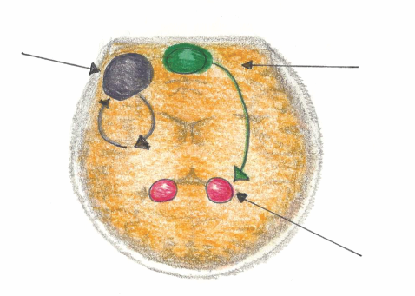
B-FIT Mindfulness to be Emotionally Self-Regulated
Mindful Emotional Self-Regulation
The main way we can consciously access the emotional brain is through self-awareness*, i.e. becoming mindful. Mindfulness increases connections in the medial pre-frontal cortex. This reduces anxiety for the Supporter and the Person Supported.
Dorsolateral pre-frontal Cortex
Working Memory
Impulse Control
Medial pre-frontal Cortex
(part of the brain that notices what’s going on)
Amygdala
*LeDoux, J. E. (2000). Emotion circuits in the brain. Annual review of neuroscience, 23(1), 155-184.
Notes:
Review the involvement of the medial prefrontal cortex (MPFC) as it relates to emotional self-regulation.
MPFC is activated when things get personal, or when feelings are involved
MPFC is also connected with our limbic system (fight, flight or freeze), our amygdala which fires twice a second to make that we are safe.
MPFC acts as a big brother or sister and checks in with the amygdala to keep it better regulated without need to go into fight flight or freeze.
If a person has an underactive MPFC, anxiety often results. An underactive MPFC means that the person doesn’t experience the calming of the amygdala.
Much research has been done with respect to this underactive part of the brain and to increase the activation of MPFC is strongly influenced by exercises that develop self-awareness- mindfulness.

Slide 18
According to Dr. Daniel Siegel in The Mindful Brain (pgs. 42-43) the following brain, body and being functions correlate with the activity of areas within the medial prefrontal cortex:
Body regulation: the emotional brakes and accelerator functions;
Attuned communication involves the coordination of the input from another person with the activity of one’s own (as with mirror neurons);
Emotional balance: to have enough activation so that life has meaning and vitality but not so much that life becomes chaotic;
Response flexibility: the capacity to pause before action;
Empathy: knowing what might be going on inside someone else;
Insight or self-knowing: awareness to be able to link the past, present and future;
Fear modulation that may be carried out by the release of the inhibitory neurotransmitter GABA;
Intuition: a neural mechanism by which we process deep ways of knowing via our body, i.e. somatic intelligence;
Morality: taking into consideration the larger picture, to image what is best for the whole not just one’s self, even when alone.
Siegel, D. J. (2007). The Mindful Brain: Reflection and attunement in the cultivation of well being. WW Norton & Company.
Notes:
Review the correlations of the activation of the MPFC that all contribute to emotional self-regulation:
Body regulation – the emotional brakes and accelerator functions.
Attuned communication involves the coordination of the input from another person with the activity of one’s own (as with mirror neurons).
Emotional balance to have enough activation so that life has meaning and vitality but not so much that life becomes chaotic.
Response flexibility is the capacity to pause before action.
Empathy – knowing what might be going on inside someone else.
Insight or self-knowing awareness to be able to link the past, present and future.
Fear modulation that may be carried out by the release of the inhibitory neurotransmitter GABA.
Intuition – a neural mechanism by which we process deep ways of knowing via our body i.e. ‘somatic intelligence’.
Morality – taking into consideration the larger picture, to image what is best for the whole not just one’s self, even when alone.
Explain that the way in how we activate this part of our brain (MPFC) is through practices of self-awareness- mindfulness. The more that we engage in practices of self-awareness the more that we grow this part of our brain. We then build greater capacity for emotional self-regulation and all of the above-mentioned correlations.

Slide 19
Brain Development
The areas for brain development are mainly the insula, superior temporal and medial prefrontal cortex (MPFC). This system forms the interconnected “resonance circuitry”. Each time we become mindful, we fire-up these regions and what fires, wires (i.e. grows new neuron cells i.e. neurogenesis).
Siegel, D. J. (2007). The Mindful Brain: Reflection and attunement in the cultivation of wellbeing. WW Norton & Company. pp. 165-190.
Notes:
Explain that every time we fire up regions of the brain, we wire it more completely, lending to better connectivity or resonance circuitry.
“What fires wires!”

Slide 20
Why Invest in Mindfulness?
For this reason, CCS invests heavily in mindfulness training to enhance the development of emotional self-regulation in supporters, who in turn will then be competent and committed to teach mindful awareness to people with developmental disabilities to enhance their emotional self-regulation.

Slide 21
Prefrontal Cortex Development – Autism
Research has shown that the medial pre-frontal cortex of people supported with neurodiversity can be functional, but not as readily activated as those who are not neurodiverse. The goal is to offer strategies to enhance the functioning of this region of the brain.
Richey, J. A., et al. (2015). Neural mechanisms of emotion regulation in autism spectrum disorder. Journal of autism and developmental disorders, 45, 3409-3423.
Notes:
Explain the research has shown that the medial pre-frontal cortex of people supported with neurodiversity can be functional but not as
readily activated as those who are not neurodiverse. Our goal in this section is to offer strategies to enhance the functioning of this region of the brain.

Slide 22
CCS Brain Coherence, Balancing & Inflammation Regulating Interventions
1. Enhance essential brain calming elements
(e.g. GABA and Serotonin)
2. Prevent excess of excitatory elements
(e.g. Cortisol, Glutamate, PPA)
3. Balance anxiety producing vitamins and minerals
(e.g. Magnesium, Vitamin B6, Vitamin B12)
4. Cerebellum activation
(e.g. 20 minutes of bouncing and balancing)
Maintain adequate glutathione levels to prevent brain inflammation
(e.g. NAC)
Notes:
Enhance essential brain calming elements
(e.g. GABA and Serotonin)
Prevent excess of excitatory elements
(e.g. Cortisol, Glutamate, PPA)
Balance anxiety producing vitamins and minerals
(e.g. Magnesium, Vitamin B6, Vitamin B12)
Cerebellum activation
(e.g. 20 minutes of bouncing and balancing to activate the cerebellum which then can increase brain energy in MPFC)
Maintain adequate glutathione levels to prevent brain inflammation (e.g. NAC)
eliminating triggers for inflammation and providing anti-inflammatory supplements (e.g.
N-acetylcysteine (NAC)) increases the body’s own production of glutathione (GSH) which is the most critical antioxidant that protects the brain from many toxins and contaminants that cause inflammation. Many people supported are dangerously low in GSH. This deficiency can be remedied by increasing the intake of sulfur-rich foods and supplements such as NAC. NAC, given to a group of children with ASD/DD during a controlled research study by Stanford University in 2013, was 72% effective in reducing the levels of irritation.

Slide 23
6. Keep the Mitochondria Cell System Healthy:
  Mitochondria are known as the powerhouse of each cell
  They give cells their energy to do their work such as maintaining healthy brain functioning
Controllable Mitochondria Killers:
  Sugar and Simple Carbohydrates
  Oxidative Stress causing Brain Inflammation – low glutathione
  Medications such as Antibiotics and Antipsychotics
  Vitamins and Minerals Imbalance – low B vitamins, folic acid, magnesium, vitamin D

Slide 24
Cardio Exercise:
Cardio exercise, especially bouncing and balancing, increases brain wave activity (e.g. cerebellum) to give better brain coherence for optimal functioning.
Improved coherence results in thoughts becoming more organized and focused.
This results in less fear and therefore more calm.

Slide 25
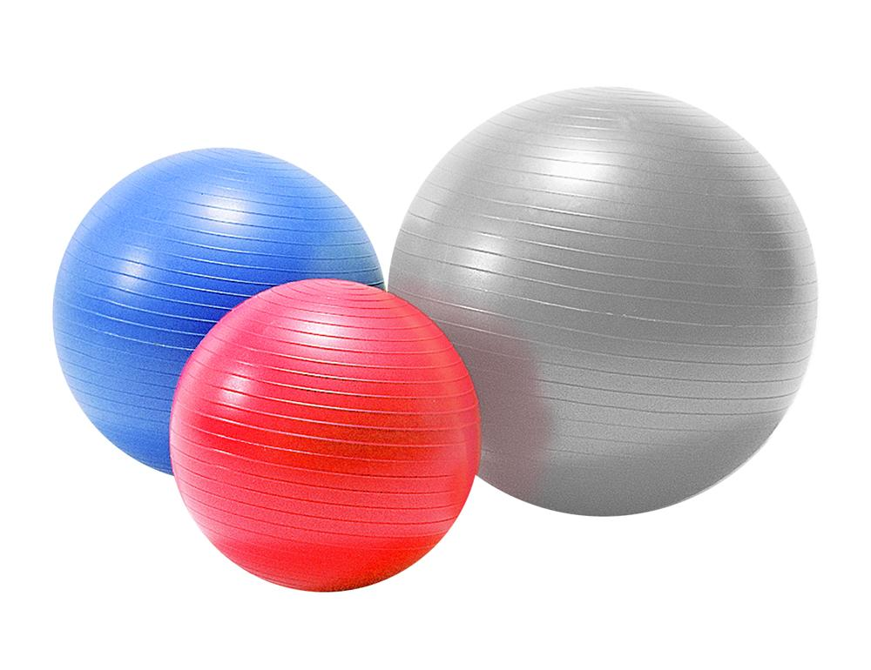
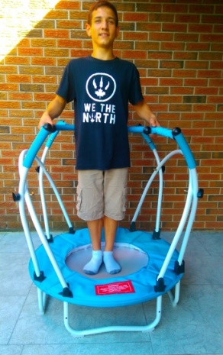
stabilization balls
and elliptical stabilization cushions

Slide 26

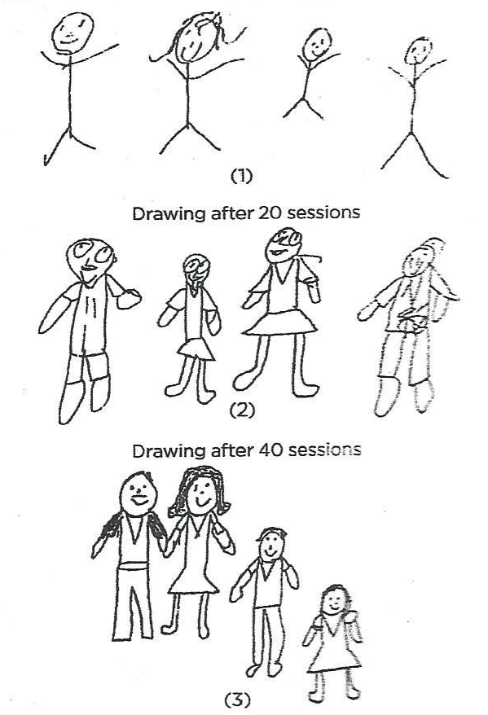
Autism and Neurofeedback
From Stick People to
Clearly Defined Human Beings
After four months of neurofeedback, a ten-year-old boy’s family drawings show the equivalent of six years of mental development.
van der Kolk, B. (2015). The body keeps the score: brain, mind, and body in the healing of trauma. Penguin Books.
Notes:
Studies have shown that neurofeedback and biofeedback have an influence to increase the coherence of brain waves with people who have autism. This brain coherence then allows for a more organized pattern of thought and therefore lowered experiences of anxiety and agitation.
Overview the EMWave2 technology of biofeedback and identifying an image of calm through their biofeedback of heart rate and breath rate and visualization activities.
Overview the technology of the MUSE Headband and identifying a sense of calm through their biofeedback of heart rate and brain activity from frontal lobe

Slide 27
JJanuary 11, 2016
Training in Self-Regulation with those with ASD/DD can be
Successful and Sustainable in the Following Areas:
Attentional control, inhibition of verbal responses, cognitive flexibility and planning – through neurofeedback
Some areas of executive functioning and behavioural control
Resistance to distraction and concentration
Affective, cognitive, physical self-regulation and pro-social behaviour
MacKenzie, H. (2013). The autistic child’s guide: presenting spark* (self-regulation program of awareness & resilience in kids). Wired Fox. pp. 321-323.

Slide 28
Summary
Brain development, coherence and inflammation prevention are essential to promote the well-being of children, youth and adults with ASD/DD.
Brain development and coherence are proven to absolutely be possible through mindfulness, physical exercise, nutrition and other support initiatives as outlined in Need #1 – 15 BB-ABC Best Practices/Tools.

