Slide 1

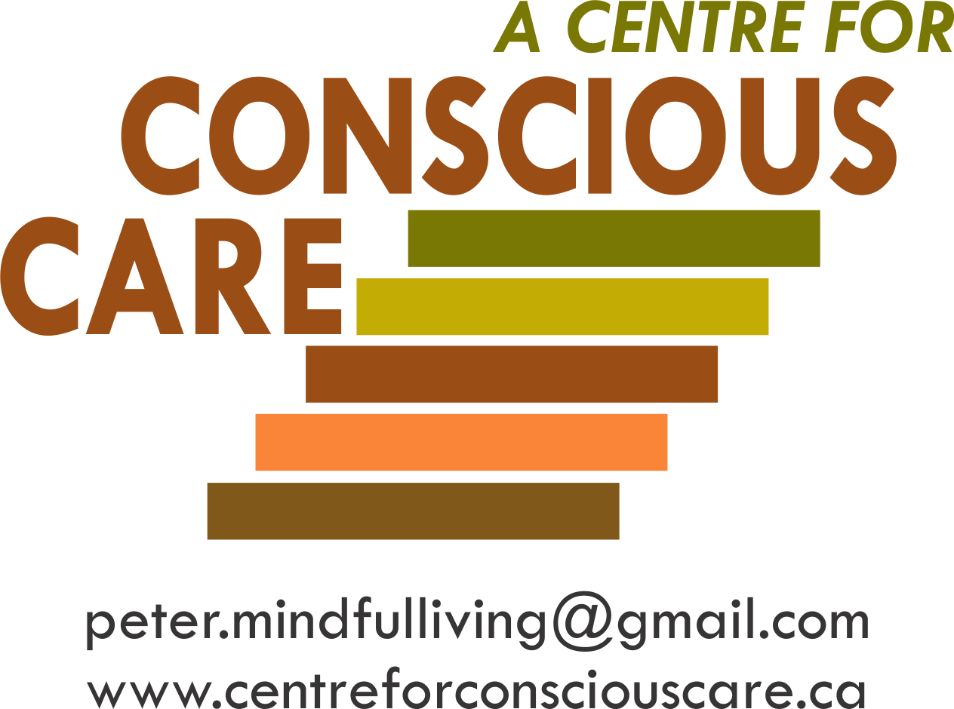
Human Energy System – A Need for
Building, Balancing and Protection
Session 7 – Resource 1

Slide 2
Introduction to the Biological Vulnerabilities
of People Supported
This section on the human energy system – building, balancing and protection begins by examining some of the main environmental toxins. Empirical research is suggesting that these toxins are contributing to the compromised well-being, including in part, causing anxiety, anger and aggression for people supported.

Slide 3

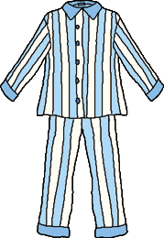

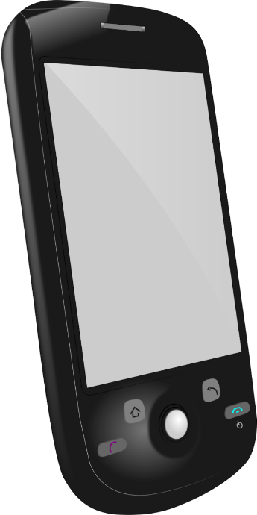

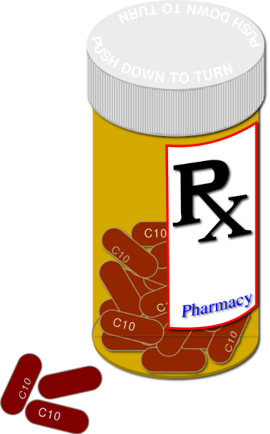

Potential Allergens Cause Maladaptive Behaviours

Slide 4
Probable Risks Associated With
Short and Long Term Cumulative Exposure to Dirty Electricity
damage to human cells, e.g. different forms of cancer and chronic disease;
interference with natural processes including sleep, hormone production and the immune system;
children seem more vulnerable – symptoms could include, headaches, chronic fatigue, vertigo, concentration and memory problems, learning and behavioural disorders and more frequent incidents of ADHD.

Slide 5
The following is a quote from the abstract from research reported by Martha Herbert, author of The Autism Revolution (2013). Dr. Herbert is a Pediatric Neurologist with Harvard Medical School who offered important insights and collaboration to assist in the development of CCS.
“The evidence is sufficient to warrant new public exposure standards benchmarked to low-intensity (non-thermal) exposure levels now known to be biologically disruptive, and strong, interim precautionary practices are advocated.”

Slide 6
Supporters’ Optimal Solutions to
Minimize the ‘Fallout’ of EMF are:
Insert protective filters in 110 volt outlets that reduce EMF risks by 80%;
Turn routers down to minimum settings. In most home environments, 10% is sufficient to send out and receive online communications. Turn to the lowest power required to transmit;
Do not use wireless devices close to people supported;
According to manufacturers, cell phones should never be closer than 5 to 15 mm to the human body;
Use landlines as much as possible;
All people supported should wear shoes with non-rubber treads e.g. leather or cork. (This will help to ground EMF out of the body);
All people supported should walk on mother earth or on basement floors for a minimum of several minutes a day.

Slide 7
Assess and Eliminate Airborne Indoor Toxins
Mould Bacteria;
Mycotoxins (secondary metabolites produced by microfungi);
Chemical Off-Gassing e.g. formaldehyde from particle board cabinets and furniture.

Slide 8
Sleep Disturbances
Basic Facts:
Adequate sleep is one of the most critical elements to facilitate optimal health, quality of life and adaptive behaviour.

Slide 9
At night (if feasible) –
Unplug bedroom monitors;
Unplug wireless charging stations;
Unplug WiFi;
Keep cell phones off as much as possible;
Shut off breakers from electrical circuits in bedrooms.

Slide 10
Support Solutions for Sleep Disturbances
The following are considerations for discussion to use while advocating with community professionals for recommendations to help ensure adequate sleep:
Do muscle testing with person, using clothing and bedding to rule out environmental intolerances disturbing sleep;
Consult a naturopathic doctor to test and recommend supplements/diet.
Taurine is a powerful antioxidant that increases the activity of the calming neurotransmitter GABA. Supplements in the range of 500-2000 mg per day have been successful, if testing shows a deficiency;
GABA supplement (a calming neurotransmitter);
Magnesium supplement (100-500 mg/day) if testing shows a deficiency;

Slide 11
Melatonin supplement (3-5 mg/day);
Eliminate alcohol – a central nervous system suppressant that backfires as a sleep aid;
Eliminate all stimulants such as caffeine, nicotine;
Use antihistamine medications for short periods (three nights maximum) to break the cycle of histamine dependence;
Ashwagandha is an herb that regulates the production of cortisol (that wakes people up in the middle of the night). Regulation recalibrates the circadian rhythms closer to morning (back to its normal time);
Increase serotonin levels;
Exercise (30 minutes of cardio) early in the day (see below);
Low/no refined sugar – one of the best substitutes is organic coconut palm sugar, but still use limited amounts;
Essential oils therapies.

