Slide 1

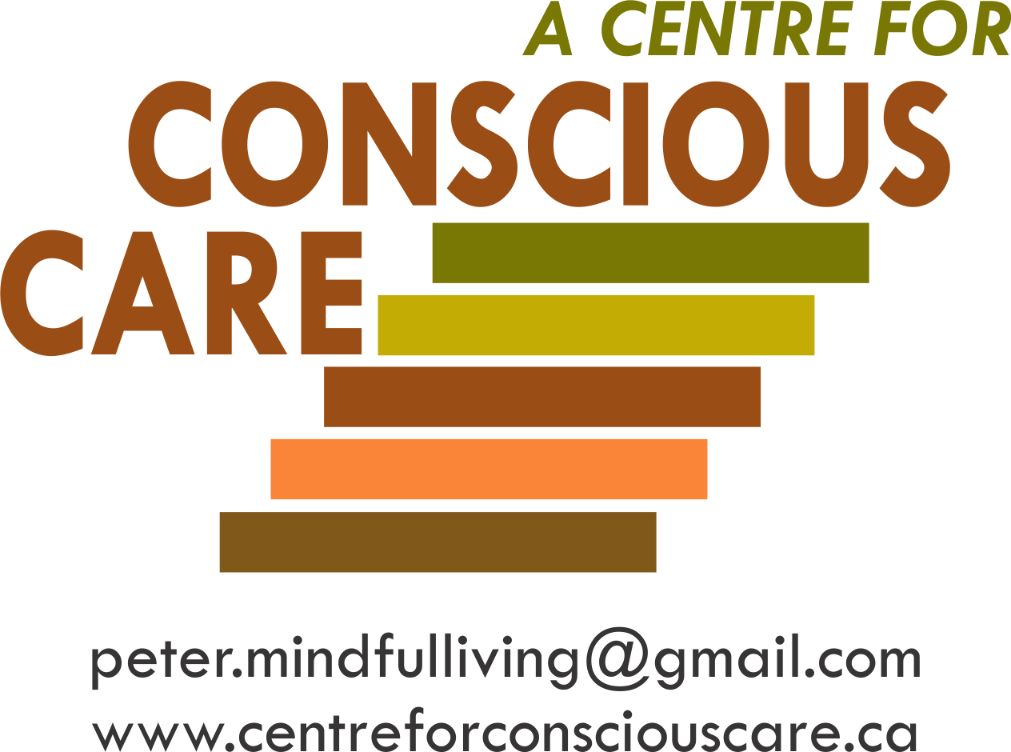
Conscious Care and Support
Developing
Emotionally Self-Regulated & Kind Supporters
Facilitating
Comprehensive Biomedical Support & Treatment
Session I – Resource 1

Slide 2
JJanuary 11, 2016
Contributors to Conscious Care and Support
Conscious Care and Support has been developed while supporting, training or in direct consultation with:
Approximately 3,000 Moms, Dads, and Support Professionals.
Dr. John Ratey, Associate Clinical Professor of Psychiatry at Harvard Medical School (reference 8 books on mental health and autism and other developmental disabilities including ‘Spark’ and ‘Shadow Syndromes’).
Dr. Theresa Hamlin, Associate Executive Director of The Center for Discovery and her staff. Dr. Hamlin is the author of ‘Autism and the Stress Effect’.
Dr. Martha Herbert, Assistant Professor of Neurology at Harvard Medical School and a Pediatric Neurologist at Massachusetts General Hospital, where she is Director of the Transcend Research Program. She sits on the Scientific Advisory Committee for Autism Speaks (reference ‘The Autism Revolution’).
Dr. Shinzen Young, Mindfulness Research Consultant, Harvard Medical School.
Universities of Toronto and Western Ontario/London Health Sciences Centre and Centre for Addiction
and Mental Health (CAMH)

Slide 3
CCS Contributing and/or Trained Organizations & Agencies
January 11, 2016
Autism Ontario
Community Living Ontario
L’Arche Daybreak
OASIS (Ontario Agencies Supporting Individuals with Special Needs)
Community Living Windsor
Community Living Cambridge
Rygiel Supports for Community Living
Community Living Oakville
London Health Sciences Centre
McMaster University
University of Toronto
Kerry’s Place
Ministry of Education Special Needs Division
Ongwanada
Sunbeam Community & Developmental Services
Crest Support Services
Norfolk Association for Community Living
Community Living Kincardine
Durham Association for Family Respite Services
Christian Horizons
Community Living Burlington
Parents for Community Living
Extend-A-Family Toronto and Waterloo
Community Living Welland Pelham
Community Living St. Marys and Area
Community Living Chatham-Kent
Community Living Stratford and Area
Windsor-Essex Family Network
Community Living Prince Edward

Slide 4

Quotes by Shinzen Young - Harvard Medical School Researcher
From the Foreword of The Conscious Care & Support Book
“The Practical Tools and the 5 Essential Mindfulness Based Human Competencies that Peter has developed are examples of an excellent blending of Science and Heart. The results are improved levels of compassionate services while offering best practices.”

Slide 5
JJanuary 11, 2016
Conscious Care and Support
First Principles

Slide 6

To Consistently Deliver Optimal Support – The Supporter Needs
Three Key Professional and Intrapersonal Qualities
Conscious
and Caring
Emotional
Self-Regulation
OPTIMAL
SUPPORT
Knowledge
and
Understanding
of Best
Practices
Competent
Services
Delivery
Process

Slide 7

JJanuary 11, 2016
Facts About Autism and Other Developmental Disabilities
The American Academy of Pediatrics dedicated to the health of all children.
“Autism behaviours have been adopted as unofficial criteria in the assessment of Autism, but there is no evidence supporting the attribution of behaviours such as head banging, aggression and night waking to the pathophysiology of Autism. Parents and supporters should be aware that these maybe the primary or sole symptom of underlying (bio) medical conditions.” (Buie et al, 2010)
(Buie, T., Harvard Medical School – Professional of the Year, Autism Society of America, 2009). Reference: Evaluation, Diagnosis and Treatment of Gastrointestinal Disorders in Individuals with ASD; A Consensus Report.

Slide 8

Autism Study Finds High Rates of Unmet Healthcare Needs; Suggests Public Policy Solutions
Complex Healthcare Needs
According to the national survey, 93 percent of children with autism have one or more co-occurring health conditions. This finding is backed by considerable research associating autism with high rates of many medical and mental health issues, including seizures (epilepsy), digestive disorders, disrupted sleep, anxiety and depression, among others.
See “Autism and Health: A special report by Autism Speaks”, 2017

Slide 9
Dr. Theresa Hamlin,
Associate Executive Director at The Center for Discovery
It’s well documented, but not well understood that people with Autism suffer from a whole host of chronic problems such as:
brain and body inflammation
gastrointestinal and metabolic problems
seizures
sleep problems
high levels of chronic stress and anxiety
general dysregulation of the emotional and psychological body systems
immune and autoimmune problems
e.g. Harvard study examining medical problems occurring in 14,000 individuals with Autism (Kohane et al. 2012)

Slide 10

The Kilee Patchell-Evans Autism Research Group,
University of Western Ontario
Collectively, this suggests alterations in gut function, energy production and the immune system, a variety of environmental factors, possibly stemming from chemicals produced by gut bacteria, that may contribute to Autism associated behaviour.
It appears that these biological compounds, largely stemming from the digestive track but also present in diet, are, either directly or indirectly altering brain function at a variety of levels.
This has profound implications in identification prevention and treatment
(of people with developmental disabilities).

Slide 11
Associated Medical & Mental Health Conditions
Children with autism are nearly eight times more likely to suffer from one or more chronic gastrointestinal disorders than are other children.

Slide 12
Autism and Sensory Processing Disorders
Recent estimates of the prevalence of the symptoms of sensory processing disorder of people with Autism range from 69% – 93% in children and adults (Baranek et al., 2006; Billstedt et al., 2007; Klintwall et al., 2011; Leekam et al., 2007) and were recently added as a diagnostic criteria of ASD in the diagnostic and statistical manual of mental health disorders (American Psychiatric Association) 2013.

Slide 13
Dr. Theresa Hamlin,
Associate Executive Director at The Center for Discovery (continued)
“Adrenaline (that is released when the person is stressed) causes a rapid release of glucose and fatty acids into the blood stream, causing our senses to become keener and less sensitive to pain and muscles to become activated. When all of this occurs together we are in metabolic overdrive.”
Chronic stress causing increased activation of cortisol in the body and brain can be a major problem. Particularly susceptible to damage from cortisol is the hippocampus that is critical for learning and memory.

Slide 14

Dr. Martha Herbert,
Assistant Professor of Neurology at Harvard Medical School and Pediatric Neurologist at Massachusetts General Hospital
“Over time I gathered more and more evidence to support the idea that Autism is not about having a ‘broken brain’ but about having a brain that is having a hard time regulating its self.”
So what kind of things can dysregulate a brain?
insomnia
pesticides and fumes from automobiles or household chemicals
poor nutrition e.g. low zinc or magnesium or other vital nutrients
too much sugar or additives or other junk
gut inflammation and irritability that can not absorb nutrients well
EMFs/RFRs that degrade optimal chemical/electrical functions thereby detuning
our brains and nervous system

Slide 15
Associated Medical & Mental Health Conditions
Autism can affect the whole body.
Attention Deficient Hyperactivity Disorder (ADHD) affects an estimated 30 to 61 percent of children with autism.
More than half of children with autism have one or more chronic sleep problems.
Anxiety disorders affect an estimated 11 to 40 percent of children and teens on the autism spectrum.
Depression affects an estimated 7% of children and 26% of adults with autism.
As many as one-third of people with autism have epilepsy (seizure disorder).

Slide 16
Ontario Association for Behaviour Analysis (ONTABA)
CCC acknowledges ONTABA as an important contributor to the objectives of Conscious Care & Support. In January 2019 the following vitally important study was published by (ONTABA).
Evidence-Based Practices for the Treatment of Challenging Behaviour in Intellectual and Developmental Disabilities: Recommendations for Caregivers, Practitioners, and Policy Makers – Report of The Ontario Scientific Expert Task Force for The Treatment of Challenging Behaviour.

Slide 17
Scientific Expert Task Force Report - Quotations
“All individuals who engage in challenging behaviour should receive a medical assessment to rule out the possibility that the behaviour is occurring due to an underlying medical condition.”
“The Canadian Consensus Guidelines (CCG) for the Primary Care of Adults with Intellectual and Developmental Disabilities (Sullivan et al., 2018) provide a comprehensive set of recommendations.” (Reference The College of Family Physicians of Canada)
“These guidelines also identify a number of common medical issues that may contribute to the onset of challenging behaviour.”

Slide 18
Scientific Expert Task Force Report – Quotations continued
“If medical concerns have been ruled out as a cause for challenging behaviour, subsequent assessment strategies should be employed.”
– Reference page 20.
“The bio-behavioural model of challenging behaviour indicates that both biological and environmental factors must be considered during assessment and addressed in treatment.”
– Reference page 6.

Slide 19
Behaviour Analyst Certification Board (BACB) Standards
BACB 2019, 3.02:
“Behaviour analysts recommend seeking a medical consultation if there is any reasonable possibility that a referred behaviour is influenced by medical or biological variables.”

Slide 20
11, 2016
Examples of Prevalence (30% - 88%) of Co-occurring Conditions* in PwDD with Complex Needs Contributing to Anxiety, Self-Injurious Behaviour & Aggression
Gastrointestinal
Sensory Integration and Processing
Gastrointestinal
- infections
- intolerances
- imbalances (e.g. vit/min)
- physical pain
Mental & Neurological
e.g. seizures and mood disorders
Brain Imbalances
- inflammations
- coherence (lack of)
- under development
- motor planning problems
Sensory Processing
- hyper/hypo activation
Human Energy
- sensitivities (e.g. EMF/ RWF)
- intolerances
Cellular
- mitochondria dysfunction
Emotional
- fears and phobias
Adrenal Glands
- over production of cortisol
Human Energy
Mental & Neurological
Cellular
Brain Imbalances
Emotional
Adrenal Glands
*Reference Hamlin, T. Autism and The Stress Effect (The Centre for Discovery)
“Autism itself does not cause challenging behaviour” – Autism Speaks 2012

Slide 21
JJanuary 11, 2016
Anxiety and Pain → Aggression → Calm
Unmet regulation needs result in physical and emotional pain e.g. anxiety and stress.
This often results in cycles of increased frequency and intensity of chronic and acute self injurious behaviours and aggressions.
This is very often because the behaviours reduce the person’s feelings of anxiety.
This eventually results in temporary calm.

Slide 22
JJanuary 11, 2016
Anxiety is Counterproductive
Support interventions that increase anxiety and stress are counterproductive and often increase challenging behaviours and the eventual compromise of the sympathetic nervous system’s regulation.
“For us to live our life to the fullest, we must prevent and better manage our fears.”
Temple Grandin

Slide 23
JJanuary 11, 2016
Behavioural Interventions Are Often Necessary
Behavioural interventions such as ABA and IBI that follow the Behaviour Analyst Board Standards for Certification are useful and often necessary complements to the fully integrated biomedical support and supporter development process.
The more complete the integrated process, the greater the potential for ABA/IBI to enhance well-being and prevent and manage anxiety and aggression.

Slide 24
From 0-60 mph in Seconds?
“Individuals with Autism live in a challenging state of hyperarousal. Many live in pre-panic states day in and day out.”
“Anger can be a strangely soothing emotion – Rage is organizing:
When we have worked ourselves up into a fury, we are completely focused, involved and unified…….”
(Our fear is replaced by anger – a much more ‘user friendly’ emotion).
Shadow Syndrome
John Ratey M.D.
Associate Clinical Professor, Harvard Medical School
Author and Co-author of 8 Books
Over 60 Peer Reviewed Papers

Slide 25
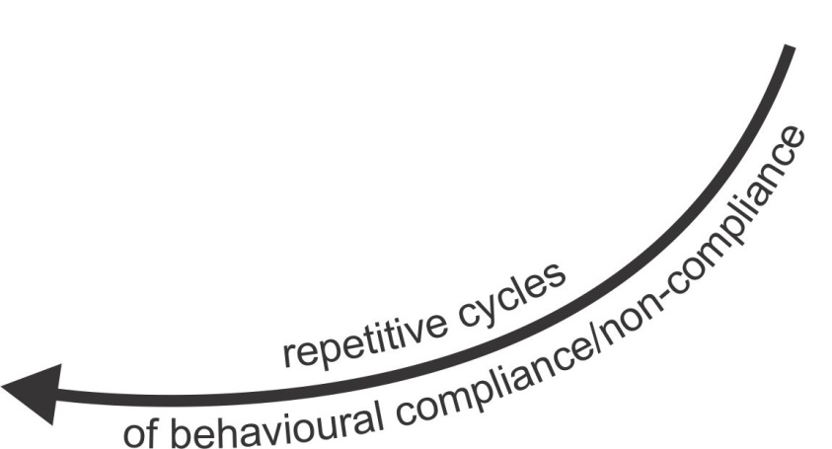
The Recurring Cycles of
Behaviour to Compliance to Behaviour
CO-OCCURRING CONDITIONS AND
AREAS OF POTENTIAL UNMET NEEDS
• Gastrointestinal
- infections
- intolerances
- imbalances
(e.g. vitamins/minerals)
- physical pain
• Mental & Neurological
e.g. seizures and mood disorders
• Brain Imbalances
- inflammations
- coherence (lack of)
- under development
- motor planning problems
• Sensory Integration
and Processing
- hyper/hypo activation
• Human Energy
- sensitivities
(e.g. EMF/ RWF)
- intolerances
• Cellular
- mitochondria dysfunction
• Emotional
- fears and phobias
• Adrenal Glands
- over production of cortisol
Gastrointestinal
LIVING & LEARNING
CHALLENGES
• Physical pain
• Sensory over/under
load
• Psychological distress
• Speech/hearing
limitations
• PTSD/Trauma
• Environmental stress
• Neglect/Abuse,
Isolation/Loneliness
• Supporter 4 outs
ANXIOUS REACTIONS
Mental & Neurological
BLOW-OUTS
• Repetitive behaviour
• 4 functional goals
• SIB and aggression
IF
People
with
Autism and Other Developmental Disabilities
with
Complex
Needs
Only Behavioural Interventions
Without
Primary Care As Recommended
Brain Imbalances
Resulting In
Supporter
Response
Have
One
or
More
Contributing To
Sensory Integration
and processing
BLOW-INS
• Withdrawal
• Compliance
• Depression
Human Energy
Cellular
Emotional
Adrenal Glands

Slide 26
“A counterfeit peace exists when people supported are pacified, distracted, frightened or so tired of fighting that all appears to others to be calm.”
(Adapted from Claiborne, Wilson-Hartgrove & Okoro.
(2012). Common Prayer, A Liturgy for Ordinary Rascals.)

Slide 27
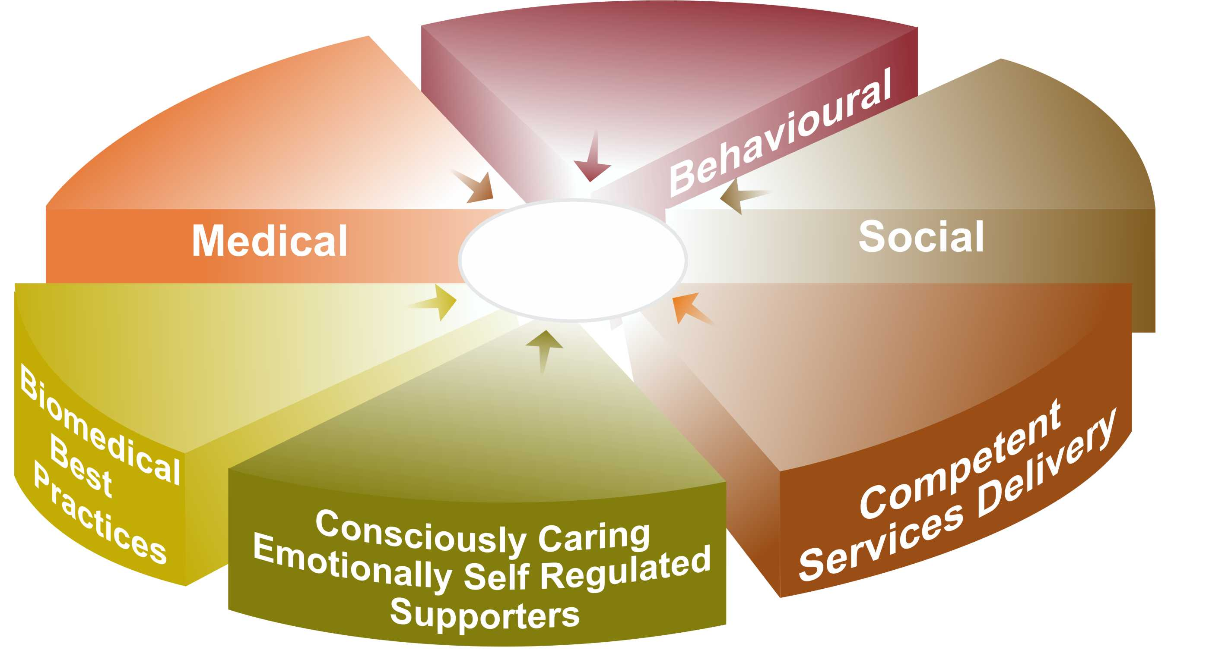
Evidence Based CCS Components for
Well-being and the Prevention and
De-escalation of Challenging Behaviours*
Crisis Interventions and
Learned Life Skills
e.g. ABA, IBI
Adequate Access to
Services to meet Physical,
Dental, Neurological and Mental
Health Services Needs
Socially Valued Roles,
Relationships and Meaningful
Life Experiences
Optimal
Well-being
Adequate Access to Services
to Meet Biomedical, Body,
Bowel, Brain,
Being, etc. Needs
‘How-Tos’ that Meet and
Exceed Professional Standards
e.g. 5 C’s Process
Mindful, Emotionally
Self Regulated and Unconditionally
Caring Supporters
* CCS reduces challenging behaviours by 50%-75% compared to MCCSS current ‘must use’ crisis protocols alone.
27

Slide 28
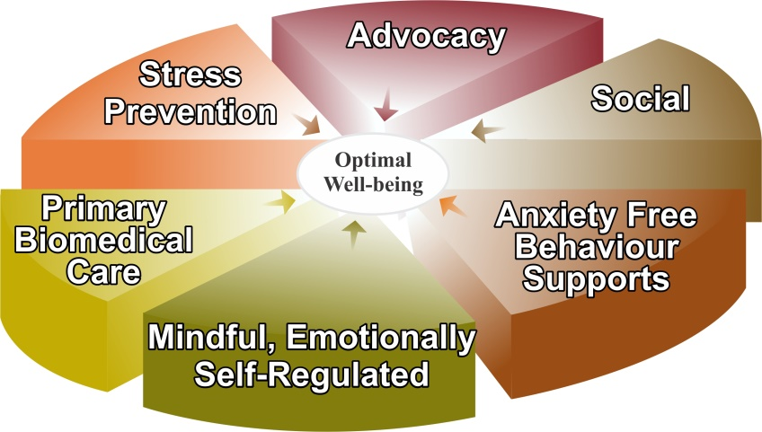
Breaking the Recurring Cycles of
Behaviour to Compliance to Behaviour
CO-OCCURRING CONDITIONS AND
AREAS OF POTENTIAL UNMET NEEDS
• Gastrointestinal
- infections
- intolerances
- imbalances
(e.g. vitamins/minerals)
- physical pain
• Mental & Neurological
e.g. seizures and mood disorders
• Brain Imbalances
- inflammations
- coherence (lack of)
- under development
- motor planning problems
• Sensory Integration
and Processing
- hyper/hypo activation
• Human Energy
- sensitivities
(e.g. EMF/ RWF)
- intolerances
• Cellular
- mitochondria dysfunction
• Emotional
- fears and phobias
• Adrenal Glands
- over production of cortisol
LESS AND LESS
LIVING & LEARNING
CHALLENGES
Gastrointestinal
BETTER AND BETTER
OPTIMAL LIVING
CONDITIONS
• Physical pain
• Fears and phobias
• Sensory over/under
load
• Psychological distress
• Speech/hearing
limitations
• PTSD/Trauma
• Environmental stress
• Neglect/Abuse,
Isolation/Loneliness
• Supporter 4 outs
Mental & Neurological
• Self Regulated
Nervous System
• Relative
Calm
• Well-being
Brain Imbalances
CCS
Interventions
Contributing To
Resulting
In
Sensory Integration
and processing
Human Energy
Cellular
Emotional
Note: living and learning challenges become less, directly proportionate to the implementation of CCS interventions resulting in enhanced optimal living conditions.
Adrenal Glands

Slide 29

Comprehensive Anxiety Reduction
Biomedical
Traditional
Medical
priorities, e.g.
• GI health
• neurodevelopment
• emotional wellness
• sensory processing
• energy protection
priorities, e.g.
• pathologies
• illnesses
• DSM disorders
• medications
• psychotherapy
Supporters’
Emotional
Maturity &
Mindful
Self
Regulation
Supporters’
Behavioural
Interventions
(e.g.
ABA, IBI
strategies)

Slide 30
CCS Well-being Facilitation Plan
Reference Session I – Resource 2

Slide 31


Physical and
Emotional Well-being
Toward A More Complete Understanding
of the hierarchy of special needs to meet in order to facilitate optimal well-being and to prevent and mindfully manage anxiety, anger and aggression
Awareness-based calming and de-escalation skills offered by mindful, emotionally self-regulated and kind supporters

Slide 32
January 11, 2016
Examples of CCS Tools to Enhance Self and
Others’ Mindful Emotional Self Regulation
B-FIT Mindfulness (the essential tool to initiate Conscious Care and Support)
Calming others by calming oneself – emotional contagion and mirror neurons e.g. Pain Empathy
Bilateral, Biomeridian Awareness Based Calming
(BB-ABC) e.g. Rocking and 15 Tools
All Tools must be practised during times of calm.

Slide 33
Mindfulness Benefits
for Individuals with
Developmental Disabilities

Slide 34
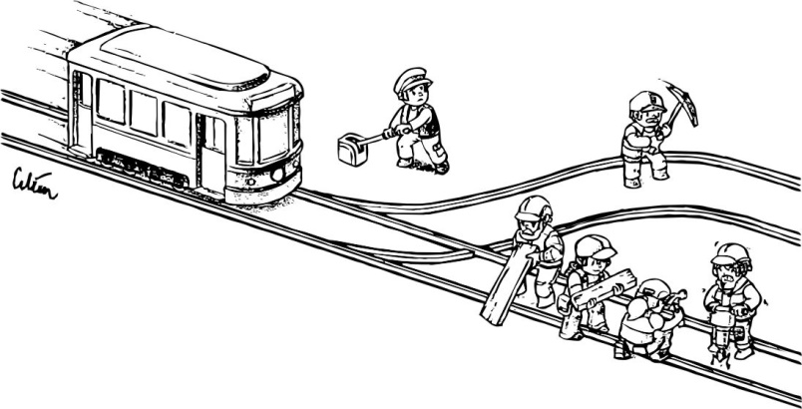
JJanuary 11, 2016

Slide 35
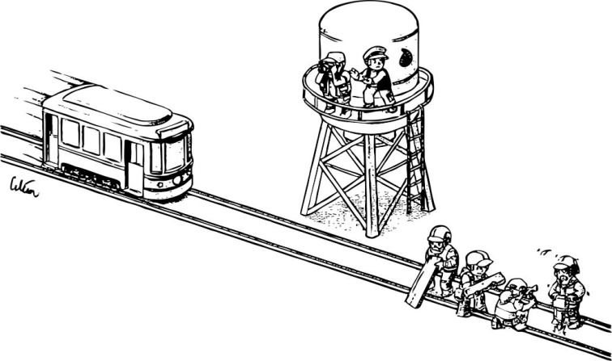
JJanuary 11, 2016

Slide 36
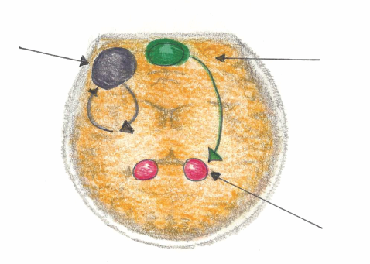
Mindful Emotional Self Regulation
The main way we can consciously access the emotional brain is through self awareness*, i.e. becoming mindful. Mindfulness increases connections in the medial pre-frontal cortex. This reduces anxiety for the Supporter and the Person Supported.
Dorsolateral pre-frontal Cortex
Working Memory
Impulse Control
Medial pre-frontal Cortex
(part of the brain that notices what’s going on)
Amygdala
(*Research reference: J. LeDoux, “Emotion Circuits in the Brain”, Journal of Neuroscience 33, no. 9 (2013) 3815-23)

Slide 37
According to many published Neuroscientists, including Dr. Daniel Siegel (UCLA) in his book called The Mindful Brain (page 42 and 43) the following brain, body and being functions correlate with the activity of medial areas of the prefrontal cortex:
1. Body regulation – the emotional brakes and accelerator functions.
2. Attuned communication involves the coordination of the input from another person with the activity of one’s own (as with mirror neurons).
3. Emotional balance to have enough activation so that life has meaning and vitality but not so much that life becomes chaotic.
4. Response flexibility is the capacity to pause before action.
5. Empathy – knowing what might be going on inside someone else.
6. Insight or self-knowing awareness to be able to link the past, present and future.
7. Fear modulation that may be carried out by the release of the inhibitory neurotransmitter GABA.
8. Intuition – a neural mechanism by which we process deep ways of knowing via our body i.e. ‘somatic intelligence’.
9. Morality – taking into consideration the larger picture, to image what is best for the
whole not just one’s self, even when alone.

Slide 38
JJanuary 11, 2016
The You
Who is Listening to Me
Did Not Make the Choice
To Push or Not!
(Unless you were mindful/conscious)

Slide 39
,
Definitions to Better Understand the ‘Set-up’
Over each 24 hour period, we can be experiencing consciousness on a 1-10 continuum.
Unconscious: (1)
  like when we are asleep in our bed.
Semiconscious: (autopilot) (5)
  like how we typically drive our car, relate to people and do most ‘doings’.
Fully Conscious: (self aware) (10)
  like when we are paying attention – noticing what we are doing e.g. how we drive when a police car is following us;
  knowing that we are doing it and
  knowing how our body’s sensations, feelings and thoughts are
  reacting to what is happening.
Subconscious:
  our data bank of ‘files’ that we inherit and develop.

Slide 40

The Role of Early Educational Interventions
Physician Handbook
Studies have shown that early intensive educational interventions result in improved outcomes for the child and family. Initial strategies may include teaching the child to notice what is going on in their environment, to be able to pay attention.
40

Slide 41
Physical and
Emotional Well-being
Toward A More Complete Understanding
of the hierarchy of special needs to meet in order to facilitate optimal well-being and to prevent and mindfully manage anxiety, anger and aggression
Gastrointestinal (GI), bowel, digestive and immune systems’ treatment, nutrition, pain management, dental and myofunctional disorders, illness prevention and treatment
Awareness-based calming and de-escalation skills offered by mindful, emotionally self-regulated and kind supporters

Slide 42
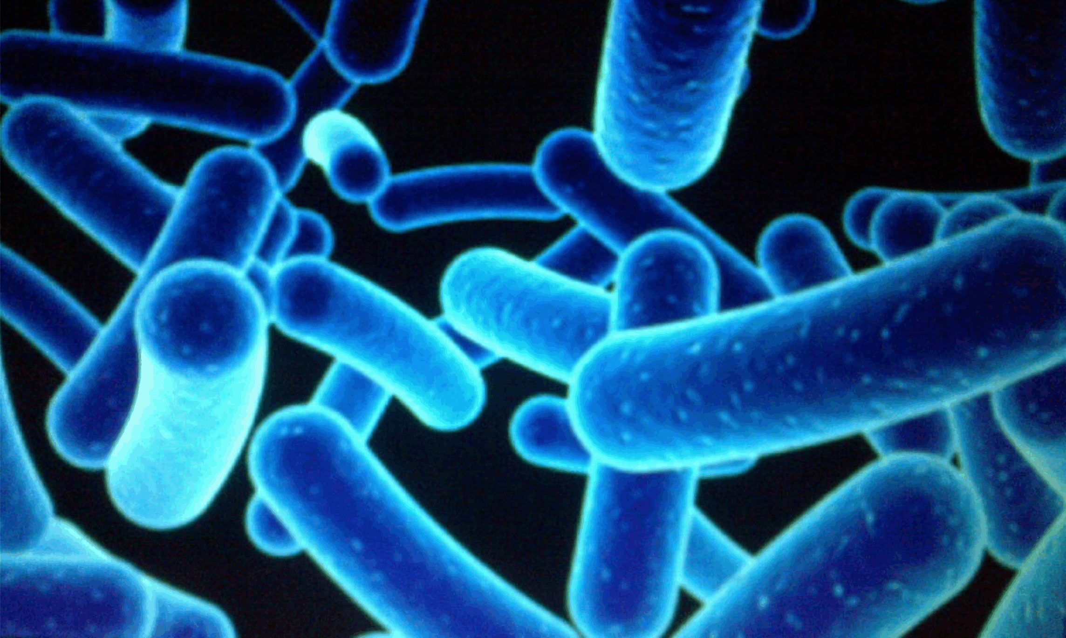
Needs for GI and Bowel Management and Holistic Treatment
Distressed Gut Microbes – produce Mind/Body Agitation, Pain and Anxiety which often leads to aggression.
1% Human
99 % Bacterial and Fungal
Some Microbes found in the gut of individuals with Autism, when introduced into healthy rodents, create numerous Autistic like symptoms.
e.g.
  Repetitive behaviours
  Social aversion
  Easy to startle
(Reference: Dr. Derrick MacFabe, The University of Western Ontario)
(Young, E. - I Contain Multitudes, pages 69 & 70)

Slide 43
Microbes, Anxiety and Aggression
Chronic anxiety means excessive toxic cortisol in the body. To neutralize this toxin, the body uses up basic building blocks like amino acids that are needed to:
  digest food
  build the immune system
  produce calming neurotransmitters
  This depletion causes anxiety leading to challenging
  behaviour.

Slide 44
CCS GI and Bowel Management and Holistic Treatments
Engage a qualified holistic GI specialist, e.g. qualified and available MD, ND or nutritionist who will for example:
Complete a comprehensive biomedical assessment e.g. Organic Acid Test
Remove food toxins/allergens and metals
Balance minerals, vitamins and neurotransmitters
Implement holistic bowel management
Optimize nutrition
Optimize sleep

Slide 45

Dental and Myofunctional Needs
10 Observations to Identify Oral Health Problems that Could be Causing Pain and therefore Challenging Behaviours (reference OHTH*)
1. Noticed any changes in their eating and/or drinking?
2. Noticed any changes in their behaviour - more aggressive to themselves or others, more excited or more withdrawn?
3. Noticed any changes in their sleeping pattern?
4. Noticed an increase in teeth grinding, clenching or drooling?
5. Are they recently avoiding daily oral care?
6. Noticed any facial swelling or redness on one side, possibly with a fever?
7. Are their lips apart at rest and/or snoring at night?
8. Do they have really bad breath?
9. Look in the mouth: Red inflamed gums that bleed on looking or touching with a toothbrush, broken teeth, holes in teeth, pimples/boils/ swellings on the gums?
10. Need for more medications such as PRN medications for pain or behaviour?
Website: www.ohth.ca

Slide 46
Physical and
Emotional Well-being
Toward A More Complete Understanding
of the hierarchy of special needs to meet in order to facilitate optimal well-being and to prevent and mindfully manage anxiety, anger and aggression
Emotional Wellness:
• mental and neurological health and
disorders’ treatment
• trauma desensitization and triggers’
elimination
• psychological well-being
• medication side effects
• ABA behavioural interventions
Gastrointestinal (GI), bowel, digestive and immune systems’ treatment, nutrition, pain management, dental and myofunctional disorders, illness prevention and treatment
Awareness-based calming and de-escalation skills offered by mindful, emotionally self-regulated and kind supporters

Slide 47
Mental and Neurological Health
  Ensure accurate tracking of symptoms and report to the Primary Care Physician.
  Behaviour check lists must be an accurate reflection of the supported person’s behaviour – not contaminated with the supporter’s inadvertent ‘Challenging Behaviour’

Slide 48
Mental and Neurological Health
  Benefits and Risks of Psychotropic Medications:
      Anti-psychotics
      Anti-anxiety
      Anti-depressants
  Questions for the Primary Care Physician:
      How will we know that it is effective and helpful?
      What will we observe if there are unacceptable side
      effects or risks e.g. Akathisia?

Slide 49
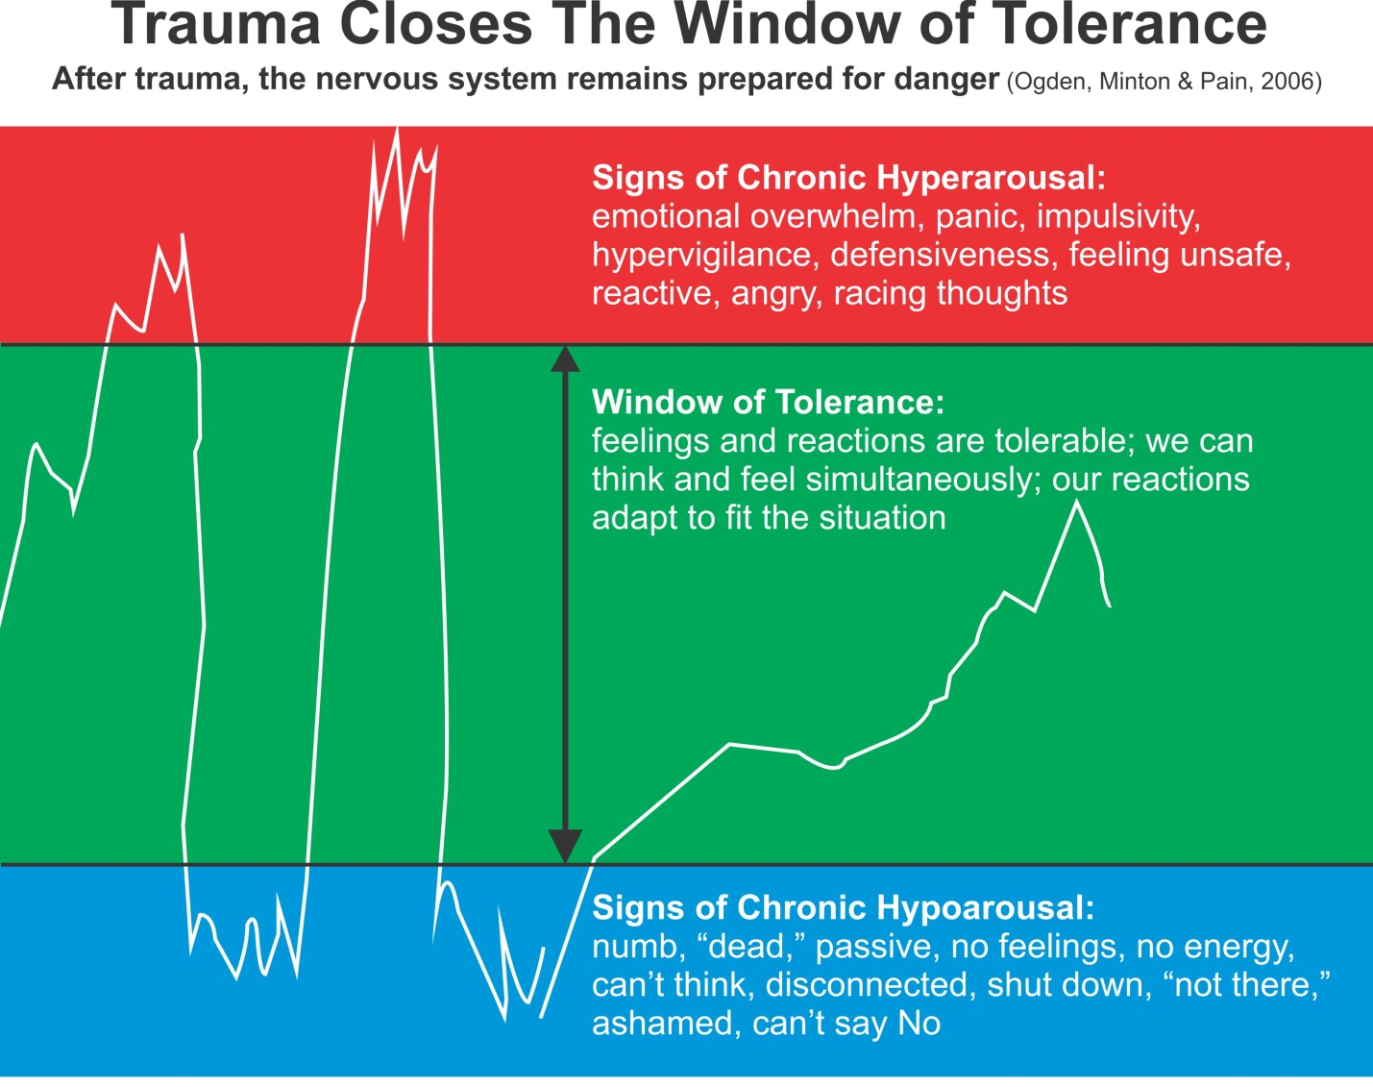

Slide 50
Physical and
Emotional Well-being
Toward A More Complete Understanding
of the hierarchy of special needs to meet in order to facilitate optimal well-being and to prevent and mindfully manage anxiety, anger and aggression
Brain development, coherence balancing and inflammation regulation
Emotional Wellness:
• mental and neurological health and
disorders’ treatment
• trauma desensitization and triggers’
elimination
• psychological well-being
• medication side effects
• ABA behavioural interventions
Gastrointestinal (GI), bowel, digestive and immune systems’ treatment, nutrition, pain management, dental and myofunctional disorders, illness prevention and treatment
Awareness-based calming and de-escalation skills offered by mindful, emotionally self-regulated and kind supporters

Slide 51
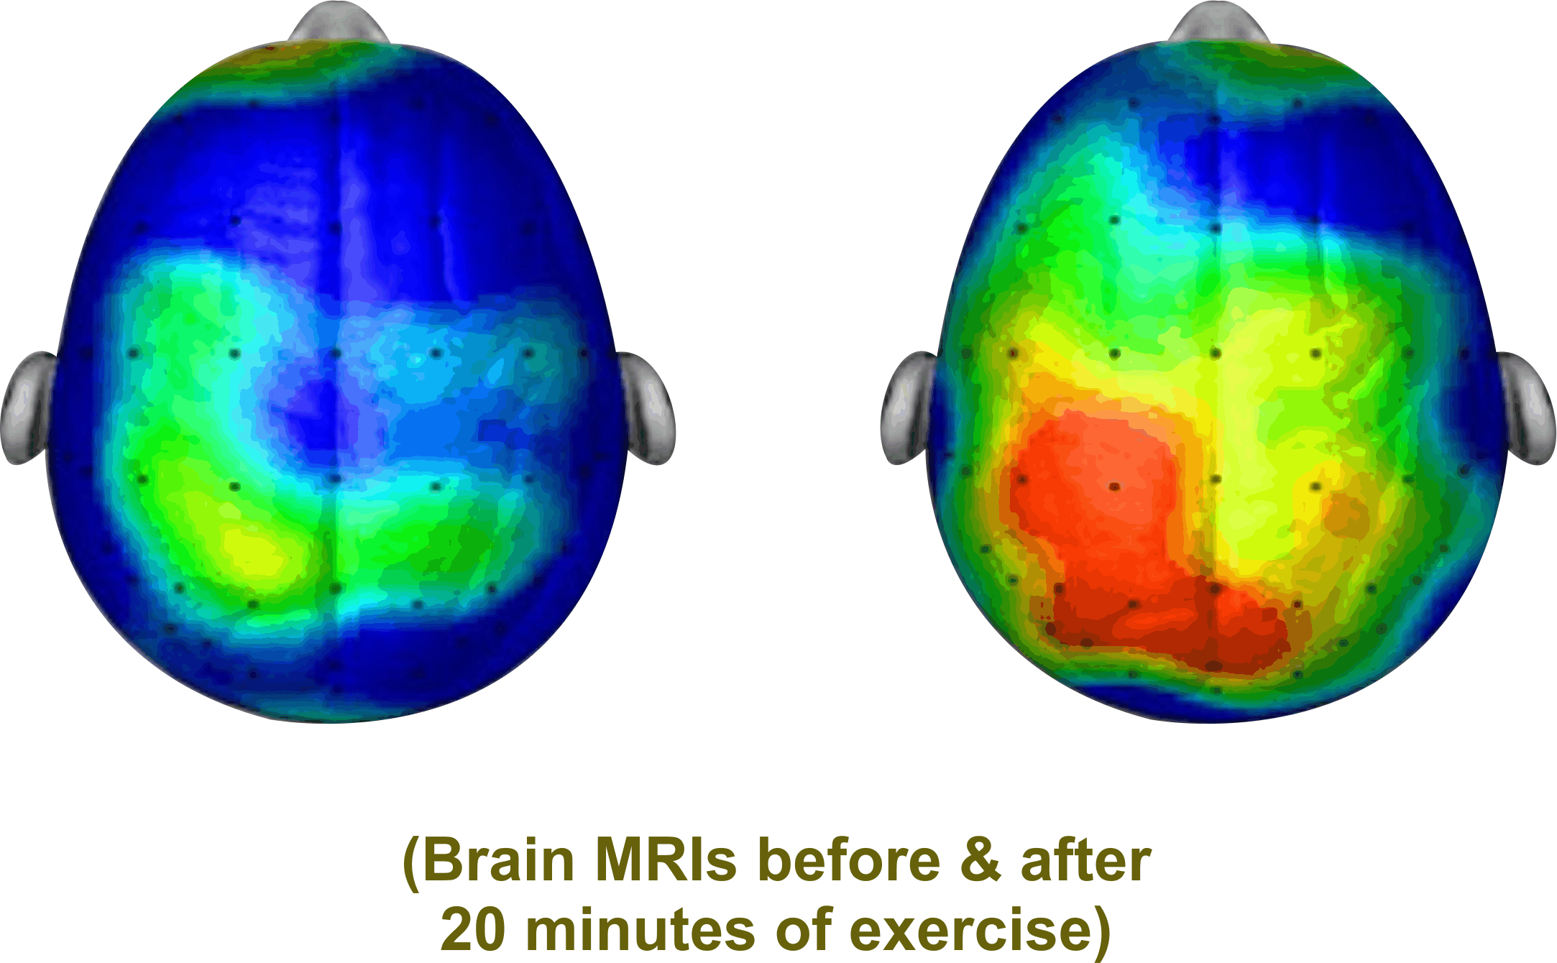
Brain Coherence
i.e. Many Parts of the Brain ‘Talking’ to Each Other
“Like you, I need to be able to understand and process information”. This requires optimal Brain Functioning e.g.
        neurogenesis (new neurons)
        neuroplasticity (more complete neuro networks)
        neuro electrical stimulation (brain firing)
        neurochemicals production (endorphins, dopamine, serotonin, oxytocin)
        Hertz e.g. Beta, Alpha, Theta, Delta

Slide 52
JJanuary 11, 2016
Neuroscience also near unanimously concurs that neurogenesis, neuroelectric stimulation, neurochemicals’ production, and neuroplasticity are, with appropriate training and conditioning, not only possible but highly predictable to measurably enhance cognition, empathy and emotional self regulation.
Reference:
N. Doidge – The Brain’s Way of Healing
D. Siegel – The Mindful Brain
D. Eagleman – The Brain

Slide 53
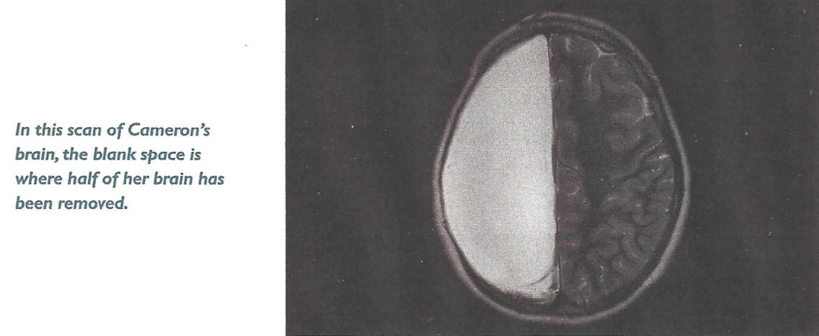
JJanuary 11, 2016
Could This Indicate Potential for Well-being for People Supported?
In 2007, Neurosurgeons removed half of Cameron Mott’s Brain
The Results:
Aside from some weakening on one side of her body, she is indistinguishable from her classmates. She is a good student and participates in sports.
(Reference D. Eagleman The Brain)

Slide 54
JJanuary 11, 2016
Neuroscience and Gastrointestinal (GI) Research Conclusions
No evidence to suggest that the Brain and GI of people supported cannot heal, grow and develop.
Evidence that the Brain and GI can heal, grow and
develop with appropriate (CCS type) training and conditions.
(Reference Bibliography)

Slide 55
CCS Brain Coherence, Balancing & Inflammation Regulating Interventions
1. Enhance essential brain calming elements
e.g. GABA and Serotonin
2. Prevent excess of excitatory elements
e.g. Cortisol, Glutamate, PPA
3. Balance anxiety producing vitamins and minerals
e.g. Magnesium, Vitamin B6, Histamine reduction, Vitamin B12
4. Cerebellum activation
e.g. 20 minutes of bouncing and balancing, and neurofeedback
5. Maintain adequate glutathione levels to prevent brain inflammation e.g. NAC

Slide 56
JJanuary 11, 2016
6. Keep the Mitochondria Cell System Healthy:
  Mitochondria are known as the powerhouse of each cell
  They give cells their energy to do their work such as maintaining healthy brain functioning
Controllable Mitochondria Killers:
  Sugar and Simple Carbohydrates
  Oxidative Stress causing Brain Inflammation – low glutathione
  Medications such as Antibiotics and Antipsychotics
  Vitamins and Minerals Imbalance – low B vitamins, folic acid, magnesium, vitamin D

Slide 57
Cardio Exercise:
Cardio exercise, especially bouncing and balancing, increases brain wave activity (e.g. cerebellum) to give better brain coherence for optimal functioning.
Improved coherence results in thoughts becoming more organized and focused.
This results in less fear and therefore more calm.

Slide 58

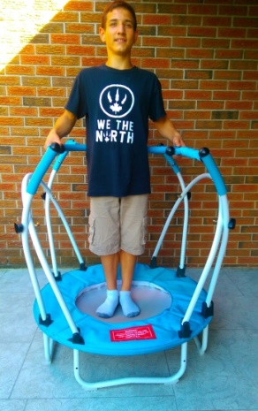
stabilization balls
and elliptical stabilization cushions

Slide 59
Physical and
Emotional Well-being
Toward A More Complete Understanding
of the hierarchy of special needs to meet in order to facilitate optimal well-being and to prevent and mindfully manage anxiety, anger and aggression
Human energy system – building, balancing and protecting from wireless radiation and electromagnetic fields (EMF)
Brain development, coherence balancing and inflammation regulation
Emotional Wellness:
• mental and neurological health and
disorders’ treatment
• trauma desensitization and triggers’
elimination
• psychological well-being
• medication side effects
• ABA behavioural interventions
Gastrointestinal (GI), bowel, digestive and immune systems’ treatment, nutrition, pain management, dental and myofunctional disorders, illness prevention and treatment
Awareness-based calming and de-escalation skills offered by mindful, emotionally self-regulated and kind supporters

Slide 60

JJanuary 11, 2016
Human Energy – Building, Balancing and Protection
Protection from Environmental Toxins
e.g. - reduce electromagnetic energy fields (EMF)
(a.k.a. dirty electricity)
- reduce Wi-Fi and cell phone radiation
The Bioinitiative Report 2012 links EMF Exposure to Autism concluding: Based on strong evidence for vulnerable biology, in Autism, EMF/ Radio Frequency Radiation (RFR) can plausibly increase Autism risk and symptoms. "While we aggressively investigate the links between Autism disorders and wireless technologies, we should minimize wireless and EMF exposures for people with Autism disorders, children of all ages, people planning a baby, and during pregnancy,”
says Martha Herbert, MD, PhD, Pediatric Neurologist Harvard Medical School.

Slide 61
Physical and
Emotional Well-being
Toward A More Complete Understanding
of the hierarchy of special needs to meet in order to facilitate optimal well-being and to prevent and mindfully manage anxiety, anger and aggression
Sensory integration and processing
Human energy system – building, balancing and protecting from wireless radiation and electromagnetic fields (EMF)
Brain development, coherence balancing and inflammation regulation
Emotional Wellness:
• mental and neurological health and
disorders’ treatment
• trauma desensitization and triggers’
elimination
• psychological well-being
• medication side effects
• ABA behavioural interventions
Gastrointestinal (GI), bowel, digestive and immune systems’ treatment, nutrition, pain management, dental and myofunctional disorders, illness prevention and treatment
Awareness-based calming and de-escalation skills offered by mindful, emotionally self-regulated and kind supporters

Slide 62
JJanuary 11, 2016
Filling the Gap – Sensory Integration and Processing:
Because research indicates that there is an 80% likelihood that
individuals with ASD/DD will have sensory processing and
integration challenges that cause and/or greatly influence
anxiety and for some aggression, CCS advocates for screening,
assessments and treatments by qualified Occupational
Therapists.
This treatment does not generally appear to be the
case for many people supported throughout Ontario.

Slide 63



Hyperactive Senses Lead to Challenging Behaviours
Hyperactive Senses
means that
people, objects and places can be:
e.g.
  too loud
  too fast
  too scratchy
  too tight
  too bright
  too off balance
  too confusing
  too chaotic
Agitation, Anger and/or Aggression
e.g.
repetitive behaviour
challenging behaviour
Injury to self or others
A
N
X
I
E
T
Y
=
=

Slide 64
Hypoactive Senses Lead to Challenging Behaviours
Hypoactive Senses
means that
people, objects and places can be:
e.g.
  too quiet
  too slow
  too dark
  too loose
  too tickly
  too confusing
  too chaotic
Agitation, Anger and/or Aggression
e.g.
low energy
low motivation
quiet/withdrawn
Eventually -
repetitive behaviour
challenging behaviour
Injury to self or others
A
N
X
I
E
T
Y
=
=

Slide 65
Physical and
Emotional Well-being
Environmental – supporter’s accommodations,
behaviour (ABA learning), social interactions and
contributing to others’ well-being
Toward A More Complete Understanding
of the hierarchy of special needs to meet in order to facilitate optimal well-being and to prevent and mindfully manage anxiety, anger and aggression
Sensory integration and processing
Human energy system – building, balancing and protecting from wireless radiation and electromagnetic fields (EMF)
Brain development, coherence balancing and inflammation regulation
Emotional Wellness:
• mental and neurological health and
disorders’ treatment
• trauma desensitization and triggers’
elimination
• psychological well-being
• medication side effects
• ABA behavioural interventions
Gastrointestinal (GI), bowel, digestive and immune systems’ treatment, nutrition, pain management, dental and myofunctional disorders, illness prevention and treatment
Awareness-based calming and de-escalation skills offered by mindful, emotionally self-regulated and kind supporters
65

Slide 66
Environmental Well-being
Communications – Validate not Vet
Accommodations e.g. – Limited Choices
– Avoid ‘No’
Behavioural Learning e.g. – ABA, IBI, Best Practices
Social Interactions e.g. – “Go slow in ways I know”
Contributing to Others’ Well-being e.g. – socially valued roles

Slide 67
Stress Inducers and Reducers
Reference CCS Textbook – Page 169 – 175

Slide 68

The 5 Step Conscious Care and Support Process
CARING &
COMPETENT SERVICES
Step 5
Step 4
CONSIOUSLY CONNECT
Step 3
CLARIFY AND CHOOSE
Step 2
CALM
Step 1
CATCH
“My mindful words and actions are useful, truthful, timely and kind”

Slide 69
JJanuary 11, 2016
What My Symptoms Are Saying:
“Even though I don’t control them, most of my behavioural
symptoms are messages to you. My nervous system is asking
you for certain kinds of support to have its specific needs met.
Please listen to what it is doing. If you don’t, I can’t stop it
from becoming anxious and frightened. And the main way
that it has learned to calm its fears is to get irritated, angry
and even aggressive. I hate when it does that but the calm
that follows my aggression makes me feel normal again.
Please help me to find a better way.”

Slide 70
Through Substantial and Sustainable Supporters’ & Leaders’:
    Training in Evidence Based Best Practices;
    Development in Conscious Self-regulation;
    Resulting in Competence & Commitment –
    People Supported
    Will
Live to Their Fullest Mind, Body and Spiritual Potential.

