Slide 1


GI, Bowel, Digestive and Immune Systems
Holistic Treatment and Pain Management
Session III– Resource 1

Slide 2
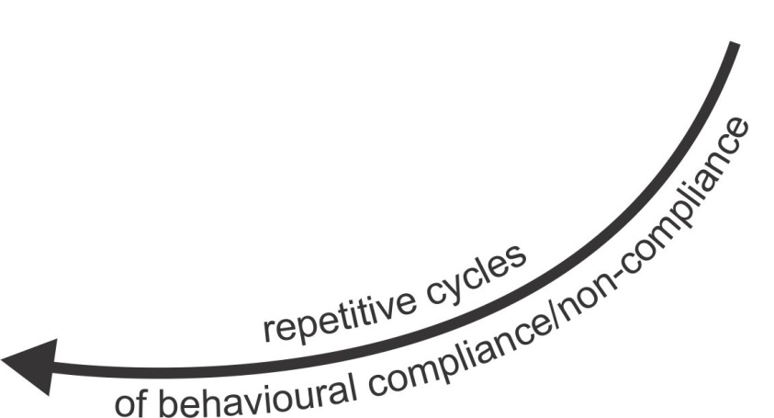
The Recurring Cycles of
Behaviour to Compliance to Behaviour
CO-OCCURRING CONDITIONS AND
AREAS OF POTENTIAL UNMET NEEDS
• Gastrointestinal
- infections
- intolerances
- imbalances
(e.g. vitamins/minerals)
- physical pain
• Mental & Neurological
e.g. seizures and mood disorders
• Brain Imbalances
- inflammations
- coherence (lack of)
- under development
- motor planning problems
• Sensory Integration
and Processing
- hyper/hypo activation
• Human Energy
- sensitivities
(e.g. EMF/ RWF)
- intolerances
• Cellular
- mitochondria dysfunction
• Emotional
- fears and phobias
• Adrenal Glands
- over production of cortisol
Gastrointestinal
LIVING & LEARNING
CHALLENGES
• Physical pain
• Sensory over/under
load
• Psychological distress
• Speech/hearing
limitations
• PTSD/Trauma
• Environmental stress
• Neglect/Abuse,
Isolation/Loneliness
• Supporter 4 outs
ANXIOUS REACTIONS
Mental & Neurological
BLOW-OUTS
• Repetitive behaviour
• 4 functional goals
• SIB and aggression
IF
People
with
Autism and Other Developmental Disabilities
with
Complex
Needs
Only Behavioural Interventions
Without
Primary Care As Recommended
Brain Imbalances
Resulting In
Supporter
Response
Have
One
or
More
Contributing To
Sensory Integration
and processing
BLOW-INS
• Withdrawal
• Compliance
• Depression
Human Energy
Cellular
Emotional
Adrenal Glands

Slide 3
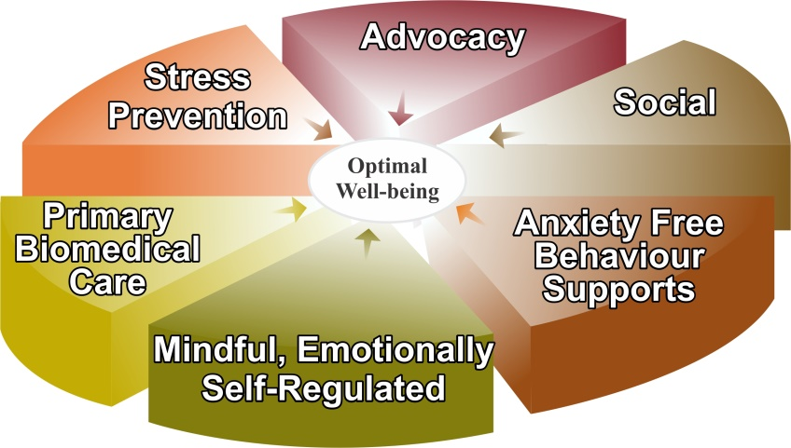
Breaking the Recurring Cycles of
Behaviour to Compliance to Behaviour
CO-OCCURRING CONDITIONS AND
AREAS OF POTENTIAL UNMET NEEDS
• Gastrointestinal
- infections
- intolerances
- imbalances
(e.g. vitamins/minerals)
- physical pain
• Mental & Neurological
e.g. seizures and mood disorders
• Brain Imbalances
- inflammations
- coherence (lack of)
- under development
- motor planning problems
• Sensory Integration
and Processing
- hyper/hypo activation
• Human Energy
- sensitivities
(e.g. EMF/ RWF)
- intolerances
• Cellular
- mitochondria dysfunction
• Emotional
- fears and phobias
• Adrenal Glands
- over production of cortisol
LESS AND LESS
LIVING & LEARNING
CHALLENGES
Gastrointestinal
BETTER AND BETTER
OPTIMAL LIVING
CONDITIONS
• Physical pain
• Fears and phobias
• Sensory over/under
load
• Psychological distress
• Speech/hearing
limitations
• PTSD/Trauma
• Environmental stress
• Neglect/Abuse,
Isolation/Loneliness
• Supporter 4 outs
Mental & Neurological
• Self Regulated
Nervous System
• Relative
Calm
• Well-being
Brain Imbalances
CCS
Interventions
Contributing To
Resulting
In
Sensory Integration
and processing
Human Energy
Cellular
Emotional
Note: living and learning challenges become less, directly proportionate to the implementation of CCS interventions resulting in enhanced optimal living conditions.
Adrenal Glands

Slide 4


Physical and
Emotional Well-being
Environmental – supporter’s accommodations,
behaviour (ABA learning), social interactions and
contributing to others’ well-being
Toward A More Complete Understanding
of the hierarchy of special needs to meet in order to facilitate optimal well-being and to prevent and mindfully manage anxiety, anger and aggression
Sensory integration and processing
Human energy system – building, balancing and protecting from wireless radiation and electromagnetic fields (EMF)
Brain development, coherence balancing and inflammation regulation
Emotional Wellness:
• mental and neurological health and
disorders’ treatment
• trauma desensitization and triggers’
elimination
• psychological well-being
• medication side effects
• ABA behavioural interventions
Gastrointestinal (GI), bowel, digestive and immune systems’ treatment, nutrition, pain management, dental and myofunctional disorders, illness prevention and treatment
Awareness-based calming and de-escalation skills offered by mindful, emotionally self-regulated and kind supporters

Slide 5

Physical and
Emotional Well-being
Toward A More Complete Understanding
of the hierarchy of special needs to meet in order to facilitate optimal well-being and to prevent and mindfully manage anxiety, anger and aggression
Gastrointestinal (GI), bowel, digestive and immune systems’ treatment, nutrition, pain management, dental and myofunctional disorders, illness prevention and treatment
Awareness-based calming and de-escalation skills offered by mindful, emotionally self-regulated and kind supporters
5

Slide 6
GI, Bowel and Digestive Health
Is the Foundation for a
Healthy Mind

Slide 7
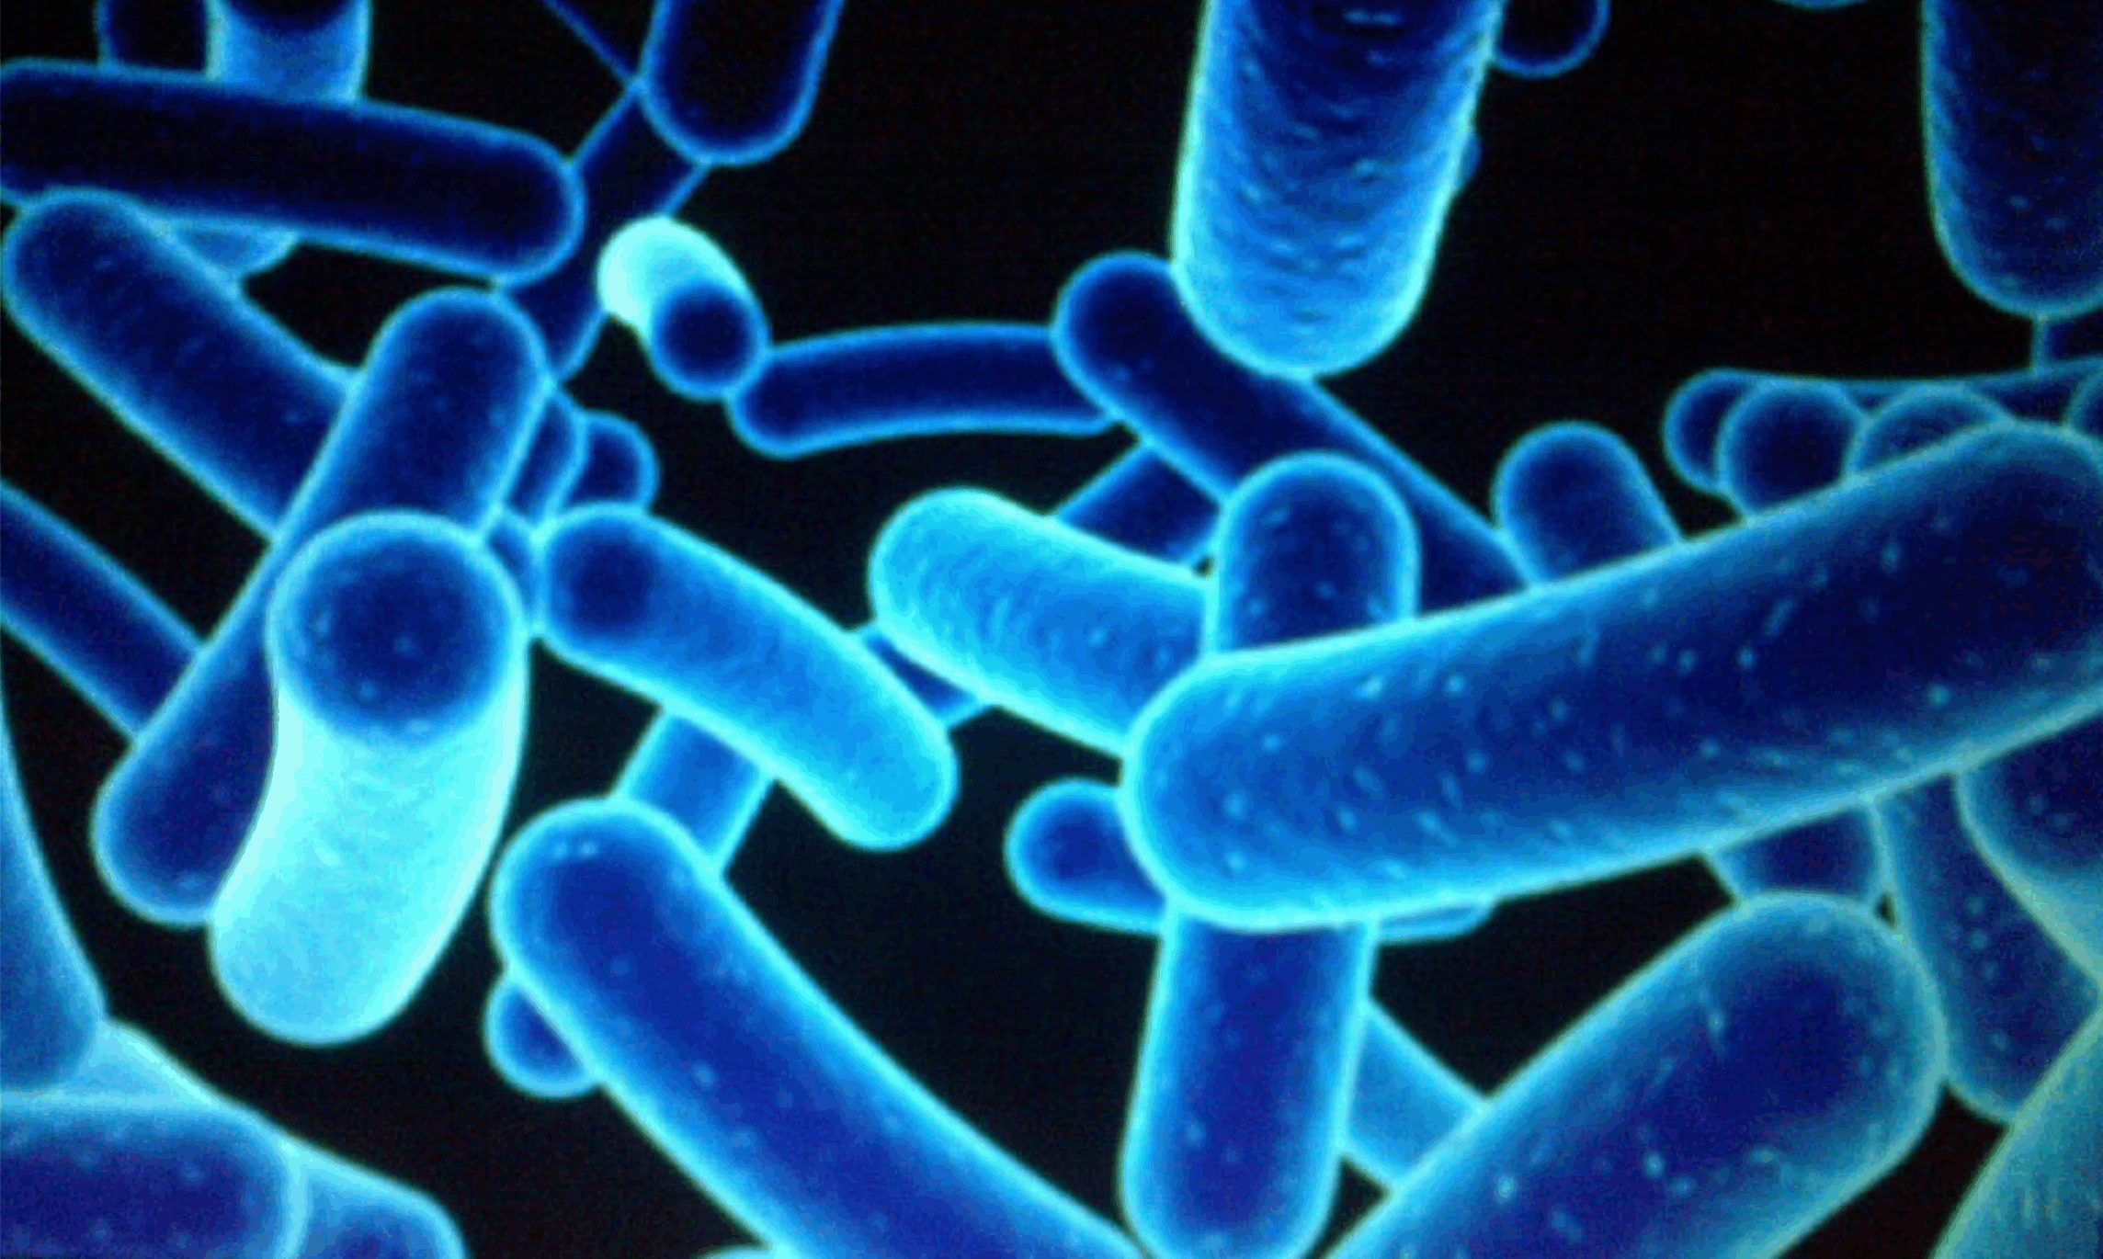
Needs for GI and Bowel Management and Holistic Treatment
Distressed Gut Microbes – produce Mind/Body Agitation, Pain and Anxiety which often leads to aggression.
1% Human
99 % Bacterial and Fungal
Some Microbes found in the gut of individuals with Autism, when introduced into healthy rodents, create numerous Autistic like symptoms.
e.g.
  Repetitive behaviours
  Social aversion
  Easy to startle
*Yong, E. (2018). I Contain Multitudes: the microbes within us and a grander view of life. P. 69-70. Ecco.
**MacFabe, D.F., Cain, N.E., Boon, F., Ossenkopp, K.P., & Cain, D.P. (2010). Effects of the enteric bacterial metabolic product propionic acid on object-directed behavior, social behavior, cognition, and neuroinflammation in adolescent rats: Relevance to autism spectrum disorder. Behav Brain Res. https://www.ncbi.nlm.nih.gov/pubmed/23990817

Slide 8
…Perspective
The majority of individuals with ASD/DD have GI, bowel and digestive problems that significantly contributes to their anxiety, agitation, anger and aggression.

Slide 9
Chronic Anxiety
Chronic anxiety means ongoing excessive toxic cortisol in the body. To neutralize this toxin, the body uses up basic building blocks like amino acids needed to:
Build the immune system
Digest food
Develop neurotransmitters
Depletion of these vital amino acids significantly compromises these systems causing illnesses that are treated with antibiotics
that causes greater distressed gut flora.

Slide 10
Examples of Behavioural Symptoms of Unmet GI, Bowel and Digestion Needs (all of these behaviours are reactionary and cognitively unintended):
To create situations or take advantage of situations to become agitated, angry and aggressive; this distracts from physical and/or emotional pain;
To eat soothing but addictive and toxic “junk” foods;
To withdraw;

Slide 11
To reduce the preoccupation with pain in for example the bowel, the individual may harm themselves so that they will have a stronger, self-induced physical pain from, for example, biting;
To escape into rage or OCD;
To self-induce vomiting to relieve the stomach pain.

Slide 12
The Brain – Bowel Connection?
For numerous reasons, including excess sugar or following courses of antibiotics, a waste product known as Propionic Acid (PPA) tends to overgrow in the gut.
High levels of PPA producing bacteria are found in the gut of many children with Autism.
When healthy pregnant rodents are fed diets high in PPA, they give birth to pups that in 4-7 weeks show numerous signs of Autism.
(reference PPA Research, Dr. Derrick MacFabe, the University of Western Ontario)
PPA thrives on simple carbs and refined sugar.

Slide 13
Causes of Unhealthy Gut Flora
Antibiotics
Inadequate Chewing
Poor Nutrition
Chronic Long Term Constipation
Chronic Anxiety and Depression
Diets Rich in Refined Foods
Inflammatory Bowel Disease, Irritable Bowel
Allergies
Diabetes (Type I and II)

Slide 14
Why Vulnerable?
Poor Diet (e.g. refined foods, sugar etc.) inevitably leads to poor GI health.
The area of the brain that controls attention, motor impulses and the capacity to inhibit impulses (for individuals with ASD) was discovered to be metabolizing sugar at the rate of 10-12 percent slower than that of a neurotypical person. The brain needs energy to keep the mind and body focused. Without that energy, thoughts and actions spin out of control (reference Shadow Syndrome, Ratey, John page 196).
Researcher Alan J. Zametkin of the National Institute of Mental Health

Slide 15
The impact of a Poor Diet
An average Canadian diet
- is rich in refined foods
- is low in fermented foods, complex carbohydrates and fibre
Refined foods are easily broken down in the upper GI track
- therefore very little healthy food makes it to the colon
The colon should be the site of most beneficial gut microbe activity
- starvation of this community can lead to ecosystem damage
(video resource references - “Hungry for Change” and “Fed Up”)

Slide 16
Why Vulnerable? continued
Chewing Problems - Good balanced meals do not necessarily result in good gut nutrition.
Proper chewing is essential to: - break down food for the gut to process.
- activate flow of specific digestive enzymes
- facilitate pain free swallowing

Slide 17
Why Vulnerable? continued
Inflammation in the gut and brain can be caused by toxins, food sensitivities or bad bacteria or yeast in the gut. This can cause pain that affects behaviour – such as self-injurious behaviour; eye poking, and head banging can all be signs of pain.
(reference John Hopkins Hospital research 2015 re: ASD brain inflammation)
When detoxification is poor as is common with individuals with ASD/DD, toxins from food and the environment can result in brain inflammation causing irritability, aggression, brain/cellular damage.

Slide 18
Why Vulnerable? continued
When digestion is poor and the gut is too permeable (leaky gut), the nutrients that are supposed to get through cannot absorb properly. This leads to nutrient deficiencies, which can affect all cellular function including poor brain function.
Opiates can be created from inadequate breakdown of gluten, casein, and soy leading to symptoms of opiate excess – foggy thinking, insensitivity to pain, opiate addiction and withdrawal, and irritability.
Yeast - when there is yeast overgrowth in the GI tract, toxins enter the bloodstream and make their way to the brain where they can cause symptoms ranging from spaciness, foggy thinking, and aggressive behaviour.

Slide 19
Why Vulnerable? continued
Neurotransmitters. When the biochemistry is not working properly, neurotransmitters are not produced and cannot function as they need to. This increases the likelihood of anxiety, depression, ADHD, and sleeping issues.
Serotonin
Learning
Appetite
Language development
Mood and noise sensitivity
Sleep
Behaviour
Sensory perception
Memory
Dopamine
Sensitivity and processing of information
Perception of change
Relaying information
Fundamental brain function – cognition
Motivation
Emotional responses
Attention and focus
Transitions

Slide 20
Why Vulnerable? continued
Enzymes. In this study, the researchers found that levels of 3 enzymes responsible for breaking down sugars are significantly lower in the small intestines of children with autism.
More than 90% of these children have deficiencies in at least 2 of the 3 enzymes and 73% in all three.
According to Dr. Derrick MacFabe, Director of The Kilee Patchell-Evans Autism Research Group at the University of Western Ontario “this study is consistent with data showing disruption of the gut microbiomes as a key factor in autism. It also provides indirect evidence of carbohydrate rich meals increasing ASD/DD gut symptoms and behaviour worsens.”
Reference: Williams B.L., PLoS One 2011;6(9):e24585. (PubMed)

Slide 21
Harmful Effects of Sugar
Suppresses the immune system
Contributes to hyperactivity, anxiety, depression, concentration difficulties
Reduces helpful high density cholesterol
(HDLs) and raises harmful cholesterol (LDLs)
Increases the risk of coronary heart disease
and high blood pressure
Increases fasting levels of blood glucose and contributes to diabetes
  Promotes tooth decay
  Contributes to weight gain and obesity
  Increases the water retention and bloating
  Causes headaches, including migraines
  Increases bacterial fermentation in the colon
  Increases risk of Alzheimer’s disease

Slide 22
Solutions
Note: as with all other needs described in the Hierarchy Needs Model, the following information is presented to help develop the family and support professionals to become well informed, effective advocates to search and find competent community medical professionals e.g. Primary Care Physicians, Naturopathic Doctors, Registered Nutritionists to assess and implement the comprehensive support plan.
All assessment tests and treatment services will be directed by the community professionals and as applicable authorized by the primary care physician e.g. Organic Acid Test, Hair Analysis Test and Urine, Blood and Stool testing.

Slide 23
Solutions continued
1. Reduction and elimination of unhealthy foods and toxins
  sugar (maximum 50 gm. per day for adults) e.g. soft drinks, power
  drinks, juice, bars and candy
  grains/gluten – especially white and refined grain carbohydrates
  dairy – a high percentage of all Canadians have a dairy intolerance
  deep fried foods
  artificial sweeteners
  preservatives, e.g. MSG, artificial food dyes
  processed meats and cheese
  hydrated or heated fats, e.g. Crisco and Mazola oil, and margarine
  toxic minerals, e.g. lead and mercury

Slide 24
Solutions continued
2. Facilitate assessment and testing as indicated
  Food intolerances, e.g. gluten, casein, egg, nuts
  Nutrient deficiencies and imbalances
- minerals and metals, e.g. copper, zinc, magnesium, calcium, iron, mercury, lead, sulphur, PCB
- vitamins, e.g. B12, B3, B6, D, C, E, Omega 3, Folate
- glutathione
- glutamate
  Bowel x-ray if constipated
  Celiac Disease and non-celiac gluten intolerances
  Urine and stool sample for infections, e.g. yeast, staph and clostridium.

Slide 25
Solutions continued
A Nutritious Diet
The Whole Foods Transition and Approach
(Reference www.thecenterfordiscovery.org)
We know now that the additives used in food production and processing are a hidden cause of all sorts of problematic behaviours and cognitive deficits. Our goal then, is to move away from processed foods as much as possible, and towards a diet of transitional, or ideally whole, foods. The following chart shows the healthy alternatives.

Slide 29
Solutions continued
Examples of herbal, vitamin and mineral supplements that could be recommended by a Registered Nutritionist and Naturopathic Doctor:
  Methyl B12 and folate (B9) to keep mitochondria (the cells’ engine) tuned up to drive methylation (the cells’ production process)
  N-Acetyl Cystine (NAC)*, milk thistle, selenium to enhance glutathione** levels
  Carnitine
  Vitamins D, E, & C
  Calming herbs such as Kava to help with production of neurotransmitters, e.g. GABA, and serotonin
  Zinc (to balance copper)
  Probiotics
*Stanford University 2013, NAC reduced irritation in individuals with Autism by 82%
**Glutathione is the ‘mother’ of all antioxidants. It is essential to prevent Brain Inflammation

Slide 30
Tips to Optimize Glutathione Levels:
Eat Foods that Support Glutathione Production
Consume sulfur-rich foods. The main ones in the diet are garlic, onions and the cruciferous vegetables (broccoli, kale, collards, cabbage, cauliflower, watercress).
Bioactive whey protein. This is a great source of cysteine and the amino acid building blocks for glutathione synthesis. The whey protein MUST be bioactive and made from non-denatured proteins ("denaturing" refers to the breakdown of the normal protein structure). Choose non-pasteurized and non-industrially produced milk that contains no pesticides, hormones, or antibiotics. ‘Immunocal’ is a prescription bioactive non-denatured whey protein.
Exercise boosts your glutathione levels and thereby helps boost your immune system, improve detoxification and enhance your body's own antioxidant defenses.

Slide 31
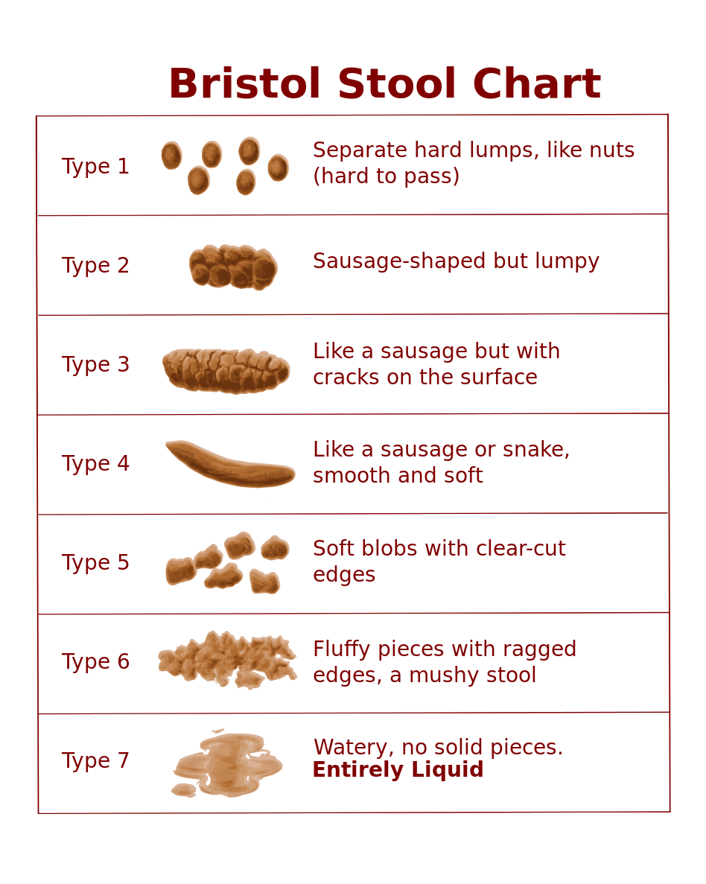
Solutions continued
Treat problems holistically
Problems
constipation
Cost of unresolved problems
Pain, anxiety, hormone dysfunction, nutrient deficiencies, cells stimulating behaviours.
Possibly no other symptom is more indicative of the individual’s pain, discomfort and health risks than the quality of their BM/stools. Included is the Bristol Stool Chart. If stools are not generally Type 3 and Type 4 and daily (as a minimum) the individual must be referred to a qualified bowel management specialist to treat their condition holistically. (i.e. nutrition, supplements and pharmacological treatments as required.
Only treating the symptoms of constipation or diarrhea is absolutely incomplete and unacceptable.

Slide 32
Constipation:
Constipation must be corrected otherwise maladaptive behaviours are 100% predicable because constipation is most often an indicator of GI problems, infections etc. and results in:
Physical discomfort from retained stool, gas and bloating.
Urinary frequency and incontinence from the stool pressing on the bladder.
Inadequate excretion of ‘behaviour’ producing toxins.
Worsened reflux symptoms.
Bowel ballooning and loss of peristalsis is generally a big part of the problem
Examples of Solutions to guide discussions with Health Care Professionals:
Strict adherence to nutritional diet (see below).
Elimination of most dairy products per diet.
4-5 teaspoons of ‘Hemp Hearts’ per day.
Proper hydration – 4-6 glasses of water per day.
Adequate fibre (reference diet).
As a minimum, test for Magnesium and Vitamin C deficiencies.
If yellow or gritty/sandy stools, check Taurine (essential amino acid).
If constipation continues, refer to a medical doctor to check for impacted bowel. Supplementing a pharmacological laxative regime with 1-7 above is generally an essential part of the protocol.

Slide 33
Solutions continued
Problems
anxiety
The vast majority of people supported who have
daily symptoms of lack of well-being, including
agitation, anger, and aggression toward self and
others have generalized or specific anxiety disorders.
Anxiety causes can be biological, social or
psychological.
In addition to pharmacological interventions as
recommended by the Primary Care Physician and
specialists, discussion with integrative medical
professionals e.g. medical doctor and naturopathic
doctor is essential.

Slide 34
Anxiety:
Examples of natural supplements’ solutions to guide discussions with the M.D. and N.D. related to biological causes could be:
Could the symptoms be caused by low levels of GABA and serotonin?
If so, might the following supplements* be helpful?
kava, passionflower L-lysine, L-arginine, L-theanine, 5 HTP, ashwagandha (provided these do not compete with psychotropic medications).
  * Reference MEDLINE/PubMed Meta Study
  Nutritional and herbal supplements for anxiety and anxiety-related disorders:
  systematic review Lakhan, S. and Vierira, K.

Slide 35
Solutions continued
Problems
Brain inflammation
Excessive Cortisol from stress
Glutamate
PPA
Methylation
Enzymes
Low/no exercise
Cost of unresolved problems
Pain, anxiety, immune dysfunction
Compromised - immune system, digestion, neurotransmitter production
Anxiety from sensory processing problems
Socialization problems, brain inflammation, repetitive behaviours
Compromised detox and neurotransmitter imbalance
Nutrient deficiencies, digestive problems
Poor glutathione production

Slide 36
GI, Bowel and Digestion Conclusions
Continued GI, bowel and digestive problems will 100% ensure ongoing risk for anxiety, agitation, anger and aggression.
GI, bowel and digestive health will likely need ongoing effective support, not unlike diabetes. This is not a quick fix but a deep fix.
GI, bowel and digestive health will impact all other important parts of the individual’s wellbeing and quality of life, e.g. impulse control, emotional self-regulation, communications and socialization, etc. Ideally recruit a GP who is qualified and willing to consult with GI specialists if necessary.
A member of the support team must manage this vital need as their number one priority.
The team must have zero tolerance for making conditions worse.

Slide 37
References:
The Center for Discovery.org
The Autism Revolution – Martha Herbert & Karen Weintraub
Autism Nutritional Supplement Handbook – Dana Godbout Laake & Pamela Compart
Bugs, Bowels and Behaviour – Teri Arranga, Claire I. Viadro, and Lauren Underwood
Grain Brain – David Perimutter and Kristin Loberg
Breaking the Vicious Cycle: Intestinal Health Through Diet With The Specific Carbohydrate Diet (SCD) – Elaine Gottschall
Healing the New Childhood Epidemic – Ken Bock and Cameron Stauth

Slide 38
Needs Area # 2 Gastrointestinal (GI), bowel, digestive and immune systems’ treatment, nutrition, pain management, dental and myofunctional disorders, illness prevention and treatment: | Who | Date Initiated
Continue:
Stop:
Start:

