Slide 1

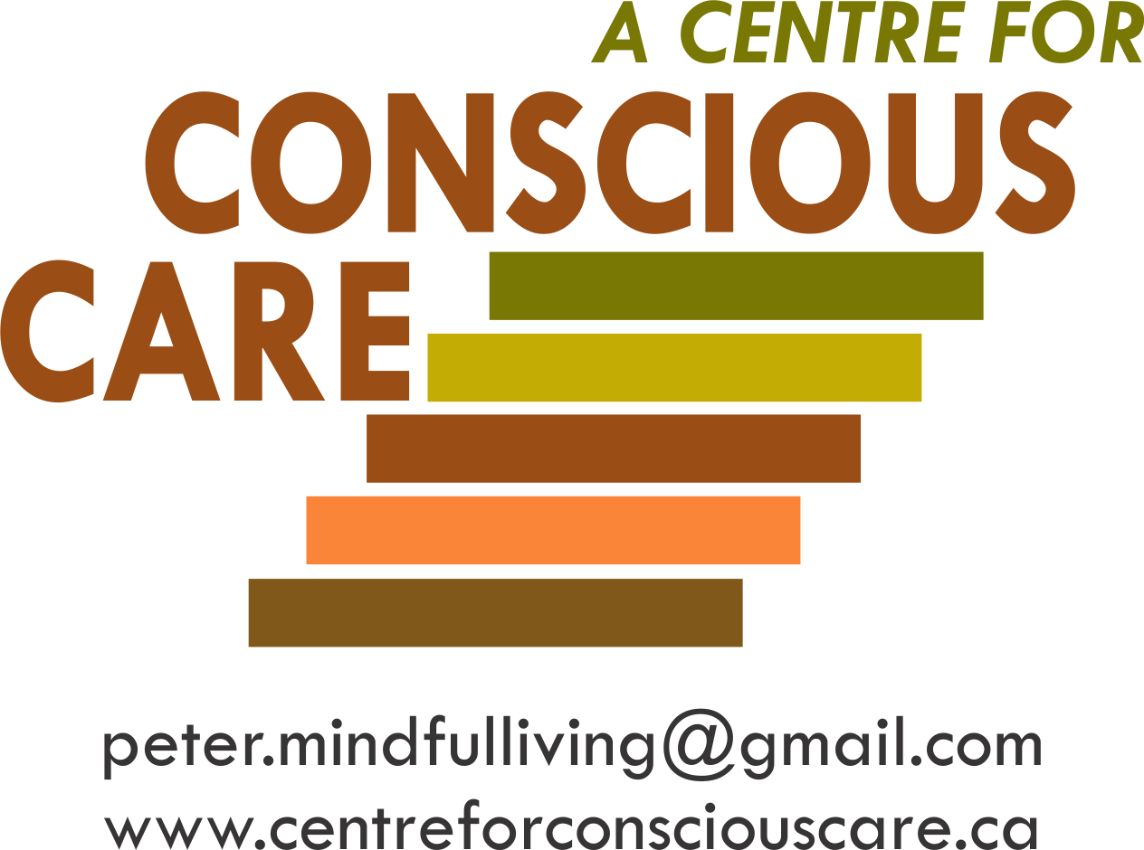
Brain Development, Coherence Balancing and Inflammation Regulation
Session VII – Resource 1

Slide 2
“The idea that the brain can change (heal) its own structure and function through thought and activity is, I believe, the most important discovery of the brain since we sketched out its basic anatomy and the workings of its basic components, the neuron.”
Norman Doidge
The Brain That Changes Itself

Slide 3
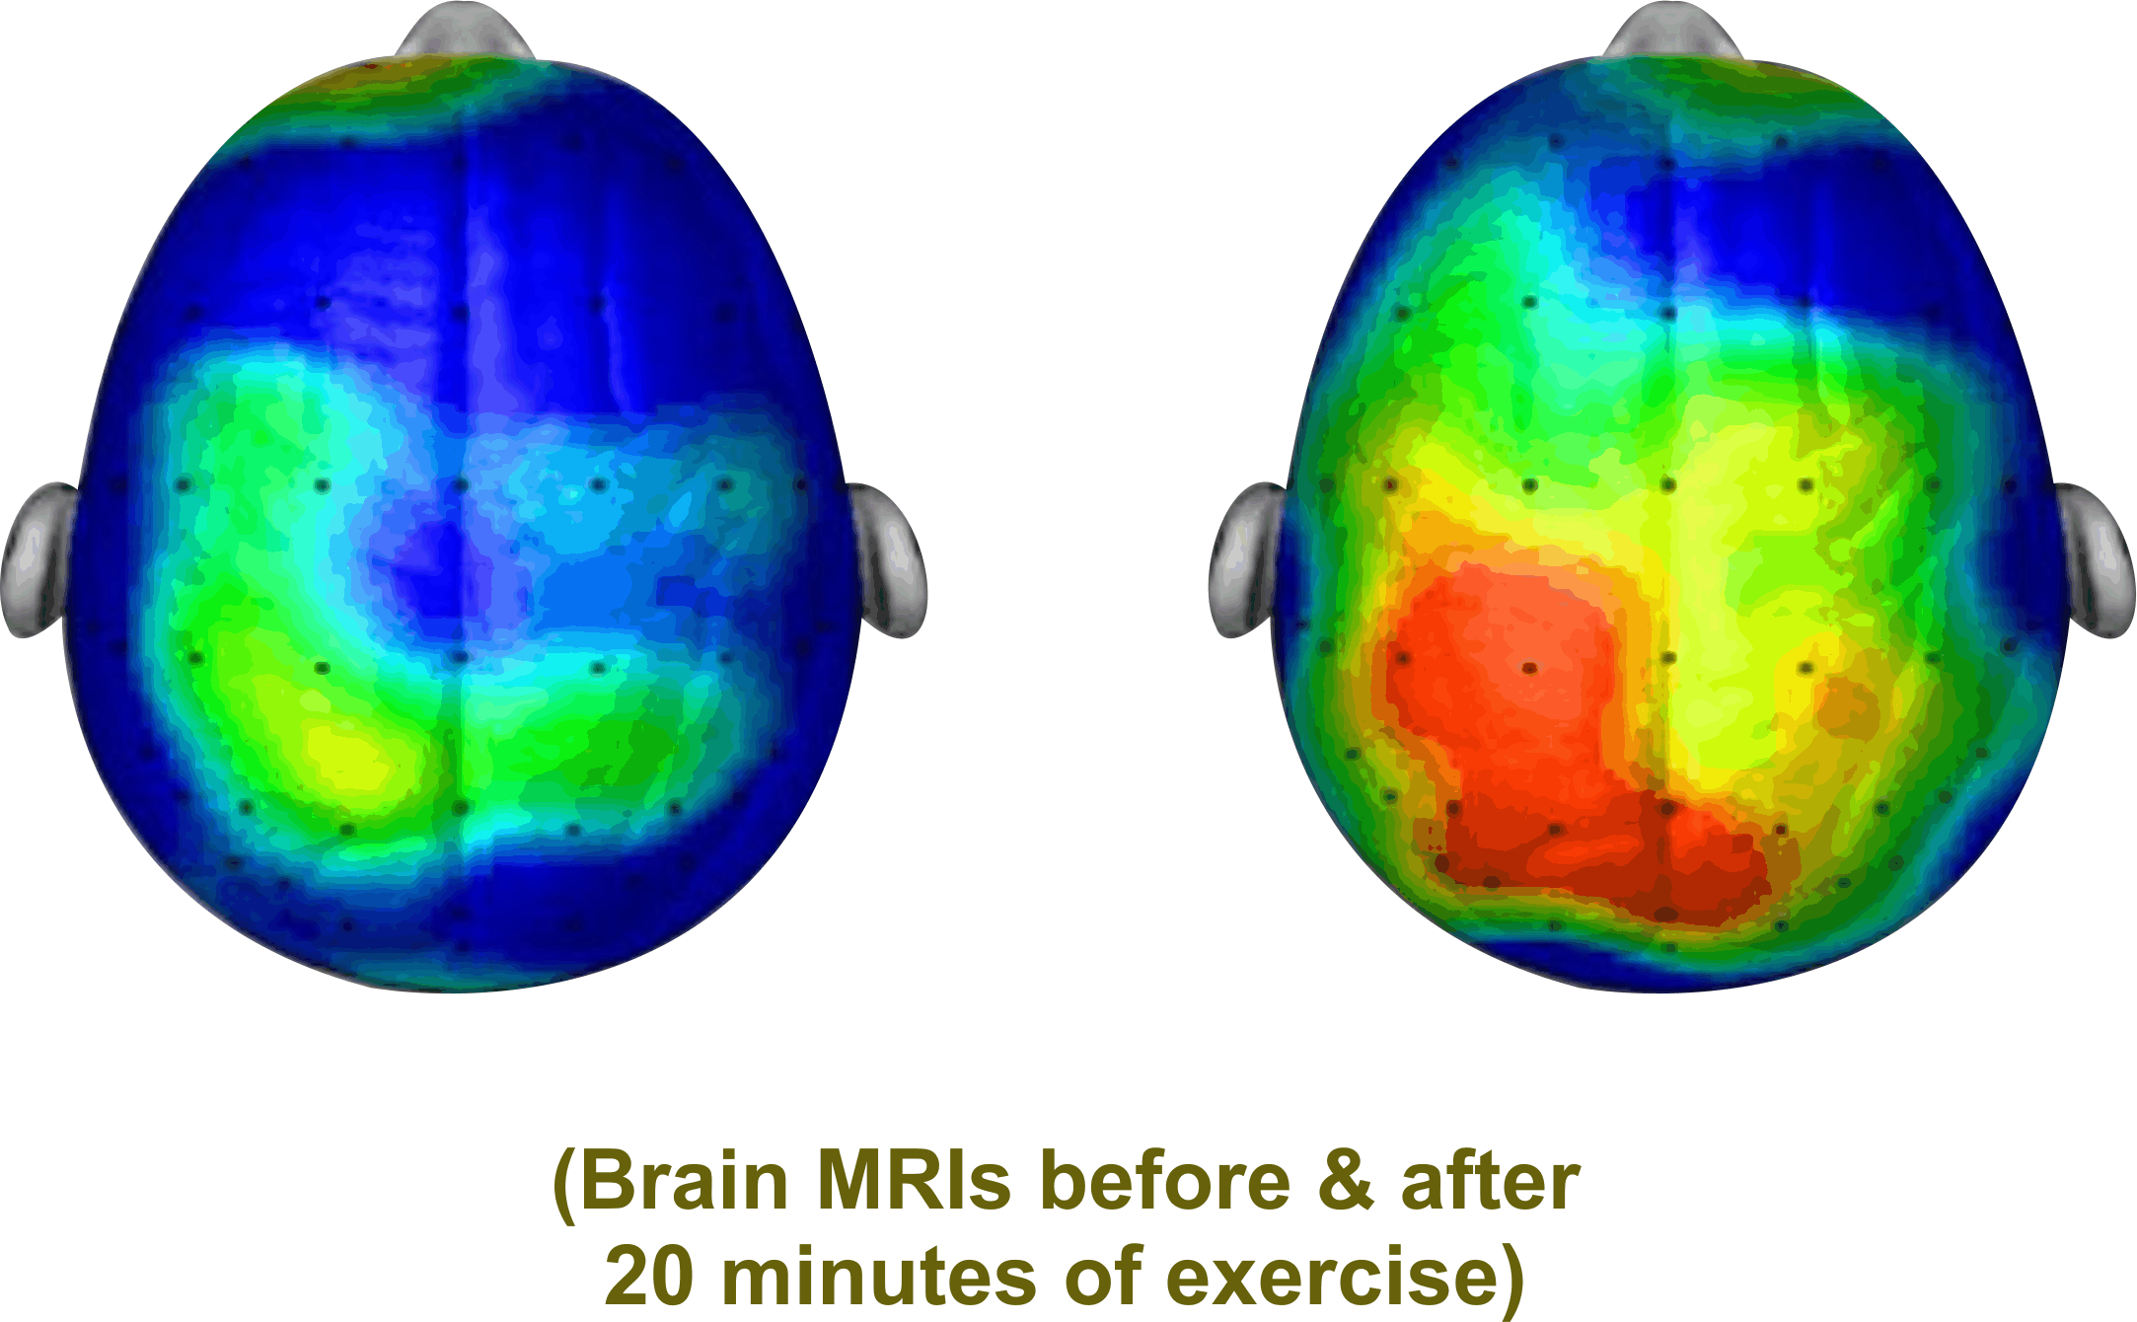
Brain Coherence
i.e. Many Parts of the Brian ‘Talking’ to Each Other
“Like you, I need to be able to understand and process information”. This requires optimal Brain Functioning e.g.
        neurogenesis (new neurons)
        neuroplasticity (more complete neuro networks)
        neurostimulation (brain firing)
        neurochemicals production (endorphins, dopamine, serotonin, oxytocin)

Slide 4
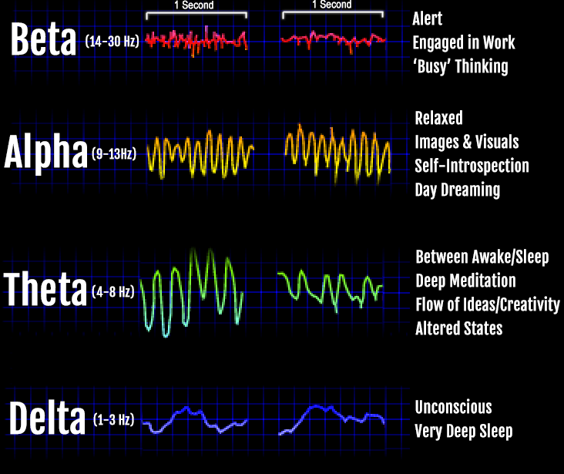
Brain Coherence Balancing & Inflammation Regulation
ASD Neurological Abnormalities
Left Right
Resting State EEG Abnormalities Including Enhanced Power
in the Left Hemisphere of The Brain is Shown in ASD
(Journal of Neurodevelopmental Disorders 2013, 5:24)

Slide 5
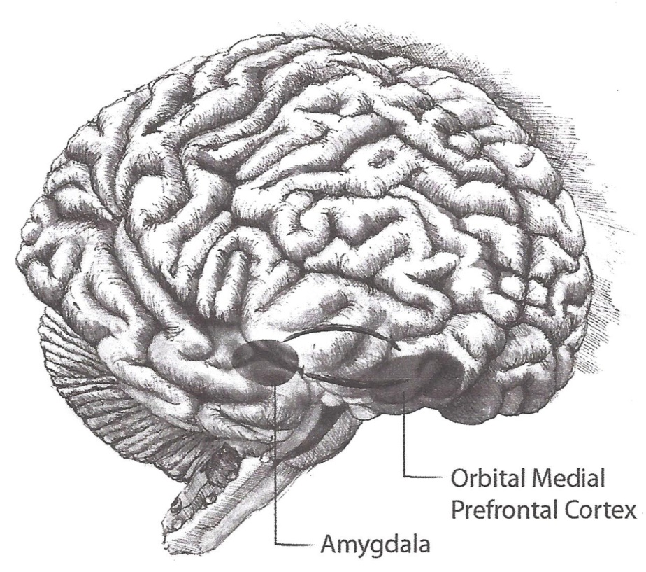
A Main CCS Focus
Mindful Neuro Development for Supporters and People with ASD/DD

Slide 6
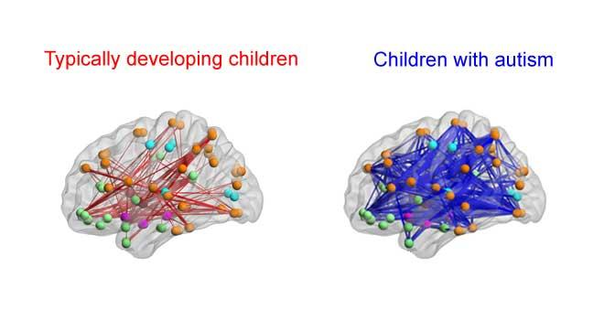
JJanuary 11, 2016
Potential for Well-being for People with Developmental Disabilities
Neuroscience is generally in agreement that for most people with developmental disabilities, reduced brain information transfer that contributes to deficits in executive function, understanding what others are thinking and some lack of empathy, in great part are a consequence of local over-connectivity and long range under-connectivity.

Slide 7
JJanuary 11, 2016
However:
Neuroscience also near unanimously concurs that neurogenesis, neuroelectric stimulation, neurochemicals production, and neuroplasticity are, with appropriate training and conditioning, not only possible but highly predictable to measurably enhance cognition, empathy and emotional self regulation.
Reference:
N. Doidge – The Brain’s Way of Healing
D. Siegel – The Mindful Brain
D. Eagleman – The Brain

Slide 8
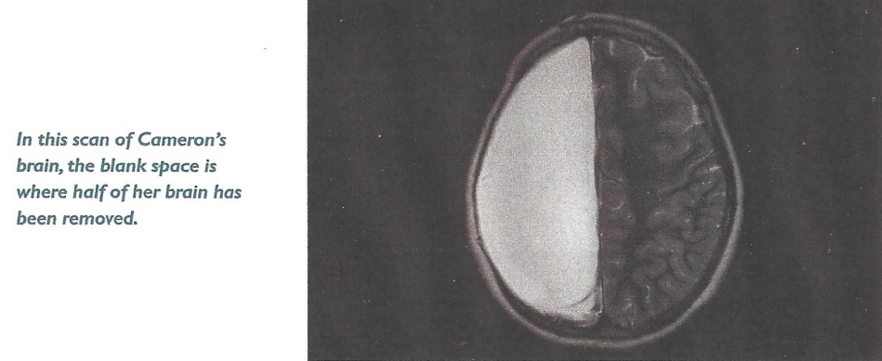
JJanuary 11, 2016
Could This Indicate Potential for Well-being?
In 2007, Neurosurgeons removed half of Cameron Mott’s Brain
The Results:
Aside from some weakening on one side of her body, she is indistinguishable from her classmates. She is a good student and participates in sports.
(Reference D. Eagleman The Brain)

Slide 9
JJanuary 11, 2016
Neuroscience and Gastrointestinal (GI) Research Conclusions
Hundreds of Studies Indicate:
No evidence to suggest that the Brain and GI of people with developmental disabilities cannot heal, grow and develop.
Evidence that the Brain and GI can heal, grow and
develop with appropriate (CCS type) training and conditions.
(Reference above Bibliography)

Slide 10
Maladaptive Behaviours
Related to Brain Balancing
In trying to satisfy their need for brain central coherence, individuals experiencing problems associated with brain balancing may behave in reactionary and cognitively unintended ways.
They may:
become angry. Anger stimulates the brain to focus and in so doing organizes the individual’s thoughts, and therefore offers the individual relative calm. For everyone, anger is a much less painful emotion than fear.

Slide 11
obsess and become compulsive. These behaviours organize the individual’s thoughts, create focus and therefore calm the individual;
blame and even hit others. This is one way that the individual can self-medicate with anger. These behaviours are magnified by a supporter’s mindless fear and unknowing powerful communication of that fear.

Slide 12
Brain Facts to Enhance Brain Coherence and Functioning and Reduce Challenging Behaviours
The proven potential for brain development and enhanced functioning is sadly, possibly the least appreciated and understood fact regarding needs in supporting individuals with ASD/DD to be all that they can be.

Slide 13
Through proven training and maintenance of a healthy brain (e.g. inflammation prevention) enhanced brain functioning is possible as a result of development in the following area:
Neurochemicals Production e.g. endorphins, oxytocin, neurotransmitters like dopamine (pleasure) and serotonin and GABA (calming). Reference J. Ratey and R. Manny 2014;

Slide 14
Neurogenesis i.e. promotion of the growth of new neuron cells (reference Mayo Clinic Ahlskog JE, et al. 2011) (D. Siegel, The Mindful Brain);
Neuroplasticity i.e. the reformation of neuron networks to take on new and extra ‘tasks’ (reference Doidge, N., The Brain That Changes Itself and The Brain’s Way of Healing);

Slide 15
Neurostimulation
Promoting Motor Function by Exercising the Brain (reference
Brain Science 2013, Mar:3 (1) 101-122).
Transcranial Magnetic Stimulation (reference Eagleman, David,
The Brain pages 94-95).

Slide 16
“In his book The Mindful Brain, Siegel has both a meticulous understanding of the roles of different parts of the brain and an intimate relationship with mindfulness”.
Scientific American Mind

Slide 17
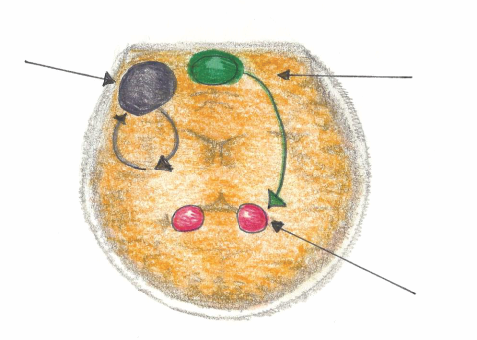
B-FIT Mindfulness to be Emotionally Self Regulated
Mindful Emotional Self Regulation
The main way we can consciously access the emotional brain is through self awareness*, i.e. becoming mindful. Mindfulness increases connections in the medial pre-frontal cortex. This reduces anxiety for the Supporter and the Person Supported.
Dorsolateral pre-frontal Cortex
Working Memory
Impulse Control
Medial pre-frontal Cortex
(part of the brain that notices what’s going on)
Amygdala
(*Research reference: J. LeDoux, “Emotion Circuits in the Brain”, Journal of Neuroscience 33, no. 9 (2013) 3815-23)

Slide 18
According to Dr. Daniel Siegel in The Mindful Brain (2007, pp. 42-43) the following brain, body and being functions correlate with the activity of areas within the medial prefrontal cortex:
Body regulation: the emotional brakes and accelerator functions;
Attuned communication involves the coordination of the input from another person with the activity of one’s own (as with mirror neurons);
Emotional balance: to have enough activation so that life has meaning and vitality but not so much that life becomes chaotic;
Response flexibility: the capacity to pause before action;
Empathy: knowing what might be going on inside someone else;
Insight or self-knowing: awareness to be able to link the past, present and future;
Fear modulation that may be carried out by the release of the inhibitory neurotransmitter GABA;
Intuition: a neural mechanism by which we process deep ways of knowing via our body, i.e. somatic intelligence;
Morality: taking into consideration the larger picture, to image what is best for the whole not just one’s self, even when alone.

Slide 19
Brain Development
The areas for brain development are mainly the insula, superior temporal and medial pre frontal cortex (MPFC). This system forms the interconnected “resonance circuitry”. Each time we become mindful, we fire-up these regions and what fires, wires (i.e. grows new neuron cells i.e. neurogenesis) (reference Seigel, D., The Mindful Brain pages 165-190).

Slide 20
Why Invest in Mindfulness?
For this reason, CCS invests heavily in mindfulness training to enhance the development of emotional self regulation in supporters, who in turn will then be competent and committed to teach mindful awareness to people with developmental disabilities to enhance their emotional self regulation.

Slide 21
Prefrontal Cortex Development – Autism
(reference News Medical Life Sciences Jan 2015, Improving the prefrontal cortex activity could help autistic people regulate emotions, UNC School of Medicine, published in the Journal of Autism Developmental Disorders, Gabriel Dichter, PhD, associate professor of psychiatry and psychology).

Slide 22
Supporters’ Optimal Solutions to Help People Supported with Aerobic Exercise
Aim for twenty minutes twice a day of aerobic exercise;
Establish a walking speed similar to someone in a hurry;
Include balancing movement such as exercise on a mini-trampoline to activate and grow the cerebellum, therefore amplifying the operations of the prefrontal cortex;
As approved by a physician, use interval training twice a week. The pattern could be 20 seconds intense exercise followed by 10 seconds of rest repeated for 4 minutes.

Slide 23
Exercise Proven Development
Doctors Ratey and Manning in 2014 proposed that exercise improves all brain learning in the following ways:
Increase attention, less fidgety, less impulsive;
Causes over 100 billion brain cells to be better nourished by neurotransmitters, growth factors and hormones that wire in memories more easily;
Grows new and better brain cells (Homeostasis).

Slide 24
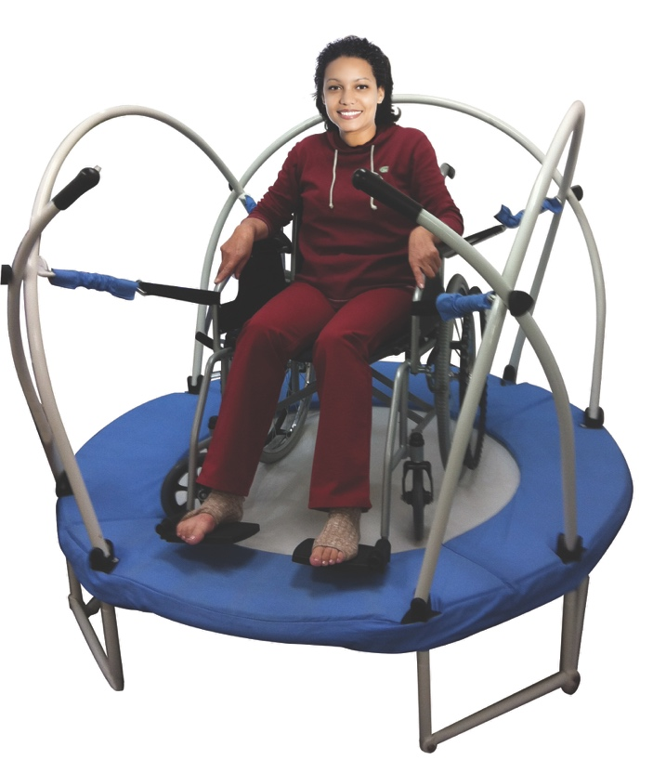
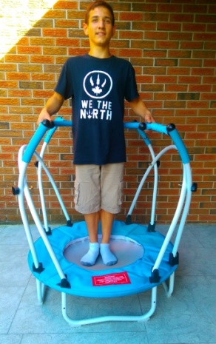

Slide 25
Cardio exercise, especially bouncing on a mini trampoline/rebounder, increases electrical activity in the brain to the required level for optimal processing.
This activity creates more constant rhythms, which results in thoughts becoming more organized and focus becoming clearer, both of which increase the sense of calm.

Slide 26

Stimulation of the cerebellum through bouncing and balancing exercises significantly improves the brain’s electrical distribution system.
Less confusion, more coherence and cognition, and therefore fewer maladaptive behaviours.
Stabilizing balls and cushions are extremely helpful to improve brain energy balance as a result of increased cerebellum activation.

Slide 27

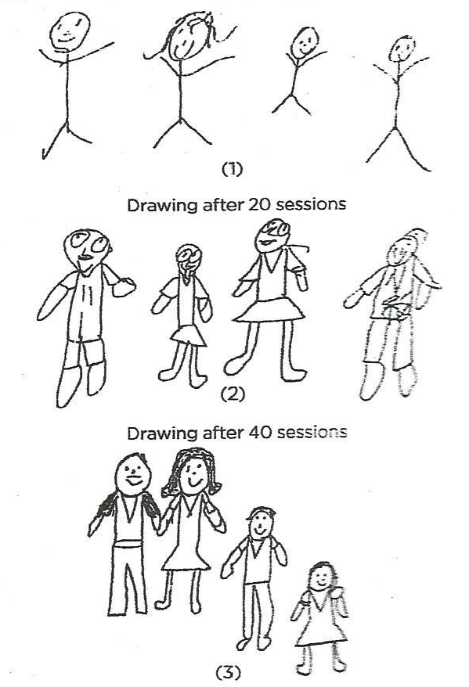
Autism and Neurofeedback
From Stick People to
Clearly Defined Human Beings
After four months of neurofeedback, a ten-year-old boy’s family drawings show the equivalent of six years of mental development.
(Research Reference: B. van der Kolk, “The Brain Keeps the Score”)

Slide 28
JJanuary 11, 2016
Training in ASD/DD Self Regulation can be Successful and
Sustainable in the Following Areas:
Attentional control, inhibition of verbal responses, cognitive flexibility and planning – through neurofeedback.
Some areas of executive functioning and behavioural control
Resistance to distraction and concentration
Affective, cognitive, physical self regulation and pro-social behaviour
(Reference The Autistic Child’s Guide, MacKenzie, H., 184-204 pages 321-323)

Slide 29
Summary
Brain development, coherence and inflammation prevention are essential to promote the well-being of children, youth and adults with ASD/DD.
Brain development and coherence are proven to absolutely be possible through mindfulness, physical exercise, nutrition and other support initiatives as outlined in Need #1 – 15 BBABC Best Practices/Tools.

