Slide 1


Making Sense of the Senses
Session IX – Resource 1

Slide 2
MAKING SENSE OF THE SENSES
Everyone’s ‘reality’/life experience comes through 8 senses
Our sense doors are:
• Taste
• Smell
• Hearing (Auditory)
• Seeing (Visual)
• Touching (Tactile)
• Balancing (Vestibular)
• Body Awareness (Proprioception)
• Interoception (sensing pain or too hot/cold
If any sense door isn’t fully developed and operational, it can be overly sensitive (hyperactive) or under sensitive (hypoactive).

Slide 3

The Recurring Cycles of Behaviour to Calm to Behaviour
UNMET NEEDS
• Traditional Medical
• Behavioural
• Social
• Biomedical
Best Practices
• Supporter’s
Mindful
Emotional
Self Regulation
and Kindness
• Competent
Intervention
Process
Blow-Out
(fight or flight)
e.g. • anger • SIB
• external aggression
(people and property)
Primarily
Behavioural
and
Traditional
Medical
Responses
and
Follow Up
GOALS’ ACHIEVEMENT
OUTCOMES OF
UNMET NEEDS
• Agitation
• Anxiety
Mainly behavioural compliance, e.g. reduction of functional goals
or
Behavioural
Blow-In
(freeze)
e.g. • withdraw
• depression

Slide 4



Hyperactive Senses Lead to Challenging Behaviours
Hyperactive Senses
means that
people, objects and places can be:
e.g.
  too loud
  too fast
  too scratchy
  too tight
  too bright
  too off balance
  too confusing
  too chaotic
Agitation, Anger and/or Aggression
e.g.
repetitive behaviour
challenging behaviour
Injury to self or others
A
N
X
I
E
T
Y
=
=

Slide 5
Hypoactive Senses Lead to Challenging Behaviours
Agitation, Anger and/or Aggression
e.g.
low energy
low motivation
quiet/withdrawn
Eventually -
repetitive behaviour
challenging behaviour
Injury to self or others
Hypoactive Senses
means that
people, objects and places can be:
e.g.
  too quiet
  too slow
  too dark
  too loose
  too tickly
  too confusing
  too chaotic
A
N
X
I
E
T
Y
=
=

Slide 6
Prevalence of Sensory Problems
People with autism and other developmental disabilities are at a much higher risk of having sensory integration problems (approximately 80% of this population have sensory integration problems).

Slide 7
Prevalence of Sensory Problems (cont’d)
Startle Response
A majority of people with developmental disabilities startle much more readily due in part to hyperactive hearing (the inner ear does not form properly). They also startle for up to 1 hour versus 5-10 seconds for neurotypical individuals.
Senses must all be working together i.e. be integrated. If they are not, several of the person’s senses can react to over stimulation e.g. a startle often makes light seem 5 times brighter and noises 5 times louder.

Slide 8
Prevalence of Sensory Problems (cont’d)
A high percentage of challenging behaviours such as aggression or self harm are caused by sensory problems (reference Aggression to Calming).
A high percentage of these challenging behaviours can be prevented and deescalated with sensory interventions to improve sensory processing (in the moment) and sensory integration.

Slide 9
Prevalence of Sensory Problems (cont’d)
A person’s preferred stimulating activities are often clues leading to what need they are trying to meet and how best to meet that need. Encourage safe self stimulation and add a well balanced, prescribed (by Occupational Therapist if possible) daily sensory diet (reference below).
Occupational Therapists who are trained and certified in Sensory Integration methods are the best qualified to assess and plan interventions and daily sensory diets.
The following are examples of typical sensory processes that are more often problematic for people with developmental disabilities.

Slide 10
JJanuary 11, 2016
Balanced Gastrointestinal (GI) is required for….
Balanced Neurotransmitters which are required for….
Balanced Sensory Integration & Processing

Slide 11
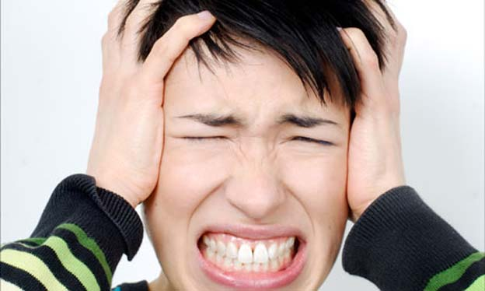
Audio Sensory Processing Problems

Slide 12
Inner Ear Problems
PwDD often can not tune into human speech because they cannot use
their Middle Ear Muscles to dampen the lower sound frequencies as all
neurotypical people can do.
  Because lower frequencies are at full volume, they mask higher frequencies
  Lower frequencies trigger Fight/Flight brain responses
  Autopsies often find cerebellum inflammation which has close links to the vestibular inner ear system (ref. John Hopkins 2005)
  Sound Therapy is often an effective treatment

Slide 13
Complete the Sensory Screening Tool
Session IX – Resource 2

Slide 14
What to do?
Occupational Therapists who are trained and certified
in Sensory Integration methods are the best qualified
to assess and plan interventions and daily sensory
diets.
The following are examples of typical sensory processes
that are more often problematic for people with
developmental disabilities.

Slide 15
Proprioception – Sense of Movement of Body
What Is It?
This sense system receives sensory stimulus from the muscles and joints which affect fine and gross motor development skills and body awareness.
Brain should develop awareness and a subconscious ‘body map’ about our body parts position, orientation and location at all times.
An improved ‘map’ leads to better orientation, coordination of movements and the maintaining of position and balance.
Often the real reason that s/he keeps crashing, jumping, tripping, falling, enjoys tight clothing, avoids playing sports, writing too dark, breaking things, and bangs their head is that they are trying to reorganize/make stronger the messages from joints to the brain to improve motor skills i.e. improve the map.

Slide 16
Proprioception Regulating Exercises – Daily Sensory Diet
Vibration is highly stimulating to our proprioception sense e.g. massage chair.
Weighted/compression clothing and blankets are self calming to this sense.
Practice measured strengthening exercises to learn to use right level of force.
Squeeze machine.
Regular doses of touch from massage, brushing, handholding is excellent.
Caving/Rock climbing.
Pushing and pulling.
Carrying heavy objects.
Weight resistance and pressure work-outs.
Jumping on the trampoline
Throwing or catching a heavy ball or beanbag
Rolling up tightly in a blanket
Two people laying on backs playing bicycle together
Digging in heavy sand
Sucking on a water bottle
Chewing heavy crunchy food

Slide 17
Tactile – Sense of Touch
What Is It?
The sense of touch is critical to lay the foundation for a more balanced, organized central nervous system.
The Tactile system may need to be Stimulated if it is hyposensitive
  therefore they may get too close to people and/or touch others too much
  it may take a lot for them to feel pain
  when they get agitated they need to hold or play with an object
The Tactile system may need to be inhibited if it is hypersensitive
  therefore it may be hard for people with developmental disabilities to have people touch them
  they take off their clothes when they are anxious
  they may feel pain very easily
  they may avoid certain textures like sand, grass or slimy foods

Slide 18
Tactile Regulating Exercises – Daily Sensory Diet
To Stimulate:
Chewing appliances
Walking on a variety of textures in bare feet
Gripping appliances to stimulate ‘feel’
Colourful clothing, pictures etc.
Hand stimulation with many different textures - e.g. - from sand to water,
- to rough to smooth,
- to hot to cold
To Calm:
Avoid people who get too close
User friendly clothing – not too tight or too scratchy
‘Snoozelin type’ environments, slow moving soft light, soft textures and colours, soft music/’bubble tubes’
Ear plugs/head phones
Soft food textures e.g. minced or puréed or smoothies
Sunglasses

Slide 19
Vestibular – Sense of Balance – What to Do
What Is It?
• The Vestibular system receptors are in the inner ear.
• The system responds both to movement and gravity.
• The system affects balance, eye movements, posture, muscle
tone and attention.
• Is often related to hearing regulation problems.

Slide 20
Vestibular Regulating Exercises - Daily Sensory Diet
Through planned and controlled sensory stimuli with adaptive responses, levels of organization in the brain are
enhanced. New neuron cells are grown.
Jumping, hopping, bouncing (on a mini trampoline or stabilization ball), catching, throwing, skipping and pogo stick.
Swinging, rotating and hammocking in all directions also improves inner ear functioning.
Balance beam (1”x 6” x 8’ boards in pattern). Walk toe to heel.
Balance on boat bumpers.
Boat in the ocean exercise.
Vaulting – sudden jolts are very helpful.
Standing and balancing on elliptical cushion while catching balls.
Wii and Xbox balancing exercises.
Sit on air cushion.
Weight shifting stimulates balance and improves
inner ear and motor behaviour functioning. This
reduces movement fear and anxiety that often
leads to agitation, anger or aggression.
To be most effective, activities must be done frequently and consistently.
Note: Pay attention as to how the individual responds to activity. If they appear over or under-stimulated,
adjust ‘speed’ accordingly.

Slide 21
Sensory Processing and Integration Summary
Any sense can be over or under stimulated. Observations should also be made concerning:
  visual (sight) – too bright or too dull
  auditory (hearing) – too loud or too quiet
  gustatory (taste) – too sour or sweet, bitter or salty or spicy
  olfactory (smell) – too musty, putrid, pungent or not enough
Observe the people with developmental disabilities who you support to see what repetitive activities they prefer, and what their symptoms of sensory dysfunction might be. Keep accurate records and share observations with an Occupational Therapist or Medical Doctor in order for them to plan a work-out sensory diet regime.
People with developmental disabilities need patterns/order, organization and consistency/predictability to keep senses working properly. Due to neurophysical irregularities (e.g. sensory dysfunction) always, always ask “Is their maladaptive behaviour to this experience, organizing their senses right now?”
To ensure optimal sensory integration, absolutely no synthetic materials e.g. plastics, polyesters in shoes, clothes, carpets etc. Use totally natural fibers to minimize risks of energy build up causing behavioural explosions.
Environmental toxins e.g. cell phone radiation, must be minimized.
Whole Foods Nutrition is critical.
Consult a qualified Occupational Therapist for assessments and treatments.

Slide 22
Essential Proprioception and Vestibular
Sensory Integration & Processing Equipment & Exercises
Mini-trampoline Workout.
Trampoline and Medicine Ball Rebounding.
Bosu Ball Exercise – ball catch, step-ups, and squats.
Weight Lifts (in gym).
Balance Beam – figure 8, toe to heel course.
Vibrating Massage.
Compression Vest.
Weighted Blanket.
Wii and Xbox Balancing Exercises.

Slide 23
Essential Proprioception and Vestibular
Sensory Integration & Processing Equipment & Exercises
(continued)
Sensory Regulator Proprioception Exercises.
Stabilization Ball Exercises.
Elliptical Cushion.
Treadmill (cardio).
Stair Stepper (cardio).
Elliptical (cardio).

Slide 24
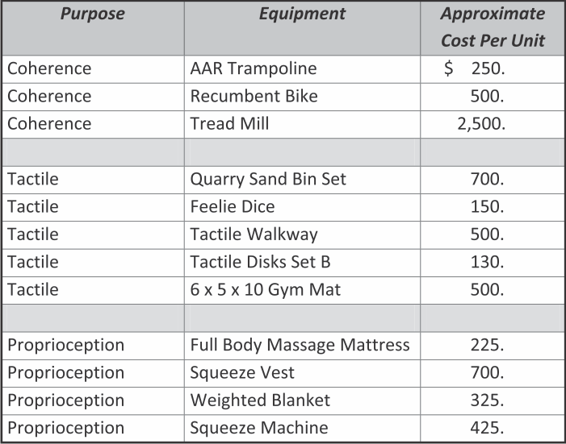
Useful Equipment
Examples of Equipment for Sensory Integration and Brain Coherence Exercise

Slide 25
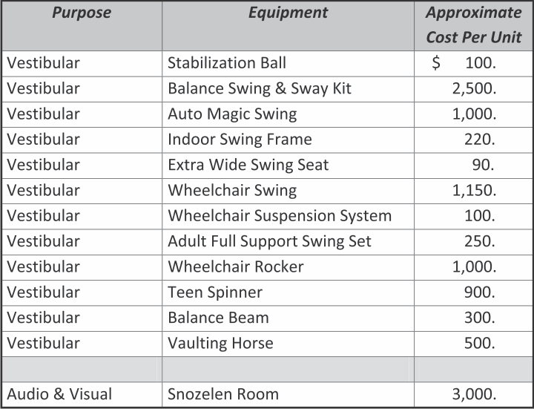
Useful Equipment
Examples of Equipment for Sensory Integration and Brain Coherence Exercise

