Slide 1

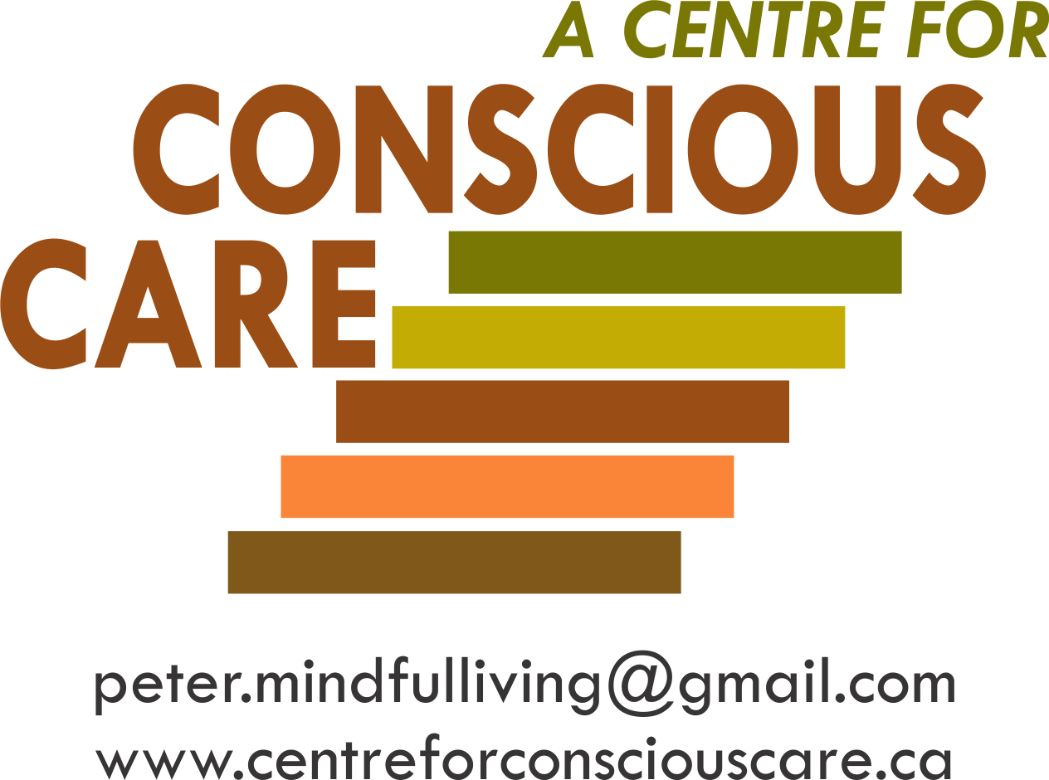
Conscious Care and Support
Developing
Emotionally Self-Regulated & Kind Supporters
Facilitating
Comprehensive Recommended
Holistic Support & Treatment
Session 1

Slide 2
JJanuary 11, 2016
Contributors to Conscious Care and Support
Conscious Care and Support has been developed while supporting, training or in direct consultation with:
Approximately 3,000 Moms, Dads, and Support Professionals.
Dr. John Ratey, Associate Clinical Professor of Psychiatry at Harvard Medical School (reference 8 books on mental health and autism and other developmental disabilities including ‘Spark’ and ‘Shadow Syndromes’).
Dr. Theresa Hamlin, Associate Executive Director of The Center for Discovery and her staff. Dr. Hamlin is the author of ‘Autism and the Stress Effect’.
Dr. Martha Herbert, Assistant Professor of Neurology at Harvard Medical School and a Pediatric Neurologist at Massachusetts General Hospital, where she is Director of the Transcend Research Program. She sits on the Scientific Advisory Committee for Autism Speaks (reference ‘The Autism Revolution’).
Dr. Shinzen Young, Mindfulness Research Consultant, Harvard Medical School.
Universities of Toronto and Western Ontario/London Health Sciences Centre and Centre for Addiction
and Mental Health (CAMH)

Slide 3
January 11, 2016
CCS Contributing and/or Trained Organizations & Agencies
Autism Ontario
Community Living Ontario
L’Arche Daybreak
OASIS (Ontario Agencies Supporting Individuals with Special Needs)
Community Living Windsor
Community Living Cambridge
Rygiel Supports for Community Living
Community Living Oakville
London Health Sciences Centre
McMaster University
University of Toronto
Kerry’s Place
Ministry of Education Special Needs Division
Ongwanada
Sunbeam Community & Developmental Services
Crest Support Services
Norfolk Association for Community Living
Community Living Kincardine
Durham Association for Family Respite Services
Christian Horizons
Community Living Burlington
Parents for Community Living
Extend-A-Family Toronto and Waterloo
Community Living Welland Pelham
Community Living St. Marys and Area
Community Living Chatham-Kent
Community Living Stratford and Area
Windsor-Essex Family Network
Community Living Prince Edward

Slide 4

Quotes by Shinzen Young - Harvard Medical School Researcher
From the Foreword of The Conscious Care & Support Book
“The Practical Tools and the 5 Essential Mindfulness Based Human Competencies that Peter has developed are examples of an excellent blending of Science and Heart. The results are improved levels of compassionate services while offering best practices.”

Slide 5
JJanuary 11, 2016
Conscious Care and Support
First Principles

Slide 6

To Consistently Deliver Optimal Support – The Supporter Needs
Three Key Professional and Intrapersonal Qualities
Conscious
and Caring
Emotional
Self-Regulation
OPTIMAL
SUPPORT
Knowledge
and
Understanding
of Best
Practices
Unconditional
Compassionate
Services

Slide 7

JJanuary 11, 2016
Facts About Autism and Other Developmental Disabilities
The American Academy of Pediatrics dedicated to the health of all children.
“Autism behaviours have been adopted as unofficial criteria in the assessment of Autism, but there is no evidence supporting the attribution of behaviours such as head banging, aggression and night waking to the pathophysiology of Autism. Parents and supporters should be aware that these maybe the primary or sole symptom of underlying (bio) medical conditions.” (Buie et al, 2010)
(Buie, T., Harvard Medical School – Professional of the Year, Autism Society of America, 2009). Reference: Evaluation, Diagnosis and Treatment of Gastrointestinal Disorders in Individuals with ASD; A Consensus Report.

Slide 8
January 11, 2016
CCS Services
The following Governing Organizations and Associations recommends Biological, Medical and Environmental Variables (based on a Consensus of International Science) be assessed and treated as part of a complete Prevention and Support Program.
Ontario Association of Behaviour Analysis (ONTABA)
The College of Family Physicians of Canada
Canadian Consensus Guidelines for Clinical Practice for People with IDD
Behavioural Analyst Certification Board (BACB)
CCS is committed to facilitate inclusion of these recommendations in families and agencies, supporting people with IDD and ASA.

Slide 9
Behaviour Analyst Certification Board (BACB) Standards
BACB 2023
“Behaviour analysts recommend seeking a medical consultation if there is any reasonable possibility that a referred behaviour is influenced by medical or biological variables.”

Slide 10
JJanuary 11, 2016
Anxiety and Pain → Aggression → Calm
Unmet regulation needs result in physical and emotional pain e.g. anxiety and stress.
This often results in cycles of increased frequency and intensity of chronic and acute self injurious behaviours and aggressions.
This is very often because the behaviours reduce the person’s feelings of anxiety.
This eventually results in temporary calm.

Slide 11
To Repeat
There is much excellent work being done by primary care physicians and ONTABA and BCBA, acute risk management regulated behavioural treatment professionals.
And
Primary Medical Care Treatment Plans, Behavioural Support Plans and Supporters especially trained in Emotional Self-Regulation and Unconditional Compassion, working together in a holistic preventative model, significantly increases the likelihood of optimal quality of life outcomes.
11

Slide 12
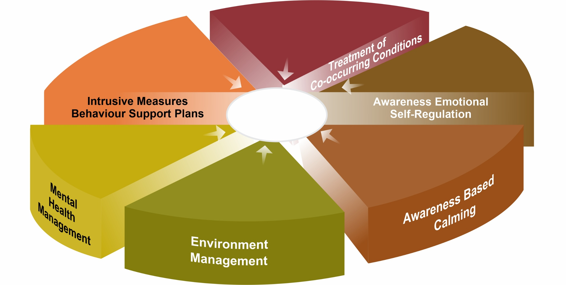

What To Do – Consider Implementing…
Evidence Based Holistic and Integrated CCS Components for Well-being and the Prevention and De-escalation of Challenging Behaviours*
Evidence Based Assessment and Treatment of Biomedical and Medical Co-occurring Conditions
ABA and Behaviour
Management Medications,
e.g. anti-anxiety, PRN
CCS training is certified by the University of Toronto.
Supporter’s Emotional
Self-Regulation Skills Development and Relationship Building
Optimal
Well-being
Mental Health Disorders’ Therapies and Medications Management
Awareness Based Calming Facilitated by Emotionally Self-Regulated Supporters
Supporter’s Environmental Management, E.G. 45 Stress Reducers and Functional Behavioural ABA Strategies
*QAM Compliant Services for people with IDD symptoms of anger, SIB and aggression are 50-100% more effective when combined with Conscious Care and Support type services.
(Reference CCS independent research, 2016)

Slide 13
5 Limitations in the Delivery of QAM Services
Limitations | CCS Response
Incomplete assessments of potential biomedical and other comorbidities that results in bio-psycho-social unmet needs that most often are the actual ‘up stream’ antecedents of challenging behaviours. | CCS screens for and as appropriate, assesses and facilitates treatments of 25 potential comorbidities that are generally not identified, assessed and treated with current QAM practices. Any of these comorbidities have the potential to cause challenging behaviours’ (reference next two pages).

Slide 14
Many Incidents of Lack of Well-Being Including Anger, Self-Injurious Behaviours
and Aggression (ASA) of People with IDD, result when the Following Conditions
are Not Prevented or Fully Treated
Biomedical Co-Occurring Conditions |  |  | Supporters
 |  |  | Mindful Emotional Self-Regulation and Calming Strategies CATCH (be here now) CALM (BB-ABC) CLARIFY (what to do and how) CONSCIOUSLY CONNECT (unconditional / Presence – ‘Us-ness’)
• GI infections, e.g. Clostridium
• Mineral Imbalances, e.g.
Low Zinc
High Copper
Low Magnesium
Low Iron
• Food Intolerances, Allergies
• Gluten Intolerance – Villi Damage
• Human Energy
Sensitivities, e.g. EMF/RWF
• Glutamate – Excess – Glial Cell
Dysfunction
• Gut Permeability/Leaking
• Vitamin Imbalances
e.g. B12, B9, B6 Brain Methylation
D3 Omega
• Medical Side Effects
(see attached)
• Glutathione – Low Causing
Neuro Inflammation
• GIRD – GI Reflux Disease
• Brain Coherence Dysregulation
• Anxiety Inducers
Thyroid Dysfunction
Blood/Sugar Imbalance
Excessive Cortisol & Adrenaline
Cardiovascular Respiratory Condition
Unresolved Trauma
• Behavioural Practices without
Biomedical Treatments
• Glutamine – High Causes
Brain Excitatory Imbalance
• Antipsychotic Medications
- Unresearched Use
• GI Imbalances – Impacted
Bowel, Diarrhea, Constipation
• Emotional
Fears and Phobia from Unmet Biomedical Needs
• Gut Bacterial Overgrowth
(Dysbiosis Lowers Neuro-
Transmitter Balance)
• Non-Restorative Sleep
• Lactic Acid (high)
• GABA – Calming Neuro-
Transmitter – too low
• Physical Pain
• Immune System Dysregulation

Slide 15
Many Incidents of Anger, Self-Injurious Behaviours and Aggression (ASA) of People with IDD, result when the Following Conditions are Not Prevented or Fully Treated
Disorders and Illnesses Management | Physical Pain Prevention and Management | Environmental Challenges | Opportunities to Live a Complete Life
Primary Medical Conditions
GERD
PICA
PANDAS
H-Pylori
Blood Sugar Imbalances
Seizures
Constipation/Diarrhea
Other Illnesses
• Sensory Integration and
Processing
Hyper/Hypo Activation
Motor Planning Problems
Personal Satisfaction
Dental/Myofunctional Disorders
Socially Helpful
Headaches
Highly Motivated
Chronic Body Pain
Supporters lack of Environmental Management Skills
Socially Valued Roles
Other
Mental Health Disorders
Trauma/PTSD
Anxiety
Depression
FASD
ADHD
OCD
Other
Safe and Secure Living Supports
Behavioural Interventions not per ONTABA/CCG

Slide 16
5 Limitations in the Delivery of QAM Services
Limitations | CCS Response
Lack of qualified Primary Care Physicians, Psychiatrists and Psychologists available and confident to adequately assess and treat biomedical and other comorbidities required to develop and implement treatment plans to meet all holistic bio-psycho-social needs. | CCS is successfully filling this most serious gap by training family and agency supporters and leaders to recruit Medical and Functional Medicine Doctors, Nurse Practitioners, Naturopathic Doctors, and Registered Nutritionists who are qualified to treat actual causes – not mainly only manage symptoms.

Slide 17
5 Limitations in the Delivery of QAM Services
Limitations | CCS Response
Current NVCI and CITP behavioural interventions training is proven to be very effective in ‘short term risk management’ however does not adequately address the person’s holistic bio-psycho-social interdisciplinary needs. | CCS training and consulting is designed to augment the needs for safer risk management but also ensures optimal quality of life by training supporters in how to identify needs and to facilitate resolving 25 comorbidities. This also optimally prevents the challenging behaviours.

Slide 18
5 Limitations in the Delivery of QAM Services
Limitations | CCS Response
There is a near total absence of research and training for supporters to be Mindfully Emotionally Self-Regulated to calmly implement optimal crisis de-escalation practices so as to result in the application of the least intrusive measures of Crisis Intervention. | CCS is the only supporter training in Ontario that effectively trains supporters to actually regulate their autonomic nervous system through Mindful Emotional Self-Regulation De-escalations including Bi-lateral Bio-meridian Awareness Based Calming (BB-ABC)

Slide 19
January 11, 2016
Supporters’ Emotional Self-Regulation
50% of the 10’s of 1000’s of incidents of anger, SIBs and/or aggression in Ontario each year are, according to family and support professionals, directly caused by or significantly influenced by the supporters’ unintended personal emotional hijacks resulting in power struggles.
This is because supporters are generally not trained to prevent their own emotional hijacks and power struggles, using Emotional Self-Regulation Skills.
Another serious omission of the supporters’ training is the lack of evidence-based prevention calming strategies to support the person with IDD. (BB-ABC)
19

Slide 20


Physical and
Emotional Well-being
Toward A More Complete Understanding
of the hierarchy of special needs to meet in order to facilitate optimal well-being and to prevent and mindfully manage anxiety, anger and aggression
Awareness-based calming and de-escalation skills offered by mindful, emotionally self-regulated and kind supporters

Slide 21
January 11, 2016
Examples of CCS Tools to Enhance Self and
Others’ Mindful Emotional Self Regulation
B-FIT Mindfulness (the essential tool to initiate Conscious Care and Support)
Calming others by calming oneself – emotional contagion and mirror neurons e.g. Pain Empathy
Bilateral, Biomeridian Awareness Based Calming
(BB-ABC)
All Tools must be practised during times of calm.

Slide 22
Mindfulness Benefits
for Individuals with
Developmental Disabilities

Slide 23
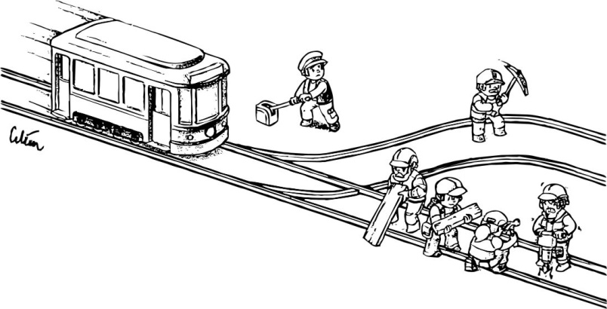
JJanuary 11, 2016

Slide 24
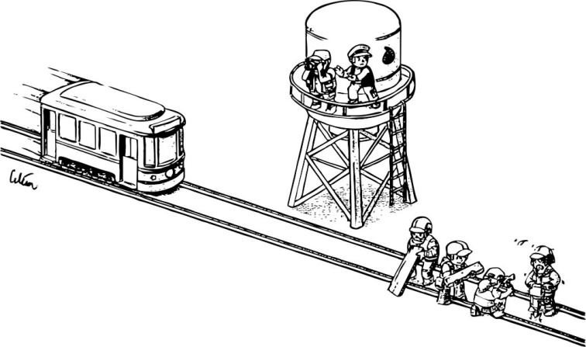
JJanuary 11, 2016

Slide 25
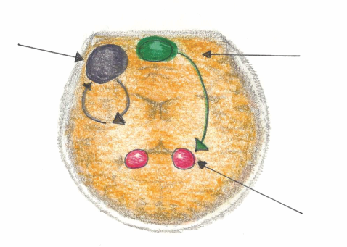
Mindful Emotional Self Regulation
The main way we can consciously access the emotional brain is through self awareness*, i.e. becoming mindful. Mindfulness increases connections in the medial pre-frontal cortex. This reduces anxiety for the Supporter and the Person Supported.
Dorsolateral pre-frontal Cortex
Working Memory
Impulse Control
Medial pre-frontal Cortex
(part of the brain that notices what’s going on)
Amygdala
(*Research reference: J. LeDoux, “Emotion Circuits in the Brain”, Journal of Neuroscience 33, no. 9 (2013) 3815-23)

Slide 26
According to many published Neuroscientists, including Dr. Daniel Siegel (UCLA) in his book called The Mindful Brain (page 42 and 43) the following brain, body and being functions correlate with the activity of medial areas of the prefrontal cortex:
1. Body regulation – the emotional brakes and accelerator functions.
2. Attuned communication involves the coordination of the input from another person with the activity of one’s own (as with mirror neurons).
3. Emotional balance to have enough activation so that life has meaning and vitality but not so much that life becomes chaotic.
4. Response flexibility is the capacity to pause before action.
5. Empathy – knowing what might be going on inside someone else.
6. Insight or self-knowing awareness to be able to link the past, present and future.
7. Fear modulation that may be carried out by the release of the inhibitory neurotransmitter GABA.
8. Intuition – a neural mechanism by which we process deep ways of knowing via our body i.e. ‘somatic intelligence’.
9. Morality – taking into consideration the larger picture, to image what is best for the
whole not just one’s self, even when alone.

Slide 27
JJanuary 11, 2016
The You
Who is Listening to Me
Did Not Make the Choice
To Push or Not!
(Unless you were mindful/conscious)

Slide 28
,
Definitions to Better Understand the ‘Set-up’
Over each 24 hour period, we can be experiencing consciousness on a 1-10 continuum.
Unconscious: (1)
  like when we are asleep in our bed.
Semiconscious: (autopilot) (5)
  like how we typically drive our car, relate to people and do most ‘doings’.
Fully Conscious: (self aware) (10)
  like when we are paying attention – noticing what we are doing e.g. how we drive when a police car is following us;
  knowing that we are doing it and
  knowing how our body’s sensations, feelings and thoughts are
  reacting to what is happening.
Subconscious:
  our data bank of ‘files’ that we inherit and develop.

Slide 29
5 Limitations in the Delivery of QAM Services
Limitations | CCS Response
Low to no actual relevant researched supervisory training to build competent and caring teams of Motivating and leading supporters to competently compassionately care for and about others | The CCS situational leadership supervisory training is the only supervisory training in the MCCSS DS sector that has been researched to meet this need. (Reference next page)

Slide 30

Consider The Following Team Member (TM) Development Levels
HIGH
Can
but Won’t
Can’t and Won’t
D3
D2
SUPPORTIVE BEHAVIOR
D4
D1
Can
and
Will
Can’t
but
Will
LOW
DIRECTIVE BEHAVIOR
HIGH
Goal Setting • Action Planning • Showing How • Establishing Timelines • Clarifying Roles • Evaluating Work • Identifying Priorities
For Each of the Many Roles and Responsibilities of Team Members, they have One of the above Levels of Development?
Leaders must identify and help supporters to overcome their specific needs
30

Slide 31
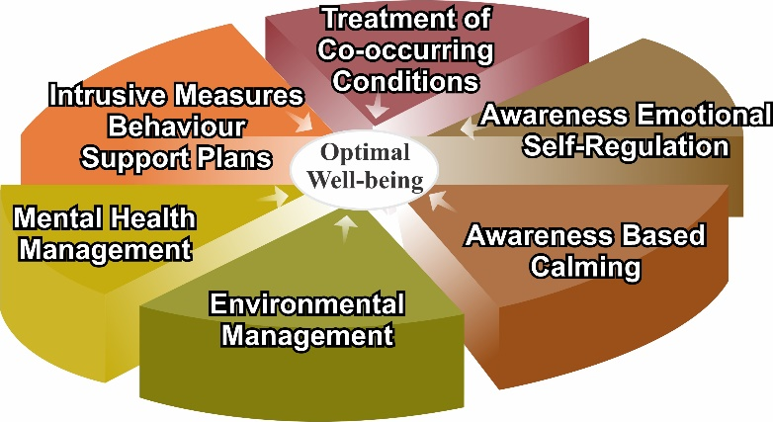
CCS Breaking the Recurring Cycles of Behaviour to Compliance to Behaviour
• Biomedical Co-Occurring Conditions
• Supporters
• Primary Medical Conditions
• Mental Health Disorders
• Physical Pain
Prevention and Management
• Environmental Challenges
• Opportunities to Live a Complete Life
BETTER AND
BETTER
OPTIMAL LIVING
CONDITIONS
Anxiety
• Hormone Dysregulation
Cortisol
Adrenalin
• Physical pain
• Sensory over/under
load
• Psychological distress
• Speech/hearing
limitations
• PTSD/Trauma
• Chronic Illness
• Self
Regulated
Nervous System
• Relative
Calm
• Well-being
Causing
Resulting
In
CCS
Interventions
Note: living and learning challenges become less, directly proportionate to the implementation of CCS interventions resulting in enhanced optimal living conditions.

Slide 32
JJanuary 11, 2016
Behavioural Interventions Are Often Necessary
Behavioural interventions such as ABA and IBI that follow the Behaviour Analyst Board Standards for Certification are useful and often necessary complements to the fully integrated biomedical support and supporter development process.
The more complete the integrated process, the greater the potential for ABA/IBI to enhance well-being and prevent and manage anxiety and aggression.

Slide 33
January 11, 2016
Advocacy –
People with moderate to high risk of ASA will require advocacy with the following service professionals:
Primary Care Physician
Psychiatrists
Naturopathic Doctors
Nutritionists
Nurse Practitioners
Dietitians
OT Sensory Specialist
Behavioural Therapist
Speech and Language
33

Slide 34
Physical and
Emotional Well-being
Toward A More Complete Understanding
of the hierarchy of special needs to meet in order to facilitate optimal well-being and to prevent and mindfully manage anxiety, anger and aggression
Gastrointestinal (GI), bowel, digestive and immune systems’ treatment, nutrition, pain management, dental and myofunctional disorders, illness prevention and treatment
Awareness-based calming and de-escalation skills offered by mindful, emotionally self-regulated and kind supporters

Slide 35
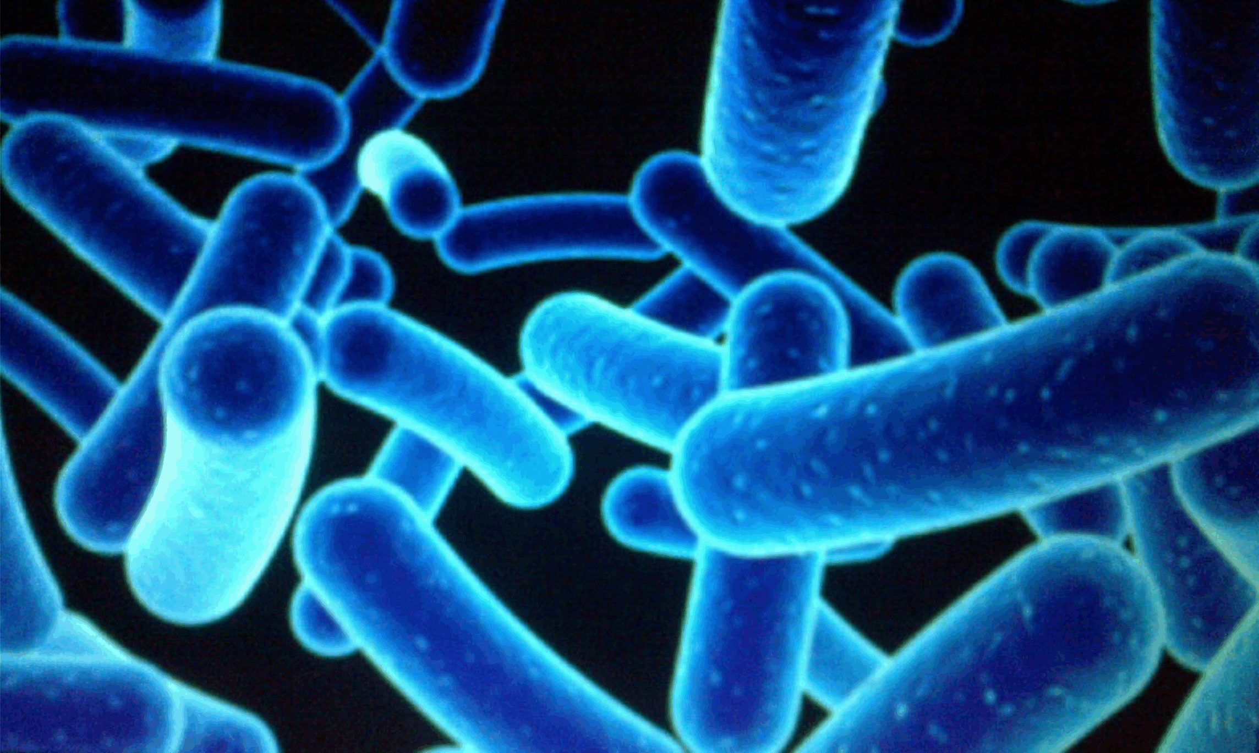
Needs for GI and Bowel Management and Holistic Treatment
Distressed Gut Microbes – produce Mind/Body Agitation, Pain and Anxiety which often leads to aggression.
1% Human
99 % Bacterial and Fungal
Some Microbes found in the gut of individuals with Autism, when introduced into healthy rodents, create numerous Autistic like symptoms.
e.g.
  Repetitive behaviours
  Social aversion
  Easy to startle
(Reference: Dr. Derrick MacFabe, The University of Western Ontario)
(Young, E. - I Contain Multitudes, pages 69 & 70)

Slide 36
Microbes, Anxiety and Aggression
Chronic anxiety means excessive toxic cortisol in the body. To neutralize this toxin, the body uses up basic building blocks like amino acids that are needed to:
  digest food
  build the immune system
  produce calming neurotransmitters
  This depletion causes anxiety leading to challenging
  behaviour.

Slide 37
JJanuary 11, 2016
Keep the Mitochondria Cell System Healthy:
  Mitochondria are known as the powerhouse of each cell
  They give cells their energy to do their work such as maintaining healthy brain functioning
Controllable Mitochondria Killers:
  Sugar and Simple Carbohydrates
  Oxidative Stress causing Brain Inflammation – low glutathione
  Medications such as Antibiotics and Antipsychotics
  Vitamins and Minerals Imbalance – low B vitamins, folic acid, magnesium, vitamin D

Slide 38
January 11, 2016
Sonya Doherty N.D.
Video
Medical and Bio Medical Preventive Services to Enhance Quality of Life
of People with IDD and Challenging Moods and Behaviours

Slide 39
Physical and
Emotional Well-being
Toward A More Complete Understanding
of the hierarchy of special needs to meet in order to facilitate optimal well-being and to prevent and mindfully manage anxiety, anger and aggression
Emotional Wellness:
• mental and neurological health and
disorders’ treatment
• trauma desensitization and triggers’
elimination
• psychological well-being
• medication side effects
• ABA behavioural interventions
Gastrointestinal (GI), bowel, digestive and immune systems’ treatment, nutrition, pain management, dental and myofunctional disorders, illness prevention and treatment
Awareness-based calming and de-escalation skills offered by mindful, emotionally self-regulated and kind supporters

Slide 40
Mental and Neurological Health
  Ensure accurate tracking of symptoms and report to the Primary Care Physician.
  Behaviour check lists must be an accurate reflection of the supported person’s behaviour – not contaminated with the supporter’s inadvertent ‘Challenging Behaviour’

Slide 41
Mental and Neurological Health
  Benefits and Risks of Psychotropic Medications:
      Anti-psychotics
      Anti-anxiety
      Anti-depressants
  Questions for the Primary Care Physician:
      How will we know that it is effective and helpful?
      What will we observe if there are unacceptable side
      effects or risks e.g. Akathisia?

Slide 42

Medication Overview for:
January 11, 2016
Medication | Hours taken | Prescribing Physician & Date Prescribed | Half- life | Type | Monitor Closely For: (Note: different medications and combinations have different potential side effects. Items listed below do not indicate they will occur with everyone).
 |  |  |  | Antidepressant Also used for anxiety, OCD, panic disorder. | Combinations of 2 antidepressant medications can increase the likelihood of high blood pressure and increase heart rate.
 |  |  |  | Antipsychotic - Also used for the treatment of schizophrenia and bipolar disorder. | Combinations of antipsychotic medications can increase the likelihood of severe muscle stiffness or spasms, difficulty speaking or swallowing, restlessness, tremor or more serious reactions such as uncontrollable muscle or facial movements. Look for akathisia characterized by: rocking while sitting, standing. crossing and uncrossing legs. pace, fidget, can’t sit still. Look for tardive dyskinesia, characterized by: involuntary movement of face, neck, limbs. grimacing, frowning. repetitive finger movements. inability to sit still.
 |  |  |  | ADHD treatment. | Keep an eye out for: decreased appetite, weight loss, difficulty sleeping, and changes in blood pressure and heart rate.
 |  |  |  | Antiepileptic | Keep an eye out for: headaches, fatigue, dizziness, nausea, weight gain or loss.
 |  |  |  | Benzodiazepine – Used to treat anxiety and sleep disorders. | May significantly boost drowsiness and sleepiness. Keep an eye out for: confusion, muscle weakness and loss of coordination or balance.
 |  |  |  | Sedative | Keep an eye out for: sleepiness, dizziness, blurred vision, difficulty focusing or thinking, and addiction potential.
 |  |  |  | Antibiotic | Keep an eye out for: diarrhea, nausea, dizziness, rash, and yeast infections.
Information source: https://www.webmd.com/interaction-checker/default.htm; https://health-products.canada.ca/dpd-bdpp/; https://www.mayoclinic.org/drugs-supplements.
If you have any concerns regarding medication or potential medication interactions, contact your health care professional immediately.

Slide 43
Physical and
Emotional Well-being
Toward A More Complete Understanding
of the hierarchy of special needs to meet in order to facilitate optimal well-being and to prevent and mindfully manage anxiety, anger and aggression
Brain development, coherence balancing and inflammation regulation
Emotional Wellness:
• mental and neurological health and
disorders’ treatment
• trauma desensitization and triggers’
elimination
• psychological well-being
• medication side effects
• ABA behavioural interventions
Gastrointestinal (GI), bowel, digestive and immune systems’ treatment, nutrition, pain management, dental and myofunctional disorders, illness prevention and treatment
Awareness-based calming and de-escalation skills offered by mindful, emotionally self-regulated and kind supporters

Slide 44
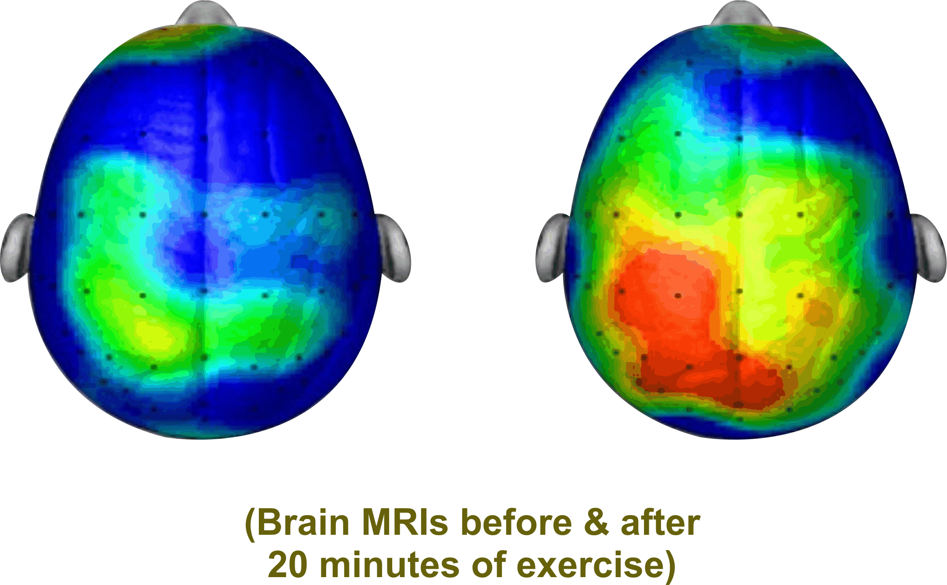
Brain Coherence
i.e. Many Parts of the Brian ‘Talking’ to Each Other
“Like you, I need to be able to understand and process information”. This requires optimal Brain Functioning e.g.
        neurogenesis (new neurons)
        neuroplasticity (more complete neuro networks)
        neuro electrical stimulation (brain firing)
        neurochemicals production (endorphins, dopamine, serotonin, oxytocin)
        Hertz e.g. Beta, Alpha, Theta, Delta

Slide 45
JJanuary 11, 2016
Neuroscience also near unanimously concurs that neurodevelopment, with appropriate training and conditioning, is not only possible but highly predictable to measurably enhance cognition, empathy and emotional self regulation.
Reference:
N. Doidge – The Brain’s Way of Healing
D. Siegel – The Mindful Brain
D. Eagleman – The Brain

Slide 46
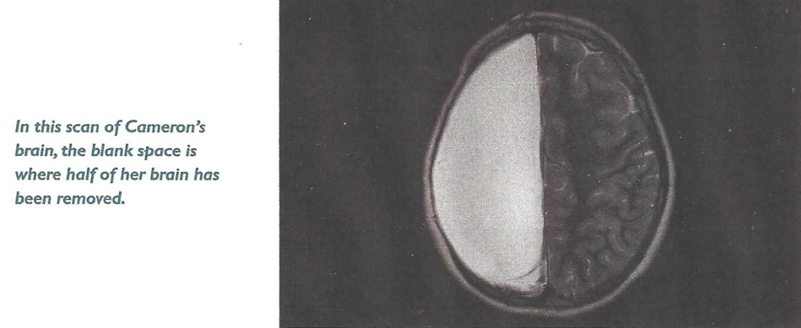
JJanuary 11, 2016
Could This Indicate Potential for Well-being for People Supported?
In 2007, Neurosurgeons removed half of Cameron Mott’s Brain
The Results:
Aside from some weakening on one side of her body, she is indistinguishable from her classmates. She is a good student and participates in sports.
(Reference D. Eagleman The Brain)

Slide 47
JJanuary 11, 2016
Neuroscience and Gastrointestinal (GI) Research Conclusions
No evidence to suggest that the Brain and GI of people supported cannot heal, grow and develop.
Evidence that the Brain and GI can heal, grow and
develop with appropriate (CCS type) training and conditions.
(Reference Bibliography)

Slide 48
Cardio Exercise:
Cardio exercise, especially bouncing and balancing, increases brain wave activity (e.g. cerebellum) to give better brain coherence for optimal functioning.
Improved coherence results in thoughts becoming more organized and focused.
This results in less fear and therefore more calm.

Slide 49

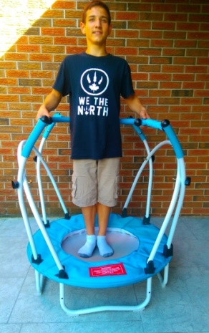
stabilization balls
and elliptical stabilization cushions

Slide 50
Physical and
Emotional Well-being
Toward A More Complete Understanding
of the hierarchy of special needs to meet in order to facilitate optimal well-being and to prevent and mindfully manage anxiety, anger and aggression
Human energy system – building, balancing and protecting from wireless radiation and electromagnetic fields (EMF)
Brain development, coherence balancing and inflammation regulation
Emotional Wellness:
• mental and neurological health and
disorders’ treatment
• trauma desensitization and triggers’
elimination
• psychological well-being
• medication side effects
• ABA behavioural interventions
Gastrointestinal (GI), bowel, digestive and immune systems’ treatment, nutrition, pain management, dental and myofunctional disorders, illness prevention and treatment
Awareness-based calming and de-escalation skills offered by mindful, emotionally self-regulated and kind supporters

Slide 51

JJanuary 11, 2016
Human Energy – Building, Balancing and Protection
Protection from Environmental Toxins
e.g. - reduce electromagnetic energy fields (EMF)
(a.k.a. dirty electricity)
- reduce Wi-Fi and cell phone radiation
The Bioinitiative Report 2012 links EMF Exposure to Autism concluding: Based on strong evidence for vulnerable biology, in Autism, EMF/ Radio Frequency Radiation (RFR) can plausibly increase Autism risk and symptoms. "While we aggressively investigate the links between Autism disorders and wireless technologies, we should minimize wireless and EMF exposures for people with Autism disorders, children of all ages, people planning a baby, and during pregnancy,”
says Martha Herbert, MD, PhD, Pediatric Neurologist Harvard Medical School.

Slide 52
Physical and
Emotional Well-being
Toward A More Complete Understanding
of the hierarchy of special needs to meet in order to facilitate optimal well-being and to prevent and mindfully manage anxiety, anger and aggression
Sensory integration and processing
Human energy system – building, balancing and protecting from wireless radiation and electromagnetic fields (EMF)
Brain development, coherence balancing and inflammation regulation
Emotional Wellness:
• mental and neurological health and
disorders’ treatment
• trauma desensitization and triggers’
elimination
• psychological well-being
• medication side effects
• ABA behavioural interventions
Gastrointestinal (GI), bowel, digestive and immune systems’ treatment, nutrition, pain management, dental and myofunctional disorders, illness prevention and treatment
Awareness-based calming and de-escalation skills offered by mindful, emotionally self-regulated and kind supporters

Slide 53
JJanuary 11, 2016
Filling the Gap – Sensory Integration and Processing:
Because research indicates that there is an 80% likelihood that
individuals with ASD/DD will have sensory processing and
integration challenges that cause and/or greatly influence
anxiety and for some aggression, CCS advocates for screening,
assessments and treatments by qualified Occupational
Therapists.
This treatment does not generally appear to be the
case for many people supported throughout Ontario.

Slide 54



Hyperactive Senses Lead to Challenging Behaviours
Hyperactive Senses
means that
people, objects and places can be:
e.g.
  too loud
  too fast
  too scratchy
  too tight
  too bright
  too off balance
  too confusing
  too chaotic
Agitation, Anger and/or Aggression
e.g.
repetitive behaviour
challenging behaviour
Injury to self or others
A
N
X
I
E
T
Y
=
=

Slide 55
Hypoactive Senses Lead to Challenging Behaviours
Hypoactive Senses
means that
people, objects and places can be:
e.g.
  too quiet
  too slow
  too dark
  too loose
  too tickly
  too confusing
  too chaotic
Agitation, Anger and/or Aggression
e.g.
low energy
low motivation
quiet/withdrawn
Eventually -
repetitive behaviour
challenging behaviour
Injury to self or others
A
N
X
I
E
T
Y
=
=

Slide 56
Physical and
Emotional Well-being
Environmental – supporters’ implement 45 stress reducers, reinforce ABA learning, teach social interactions and how to contribute to others’ well-being
Toward A More Complete Understanding
of the hierarchy of special needs to facilitate optimal well-being and to prevent and mindfully manage anxiety, anger and aggression
Sensory integration and processing
Human energy system – building, balancing and protecting from wireless radiation and electromagnetic fields (EMF)
Brain development, coherence balancing and inflammation regulation
Emotional Wellness:
• mental and neurological health and
disorders’ treatment
• trauma desensitization and triggers’
elimination
• psychological well-being
• medication side effects
• ABA behavioural interventions
Gastrointestinal (GI), bowel, digestive and immune systems’ treatment, nutrition, pain management, dental and myofunctional disorders, illness prevention and treatment
Awareness-based calming and de-escalation skills offered by mindful, emotionally self-regulated and kind supporters
56

Slide 57
Environmental Well-being
Communications – Validate not Vet
Accommodations e.g. – Limited Choices
– Avoid ‘No’
Behavioural Learning e.g. – ABA, IBI, Best Practices
Social Interactions e.g. – “Go slow in ways I know”
Contributing to Others’ Well-being e.g. – socially valued roles

Slide 58
Stress Inducers and Reducers
Reference CCS Textbook – Page 169 – 175

Slide 59

The 5 Step Conscious Care and Support Process
CARING &
COMPETENT SERVICES
Step 5
Step 4
CONSIOUSLY CONNECT
Step 3
CLARIFY AND CHOOSE
Step 2
CALM
Step 1
CATCH
“My mindful words and actions are useful, truthful, timely and kind”

Slide 60
JJanuary 11, 2016
What My Symptoms Are Saying:
“Even though I don’t control them, most of my behavioural
symptoms are messages to you. My nervous system is asking
you for certain kinds of support to have its specific needs met.
Please listen to what it is doing. If you don’t, I can’t stop it
from becoming anxious and frightened. And the main way
that it has learned to calm its fears is to get irritated, angry
and even aggressive. I hate when it does that but the calm
that follows my aggression makes me feel normal again.
Please help me to find a better way.”

Slide 61
“A counterfeit peace exists when people supported are pacified, distracted, frightened or so tired of fighting that all appears to others to be calm.”
(Adapted from Claiborne, Wilson-Hartgrove & Okoro.
(2012). Common Prayer, A Liturgy for Ordinary Rascals.)

Slide 62
Through Substantial and Sustainable Supporters’ & Leaders’:
    Training in Evidence Based Best Practices;
    Development in Conscious Self-regulation;
    Resulting in Competence & Commitment –
    People Supported
    Will
Live to Their Fullest Mind, Body and Spiritual Potential.

Slide 63
January 11, 2016
QAM Compliant Services for people with IDD and Symptoms of ASA are significantly and measurable more effective when combined with Conscious Care and Support type services.
(Reference CCS Independent Research, 2016)

Slide 64
January 11, 2016
The Autism Enigma
The Nature of Things
Video
The importance of GI Health to Enhance the Quality of Life of People with IDD and Prevent Challenging Moods and Behaviours

