Slide 1


Facilitating Optimal Living, Learning & Well-being
Through
Discovering and Disengaging From
PFP Programming
Session 4 – Resource 1

Slide 2
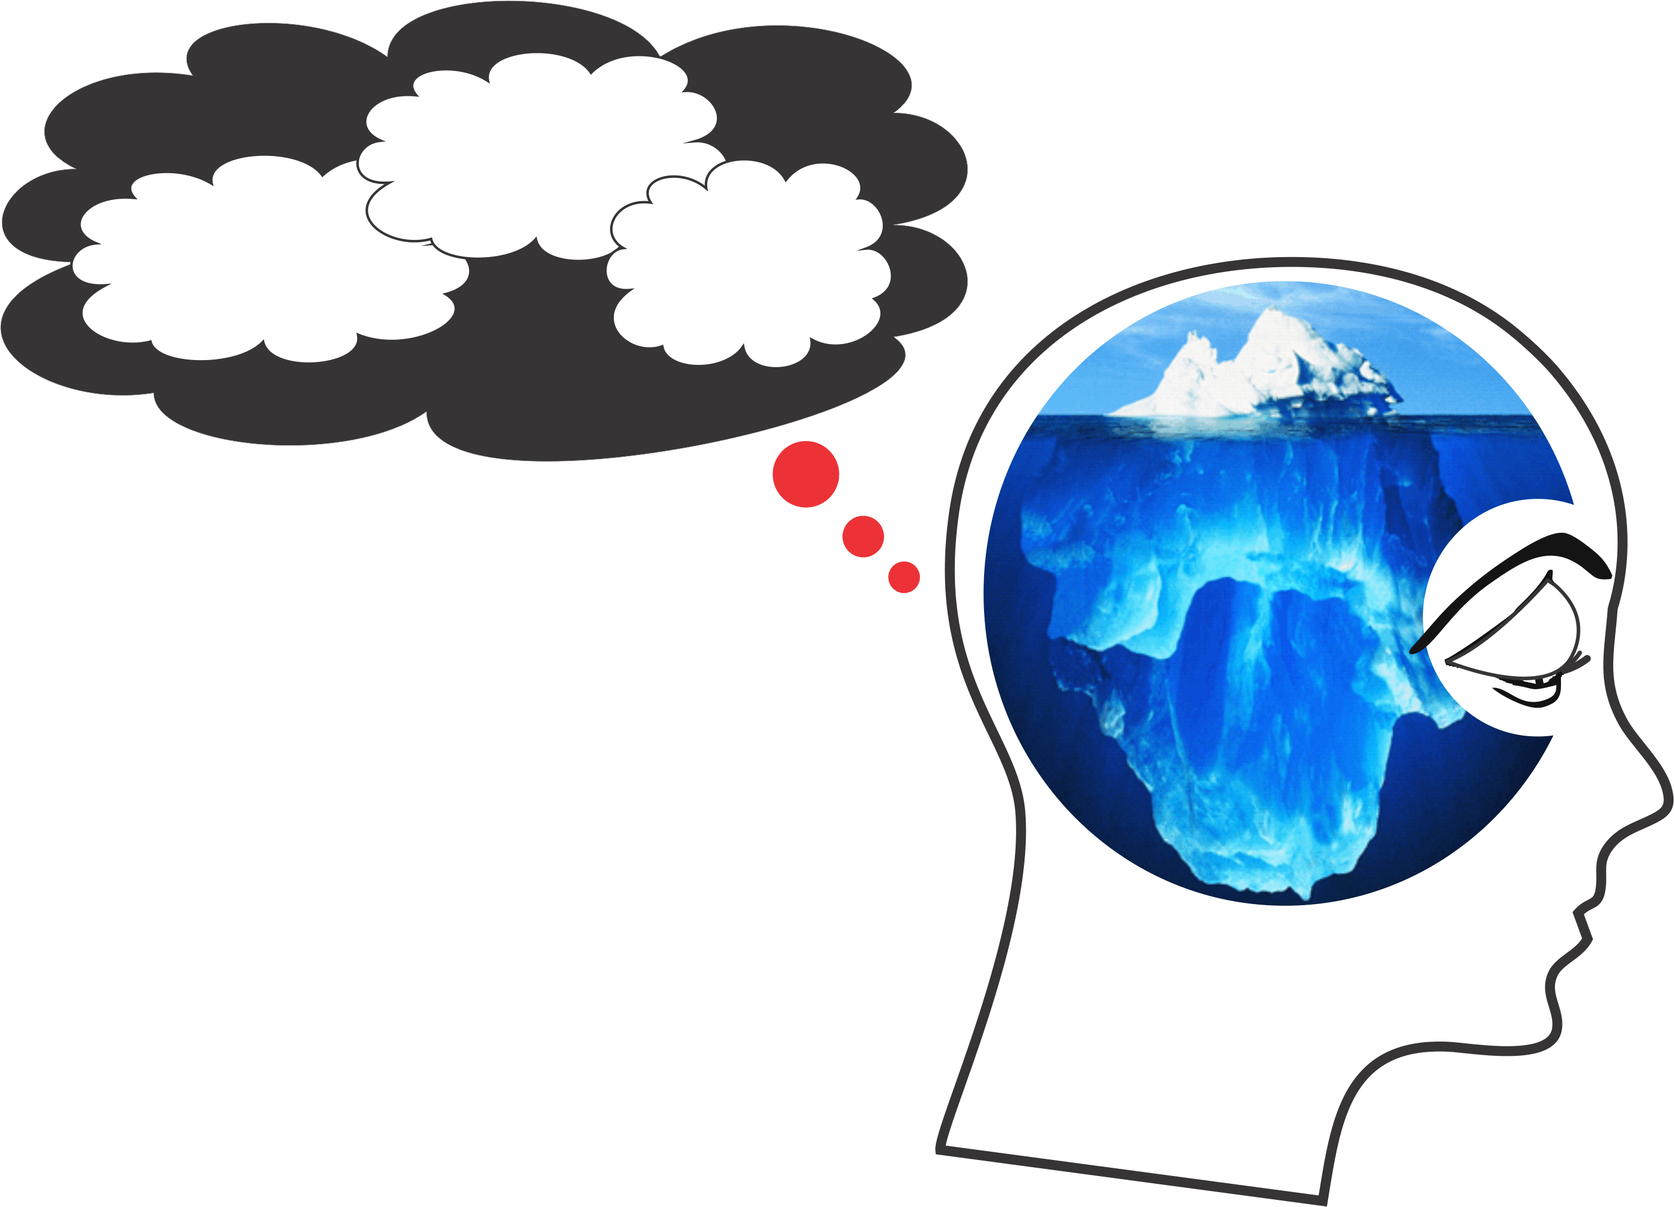
Understanding and Knowing that You - are in PFP Prison
Filters
Primitive
Predispositions
Primed
Prompts
Mindless Mind
Primitive
Predispositions
Inherited genetic makeup
re: survival and reproduction
drives (i.e. ‘Nature’ You)
PFP
Brain
Filters
Illogical beliefs/faulty filters from
childhood conditioning e.g. “I need”,
“I am”, “Others are” (i.e. ‘Nurture’ You)
Primed
Prompts
Societal and cultural brain washing/
stereotyping/branding/bigotry
(i.e. ‘Numbed’ You)
Mindless
Mind
The ‘You’ who is reading this but doesn’t know it (i.e. ‘Normal’ You)

Slide 3
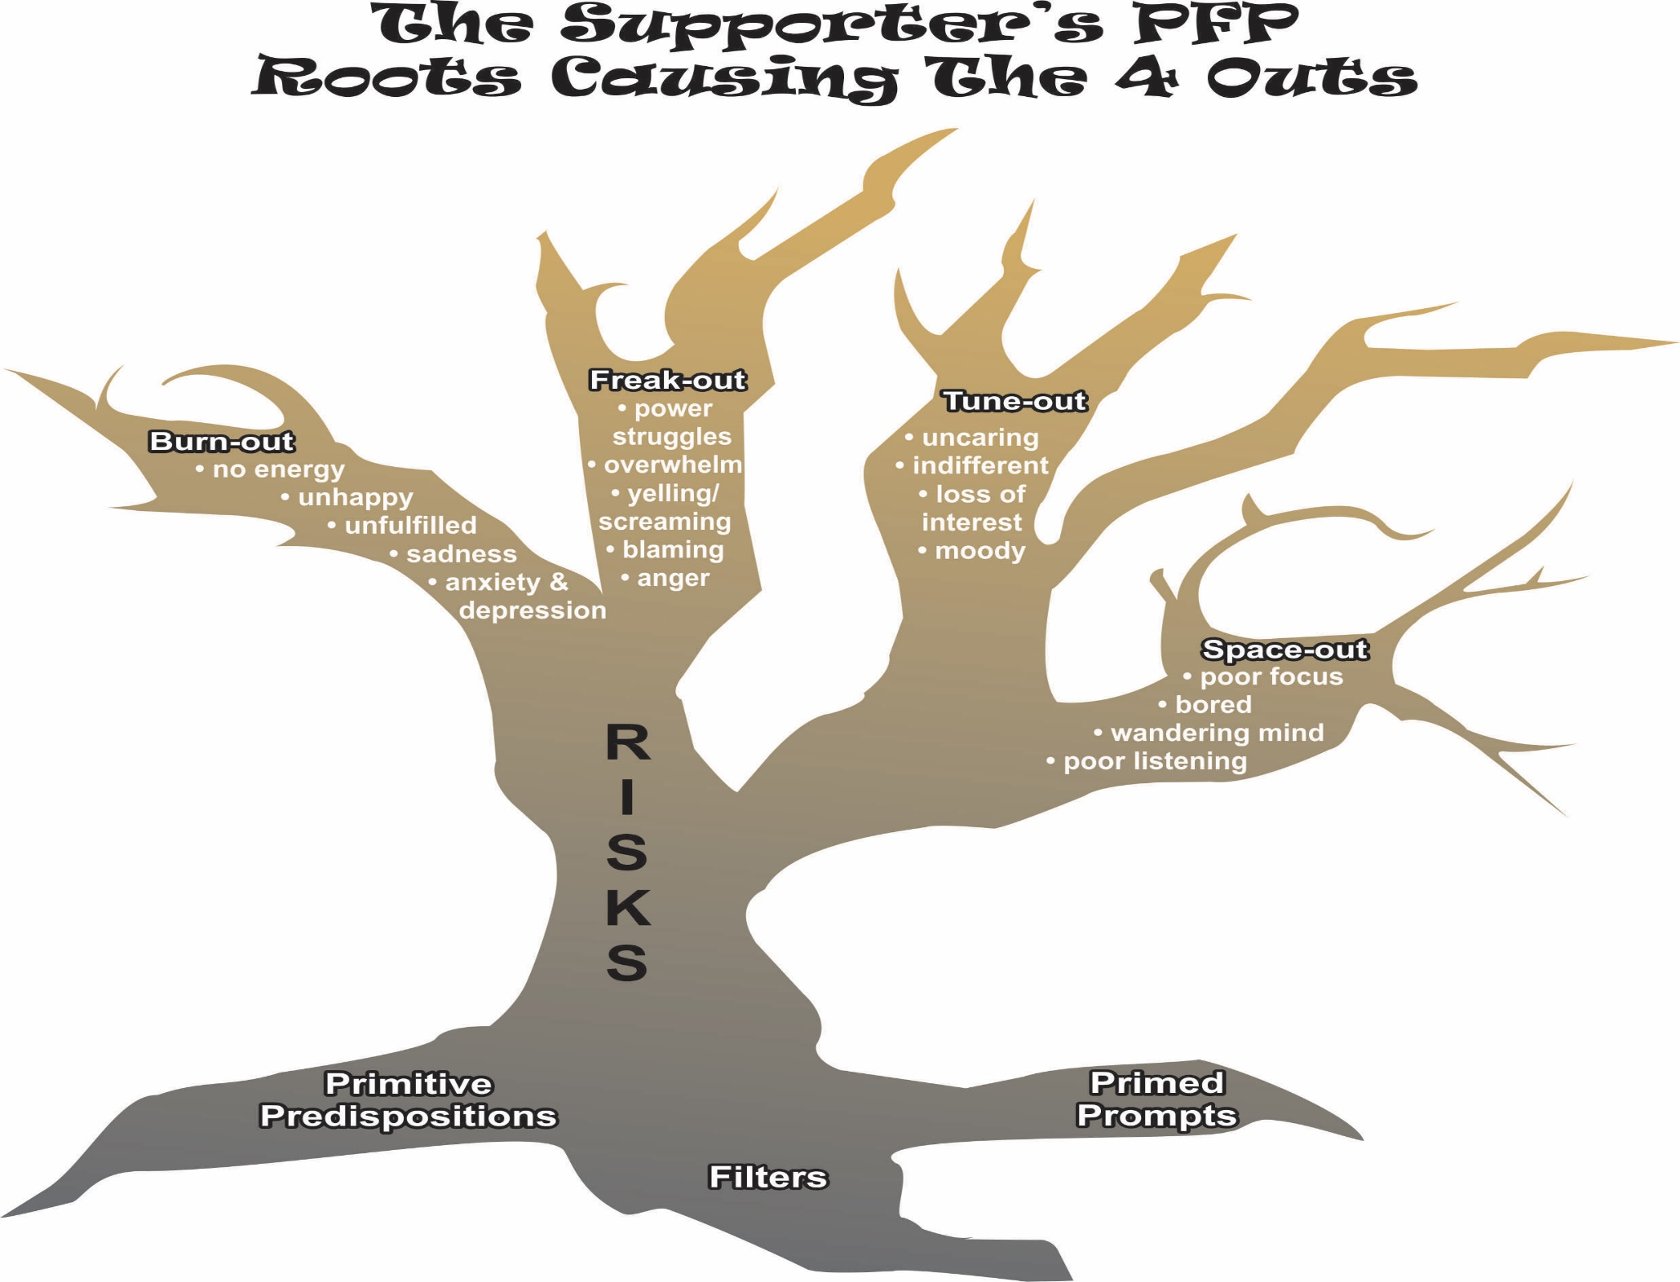

Slide 4
JJanuary 11, 2016
Discovering & Disengaging from Faulty Filters
When a pick pocket meets a saint –
All he sees are the saint’s pockets.
Ram Dass
Why Bother?
You will find that discovering and disengaging from Faulty Filters is particularly helpful to you if:
you logically know that you over-react to a certain situation or person but just can’t pull yourself out of it;
through-out your life you have had difficulty feeling close to another or have fallen out of a relationship with someone and really can’t explain why (except to blame others);

Slide 5
JJanuary 11, 2016
you realize that what upsets you wouldn’t or doesn’t seem to upset others nearly as much as you, or that different things upset them but not you and you don’t know why.
you feel that certain situations need to be changed now; others would generally agree that it is important, but your urgency is a little over the top. This is often a clue that you are being driven by your filters in this situation.

Slide 6
JJanuary 11, 2016
Understanding the Set-up
The child starts life perceiving that “I am weak and vulnerable,” both emotionally and physically. She therefore gropes for ways to feel secure through inclusion, which gives her a sense of counting for something and connection in the “herd”/family. To figure this out, she becomes a good mind reader.

Slide 7
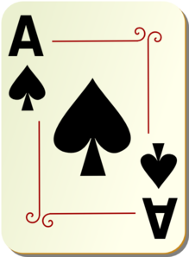
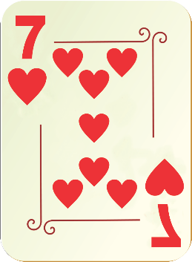
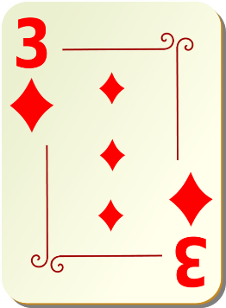
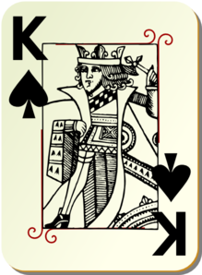
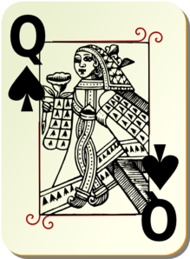
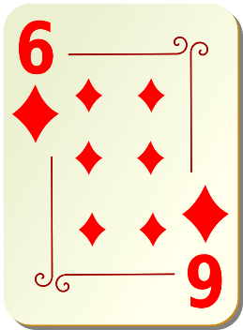
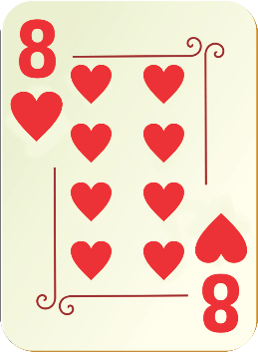
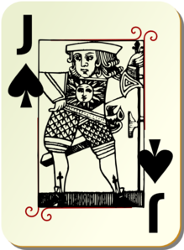

Slide 8
JJanuary 11, 2016
With these deeply-rooted primary directives, the child observes and makes quick (usually very incomplete) judgments about how to win this game.
The child learns very quickly what will bring reward (inclusion) and what will bring punishment (exclusion) and acts accordingly.
Here many highly subjective judgments are made that soon become filters through which all adult life situations must pass and be tested.

Slide 9
JJanuary 11, 2016
Examples of Faulty Filters
I think that I need to be in control of most situations and people in order to feel normal.
I think that I need to not be controlled by other people or circumstances.
I think that I need to be right and above criticism in order to feel normal.
I think that I need approval from important people in my life in order to feel worthwhile and normal.
I think that others and life must treat me fairly; otherwise I have a God-given right to feel awful.
I think that I must be included or not be excluded from social situations that I feel are important in order for me to have adequate self-worth.

Slide 10
JJanuary 11, 2016
Consistent Behaviour is Purposeful
Consistent behaviour generally feeds the needs of PFP and in particular faulty filters.
“No behaviour is ever crazy.”

Slide 11
JJanuary 11, 2016
‘Filter Rules’ define a person’s gifts and assets, as well as their self-limiting beliefs, difficult feelings and maladaptive behaviours.
They create their own subjective reality, a “private illogic” that is learned up to the age of twelve.

Slide 12
JJanuary 11, 2016
Everyone develops Filter Rules as they attend “somebody school” from age zero to twelve. This includes people with intellectual disabilities. The three most prevalent Filters for people with intellectual disabilities are:
I must be pleasing,
I must be in control,
Life must be fair.

Slide 13
JJanuary 11, 2016
Filters not only define us, they define our reality. “When I think I am a hammer, everything looks like a nail”.
I can win an argument on any topic against any opponent. People know this and steer clear of me at parties.
Often as a sign of great respect, they don’t even invite me anymore.
Lily Tomlin

Slide 14
JJanuary 11, 2016
However, with insights into our personal filters and mindfulness skills, we can reframe filters to be positive and less addictive, driving and griping.
The subconscious stores and prioritizes all of our filters’ data within its 11 million bits per second processing capacity.
Discovery and mindfulness facilitates the conscious 50 bits per second of data processing to lessen the filters’ driving, gripping power.

Slide 15
JJanuary 11, 2016
Factors Influencing our
Programmed Priorities/Filters
The Birth Order Influence
firstborn, middle, youngest, only
Heredity
physical problems, for example delayed social or intellectual development gifts

Slide 16
JJanuary 11, 2016
Family Atmosphere (climate at home)
Competitive vs. cooperative
Authoritarian vs. egalitarian
Critical vs. encouraging
Excessively high standards
Overly-protective
Pampering/spoiling
Lots of messages that we must impress others

Slide 17
JJanuary 11, 2016
Family Values (Mom/Dad “ideals”)
honesty
caring
hard work
orderliness
impressing others
being good
Role Models
How does Mom/Dad behave that makes the child feel secure/worthwhile or insecure/inferior? As an adult, this same behaviour will be sought or resisted.

