Slide 1


Emotional Well-being
PTSD Desensitization & Triggers’ Prevention
“Trauma results in a fundamental reorganization of the way mind and brain manage perceptions. It changes not only how we think and what we think about, but also our very capacity to think.”
Bessel A. van der Kolk
Session V – Resource 2

Slide 2

Prevalence of PTSD in People with Autism and Other Developmental Disabilities
Given most relevant findings and studies* it would appear that there is a reasonable probability that PTSD sufficient to cause maladaptive behaviours effects one out of every two to three supported people.
* Reference Adverse Childhood Experiences (ACE) Study of 17421 individuals Felitti V., Stevens, J.E., 2001

Slide 3
Abuse Data Implications for People with Autism and Other Developmental Disabilities
Autism Speaks
“It is estimated that children with developmental disabilities are more than twice as likely to be physically or sexually abused as their typically-abled peers.” (Petersilia, J., 2001).
Reference Sullivan and Knutson 2000 reports (from 55,000 studied) children with intellectual disabilities are 3-4 times more likely to experience sexual abuse before age 18 than children in the general population.
Kerry’s Place
“As children they are 5 times more likely to be abused than neurotypical individuals.”
(Monsell and Sobsey, 2001).

Slide 4
People with Developmental Disabilities
Hypersensitivity to Non Traumatic Life Events
(i.e. Emotional Dysregulation (ED)
It may well be that the fear created by:
Sensory irregularities causing overwhelm
Isolation and lack of socializing
Inability to cognitively comprehend and assess the safety of many normally stressful situations
‘Normal’ levels of yelling, shouting and criticism
Exclusion, boredom and being bullied
Other
….could result in traumatic stress for people who have autism or other developmental disabilities.
(Reference American Academy of Neurology 2002)

Slide 5
Symptoms of a Triggered Traumatized Emotional Brain
That Often Causes Challenging Behaviour
sensory irregularity
inattention, anger, aggression
gut wrenching sensations
loss of control of bowels and urination
head pounding
breathing becomes fast and shallow
intense feelings of heartbreak, emptiness, sadness
speaking with an uptight and reactive argumentative voice
not speaking at all
body movements that signal collapse, rigidity, rage or defensiveness
reactive and disorganized
"self control strategies" stop working
sounds and lights are intense and therefore fearful
unwanted images from the past take control of the mind
ADHD like symptoms
panic, fear, rage
shut down
feel numb in body and mind
thinking becomes slow and sluggish
trouble standing up

Slide 6
Triune Brain Theory
Thinking brain: reasoning, problem solving, verbal expression, memory for events and facts
Mammalian brain: non-verbal, emotional and relational experience, feeling and gut memories, and traumatic memory
Reptilian brain: instinctive responses, heart rate, breathing

Slide 7
Trauma response
Brain scan research shows when we remember a traumatic event, memory centres in the frontal lobes shut down, and we get overwhelmed by feelings and impulses instead of recalling events.

Slide 8
Trauma response
The Limbic system responds to memories with increased activity, especially the amygdala, the brain’s smoke detector and emotional memory centre. The amygdala sounds the alarm as if we were in danger right now.

Slide 9
Trauma response
The reptilian brain reacts to the amygdala’s alarm.
Heart rate increases.
We stop breathing or hyperventilate.
Muscles tense.
We either speed up or shut down.

Slide 10
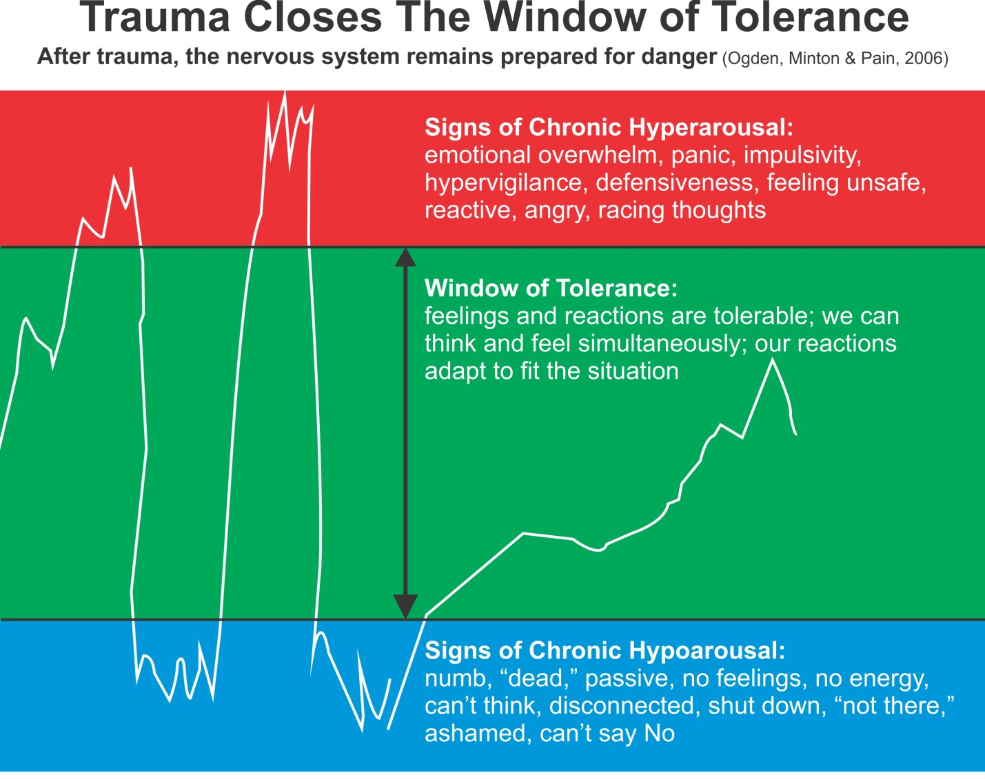

Slide 11
At Its Roots, PTSD Behaviour Is Not Based On Social Motives Such As Task Avoidance, Attention Or Power And Control
Above is a comparison between a normal versus a PTSD brain. Normally all regions of the brain collaborate in a synchronized pattern (left), while the brainwaves in PTSD are less well coordinated; the brain has trouble filtering out irrelevant information, and has problems attending to the stimulus at hand. This causes anxiety that leads to agitation, anger and aggression especially if brain waves are destabilized through inadvertently triggering PTSD symptoms.
(Adapted from “The Body Keeps The Score” - Bessel A. van der Kolk)

Slide 12
How PTSD Changes Body And Brain Hard Wiring
“Trauma results in a fundamental reorganization of the way mind and brain manage perceptions. It changes not only how we think and what we think about, but also our very capacity to think.”
“The act of telling the story doesn’t alter the automatic physical and hormonal responses of the body that remains hyper vigilant as it prepares to be assaulted or violated at any time.”
Bessel A. van der Kolk

Slide 13

The Recurring Cycles of Behaviour to Calm to Behaviour
UNMET NEEDS
• Medical
• Behavioural
• Social
• Biomedical
Best Practices
• Supporter’s
Mindful
Emotional
Self Regulation
and Maturity
• Competent
Delivery
Blow-Out
(fight or flight)
e.g. • anger • SIB
• external aggression
(people and property)
Primarily
Behavioural
and
Traditional
Medical
Responses
and
Follow Up
GOALS’ ACHIEVEMENT
OUTCOMES OF
UNMET NEEDS
• Agitation
• Anxiety
Mainly behavioural compliance, e.g. reduction of functional goals
or
Behavioural
Blow-In
(freeze)
e.g. • withdraw
• depression

Slide 14
Supporters – first do no harm
Let us ensure that Supporters do not become part of the reactive trauma response.
The Supporter must catch and calm themselves (become Mindful) to avoid fearful entrainment of the student. "Fear begets fear, calm begets calm.“ (Reference CCS five step model)
Reduce/eliminate environmental triggers e.g. overwhelming stressors, people, places, situations etc. until coping skills are adequate.
Interact calmly - Power for example yelling, always creates fear and manifests as challenging behaviours or withdraw.

Slide 15
“Bottom Up” Supporting Strategies
to Heal the Brain, Body and Being
Cardio Exercise e.g. mini trampoline, platform swing.
Be intentional with positive emotions e.g. body, eyes, smile i.e. entrain positive.
Bilateral, Biomeridian Awareness Based Calming as much as is possible.
Provide prescribed sensory integration exercises.
Hand massage.

Slide 16
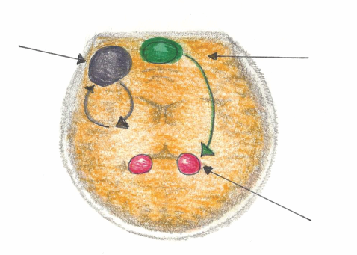
Mindful Emotional Self Regulation
The main way we can consciously access the emotional brain is through self awareness*, i.e. becoming mindful. Mindfulness increases connections in the medial pre-frontal cortex. This reduces anxiety for the Supporter and the Person Supported.
Dorsolateral pre-frontal Cortex
Working Memory
Impulse Control
Medial pre-frontal Cortex
(part of the brain that notices what’s going on)
Amygdala
(*Research reference: J. LeDoux, “Emotion Circuits in the Brain”, Journal of Neuroscience 33, no. 9 (2013) 3815-23)

Slide 17
“Bottom Up”
Support Strategies to Heal the Emotional Brain cont’d
Teach/Model individual to do Calming Breathing Exercises
Exercise:
Mindfully inhale as arms are lifted to shoulder height.
Mindfully exhale as arms are lowered to side.
Let exhale be slower than inhale
NOTE: Mindful feeling body awareness activates the Vagus nerve. 80% of the fibres of the Vagus nerve run from the body into the brain. This means that one can directly calm an aroused (emotional brain) system by mindful movement practise, like Nei Yang Gong.
(Reference Spark, Ratey, J.)

Slide 18
Engaging Family and Professionals
Engage the services of professionals.
e.g.
A Qualified “Bottom Up” PTSD Counsellor e.g. EMDR Therapist
Occupational Therapist
Naturopath
Psychiatrist
Neurofeedback Specialist
Other

Slide 19
Supporting Others
Through Mindful Connecting
As we quiet our mind and heart while supporting others, Our stillness nurtures their calm and courage.
Now they can peacefully manifest more of their complete Being, in part because of our mindful presence.

