Slide 1


JJanuary 11, 2016
Developing Emotionally Self-Regulated and Kind People
Claim Your Brain, Start Your Heart
Session 2 – Resource 1 and 2

Slide 2
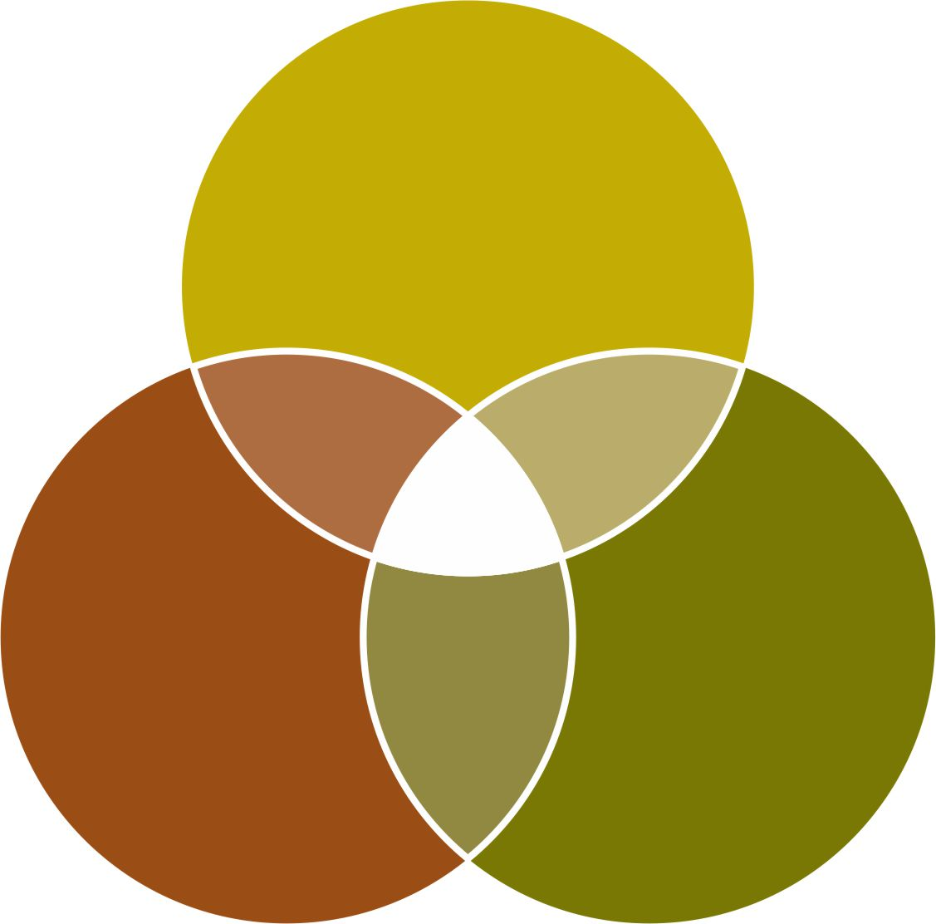
To Consistently Deliver Optimal Support – The Supporter Needs
Three Key Professional and Intrapersonal Qualities
Conscious
and Caring
Emotional
Self-Regulation
OPTIMAL
SUPPORT
Knowledge
and
Understanding
of Best
Practices
Unconditional
Compassion
Services

Slide 3
JJanuary 11, 2016
How often do power struggles with supporters and people supported compromise the quality of the supported person’s well-being?
It appears that a minimum of 40% of behavioural incidents
result from or are significantly influenced by generally good
and caring supporters’ unintended and unaware loss of
emotional self-regulation. This often results in power
struggles and other supporter induced behavioural
antecedents.

Slide 4
Why might the average good and caring supporter become emotionally hijacked into power struggles that can cause challenging behaviours in the person being supported?

Slide 5

Why might the average good and caring person at times only play our ‘C’ game?
5

Slide 6

Let’s start by reminding you of the human predicament, that most everyone struggles with unless we personally and intrapersonally develop, e.g. become more emotionally self-regulated and conscious.
We worry about a concern that we have done all we can do to correct, but something won’t let us stop worrying.
We can’t stop being angry or fearful, when we want to.
We get pulled into harmful power struggles but can’t stop them from escalating.
We are unable to forgive someone, even when we want to and know that
it would be helpful to forgive.
6

Slide 7
We don’t want to lose our temper or be moody, but it seems to just happen.
We struggle to be motivated to self-manage and improve ourself, even though we realize we still have some ‘growing up’ to do.
We too often do not play our A-game, then later regret what we said or did.
7

Slide 8
We know that some of the following life challenges are on their way into our life, but we just can’t ‘find the time’ to prepare to prevent them from being overwhelming.
loneliness emotional insecurity boredom a challenging, disabled or ill child blow ups in important relationships unemployment life-partner betrayals and break ups depression/anxiety | excessive chronic guilt grief/loss physical illness/disability mental health disorders, e.g. ADHD financial crisis substance abuse dementia life-threatening illness
8

Slide 9
,
Definitions to Better Understand the ‘Set-up’
Over each 24-hour period, we can be experiencing consciousness on a 1-10 continuum.
Unconscious: (1)
  like when we are asleep in our bed.
Semiconscious: (autopilot) (5)
  like how we typically drive our car, relate to people and do most ‘doings’.
Fully Conscious: (self-aware) (10)
  like when we are paying attention – noticing what we are doing e.g. how we drive when a police car is following us;
  knowing that we are doing it and
  knowing how our body’s sensations, feelings and thoughts are
  reacting to what is happening.
Subconscious:
  our data bank of ‘files’ that we inherit and develop.

Slide 10
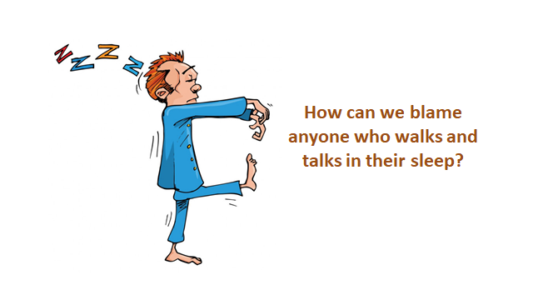
We Are in Effect, Most Often Walking in Our Sleep - Semi-conscious
Like how we drive our car most of the time.
10

Slide 11
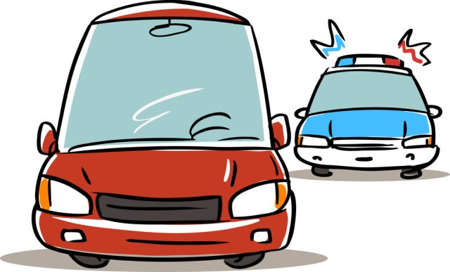
To be aware, i.e. more fully conscious, we start by paying attention to what we are doing. It is as if we were driving our car and a police car was right behind us - we are really focused on our driving and also 100% aware that we are being followed.

Slide 12
Life’s Set-up
Understanding The Main Sources of
Our Loss of Emotional Self-Regulation
To survive in the early, dangerous Paleo jungles, we needed Quick and Simple Reactions to solve life threatening problems.
“Our Brain hasn’t changed much
over the last 50,000 years.”
                Dr. John Ratey
                Associate Professor of Psychiatry
                Harvard Medical School
‘The Chemical Factory’

Slide 13
Life’s Set-up
Understanding The Main Sources of
Our Loss of Emotional Self-Regulation (cont’d)
The Brain therefore inherited and develops ‘Files’/a data bank from which to semiconsciously speed-dial reactions to manage our world and keep us (mainly our ego) safe.
Workshop - with a partner determine teacher and student.

Slide 14
JJanuary 11, 2016
Speed Dialing Often Means…………
Being Semiconsciously Driven by the Brain’s
Primitive and Programmed Needs to:
  look good and impress
  be in control
  be right
  be treated fairly
  not be criticized
  be judgmental
  be accepted by the ‘herd’

Slide 15
Life’s Set-up – Being Mostly Semiconscious
Means that we have insufficient consciousness to consistently offer our ‘A’ Game
Especially in crisis, we speed dial our ‘C’ survival game as our ancestors have done for thousands of years.

Slide 16
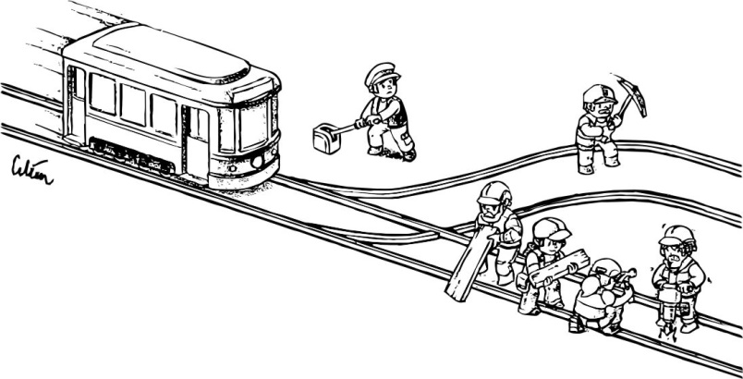
JJanuary 11, 2016

Slide 17
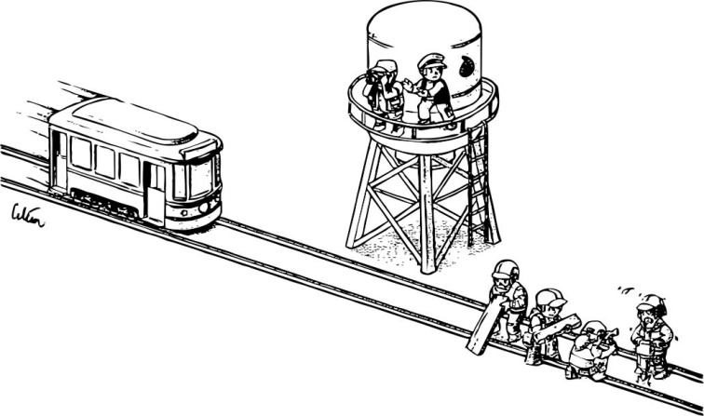
JJanuary 11, 2016

Slide 18
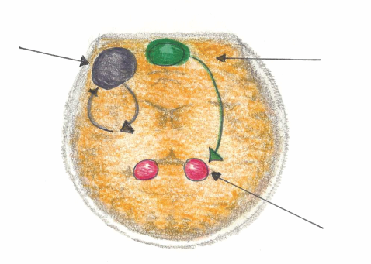
Mindful Emotional Self Regulation
The main way we can consciously access the emotional brain is through self awareness*, i.e. becoming mindful. Mindfulness increases connections in the medial pre-frontal cortex. This reduces anxiety for the Supporter and the Person Supported.
Dorsolateral pre-frontal Cortex
Working Memory
Impulse Control
Medial pre-frontal Cortex
(part of the brain that notices what’s going on)
Amygdala
(*Research reference: J. LeDoux, “Emotion Circuits in the Brain”, Journal of Neuroscience 33, no. 9 (2013) 3815-23)

Slide 19
According to many published Neuroscientists, including Dr. Daniel Siegel (UCLA) in his book called The Mindful Brain (page 42 and 43) the following brain, body and being functions correlate with the activity of medial areas of the prefrontal cortex:
1. Body regulation – the emotional brakes and accelerator functions.
2. Attuned communication involves the coordination of the input from another person with the activity of one’s own (as with mirror neurons).
3. Emotional balance to have enough activation so that life has meaning and vitality but not so much that life becomes chaotic.
4. Response flexibility is the capacity to pause before action.
5. Empathy – knowing what might be going on inside someone else.
6. Insight or self-knowing awareness to be able to link the past, present and future.
7. Fear modulation that may be carried out by the release of the inhibitory neurotransmitter GABA.
8. Intuition – a neural mechanism by which we process deep ways of knowing via our body
i.e. ‘somatic intelligence’.
9. Morality – taking into consideration the larger picture, to image what is best for the
whole not just one’s self, even when alone.

Slide 20
JJanuary 11, 2016
The You
Who is Listening to Me
Did Not Make the Choice
To Push or Not!
(Unless you were mindful/conscious)

Slide 21
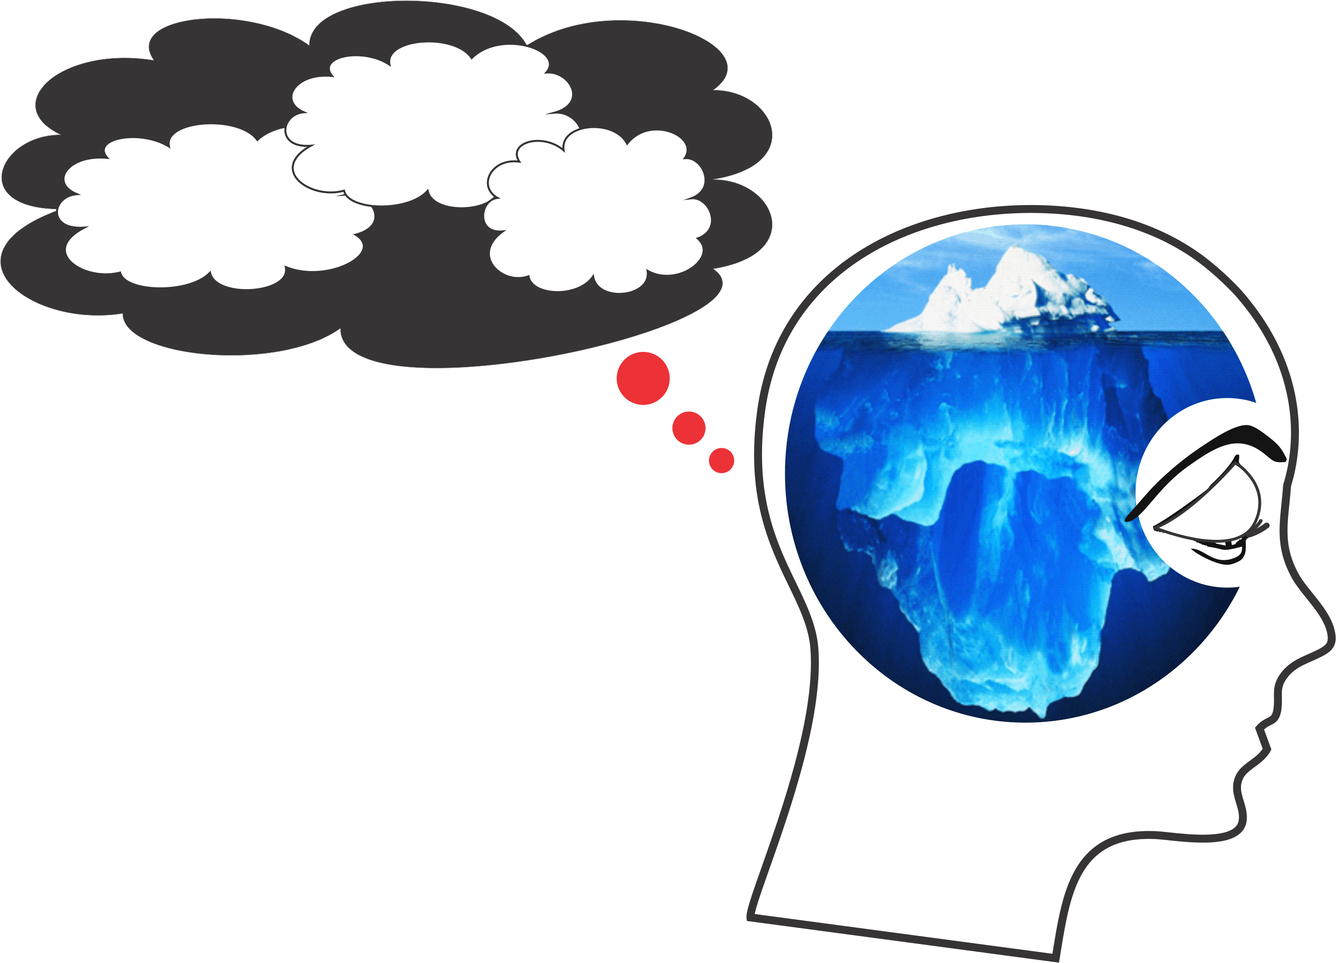
Filters
Primitive
Predispositions
Pseudo-
Awareness
Mindless
Semi-Conscious Mind
Primitive
Predispositions
Inherited survival and sex driven ‘Nature’ brain.
PFP
Programming
Filters
Our childhood learned “I need”,
“I am”, “Others are” ‘Nurtured’ brain
Pseudo-Awareness
Erroneously believing that we are aware, here now when really we are not.
Me Mind
Our semi-conscious ‘Not Here’ brain.
21

Slide 22
Question?
Why do people say and do things that they later regret, when they knew better?
and
Why don’t people say and do things that later they wish they had?
22

Slide 23

Making Choices
Place your hand on your desk or knee and sometime over the next 5 seconds, raise your index finger and watch it raise.
What happened?
23

Slide 24
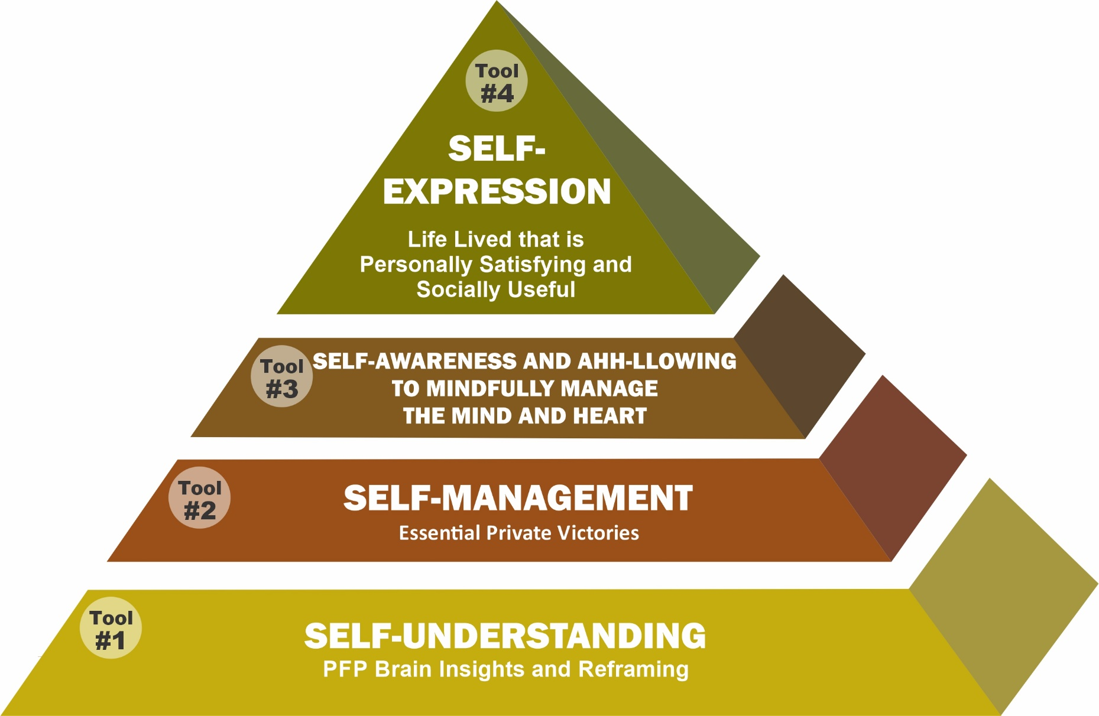
The 4 Essential Inner and Outer Life Tools of
Personal Development and Optimal Self-Expression
24

Slide 25
Optimal Self-Expression
is not consistently possible without
Self-Awareness
which requires ongoing
Self-Management
as a result of the motivation stimulated by
Self-Understanding
of the Human Predicament
25

Slide 26

Self-Understanding
Self-Understanding is the first tool. This critical tool is applied to enhance our understanding of how deeply controlled we are by our Primitive/nature brain, Filters/nurture brain and Pseudo-awareness that unknowingly drives most of our feelings and behaviours.
We call this PFP Prison and most people are not motivated to break out of it until they better understand their predicament and its costs.
26

Slide 27
Do You Have A Thinking Problem?
More of The Human Predicament of Being Semiconscious Indicating Limitations of Free Will To Think and Feel
Do you know what your next thought will be before you have it?
Do you have incessant talking thoughts with yourself all day long?
Can you stop these thoughts at will for even 15 seconds?
When you are emotionally hijacked, how long does it take you to realize it and stop it?
Would you share all the thoughts you had yesterday with anyone?
27

Slide 28
We are Born to Lose
One of the most significant and important parts of self- understanding is to know that we are only naturally prepared to survive and reproduce.
Personal qualities like meaning, purpose, compassion, love and unconditional caring, and even happiness must for the most part be learned and earned.

Slide 29
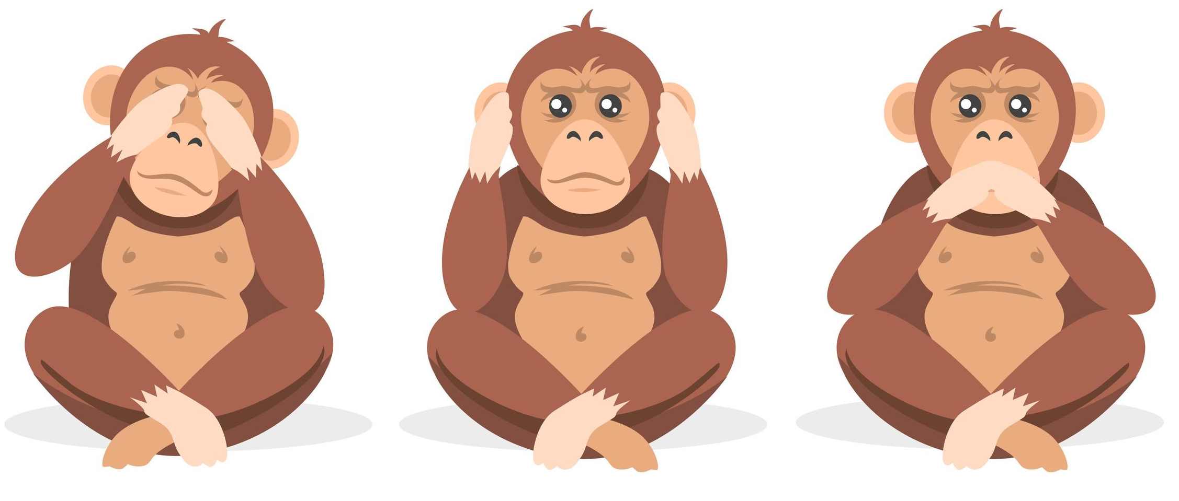
Monkey Business
Inattentional Blindness
We Take In Only Some of What We See and Hear – Then Remember Less
We Miss… Buildings - Pain - Cars and Other Truths
29

Slide 30
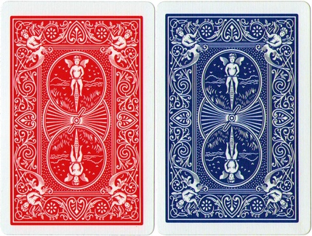
More Primitive Predisposition Problems
Examples of Inherited Primitive Predispositions
(The Hard-drive)
75 – 45 - 10
30

Slide 31

JJanuary 11, 2016
Brain Priming – Cognitive Bias
1.
$90
$10
MRI Research
If you are shown a picture that you find disgusting, you will be much more likely to vote conservative.
Sound waves can significantly change our moods and feelings (Classical versus Hip Hop, Rap music (Sound Waves/Sonication Science).
31

Slide 32
JJanuary 11, 2016
Experiment
Divide into pairs and decide who is #1 and who is #2.
2. Everyone close your eyes.

Slide 33
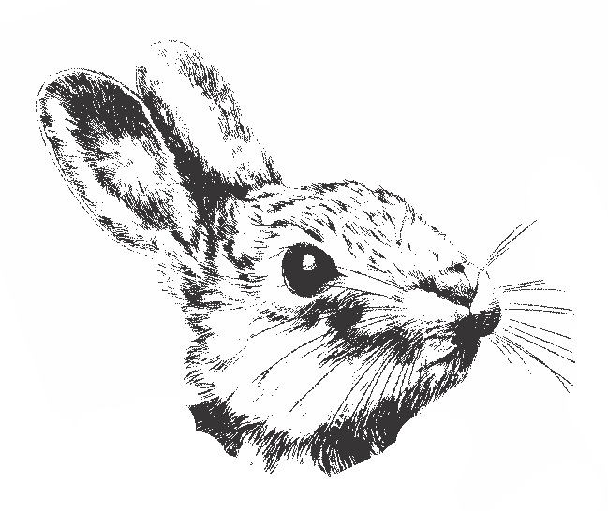
JJanuary 11, 2016

Slide 34
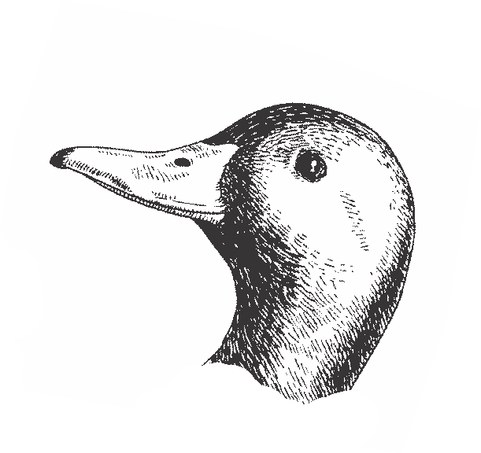
JJanuary 11, 2016

Slide 35
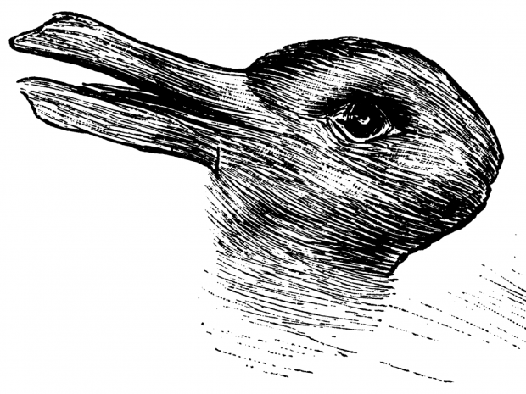
JJanuary 11, 2016

Slide 36
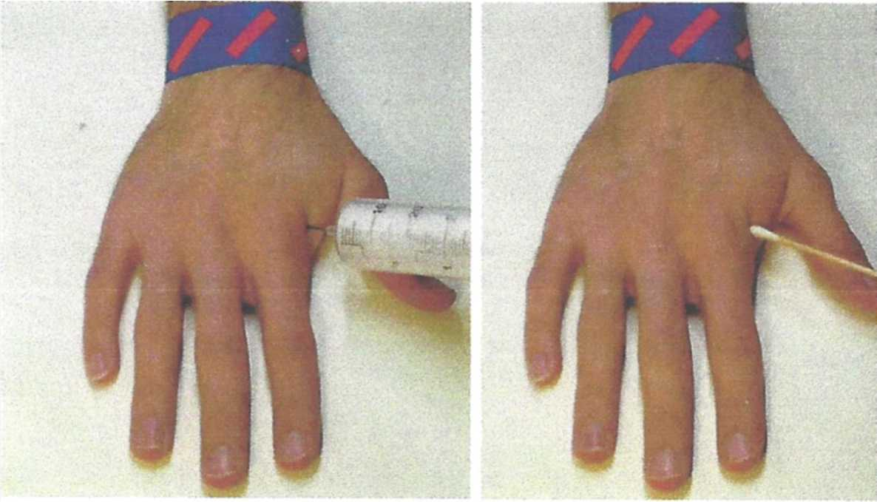
JJanuary 11, 2016
Is Most Everyone’s Brain Designed to
Devalue People Supported?
MRIs indicate that most individuals’ brains react with strong pain empathy
when they witness this painful procedure.
Provided…………………….

Slide 37
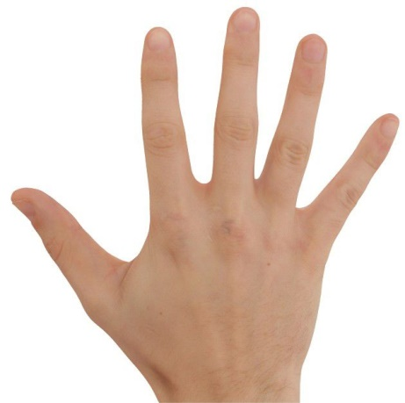
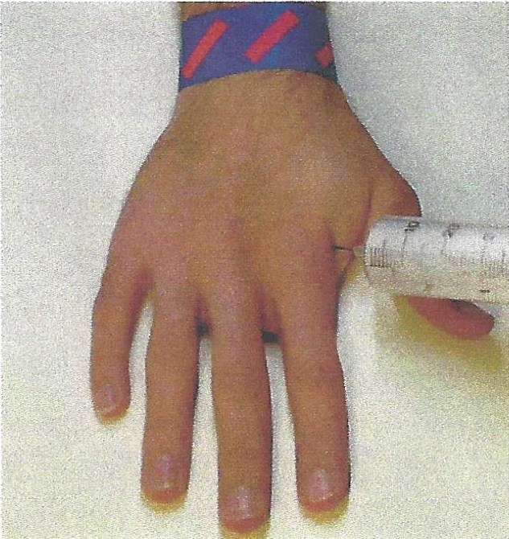
Provided the brain relates to the injured hand as being a lot like its own!
Muslim
Atheist
Atheist
Christian
Buddhist
Jew

Slide 38
JJanuary 11, 2016
Understanding ‘In’ and ‘Out’ Groups
The brain is wired to devalue/exclude others who it perceives to be different. In the old days, in the jungle, ‘different was dangerous’ so the brain evolved to reward taking care of our ‘in- group’ not other’s i.e. the ‘out-group’.

Slide 39

JJanuary 11, 2016
Neuroscience research is showing that for average Canadians and Americans, homeless people are dehumanized by the semiconscious/mindless brain. They are generally seen as ‘different’ and therefore our PFP Programming (not us) often relates to them impersonally, not like our ‘in’ group members who we feel with and for.
Department store research
and MRI Research – Dr. L. Harris

Slide 40
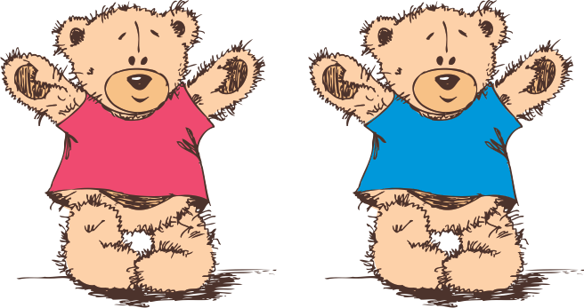
JJanuary 11, 2016
What do we mean by an ‘Inherited DATA BANK’ of Primitive Predispositions?
In – Out - We Start Early
40

Slide 41
Jung
Fellow Explorers
In each of us there is another whom we do not know – Carl Jung
There is someone in my head and it’s not me – Pink Floyd
We don’t really see things as they are, we see them as we are – Anais Nin
How can I know what I think, until I hear what I say – Forrester
41

Slide 42
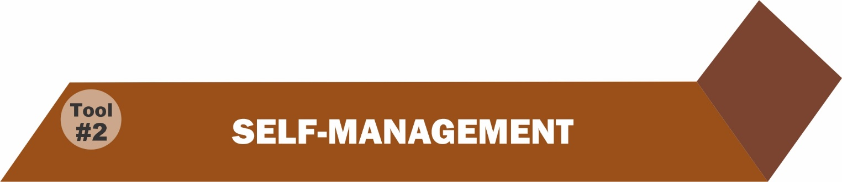
Self-Management
The Second tool is self management to more optimally manage our feelings, behaviour, growth and how we relate to others.
42

Slide 43
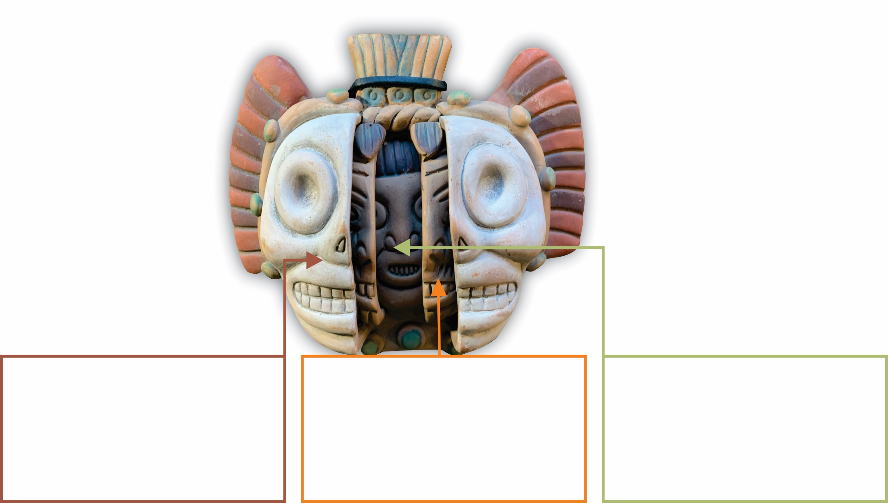
From Masks
to Meaning
Mask 2 – Filters
Our childhood ‘nurtured’ programs, i.e. faulty and fruitful filters - pipelines that carry the chemicals that need self-understanding for us to know why we do what we do and to make positive changes, e.g. emotional
self-regulation and unconditional compassion.
Mask 3 - Pseudo-Awareness
Our mindless semi-consciousness that needs self-awareness to actually be present and conscious, to turn off malfunctioning chemical factory pipeline valves and turn on Conscious Connecting switches to experience authentic happiness beyond do’n, get’n and hav’n to make our life and the world a better place.
Mask 1 – Primitive Predispositions
Our inherited ‘nature’ chemical factory’ that needs Self-management to skillfully manage the 4 essential life tasks of relationships, work, compassionate action and loving.

Slide 44

Keep Feeling Reasons to Stay Motivated and Committed to Self-Management – Front and Centre
e.g. Screen Savers
Friends, Parents, Children,
Life Partners,
Physical Health,
Less Pain

Slide 45

45

Slide 46
We First Self-Manage by Applying the Following Growth and Development Principles
Cultivate an attitude of indebtedness / gratitude instead of entitlement, especially about happiness – no one is entitled to it!
Ask yourself, “What am I missing at this moment that would be helpful?” Remember that every story has three sides because of inattentional blindness.
The best way to successfully change conditions in your life, to become happier or manage a crisis, is first to work hardest on changing and growing yourself—not more communications and behavioural strategies, e.g. can’t drift/sleep to the top of a mountain.

Slide 47
Development Principles - continued
Some things in life are not fair or just. You don’t have to like it; it is just the way it is. Move on! “When the horse is dead—get off”.
Success leaves clues, e.g. initiate connections with happy people who consistently manifest their ‘A’ game even in chaos.
Life is a matter of odds, so plant many ‘crops’, interests, friends, etc. and expect some failures - gym.
Ignorance is not bliss. What we don’t know can and will hurt us.
Pay attention to our physical and emotional health
– the Great Depression.

Slide 48
Development Principles - continued
Follow the laws of sowing and reaping.
Honour mood disorders and get help, e.g. my resistance.
Life requires resolve: “I will” - stay motivated, revisit self-understanding.
Life requires action: “Do” - intentions without action breeds delusion.
Life demands commitment: “I am”.
Intention, intention, intention - beam and fire walk.

Slide 49
Development Principles - continued
Build muscles of resilience by stretching limits of comfort each day, (e.g. make some sacrifices and be equanimous with them).
Celebrate successes but make failures painful. Own it! “I am unhappy today because I didn’t or don’t _________________________________________________________.”
As you come to awareness throughout your day, activate intense awareness of the moment by moment pleasant experience that you have with routine interactions and situations, i.e. one bite of food or saying
good morning to a friend.

Slide 50
When People are Difficult
When people are difficult people
in their presence, a chore.
With catch and calm their pain you’ll feel,
when you question more!
What sad life could that child have had,
to have so tightly closed their heart’s door.
50

Slide 51
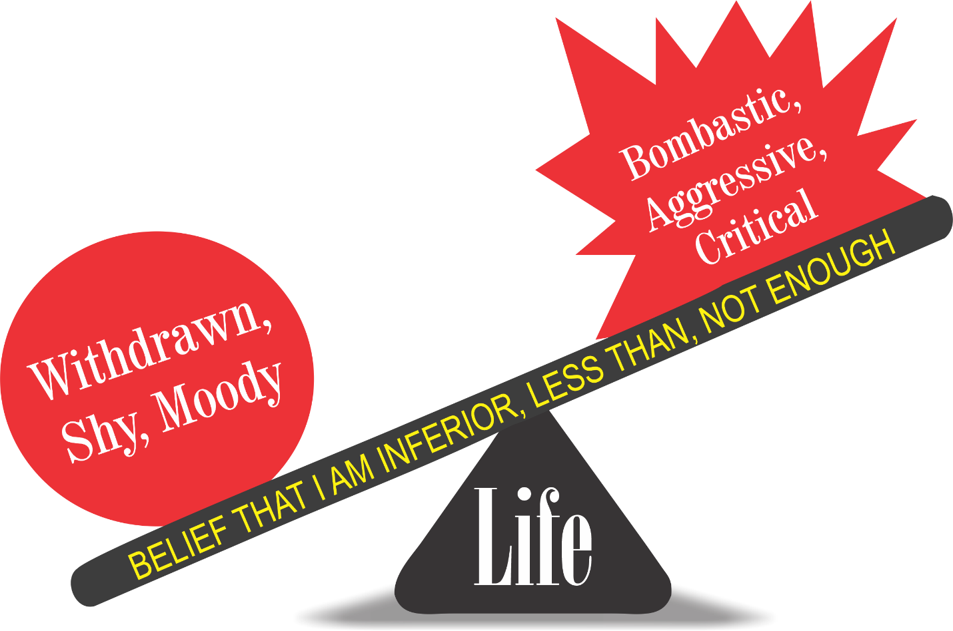
Two Different Behaviours, One Erroneous Belief
51

Slide 52

JJanuary 11, 2016
Actually preventing and managing anger/emotional hijacks
Anger
Annoyed Hurt/Upset Frustrated Resentful Overwhelmed Angry Enraged
The Anger Continuum

Slide 53

JJanuary 11, 2016
Control
The mind becomes relatively calm when it perceives it is in charge.
Thank You Anger,
My Dear Friend -
Anger’s 3 PFP Survival Based Illusion of Hidden Benefits
– Payoffs and Purposes
Increases Brain Power to Focus
Anger focuses the mind. Focus is a primordial survival instinct which is therefore relatively calming.
Displacement
of the mind’s preoccupation with the ‘awful’ experience of fear, embarrassment, sadness, pain, etc. with the much less ‘awful’ experience of anger.

Slide 54
Steps to Prevent and Manage Anger
Catch yourself starting to become angry.
With mindfulness restructure belief, ‘the heart transplant’ – Who is to blame here?
With mindfulness keep the ‘upper brain’ online to problem solve.
We don’t have to feel kind to authentically be it.
54

Slide 55
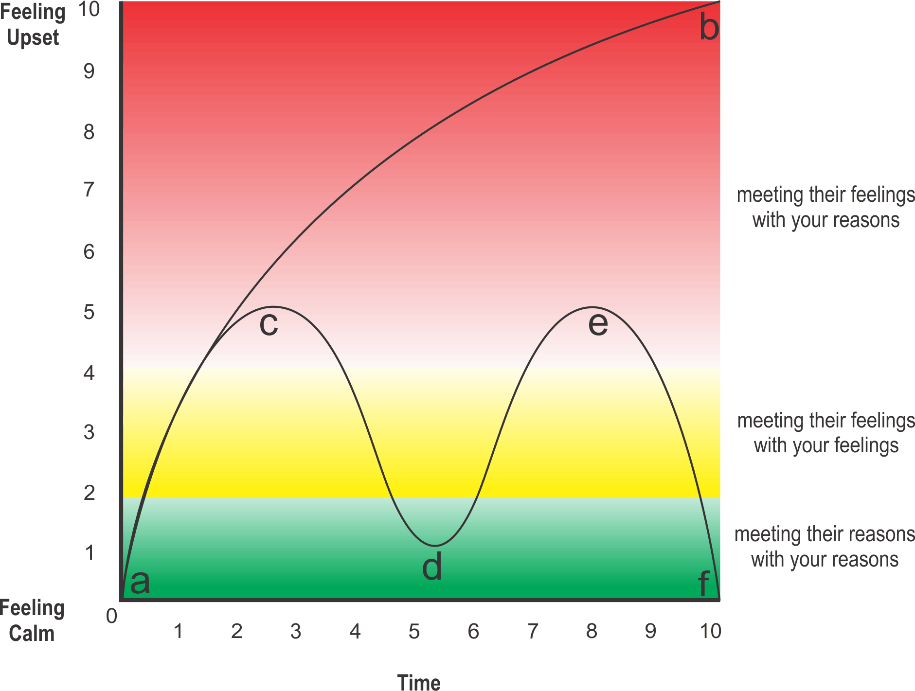
Effectively Expressing conflict –
feelings to feelings and reasons to reasons
55

Slide 56
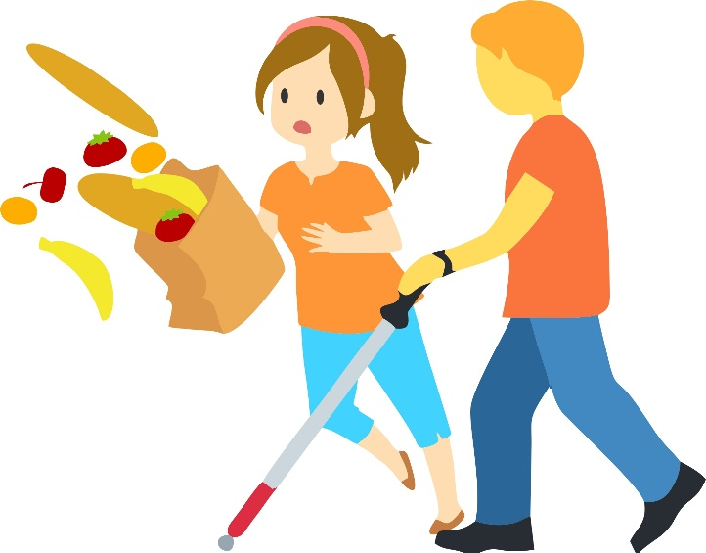
56

Slide 57
The Human Predicament
Most people go through their entire life being caught in, identified with, directed by their thousands of body, feeling and thought (BFT) reactions each day that pop in from their unique PFP programming.
When mindless, we have relatively little influence in developing or managing our PFP.
When we are mindful we have options.

Slide 58


JJanuary 11, 2016
Breaking Out of PFP Prison
Is An Inside Job
Consciousness/Mindfulness
Session 2 - Resource 2
Notes:
Notes:

Slide 59
JJanuary 11, 2016
The VERY, VERY GOOD NEWS
The Power/Influence of Negative PFP Programming can be significantly Reduced as a result of becoming more Mindful/Conscious.
Mindfulness actually rewires the Brain's ‘Live’ Drive Modules like the Medial Prefrontal Cortex to give 5 ways to Prevent and Eliminate Emotional Hijacks and enhance our capacity to make better choices.
Notes:
Notes:

Slide 60

B-FIT
MINDFULNESS
it’s not what you think

Slide 61
Write Your Signature
Notes:
Notes:

Slide 62


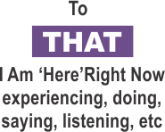
Being Ahh-llowing* of and Paying Attention:
Practical Outcomes Guaranteed
• fewer emotional hijacks,
less intense and quicker recovery
• more experiences of happiness,
more intense, last longer
• measurable growth of
unconditional compassion
• increased intentional skills
• increased entrainment
skills
TO HOW SENSES ARE PERCEIVING WHAT IS HAPPENING
*Ahh-llowing is to be subjectively/internally accepting of what B-FIT is doing moment by moment. It starts as an intended ‘let it be’ attitude of one’s inner world with a simultaneous passionate commitment to change objective/outside reality as useful.
THOUGHTS
Notes:
Notes:

Slide 63

Looking with greater clarity
The Mindfulness microscope reveals a more complete and accurate experience of one’s B-FIT senses, perceptions and misperceptions.
Complete the B-FIT Mindful Exercise
Notes:
Notes:

Slide 64
Mindfulness Exercise Debrief
What was your Predominant Experience of Thinking - Image or Talk? Conclusion? You are not your thoughts or feelings.
What happened when you just noticed a thought?
Did you feel relatively calm? This means Set Point movement of the Parasympathetic Nervous System and Vagus Nerve activation = Unconditional Compassion-after 25 hours some of the PNS stays turned on.
Feelings – ‘There is’ versus ‘I am’.
Mindfulness exercise reference www.centreforconsciouscare.ca Audio Resources,
Spotify Link ‘Stealing Happiness from Life’ – A Centre for Conscious Care
Military 211
Notes:
Notes:

Slide 65
The following 5 Ways are How We Accomplish Radical Changes to Nature, Nurture and Normal’s Nasty PFP Programming
B-FIT Mindfulness has been specifically designed to interrupt this authoritarian regime’s power in the following 5 ways:
A reminder of being in prison:
Firstly, mindfulness reminds us that our Mind has a Mind of its own and that when we are only semiconscious (like how we drive our car), our PFP (not mindful us) is making many poor choices.
Notes:
Notes:

Slide 66
  Awareness right now of More Optimal Responses: The ‘mindful me’ has a much greater likelihood of not being as semiconsciously driven to behave in accordance with PFP Programming initial thoughts’ and feelings’ directives.
The more conscious we become in the moment, we immediately ‘rethink’ more optimal responses than initially offered by PFP.
I call this the Catch, Calm and Clarifying process.
Notes:
Notes:

Slide 67
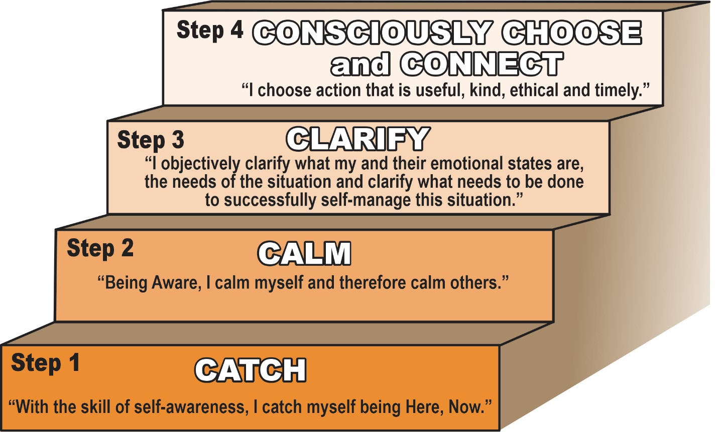
67

Slide 68
No matter what situation presents itself, from fun to fear, in order to respond optimally you will learn how to follow these steps:
CATCH our self being here, in the moment with awareness and ahh-llowing (Tool #3).
If applicable, we then become aware of getting stressed, impatient, angry and move into a CALMING strategy (applying for example the Awareness-Based Calming strategies outlined in Appendix 4).
Just catching ourself starts the process of calming.
68

Slide 69
Now we CLARIFY the needs of the situation. What is happening? Should I back off? Should I say something useful, ethical, timely and kind? Should I be empathetic because they are upset? What is the best way to meet their needs and mine?
Now and only now can you CONSCIOUSLY CHOOSE (i.e. actually have some relative control to not be driven by the PFP thinking process) and CONNECT in the most helpful ways.
69

Slide 70
How You Will Learn to Break Free of PFP Prison
• Become aware of the fact that you are here NOW;
• Become aware of what you are doing, saying, feeling and thinking NOW;
• Become aware of your body sensations, feeling and thought reactions;
• Deliberately self-talk conscious positive intentions, e.g. “may we be at peace now.”
When we fully and consciously connect as described above, we move beyond what our survival reactive senses tell us to a place of stillness, wisdom and compassion.
70

Slide 71
Social and neurosciences are clear that our happiness is in great part dependent on how often and how completely we give and share our time and resources with others. Research on the science of happiness shows that it is very much dependent on mindfully:
Being useful, ethical and kind to others (even strangers).
Being grateful for what we have.
Having healthy physical habits (breathing, nutrition and exercise) and
Offering unconditional compassion and help to others as applicable.
Ben, Me, and Me – Self-Management and the 5 ‘C’s
71

Slide 72
Upgrade the Live-Drive:
As we mature to B-FIT wisdom and kindness and intrapersonal skills, the PFP live-drive seems to be upgraded to a more complete version (i.e. me version 2.0) so even the PFP autopilot thoughts, feelings and actions are now more aligned with the more conscious ‘ideal self’ me.
Notes:
Notes:

Slide 73
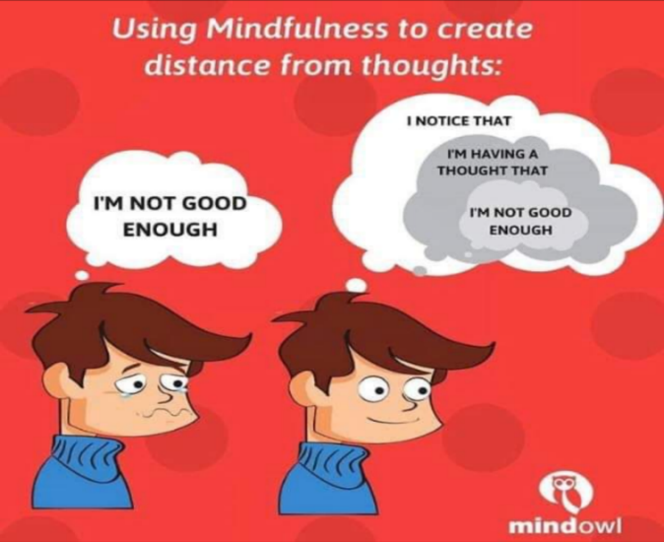
4. Those Thoughts and Feelings Are Not Me:
  As we are ‘just naturally’ more and more mindful, the ‘Mindful Me’ (witness, noticer, observer), less and less identifies with ‘the’ thoughts and feelings as ‘me’.
  This results in consistently manifesting our highest level of Competence, Calm and Care for all others.
Notes:
Notes:

Slide 74
5. Wisdom and Authentic Kindness:
With sufficient:
    Time
    Focus
    Sensory clarity
    Ahh-llowingness
B-FIT starts to self-organize into flowing ‘emerging’ wisdom and ‘usness’ authentic kindness.
Consider the following…
Notes:
Notes:

Slide 75
“From a mindful centre we can respond instead of react. Unconscious reactions create problems.
Mindful responses bring peace.
Whatever happens can be met with wisdom and compassion.”
Jack Kornfield
Notes:
Notes:

Slide 76
WE MUST LEARN TO……
Be Self-Aware e.g. Mindful and Intentional in the Moment to:
Know/realize that you are here now.
Experience Thoughts and Feelings as messages – not you.
Ahh-llow Thoughts and Feelings to come and go and not drive and distort your subjective experiences.
Ensure emotional self regulation regardless of Thought content.
Be unconditionally compassionate – regardless of how you are Feeling.
Notes:
Notes:

Slide 77

Practise
Practise
Practise

Slide 78
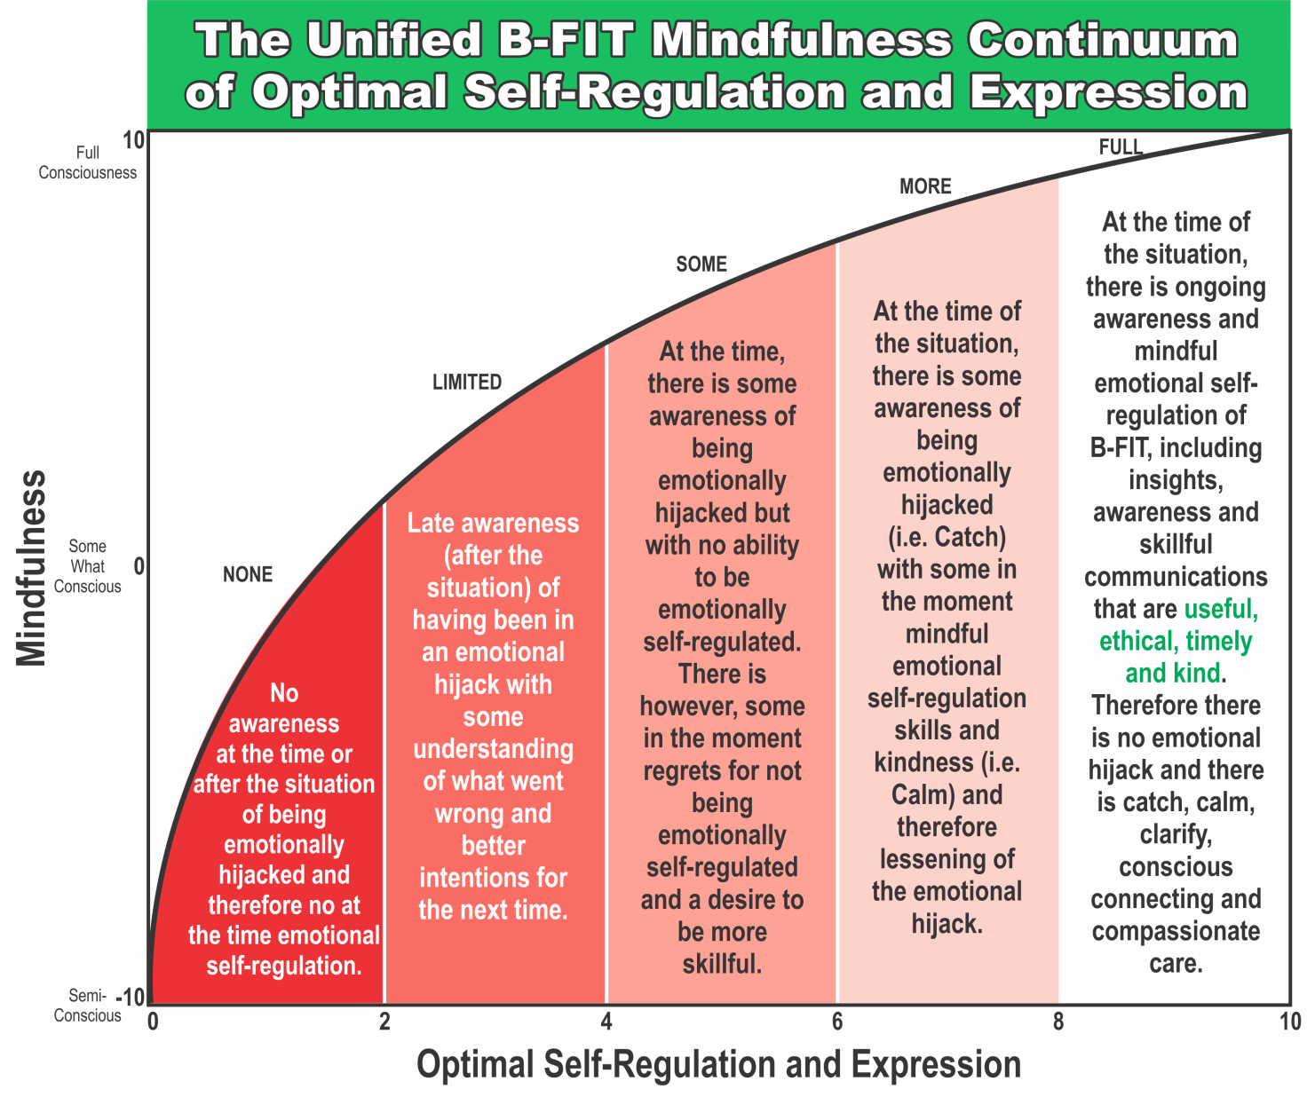
JJanuary 11, 2016

Slide 79
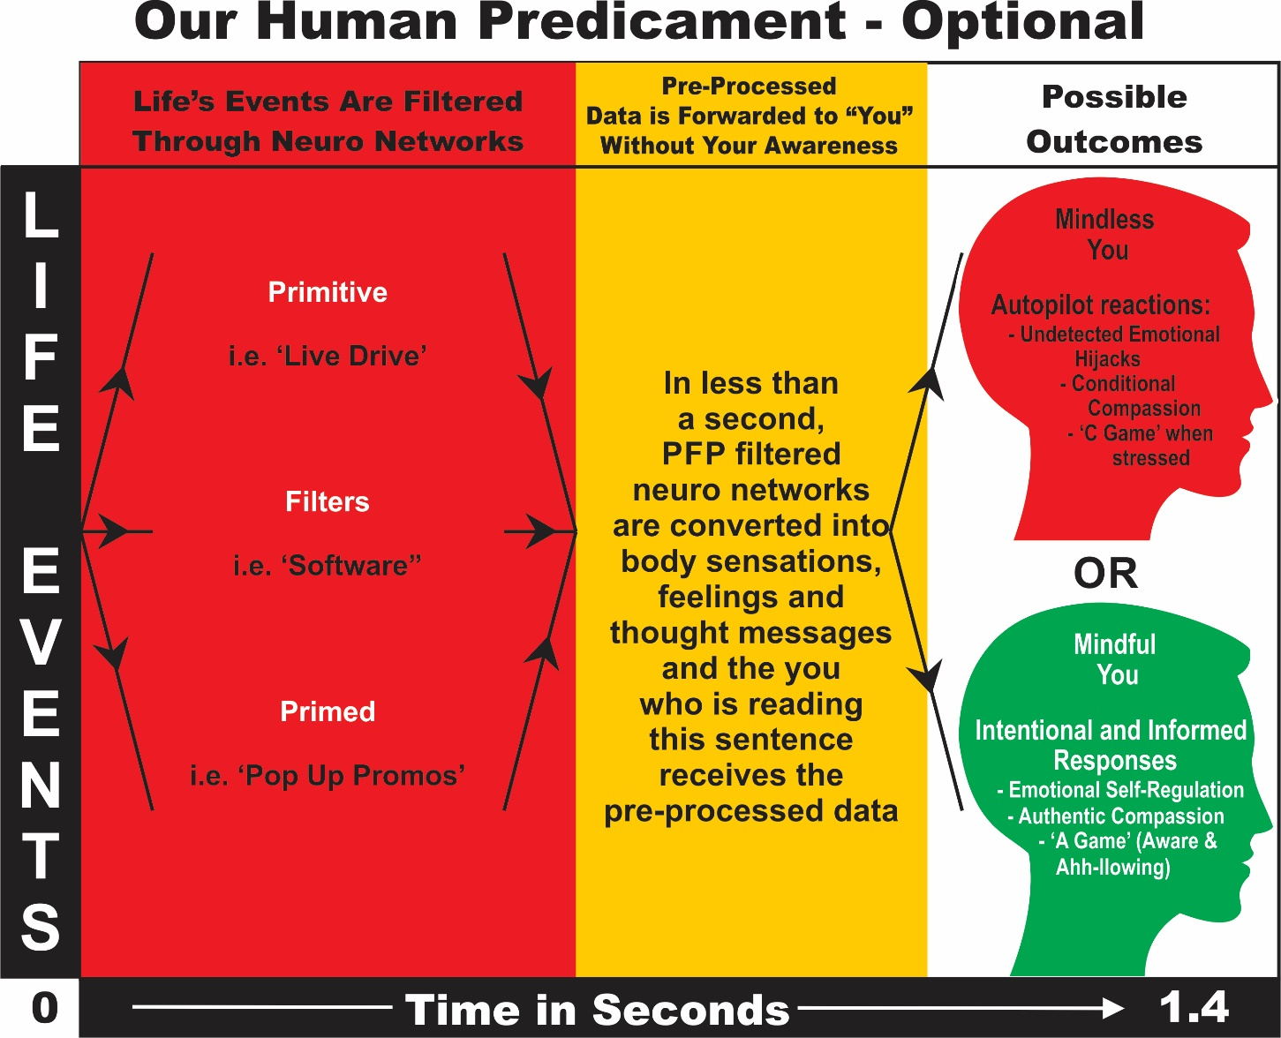
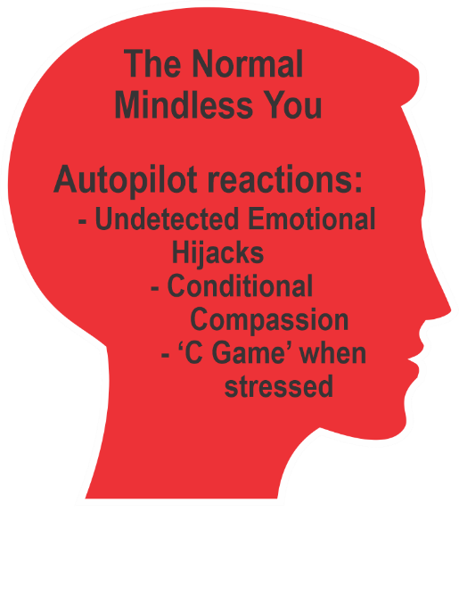
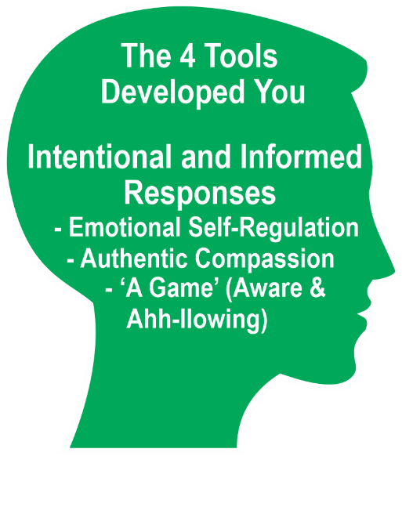

Slide 80
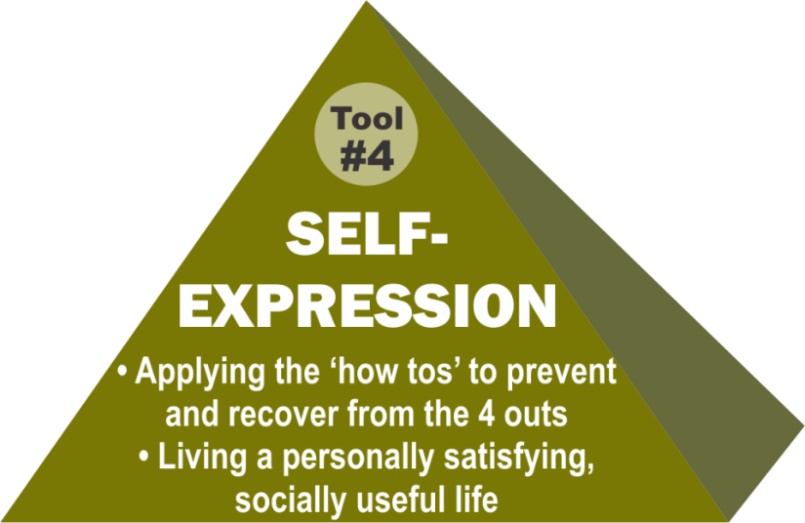
Self-Expression
The fourth and last tool on the pyramid is Self-Expression.
Simply put, this is bringing our best self, our A-Game, to whatever we do and say.
Not driven by the 4 outs of burn-out, tune-out, freak-out and space-out.
All speech and actions spontaneously become useful, ethical, kind, and timely.

Slide 81
Rid the Weeds that Kill Good Seeds in Life’s Garden –
Indecision – get down off the fence. Even the wrong side is better because you will learn sooner what you must do;
Self-Doubt is in part a lack of awareness. Process it with mindfulness.
Substitute worry with good activity. New behaviour almost always changes moods.

Slide 82
Rid the Weeds that Kill Good Seeds in Life’s Garden –
Overcaution: take justified risks and process your reactions skillfully.
Pessimism: “As you think, so you will become” beliefs – muscle testing.
Avoid passive hope –“Maybe it will get better”. Avoid happy hope – “It’s not great, but it’s okay”.
Monitor your use of social media. Stand guard at the doorway of your mind: garbage in, garbage out.

Slide 83
“From a mindful centre we can respond instead of react. Unconscious reactions create problems.
Mindful responses bring peace.
Whatever happens can be met with wisdom and compassion.”
Jack Kornfield
Notes:
Notes:

Slide 84
WE MUST LEARN TO……
Be Self-Aware e.g. Mindful and Intentional in the Moment to:
Know/realize that you are here now.
Experience Thoughts and Feelings as messages – not you.
Ahh-llow Thoughts and Feelings to come and go and not drive and distort your subjective experiences.
Ensure emotional self regulation regardless of Thought content.
Be unconditionally compassionate – regardless of how you are Feeling.
Notes:
Notes:

Slide 85
Start Your Heart – Money Back Guarantee
As a result, happy and fulfilling and compassionate times can be more often, more intense and last longer
and
Times of suffering such as emotional hijacks and power struggles can be less frequent, less intense and recovery time will be quicker.
Notes:
Notes:

Slide 86

JJanuary 11, 2016
Compassion appears as selfless service, yet in mindful care and support we do not serve the other; we serve “us”. Compassion’s communion brings us together in a whole. It does not see the world’s pain and sorrow as other, it is shared, and it is ours. When we allow our shared vulnerability and humanness, our compassion is as natural as our breath and without hesitation we act to help.
Thich Nhat Hanh
Notes:
Notes:

Slide 87
Think Big but Start Small
and Do Small Everyday
87

