Slide 1

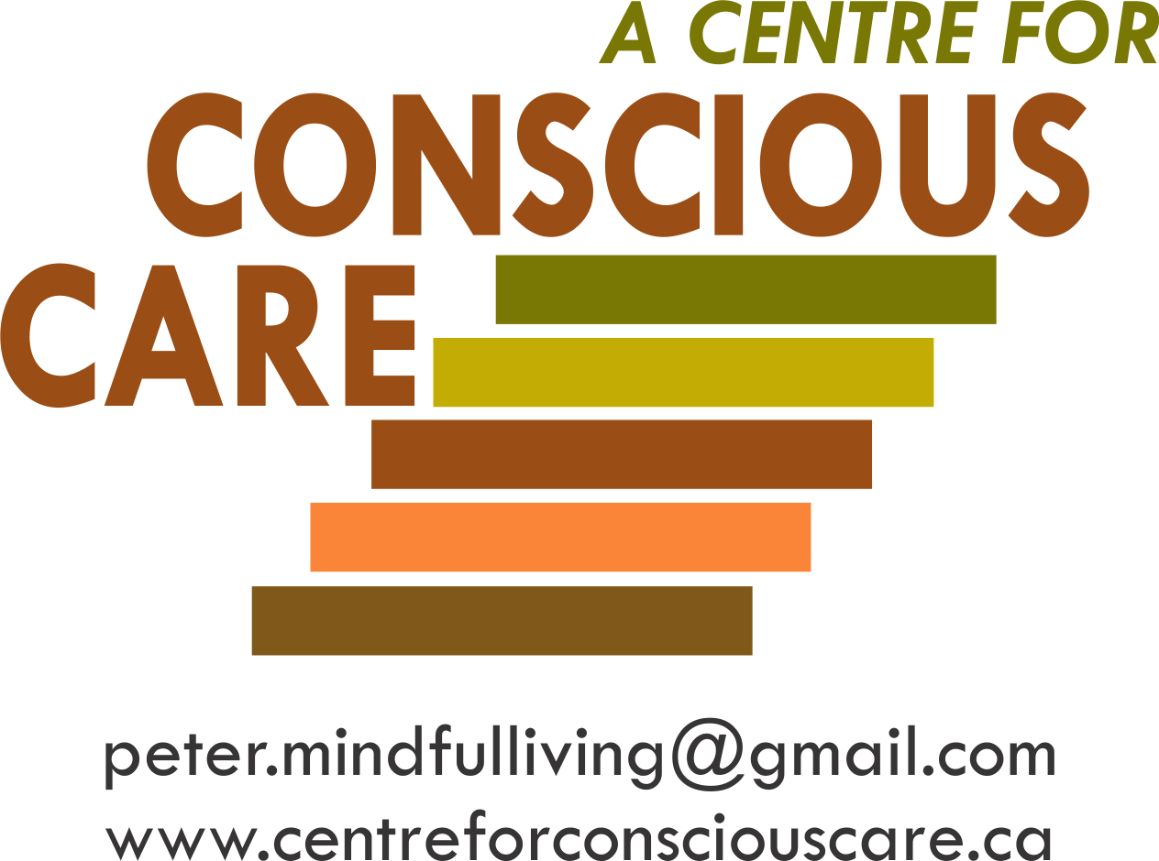
Conscious Care and Support
Developing
Emotionally Self-Regulated & Kind Supporters
Facilitating
Comprehensive Biomedical Support & Treatment
Orientation
Notes:
2 mins
Welcome and Introductions
Introduction of Instructors.
Quick overview of what brings you here today and Icebreaker for class participants, if applicable.

Slide 2
JJanuary 11, 2016
Contributors to Conscious Care and Support
Conscious Care and Support has been developed while supporting, training or in direct consultation with:
Approximately 3,000 Moms, Dads, and Support Professionals.
Dr. John Ratey, Associate Clinical Professor of Psychiatry at Harvard Medical School (reference 8 books on mental health and autism and other developmental disabilities including ‘Spark’ and ‘Shadow Syndromes’).
Dr. Theresa Hamlin, Associate Executive Director of The Center for Discovery and her staff. Dr. Hamlin is the author of ‘Autism and the Stress Effect’.
Dr. Martha Herbert, Assistant Professor of Neurology at Harvard Medical School and a Pediatric Neurologist at Massachusetts General Hospital, where she is Director of the Transcend Research Program. She sits on the Scientific Advisory Committee for Autism Speaks (reference ‘The Autism Revolution’).
Dr. Shinzen Young, Mindfulness Research Consultant, Harvard Medical School.
Universities of Toronto and Western Ontario/London Health Sciences Centre and Centre for Addiction
and Mental Health (CAMH)
Notes:
2 minutes
Review Slide
Overall, CCS is Based on the Consensus of Relevant Internationally Published Research in the Sciences of:
Humanistic Psychology
Social Neurobiology
Integrative Biomedicines, e.g. GI, Sensory, Energy
Developmental Cognitive Neuroscience
Electromagnetic Fields (EMF)
B-FIT Mindfulness
Emotional Freedom Therapy (EFT)
Behavioural Analyst Certification Board (BACB)
Reference 3.02 and 4.07A
3.02- seek consultation if possibly behaviours are biological or medical in nature
4.07 –if conditions present implementation of a plan to be less than optimal or plan cannot be implemented to its effectiveness, consultation of other professionals should be sought out to help.

Slide 3
January 11, 2016
Contributing and/or Trained Organizations & Agencies
Autism Ontario
Community Living Ontario
L’Arche Daybreak
OASIS (Ontario Agencies Supporting Individuals with Special Needs)
Community Living Windsor
Community Living Cambridge
Rygiel Supports for Community Living
Community Living Oakville
London Health Sciences Centre
Kerry’s Place
Ministry of Education Special Needs Division
Ongwanada
Participation House
Jeder Group (NSW, Australia)
Community Living Trent Highlands
Community Living Owen Sound & District
Durham Association for Family Respite Services
Christian Horizons
Community Living Burlington
Parents for Community Living
Extend-A-Family Toronto and Waterloo
Community Living Walkerton and District
Community Living Welland Pelham
Community Living St. Marys and Area
Community Living Chatham-Kent
Community Living Stratford and Area
Windsor-Essex Family Network
Community Living Prince Edward

Slide 4

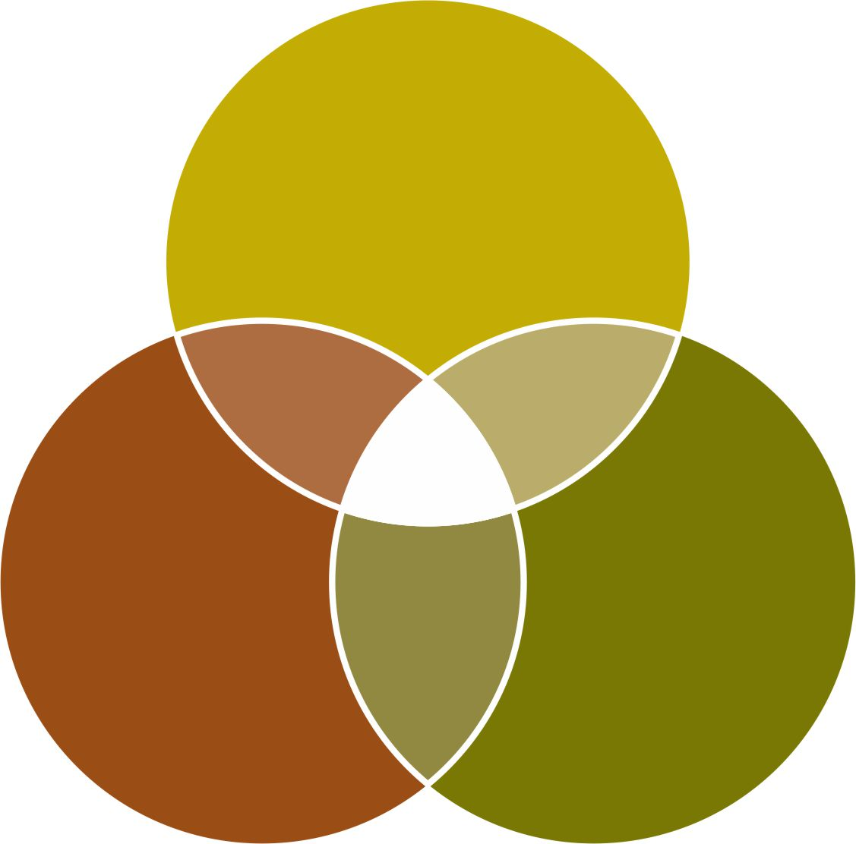
To Consistently Deliver Optimal Support – The Supporter Needs
Three Key Professional and Intrapersonal Qualities
Conscious
and Caring
Emotional
Self-Regulation
OPTIMAL
SUPPORT
Knowledge
and
Understanding
of Best
Practices
Competent
Services
Delivery
Process
Notes:
1 minute
Read Slide
Review 2 Main Pillars of Model
First Pillar
Optimal Supports for Wellness (looking deeper to complement and complete best practices).
Second Pillar
Development of the skills of emotional self-regulation, authenticity, compassion and kindness of the supporter

Slide 5
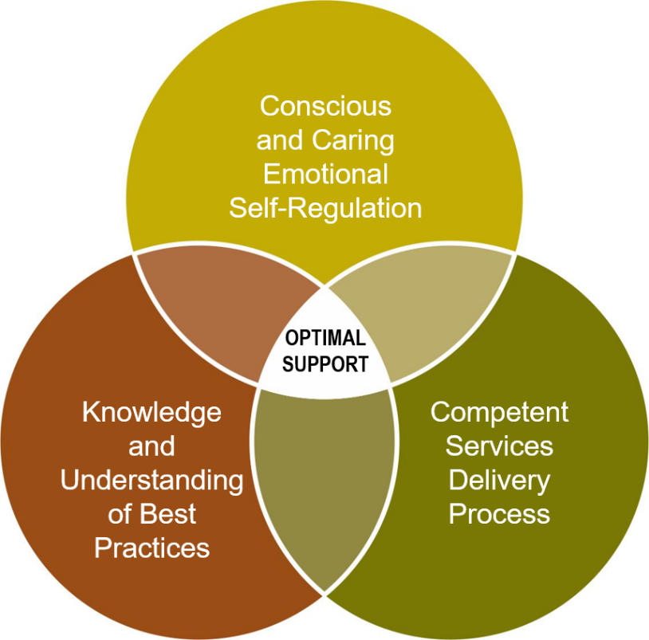
JJanuary 11, 2016
PART 1- Knowledge and Understanding
of Best Practices
The Hierarchy of Special Needs to Facilitate Optimal Well-being

Slide 6

Physical and
Emotional Well-being
Environmental – supporter’s accommodations,
behaviour (ABA learning), social interactions and
contributing to others’ wellbeing
Toward A More Complete Understanding
The Hierarchy of Special Needs to Facilitate Optimal Wellbeing
Sensory integration and processing
Human energy system – building, balancing and protecting from wireless radiation and electromagnetic fields (EMF)
Brain development, coherence balancing and inflammation regulation
Emotional Wellness:
• mental and neurological health and
disorders’ treatment
• trauma desensitization and triggers’ elimination
• psychological wellbeing
• medication side effects
• ABA behavioural interventions
Gastrointestinal (GI), bowel, digestive and immune systems’ treatment, nutrition, pain management, dental and myofunctional disorders, illness prevention and treatment
Awareness-based calming and de-escalation skills offered by mindful, emotionally self-regulated and kind supporters

Slide 7
Physical and
Emotional Well-being
Toward A More Complete Understanding
of the Hierarchy of Special Needs to Facilitate Optimal Well-being
Gastrointestinal (GI), bowel, digestive and immune systems’ treatment, nutrition, pain management, dental and myofunctional disorders, illness prevention and treatment

Slide 8
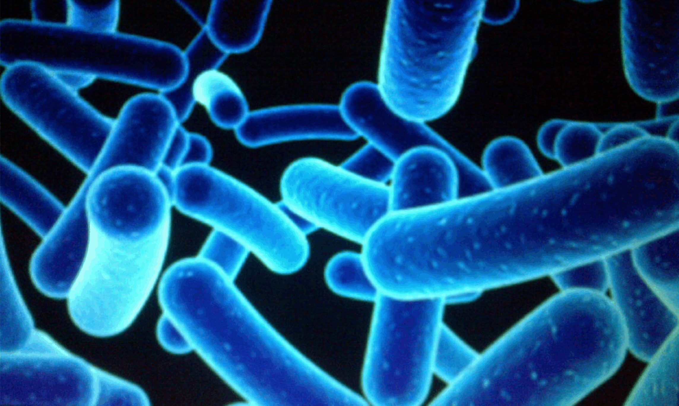
January 11, 2016
Needs for GI and Bowel Management and Holistic Treatment
Distressed Gut Microbes – produce Mind/Body Agitation, Pain and Anxiety which often leads to aggression.
1% Human
99 % Bacterial and Fungal
Some Microbes found in the gut of individuals with Autism, when introduced into healthy rodents, create numerous Autistic like symptoms.
e.g.
  Repetitive expressions of behaviours
  Social aversion
  Easy to startle
(Reference: Dr. Derrick MacFabe, The University of Western Ontario)
(Young, E. - I Contain Multitudes, pages 69 & 70)
Notes:
3 minutes
Review slide
Kilee Patchell Evans Institute- London, ON
McFabe (2014)- rodents ingest PPA and give birth to pups with top signs of autism
Yong (2016) PPA from stool sample of ASD, autism symptoms became noticeable and then after a while disappeared
PPA in guts of people with ASD are three times stronger- neurotypical we have 3 families, ASD has nine families
Suggest the Nature of Things Documentary titled The Autism Enigma for people to learn more about the work of McFabe and the brain gut connection.

Slide 9
Microbes, Anxiety and Aggression
Chronic anxiety means excessive toxic cortisol in the body. To neutralize this toxin, the body uses up basic building blocks like amino acids that are needed to:
  digest food
  build the immune system
  produce calming neurotransmitters
  This depletion causes anxiety leading to aggression
Notes:
1 minute
Read slide
Discuss the brain-bowel connection and how distressed microbes can lead the biological system into an anxious state.

Slide 10
CCS GI and Bowel Management and Holistic Treatments
Engage a qualified holistic GI specialist, e.g. qualified and available MD, ND or nutritionist who will, for example:
Complete a comprehensive biomedical assessment e.g. Organic Acid Test
Remove food toxins/allergens and metals
Balance minerals, vitamins and neurotransmitters
Implement holistic bowel management
Optimize nutrition
Notes:
3 minutes
Read Slide

Slide 11
Physical and
Emotional Well-being
Toward A More Complete Understanding
of the Hierarchy of Special Needs to Facilitate Optimal Well-being
Brain development, coherence balancing and inflammation regulation

Slide 12
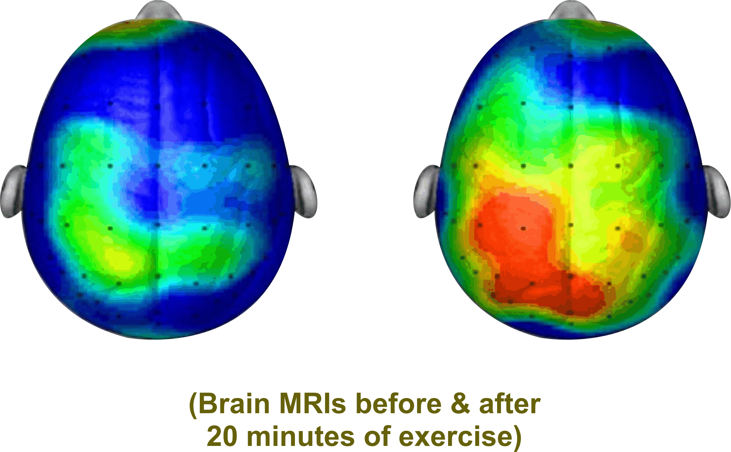
Brain Coherence
i.e. Many Parts of the Brian ‘Talking’ to Each Other
“Like you, I need to be able to understand and process information”. This requires optimal Brain Functioning e.g.
        neurogenesis (new neurons)
        neuroplasticity (more complete neuro networks)
        neuro electrical stimulation (brain firing)
        neurochemicals production (endorphins, dopamine, serotonin, oxytocin)
        Hertz e.g. Beta, Alpha, Theta, Delta
Notes:
3 minutes
Review Brain Coherence illustration
Typical brain runs at 25 Hz of energy for processing
Atypical brain runs at 17Hz much like how we feel when we first open our eyes after sleeping.
Often people will aggress to raise the level of brain energy or, they can activate the cerebellum through activities of bouncing and balancing.
Reference work of John Ratey, SPARK that speaks to exercise and revving up the brain to increase coherence.
When activities are in engaged that stimulate the above considerations, improve levels of anxiety and agitation can occur leading to improved quality of life.
Reference:
N. Doidge – The Brain’s Way of Healing
D. Siegel – The Mindful Brain
D. Eagleman – The Brain

Slide 13
c
CCS Brain Coherence, Balancing & Inflammation Regulating Interventions
Connect with a biomedical practitioner to address:
  Enhance essential brain calming elements e.g. GABA, Serotonin, PPA
  Balance anxiety producing vitamins and minerals e.g. Magnesium, Vitamin B6, B12
  Maintain adequate glutathione levels to prevent brain inflammation e.g. NAC
  Optimal Nutrition
Cerebellum Activation e.g. 20 minutes of bouncing and balancing
Keep the Mitochondria Cell System Healthy:
  Mitochondria are known as the powerhouse of each cell
  They give cells their energy to do their work such as maintaining
  healthy brain functioning
Notes:
2 minutes
Read Slide
Controllable Mitochondria Killers:
Sugar and Simple Carbohydrates
Oxidative Stress causing Brain Inflammation – low glutathione
Medications such as Antibiotics and Antipsychotics
Vitamins and Minerals Imbalance – low B vitamins, folic acid, magnesium, vitamin D

Slide 14
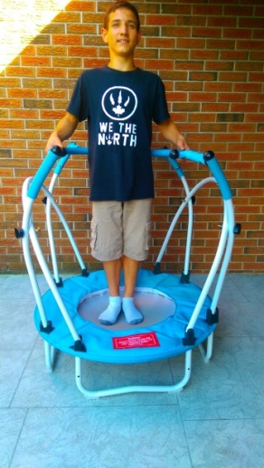
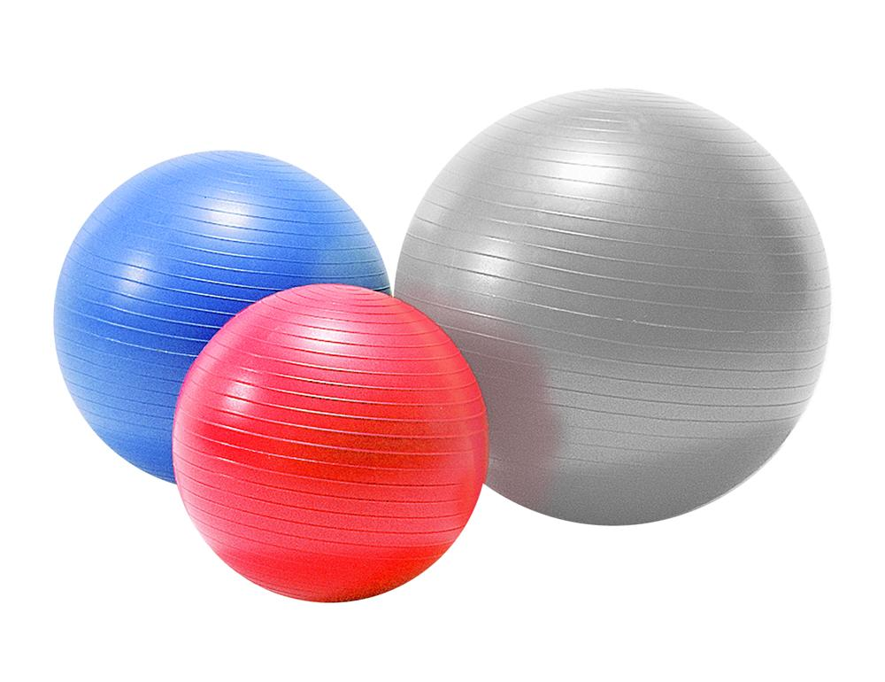
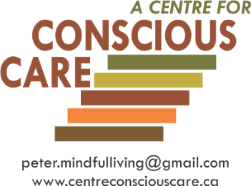
Cardio Exercise:
Cardio exercise, especially bouncing and balancing, increases brain wave activity (e.g. cerebellum) to give better brain coherence for optimal functioning.
Improved coherence results in thoughts becoming more organized and focused.
This results in less fear and therefore more calm.
stabilization balls
and elliptical stabilization cushions
Notes:
1 minute
Read Slide

Slide 15
Physical and
Emotional Well-being
Environmental – supporter’s accommodations,
behaviour (ABA learning), social interactions and
contributing to others’ wellbeing
Toward A More Complete Understanding
of the Hierarchy of Special Needs to Facilitate Optimal Well-being
Sensory integration and processing
Human energy system – building, balancing and protecting from wireless radiation and electromagnetic fields (EMF)
Brain development, coherence balancing and inflammation regulation
Emotional Wellness:
• mental and neurological health and
disorders’ treatment
• trauma desensitization and triggers’ elimination
• psychological wellbeing
• medication side effects
• ABA behavioural interventions
Gastrointestinal (GI), bowel, digestive and immune systems’ treatment, nutrition, pain management, dental and myofunctional disorders, illness prevention and treatment
Awareness-based calming and de-escalation skills offered by mindful, emotionally self-regulated and kind supporters

Slide 16
JJanuary 11, 2016
PART 2- Conscious and Caring
Emotional Self-Regulation
Building Key Intrapersonal Skills

Slide 17
JJanuary 11, 2016
How often do power struggles compromise the quality of the supported person’s well-being?
It appears that a minimum of 40% of incident reports based
on challenging expressions of behaviour result from or are
significantly influenced by generally good and caring
supporters’ unintended and unaware loss of mindful
emotional self-regulation. This often results in power
struggles and other supporter induced antecedents.
Notes:
1 minute
Read slide

Slide 18
Why might the average good and caring supporter become emotionally hijacked into power struggles that can cause challenging expressions of behaviour in the person being supported?
Notes:
Read Slide

Slide 19
11, 2016
The 4 Outs
Tune-out is typically how the
Spaced-out Supporter
Protects themself from
Burn-out and Freak-out
Notes:
1 minute
Read Slide
Review how many of us mindlessly go through our day affected by the 4 outs:
Burn Out-e.g. unfulfilled, worried, anxious, depressed, irritable
Freak Out-e.g. emotional hijacks (passive or active), unkind
Tune Out-e.g. indifferent, bored, uncaring
Space Out-e.g. mindless, unaware

Slide 20
Loss of Emotional Self-Regulation of Good and Caring Supporters Can Result in Some of the Following:
being impatient and becoming emotionally hijacked into power struggles (i.e. silent temper tantrums or anger);
being self righteous, judgmental, critical and unforgiving;
being generally indifferent to some supported persons’ suffering;
being overtaken by 1 of the 4 outs – (Burn-out, Freak-out, Tune-out, Space-out);
the physical redirect/restraint that is executed mindlessly, mechanically and without compassion;
the closed, “whatever,” attitude that shows on the face of the supporter as they hear the same story over and over again;
the powerful enforcing of ‘unnecessary rules’.
Notes:
2 minute
Read Slide
In the absence of staying dedicated to an internal growth process of mindful, emotional self-regulation, you will pretty much remain ‘normal’ and always be at significantly greater risk to the 4 Outs

Slide 21
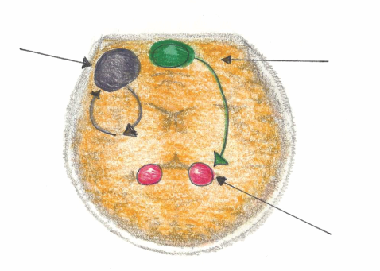
JJanuary 11, 2016
Mindful Emotional Self Regulation
The main way we can consciously access the emotional brain is through self awareness*, i.e. becoming mindful. Mindfulness increases connections in the medial pre-frontal cortex. This reduces anxiety for the Supporter and the Person Supported.
Dorsolateral pre-frontal Cortex
Working Memory
Medial pre-frontal Cortex
(part of the brain that notices what’s going on)
Amygdala
(*Research reference: J. LeDoux, “Emotion Circuits in the Brain”, Journal of Neuroscience 33, no. 9 (2013) 3815-23)
Notes:
3 minutes
MPFC is activated when things get personal, or when feelings are involved
MPFC is also connected with our limbic system (fight, flight or freeze) , our amygdala which fires twice a second to make that we are safe.
MPFC acts as a big brother or sister and checks in with the amygdala to keep as regulated without need to go into fight flight or freeze.
If a person has an underactive MPFC, anxiety often results. An underactive MPFC means that the person doesn’t experience the calming of the amygdala.
Increasing activation of MPFC is strongly influenced by exercises that develop self-awareness.
Mindfulness (knowing what is happening when it’s happening) grows neurons in the MPFC.

Slide 22
JJanuary 11, 2016
According to many published Neuroscientists, including Dr. Daniel Siegel (UCLA) in his book called The Mindful Brain (page 42 and 43) the following brain, body and being functions correlate with the activity of medial areas of the prefrontal cortex:
1. Body regulation – the emotional brakes and accelerator functions.
2. Attuned communication involves the coordination of the input from another person with the activity of one’s own (as with mirror neurons).
3. Emotional balance to have enough activation so that life has meaning and vitality but not so much that life becomes chaotic.
4. Response flexibility is the capacity to pause before action.
5. Empathy – knowing what might be going on inside someone else.
6. Insight or self-knowing awareness to be able to link the past, present and future.
7. Fear modulation that may be carried out by the release of the inhibitory neurotransmitter GABA.
8. Intuition – a neural mechanism by which we process deep ways of knowing via our body i.e. ‘somatic intelligence’.
9. Morality – taking into consideration the larger picture, to image what is best for the
whole not just one’s self, even when alone.
Notes:
3 minutes
What fires, wires….what fires wires.
Siegel, 2007 determined that we can develop mindful awareness and grow new neurons in the MPFC.

Slide 23

JJanuary 11, 2016
B-FIT
MINDFULNESS
it’s not what you think
Notes:
Read Slide Title

Slide 24
How to Escape from
the ‘Dog Eat Dog’ World
If you can always be cheerful, ignoring aches and pains;
If you can resist complaining and boring people with your troubles;
If you can understand when your loved ones are too busy to give you any time;
If you can take criticism and blame without resentment;
If you can relax without alcohol;
...Then You Are Probably ...........
Notes:
1 minute
Read Slide

Slide 25

The Family Dog!
Notes:
Show Slide

Slide 26
Our Human Predicament and Potential
We human folks are different from other animals with whom we share this planet.
This is because we have the potential to be conscious. This is to know that we are here and as a result can make choices that your average dog likely can’t.
Become aware that you are listening to me right now. Let’s call this being somewhat more conscious.
Notes:
1 minute
Read Slide

Slide 27
Write Your Signature
Notes:
1 minutes
Write Your Signature Exercise
Firstly, have each person write their signature down how they normally would
Secondly, have them write their signature with their non-dominant hand
Thirdly, have them write their signature with their non-dominant hand and ask them to become aware of what they are doing.
Encourage they say to themselves “I am aware of writing with my non-dominant hand”
Explain that this exercise parallels the action of becoming more mindful/conscious
Semiconscious (the auto pilot experience of writing the signature normally)
Beginner’s mind/ More conscious (writing with your non-dominant hand)
Fully Conscious (writing with non-dominant hand but also being aware that you were doing it)

Slide 28


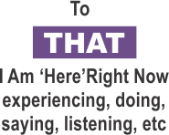
Being Ahh-llowing* of and Paying Attention:
Practical Outcomes Guaranteed
• fewer emotional hijacks,
less intense and quicker recovery
• more experiences of happiness,
more intense, last longer
• measurable growth of
unconditional compassion
• increased intentional skills
• increased entrainment
skills
TO HOW SENSES ARE PERCEIVING WHAT IS HAPPENING
*Ahh-llowing is to be subjectively/internally accepting of what B-FIT is doing moment by moment. It starts as an intended ‘let it be’ attitude of one’s inner world with a simultaneous passionate commitment to change objective/outside reality as useful.
THOUGHTS
Notes:
3 minutes
Explain that B-FIT is a set of intrapersonal tools to help develop capacity to be conscious (more fully awake) as much as possible.
Overview the skill set incorporating different areas of awareness:
Notice What You Are Saying/Doing
Notice That You Are Saying/Doing
Notice B- Body sensations
Notice F- Feelings
Notice I- Image Thoughts
Notice T- Talk Thoughts
Discuss subjective ahh-llowingness:
While we become aware, we still work passionately to change what we can objectively to make life better for others.

Slide 29

Looking with greater clarity
The Mindfulness microscope reveals a more complete and accurate experience of one’s B-FIT senses, perceptions and misperceptions.
Complete the B-FIT Mindful Exercise
Notes:
6 minutes
Read Slide
Walk group through a 3 minute BFIT Mindfulness exercise
Refer to CCS Textbook (pgs. 266-267)
Debrief exercise with group referring to slide 31

Slide 30
Mindfulness Exercise Debrief
What was your Predominant Experience of Thinking - Image or Talk? Conclusion? You are not your thoughts or feelings.
What happened when you just noticed a thought?
Did you feel relatively calm? This means Set Point movement of the Parasympathetic Nervous System and Vagus Nerve activation = Unconditional Compassion-after 25 hours some of the PNS stays turned on.
Feelings – ‘There is’ versus ‘I am’.
Mindfulness exercise reference www.centreforconsciouscare.ca Audio Resources
Notes:
5 minutes
You are not your thoughts.
There was a part of you that was able just to label the thought instead of being gripped by its content.
What happened when you noticed a thought?
It left…or burst into another thought…or just dissolved
Thoughts are thought molecules. There is only finite amount of energy to hold onto a thought. When we can build our skill set, we notice that thoughts are not unlike any other message from our sense stores. We have the capacity to not be gripped our thoughts—especially our less than optimal ones.
Did you feel relative calm?
Activated the MPFC and vagus nerve.
Feelings- There is vs. I am
Similar to our thoughts. Our feelings are just like any other message from our sense stores. We have the capacity not to be so gripped by our feelings- our emotional hijacks of fear, anger or indifference.

Slide 31
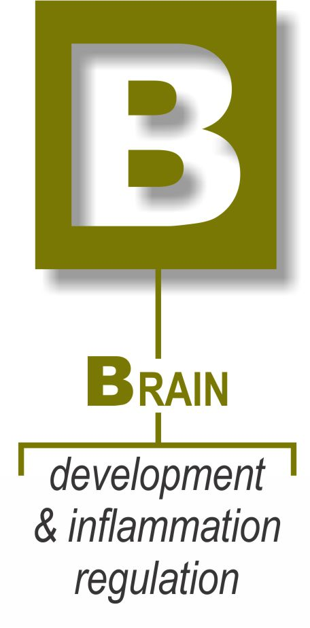
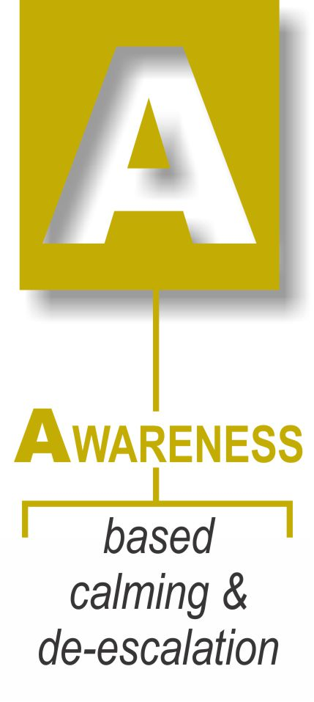


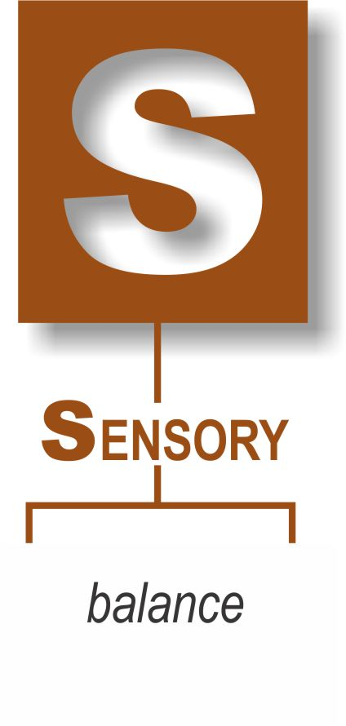

Summing It Up
for
Well-being
Notes:
1 minute
Review Slide

