Slide 1

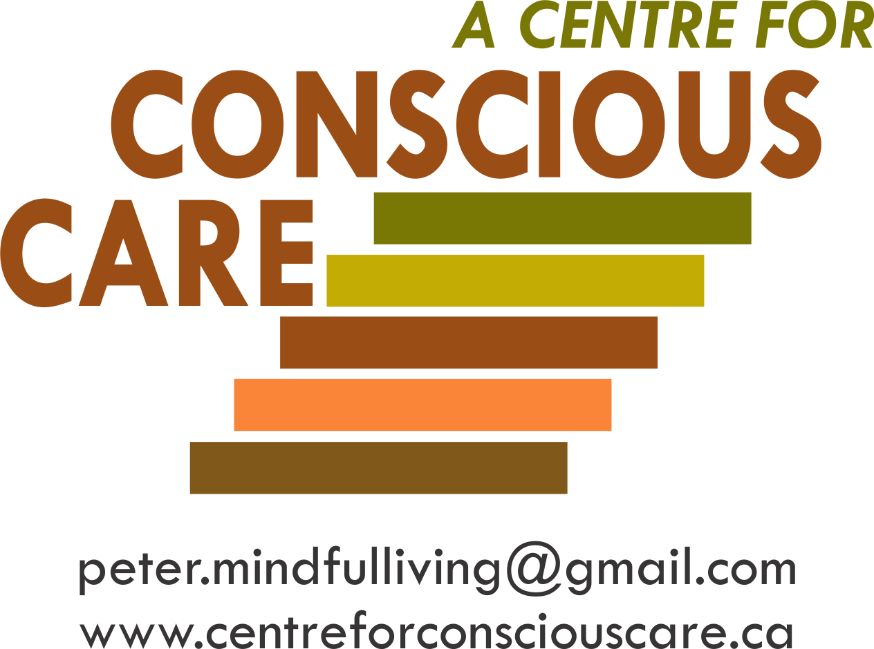
Developing
Emotionally Self-Regulated & Kind Supporters
Facilitating
Comprehensive Biomedical Support & Treatment
Notes:
2 mins
Welcome and Introductions
Introduction of Instructors.
Quick overview of what brings you here today and Icebreaker for class participants, if applicable.
Review 2 Main Pillars of Model
First Pillar
Optimal Supports for Wellness (looking deeper to complement and complete best practices).
Second Pillar
Development of the skills of emotional self-regulation, authenticity, compassion and kindness of the supporter

Slide 2
JJanuary 11, 2016
Contributors to Conscious Care and Support
Conscious Care and Support has been developed while supporting, training or in direct consultation with:
Approximately 3,000 Moms, Dads, and Support Professionals.
Dr. John Ratey, Associate Clinical Professor of Psychiatry at Harvard Medical School (reference 8 books on mental health and autism and other developmental disabilities including ‘Spark’ and ‘Shadow Syndromes’).
Dr. Theresa Hamlin, Associate Executive Director of The Center for Discovery and her staff. Dr. Hamlin is the author of ‘Autism and the Stress Effect’.
Dr. Martha Herbert, Assistant Professor of Neurology at Harvard Medical School and a Pediatric Neurologist at Massachusetts General Hospital, where she is Director of the Transcend Research Program. She sits on the Scientific Advisory Committee for Autism Speaks (reference ‘The Autism Revolution’).
Dr. Shinzen Young, Mindfulness Research Consultant, Harvard Medical School.
Universities of Toronto and Western Ontario/London Health Sciences Centre and Centre for Addiction
and Mental Health (CAMH)
Notes:
3 minutes
Review Slide
Overall, CCS is Based on the Consensus of Relevant Internationally Published Research in the Sciences of:
Humanistic Psychology
Social Neurobiology
Integrative Biomedicines, e.g. GI, Sensory, Energy
Developmental Cognitive Neuroscience
Electromagnetic Fields (EMF)
B-FIT Mindfulness
Emotional Freedom Therapy (EFT)
Behavioural Analyst Certification Board (BACB)
Reference 3.02 and 4.07A
3.02- seek consultation if possibly behaviours are biological or medical in nature
4.07 –if conditions present implementation of a plan to be less than optimal or plan cannot be implemented to its effectiveness, consultation of other professionals should be sought out to help.

Slide 3
JJanuary 11, 2016
Conscious Care and Support
First Principles
Notes:
Review Title Slide

Slide 4

Co-Occurring Conditions not the Diagnosis
Notes:
Review Title Slide

Slide 5

Facts About Autism and Other Developmental Disabilities
The American Academy of Pediatrics dedicated to the health of all children.
“Autism behaviours have been adopted as unofficial criteria in the assessment of Autism, but there is no evidence supporting the attribution of behaviours such as head banging, aggression and night waking to the pathophysiology of Autism. Parents and supporters should be aware that these maybe the primary or sole symptom of underlying (bio) medical conditions.” (Buie et al, 2010)
(Buie, T., Harvard Medical School – Professional of the Year, Autism Society of America, 2009)
(Reference: Evaluation, Diagnosis and Treatment of Gastrointestinal Disorders in Individuals with ASD; A Consensus Report)
Notes:
1 min
Read Slide
It’s not the diagnosis that is responsible for maladaptive outcomes, yet it is various co-occurring conditions that are contributing to elevated levels of agitation, irritability or anxiety.

Slide 6
11, 2016
Examples of Prevalence (30% - 88%) of Co-occurring Conditions
Contributing to Anxiety, Self-Injury & Aggression
Gastrointestinal
Sensory Integration and Processing
Gastrointestinal
- infections
- intolerances
- imbalances (e.g. vit/min)
- physical pain
Mental & Neurological
e.g. seizures and mood disorders
Brain Imbalances
- inflammations
- coherence (lack of)
- under development
- motor planning problems
Sensory Processing
- hyper/hypo activation
Human Energy
- sensitivities (e.g. EMF/ RWF)
- intolerances
Cellular
- mitochondria dysfunction
Emotional
- fears and phobias
Adrenal Glands
- over production of cortisol
Human Energy
Mental & Neurological
Cellular
Brain Imbalances
Emotional
Adrenal Glands
“Autism itself does not cause challenging behaviour” – Autism Speaks 2012
Notes:
2 minutes
Read Slide
*Reference Hamlin, T. -- Autism and The Stress Effect (The Centre for Discovery)

Slide 7
Anxiety Aggression Calm
Notes:
3 minutes
Anxiety and Pain → Aggression → Calm
Unmet regulation needs result in physical and emotional pain e.g. anxiety and stress.
This often results in cycles of increased frequency and intensity of chronic and acute self injury and aggressions.
This is very often because the behaviours reduce the person’s feelings of anxiety.
This eventually results in temporary calm.
Anger is the body’s PRN for when it feels anxious.
Whenever you see someone who is angry, always remind yourself to look upstream at what is causing someone to feel unsafe, anxious or discouraged.

Slide 8
Anxiety is Counterproductive
Notes:
Review Title Slide

Slide 9
JJanuary 11, 2016
Anxiety is Counterproductive
“For us to live our life to the fullest, we must prevent and better manage our fears.”
Temple Grandin
Notes:
2 minutes
Support interventions that increase anxiety and stress are counterproductive and often increase challenging expressions of behaviour. This then can lead to the eventual compromise of the regulation of the sympathetic nervous system.
Anxious brains cannot focus learn, focus or remember because of the release of adrenaline and cortisol as defense mechanisms. This de-regulates the body and brain and leads to problems in learning and maladaptive expressions of behaviour and added health problems.

Slide 10
JJanuary 11, 2016
From 0 – 60 mph in seconds?
Notes:
Review Title Slide

Slide 11
From 0-60 mph in Seconds?
“Individuals with Autism live in a challenging state of hyperarousal. Many live in pre-panic states day in and day out.”
“Anger can be a strangely soothing emotion – Rage is organizing:
When we have worked ourselves up into a fury, we are completely focused, involved and unified…….”
(Our fear is replaced by anger – a much more ‘user friendly’ emotion).
Shadow Syndrome
John Ratey M.D.
Associate Clinical Professor, Harvard Medical School
Author and Co-author of 8 Books
Over 60 Peer Reviewed Papers
Notes:
3 minutes
There is no such thing. Many of the people we support are sitting in a state of hyperarousal most, if not all of the time…like running at 50 miles an hour.
It then only take 1 thing to knock them up over 60 miles/ hr.

Slide 12
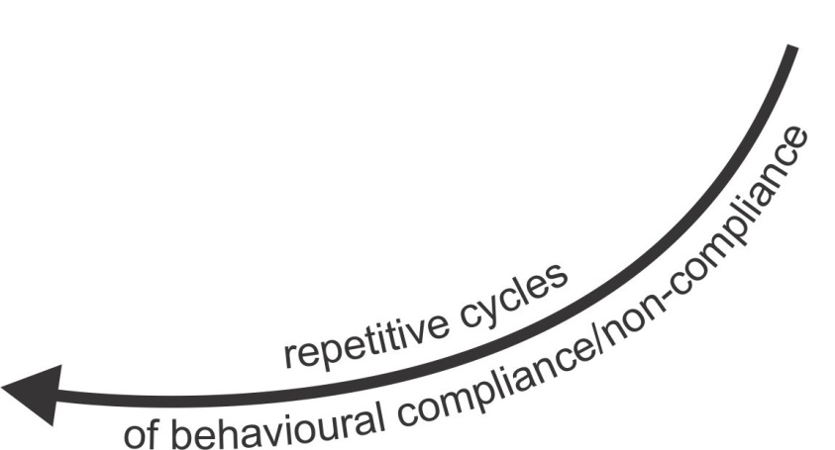
The Recurring Cycles
CO-OCCURRING CONDITIONS’ AND
AREAS OF POTENTIAL UNMET NEEDS
• Gastrointestinal
- infections
- intolerances
- imbalances
(e.g. vitamins/minerals)
- physical pain
• Mental & Neurological
e.g. seizures and mood disorders
• Brain Imbalances
- inflammations
- coherence (lack of)
- under development
- motor planning problems
• Sensory Integration
and Processing
- hyper/hypo activation
• Human Energy
- sensitivities
(e.g. EMF/ RWF)
- intolerances
• Cellular
- mitochondria dysfunction
• Emotional
- fears and phobias
• Adrenal Glands
- over production of cortisol
Gastrointestinal
LIVING & LEARNING
CHALLENGES
• Physical pain
• Sensory over/under
load
• Psychological distress
• Speech/hearing
limitations
• PTSD/Trauma
• Environmental stress
• Neglect/Abuse,
Isolation/Loneliness
• Supporter 4 outs
ANXIOUS REACTIONS
Mental & Neurological
BLOW-OUTS
• Repetitive expressions of
behaviour
• SIB and aggression
IF
People
with
Autism and Developmental Disabilities
with
Complex
Needs
Primarily
Only Behavioural Interventions
Without
Meeting
The Other
Needs
Brain Imbalances
Resulting In
Supporter
Response
Have
One
or
More
Contributing To
Sensory Integration
and processing
BLOW-INs
• Withdrawal
• Compliance
• Depression
Human Energy
Cellular
Emotional
Adrenal Glands
Notes:
3 minutes
Run through slide
Highlight Blow In vs. Blow Out and that many folks who may look calm from the outside may actually be quite anxious if we looked at their heartrate or cortisol levels.
Note that Behavioural Interventions Are Often Necessary
Behavioural interventions such as Applied Behaviour Analysis (ABA) and Intensive Behavioural Intervention (IBI) that follow the Behaviour Analyst Board Standards for Certification are useful and often necessary complements to the fully integrated biomedical support and supporter development process.
The more complete the integrated process, the greater the potential for ABA/IBI to enhance well-being and prevent and manage anxiety and aggression.

Slide 13
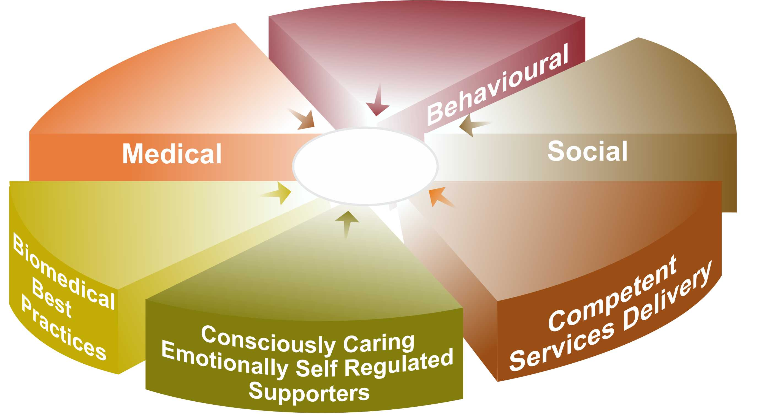
Components for Well-being and the Prevention and
De-escalation of Challenging Expressions of Behaviour*
Crisis Interventions and
Learned Life Skills
e.g. ABA, IBI
Adequate Access to
Services to meet Physical,
Dental, Neurological and Mental
Health Services Needs
Socially Valued Roles,
Relationships and Meaningful
Life Experiences
Optimal
Well-being
Adequate Access to Services
to Meet Biomedical, Body,
Bowel, Brain,
Being, etc. Needs
‘How-Tos’ that Meet and
Exceed Professional Standards
e.g. 5 C’s Process
Mindful, Emotionally
Self Regulated and Unconditionally
Caring Supporters
* CCS reduces challenging expressions of behaviours by 50%-75% compared to MCSS current ‘must use’ crisis protocols alone.
Notes:
2 minutes
Run through slide
The top pie pieces, we have done a pretty good job at as we look at providing support to the people and families we serve.
Yet to be most optimal, CCS addresses the lower pieces of the pie.

Slide 14
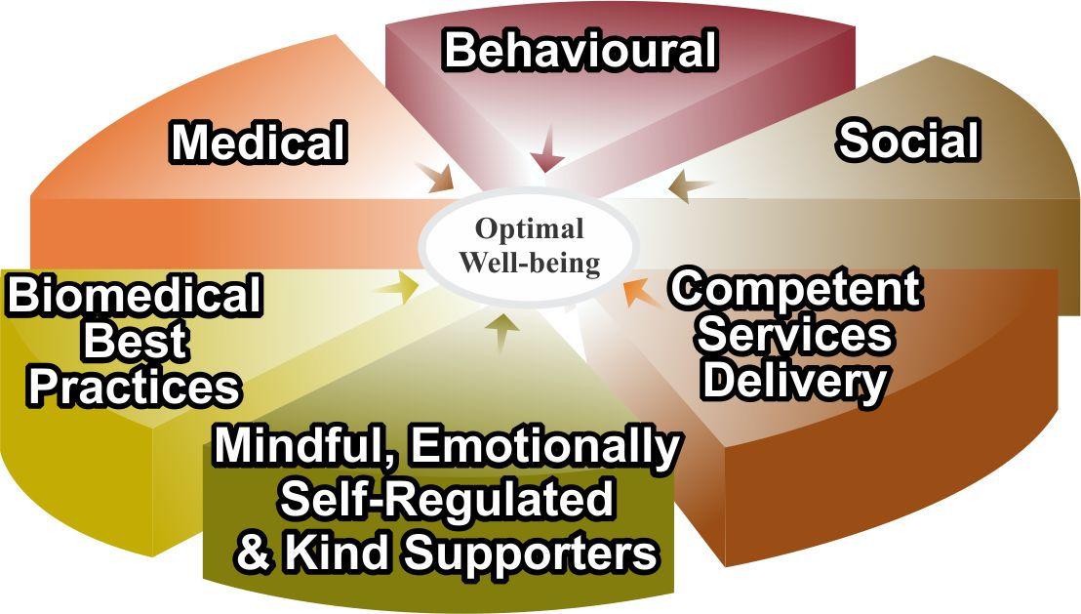
Breaking the Recurring Cycles
CO-OCCURRING CONDITIONS’ AND
AREAS OF POTENTIAL UNMET NEEDS
• Gastrointestinal
- infections
- intolerances
- imbalances
(e.g. vitamins/minerals)
- physical pain
• Mental & Neurological
e.g. seizures and mood disorders
• Brain Imbalances
- inflammations
- coherence (lack of)
- under development
- motor planning problems
• Sensory Integration
and Processing
- hyper/hypo activation
• Human Energy
- sensitivities
(e.g. EMF/ RWF)
- intolerances
• Cellular
- mitochondria dysfunction
• Emotional
- fears and phobias
• Adrenal Glands
- over production of cortisol
LESS AND LESS
LIVING & LEARNING
CHALLENGES
Gastrointestinal
BETTER AND BETTER
OPTIMAL LIVING
CONDITIONS
• Physical pain
• Fears and phobias
• Sensory over/under
load
• Psychological distress
• Speech/hearing
limitations
• PTSD/Trauma
• Environmental stress
• Neglect/Abuse,
Isolation/Loneliness
• Supporter 4 outs
Mental & Neurological
• Self Regulated
Nervous System
• Relative
Calm
• Well-being
Brain Imbalances
CC
Interventions
Contributing To
Resulting
In
Sensory Integration
and processing
Human Energy
Cellular
Emotional
Note: living and learning challenges become less, directly proportionate to the implementation of CCS interventions resulting in enhanced optimal learning conditions.
Adrenal Glands
Notes:
2 minutes
Run through slide

Slide 15

January 11, 2016
Physical and
Emotional Well-being
Toward A More Complete Understanding
of the Hierarchy of Unmet Needs
Notes:
1 minute
Note the model is in a hierarchy illustration but isn’t intended as an absolute hierarchy;
We can still offer supports, thinking and opportunities at the top of the hierarchy before all of the lower levels are completed.
People who experience heightened levels of agitation, aggression and anxiety may not necessarily have unmet needs within every level of the hierarchy. Thought the entire hierarchy is worth noting and exploring a possible avenues, it could result in only one or two of the levels to explore much more deeply.

Slide 16
January 11, 2016
Physical and
Emotional Well-being
Toward A More Complete Understanding
of the Hierarchy of Unmet Needs
Awareness-based calming and de-escalation skills offered by mindful, emotionally self-regulated and kind supporters
Notes:
1 minute
State the importance of the foundation of support being built upon the skillsets of mindful, emotionally self-regulated and kind supporters.
State the importance of incorporating awareness-based calming and de-escalation skills into daily support as they are ways to calm the system without behavioural means or through the cognitive door.

Slide 17
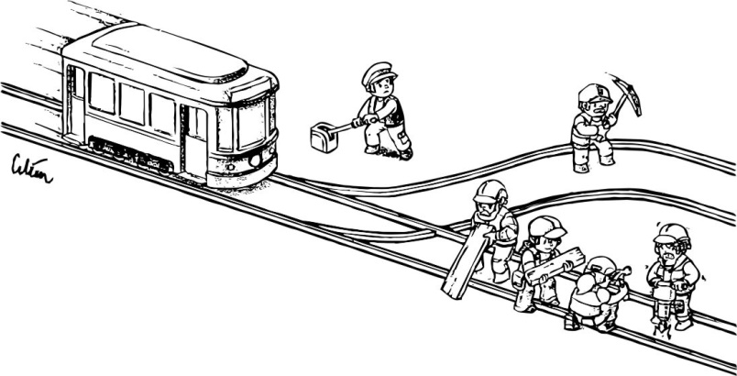
JJanuary 11, 2016
Notes:
2 minutes
TRAIN SLIDE ONE
Script:
You are part of a maintenance crew and the operator of the lever that directs trains through a work site. You notice a train coming towards you that has lost all brakes and is gaining speed. There is no time to warn your fellow maintenance team members, but have to make a millisecond decision- do you flick the switch and potentially kill one of your fellow team members, or keep the switch so the train continues ahead and potentially kills four of your fellow team members.
Ask for a show of hands for who would flick the switch?
Research and human conditioning tells us that most of you would flick the switch as one potential death is better than 4 (the numbers do the talking for you). It’s a logical math’s problem and solution.

Slide 18
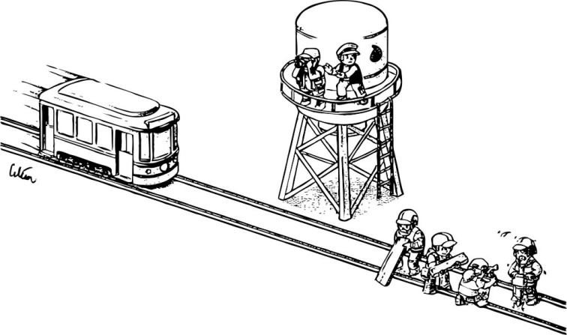
JJanuary 11, 2016
Notes:
2 minutes
TRAIN SLIDE TWO
You have the same scenario as before, but now the only option would be to push one of your colleagues off the water tower onto the rail track in the hope it will derail or slow down the train. Would you push the person?
Ask for a show of hands.
The majority would now not push the individual but rather sacrifice the 4 workers on the track.
What is different now to the simple math’s problem/solution as outlined before?
A different part of your brain was activated to now take it from a logical problem to a humanistic one. When you are closer to the action and have activated a feelings response, you are activating the Medial Pre-Frontal Cortex, the part of the brain that houses many different responses of our humanistic self.

Slide 19
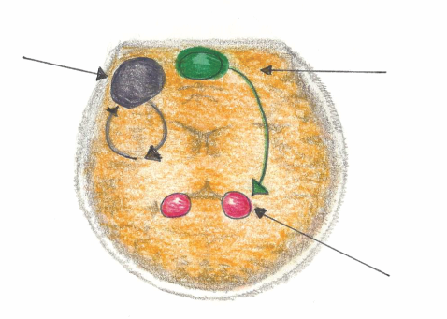
JJanuary 11, 2016
Mindful Emotional Self Regulation
The main way we can consciously access the emotional brain is through self awareness*, i.e. becoming mindful. Mindfulness increases connections in the medial pre-frontal cortex. This reduces anxiety for the Supporter and the Person Supported.
Dorsolateral pre-frontal Cortex
Working Memory
Medial pre-frontal Cortex
(part of the brain that notices what’s going on)
Amygdala
(*Research reference: J. LeDoux, “Emotion Circuits in the Brain”, Journal of Neuroscience 33, no. 9 (2013) 3815-23)
Notes:
3 minutes
MPFC is activated when things get personal, or when feelings are involved
MPFC is also connected with our limbic system (fight, flight or freeze) , our amygdala which fires twice a second to make that we are safe.
MPFC acts as a big brother or sister and checks in with the amygdala to keep as regulated without need to go into fight flight or freeze.
If a person has an underactive MPFC, anxiety often results. An underactive MPFC means that the person doesn’t experience the calming of the amygdala.
Increasing activation of MPFC is strongly influenced by exercises that develop self-awareness.

Slide 20
JJanuary 11, 2016
According to many published Neuroscientists, including Dr. Daniel Siegel (UCLA) in his book called The Mindful Brain (page 42 and 43) the following brain, body and being functions correlate with the activity of medial areas of the prefrontal cortex:
1. Body regulation – the emotional brakes and accelerator functions.
2. Attuned communication involves the coordination of the input from another person with the activity of one’s own (as with mirror neurons).
3. Emotional balance to have enough activation so that life has meaning and vitality but not so much that life becomes chaotic.
4. Response flexibility is the capacity to pause before action.
5. Empathy – knowing what might be going on inside someone else.
6. Insight or self-knowing awareness to be able to link the past, present and future.
7. Fear modulation that may be carried out by the release of the inhibitory neurotransmitter GABA.
8. Intuition – a neural mechanism by which we process deep ways of knowing via our body i.e. ‘somatic intelligence’.
9. Morality – taking into consideration the larger picture, to image what is best for the
whole not just one’s self, even when alone.
Notes:
3 minutes
What fires, wires….what fires wires.
Siegel, 2007 determined that we can develop mindful awareness and grow new neurons in the MPFC.

Slide 21
January 11, 2016
Examples of CCS Tools to Enhance Self and
Others’ Mindful Emotional Self Regulation
B-FIT Mindfulness (the essential tool to initiate Conscious Care and Support)
Calming others by calming oneself – emotional contagion and mirror neurons
Bilateral, Biomeridian Awareness Based Calming
(BB-ABC) e.g. Rocking, Butterfly Hugs, Hand Activation
All Tools must be practised during times of calm.
Notes:
1 minute
Review Slide
Mirror neurons enable us to perceive and understand others emotions-empathy as an example.
Studies show that the MPFC of neuro-atypical brains can be functional but they are not as readily activated as neurotypical brains. (Dichter, 2015)
Blakslees (2007) study shows that students with ASD/DD, their mirror neuron activation compromised because they haven’t been sufficiently activated through appropriate exercises.
We have to help activate through teaching and through the science of mirror neurons
Exercises like:
Mindful movement
Mindful walking
Mindful breathing
Mindful eating
Bouncing on a rebounder

Slide 22
January 11, 2016
Examples of CCS Tools to Enhance Self and
Others’ Mindful Emotional Self Regulation
Bilateral, Biomeridian Awareness Based Calming (BB-ABC)
            Butterfly Hug
            Collar Bone Activation
            Hand Activation
All Tools must be practised during times of calm.
Notes:
5 minutes
Review Slide
Engage group with 2-3 BB-ABC activities, depending on size following the Describe, Demonstrate, Do method.
Butterfly Hugs
Collarbone Activation
Hand Activation
Review calming benefits of awareness based calming techniques:
Activates the MPFC which stays on to help regulate the amygdala (fight, flight or freeze responses).
Not only activates but neurons can grow in MPFC therefore increasing capacity in the functioning of the MPFC around self-regulation.
Activates both hemispheres of brain in pattern with bilateral stimulation. Patterning calms.
Oxytocin levels increase with touch. Oxytocin is soothing.
Emotional contagion- calm of the support begets calm of the person supported.

Slide 23
Physical and
Emotional Well-being
Toward A More Complete Understanding
of the Hierarchy of Unmet Needs
Gastrointestinal (GI), bowel, digestive and immune systems’ treatment, nutrition etc.
Awareness-based calming and de-escalation skills offered by mindful, emotionally self-regulated and kind supporters
Notes:
1 minute
State that there is leading science to suggest a greater gut brain connection than ever before. If you think your brain in running the show, many times it’s our gut that sets anyone up for irritability, agitation and even aggression.

Slide 24
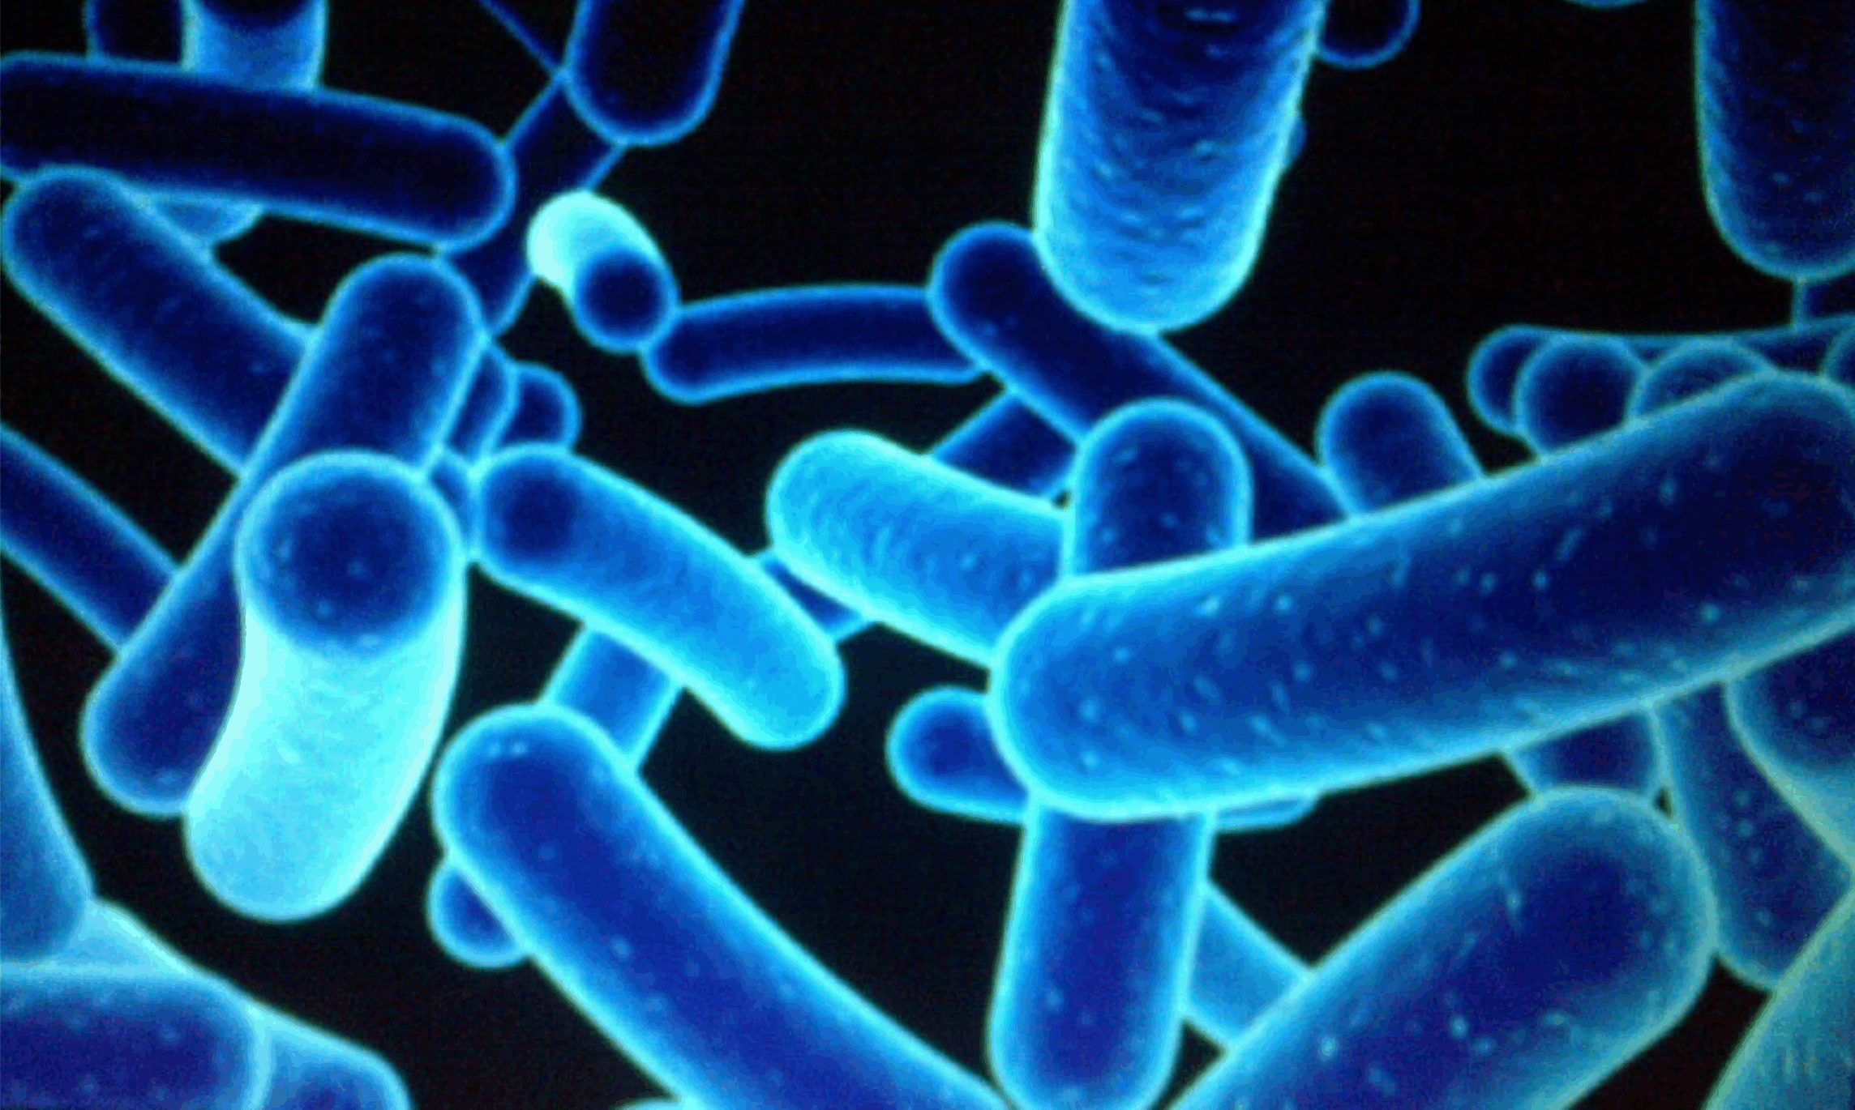
January 11, 2016
Needs for GI and Bowel Management and Holistic Treatment
Distressed Gut Microbes – produce Mind/Body Agitation, Pain and Anxiety which often leads to aggression.
1% Human
99 % Bacterial and Fungal
Some Microbes found in the gut of individuals with Autism, when introduced into healthy rodents, create numerous Autistic like symptoms.
e.g.
  Repetitive expressions of behaviours
  Social aversion
  Easy to startle
(Reference: Dr. Derrick MacFabe, The University of Western Ontario)
(Young, E. - I Contain Multitudes, pages 69 & 70)
Notes:
3 minutes
Review slide
Kilee Patchell Evans Institute- London, ON
McFabe (2014)- rodents ingest PPA and give birth to pups with top signs of autism
Yong (2016) PPA from stool sample of ASD, autism symptoms became noticeable and then after a while disappeared
PPA in guts of people with ASD are three times stronger- neurotypical we have 3 families, ASD has nine families
Suggest the Nature of Things Documentary titled The Autism Enigma for people to learn more about the work of McFabe and the brain gut connection.

Slide 25
Microbes, Anxiety and Aggression
Chronic anxiety means excessive toxic cortisol in the body. To neutralize this toxin, the body uses up basic building blocks like amino acids that are needed to:
  digest food
  build the immune system
  produce calming neurotransmitters
  This depletion causes anxiety leading to aggression
Notes:
1 minute
Read slide
Discuss the brain-bowel connection and how distressed microbes can lead the biological system into an anxious state.

Slide 26
CCS GI and Bowel Management and Holistic Treatments
Engage a qualified holistic GI specialist, e.g. qualified and available MD, ND or nutritionist who will, for example:
Complete a comprehensive biomedical assessment e.g. Organic Acid Test
Remove food toxins/allergens and metals
Balance minerals, vitamins and neurotransmitters
Implement holistic bowel management
Optimize nutrition
Notes:
3 minutes
Read Slide

Slide 27
Physical and
Emotional Well-being
Toward A More Complete Understanding
of the Hierarchy of Unmet Needs
Emotional Wellness:
• mental and neurological health and
disorders’ treatment
• trauma desensitization and triggers’ elimination
• psychological well-being
• medication side effects
Gastrointestinal (GI), bowel, digestive and immune systems’ treatment, nutrition etc.
Awareness-based calming and de-escalation skills offered by mindful, emotionally self-regulated and kind supporters

Slide 28
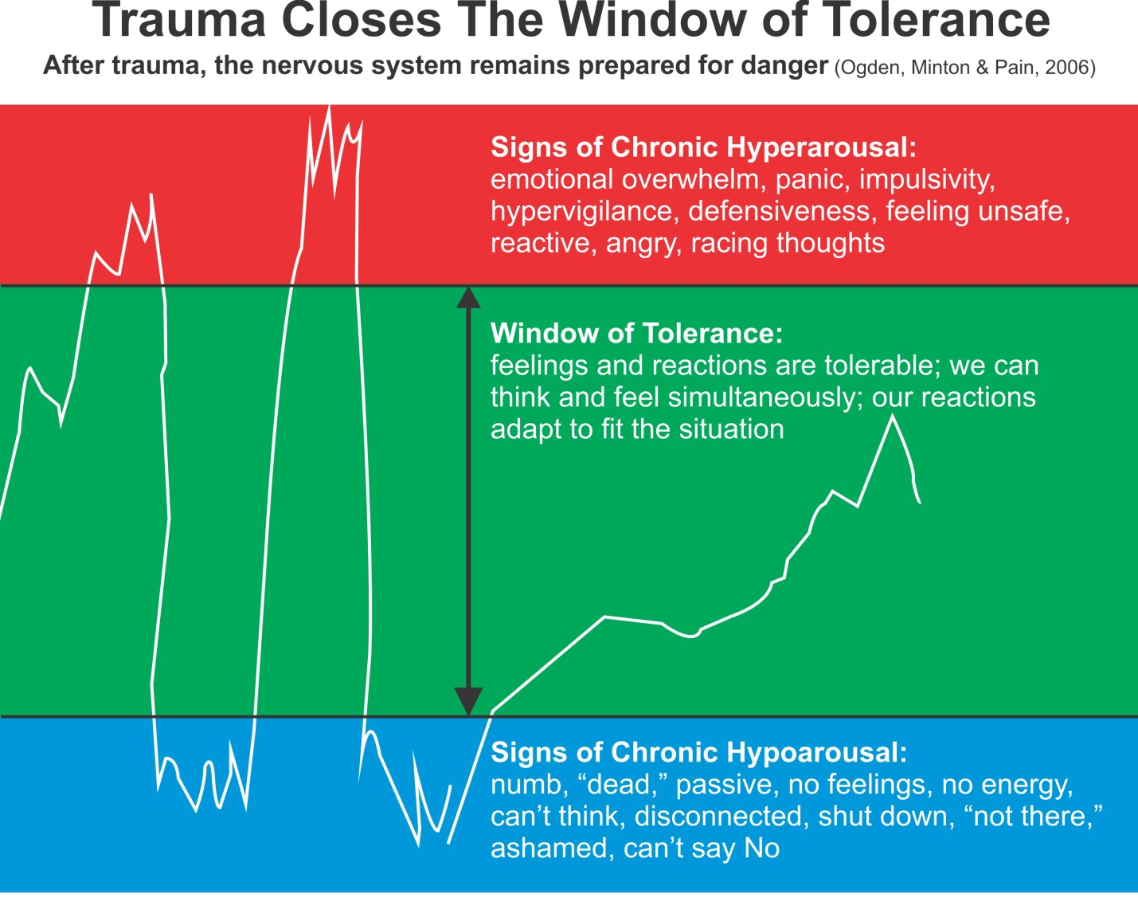
Notes:
5 minutes
Discuss the importance of the great possibility of experienced trauma for someone who has a disability, for various reasons.
Responses to trauma are a deep physiological response, not a cognitive decision.
Review the Window of Tolerance illustration which when someone is traumatized, the window of tolerance narrow leaving them to experience more signs of chronic hyper or hypo arousal.
Bessel vanDerKolk (2014)- The Body Keeps the Score
Grow the window through bottom up, instead of top down.
Activities like mindful movement and breathing
BB-ABC Exercises

Slide 29
January 11, 2016
Mental and Neurological Health
  Ensure accurate tracking of symptoms and report to the Primary Care Physician.
  Incident reports or “checklists” must be an accurate reflection of
  the person’s expression of behaviour – not contaminated with
  the supporter’s inadvertent ‘Challenging Expression of
  Behaviour’
  Benefits and Risks of Psychotropic Medications
  Advocacy with Physicians
Notes:
5 minutes
Discuss that most often, supporters are not versed well to accurately document and track the symptoms of emotional and mental health. Stress the importance that we as supporters must do a better job as emotional health can be tracked in other ways than just incident reports.
Review with participants that often incident reports are a reflection of what supporters lacked in the moment to ensure the situation did not escalate (lack of mindful emotional self-regulation) therefore misrepresenting that the incident report was indeed tracking an incident of challenging behaviour.
Refer to Emotional Wellness Tracking Tool- Based on Becks Depression Inventory - Can possibly represent more accurate picture of emotional wellness outside of incidents of challenging behaviour.
Benefits and Risks of Psychotropic Medications: Refer to Refer to CAUTION: Medication Side Effects CCS Textbook (pgs. 121-122)
Anti-psychotics
Anti-anxiety
Anti-depressants
Advocacy with Physicians
How will we know that it is effective and helpful?
What will we observe if there are unacceptable side
effects or risks e.g. Akathisia?

Slide 30
Trauma Desensitization and Mood Disorders
Prevention and Treatment Interventions
First do no harm, STOP triggering trauma symptoms
e.g. startle from yelling.
Awareness based calming and de-escalation strategies
e.g. - BB-ABC
- exercise – aerobic, strengthening, balancing and core
- mindful movement and breathing
3. Mental health and mood disorders’ treatment
e.g. - identification
- tracking (Not Only Incident Reports)
- advocacy.
Notes:
2 minutes
Read Slide

Slide 31
Physical and
Emotional Well-being
Toward A More Complete Understanding
of the Hierarchy of Unmet Needs
Brain development, coherence balancing and inflammation regulation
Emotional Wellness:
• mental and neurological health and
disorders’ treatment
• trauma desensitization and triggers’ elimination
• psychological well-being
• medication side effects
Gastrointestinal (GI), bowel, digestive and immune systems’ treatment, nutrition etc.
Awareness-based calming and de-escalation skills offered by mindful, emotionally self-regulated and kind supporters
Notes:
1 minute
Explain that neurogenesis, neuroplasticity, neuro-stimulation and neurochemical production are not well explored when provided optimal supports for people who have a disability.

Slide 32
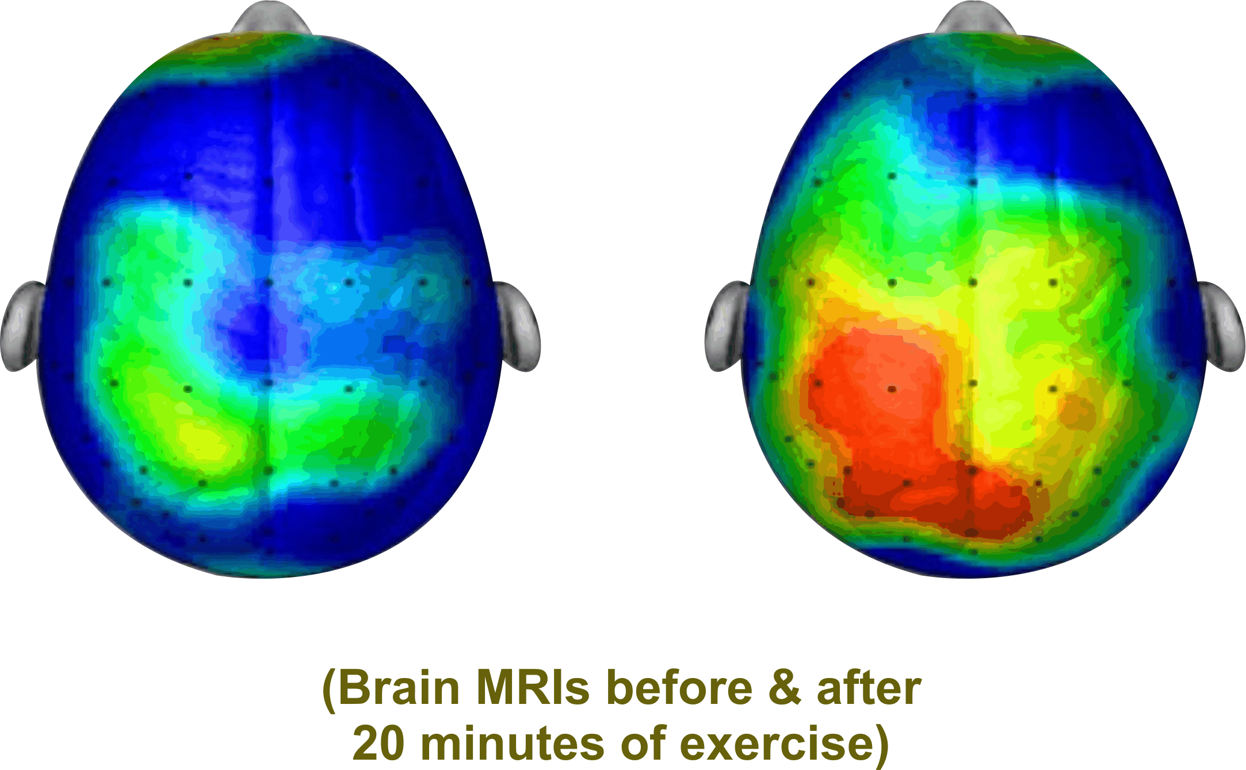
Brain Coherence
i.e. Many Parts of the Brian ‘Talking’ to Each Other
“Like you, I need to be able to understand and process information”. This requires optimal Brain Functioning e.g.
        neurogenesis (new neurons)
        neuroplasticity (more complete neuro networks)
        neuro electrical stimulation (brain firing)
        neurochemicals production (endorphins, dopamine, serotonin, oxytocin)
        Hertz e.g. Beta, Alpha, Theta, Delta
Notes:
3 minutes
Review Brain Coherence illustration
Typical brain runs at 25 Hz of energy for processing
Atypical brain runs at 17Hz much like how we feel when we first open our eyes after sleeping.
Often people will aggress to raise the level of brain energy or, they can activate the cerebellum through activities of bouncing and balancing.
Reference work of John Ratey, SPARK that speaks to exercise and revving up the brain to increase coherence.
When activities are in engaged that stimulate the above considerations, improve levels of anxiety and agitation can occur leading to improved quality of life.
Reference:
N. Doidge – The Brain’s Way of Healing
D. Siegel – The Mindful Brain
D. Eagleman – The Brain

Slide 33
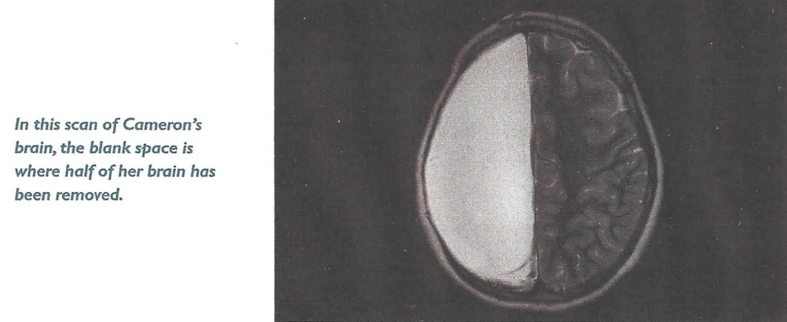
JJanuary 11, 2016
Could This Indicate Potential for Well-being for People Supported?
In 2007, Neurosurgeons removed half of Cameron Mott’s Brain
The Results:
Aside from some weakening on one side of her body, she is indistinguishable from her classmates. She is a good student and participates in sports.
(Reference D. Eagleman The Brain)
Notes:
1 minute
Consider Cameron Mott example (removal of half her brain because of a life-threatening seizure disorder) and how the brain has the potential to grow and adjust and accommodate our needs. Neurogenesis and neuroplasticity is possible! We see this in adults who have experienced a stroke or traumatic brain injury. Other parts of the brain take on responsibility for different functioning…
What Fires Wires!

Slide 34
c
CCS Brain Coherence, Balancing & Inflammation Regulating Interventions
Connect with a biomedical practitioner to address:
  Enhance essential brain calming elements e.g. GABA, Serotonin, PPA
  Balance anxiety producing vitamins and minerals e.g. Magnesium, Vitamin B6, B12
  Maintain adequate glutathione levels to prevent brain inflammation e.g. NAC
  Optimal Nutrition
Cerebellum Activation e.g. 20 minutes of bouncing and balancing
Keep the Mitochondria Cell System Healthy:
  Mitochondria are known as the powerhouse of each cell
  They give cells their energy to do their work such as maintaining
  healthy brain functioning
Notes:
2 minutes
Read Slide
Controllable Mitochondria Killers:
Sugar and Simple Carbohydrates
Oxidative Stress causing Brain Inflammation – low glutathione
Medications such as Antibiotics and Antipsychotics
Vitamins and Minerals Imbalance – low B vitamins, folic acid, magnesium, vitamin D

Slide 35
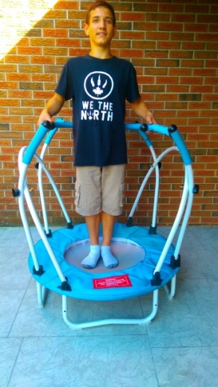
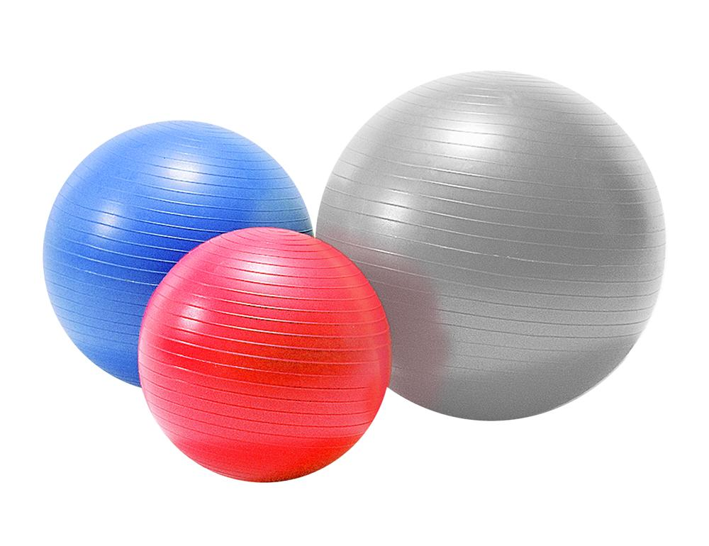

Cardio Exercise:
Cardio exercise, especially bouncing and balancing, increases brain wave activity (e.g. cerebellum) to give better brain coherence for optimal functioning.
Improved coherence results in thoughts becoming more organized and focused.
This results in less fear and therefore more calm.
stabilization balls
and elliptical stabilization cushions
Notes:
1 minute
Read Slide

Slide 36
Physical and
Emotional Well-being
Toward A More Complete Understanding
of the Hierarchy of Unmet Needs
Human energy system – building, balancing and protecting from wireless radiation and electromagnetic fields (EMF)
Brain development, coherence balancing and inflammation regulation
Emotional Wellness:
• mental and neurological health and
disorders’ treatment
• trauma desensitization and triggers’ elimination
• psychological well-being
• medication side effects
Gastrointestinal (GI), bowel, digestive and immune systems’ treatment, nutrition etc.
Awareness-based calming and de-escalation skills offered by mindful, emotionally self-regulated and kind supporters
Notes:
1 minute
Describe that like many other allergens and pollutants that can compromise health, contaminants and electromagnetic pollution (EMF and Dirty Electricity) have been directly linked to compromised wellbeing.
Lack of focus and concentration
Irritability
Sleep dysregulation
The Bioinitiative Report 2012 links EMF Exposure to Autism concluding: Based on strong evidence for vulnerable biology, in Autism, EMF/ Radio Frequency Radiation (RFR) can plausibly increase Autism risk and symptoms. –Martha Herbert
"While we aggressively investigate the links between Autism disorders and wireless technologies, we should minimize wireless and EMF exposures for people with Autism disorders, children of all ages, people planning a baby, and during pregnancy,”
says Martha Herbert, MD, PhD, Pediatric Neurologist Harvard Medical School.

Slide 37

Human Energy – Building, Balancing and Protection
Protection from Environmental Toxins
e.g. - reduce electromagnetic energy fields (EMF)
(a.k.a. dirty electricity)
- reduce Wi-Fi and cell phone radiation
CBC Marketplace The secret inside your phone
Notes:
5 minutes
Remind Participants that
Who we are –Spiritual Beings-
What we are – Electromagnetic Energy.
Muscle Testing Exercise with Cell Phone
Engage participants with Muscle Testing with a Cellphone.
Ask for a volunteer to come up with their cellphone.
Do a pre-test with their non-dominant, non-injured arm by asking them to hold their arm out in front of them palm facing down.
As the tester, you will approach them at a 90 degree angle with your dominant arm outstretched with your palm placed just above the wrist of their outstretched arm.
Asking the participant to just hold their arm up, not to push back forcefully, gently apply force downward lowering their arm.
Ask them to grab their cellphone with their dominant hand ensuring that it is on.
Repeat the muscle testing as described above for the post test.
Have the larger group break off into pairs and experience the muscle testing with the cell phone.
Your Somatic Intelligence picked up that the cellphone was a frequency that didn’t “jive” with your own-wasn’t helpful to your frequency- resulting in less strength.

Slide 38
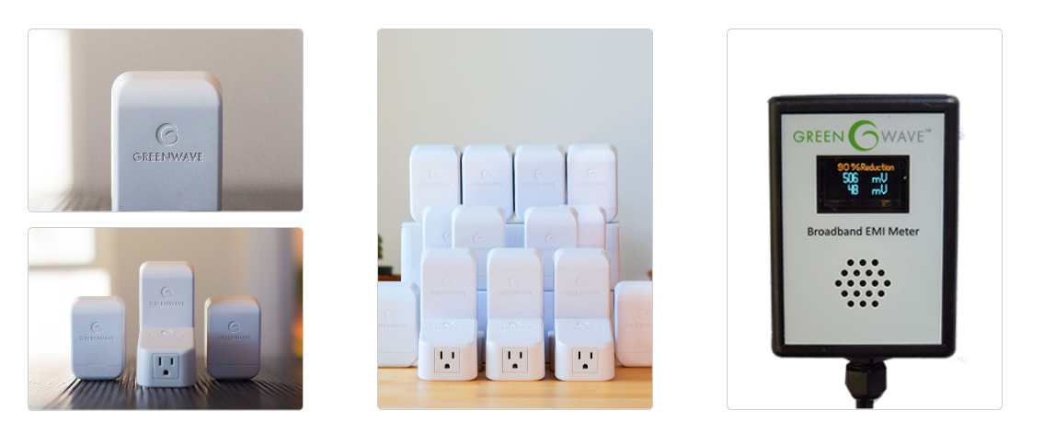
Gastrointestinal (GI), bowel, digestive and
Notes:
1 minute
Review that we can reduce the exposure of EMF by:
turning off wi-fi when not needed,
get outside into mother nature,
grounding mats etc.
Review that we can reduce the exposure to Dirty Electricity from out 110 V outlets by using a GreenWave filter.

Slide 39
Physical and
Emotional Well-being
Toward A More Complete Understanding
of the Hierarchy of Unmet Needs
Sensory integration and processing
Human energy system – building, balancing and protecting from wireless radiation and electromagnetic fields (EMF)
Brain development, coherence balancing and inflammation regulation
Emotional Wellness:
• mental and neurological health and
disorders’ treatment
• trauma desensitization and triggers’ elimination
• psychological well-being
• medication side effects
Gastrointestinal (GI), bowel, digestive and immune systems’ treatment, nutrition etc.
Awareness-based calming and de-escalation skills offered by mindful, emotionally self-regulated and kind supporters
Notes:
4 minutes
Review Main Sense Stores
Sight
Sound,
Smell
Taste
Touch
Also, Vestibular and Proprioceptive.
Vestibular Exercise- Stork Stand then with eyes closed
Proprioception Exercise- finger to nose, then back to finger
Because research indicates that there is an 80% likelihood that individuals with ASD/DD
will have a sensory processing and integration challenges the cause or greatly influence
anxiety and for some, assessments and treatments by qualified Occupational
Therapists.
This treatment does not generally appear to be the case for many people supported throughout Ontario.

Slide 40



JJanuary 11, 2016
Hyperactive Senses Lead to Challenging
Expressions of Behaviour
Hyperactive Senses
means that
people, objects and places can be:
e.g.
  too loud
  too fast
  too scratchy
  too tight
  too bright
  too off balance
  too confusing
  too chaotic
Agitation, Anger and/or Aggression
e.g.
Repetitive expressions of behaviour
challenging expressions of behaviour
Injury to self or others
A
N
X
I
E
T
Y
=
=
Notes:
2 minute
Review Slide

Slide 41
JJanuary 11, 2016
Hypoactive Senses Lead to Challenging
Expressions of Behaviour
Agitation, Anger and/or Aggression
e.g.
low energy
low motivation
quiet/withdrawn
Eventually -
repetitive expressions of behaviour
challenging expressions of behaviour
Injury to self or others
Hypoactive Senses
means that
people, objects and places
can be:
e.g.
  too quiet
  too slow
  too dark
  too loose
  too tickly
  too confusing
  too chaotic
A
N
X
I
E
T
Y
=
=
Notes:
3 minute
Review Slide
Even though the input might be different that can affect the sensory processing and integration system (hyper vs. hypo), the resulting behavior can look the same.
Explain that people can have hyper-sensitivity in one sense store but a hypo sensitivity in another.
Stress the importance that we need to discern hyper vs. hypo to best be able to help the person with a prescribed sensory diet from a qualified Occupational Therapist.
Review two common hypo sensitivities that are most often seen and some activities that can help regulate
Hypo-Vestibular sense store (balance)
Hypo-Proprioceptive sense store (knowing where body is in space)

Slide 42
JJanuary 11, 2016
Balanced Gastrointestinal (GI) is required for….
Balanced Neurotransmitters which are required for….
Balanced Sensory Integration & Processing
Notes:
1 minute
Read Slide

Slide 43
Physical and
Emotional Well-being
Environmental – supporter’s accommodations,
behavioural learning, social interactions and
contributing to others’ well-being
Toward A More Complete Understanding
of the Hierarchy of Unmet Needs
Sensory integration and processing
Human energy system – building, balancing and protecting from wireless radiation and electromagnetic fields (EMF)
Brain development, coherence balancing and inflammation regulation
Emotional Wellness:
• mental and neurological health and
disorders’ treatment
• trauma desensitization and triggers’ elimination
• psychological well-being
• medication side effects
Gastrointestinal (GI), bowel, digestive and immune systems’ treatment, nutrition etc.
Awareness-based calming and de-escalation skills offered by mindful, emotionally self-regulated and kind supporters
Notes:
1 minute
State that because we have addressed many other “upstream” potential causes of anxiety through the CCS Hierarchy of Needs, that are not through the cognitive door, the following engagements and technologies can be much more meaningful.

Slide 44
Environmental Well-being
Communications and Accommodations
  Validate not Vet
  Limited Choices
  Avoid ‘No’
Behavioural Learning
  Applied Behavioural Analysis (ABA)
  Intensive Behavioural Interventions (IBI)
  Natural and Rational Consequences
Social Interactions
  “Go slow in ways I know”
Contributing to Others’ Well-being
  Socially Valued Roles
Notes:
5 minutes
Read Slide
Recognize importance of introvert vs. extrovert
Reference John McKnight (2010) The Abundant Community

Slide 45
BREAK TIME
15 minutes please
Notes:
15 minutes

Slide 46
JJanuary 11, 2016
Developing Emotionally Self-Regulated and Kind Supporters
Claim Your Brain, Start Your Heart
Notes:
Read Title Slide

Slide 47
JJanuary 11, 2016
How often do power struggles compromise the quality of the supported person’s well-being?
It appears that a minimum of 40% of incident reports based
on challenging expressions of behaviour result from or are
significantly influenced by generally good and caring
supporters’ unintended and unaware loss of mindful
emotional self-regulation. This often results in power
struggles and other supporter induced antecedents.
Notes:
1 minute
Read slide

Slide 48
Why might the average good and caring supporter become emotionally hijacked into power struggles that can cause challenging expressions of behaviour in the person being supported?
Notes:
Read Slide

Slide 49
11, 2016
The 4 Outs
Tune-out is typically how the
Spaced-out Supporter
Protects our self from
Burn-out and Freak-out
Notes:
1 minute
Read Slide
Review how many of us mindlessly go through our day affected by the 4 outs:
Burn Out-e.g. unfulfilled, worried, anxious, depressed, irritable
Freak Out-e.g. emotional hijacks (passive or active), unkind
Tune Out-e.g. indifferent, bored, uncaring
Space Out-e.g. mindless, unaware

Slide 50
Loss of Emotional Self-Regulation of Good and Caring Supporters Can Result in Some of the Following:
being impatient and becoming emotionally hijacked into power struggles (i.e. silent temper tantrums or anger);
being self righteous, judgmental, critical and unforgiving;
being generally indifferent to some supported persons’ suffering;
being overtaken by 1 of the 4 outs – (Burn-out, Freak-out, Tune-out, Space-out);
the physical redirect/restraint that is executed mindlessly, mechanically and without compassion;
the closed, “whatever,” attitude that shows on the face of the supporter as they hear the same story over and over again;
the powerful enforcing of ‘unnecessary rules’.
Notes:
2 minute
Read Slide
In the absence of staying dedicated to an internal growth process of mindful, emotional self-regulation, you will pretty much remain ‘normal’ and always be at significantly greater risk to the 4 Outs

Slide 51
,
Definitions to Better Understand Life’s Set-up
Over each 24 hour period, we can be experiencing consciousness on a 1-10 continuum.
Unconscious: (1)
  like when we are asleep in our bed.
Semiconscious: (autopilot) (5)
  like how we typically drive our car, relate to people and do most ‘doings’.
Fully Conscious: (self aware) (10)
  like when we are paying attention – noticing what we are doing e.g. how we drive when a police car is following us;
  knowing that we are doing it and
  knowing how our body’s sensations, feelings and thoughts are
  reacting to what is happening.
Subconscious:
  our data bank of ‘files’ that we inherit and develop.
Notes:
2 minutes
Review the various definitions to better understand the set-up using terms of consciousness
Unconscious
Semiconscious
Fully Conscious
Sub Conscious
State to be more mindfully, emotionally self-regulated and kind, we much strive to be more conscious.

Slide 52
Understanding The Main Sources of
Our Loss of Emotional Self-Regulation
To survive in the early, dangerous Paleo jungles, we needed Quick and Simple Reactions to solve life threatening problems.
“Our Brain hasn’t changed much
over the last 50,000 years.”
                Dr. John Ratey
                Associate Professor of Psychiatry
                Harvard Medical School
Notes:
2 minutes
Through evolution, our brain needs simple and quick responses.
We have 60 seconds of finite data processing energy.
Our brain doesn’t like when things take time to organize, process and sort out because it takes up our data processing energy.
Our brain is hardwired to save as much energy as possible.

Slide 53
Understanding The Main Sources of
Our Loss of Emotional Self-Regulation (cont’d)
The Brain therefore inherited and develops ‘Files’/a data bank from which to semiconsciously speed-dial reactions to manage our world and keep us safe.
Notes:
5 minutes
Through evolution, we therefore store data banks/ “files” to which we can semiconsciously access.
Counting Backwards Exercise
Have group divide into pairs.
One participant asks the other to count backwards from 100 by 10’s.
Repeat the process but by counting backwards from 100 by 7’s.
Demonstrates that new information (counting by 7’s) doesn’t match our pre-existing semiconscious file (counting back by 10’s) therefore it doesn’t carry as much value
Information that matches our “files” maintains our perceived sense of safety (mainly our ego).

Slide 54
Being Mostly Semiconscious
Means that we have insufficient consciousness to consistently offer our ‘A’ Game
Especially in crisis, we speed dial our ‘C’ survival game as our ancestors have done for thousands of years.
Notes:
1 minute
Read Slide

Slide 55
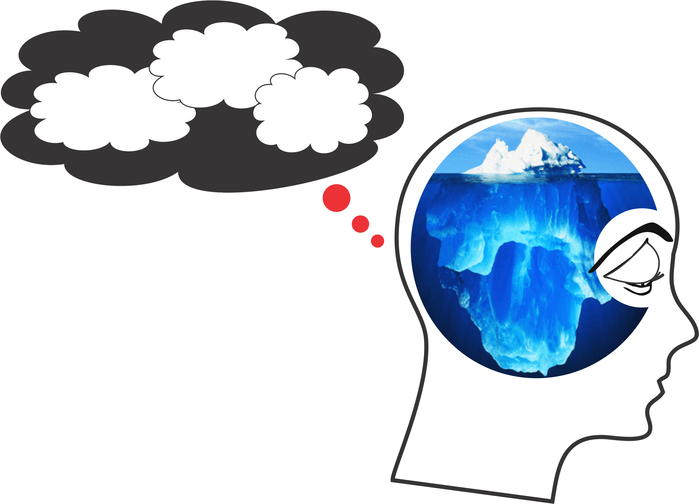
What Do We Speed Dial?
Filters
Primitive
Predispositions
Primed
Prompts
Semi-Conscious Mindless Mind
Primitive
Predispositions
Inherited genetic makeup
re: survival and reproduction
drives (i.e. ‘Nature’ You)
PFP
Subconscious
Programming
Filters
Illogical beliefs/faulty filters from
childhood conditioning e.g. “I need”,
“I am”, “Others are” (i.e. ‘Nurture’ You)
Primed
Prompts
Societal and cultural brain washing/
stereotyping/branding/bigotry
(i.e. ‘Numbed’ You)
Semi-Conscious
Mindless Mind
The “You” who is reading this but doesn’t know it (i.e. ‘Normal’ You)
Because PFP So Controls Our Life – We Call It PFP Prison!
Notes:
3 minutes
Review illustration of PFP Brain
Primitive Predispositions
Inherited genetic make up
Filters
Illogical beliefs from childhood conditioning
Primed Prompts
Societal and cultural brain washing
State that the PFP brain:
will die an hour after we
we can’t just willfully not let it affect us
we can however identify when it starts to take control and we can break free from its gripping power of less than optimal responses.

Slide 56

What do we mean by an ‘Inherited DATA BANK’?
Notes:
3 minutes
Explain the red bear, blue bear experiment:
At 18 months old, a child is show a puppet show of a red bear and blue bear. A puppet of a duck is in a box and every time he struggles to try and lift the lid, the blue bear slams the lid down trapping the duck.
The show repeats itself with the duck again struggling to lift the lid. This time, the red bear sees the duck and lifts the lid to the box to help open the box.
After the puppet show, the 18 month old is offered their choice of the bear. They are more often drawn to choose the red bear.
There is an inherited data bank of the tendency for us humans to “be good”.

Slide 57
JJanuary 11, 2016
Understanding Our Filters’ Part of PFP
Installing Our Subjective Software
Understanding the Filters’ Set-up:
We start our life perceiving that “I am weak and vulnerable,” both emotionally and physically. We therefore groped for ways to feel secure through inclusion in our family (the herd). This gives a sense of counting for something and connection which our brain registers as being safe and secure.
To figure out how to meet these needs, we became a good mind reader.
Notes:
2 minutes
Read slide
State that our filters are illogical beliefs that we created through our childhood conditioning up until the age of 10-12 yrs. of age

Slide 58
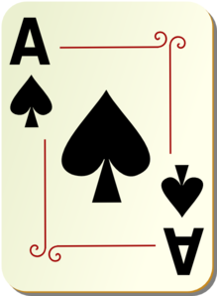
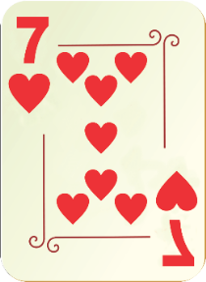
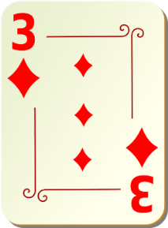
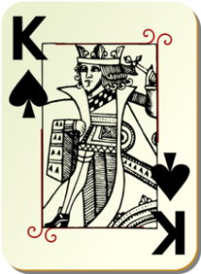
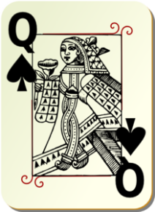
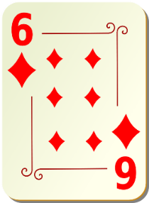
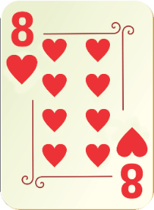
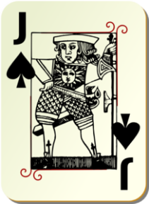
How you learnt to read minds to get included and protected and in so doing, became you i.e. got programmed with rules about:
  I must be ……….
  Men are ……….
  Women are ……….
  The world is ……….
  and
  Who my ‘In-Group’ is
Notes:
4 minutes
Review “Becoming A Good Mind Reader” Card exercise
1st pair of cards (ace of spades and 7 of hearts)
Ask the group to quietly to themselves guess which card you are thinking of. Afterwards, announce you were thinking of the ace of spades.
2nd pair of cards (3 of diamonds and king of spades)
Repeat question. Announce you were thinking of the king of spades
3rd pair of cards (queen of spades and 6 of diamonds)
Repeat question. Announce you were thinking of the queen of spades.
4th pair of cards (8 of hearts and jack of spades)
Repeat question. Announce you were thinking of the jack of spades.
Review the blue rule line
To help you predict which card was the correct cards, the group began to formulate some rules
Ask the group for some examples of rules in this card scenario:
All same suit
All black cards
Descending order
Zig Zag pattern
Highest card of the pair
State that as a child, we have created these perceived unwritten rules about the world around us hundreds of thousands of times in different situations. They have molded our belief systems including our own understanding of:
What I must be…
What women must be…
What men must be…
What the world must be…

Slide 59
JJanuary 11, 2016
Examples of Filters
I think that I need to be in control or not out of control of most situations and people in order to feel okay.
I think that I need to be right and above criticism in order to feel okay.
I think that I need approval from important people in my life in order for me to feel worthwhile and okay.
I think that others and life must treat me fairly otherwise, I have a God-given right to feel awful.
I think that I must be included or not be excluded from social situations that I feel are important in order for me to have adequate self-worth.
I think that I need to be superior to others in order to feel okay and worthwhile.
I think that I need to achieve and be busy in order to feel okay and that boredom is very emotionally painful and anxiety producing.
Notes:
2 minute
Read slide
Recognize that birth order has a huge influence on our illogical beliefs/ rules/ filters along with the likes of parenting style and heredity.

Slide 60
JJanuary 11, 2016
Experiment
Divide into pairs and decide who is #1 and who is #2.
2. Everyone close your eyes.
Notes:
5 minutes
Rabbit or Duck Activity
Divide the group into pairs.
Have them number themselves as 1 or 2
Have both partners close their eyes
Ask for partner 1 to open their eyes and look at the screen with picture of rabbit displayed.
Have them close their eyes.
Ask for partner 2 to open their eyes and look at the screen with picture of duck displayed.
Have them close their eyes.
Have both partners open their eyes and look at displayed picture on screen and describe to one another what animal they see.
What you were primed to see before (either a rabbit or a duck) would influence what you saw afterwards (either a rabbit or a duck)

Slide 61
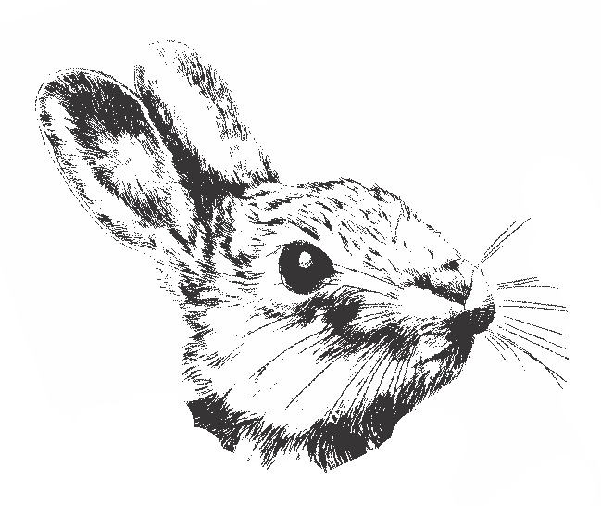
JJanuary 11, 2016

Slide 62
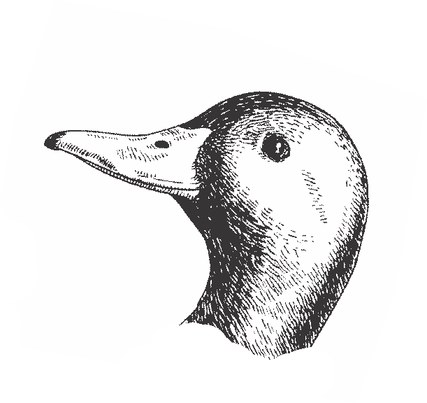
JJanuary 11, 2016

Slide 63
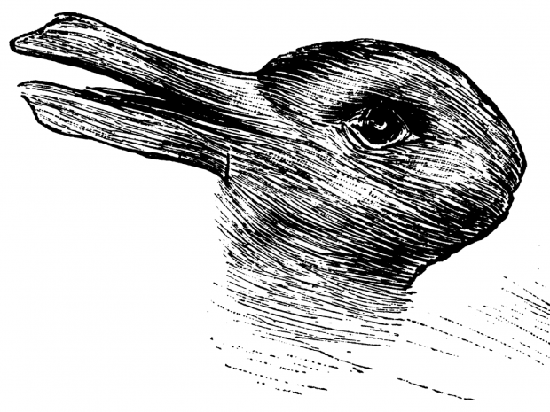
JJanuary 11, 2016

Slide 64
JJanuary 11, 2016
Primed Prompts
Our Brain Fabricates
Much of Our Reality
Based on
How our 7 Senses have been Primed

Slide 65

JJanuary 11, 2016
$90
$10
MRI Research
Notes:
1 minute
Review Priming of $90 bottle of wine over $10
Under MRI, your brain would light up more in the pleasure regions if you tasted what you believed was a $90 bottle vs. $10…and yet both samples were from the $10 bottle

Slide 66
JJanuary 11, 2016
Priming Problems
Possibly one of the most serious brain primes that negatively impacts current services is most supporters’ limited beliefs regarding the potential of people who we are supporting.
As we observe the highest level of a person supported experiencing life, know that this is probably representative of the lowest level of their potential.
66
Notes:
1 minute
Read slide
Review with group that PFP is our semiconscious selves that drives the show of how we connect with the world around us.
PFP is so deeply rooted and it isn’t until we can identify and recognize its gripping power that we can begin to unpack “the human predicament” to become most conscious therefore providing most optimal supports to others

Slide 67
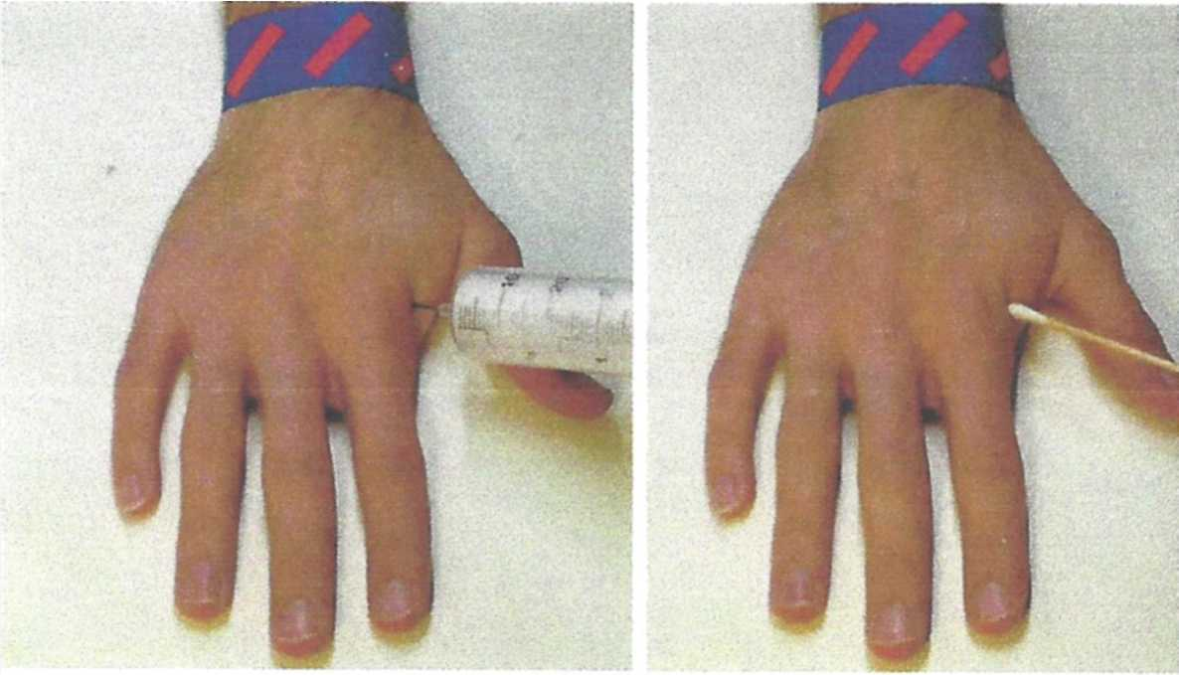
JJanuary 11, 2016
Is Most Everyone’s Brain Designed to
Devalue People Supported?
MRIs indicate that most individuals’ brains react with strong pain empathy
when they witness this painful procedure.
Provided…………………….
Notes:
3 minutes
Review hypodermic needle example
If we identify with the hand that is stuck with a hypodermic needle, (e.g. skin colour, religion, gender), the parts of our brain that house empathy would light up far more brightly (as seen under MRI) than if we saw a hand that was stuck with a needle with whom we did not identify.
Our brains are programmed to connect with “our herd”/ the “in group” and that different/ “the out group” is dangerous.

Slide 68
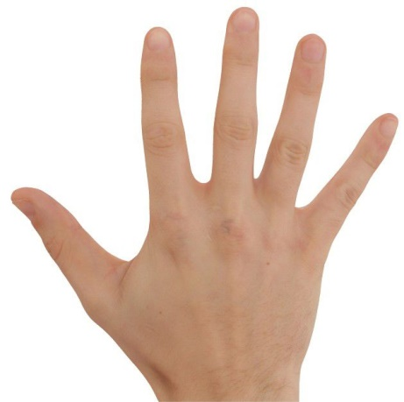
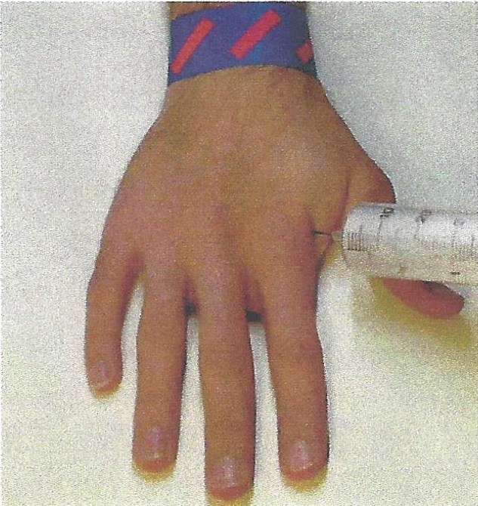
Provided the brain relates to the injured hand as being a lot like its own!
Muslim
Atheist
Atheist
Christian
Buddhist
Jew
Notes:
2 minutes
Review that the brain is wired to devalue/exclude others who it perceives to be different. In the old days, in the jungle, ‘different was dangerous’ so the brain evolved to reward taking care of our ‘in- group’ not other’s i.e. the ‘out-group’.

Slide 69
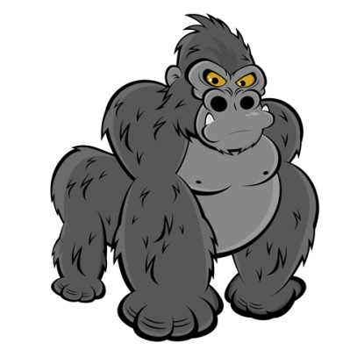
JJanuary 11, 2016
Managing Information Overload Results
in Inattentional Blindness
  Because of only 60 bits per second of data processing capacity,
  our brain filters out much information that comes our way.
  This filtering prioritizing is based on what it remembers is
  important and meaningful to it at the time, e.g. what it believes
  and wants to hear. We therefore miss buildings, pain, gorillas
  and other truths.
  Might our brain’s limited energy and narrow band width
  be compromising some of the quality of our support?
Notes:
6 minutes
Inattentional Blindness
Show the Monkey Business Illusion video that speaks to inattentional blindness and the 60 bits of finite data processing energy.
We often as supporters miss the seemingly insignificant changes that can manifest as an antecedent to an increase in anxiety.
Subtle is significant!

Slide 70
JJanuary 11, 2016
Focusing and Concentrating:
The brain needs to be focused and this makes it feel safe. More and more in great part because of the speed and sensory stimulation of electronic devices, our brain is being trained to lose focus quickly if the communication is not fast and multisensory appealing.
This fast form of communication is one of the worst ways to learn and retain new information needed for implementation of new and more complete interventions e.g. CCS Best Practices.
Many people supported, process information much slower than neurotypical people – we need to slow down!
Notes:
2 minutes
Focus and Concentration
Remind the group that the people we support most often process information much more slowly than neurotypical people
Review that focus and concentration makes our brain feel safe.
Electronic communications are destroying our ability to focus and concentrate
Learning new information like best practices of CCS thoroughly requires slow, systematic repetition…which is contrary to how the brain is being trained with the quick electronic and social media addictions.

Slide 71


JJanuary 11, 2016
  If I hadn’t seen it, I would not believe it!
  OR – could it be ……..
  If I hadn’t believed it – I would not have seen it!
Notes:
3 minutes
Review Checkboard Experiment as outlined on CCS Textbook pg. 299.
Review that your PFP Brain is primed to think that the checkerboard should be complete so it, (not you) replaces the blank space with the pattern.
It does this without your knowledge or consent.
State that much of how we see the world is filled in for us subjectively and our PFP prevents us from seeing the world objectively.

Slide 72
JJanuary 11, 2016
In summary, internationally published neuroscience & research indicates that your brain (not the mindful you):
makes things up based on PFP directives;
is prejudice against one’s out-groups;
is driven by feelings, not logic and doesn’t feel the same empathy for perceived out-groups e.g. hand needle experiment;
is cognitively biased and addicted to opening existing ‘old files’ versus new files (e.g. CCS) and therefore misses 3 storey buildings and others’ support needs etc.;
needs to process things very, very fast and therefore demands simple and easy solutions;
is losing its focusing power due to devices’ screen addiction; and
is programmed from childhood with many illogical and outdated programs of “I must, and should”.
Notes:
2 minutes
Read slide

Slide 73
JJanuary 11, 2016
So then ……..
Could it be that PFP Programming, at times is causing or seriously contributing to how we offer significantly less than optimal support?
Notes:
1 minute
Read slide

Slide 74
JJanuary 11, 2016
With your partner:
Name what you feel are 2 of the most concerning ways that PFP Programming is unknowingly compromising the quality of our support for others.
Notes:
1 minute
Allow for quick discussion

Slide 75
JJanuary 11, 2016
Developing Emotionally Self-Regulated and Kind Supporters
Breaking Out of PFP Prison
Notes:
Read Title Slide

Slide 76


JJanuary 11, 2016
Breaking Out of PFP Prison
Is An Inside Job
Consciousness/Mindfulness
Notes:
1 minute
State that now that we’ve identified the human predicament of PFP, we can break out of it…and the good news is that it is an inside job of becoming more mindful/ conscious.

Slide 77
JJanuary 11, 2016
The VERY, VERY GOOD NEWS
The Power/Influence of Negative PFP Programming can be significantly Reduced as a result of becoming more Mindful/Conscious.
Mindfulness actually rewires the Brain's ‘Live’ Drive Modules like the Medial Prefrontal Cortex to give ways to prevent and eliminate emotional hijacks and enhance our capacity to make better choices.
Notes:
Read slide

Slide 78

JJanuary 11, 2016
B-FIT
MINDFULNESS
it’s not what you think
Notes:
Read Slide Title

Slide 79
How to Escape from
the ‘Dog Eat Dog’ World
If you can always be cheerful, ignoring aches and pains;
If you can resist complaining and boring people with your troubles;
If you can understand when your loved ones are too busy to give you any time;
If you can take criticism and blame without resentment;
If you can relax without alcohol;
...Then You Are Probably ...........
Notes:
1 minute
Read Slide

Slide 80

The Family Dog!
Notes:
Show Slide

Slide 81
Our Human Predicament and Potential
We human folks are different from other animals with whom we share this planet.
This is because we have the potential to be conscious. This is to know that we are here and as a result can make choices that your average dog likely can’t.
Become aware that you are listening to me right now. Let’s call this being somewhat more conscious.
Notes:
1 minute
Read Slide

Slide 82
JJanuary 11, 2016
Mindful Emotional Self Regulation
The main way we can consciously access the emotional brain is through self awareness*, i.e. becoming mindful. Mindfulness increases connections in the medial pre-frontal cortex. This reduces anxiety for the Supporter and the Person Supported.
Dorsolateral pre-frontal Cortex
Working Memory
Medial pre-frontal Cortex
(part of the brain that notices what’s going on)
Amygdala
(*Research reference: J. LeDoux, “Emotion Circuits in the Brain”, Journal of Neuroscience 33, no. 9 (2013) 3815-23)
Notes:
1 minute
Mindfulness (knowing what is happening when it’s happening) grows neurons in the MPFC.

Slide 83
Write Your Signature
Notes:
2 minutes
Write Your Signature Exercise
Firstly, have each person write their signature down how they normally would
Secondly, have them write their signature with their non-dominant hand
Thirdly, have them write their signature with their non-dominant hand and ask them to become aware of what they are doing.
Encourage they say to themselves “I am aware of writing with my non-dominant hand”
Explain that this exercise parallels the action of becoming more mindful/conscious
Semiconscious (the auto pilot experience of writing the signature normally)
Beginner’s mind/ More conscious (writing with your non-dominant hand)
Fully Conscious (writing with non-dominant hand but also being aware that you were doing it)

Slide 84


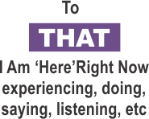
Being Ahh-llowing* of and Paying Attention:
Practical Outcomes Guaranteed
• fewer emotional hijacks,
less intense and quicker recovery
• more experiences of happiness,
more intense, last longer
• measurable growth of
unconditional compassion
• increased intentional skills
• increased entrainment
skills
TO HOW SENSES ARE PERCEIVING WHAT IS HAPPENING
*Ahh-llowing is to be subjectively/internally accepting of what B-FIT is doing moment by moment. It starts as an intended ‘let it be’ attitude of one’s inner world with a simultaneous passionate commitment to change objective/outside reality as useful.
THOUGHTS
Notes:
5 minutes
Explain that B-FIT is a set of intrapersonal tools to help develop capacity to be conscious (more fully awake) as much as possible.
Overview the skill set incorporating different areas of awareness:
Notice What You Are Saying/Doing
Notice That You Are Saying/Doing
Notice B- Body sensations
Notice F- Feelings
Notice I- Image Thoughts
Notice T- Talk Thoughts
Discuss subjective ahh-llowingness:
While we become aware, we still work passionately to change what we can objectively to make life better for others.

Slide 85

Looking with greater clarity
The Mindfulness microscope reveals a more complete and accurate experience of one’s B-FIT senses, perceptions and misperceptions.
Complete the B-FIT Mindful Exercise
Notes:
8 minutes
Read Slide
Walk group through a 5 minute BFIT Mindfulness exercise
Refer to CCS Textbook (pgs. 266-267)
Debrief exercise with group referring to slide 102

Slide 86
Mindfulness Exercise Debrief
What was your Predominant Experience of Thinking - Image or Talk? Conclusion? You are not your thoughts or feelings.
What happened when you just noticed a thought?
Did you feel relatively calm? This means Set Point movement of the Parasympathetic Nervous System and Vagus Nerve activation = Unconditional Compassion-after 25 hours some of the PNS stays turned on.
Feelings – ‘There is’ versus ‘I am’.
Mindfulness exercise reference www.centreforconsciouscare.ca Audio Resources
Notes:
5 minutes
You are not your thoughts.
There was a part of you that was able just to label the thought instead of being gripped by its content.
What happened when you noticed a thought?
It left…or burst into another thought…or just dissolved
Thoughts are thought molecules. There is only finite amount of energy to hold on to a thought. When we can build our skill set, we notice that thoughts are not unlike any other message from our sense stores. We have the capacity to not be gripped our thoughts—especially our less than optimal ones.
Did you feel relative calm?
Activated the MPFC and vagus nerve.
Feelings- There is vs. I am
Similar to out thoughts. Our feelings are just like any other message from our sense stores. We have the capacity not to be so gripped by our feelings- our emotional hijacks of fear, anger or indifference.

Slide 87
Five Ways We Can Accomplish Radical Changes to our PFP
B-FIT Mindfulness has been specifically designed to interrupt this authoritarian regime’s power in the following ways:
A reminder of being in prison:
Firstly, mindfulness reminds us that our Mind has a Mind of its own and that when we are only semiconscious (like how we drive our car), our PFP (not mindful us) is making many poor choices.
Notes:
1 minute
Read Slide

Slide 88
  Awareness right now of More Optimal Responses: The ‘mindful me’ has a much greater likelihood of not being as semiconsciously driven to behave in accordance with PFP Programming initial thoughts’ and feelings’ directives.
The more conscious we become in the moment, we immediately ‘rethink’ more optimal responses than initially offered by PFP.
I call this the Catch, Calm and Clarifying process.
Notes:
2 minutes
Read slide

Slide 89

JJanuary 11, 2016
The 5 Step
Conscious Care and Support Process
Step One: CATCH
Step 1
CATCH
“I catch myself being Here, Now: present.”
I AM AWARE
Notes:
1 minute
Read Slide
Explain that just as EMS personnel have their “go-to” steps in an emergency situation (A-airway, B-breathing, C-circulation), CCS also has a “go-to” process.
The stages of the CCS 5 Step Process are organized qualities of being mindfully, emotionally self-regulated and mature. The process is explained in steps because there is a natural order to how we move through them; in practice, however, you will find that once you have mastered them they occur almost concurrently when you are called upon to respond to someone in need.
Review the first 3 steps of the 5 Step Conscious Care and Support Process
Catch
Calm
Clarify and Choose

Slide 90
JJanuary 11, 2016
The 5 Step
Conscious Care and Support Process
Step Two: CALM
Step 2
CALM
Step 1
CATCH
Being aware and ahh-llowing of B-FIT, I calm myself and therefore calm others.
Notes:
1 minute
Read Slide

Slide 91
JJanuary 11, 2016
The 5 Step
Conscious Care and Support Process
Step Three: CLARIFY AND CHOOSE
Step 3
CLARIFY AND CHOOSE
Step 2
CALM
Step 1
CATCH
I objectively clarify my emotional state, the emotional state of the person and the needs of the situation.
I then choose what actions to take.
Notes:
1 minute
Read Slide

Slide 92
Upgrade the Live-Drive:
As we mature to B-FIT wisdom and kindness and intrapersonal skills, the PFP live-drive seems to be upgraded to a more complete version (i.e. me version 2.0) so even the PFP autopilot thoughts, feelings and actions are now more aligned with the more conscious ‘ideal self’ me.
Notes:
1 minute
Read slide

Slide 93
4. Those Thoughts and Feelings Are Not Me:
  As we are ‘just naturally’ more and more mindful, the ‘Mindful Me’ (witness, noticer, observer), less and less identifies with ‘the’ thoughts and feelings as ‘me’.
  This results in consistently manifesting our highest level of Competence, Calm and Care for all others.
Notes:
1 minute
Read Slide

Slide 94
JJanuary 11, 2016
The 5 Step
Conscious Care and Support Process
Step Four: CONSCIOUSLY CONNECT
Step 4
CONSIOUSLY CONNECT
Step 3
CLARIFY AND CHOOSE
Step 2
CALM
Step 1
CATCH
“I intend and become non-judgmental and authentically connected—no matter how I feel.”
Notes:
1 minute
Read Slide

Slide 95
JJanuary 11, 2016
The 5 Step
Conscious Care and Support Process
Step Five: CARING & COMPETENT SERVICES
CARING &
COMPETENT SERVICES
Step 5
Step 4
CONSIOUSLY CONNECT
Step 3
CLARIFY AND CHOOSE
Step 2
CALM
Step 1
CATCH
“My mindful words and actions are useful, truthful, timely and kind”
Notes:
1 minute
Read Slide
Through learning and understanding each step and the essential competency that it supports, practicing mindful exercises over and over again until they become second nature, you will find that even in an emergency or a crisis situation you will complete each step automatically and almost simultaneously.
When this happens, you will also change your outcomes and the experience of both you and the person you are supporting.

Slide 96
“From a mindful centre we can respond instead of react. Unconscious reactions create problems.
Mindful responses bring peace.
Whatever happens can be met with wisdom and compassion.”
Jack Kornfield
Notes:
Read Slide

Slide 97
WE MUST LEARN TO……
Be Self-Aware e.g. Mindful and Intentional in the Moment to:
Know/realize that you are here now.
Experience Thoughts and Feelings as messages – not you.
Ahh-llow Thoughts and Feelings to come and go and not drive and distort your subjective experiences.
Ensure emotional self regulation regardless of Thought content.
Be unconditionally compassionate – regardless of how you are Feeling.
Notes:
1 minute
Read Slide

Slide 98

Practise
Practise
Practise
Notes:
Read Slide
Parallel to calisthenics at the gym. To get stronger, you need to work the muscles.

Slide 99
JJanuary 11, 2016
Potential Accelerators:
We keep 1st world problems in perspective. ‘Awful’, relative to what?
Our actions are consistently aligned with secular moral ethics and our words are useful, truthful, timely and kind.
We live as simply as possible and consume only what we need.
We consistently take massive action on good ideas as a result of our discipline, right effort and integrity.
We have a ‘non-negotiable’ commitment to daily challenging formal
exercises and practice programs to develop our body, brain,
consciousness and mindful emotional self-regulation.
Notes:
1 minute
Read Slide

Slide 100
JJanuary 11, 2016
Potential Accelerators continued:
When possible, we relieve the suffering and enhance the well-being of others
Our heart stays ‘open’ and non-self-righteously judgmental of others who are causing suffering as we work to help them change.
We have less of a sense of ‘me’ and more of ‘we’, i.e. ‘usness’ and life ‘emerges’ beyond dualities.
After we do our Best, we Rest with the Rest - cause it’s all good.
100
Notes:
1 minute
Read Slide

Slide 101
Start Your Heart – Money Back Guarantee
As a result, happy and fulfilling and compassionate times can be more often, more intense and last longer
and
Times of suffering such as emotional hijacks and power struggles can be less frequent, less intense and recovery time will be quicker.
Notes:
1 minute
Read Slide

Slide 102
Moving Forward:
Review support interventions and consider additional areas of wellness as part of the support plan.
What is being charted and what are you doing with it?
How are decisions made to alter a support plan?
Build some skills and practices of self-reflection, self-awareness and self-regulation.
Share with others.
Notes:
5 minutes
1. Encourage that You Review Support Interventions
Does it recognize and address the unmet needs that are possibly causing the anxiety in the first place?
Do you have all of the tools in your tool box?
When we think of support teams, clinicians and practitioners, who is not around the care team that needs to be? Seek out how to get folks involved.
What you are Charting and What are you doing with it?
Is what we are charting as accurate as possible (e.g. 40 % of incident reports are at cause of supporter, not person themselves)
Are there patterns?
Are we giving this information to physicians and other prescribing professionals?
How are decisions made to alter Support Plans
Whenever possible, are choices not only self-directed but are they informed choices?
Extreme example of intravenous drug user…
Informed choice is knowing all of the ins and outs about drug use, options for harm reduction and safe injection, financial cost, relationship costs and truly informed choice would have the person experience what life is like sober to compare and feel the alternative.
4. Encourage that you do some Self-Reflective practices, build your Self-Awareness and skills of Self-Regulation.
Recognize that it’s not the you who is listening to me right now who struggles to bring their “A-Game”, yet it is very much deeply rooted within your PFP Brain.
Everyone has the capacity to become more self-regulated and compassionate; it’s not something that you have or don’t. It can be learned not unlike any other skill set you have learned.
The skill set of mindfulness is the tool to get you there. If there was an easier way, I’d already have explored it by now and we wouldn’t be here today. The more we practice mindfulness, the more you grow your competency and capacity for self-regulation along with building your conscious compassion for not only the people and families you serve but also your colleagues and your loved ones. You just have to get your tush to the cush…
Share with others
Colleagues, other families, people you are supporting, clinicians

Slide 103
JJanuary 11, 2016
Our life’s most urgent and persistent question must be; what will I do for others today?
Adapted from Martin Luther King Jr.
Notes:
Read Slide

Slide 104
JJanuary 11, 2016
Check out A Centre for Conscious Care Website
www.centreforconsciouscare.ca
Connect with Adriana (Addy) McVicker
adriana@clwindsor.org or ext. 257
or EricaTaylor
erica.taylor@clwindsor.org or ext. 258
Notes:
For follow up or further questions.

