Slide 1


JJanuary 11, 2016
Developing Emotionally Self-Regulated and Kind Supporters
Claim Your Brain, Start Your Heart
Session II – Resource 1

Slide 2
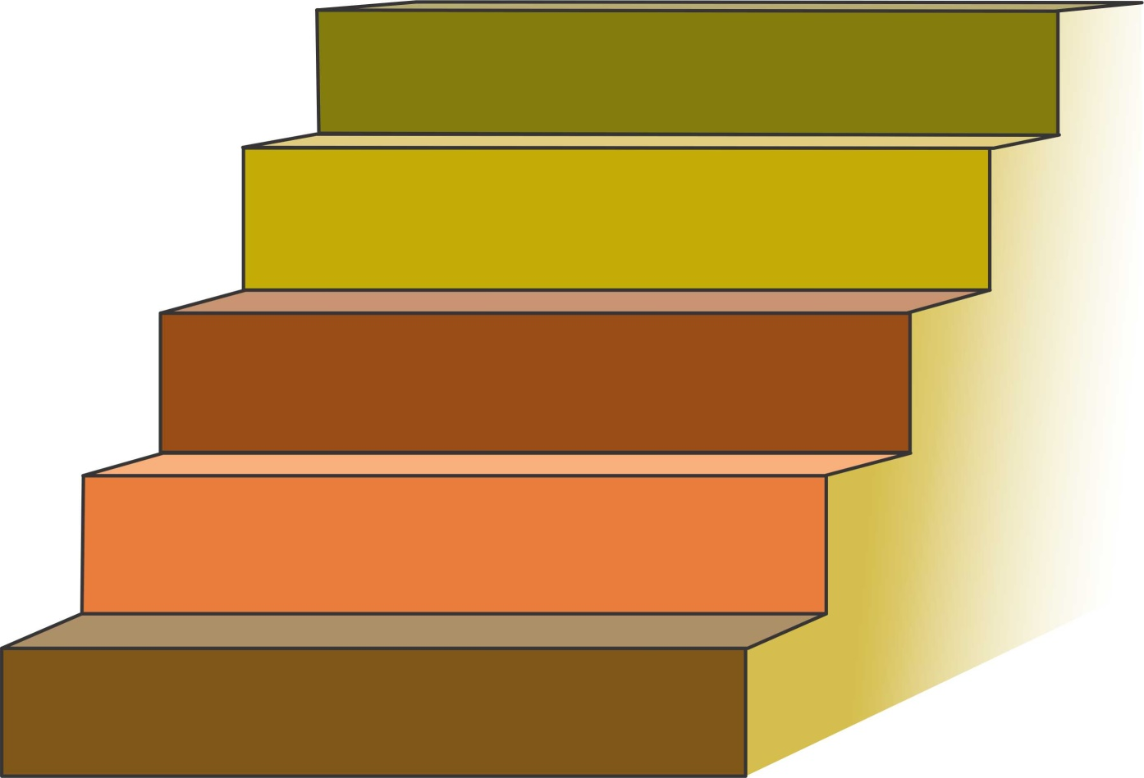
The 5 Step Conscious Care and Support Process

Slide 3
The 5 Step Conscious Care and Support Process
Step One: CATCH
Step 1
CATCH
“I catch myself being Here, Now: present.”
I AM AWARE

Slide 4
The 5 Step Conscious Care and Support Process
Step Two: CALM
Step 2
CALM
Step 1
CATCH
Being aware and ahh-llowing of B-FIT, I calm myself and therefore calm others.
(Reference B-FIT Mindfulness Tool # 3, Ahh-llowing)

Slide 5
The 5 Step Conscious Care and Support Process
Step Three: CLARIFY AND CHOOSE
Step 3
CLARIFY AND CHOOSE
Step 2
CALM
Step 1
CATCH
I objectively clarify my emotional state, the emotional state of the PwDD and the needs of the situation.
I then choose what actions to take.

Slide 6
The 5 Step Conscious Care and Support Process
Step Four: CONSCIOUSLY CONNECT
Step 4
CONSIOUSLY CONNECT
Step 3
CLARIFY AND CHOOSE
Step 2
CALM
Step 1
CATCH
“I intend and become non-judgmental and authentically connected—no matter how I feel.”

Slide 7
The 5 Step Conscious Care and Support Process
Step Five: CARING & COMPETENT SERVICES
CARING &
COMPETENT SERVICES
Step 5
Step 4
CONSIOUSLY CONNECT
Step 3
CLARIFY AND CHOOSE
Step 2
CALM
Step 1
CATCH
“My mindful words and actions are useful, truthful, timely and kind”

Slide 8

SELF-EXPRESSION
The Four Personal Qualities of
Mindful Emotional
Self-Regulation
• ‘Here Now’
• Right Speech
• Feelings to Feelings
and Reasons to Reasons
• Authentic Kindness in all Relationships
SELF-MANAGEMENT
• Catch, Calm, Clarify and Consciously Connect
• Private Victories, i.e. Self-Discipline/Sacrifice,
Persistence, & Secular Moral Ethics
SELF-UNDERSTANDING
• Discovering and Disengaging from PFP Brain
- no/low free will, e.g. choices of cities
- we have a thinking problem, e.g. your next thought?
- inattentional blindness, e.g. missing buildings, cuts and cars with 60 bits
- PFP brain cheats and makes things up, e.g. checker board, memory
- the body keeps the score, but ‘we’ ignore, e.g. cards
- we are prejudice and racist, e.g. hurting hands
- feelings not facts make our decisions, e.g. train trolley
- cognitive bias – we speed dial feeling’s reactions in 1.4 seconds
SELF-AWARENESS
• Awareness of being stuck in a ‘Good Place’, e.g. semiconscious
• Awareness of the actual cause of Suffering and what to do about it
i.e. suffering = pain x resistance + pleasure x attachment
• B-FIT Mindfulness, i.e. Concentration, Sensory Clarity, Ahh-llowing and be ‘Here Now’

Slide 9
JJanuary 11, 2016
How often do power struggles compromise the quality of the supported person’s well-being?
It appears that a minimum of 40% of behavioural incidents
result from or are significantly influenced by generally good
and caring supporters’ unintended and unaware loss of
mindful emotional self-regulation. This often results in
power struggles and other supporter induced behavioural
antecedents.

Slide 10
Why might the average good and caring supporter become emotionally hijacked into power struggles that can cause challenging behaviours in the person being supported?

Slide 11
Diane and Me
The 4 Outs in Action

Slide 12
11, 2016
The 4 Outs
Tune-out is typically how the
Spaced-out Supporter
Protects our self from
Burn-out and Freak-out

Slide 13
Loss of Emotional Self-Regulation of Good and Caring Supporters Can Result in Some of the Following:
being impatient and becoming emotionally hijacked into power
struggles (i.e. silent temper tantrums or anger);
being self righteous, judgmental, critical and unforgiving;
being generally indifferent to some supported persons’ suffering;
being overtaken by 1 of the 4 outs – (Burn-out, Freak-out,
Tune-out, Space-out);

Slide 14
JJanuary 11, 2016
Loss of Emotional Self-Regulation of Good and Caring Supporters Can Result in Some of the Following: (cont’d)
the physical redirect/restraint that is executed mindlessly,
mechanically and without compassion;
the closed, “whatever,” attitude that shows on the face of the
supporter as they hear the same story over and over again;
the change and clean-up that is now hours overdue;
the powerful enforcing of ‘unnecessary rules’.

Slide 15
Could it be that these Supporters’ 4 Outs too often
drive Emotionally and Biologically Vulnerable
People into:
      elevated levels of anxiety;
      anxious repetitive behaviour;
      self injurious behaviour;
      aggression towards peers and supporters;
      property destruction.

Slide 16
,
Definitions to Better Understand the ‘Set-up’
Over each 24 hour period, we can be experiencing consciousness on a 1-10 continuum.
Unconscious: (1)
  like when we are asleep in our bed.
Semiconscious: (autopilot) (5)
  like how we typically drive our car, relate to people and do most ‘doings’.
Fully Conscious: (self aware) (10)
  like when we are paying attention – noticing what we are doing e.g. how we drive when a police car is following us;
  knowing that we are doing it and
  knowing how our body’s sensations, feelings and thoughts are
  reacting to what is happening.
Subconscious:
  our data bank of ‘files’ that we inherit and develop.

Slide 17
Life’s Set-up
Understanding The Main Sources of
Our Loss of Emotional Self-Regulation
To survive in the early, dangerous Paleo jungles, we needed Quick and Simple Reactions to solve life threatening problems.
“Our Brain hasn’t changed much
over the last 50,000 years.”
                Dr. John Ratey
                Associate Professor of Psychiatry
                Harvard Medical School

Slide 18
Life’s Set-up
Understanding The Main Sources of
Our Loss of Emotional Self-Regulation (cont’d)
The Brain therefore inherited and develops ‘Files’/a data bank from which to semiconsciously speed-dial reactions to manage our world and keep us (mainly our ego) safe.

Slide 19
JJanuary 11, 2016
Speed Dialing Often Means…………
Being Semiconsciously Driven by the Ego’s
Primitive and Programmed Needs to:
  look good and impress
  be in control
  be right
  be treated fairly
  not be criticized
  be judgmental
  be accepted by the ‘herd’

Slide 20
Life’s Set-up – Being Mostly Semiconscious
Means that we have insufficient consciousness to consistently offer our ‘A’ Game
Especially in crisis, we speed dial our ‘C’ survival game as our ancestors have done for thousands of years.

Slide 21
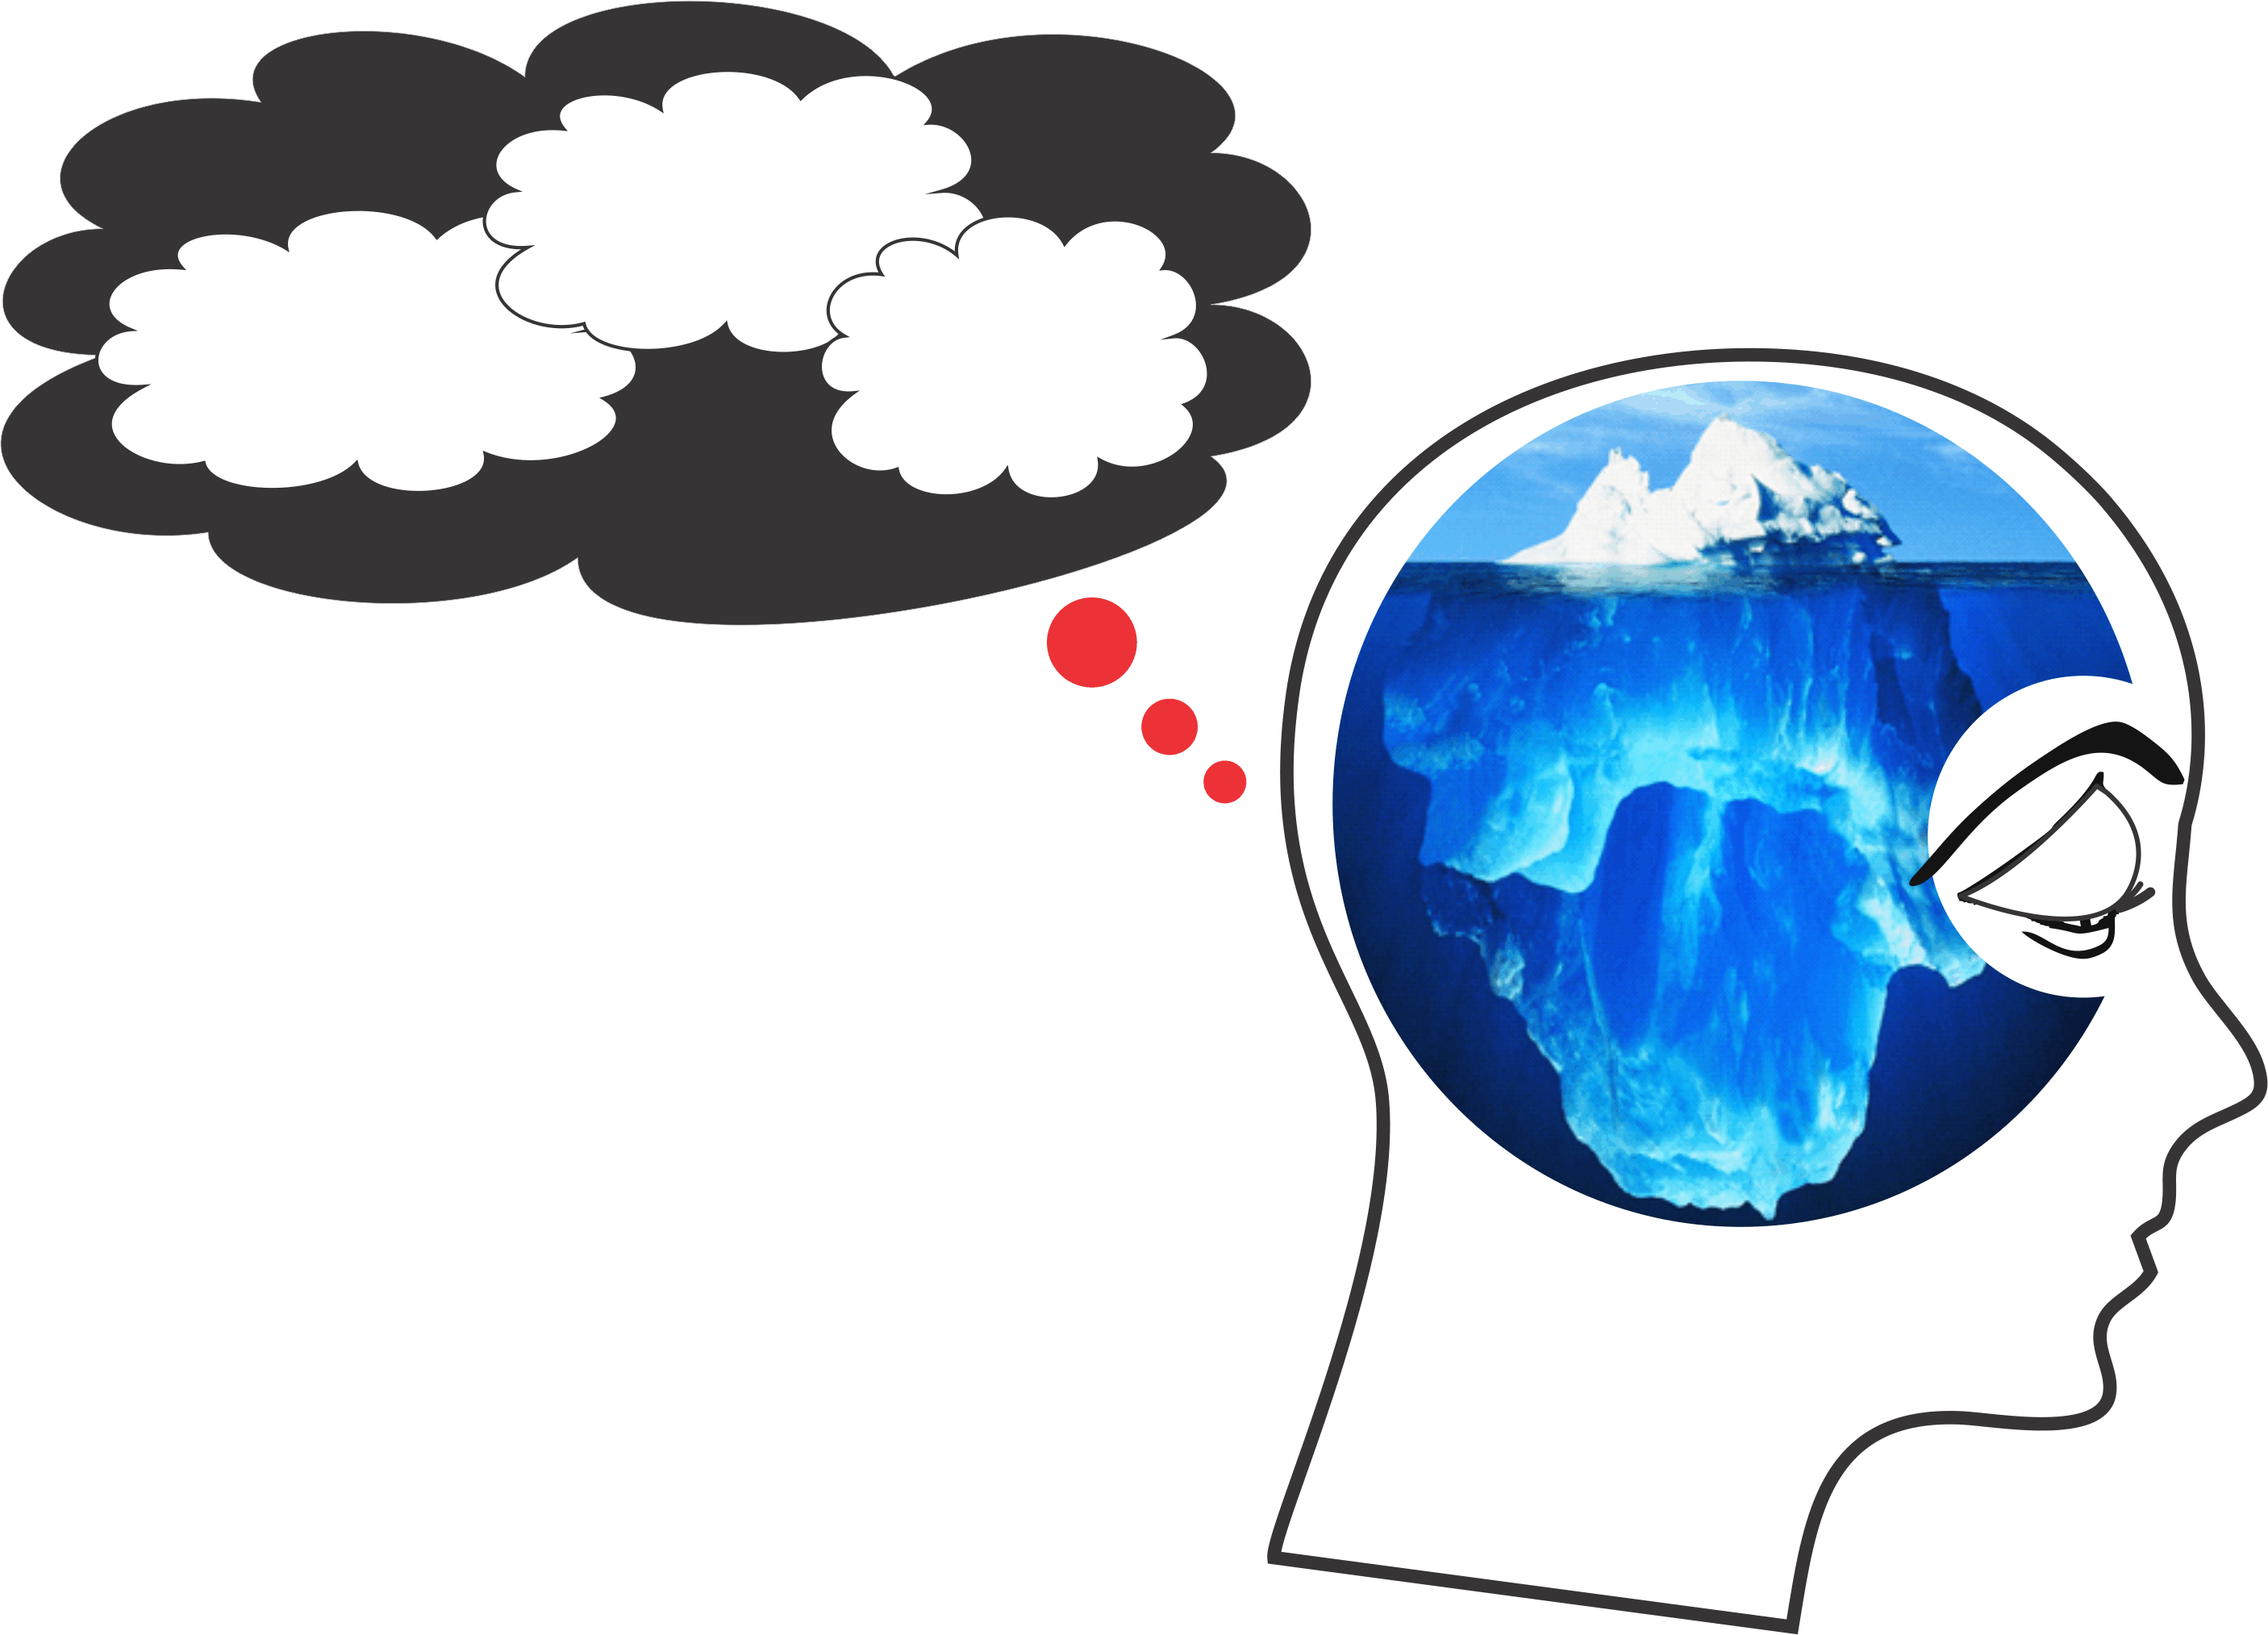
What Do We Speed Dial?
Filters
Primitive
Predispositions
Primed
Prompts
Semi-Conscious Mindless Mind
Primitive
Predispositions
Inherited genetic makeup
re: survival and reproduction
drives (i.e. ‘Nature’ You)
PFP
Subconscious
Programming
Filters
Illogical beliefs/faulty filters from
childhood conditioning e.g. “I need”,
“I am”, “Others are” (i.e. ‘Nurture’ You)
Primed
Prompts
Societal and cultural brain washing/
stereotyping/branding/bigotry
(i.e. ‘Numbed’ You)
Semi-Conscious
Mindless Mind
The “You” who is reading this but doesn’t know it (i.e. ‘Normal’ You)
Because PFP So Controls Our Life – We Call It PFP Prison!

Slide 22
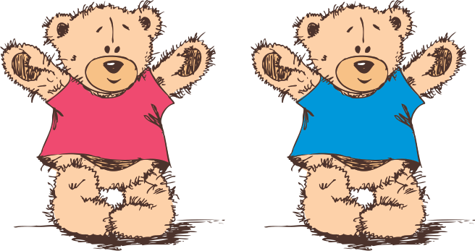
JJanuary 11, 2016
What do we mean by an ‘Inherited DATA BANK’?

Slide 23
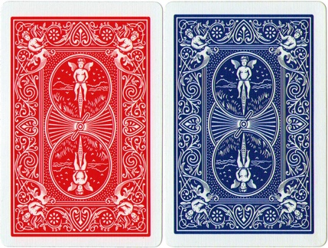
Examples of Inherited Primitive Predispositions
(The Hard-drive)

Slide 24
JJanuary 11, 2016
More Examples of Primitive Predispositions
Who Are We – Really?
Many, many decisions are made according to how hungry, tired or sensory stimulated or depleted we are and the reactions of for example, our accompanying hormone levels, neurotransmitter balances and gut health.
For example, for the same offense and similar conditions, if our case for parole is heard just after lunch rather than just before lunch, we will have a 30% better chance of gaining parole.

Slide 25
JJanuary 11, 2016
Understanding Our Filters’ Part of PFP
Installing Our Subjective Software
Understanding the Filters’ Set-up:
We start our life perceiving that “I am weak and vulnerable,” both emotionally and physically. We therefore groped for ways to feel secure through inclusion in our family (the herd). This gives a sense of counting for something and connection which our brain registers as being safe and secure.
To figure out how to meet these needs, we became a good mind reader.

Slide 26
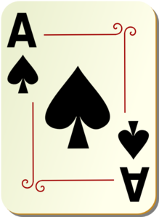
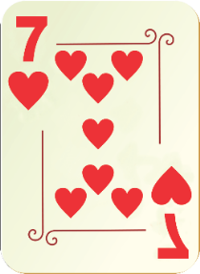
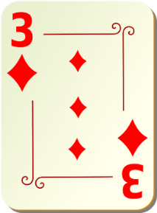
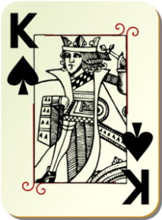
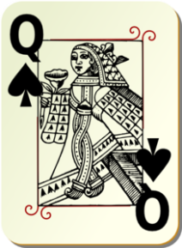
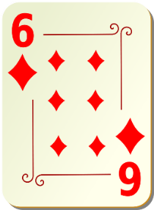
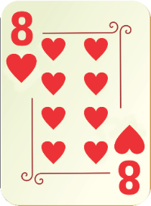
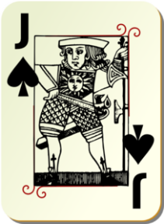
How you learned to read minds to get included and protected and in so doing, became you i.e. got programmed with rules about:
  I must be ……….
  Men are ……….
  Women are ……….
  The world is ……….
  and
  Who my ‘In-Group’ is

Slide 27

JJanuary 11, 2016
The Birth Order Experiment

Slide 28
JJanuary 11, 2016
Examples of Filters
I think that I need to be in control or not out of control of most situations and people in order to feel okay.
I think that I need to be right and above criticism in order to feel okay.
I think that I need approval from important people in my life in order for me to feel worthwhile and okay.
I think that others and life must treat me fairly otherwise, I have a God-given right to feel awful.
I think that I must be included or not be excluded from social situations that I feel are important in order for me to have adequate self-worth.
I think that I need to be superior to others in order to feel okay and worthwhile.
I think that I need to achieve and be busy in order to feel okay and that boredom is very emotionally painful and anxiety producing.

Slide 29
JJanuary 11, 2016
An Example of a Program/Filter
I can win an argument on any topic against any opponent.
People know this and steer clear of me at parties.
Often as a sign of great respect,
they don’t even invite me anymore.
Lily Tomlin
When a pick pocket meets a saint –
All they see are the saint’s pockets.
Ram Dass

Slide 30
JJanuary 11, 2016
Experiment
Divide into pairs and decide who is #1 and who is #2.
2. Everyone close your eyes.

Slide 31
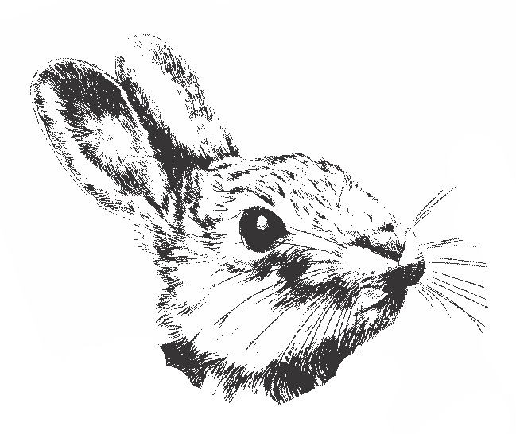
JJanuary 11, 2016

Slide 32
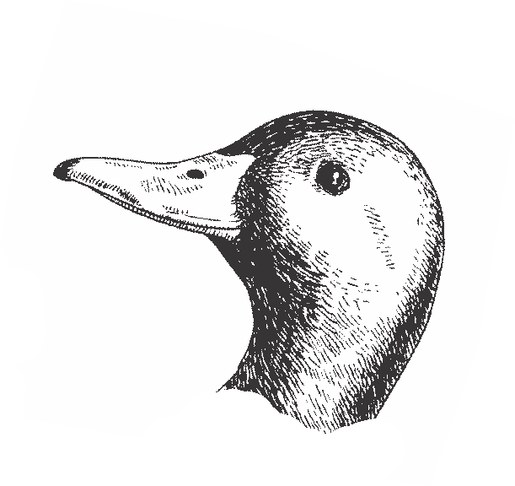
JJanuary 11, 2016

Slide 33
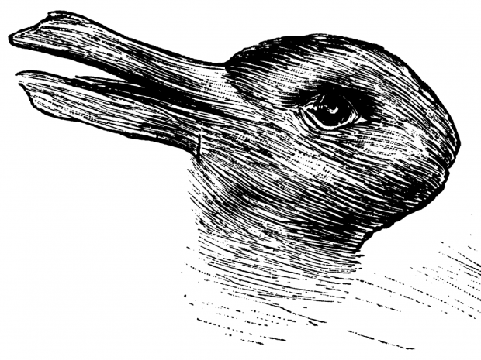
JJanuary 11, 2016

Slide 34
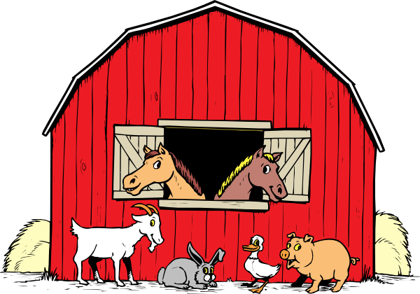
JJanuary 11, 2016
How many farm animals do you see in this picture?

Slide 35

JJanuary 11, 2016
Now tell me what you first see in this picture.

Slide 36

JJanuary 11, 2016
$90
$10
MRI Research

Slide 37
JJanuary 11, 2016
Primed Prompts
Our Brain Fabricates
Much of Our Reality
Based on
How our 7 Senses have been Primed

Slide 38
JJanuary 11, 2016
Priming Problems
Possibly one of the most serious brain primes that negatively impacts current services is most supporters’ limited beliefs regarding the potential of people who we are supporting.
As we observe the highest level of a person supported experiencing life, know that this is probably representative of the lowest level of their potential.
38

Slide 39
Examples of PFP Prison – Fellow ‘Conspiracy’ Theorists
“In each of us there is another whom we do not know.”
Carl Jung
“There’s someone in my head and it’s not me.”
Pink Floyd
“How can I tell what I think till I hear what I say?”
E.M. Forester
Could our PFP Programming be compromising the quality of some of how we offer support or leadership?

Slide 40
Examples of Supporters’ PFP Programming Prison’s Mostly Unknown Causes
For Less Than Optimal Support

Slide 41
Could it be that we have Limited Free Will to Make Optimal Choices?
Think of any city in the world.
Now think of another city.
Think of someone you know.
Now think of someone else you know.

Slide 42
So then, let’s explore our capacity for free will – Optimal Choices.
Why did you think of the first city?
Why didn’t you think of the second city first?
Why did you think of the first person?
Why didn’t you think of the second person first?
Really – did the you who is listening to me actually plan and decide what city or person ‘you’ would think about
or
did it just pop into your mind as directed by your PFP subconscious?

Slide 43
More Of The Human Predicament of Being Semiconscious Indicating Limitations Of Free Will To Think and Feel
Do you know what your next thought will be before you have it?
Do you have incessant talking thoughts with yourself all day long?
Can you stop these thoughts at will for even 15 seconds?
When you are emotionally hijacked, how long does it take you to realize it and stop it?
Would you share all the thoughts you had yesterday with
anyone?

Slide 44
I
Might this Limited*
Free Will Prison be Compromising Some of the Quality of Our Support?
* That is if we are only semiconscious i.e. mindless

Slide 45
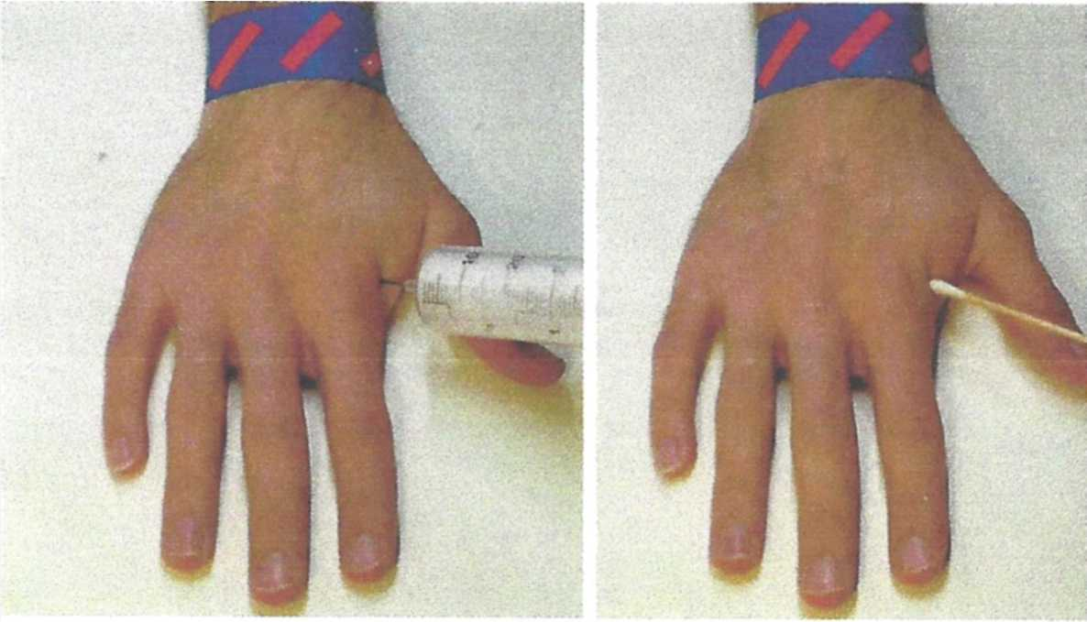
JJanuary 11, 2016
Is Most Everyone’s Brain Designed to
Devalue People Supported?
MRIs indicate that most individuals’ brains react with strong pain empathy
when they witness this painful procedure.
Provided…………………….

Slide 46
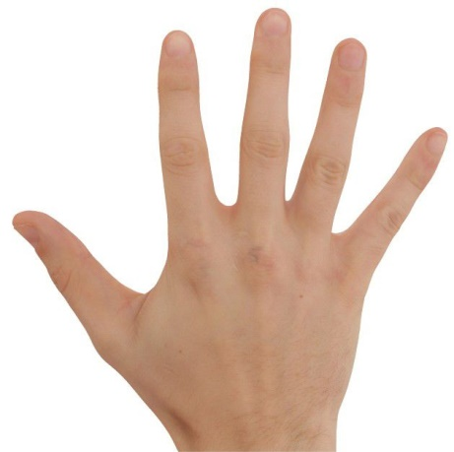
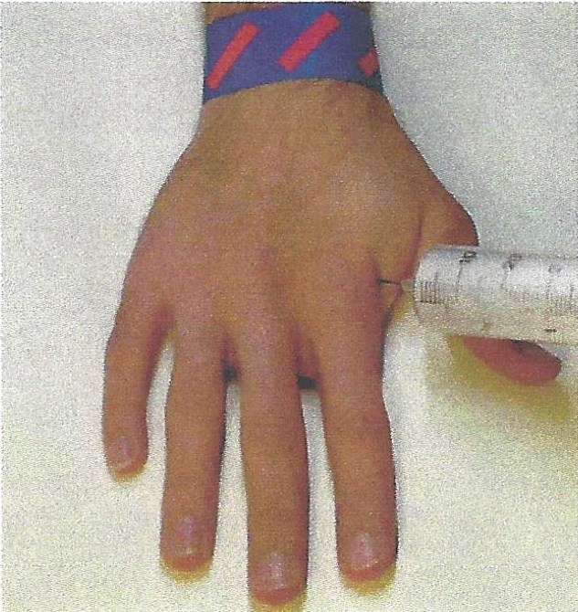
Provided the brain relates to the injured hand as being a lot like its own!
Muslim
Atheist
Atheist
Christian
Buddhist
Jew

Slide 47
JJanuary 11, 2016
Understanding ‘In’ and ‘Out’ Groups
The brain is wired to devalue/exclude others who it perceives to be different. In the old days, in the jungle, ‘different was dangerous’ so the brain evolved to reward taking care of our ‘in- group’ not other’s i.e. the ‘out-group’.

Slide 48

JJanuary 11, 2016
Neuroscience research is showing that for average Canadians and Americans, homeless people are dehumanized by the semiconscious/mindless brain. They are generally seen as ‘different’ and therefore our PFP Programming (not us) often relates to them impersonally, not like our ‘in’ group members who we feel with and for.
Department store research
and MRI Research – Dr. L. Harris

Slide 49
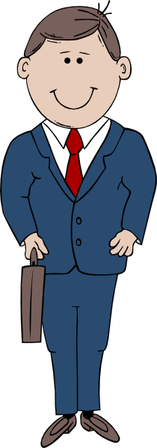
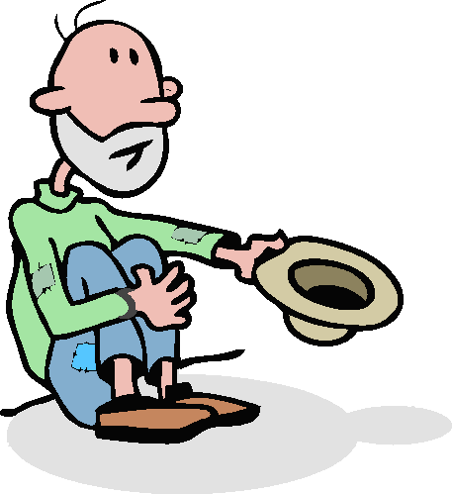
Often (good and caring) people therefore refuse to help a homeless hungry person who is asking for a toonie – Why?
Might our mindless mind’s semiconscious dehumanizing of ‘different’ be unknowingly compromising the quality of our support?

Slide 50
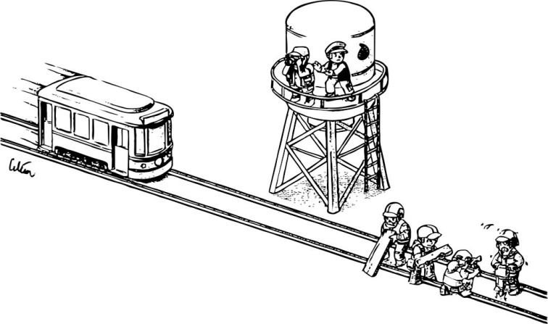
JJanuary 11, 2016
PFP-Feelings versus Logic

Slide 51
JJanuary 11, 2016
Might the example of how we supporters get our good feelings by giving unhealthy snacks or avoiding bad feelings by not encouraging more healthy life styles, be an
example of feelings overpowering logic?
Might our mindless feelings be compromising the quality of our support?

Slide 52
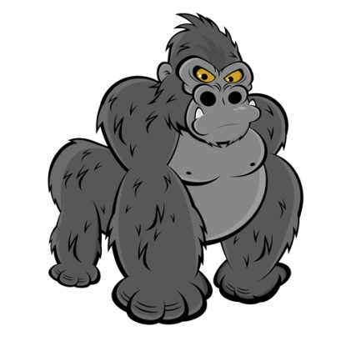
JJanuary 11, 2016
Managing Information Overload Results
in Inattentional Blindness
  Because of only 60 bits per second of data processing capacity,
  our brain filters out much information that comes our way.
  This filtering prioritizing is based on what it remembers is
  important and meaningful to it at the time, e.g. what it believes
  and wants to hear. We therefore miss buildings, pain, gorillas
  and other truths.
  Might our brain’s limited energy and narrow band width
  be compromising some of the quality of our support?

Slide 53

JJanuary 11, 2016
Focusing and Concentrating:
The brain needs to be focused and this makes it feel safe. More and more in great part because of the speed and sensory stimulation of electronic devices, our brain is being trained to lose focus quickly if the communication is not fast and multisensory appealing.
This fast form of communication is one of the worst ways to learn and retain new information needed for implementation of new and more complete interventions e.g. CCS Best Practices.
Many people supported, process information much slower than neurotypical people – we need to slow down!

Slide 54
JJanuary 11, 2016
Might Lack of Focus and Concentration be Compromising Some of the Quality of our Support?
To learn and retain and feel motivated to want to implement Best Practices thoroughly requires slow systematic repetition and persistence. This process is contrary to how the brain is being trained to learn through devices ‘sound bites’ and social media addictions.
54

Slide 55


JJanuary 11, 2016
  If I hadn’t seen it, I would not believe it!
  OR – could it be ……..
  If I hadn’t believed it – I would not have seen it!

Slide 56
JJanuary 11, 2016
To summarize, internationally published and peer reviewed neuroscience research (reference last page) indicates that our brain (not the mindful you):
makes things up based on PFP directives;
2. has a serious ‘thinking’ problem;
3. is prejudice against one’s out-groups;
4. is driven by feelings, not logic and doesn’t feel the same empathy for perceived out-groups e.g. hand needle experiment;

Slide 57
JJanuary 11, 2016
(cont’d)
5. is cognitively biased and addicted to opening existing ‘old files’ versus new files (e.g. CCS) and therefore misses 3 storey buildings and others’ support needs etc.;
needs to process things very, very fast and therefore demands simple and easy solutions;
7. is losing its focusing power due to devices’ screen addiction;
8. is programmed from childhood with many illogical and outdated programs of “I must, and should”;
9. gets ‘primed’ and acts as it has been directed e.g. when people supported have challenging behaviour, might they become an out-group for us, who we can then support in less than optimal ways without us feeling guilty?

Slide 58
JJanuary 11, 2016
So then ……..
Could it be that PFP Programming, at times is causing or seriously contributing to how we offer significantly less than optimal support?

Slide 59
JJanuary 11, 2016
With your partner:
Name what you feel are 2 of the most concerning ways that PFP Programming is unknowingly compromising the quality of our support for others.

