Slide 1

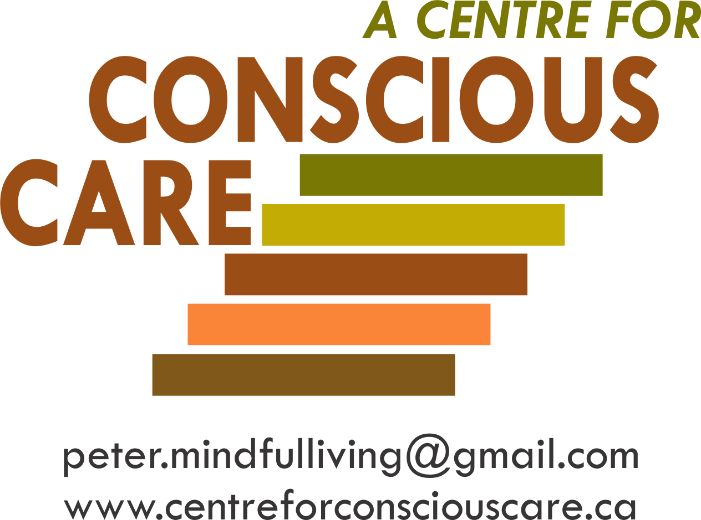
JJanuary 11, 2016
Developing Emotionally Self-Regulated and Kind Supporters
Breaking Out of PFP Prison
Session II – Resource 2
Notes:
Notes:

Slide 2
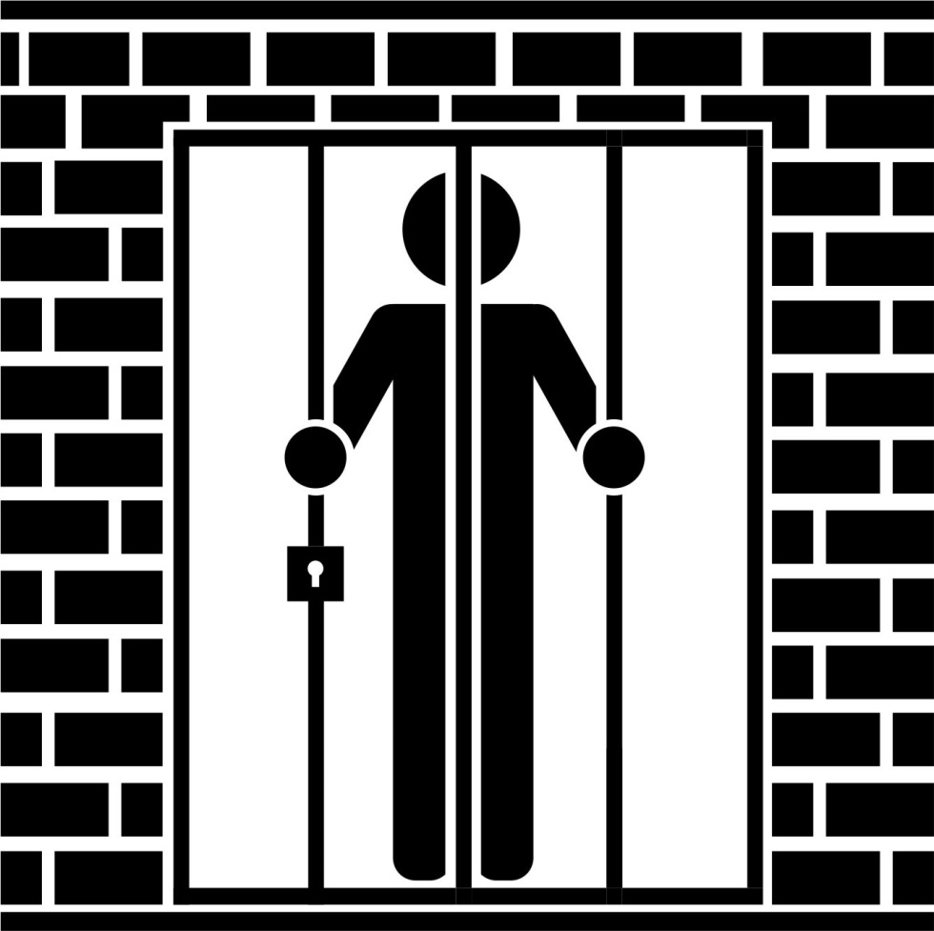

JJanuary 11, 2016
Breaking Out of PFP Prison
Is An Inside Job
Consciousness/Mindfulness
Notes:
Notes:

Slide 3
JJanuary 11, 2016
The VERY, VERY GOOD NEWS
The Power/Influence of Negative PFP Programming can be significantly Reduced as a result of becoming more Mindful/Conscious.
Mindfulness actually rewires the Brain's ‘Live’ Drive Modules like the Medial Prefrontal Cortex to give 5 ways to Prevent and Eliminate Emotional Hijacks and enhance our capacity to make better choices.
Notes:
Notes:

Slide 4

B-FIT
MINDFULNESS
it’s not what you think

Slide 5
How to Escape from
the ‘Dog Eat Dog’ World
If you can always be cheerful, ignoring aches and pains;
If you can resist complaining and boring people with your troubles;
If you can understand when your loved ones are too busy to give you any time;
If you can take criticism and blame without resentment;
If you can relax without alcohol;
...Then You Are Probably ...........
Notes:
Notes:

Slide 6

The Family Dog!
Notes:
Notes:

Slide 7
Our Human Predicament and Potential
We human folks are different from other animals with whom we share this planet.
This is because we have the potential to be conscious. This is to know that we are here and as a result can make choices that your average dog likely can’t.
Become aware that you are listening to me right now. Let’s call this being somewhat more conscious.
Notes:
Notes:

Slide 8
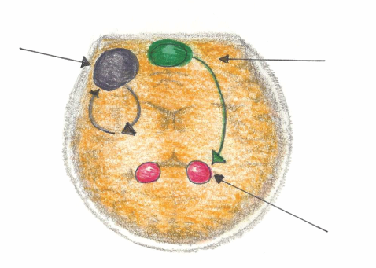
Mindful Emotional Self Regulation
The main way we can consciously access the emotional brain is through self awareness*, i.e. becoming mindful. Mindfulness increases connections in the medial pre-frontal cortex. This reduces anxiety for the Supporter and the Person Supported.
Dorsolateral pre-frontal Cortex
Working Memory
Impulse Control
Medial pre-frontal Cortex
(part of the brain that notices what’s going on)
Amygdala
(*Research reference: J. LeDoux, “Emotion Circuits in the Brain”, Journal of Neuroscience 33, no. 9 (2013) 3815-23)
Notes:
Notes:

Slide 9
According to many published Neuroscientists, including Dr. Daniel Siegel (UCLA) in his book called The Mindful Brain (page 42 and 43) the following brain, body and being functions correlate with the activity of medial areas of the prefrontal cortex:
1. Body regulation – the emotional brakes and accelerator functions.
2. Attuned communication involves the coordination of the input from another person with the activity of one’s own (as with mirror neurons).
3. Emotional balance to have enough activation so that life has meaning and vitality but not so much that life becomes chaotic.
4. Response flexibility is the capacity to pause before action.
5. Empathy – knowing what might be going on inside someone else.
6. Insight or self-knowing awareness to be able to link the past, present and future.
7. Fear modulation that may be carried out by the release of the inhibitory neurotransmitter GABA.
8. Intuition – a neural mechanism by which we process deep ways of knowing via our body i.e. ‘somatic intelligence’.
9. Morality – taking into consideration the larger picture, to image what is best for the
whole not just one’s self, even when alone.
Notes:
Notes:

Slide 10
Write Your Signature
Notes:
Notes:

Slide 11


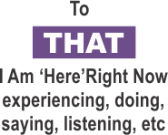
Being Ahh-llowing* of and Paying Attention:
Practical Outcomes Guaranteed
• fewer emotional hijacks,
less intense and quicker recovery
• more experiences of happiness,
more intense, last longer
• measurable growth of
unconditional compassion
• increased intentional skills
• increased entrainment
skills
TO HOW SENSES ARE PERCEIVING WHAT IS HAPPENING
*Ahh-llowing is to be subjectively/internally accepting of what B-FIT is doing moment by moment. It starts as an intended ‘let it be’ attitude of one’s inner world with a simultaneous passionate commitment to change objective/outside reality as useful.
THOUGHTS
Notes:
Notes:

Slide 12

Looking with greater clarity
The Mindfulness microscope reveals a more complete and accurate experience of one’s B-FIT senses, perceptions and misperceptions.
Complete the B-FIT Mindful Exercise
Notes:
Notes:

Slide 13
Mindfulness Exercise Debrief
What was your Predominant Experience of Thinking - Image or Talk? Conclusion? You are not your thoughts or feelings.
What happened when you just noticed a thought?
Did you feel relatively calm? This means Set Point movement of the Parasympathetic Nervous System and Vagus Nerve activation = Unconditional Compassion-after 25 hours some of the PNS stays turned on.
Feelings – ‘There is’ versus ‘I am’.
Mindfulness exercise reference www.centreforconsciouscare.ca Audio Resources, Disk 9, Track 1
Notes:
Notes:

Slide 14
“It is the mind and only the mind that determines the quality of one’s life.”
Siddhartha
Notes:
Notes:

Slide 15
The following 5 Ways are How We Accomplish Radical Changes to Nature, Nurture and Normal’s Nasty PFP Programming
B-FIT Mindfulness has been specifically designed to interrupt this authoritarian regime’s power in the following 5 ways:
A reminder of being in prison:
Firstly, mindfulness reminds us that our Mind has a Mind of its own and that when we are only semiconscious (like how we drive our car), our PFP (not mindful us) is making many poor choices.
Notes:
Notes:

Slide 16
  Awareness right now of More Optimal Responses: The ‘mindful me’ has a much greater likelihood of not being as semiconsciously driven to behave in accordance with PFP Programming initial thoughts’ and feelings’ directives.
The more conscious we become in the moment, we immediately ‘rethink’ more optimal responses than initially offered by PFP.
I call this the Catch, Calm and Clarifying process.
Notes:
Notes:

Slide 17

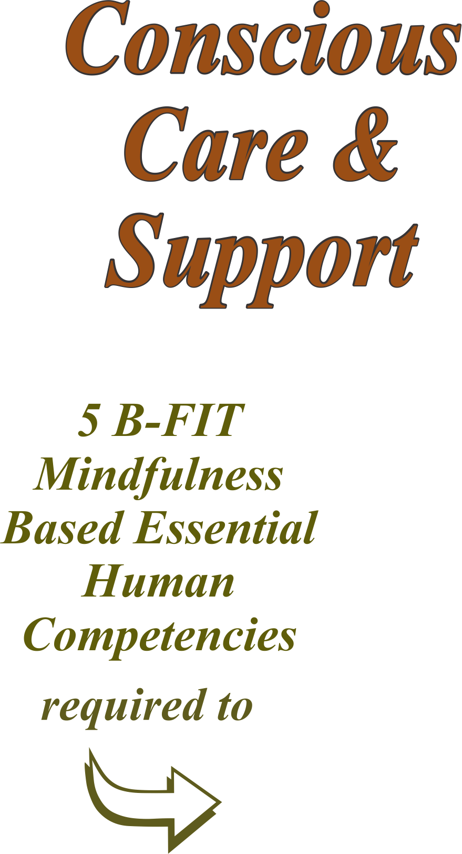
Part 5
CARING & COMPETENT SERVICES
Part 4
CONSCIOUSLY CONNECT
Part 3
CLARIFY AND CHOOSE
Part 2
CALM
Part 1
CATCH
Notes:
Notes:

Slide 18
Upgrade the Live-Drive:
As we mature to B-FIT wisdom and kindness and intrapersonal skills, the PFP live-drive seems to be upgraded to a more complete version (i.e. me version 2.0) so even the PFP autopilot thoughts, feelings and actions are now more aligned with the more conscious ‘ideal self’ me.
Notes:
Notes:

Slide 19
4. Those Thoughts and Feelings Are Not Me:
  As we are ‘just naturally’ more and more mindful, the ‘Mindful Me’ (witness, noticer, observer), less and less identifies with ‘the’ thoughts and feelings as ‘me’.
  This results in consistently manifesting our highest level of Competence, Calm and Care for all others.
Notes:
Notes:

Slide 20
5. Wisdom and Authentic Kindness:
With sufficient:
    Time
    Focus
    Sensory clarity
    Ahh-llowingness
B-FIT starts to self-organize into flowing ‘emerging’ wisdom and ‘usness’ authentic kindness.
Consider the following…
Notes:
Notes:

Slide 21
Mindful Emergence
Emergence is found in all biological (and other) systems, e.g. birds, fish, ants and drumming circles
Mindful emergence is…
Mindfulness (and several other practices) changes normal sensory conditions into sufficient qualitative and quantitative experiences so as to transform solid form (B-FIT) into flowing energy.
This flowing energy then ‘emerges’ as
radically re-ordered B-FIT wisdom and
authentic compassion e.g. B-FIT exercise – Listening to the ringing of a bell.

Slide 22

Mindful Exercise – Emergence
3. Job #1 and Job#2
4. Support examples of flow
• wisdom – self-ordering special thoughts
• authentic kindness – beyond feelings

Slide 23
“From a mindful centre we can respond instead of react. Unconscious reactions create problems.
Mindful responses bring peace.
Whatever happens can be met with wisdom and compassion.”
Jack Kornfield
Notes:
Notes:

Slide 24
WE MUST LEARN TO……
Be Self-Aware e.g. Mindful and Intentional in the Moment to:
Know/realize that you are here now.
Experience Thoughts and Feelings as messages – not you.
Ahh-llow Thoughts and Feelings to come and go and not drive and distort your subjective experiences.
Ensure emotional self regulation regardless of Thought content.
Be unconditionally compassionate – regardless of how you are Feeling.
Notes:
Notes:

Slide 25
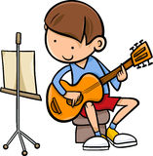
Practise
Practise
Practise

Slide 26
,
STAGES of DEVELOPMENT of MINDFUL EMOTIONAL SELF-REGULATION (MESR)
1. No awareness at the time or after the situation of being emotionally hijacked and therefore no at the time emotional self-regulation.
2. Late awareness (after the situation) of having been in an emotional hijack with some understanding of what went wrong and better intentions for the next time.
At the time, there is some awareness of being emotionally hijacked but with no ability to be emotionally self-regulated. There is however, some in the moment regrets for not being emotionally self-regulated and a desire to be more skillful.
At the time of the situation, there is some awareness of being emotionally hijacked (i.e. Catch) with some in the moment mindful, emotional self-regulation skills and kindness (i.e. Calm) and therefore lessening of the emotional hijack.
At the time of the situation, there is ongoing awareness and mindful, emotional self-regulation of B-FIT, including insights, awareness and skillful communications that are useful, truthful, timely and kind. Therefore there is no emotional hijack and there is catch, calm, clarify, conscious connecting and compassionate care.
Notes:
Notes:

Slide 27
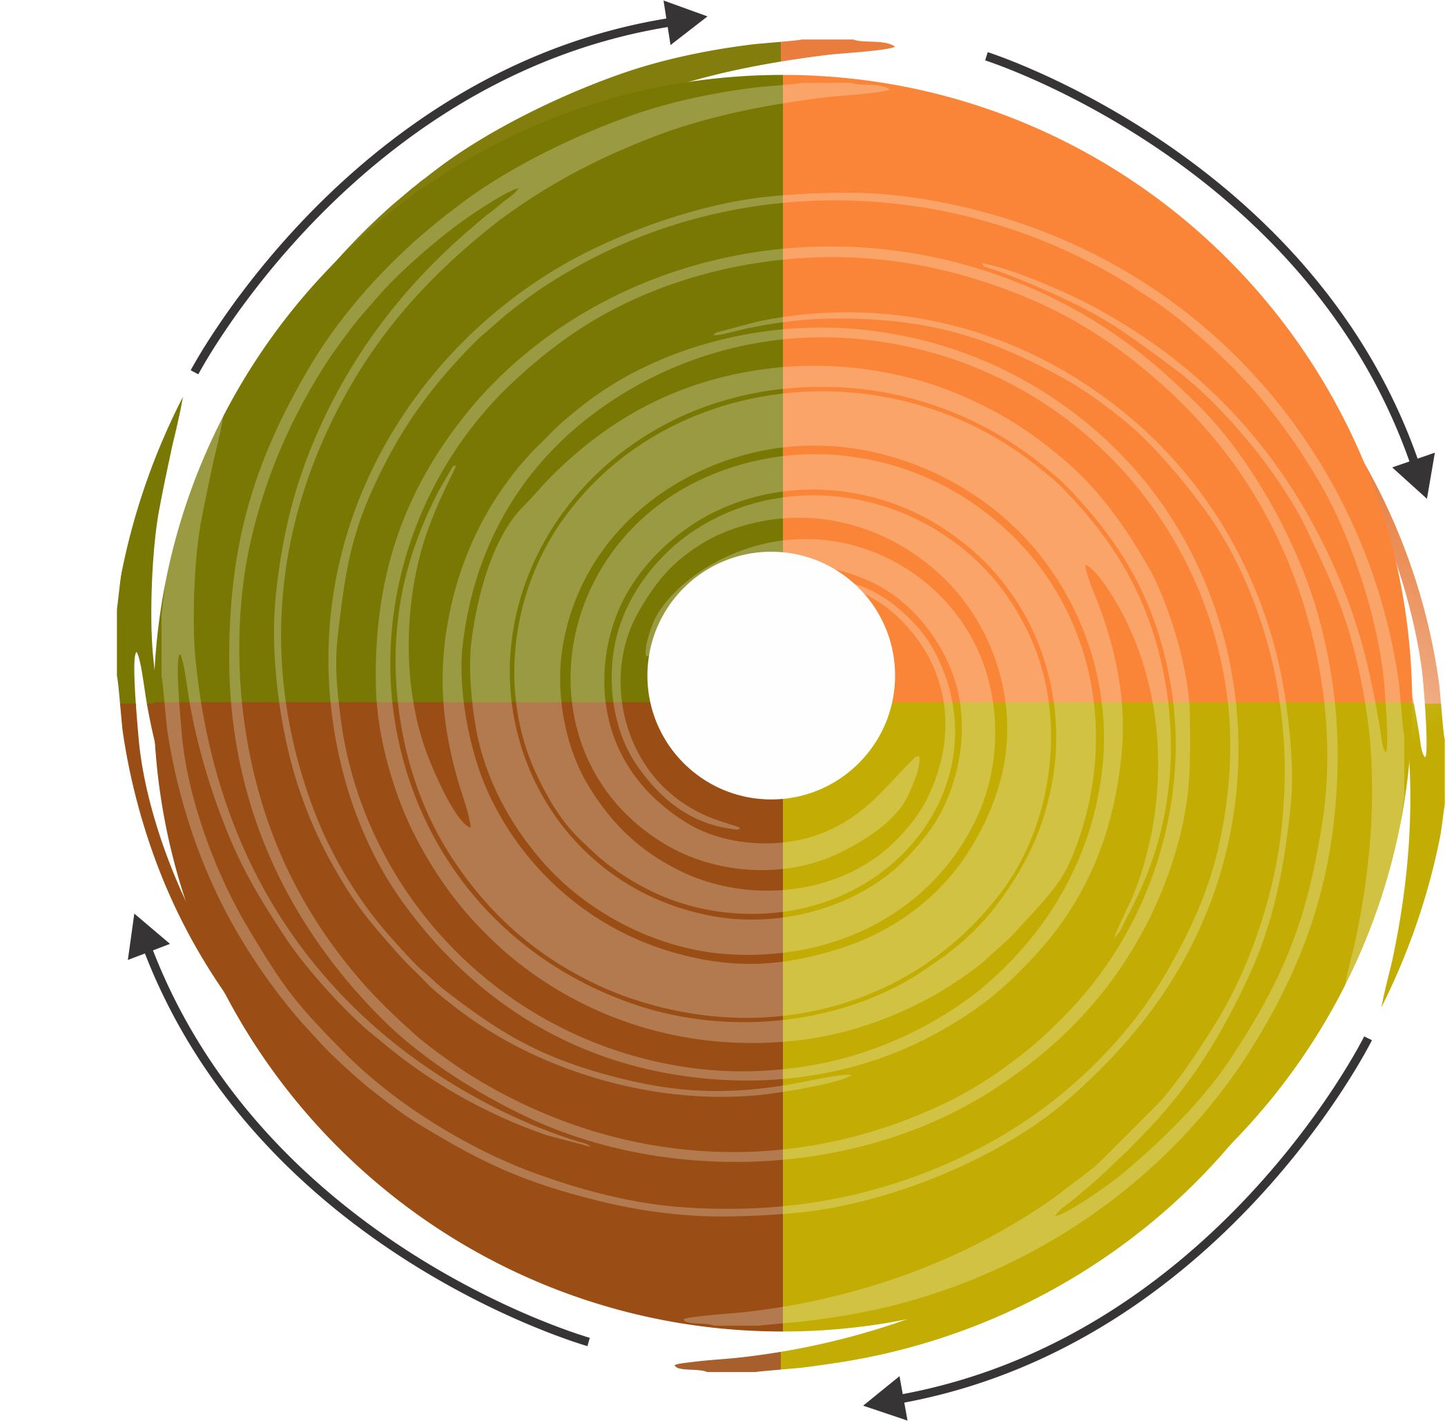




Mindful Happiness Is:
with daily acts of kindness, help all others to:
as good a life as possible
e.g.
• nutrition & fitness
• responsible lifestyle
• fulfilling relationships
• meaningful work
• voluntary simplicity
• service to others
• construct
• correct
• cultivate
‘USNESS’
awareness and ahh-llowingness
of thoughts, feelings and body
sensations to:
PFP Brain’s ‘driven’ thoughts, feelings and behaviours
i.e.
• enhance secular moral ethics
• be naturally kind and
calm in chaos
• be happy for no
particular reason
• primitive predispositions
• filters
• primed prompts
Notes:
Notes:

Slide 28
JJanuary 11, 2016
Potential Accelerators:
We keep 1st world problems in perspective. ‘Awful’, relative to what?
Our actions are consistently aligned with secular moral ethics and our words are useful, truthful, timely and kind.
We live as simply as possible and consume only what we need.
We consistently take massive action on good ideas as a result of our discipline, right effort and integrity.
Notes:
Notes:

Slide 29
JJanuary 11, 2016
Potential Accelerators continued:
‎We have a ‘non-negotiable’ commitment to daily challenging formal exercises and practice programs to develop our body, brain, consciousness and mindful emotional self-regulation.
When possible, we relieve the suffering and enhance the well-being of others.
Our heart stays ‘open’ and non-self-righteously judgmental of others who are causing suffering as we work to change them.
We have less of a sense of ‘me’ and more of ‘we’, i.e. ‘usness’ and life ‘emerges’ beyond dualities.
After we do our Best, we Rest with the Rest - cause it’s all good.
29
Notes:
Notes:

Slide 30
Start Your Heart – Money Back Guarantee
As a result, happy and fulfilling and compassionate times can be more often, more intense and last longer
and
Times of suffering such as emotional hijacks and power struggles can be less frequent, less intense and recovery time will be quicker.
Notes:
Notes:

Slide 31
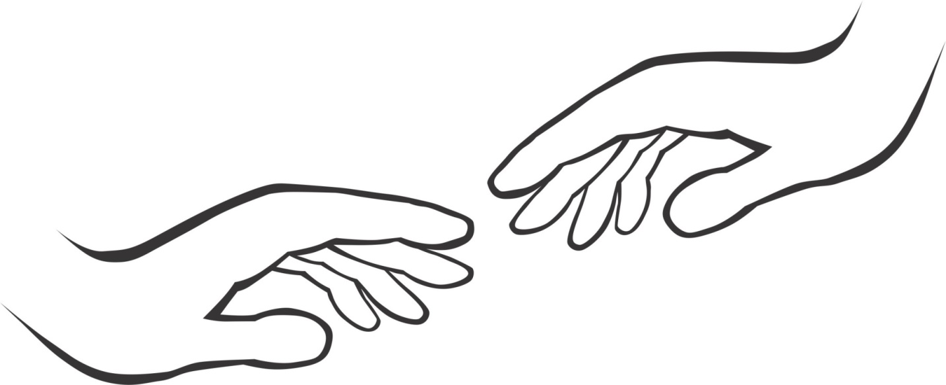
JJanuary 11, 2016
Compassion appears as selfless service, yet in mindful care and support we do not serve the other; we serve “us”. Compassion’s communion brings us together in a whole. It does not see the world’s pain and sorrow as other, it is shared, and it is ours. When we allow our shared vulnerability and humanness, our compassion is as natural as our breath and without hesitation we act to help.
Thich Nhat Hanh
Notes:
Notes:

Slide 32
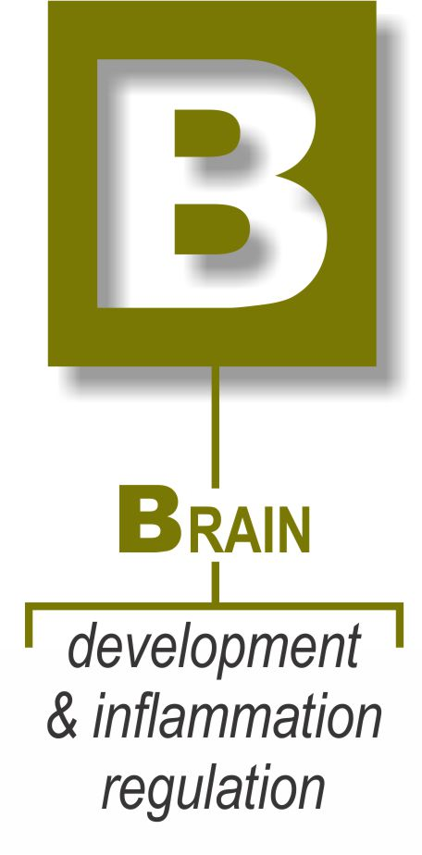
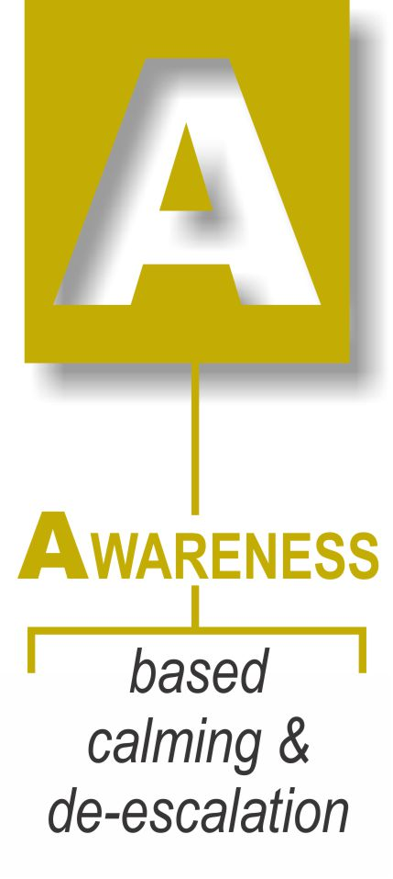


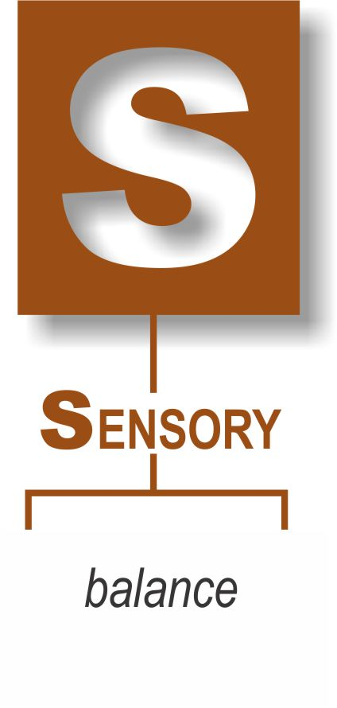
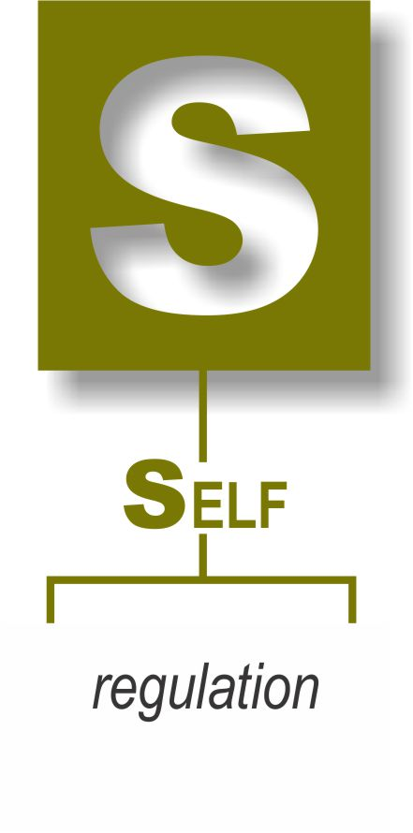
Summing It Up
for
Well-being
Notes:
Notes:

Slide 33
JJanuary 11, 2016
Our life’s most urgent and persistent question must be; what will I do for others today?
Adapted from Martin Luther King Jr.
Notes:
Notes:

Slide 34
JJanuary 11, 2016
How I Will
Further Develop and Maintain
My Emotional Self-Regulation, Maturity and
Motivation to Consistently Offer More Optimal Support
Continue: _______________________________________________________________________________
Stop: __________________________________________________
Start: __________________________________________________
Notes:
Notes:

Slide 35
Growing Up
With A Disability
Notes:
Notes:

Slide 36
The Mindfulness Alternative
Approximately 25 hours of Mindfulness Training and Practise significantly reduces these risks and enhances your Conscious and Unconditional Compassionate Thoughts, Feelings, Care and Support Skills.
References:
basicmindfulness.org – Shinzen Young
University of Wisconsin, R. Davidson
Full Catastrophe Living, J. Kabat-Zinn
The Effect of Mindfulness on Anxiety and Depression – A Meta Analytic Review, S.G. Hofmann
Stress and Parasympathetic Control, S.W. Pargee
The Mindful Brain, D.J. Siegel
The Body Keeps the Score – Bessel van der Kolk (pages 203-218)
Waking Up – Sam Harris (pages 119-123)
Notes:
Notes:

Slide 37
JJanuary 11, 2016
PFP Brain Research References
Blakeslee, M & S The Body Has A Mind of Its Own
Doidge, N. The Brain’s Way of Healing
Eagleman, D. Incognito
Eagleman, D. The Brain
Fine, C. A Mind of Its Own
Gazzaniga, M.S. Who’s In Charge?
Gladwell, M. Blink
Goldstein, J.; Kornfield, J. Seeking the Heart of Wisdom
Goleman, D. Emotional Intelligence
Goleman, T. Emotional Alchemy
Hawkins, D. Power vs. Force
Johnson, S. Mind Wide Open
Marks, P. & G Conscious Care and Support
Mlodinow, L. Subliminal
Van der Kolk, B. The Body Keeps the Score
Young, S. The Science of Enlightenment
Notes:
Notes:

