Slide 1



Week Five
Sensory Integration and Processing
Notes:
Picton
We acknowledge that Picton and Prince Edward County is on the traditional territory of the Huron-Wendat, Anishinaabe, and Haudenosaunee peoples and adjacent to the Mohawk community of Tyendinaga (tie-en-de-neh-ga).
These peoples agreed to mutual sharing obligations and responsibilities as stewards of the land and water. We recognize that these are now our shared obligations in partnership, to continue to protect the land and water. In doing our work we honour the Indigenous ancestors who came before us and who continue to be present in lands which we occupy.
Windsor
We acknowledge that we are on land and surrounded by water, originally inhabited by Indigenous Peoples who have travelled this area since time immemorial. This territory is within the lands honoured by the Wampum Treaties; agreements between the Anishinaabe (Ah-nish-naw-beh), Haudenosaunee, Lenny Lenopee and allied Nations to peacefully share and care for the resources around the Great Lakes. Specifically, we would like to acknowledge the presence of the Three Fires Confederacy (including the Ojibwe , Odawa , Potawatomi) and Huron/Wendat Peoples. . We respect the longstanding relationships with First Nations people in this place and we are dedicated to honouring Indigenous history and culture while remaining committed to moving forward respectfully with all First Nations, Inuit and Métis.

Slide 2

Physical and
Emotional Well-being
Toward A More Complete Understanding
of the Hierarchy of Unmet Needs
Sensory integration and processing
Human energy system – building, balancing and protecting from wireless radiation and electromagnetic fields (EMF)
Brain development, coherence balancing and inflammation regulation
Emotional wellness:
• mental and neurological health and
disorders’ treatment
• trauma desensitization and triggers’ elimination
• psychological well-being
• medication side effects
Gastrointestinal (GI), bowel, digestive and immune systems’ treatment, nutrition etc.
Awareness-based calming and de-escalation skills offered by mindful, emotionally self-regulated and kind supporters

Slide 3


The Recurring Cycles of Behaviour to Calm to Behaviour
UNMET NEEDS
• Traditional Medical
• Behavioural
• Social
• Biomedical
Best Practices
• Supporter’s
Mindful
Emotional
Self Regulation
and Kindness
• Competent
Intervention
Process
Blow-Out
(fight or flight)
e.g. • anger • SIB
• external aggression
(people and property)
Primarily
Behavioural
and
Traditional
Medical
Responses
and
Follow Up
GOALS’ ACHIEVEMENT
OUTCOMES OF
UNMET NEEDS
• Agitation
• Anxiety
Mainly behavioural compliance, e.g. reduction of functional goals
or
Behavioural
Blow-In
(freeze)
e.g. • withdraw
• depression

Slide 4
MAKING SENSE OF THE SENSES
Everyone’s ‘reality’/life experience comes through 8 senses
Our sense doors are:
• Taste
• Smell
• Hearing (Auditory)
• Seeing (Visual)
• Touching (Tactile)
• Balancing (Vestibular)
• Body Awareness (Proprioception)
• Interoception (sensing pain or too hot/cold)
Notes:
If any sense door isn’t fully developed and operational, it can be overly sensitive (hyperactive) or under sensitive (hypoactive).

Slide 5
Hyper vs. Hypo Sensitivities

Slide 6



Hyperactive Senses Lead to Challenging Behaviours
Hyperactive Senses
means that
people, objects and places can be:
e.g.
  too loud
  too fast
  too scratchy
  too tight
  too bright
  too off balance
  too confusing
  too chaotic
Agitation, Anger and/or Aggression
e.g.
repetitive behaviour
challenging behaviour
Injury to self or others
A
N
X
I
E
T
Y
=
=

Slide 7
Hypoactive Senses Lead to Challenging Behaviours
Agitation, Anger and/or Aggression
e.g.
low energy
low motivation
quiet/withdrawn
Eventually -
repetitive behaviour
challenging behaviour
Injury to self or others
Hypoactive Senses
means that
people, objects and places can be:
e.g.
  too quiet
  too slow
  too dark
  too loose
  too tickly
  too confusing
  too chaotic
A
N
X
I
E
T
Y
=
=

Slide 8

Prevalence of Sensory Problems
People with autism and other developmental disabilities are at a much higher risk of having sensory integration problems
Notes:
(approximately 80% of this population have sensory integration problems).

Slide 9
Prevalence of Sensory Problems (cont’d)
A high percentage of challenging behaviours such as aggression or self-harm are caused by sensory problems (reference Aggression to Calming).
A high percentage of these challenging behaviours can be prevented and deescalated with sensory interventions to improve sensory processing (in the moment) and sensory integration.

Slide 10
Prevalence of Sensory Problems (cont’d)
Startle Response
A majority of people with developmental disabilities startle much more readily due in part to hyperactive hearing (the inner ear does not form properly). They also startle for up to 1 hour versus 5-10 seconds for neurotypical individuals.
Senses must all be working together i.e. be integrated. If they are not, several of the person’s senses can react to over stimulation e.g. a startle often makes light seem 5 times brighter and noises 5 times louder.

Slide 11
Prevalence of Sensory Problems (cont’d)
A person’s preferred stimulating activities are often clues leading to what need they are trying to meet and how best to meet that need. Encourage safe self-stimulation and add a well-balanced, prescribed (by Occupational Therapist if possible) daily sensory diet.
Occupational Therapists who are trained and certified in Sensory Integration methods are the best qualified to assess and plan interventions and daily sensory diets.
The following are examples of typical sensory processes that are more often problematic for people with developmental disabilities.

Slide 12



Proprioception
Vestibular
Tactile
Notes:
Proprioception – Sense of Movement of Body
Often the real reason that s/he keeps crashing, jumping, tripping, falling, enjoys tight clothing, avoids playing sports, writing too dark, breaking things, and bangs their head is that they are trying to reorganize/make stronger the messages from joints to the brain to improve motor skills i.e. improve the map.
Vestibular – Sense of Balance
The Vestibular system receptors are in the inner ear. The system responds both to movement and gravity and affects balance, eye movements, posture, muscle tone and attention. This system can also often be related to hearing regulation problems.
Tactile – Sense of Touch
The sense of touch is critical to lay the foundation for a more balanced, organized central nervous system.

Slide 13
Balanced Gastrointestinal (GI) is required for….
Balanced Neurotransmitters which are required for….
Balanced Sensory Integration & Processing

Slide 14
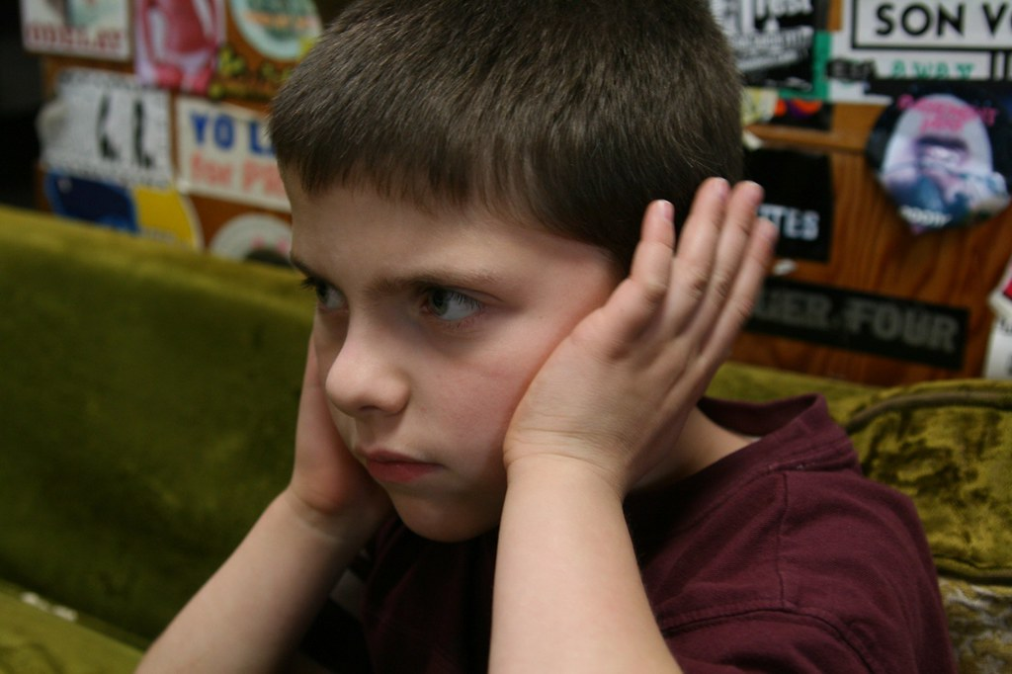
Audio Sensory Processing Problems

Slide 15
Inner Ear Problems
People with developmental disabilities or autism often cannot tune into
human speech because they cannot use their Middle Ear Muscles to
dampen the lower sound frequencies as others can.
  Because lower frequencies are at full volume, they mask higher frequencies
  Lower frequencies trigger Fight/Flight brain responses
  Autopsies often find cerebellum inflammation which has close links to the vestibular inner ear system (ref. John Hopkins, 2005)
  Sound Therapy is often an effective treatment (RE: The Listening Centre in Toronto, ON)

Slide 16
Sensory Processing and Integration Summary
Any sense can be over or under stimulated.
Observe to see what repetitive activities people prefer and their possible symptoms of sensory dysfunction.
The need for patterns/order, organization and consistency/predictability is to keep senses working properly.
Nutrition is critical.
Consult a qualified Occupational Therapist for assessments and treatments.
Notes:
Any sense can be over or under stimulated. Observations should also be made concerning:
visual (sight) – too bright or too dull
auditory (hearing) – too loud or too quiet
gustatory (taste) – too sour or sweet, bitter or salty or spicy
olfactory (smell) – too musty, putrid, pungent or not enough
Observe those you support to see what repetitive activities they prefer, and what their symptoms of sensory dysfunction might be. Keep accurate records and share observations with an Occupational Therapist or Medical Doctor in order for them to plan a work-out sensory diet regime.
People with developmental disabilities need patterns/order, organization and consistency/predictability to keep senses working properly. Due to neurophysical irregularities (e.g. sensory dysfunction) always, always ask “Is their expression of agitation to this experience, organizing their senses right now?”
Whole Foods Nutrition is critical.
Consult a qualified Occupational Therapist for assessments and treatments.

Slide 17
Proprioception Regulating Exercises
Vibration is highly stimulating to our proprioception sense e.g. massage chair
Weighted/compression clothing and blankets are self calming to this sense
Practice measured strengthening exercises to learn to use right level of force
Squeeze machine
Regular doses of touch from massage, brushing, handholding is excellent
Pushing and pulling
Carrying heavy objects
Weight resistance and pressure work-outs
Jumping on the trampoline
Throwing or catching a heavy ball or beanbag
Rolling up tightly in a blanket
Two people laying on backs playing bicycle together
Digging in heavy sand
Sucking on a water bottle

Slide 18
Vestibular Regulating Exercises
Through planned and controlled sensory stimuli with adaptive responses, levels of organization in the brain are
enhanced. New neuron cells are grown.
Jumping, hopping, bouncing (on a mini trampoline or stabilization ball), catching, throwing, skipping and pogo stick.
Swinging, rotating and hammocking in all directions also improves inner ear functioning.
Balance beam (1”x 6” x 8’ boards in pattern). Walk toe to heel.
Balance on boat bumpers.
Boat in the ocean exercise.
Vaulting – sudden jolts are very helpful.
Standing and balancing on elliptical cushion while catching balls.
Wii and Xbox balancing exercises.
Sit on air cushion.
Weight shifting stimulates balance and improves
inner ear and motor behaviour functioning. This
reduces movement fear and anxiety that often
leads to agitation, anger or aggression.
To be most effective, activities must be done frequently and consistently.
Notes:
Note: Pay attention as to how the individual responds to activity. If they appear over or under-stimulated, adjust ‘speed’ accordingly.

Slide 19
Tactile Regulating Exercises
To Stimulate:
Chewing appliances
Walking on a variety of textures in bare feet
Gripping appliances to stimulate ‘feel’
Colourful clothing, pictures etc.
Hand stimulation with many different textures - e.g. - from sand to water,
- to rough to smooth,
- to hot to cold
To Calm:
Avoid people who get too close
User friendly clothing – not too tight or too scratchy
‘Snoezelen type’ environments, slow moving soft light, soft textures and colours, soft music/’bubble tubes’
Ear plugs/head phones
Soft food textures e.g. minced or puréed or smoothies

