Slide 1

RENEWAL for Leaders and Supporters
to
RESTORE Optimal Well-Being
and
REGENERATE Competence and Commitment to Ensure That All People Supported Will Live to Their Fullest Potential
When People are Difficult…
How To Restart or Depart with an Open Heart
Session 8 – Resource 3

Slide 2

JJanuary 11, 2016
Everyone of Us Has or Soon Will Have, Someone In Our Life Who Can Be ‘Difficult’
How
(Are They Difficult)?
Negative Attitude
Moody
Disrespectful
Argumentative
Vindictive
Angry
Not Trustworthy
Discouraging
Self-Centred
Unfair
Unreasonable
Traumatizing
Highly Critical
Aggressive
Not Fulfilling Responsibilities to Others
Dominating
Deceitful
Selfish
Impatient
Uncooperative
2

Slide 3
JJanuary 11, 2016
Who?
People who we work with, we supervise or we report to.
Someone who disagrees with our position on Covid prevention and research findings, e.g. hygiene, vaccines, mandatory masking.
Self-centred/highly critical family member, friend or co-worker.
3

Slide 4
JJanuary 11, 2016
Someone who has betrayed or hurt us in some other way.
A parent who has knowingly or unknowingly hurt their child in one or more of the many ways a child can be hurt by a mindless, thoughtless mother or father.
A sibling who we have grown to dislike, distrust or do not want to be with.
4

Slide 5
JJanuary 11, 2016
An ex-marriage/significant other partner who has, as a result of an adversarial separation process, become enemy #1 in spite of years of loving each other.
Annoying store clerks, government bureaucrats, politicians, the ‘tax man’ and thoughtless drivers, etc.
Others – the unlovable enemies.
5

Slide 6
JJanuary 11, 2016
Vital Life Questions
Why are some people difficult to be with?
Why are some people difficult for me to be with – but these same people are not difficult for other people whom I respect?
What causes them to be this way?
How best to manage our interactions with them?
How to stop the emotional and social damages that their difficultness brings to our relationship?
How to, if necessary and possible, depart and feel okay with it?
6

Slide 7
JJanuary 11, 2016
Restarting or Departing - Optimal Outcomes…
In this resource you will learn to:
Determine if it is necessary to skillfully disconnect from them and if so, then to disconnect but with an open heart, without for example, hate, malaise, anger or other forms of suffering for both of us;
Manage these relationships so that they will be much less difficult;
7

Slide 8
JJanuary 11, 2016
Restarting or Departing - Optimal Outcomes…continued
Incorporate their presence in our life as a special teacher to help us ‘wake-up’/grow-up;
Be authentically kind and compassionate as we skillfully ‘manage’ them, in spite of the difficult feelings we have when we are with them;
Restructure the relationship to not only be respectful of each other, but to grow deeper as a friend, co-worker, etc.
8

Slide 9
JJanuary 11, 2016
4 Requirements to Achieve Optimal Outcomes with People When They are Difficult
Better understanding of the person when they are difficult, so as to best determine the cause of their difficultness.
Better understanding of ourself to know how to and want to effectively manage and prevent our experiences of negativity when others are difficult.
If necessary and possible, how to effectively dissolve the relationship with an open heart.
If departing is not an option, learn the 11 ways to prevent/reduce/
eliminate the negative consequences caused by their difficultness.
My Conflicted Heavy Heart
9

Slide 10

JJanuary 11, 2016
The Work Isn’t Complex – But We Must Be Persistent
It is slow, painful, and difficult for an adult to reconstruct a radically different way of seeing life, however needlessly miserable his present preconceptions make him. Peter Marris
10

Slide 11
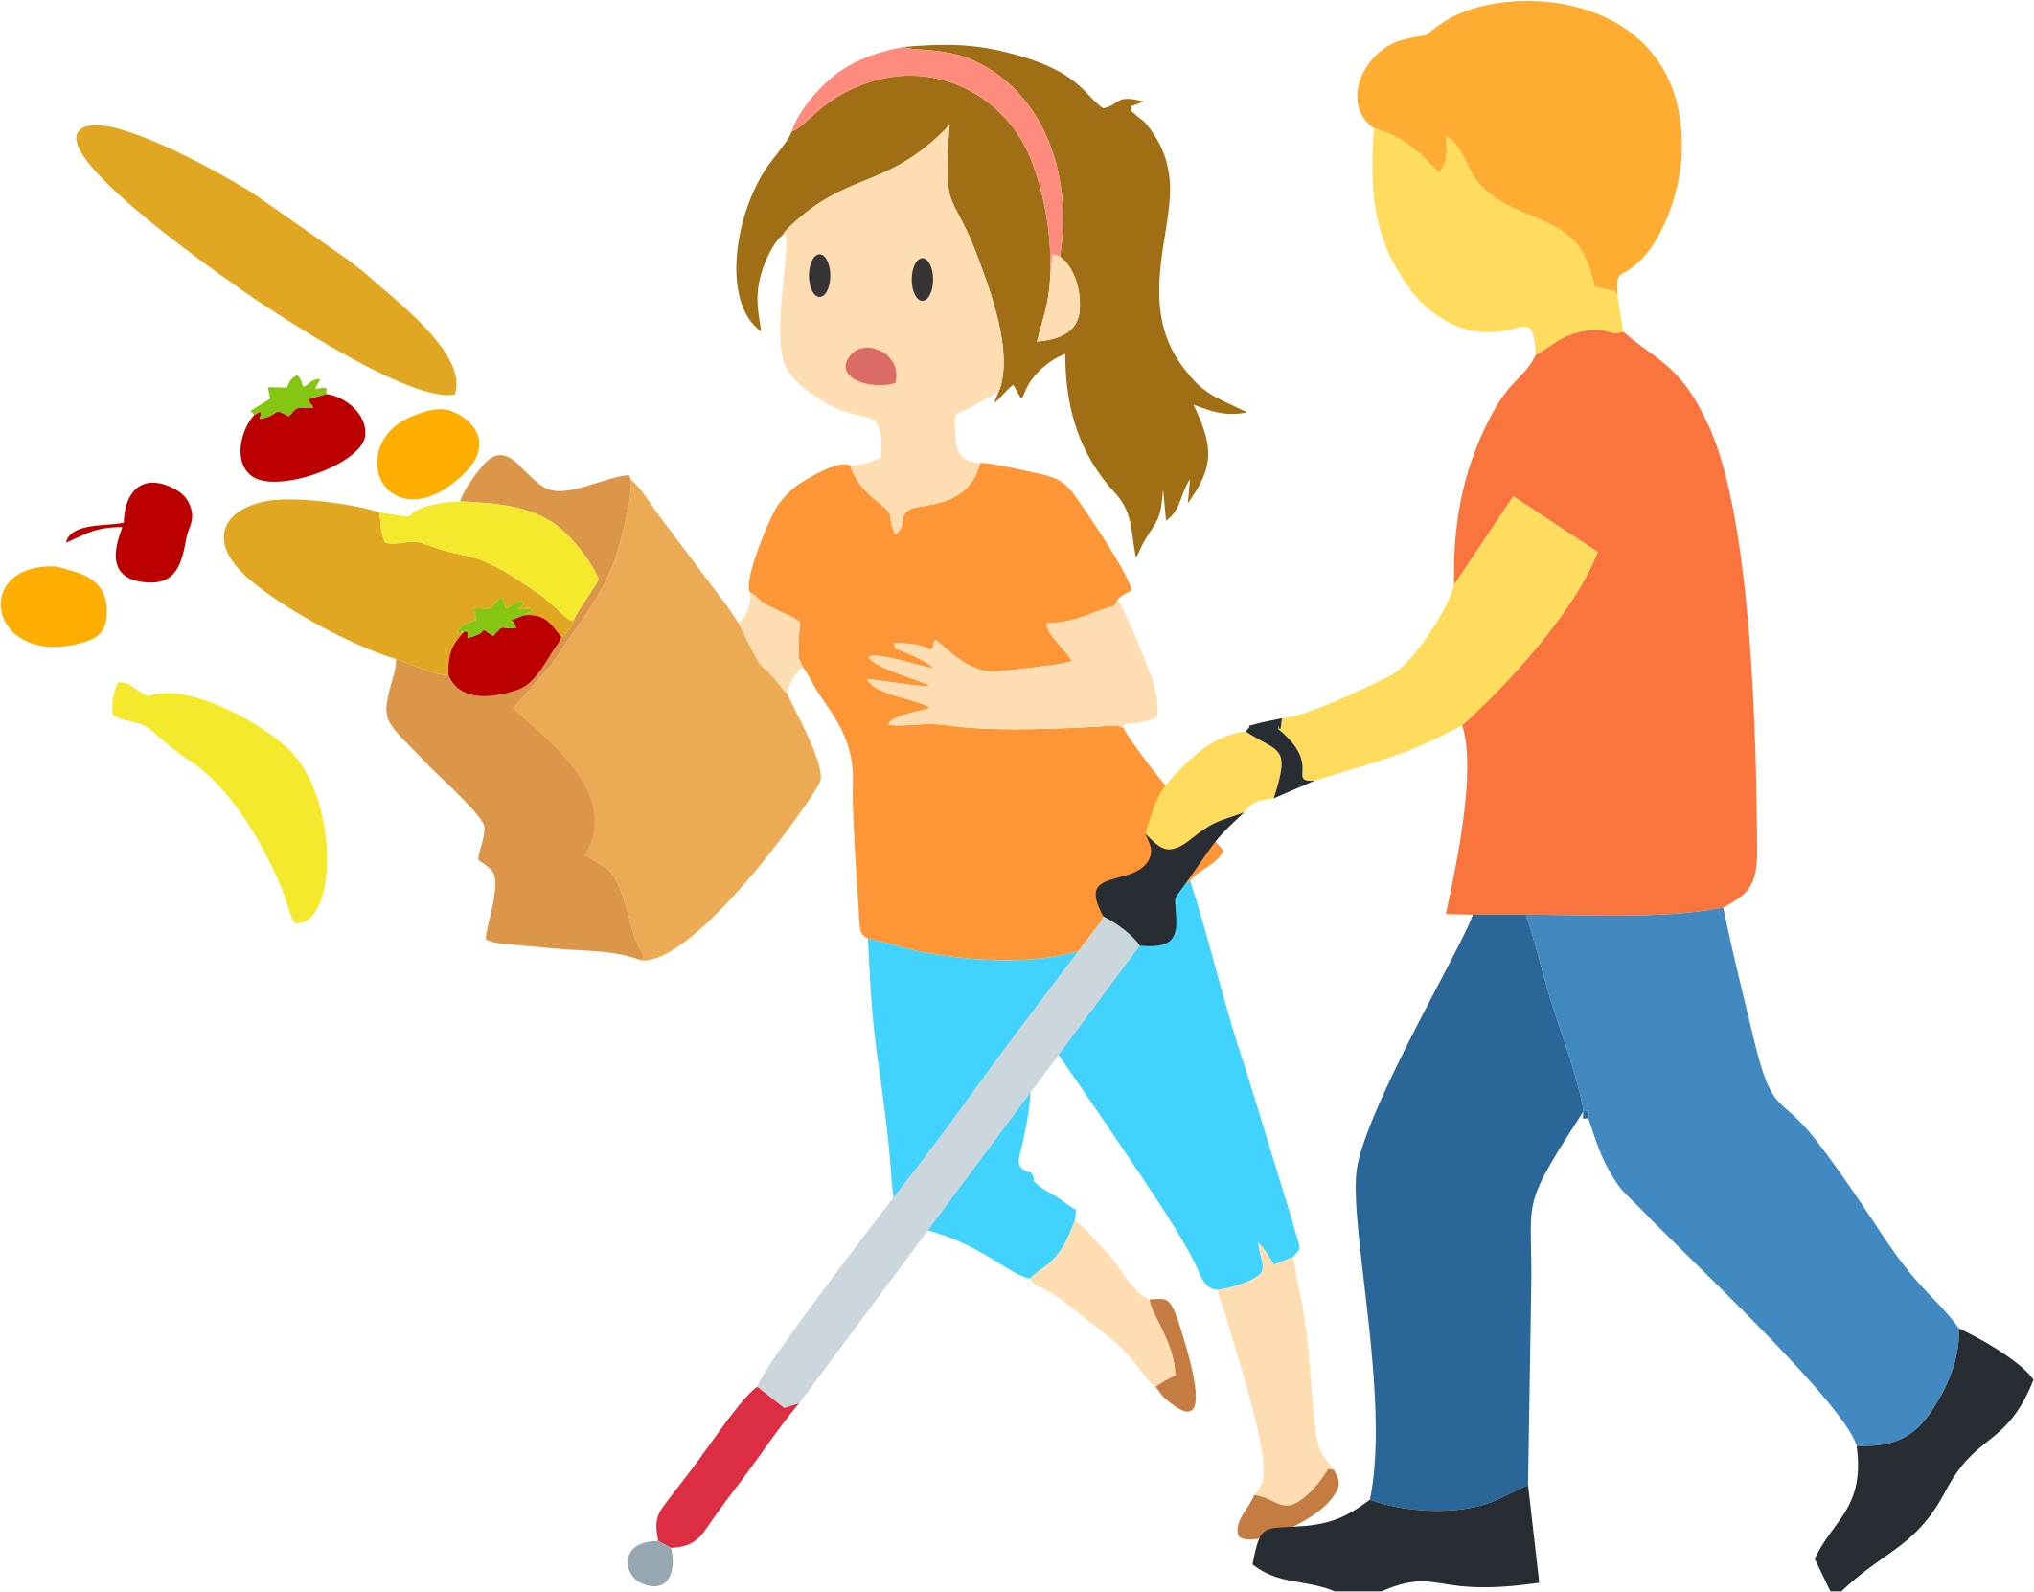
JJanuary 11, 2016
Why Bother to Learn The Causes of Other’s Difficultness
11

Slide 12
JJanuary 11, 2016
Causes of Others’ Difficultness #1
Longfellow, I think, said it well: “If we could read the secret history of those we find difficult, we would find in each life sorrow, suffering or other reasons enough to disarm all our hostility or indifference”.
Just review the following examples of some of the ‘secret history’ that can be reinforcers that drives the person’s difficult behaviour and state of mind and heart.
a mental health disorder,
e.g. anxiety, depression
fear of:
failure
looking bad
losing control
rejection
I erroneously believe that I am inferior to others – not enough
a life-threatening illness
spousal abuse
inattentional blindness
no free will to make appropriate choices
childhood trauma
a ‘sick’ gene pool
chronic physical pain
12

Slide 13
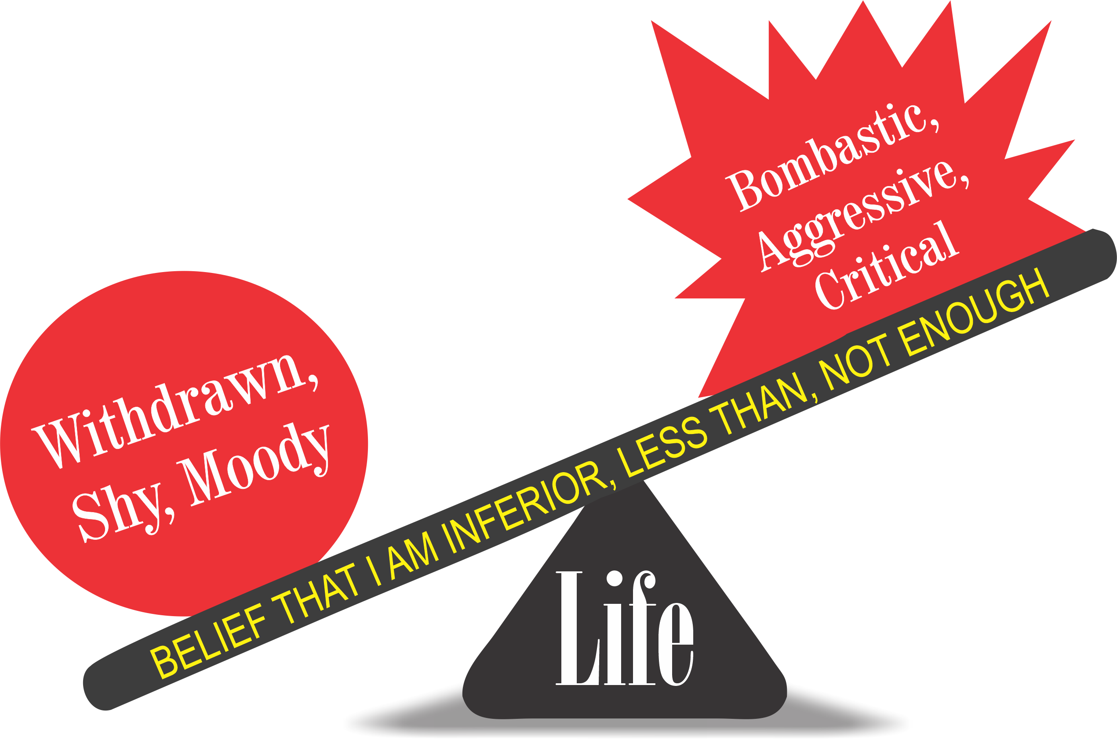
JJanuary 11, 2016
Two Different Behaviours, One Erroneous Belief
13

Slide 14
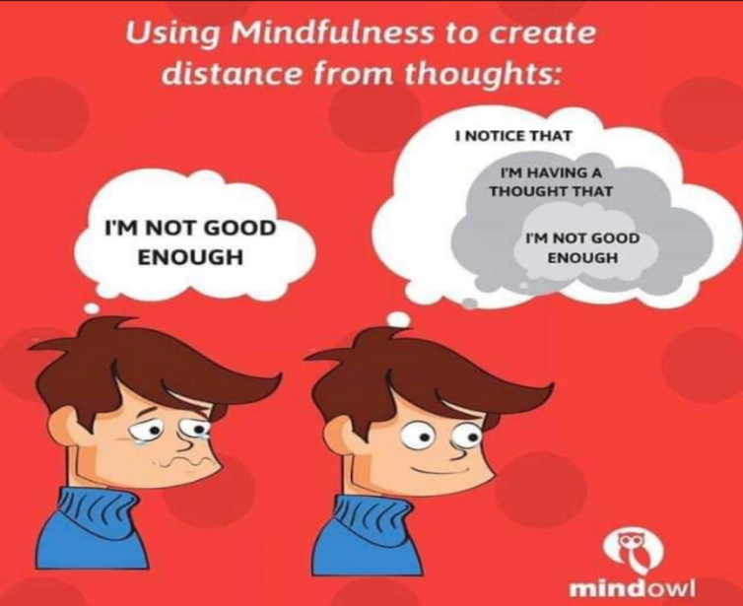
JJanuary 11, 2016
Mindfulness 101
www.centreforconsciouscare.ca
14

Slide 15
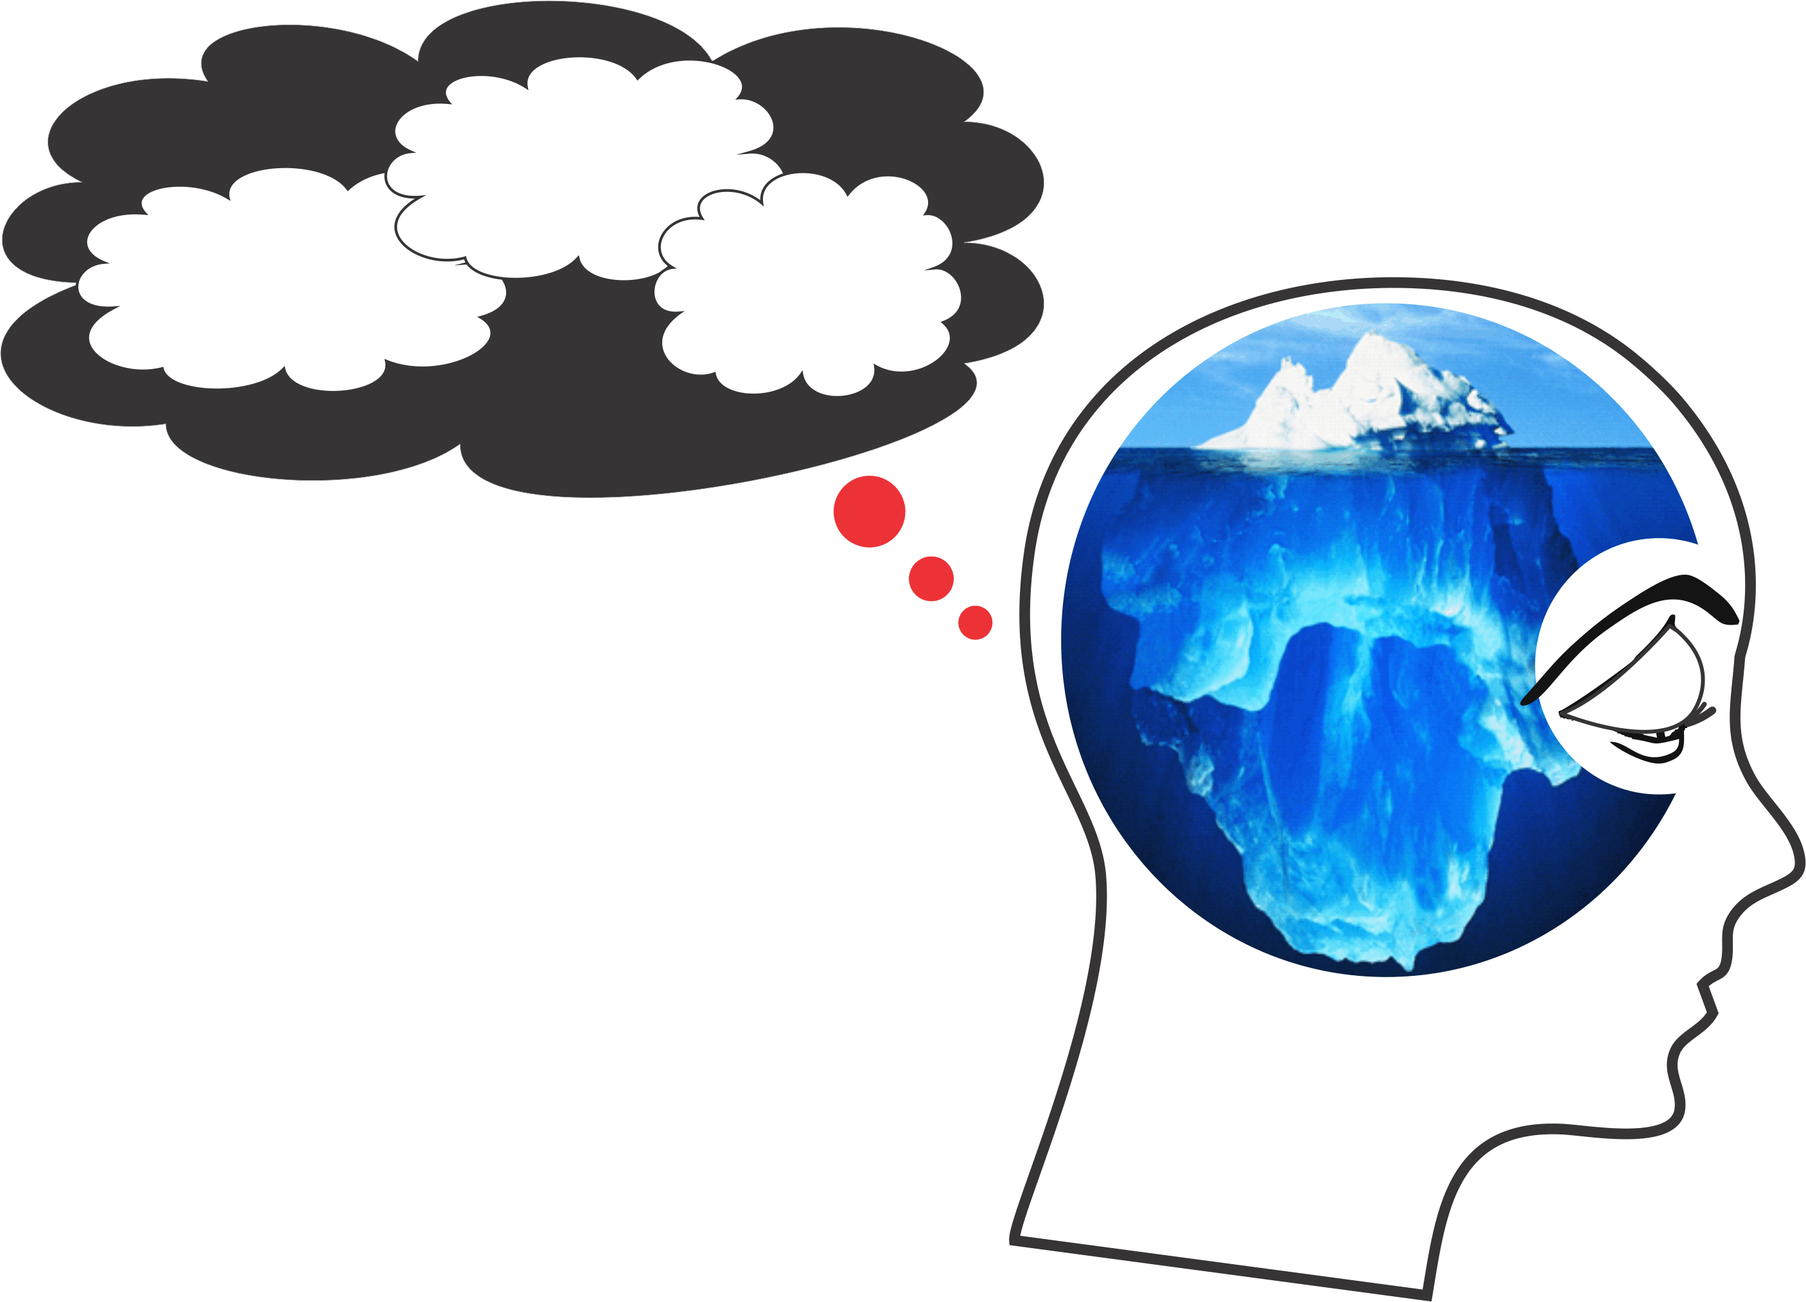
Cause #2 – The Semi-Conscious Mind
Filters
Primitive
Predispositions
Primed
Prompts
Semi-Conscious Mindless Mind
Primitive
Predispositions
Inherited genetic makeup
re: survival and reproduction
drives (i.e. ‘Nature’ You)
PFP
Subconscious
Programming
Filters
Illogical beliefs/faulty filters from
childhood conditioning e.g. “I need”,
“I am”, “Others are” (i.e. ‘Nurture’ You)
Primed
Prompts
Societal and cultural brain washing/
stereotyping/branding/bigotry
(i.e. ‘Numbed’ You)
Semi-Conscious
Mindless Mind
The “You” who is reading this but doesn’t know it (i.e. ‘Normal’ You)
15

Slide 16
Supervising Difficult People pptx - phone 65 mins, own 15 mins
Cause #3
Understanding People When They Are Difficult
The Difficult Person Prison
Mindless Mess
Must
Demands from the
Limbic Lottery
Enslavement
To Childhood Neuro
Nonsense (Filters)
Society’s
Senility
Shallow
Personal Growth
We don’t see things as they are; we see them as we are.
Anais Nin
D
16

Slide 17
JJanuary 11, 2016
Two Ways To Say – We Need To Grow Up As Well As Grow Old
This is the true joy in life, the being used for a purpose recognized by yourself as a mighty one; the being thoroughly worn out before you are thrown on the scrap heap; the being a force of consciousness instead of a (semi-conscious feverish selfish little clod) of ailments and grievances complaining that the world will not devote itself to making you happy.
George Bernard Shaw
A human being experiences himself, his thoughts and feelings as something separated from the rest—a kind of optical delusion of his consciousness. This delusion is a kind of prison for us. Our task must be to free ourselves from this prison by widening our circle of compassion to embrace all living creatures and the whole of nature in its beauty. The striving for such achievement is in itself, a part of the liberation and a foundation for inner security.
Albert Einstein
17

Slide 18
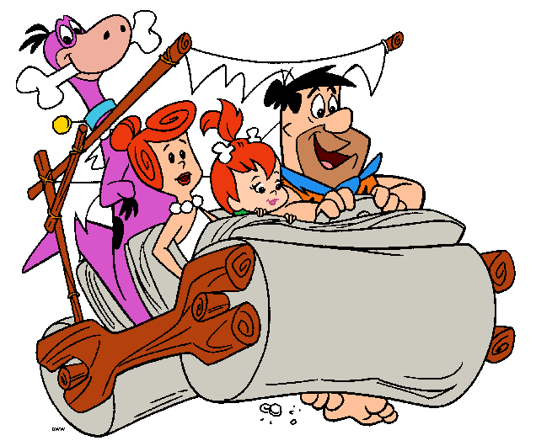
JJanuary 11, 2016
Cause #4
Examples of Primitive Predispositions –
Our Inherited Malfunctioning Hard Drive, Nature/ ‘Blindness’ of People When They are Difficult
Anger increases the brain’s electromagnetic energy/hertz to meet some folks’ need for Focusing and Concentrating;
18

Slide 19
JJanuary 11, 2016
Examples of Primitive Predispositions - continued
The brain’s inability to produce and manage calming neurotransmitters, e.g. GABA and to balance too much excitatory neurotransmitters, e.g. glutamate;
GI infections caused by food intolerances;
19

Slide 20
JJanuary 11, 2016
Examples of Primitive Predispositions - continued
Imbalances of hormones, vitamins, minerals, antioxidants;
Inattentional blindness – 60 bits of data processing per second;
Poor memory;
Physical pain;
Driven by survival code prejudice directives to group everyone into ‘good guys’ or ‘bad guys’ (bear experiment).
20

Slide 21
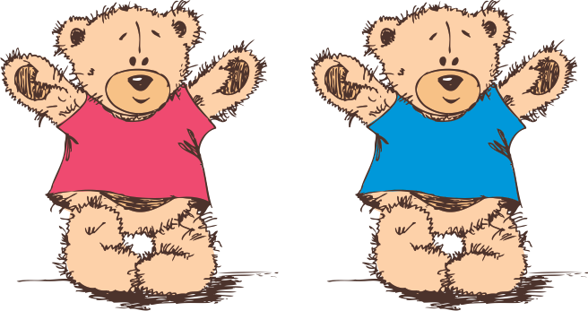
JJanuary 11, 2016
What do we mean by an ‘Inherited DATA BANK’ of Primitive Predispositions?
In – Out - We Start Early
21

Slide 22
JJanuary 11, 2016
Cause #5
Examples of Faulty Filters –
Learned, Nurtured, ‘Blindness’ Corrupted Software
Life must be fair to me or else…;
I must never be out of control or else…;
I need excitement to feel normal or else…;
I need others approving of me or else…;
I need to be busy or else…;
I’m entitled to get what I want or else…;
I must get it right or else…;
I am sensitive in the easily hurt way;
I deserve attention, recognition;
I am inferior, not enough.
22

Slide 23
JJanuary 11, 2016
Cause #6
Examples of Brain Priming –
Blindness That Results in Making People Difficult
Research – wine tasting experiment;
Cognitive bias from societies’ senility (e.g. I am entitled to do, get and have, bigger, better, more of what I want to be happy);
Social media feeds are starving people – Garbage In – Garbage Out (GI-GO);
23

Slide 24
JJanuary 11, 2016
A Better Understanding of Ourselves – Why We Experience Negative Feelings from Others’ Difficultness
When we know all of these disastrous PFP predispositions that are beyond the awareness, let alone control of the average person when they are difficult (a.k.a. they are for sure blind), –
why do we still feel…
Hurt
Angry
Irritable
Upset
Offended
Other
so… what is our anger really about?
24

Slide 25
JJanuary 11, 2016
A Better Understanding of Ourselves - continued
We lack the practical know-how skills and want to attitude to learn how to constructively manage our relationships with people when they are difficult.
We take their words and actions personally because we forget or don’t believe, that the person is not in control of them.
We are generally only semi-conscious so therefore driven by our own PFP.
e.g.
I’m out of control
This is not fair
I don’t deserve this
I am not approved of
This is not right
I am being victimized
25

Slide 26
JJanuary 11, 2016
The 4 Stages of Consciousness
How to grow far beyond our high-risk algorithm of being only semi-conscious
(a.k.a. lost in thoughts):
Over each 24-hour period, we can be experiencing consciousness on a 1-10 continuum.
Unconscious: (1)
like when we are asleep in our bed.
Semiconscious: (autopilot) (5)
  like how we typically drive our car, relate to people and do most doings,
  i.e. we are there but our mind is someplace else and we are unaware of
  what is happening in the present moment.
26

Slide 27
JJanuary 11, 2016
The 4 Stages of Consciousness – continued
Fully Conscious: (self-aware) (10) ‘mindful’
  like when we are paying attention – noticing what we are doing e.g. how we drive when a police car is following us;
  knowing that we are doing it when we are doing it and
  knowing how our body’s sensations, feelings and thoughts are reacting to what is happening.
Subconscious:
  our data bank of files that we inherit and develop (a.k.a. our algorithm).
27

Slide 28
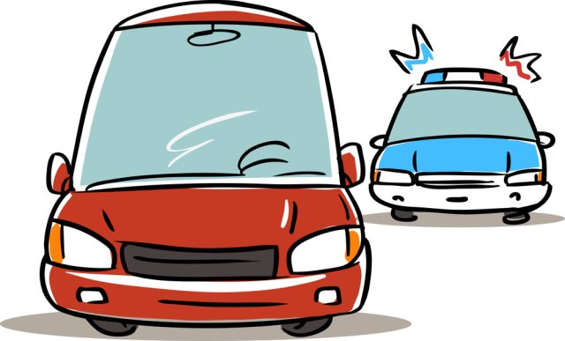
To be more fully conscious, we start by paying attention to what we are doing. It is as if we are driving our car and a police car is right behind us - we are really focused on our driving and also 100% aware that we are being followed.

Slide 29
JJanuary 11, 2016
And We Don’t Want to Go Against Nature
(Reference Student and Teacher)
Simply put, calling up PFP programmed files initially uses significantly less brain energy than the thinking problem solving mind. This inherited paleo jungle, survival based energy conservation, helps to explain why our ‘lawyer-type’ mind struggles to change its point of view. This is even in the face of substantial evidence contrary to our beliefs. Existing files get called on first, before working to problem solve or learn something new so as to save brain power to face a predator from the jungle later on that day.
So when, we need to learn new ways to better relate to people who are difficult, they tend to be average scientists but outstanding lawyers.
29

Slide 30
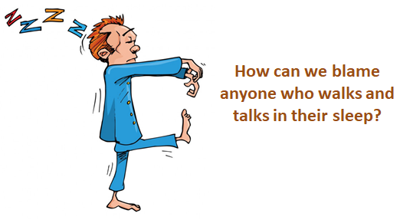
JJanuary 11, 2016
A Better Understanding of Ourselves - continued
When we are self-righteously critical of others’ difficultness, it helps us to feel less inferior/more superior.
It is much easier to blame others than to work on our own mindful emotional self-regulation skills.
And really,
30

Slide 31
JJanuary 11, 2016
11 Ways to Prevent, Eliminate and Reduce the Negative Consequences of People When They Are Difficult
Better Way #1
Really know and remember what is happening when people are difficult – to know is to grow – stay aware of their and our own PFP blindness (e.g. Longfellow).
Better Way #2
Have mercy on you, forgive those (who are difficult with you)
Always, always do what must be done to stop people hurting self and others.
Also, as much as possible, at least intend forgiveness, because our upset, hurt, anger, etc. with them often negatively impacts our other relationships.
31

Slide 32

JJanuary 11, 2016
So How to Restart or Depart With an Open Heart? - continued
Better Way #3
Understanding our own upset, hurt and anger when people are difficult with us.
Anger
Annoyed Hurt/Upset Frustrated Resentful Overwhelmed Angry Enraged
The Anger Continuum
32

Slide 33
The most predictable ways that we feel and behave when we are semi-conscious/mindless and emotionally overwhelmed by people when they are difficult with us, is some version of:
Anger/Overt/Freak-out/Power Struggle
Anger/Covert/Tune-out/Moody

Slide 34
JJanuary 11, 2016
Why Bother to Understand Our Own Anger (Blindness)
As soon as we SEE our anger for what it really is, it can vanish in an instant – so what is it?
34

Slide 35
JJanuary 11, 2016
Anger 1 verses Anger 2
Sometimes anger is a strong emotional expression of, for example irritation, all the way to a rage reaction to man’s inhumanity to man. Let’s call this anger A1.
Any point on this A1 continuum could be felt as a result of a person or situation that:
offers a personal threat;
is a violation of one’s values and ethics, e.g. cruelty;
is overwhelming due to one’s fatigue or other vulnerability;
injustice.
Reminder – My Own Conflicted Heavy Heart
35

Slide 36
JJanuary 11, 2016
Anger 2 is…
More often an activation of our own unresolved:
Primitive Predispositions
Filters
Brain Priming
Other (reference above)
What possible purpose/payoff might Anger have so much so that it keeps coming back over and over again?
36

Slide 37

JJanuary 11, 2016
Anger 2
Control
The mind becomes relatively calm when it perceives it is in charge.
Thank You Anger,
My Dear Friend -
Anger’s 3 PFP Survival Based Illusion of Hidden Benefits
– Payoffs and Purposes
Increases Brain Power to Focus
Anger focuses the mind. Focus is a primordial survival instinct which is therefore relatively calming.
Displacement
of the mind’s preoccupation with the ‘awful’ experience of fear, embarrassment, sadness, pain, etc. with the much less ‘awful’ experience of anger.
37

Slide 38
A2 Abundant ‘Make Believe’ Payoffs
What would I have to deal with if not for mindless Anger* my enabling friend?
Worry
Feeling Hurt
Insecurities
Anxiety
Exclusion
PFP Cognitive Bias
Guilt
Jealousy
Embarrassment
Treated Unfairly
Disconnected from the ‘Herd’
Grief
Boredom
An Unacceptable
Situation
Sad
Less Physical Pleasure
Feeling Unlovable
Discouragement
Lonely
Hurt feelings
* The Anger Continuum
38

Slide 39
JJanuary 11, 2016
When A2 angry, we subconsciously have the illusion that the PFP experiences of:
being more relatively in control
being more relatively focused
feeling better than if we were for example anxious, alone, deeply grieving, etc.
Are positive but they are not.
Because
39

Slide 40
JJanuary 11, 2016
They make us difficult to our friends, work colleagues and loved ones.
They give us the illusion that we have pretty much arrived/grown up when often we are not.
Our anger shuts down the constructive feedback that we need to receive from friends who care about us and want us to ‘SEE’ better.
May You Be Filled with Health and Happiness
40

Slide 41
JJanuary 11, 2016
Stay Mindful, Intentional and Positive to Offer Optimal Emotional Contagion
Emotional Contagion is the natural phenomenon whereby one person’s emotional and physical state—for example, fear or calm—so powerfully dominates the interaction, that it influences others’ emotional states and behaviours.
41

Slide 42
JJanuary 11, 2016
So then ……..
Could it be that we are naturally unknowingly being semi-consciously/mindlessly driven into Anger 2.
and
There could be better ways to be with people when they are difficult.
42

Slide 43

JJanuary 11, 2016
43

Slide 44
JJanuary 11, 2016
Better Way #4
Determine How Our Faulty Filters’ Beliefs May Be Impacting Our Relationships With People Who We Find Difficult
Ask ourself, could some of my illogical/outdated filters’ beliefs be negatively influencing my feelings toward this person who I find difficult.
Do I perceive being overly controlled by them, mainly because of my outdated obsessive need to be in control/not out of control?
44

Slide 45
JJanuary 11, 2016
Do I self-righteously judge them because of my problem of needing to be right/feel superior because of my erroneous belief that I am inferior/not enough?
Do I feel that they treat me unfairly because of my belief regarding entitlement?
Do I feel that I am not being approved of by them because of my problem with obsessively needing to be approved of?
Other.
45

Slide 46
JJanuary 11, 2016
Better Way #5
Might some of the following predispositions apply to us as well as the person who is difficult? If so correct…
Anger increases the brain’s electromagnetic energy/hertz to meet some folks’ need for Focusing and Concentrating;
The brain’s inability to produce and manage calming neurotransmitters, e.g. GABA and to balance too much excitatory neurotransmitters, e.g. glutamate;
GI infections caused by food intolerances;
46

Slide 47
JJanuary 11, 2016
Better Way #5 - continued
Imbalances of hormones, vitamins, minerals, antioxidants;
Inattentional blindness – 60 bits of data processing per second;
Poor memory;
Physical pain;
Driven by survival code prejudice directives to group everyone into
‘good guys’ or ‘bad guys’ (bear experiment).
47

Slide 48
JJanuary 11, 2016
Better Way #6
Take Responsibility for Our Emotional Hijacks
Given all that we now know that explains much of why a person is difficult (e.g. obnoxious, hurtful, etc. is there really someone that deserves our anger?
To repeat - we do what we must do to correct, change, this person to prevent them from harming us and others – but could our closed anger 2 heart be our work to do.
I so dislike that man – I must spend more time with him.
Doctor Martin Luther King Jr.
48

Slide 49
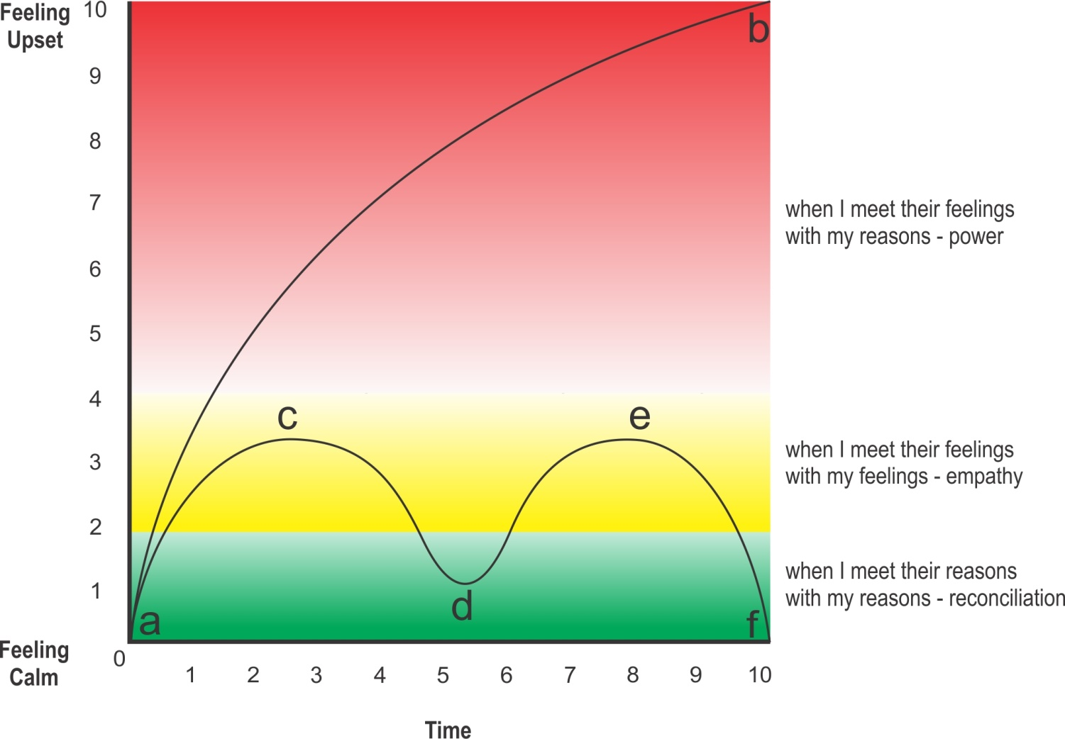
Better Way #7
Communications are useful, truthful, kind and timely.
Let’s walk through a positive calming sequence, using the letters in the above illustration:
At point a the conversation starts with speaking reasons to reasons.
Before the other person can become emotionally hijacked (point b),
mindfully meet their feelings with your feelings (point c).
When they become calm, return to the topic (a) with reasons to reasons (d).
When they escalate again, mindfully meet their feelings with your feelings (e).
When they return to calm, return to topic (d) with reasons to reasons (f).
Feelings to Feelings – Reasons to Reasons
49

Slide 50
JJanuary 11, 2016
SEE Empathic, Right Speech as Service to Others Through Mindful Relationships
When we are more conscious, love and compassion appear as being selfless. In mindful relationships we do not relate only to the other; we relate to “us”. Compassion’s communion brings us together in a whole. It does not see the world’s pain and sorrow as other, it is shared, and it is ours. When we allow our shared vulnerability and humanness, love and compassion are as natural as our breath and without hesitation we act to help. Thich Nhat Hanh
People who are mindful are positive role models not because they are admired by others but because the skill of mindfulness makes it possible for them to admire everyone else.
Thomas Merton
50

Slide 51
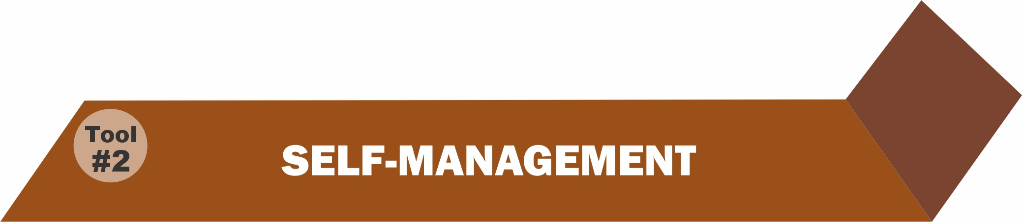
Better Way #8
Self-Management
We must self-manage to be able and want to more optimally manage our feelings, behaviour, growth and how we relate to others.
As a result of our work with self-understanding, we now realize that we and most others have been locked in PFP Prison and what the costs are.
Hopefully, this has helped to motivate us to want to learn how to better self-manage our growing-up process.
51

Slide 52
We First Self-Manage by Applying the Following Growth and Development Principles
The best way to successfully change conditions in our life, to become more resilient, happier or manage a crisis, etc., is first to work hardest on changing and growing ourself—not more communications and behavioural strategies, because we can’t drift/sleep to the top of a mountain.
Cultivate an attitude of indebtedness / gratitude instead of entitlement, especially about happiness – no one is entitled to it!

Slide 53
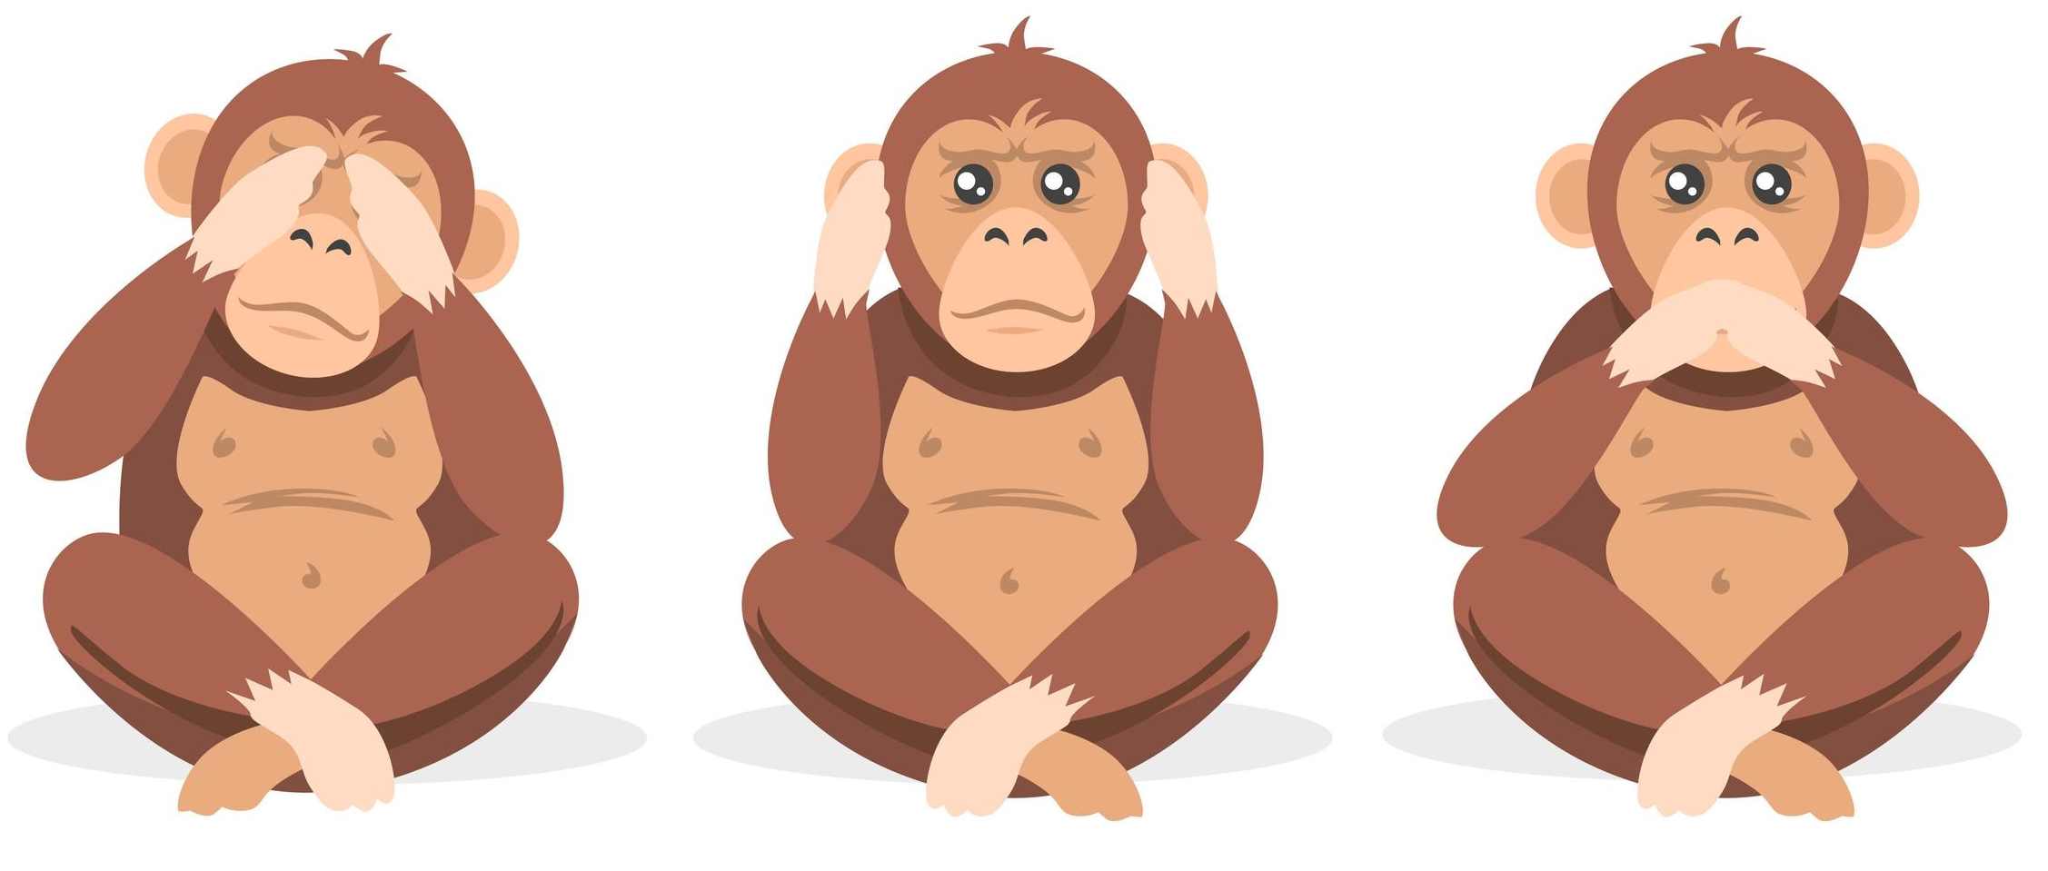
Development Principles - continued
Ask ourself, “What am I missing at this moment that would be helpful?”
Remember that every story has three sides, and because of inattentional blindness, we miss many important truths.
Managing and living a personally satisfying and socially useful life is significantly dependent on private victories – i.e. what no one
knows about (e.g. out of bed 45 minutes before ‘necessary’ to work-out – Mind, Body, and Heart).

Slide 54
Essential Authentic Messaging – Not Tactics
Acknowledge when we are wrong with a sincere apology.
When the person is calm and we are mindful, ask them if we could talk about an incident, “Peter, could we talk about ____________?”
If no, be empathic, e.g. “yes and tell me more.”
If yes, and they are calm proceed.
Clarify by reframing their criticism , judgements, lack of support, etc. “last week when you said__________ was your question _____________?”
If yes, “if we could understand each other on this, would it be helpful for you?”
If no, be empathic “yes and tell me more.”
If yes share your view “I am concerned when we_______________that______________.”
Ask the what if question, “Peter what if you continue to ______________and I continue to _____________ how would you feel about______________(not think about).”
Reframe, “So Peter, I understand you saying _____________ is that more or less how you feel?”
“Okay good, this has been helpful.”

Slide 55
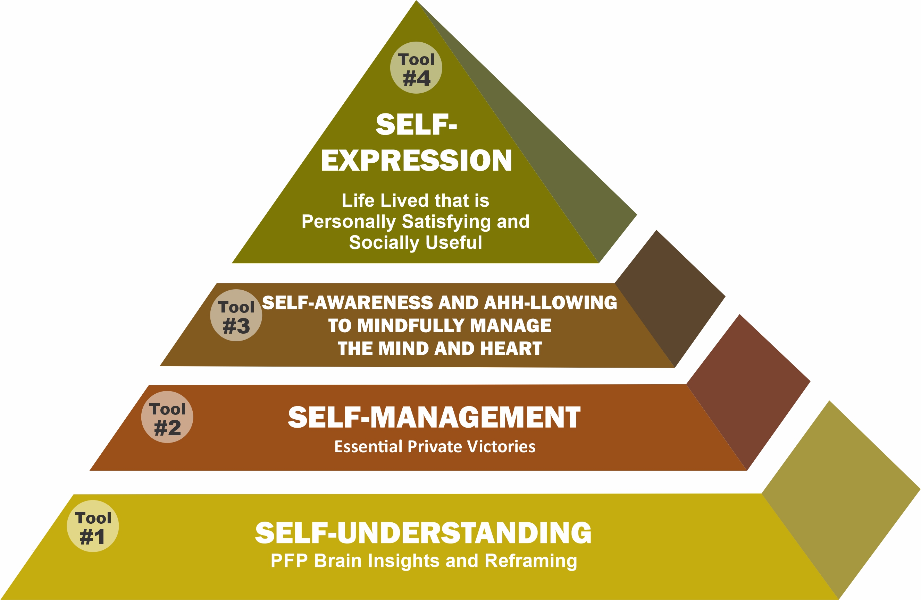
RRR Personal Development Progress Report –
Self-Management Tool #2
Statements Reflecting My 4 PFP Tools’ Development | Most of the Time 5 | Frequently 4 | Occasionally 3 | Infrequently 2 | Almost Never 1 | Totals
I have a daily ‘workout’ commitment of mind, body, heart and consciousness development
I skillfully experience and process difficult feelings, e.g. anger, fear, sadness, etc.
I have a plan and people to help with my inevitable crash and burn
I experience ‘difficult’ people with kindness and skillful interpersonal relating
Every day I accentuate the positive
Totals |  |  |  |  |  | =
Instruction
Add up the values of all columns and then add the total of the columns. To get an approximate percentage indicator of your current 4 Tools’ Personal Development Level, add totals for all 4 Tools. Consider asking a friend/friends to give their ratings of your progress.
Plan for Action See Attachment

Slide 56
Self-Management Essentials
I’m not a great shot, but…I shoot often. President Theodore Roosevelt
COMMITMENT
Until one is committed, there is hesitancy, the chance to draw back, always ineffective. Concerning all acts of initiative, there is one elementary truth, the ignorance of which kills countless ideas and splendid plans: that the moment one definitely commits oneself, then “hidden hands” help with the “heavy lifting”, all sorts of things occur to help one that would never otherwise occur. A whole stream of events comes from the decision, raising in one’s favour all manner of unforeseen incidents and meetings and material assistance which no one could have dreamt would have come this way.
Whatever you can do, or dream you can, begin it.
Getting started has genius, power and magic in it.
W.H. Murray

Slide 57
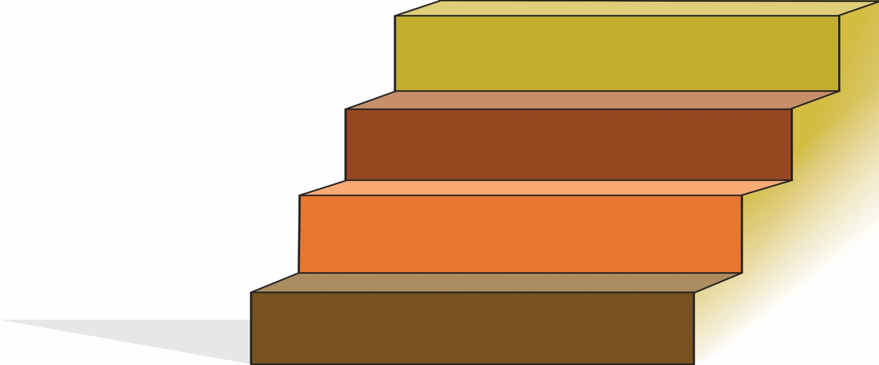
Better Way #9
The 4 Step Conscious Connecting Process
The Anger App. – Stress Rehearsal and Compassion Practice
Step One: CATCH
I know of no more encouraging fact than the unquestionable ability of men and women to elevate their life (and the lives of others) by conscious endeavours.
Henry David Thoreau
Step 1
CATCH
I Catch Myself Being ‘Here Now’
I Become Aware That – ‘There Is Anger/Impatience’ vs. Lost In The Anger Movie
57

Slide 58
The 4 Step Conscious Connecting Process
Step Two: CALM (redeploying 60 bits of date processing capacity)
Step 2
CALM
Step 1
CATCH
Being Aware and Ahh-llowing of ‘Resistant’ B-FIT,
e.g. Body Sensations – Location, Shape, Intensity
Start Mindful Calming Collarbone/Hand Activation
B-FIT Choiceless Awareness and Ahh-llowing
58

Slide 59
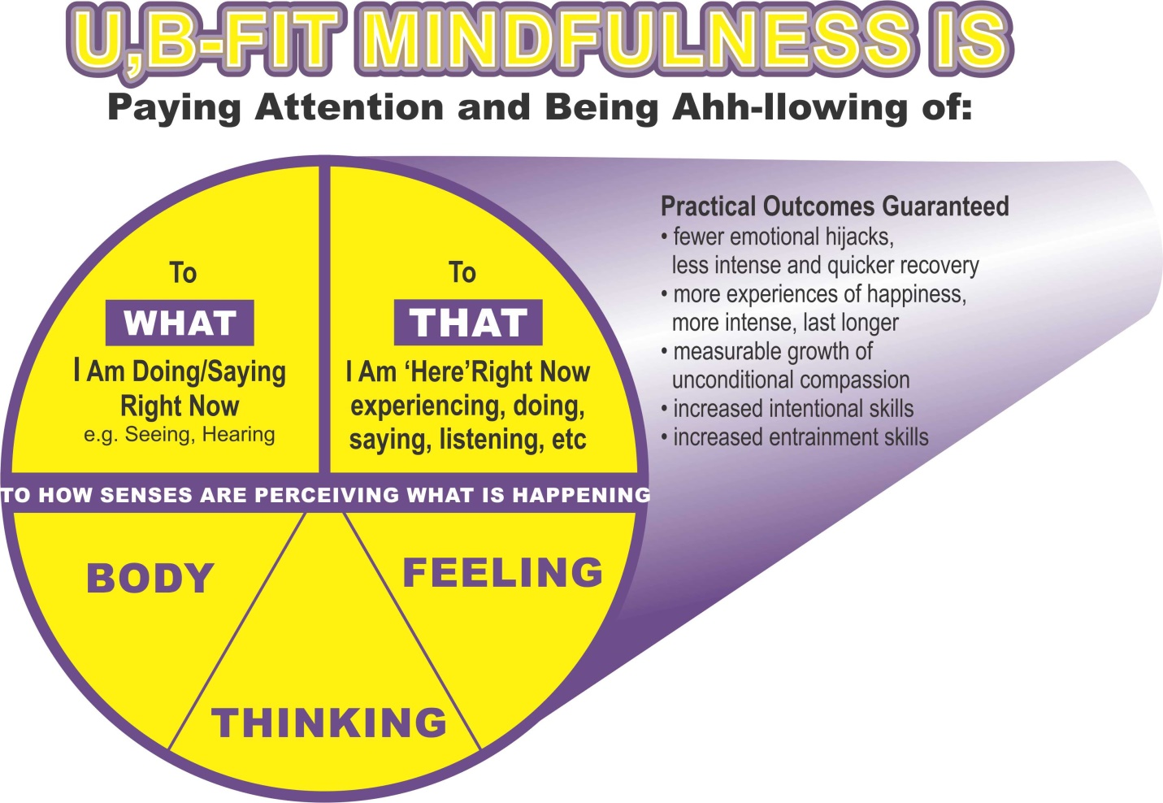
59

Slide 60
The 4 Step Conscious Connecting Process
Step Three: CLARIFY AND CHOOSE
Step 3
CLARIFY AND CHOOSE
Step 2
CALM
Step 1
CATCH
I Now Can Consciously Objectively Clarify The Emotional State of Myself and The Other Person and The Needs of The Situation
I Then Choose What Actions to Take
What would I be experiencing if not for being angry right now?
60

Slide 61
The 4 Step Conscious Connecting Process
Step Four: CONSCIOUSLY CONNECT
Step 4
CONSIOUSLY CONNECT
Step 3
CLARIFY AND CHOOSE
Step 2
CALM
Step 1
CATCH
I Intend and Become Non-judgmental and Authentically Connected - No Matter How I Feel
Mindfully Visualize an Ideal Conscious Connect
Intend Calm for Self and Others – Damage Control

Slide 62
JJanuary 11, 2016
Better Way #10
Activate Conscious Connecting - People Who Are Difficult Can Be Special Teachers
Human life should be like a vow, dedicated to uncovering the meaning of life. The meaning of life is in fact not complicated; yet it is veiled from us by the way we see our difficulties. It takes the most patient practice to begin to see through that, to discover that the sharp rocks are truly jewels.
Joko Beck
Better Way #11
Conscious Connecting is Developed Through Mindful Compassion Practice
62

Slide 63
Conscious Connecting Essential Truths
In The End
In the end, only four things really matter: how much you loved, how gently you lived, how gracefully you let go of things not meant for you and how well you helped others to love, live gently and let go.
(Adapted from Buddha)
There is this unseen order, and our superior good lies in harmoniously adjusting ourselves there too.
William James
We will not cease from exploration
And the end of all our exploring
Will be to arrive where we started
And know the place for the first time
T.S. Elliot – “Little Gidding”

Slide 64
JJanuary 11, 2016
Reflections re. Conscious Connecting
When we consciously connect with people who are difficult…
When we really get it – i.e. the human predicament:
we SEE that people who are difficult are victims;
we have gratitude for our good luck;
we have sadness for them when they are difficult, e.g. angry, etc.;
we passionately commit to helping them, first by not doing harm, e.g. power struggles;
our heart begins to stay open longer when we are with them;
The Great Escape
64

Slide 65
The 4 Essential Inner and Outer Life Tools to Escape
65

Slide 66
JJanuary 11, 2016
Reflections re. Conscious Connecting - continued
We SEE their insensitive words and actions as masking over deeper wounds and from a driven, less angry place we stop them from doing harm.
We catch our PFP starting to become emotionally hijacked.
We then consciously connect with them with empathic right speech (useful, truthful, kind and timely).
The Tao Te Ching
“We take action as if we are going to the funeral of our best friend.”
66

Slide 67
JJanuary 11, 2016
Reflections re. Conscious Connecting - continued
Although we often can’t help them through advice or suggestions, when we consciously connect there is much that we are doing for them.
This is because we are not stimulating and reinforcing their negative payoffs with harmful power struggles and we therefore are starting to weaken the source of their suffering.
67

Slide 68
JJanuary 11, 2016
Reflections re. Conscious Connecting - continued
We call this the sacred Dual Path because as we are working and growing ourself to be our best mindful emotional regulated self,
Our actions are training them to be less fearful, less discouraged, and therefore more likely to be less difficult.
Our Emotional Contagion Enhancement
68

Slide 69
JJanuary 11, 2016
Reflections re. Conscious Connecting - continued
This conscious connecting is being calm/ahh-llowing of all subjective experiences so as to eliminate resistance and negativity.
This reduces both our and their suffering as we more and more transcend the illusion of our separateness, i.e. no ‘good guys’ and no ‘bad guys’.
This harmful, incorrect binary choice is Oxygen for Anger.
69

Slide 70
JJanuary 11, 2016
Reflections re. Conscious Connecting - continued
Now we have unconditional and authentic kindness as we care for and about all others, regardless of our feelings about them and even how our body, thoughts and feelings’ senses are reacting to them.
When we consciously connect, we know that we are not our thoughts or feelings, when we are conscious of them.
Now we don’t just feel caring - we are care and
like the musician becomes the song and
the artist becomes the art.
70

Slide 71
JJanuary 11, 2016
Reflections re. Conscious Connecting - continued
These moments of ‘loving the enemy’, for ‘they know not what they do’, opens up a whole new paradigm of living and caring experience. Here (Now), forgiveness just happens and natural healing and resiliency just happens within us.
71

Slide 72
JJanuary 11, 2016
Reflections re. Conscious Connecting - continued
And when we at some mindless times do not consciously connect, as we recover from our suffering PFP prison, we are reminded of our own and all peoples’ fragility and vulnerabilities to be overwhelmed by PFP.
This opens our heart to forgiveness and our minds to be motivated to recommit to a path of liberation away from society’s pitiful, mindless tragic ‘religion’ of ‘good guys’ and ‘bad guys’.
We really know that the truth of our predicament is more asleep/mindless versus awake/aware people.
72

Slide 73
JJanuary 11, 2016
Know Thy Self
P&J
Ahh the sacred evidence,
of knowing self so deep.
Anger with an open heart,
now awakened from ‘the’ sleep.
Aware and ahh-llowing conflict,
loving presence – each moment new.
To all who hurt and hate forgiven,
for they know not what they do.
73

Slide 74
JJanuary 11, 2016
Reflections re. Conscious Connecting - continued
To help open our heart in forgiveness, we remember to ask “I wonder what terrible childhood this 5 year old boy or girl must have had, to have turned their innocence into such insensitivity?”
Finding and sustaining meaning and happiness in life . . . means an ordering and guiding of our energy and our desires, a partial restraint in some directions in order to secure greater abundance of life in other directions. It involves a daily deliberate (mindful) organization of life for a purpose.
Richard Gregg
74

Slide 75
JJanuary 11, 2016
Summary
As we recall our grievances with this person, our B-FIT Mindful Exercises will help us to stay conscious of:
our fabricating inaccurate memory,
our prejudicial cognitive bias,
our inattentional blindness,
our lack of free will to make choices (unless we are conscious),
the stinking thinking problem of being thought and
our PFP faulty filters
are all grossly distorting our feelings and blocking our awareness of how best and why to reconstruct our relationship/s.
Leading to
75

Slide 76
JJanuary 11, 2016
Incrementally, slowly at first, starting to more and more be transformed to be able to and wanting to effectively restart or depart with an open heart.
We work to compassionately
change what must and should be changed
e.g. injustice, exclusion
And as we do our Best, we Rest with the Rest
76

Slide 77
JJanuary 11, 2016
Claim Your Brain – Start Your Heart
Mind transforms to consciousness,
through the stillness of mindful breath.
This tortured prisoner is released,
From difficult, at PFP’s death.
Kindness emerges, beyond mere feel,
conditional love departs.
See all in the game, as my own name,
The way of awakened heart.
The way of awakened heart.
PFP ice transforms to steam,
revealed in conscious connect.
No good or bad guys on the field,
for all others, never neglect.
Even the words “all others,”
lose meaning and resolve,
As “I am” morphs to “There is,”
“Here” ego self dissolves.
77

