Slide 1

Stock Market Game

Slide 2
Basics
Teams of 1 – 5 members
Game runs 10 weeks
  Team gets $100,000 to spend and a margin credit line of $50,000
  Trade only stocks and mutual funds listed on the NASDAQ and the New York Stock Exchanges
  Must purchase at least 10 shares of a Stock
  Stocks are limited to more than $3; market capitalization of $25 million
Mobile App is available to help track weekly performance of your portfolio (SIFMA Foundation – The Stock Market Game)
All trades are computed as of 1 pm daily (4 pm EST)
Notes:
These are not ALL of the rules, however they are some of the basic important ones to emphasize.
Emphasize that trades are not made in real time. Students should generally not make multiple transactions (Buy and Sell) in the same stock or security on the same day.
Another important rule is the SMG requires students to hold at least 3 different stocks. Emphasize that students should generally make large dollar purchases in the $5,000-10,000 range. The price of a stock will drive how many shares they can purchase.
Students may not initially purchase stocks representing more than 1/3 of the total value of the $100,000 (or $33,333).

Slide 3
What is a Company?
Company: A business or association usually formed to manufacture or supply products or services for profit.
  What are some companies you and your family regularly do business with?
Notes:
A good place for students (or any investor for that matter) to start is with products and companies they know.
- Where does your family purchase: gas, clothes, food, restaurants, etc.
What do your peers like? Nintendo, Apple, Nike, Underarmor, etc.
Once students identify products and companies they like, they can look for those companies’ stocks. Encourage students to google the company and look at the corporate webpage for information.
Is the company publicly traded? In other words, can you actually buy it on a market exchange?
Chik-fil-A is a popular fast food restaurant, but it is not publicly traded.
Taco Bell is popular, but it is owned by a holding or parent company, Yum! Brands, Inc. The corporation is traded on the NYSE under the ticker symbol, YUM. The company also owns KFC and Pizza Hut.
Adidas is a popular sportswear brand, the second largest in the world. It is a German company, traded in Europe and cannot be purchased on US exchanges, and therefore not in the SMG
Is the company part of a larger corporation, such as Taco Bell. What other brands do they own? Walt Disney is a huge conglomerate. Students may be surprised to learn all the companies Disney owns.

Slide 4
What is a Corporation?
Corporation: A business that is owned by share holders.
  Shareholders can buy or sell their stock
  Public Corporations
  Private Corporations
Corporations are traded in a stock market
  New York Stock Exchange – Wall Street – dates back to 1792
  NASDAQ – National Association of Securities Dealers Automatic Quotation – dates to 1971
Notes:
Corporations are the kinds of companies students will be buying. This is a good opportunity to explain that when an investor purchases stock, they are actually purchasing a portion, however small, of the company. Stockholders are actual owners of the company.
The SMG only deals in stocks traded on the NYSE and NASDAQ exchanges. Students may find companies traded on the OTC – Over the Counter exchange – which are not eligible for purchase in the game.

Slide 5
Why do we want to own stock?
Good financial planning has 3 main components
  Savings
  Insurance
  Investment
The earlier you start, the better off you will be.
Risk vs. Reward
Time value of money – compounding interest Rule of 72
Notes:
In developing an overall personal financial plan, most advisors address the three components [think of a plan as a three-legged stool – if you remove one element, the stool (the plan) becomes unbalanced.
Financial planning is an important overarching goal of having students participate in the SMG. If they are going to invest – and they should – they need to understand how to invest and how to participate.
Simple time-value of money is one of the key lessons students need to understand as investors. Risk and reward are important to understanding one’s own investment style. Generally risk indicates volatility of a stock. The general rule of thumb is the higher the risk the greater the opportunity for higher gains – and higher losses. An investor’s risk tolerance is an important factor in what stocks they might purchase.
Risk for the SMG and ultimately future investments – when students actually invest their own money – may be two very different levels of comfort. It is a theme to revisit throughout the game and when coaching students about their own financial futures. As young investors for the long term, they may be interested in preserving their money, however, given they have the luxury of 40 years in which to invest, their portfolio, especially early on, should be fairly risk tolerant. This changes over time.
The newer a company is, the riskier it is generally thought to be. Those companies may provide wide-ranging, and exciting results in the SMG.
TIME VALUE OF MONEY – is THE reason we want to educate students about investing. Rule of 72 is explained on slides 8 & 9.

Slide 6
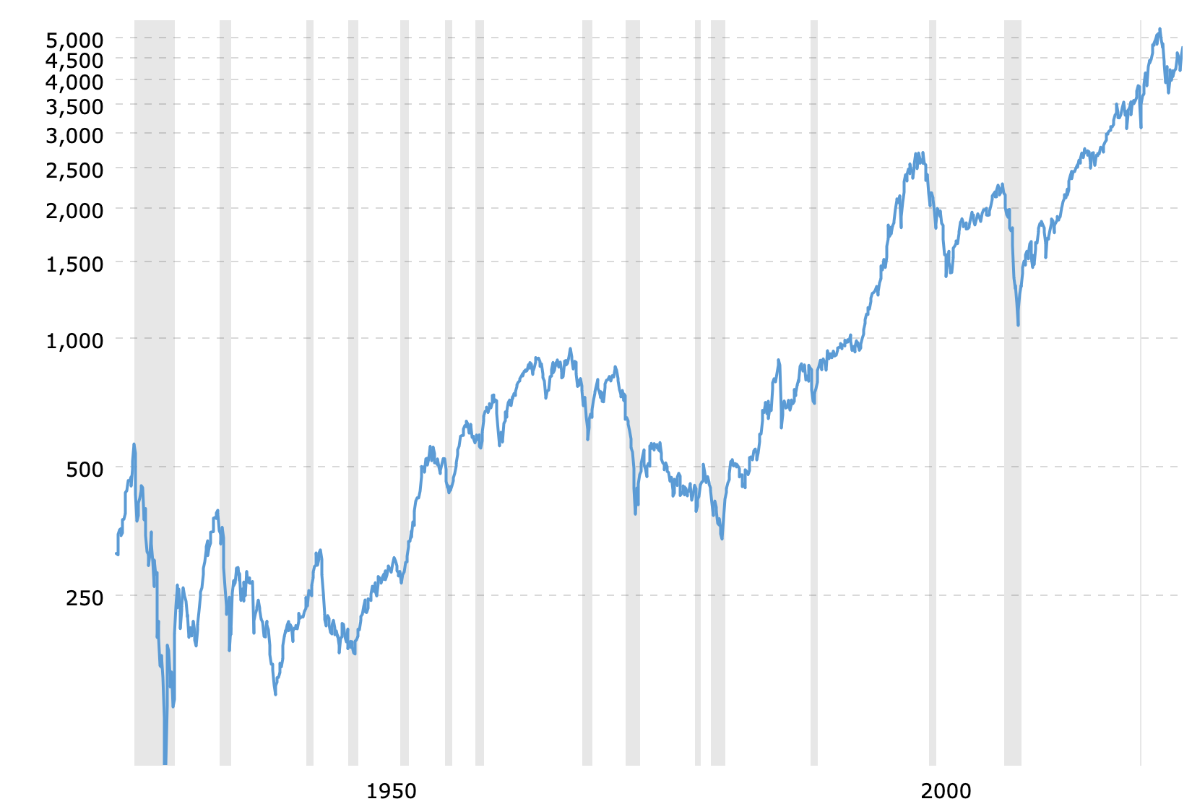
Stock Market Rate of Return
Historic rate of return
10.00%
Over time the market has
gone up in about 70% of years.
1928
1950
2000
2023
Notes:
Investing, as opposed to savings, involves a number of different strategies. Real Estate is one way to invest and can provide very satisfactory returns. However, purchasing real estate requires substantial amounts of capital – cash. Students can invest in stocks for relatively small amounts.
The stock market since 1928 (the year before the Crash of 1929) has an historic rate of return of 10-11%. Students should understand that is not a constant rate of return, as can be seen from the chart.
The gray lines in the chart represent recessions – the widest gray bar is the Great Depression. Point out to students the time value of money enables them to take advantage of historic rates of return.
Source: https://www.macrotrends.net/2324/sp-500-historical-chart-data

Slide 7
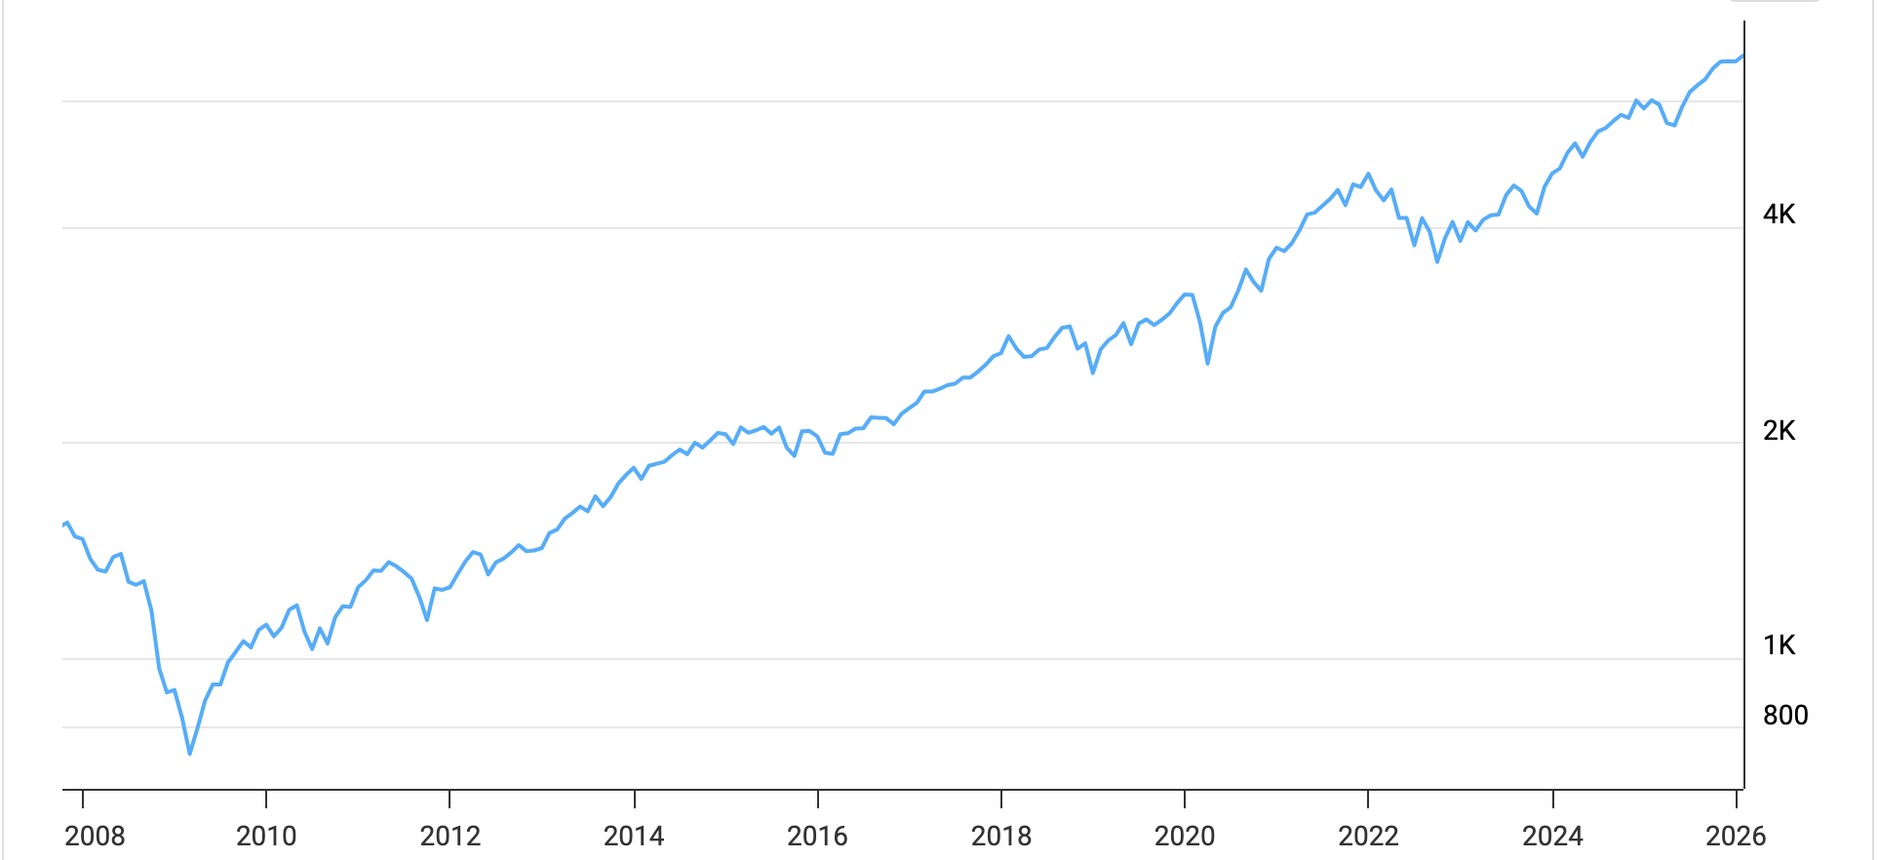
Stock Market Rate of Return
2025: 16.39 %
2024: 24.31 %
2023: 24.23 %
2022: -19.44 %
2021: 26.89 %
2020: 16.26 %
5-year return 100%
10-year return 11.83%
Historic return 10.00%
5000
4000
2000
1000
Notes:
This chart is a slice of the previous stock market chart. The rates of return can help students understand that not every year will provide positive returns. Even so, over the 30-year+ period of this chart, the market was only down significantly in six of the 33 years. Investment strategies, like dollar cost averaging – discussed in later lessons – actually provide investors the opportunity to take advantage of market downturns to provide greater rates of return.
The key point to emphasize is that the general trend is up – reference to the historic rate of return
Source: https://www.macrotrends.net/2324/sp-500-historical-chart-data

Slide 8
Rule of 72
Discovered by Albert Einstein
Approximates the “doubling effect” of interest
7% interest rate
72/7 = 10.28 years
72 / Interest Rate = Years to double
72 / Years to double = Interest Rate
Double in 6 years
72/6 = 12 → 12% Interest
Notes:
The Rule of 72 is an important tool to use in explaining WHY students want to begin investing early on - the earlier the better.
Have students operate with the Rule of 72 using different rates of return and different time periods.
Understanding the Rule of 72 can help student better understand the context of stock yields.
The next slide illustrates how young investors can take advantage of the time value of money.

Slide 9
Rule of 72
$1000 invested at 8% average rate of return
Rule of 72 – Double every 9 years
72 / Interest Rate = Years to double
72 / 8 = 9
18 | $ 1000
27 | $ 2000
36 | $ 4000
45 | $ 8000
54 | $ 16000
63 | $ 32000
19 | $ 1000
28 | $ 2000
37 | $ 4000
46 | $ 8000
55 | $ 16000
64 | $ 32000
20 | $ 1000
29 | $ 2000
38 | $ 4000
47 | $ 8000
56 | $ 16000
65 | $ 32000
$3000 → $96,000
Notes:
This slide illustrates the average return of the modest (for the stock market) rate of 8%.
Have students calculate other rates of return, both higher and lower than 8%. Have them use 1%, which is more than they currently can receive with a simple savings account. This illustration may help students understand why they need to think about investing rather than just saving money.
These charts can also be used to help students understand how their investment opportunities are handicapped by waiting longer to invest. IF an investor waits until age 27 or 28 to begin investing, they will have to invest MORE in order to make up for the lost advantage TIME provides.
For young students, $1000 may seem like a very large amount of money. In reality, it is only $83.33 a month.
An example such as the one above, might be easily achieved by purchasing an Index fund stock, such as VOO (Vanguard 500 Index Fund ETF) or QQQ (NASDAQ ETF), which track stock market indices.
For background, refer to https://www.fool.com/investing/2021/03/29/better-buy-qqq-vs-voo/

Slide 10
Stock Market Game

