Slide 1
Stock Market Game
Ways to Diversify

Slide 2
How did the Market do today?
Indexes:
S&P 500 – Up – 28 points
Dow Jones Industrial Average (DOW) – Up – 239.9 points
Nasdaq Composite (NASDAQ) – Up – 31.5 points
Flat – tech stocks earnings are being released this week
The Federal Reserve met this week and released a statement on Wednesday that the economy continues to strengthen

Slide 3
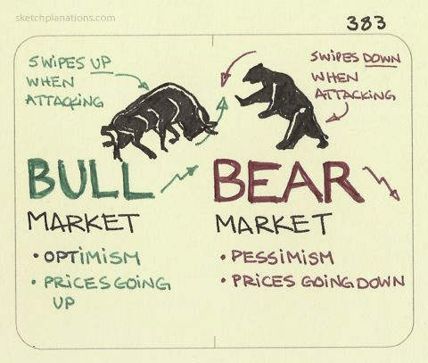
Bull vs Bear Market
Notes:
Often in investing we hear the terms Bull Market or Bear Market.
These refer to the direction the backs of the animals – Bull – up; Bear - down

Slide 4
Diversity in Diversity
Some advisors recommend 10% of the portfolio in the discretionary sector
Other sectors offer similar diversity
Consumer Discretionary
Other Sectors
Notes:
Over the past couple of weeks we have looked at diversifying a portfolio by purchasing stocks from each of the 12 sectors.
As seen here, some advisors recommend having 10% of a portfolio invested in the Consumer Discretionary sector

Slide 5
Consumer Discretionary Sector
Consists of businesses whose demand rises and falls based on general economic conditions. Products in this sector include everything from washers and dryers to sporting goods to new cars to diamond engagement rings and more.
Notes:
Sources: - https://www.thebalance.com/what-are-the-sectors-and-industries-of-the-sandp-500-3957507#consumer-discretionary
https://www.barchart.com/stocks/indices/sp-sector/consumer-discretionary
Here a number of the stocks in the Consumer Discretionary sector.
Notice that many of the companies sell different products than others – Coffee, Cars, hotels, on-line shopping, food
The idea for diversifying within a sector is to not choose stocks that all sell the same thing.

Slide 6
Diversity in Diversity
Some advisors recommend 10% of the portfolio in the discretionary sector
It’s also possible to diversify within the sector
58% - Retail
17% - Consumer services
9% - Consumer durables
16% - Auto and components
Auto & components
Consumer durables
Retail
Consumer services
Notes:
When we look at the sector itself, we see there are different sectors within the sector
Retail
Consumer services
Consumer durable (products that last 3-years or longer)
Automobiles
In the next slides, we will look at some stocks in each sub-sector
https://disfold.com/united-states/sector/consumer-discretionary/companies/#google_vignette

Slide 7
Retail Sector – recent stock prices
AMZN | $150.38
ORLY | $ 954.91
LOW | $ 213.89
CHWY | $ 21.07
TJX | $ 69.80

Slide 8
Consumer Services
MCD | $ 295.58
SBUX | $ 93.31
DPZ | $ 402.87
BROS | $ 31.26
YUM | $ 129.21

Slide 9
Consumer Durables – recent stock prices
NKE | $ 104.49
LEVI | $ 15.84
UA | $ 7.91
LZB | $ 36.75
WHR | $ 118.41
SONY | $ 118.29
MHK | $ 105.28
Notes:
https://finrange.com/en/industries/household-durables?page=2

Slide 10
Auto and Components
F | $11. 81
TSLA | $ 239.60
STLA | $ 22.30
GM | $ 35.11
RIVN | $ 20.40
Notes:
Ask students if they know all of these brands
Stellantis brands include Dodge, Chrysler, Jeep, Fiat, Alfa Romeo and Maserati
GM brands include Chevrolet, GMC, Cadillac and Buick

Slide 11
Diversity in Diversity - ETFs
ETFs hold multiple underlying assets, rather than a single stock It is a popular choice for DIVERSITY
Gain exposure to the entire sector Each ETFs has its own investment strategy and focus.
Benefit from the potential for growth and returns without the risk of a single stock
Auto & components
Consumer durables
Retail
Consumer services
Consumer Discretionary ETFs:
VCDAX IBUY FDIS RCD
Notes:
You can also buy the sector by purchasing an ETF of the sector – ETFs are like mutual funds.
ETFs are managed by different investment firms. ETF providers create an ETF based on a particular methodology and sells shares of that fund to investors.
https://www.marketbeat.com/originals/best-consumer-discretionary-ETFs/
https://www.investopedia.com/terms/e/etf.asp

Slide 12
Stock Market Game
Ways to Diversify

