Slide 1

Stock Market Game
Following “the Market”

Slide 2
Basics
Student teams of 1 –5 members
  Team gets $100,000 to spend and a margin credit line of $50,000
  Trade only stocks and mutual funds listed on the NASDAQ and New York Stock Exchanges
  Must purchase a minimum of 10 shares
  Stocks must cost more than $3; market capitalization of $25 million
Mobile App is available to help track your portfolio
All trades are computed as of 1 pm daily

Slide 3
What is a Stock Index?
A stock index is any collection of stocks that fit a certain theme and replicate (track) an overall economy, market, or sector.
Indexes allow investors to more broadly track the market.
Most common indexes:
  S&P 500
  Dow Jones Industrial Average (DOW)
  Nasdaq Composite (NASDAQ)

Slide 4


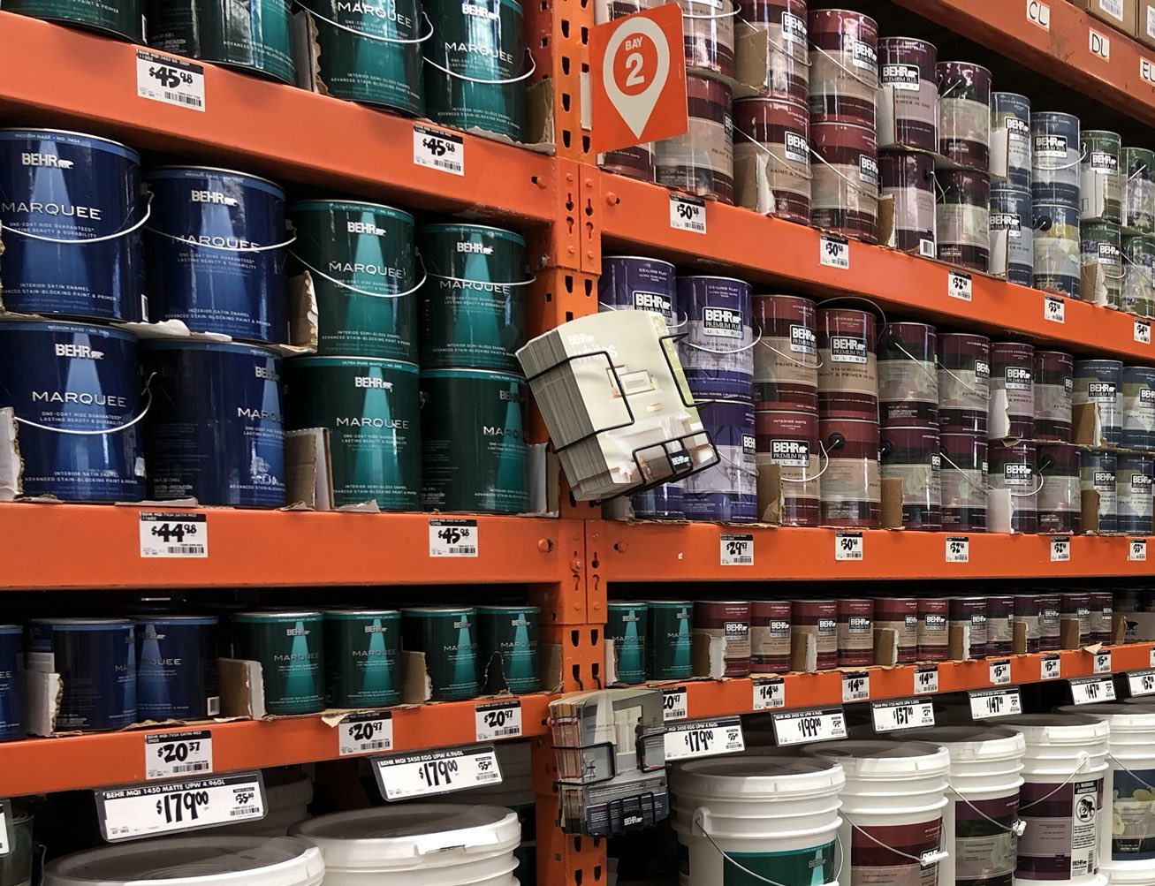

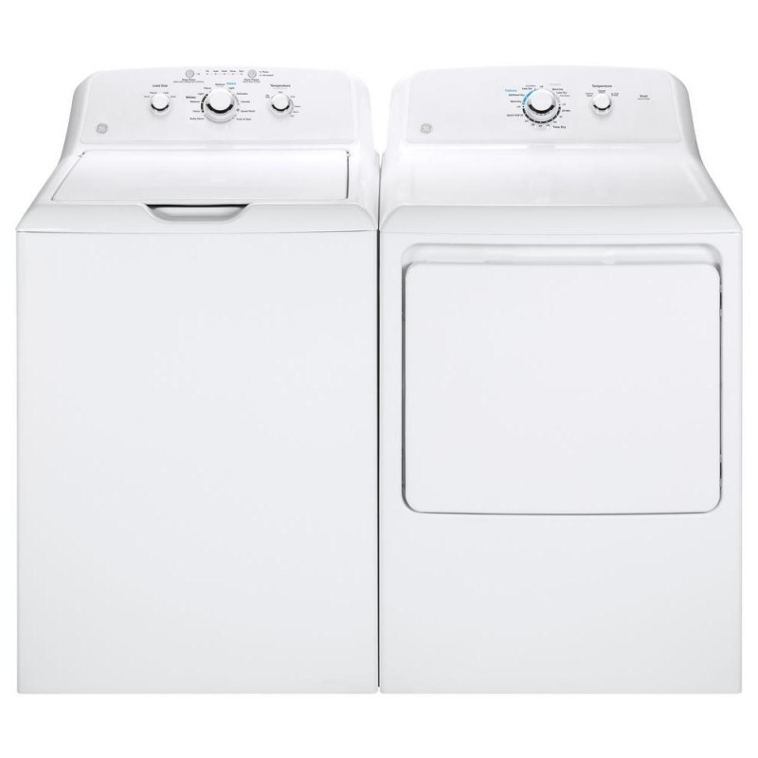


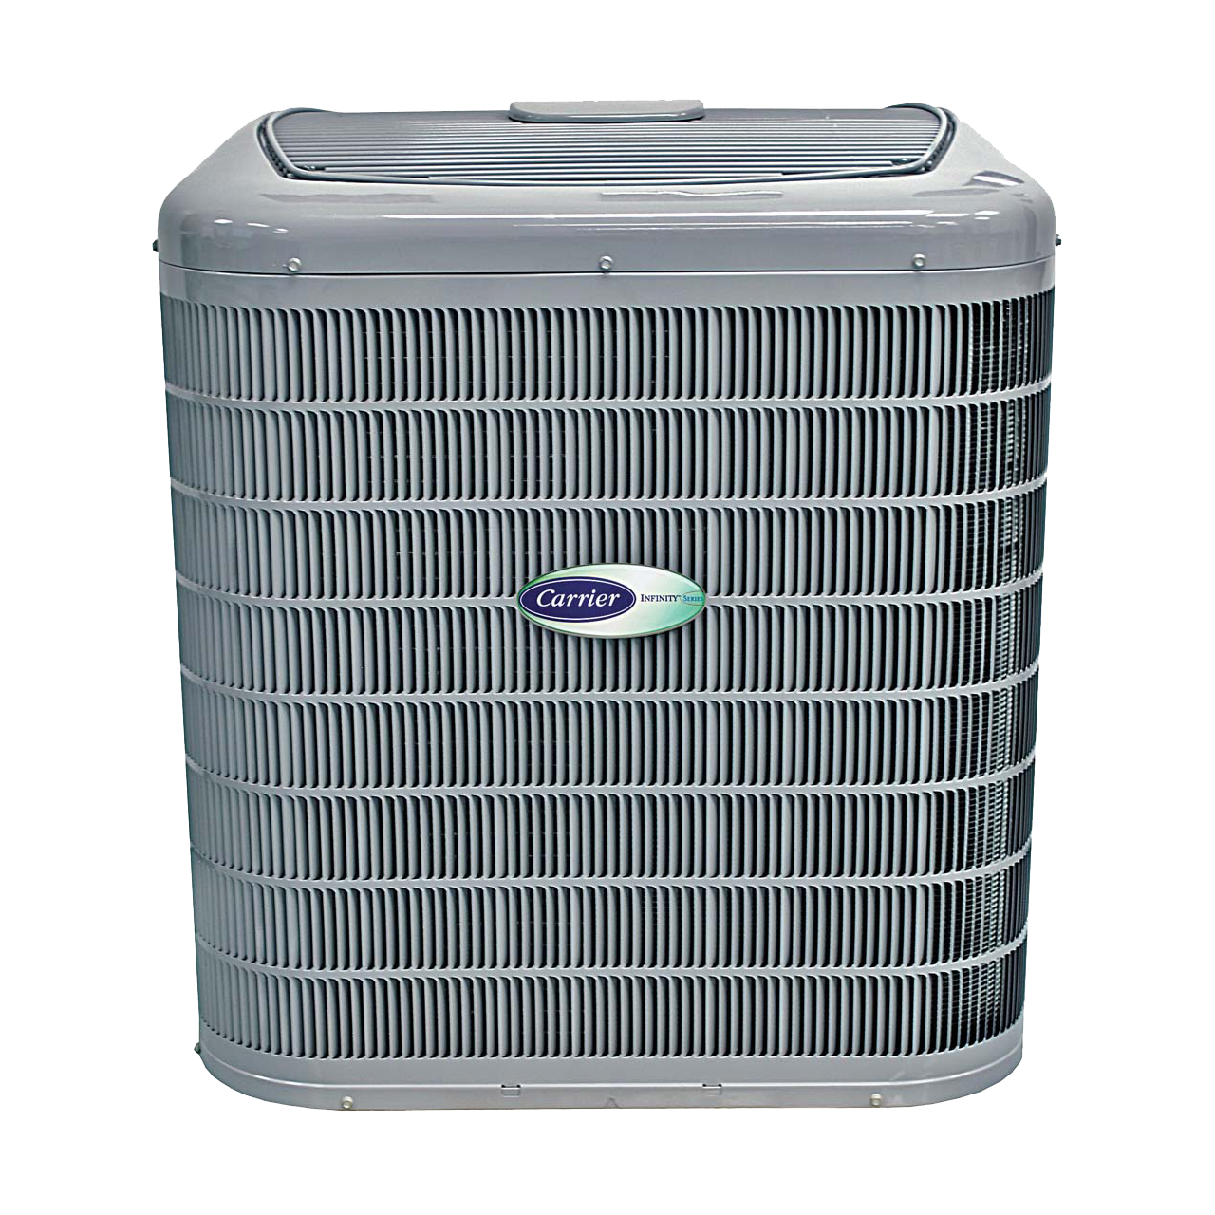


What goes into building a House?
Weyerhaeuser (WY)
(SWP)
(CARR)
Owens Corning (OC)
Notes:
Suppose I thought the house building industry was going to take off because people are building a lot of houses.
I would consider all the components that go into a house. Here we see, wood, paint, roofing materials, appliances, and air conditioning/heating.
Then [click] I would find companies that sold those materials and components – and hopefully select the companies with the best performing stocks.
Or [next slide]

Slide 5


Or you can buy the whole house
Notes:
I could simply buy “the house” or an index that is made up of all the stocks of companies that go into the house.
This is how a stock index works – it tracks the collection of stocks that fit a theme.

Slide 6
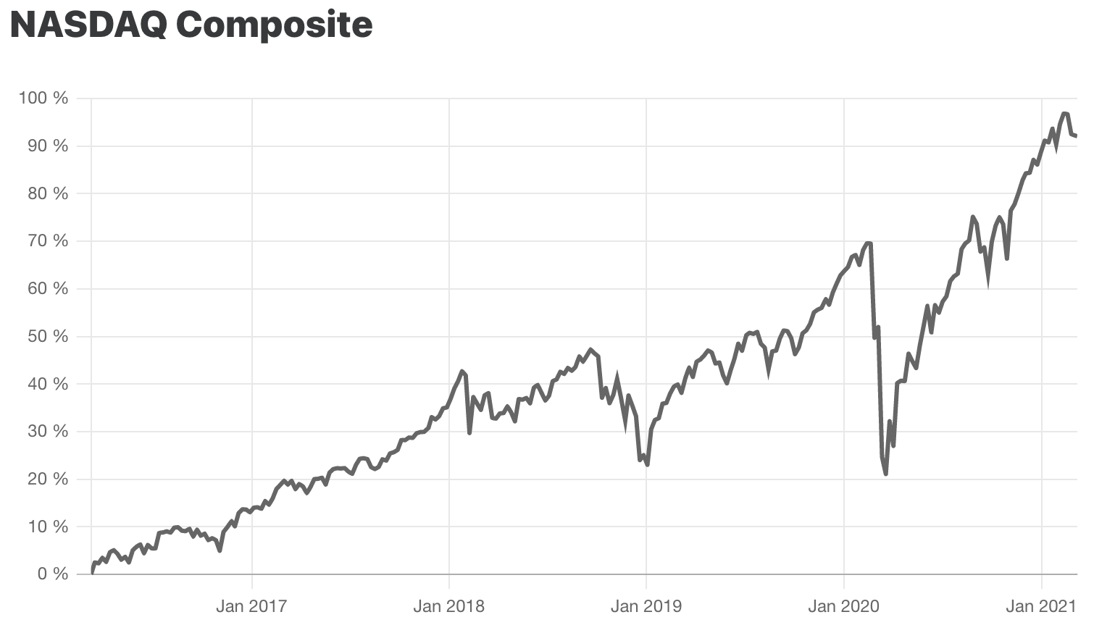
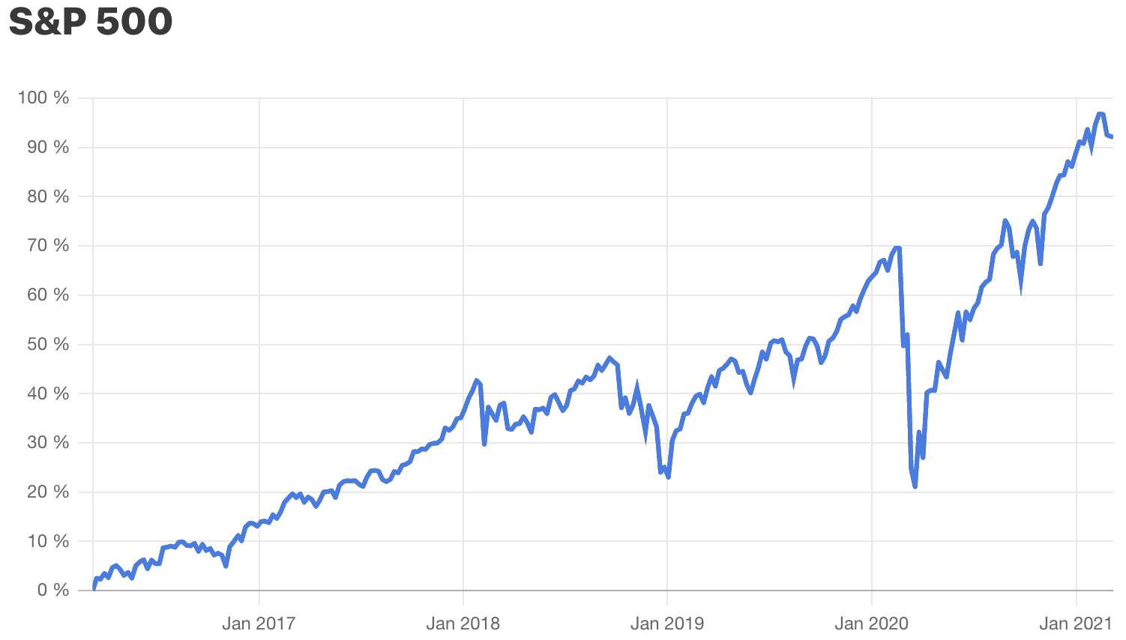
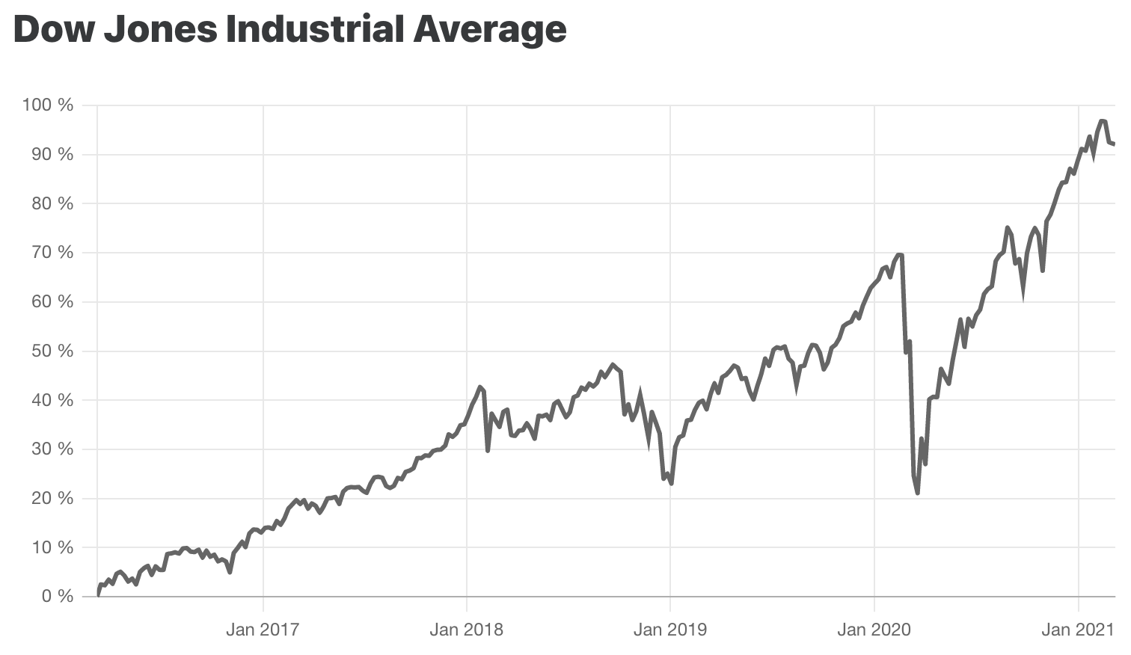
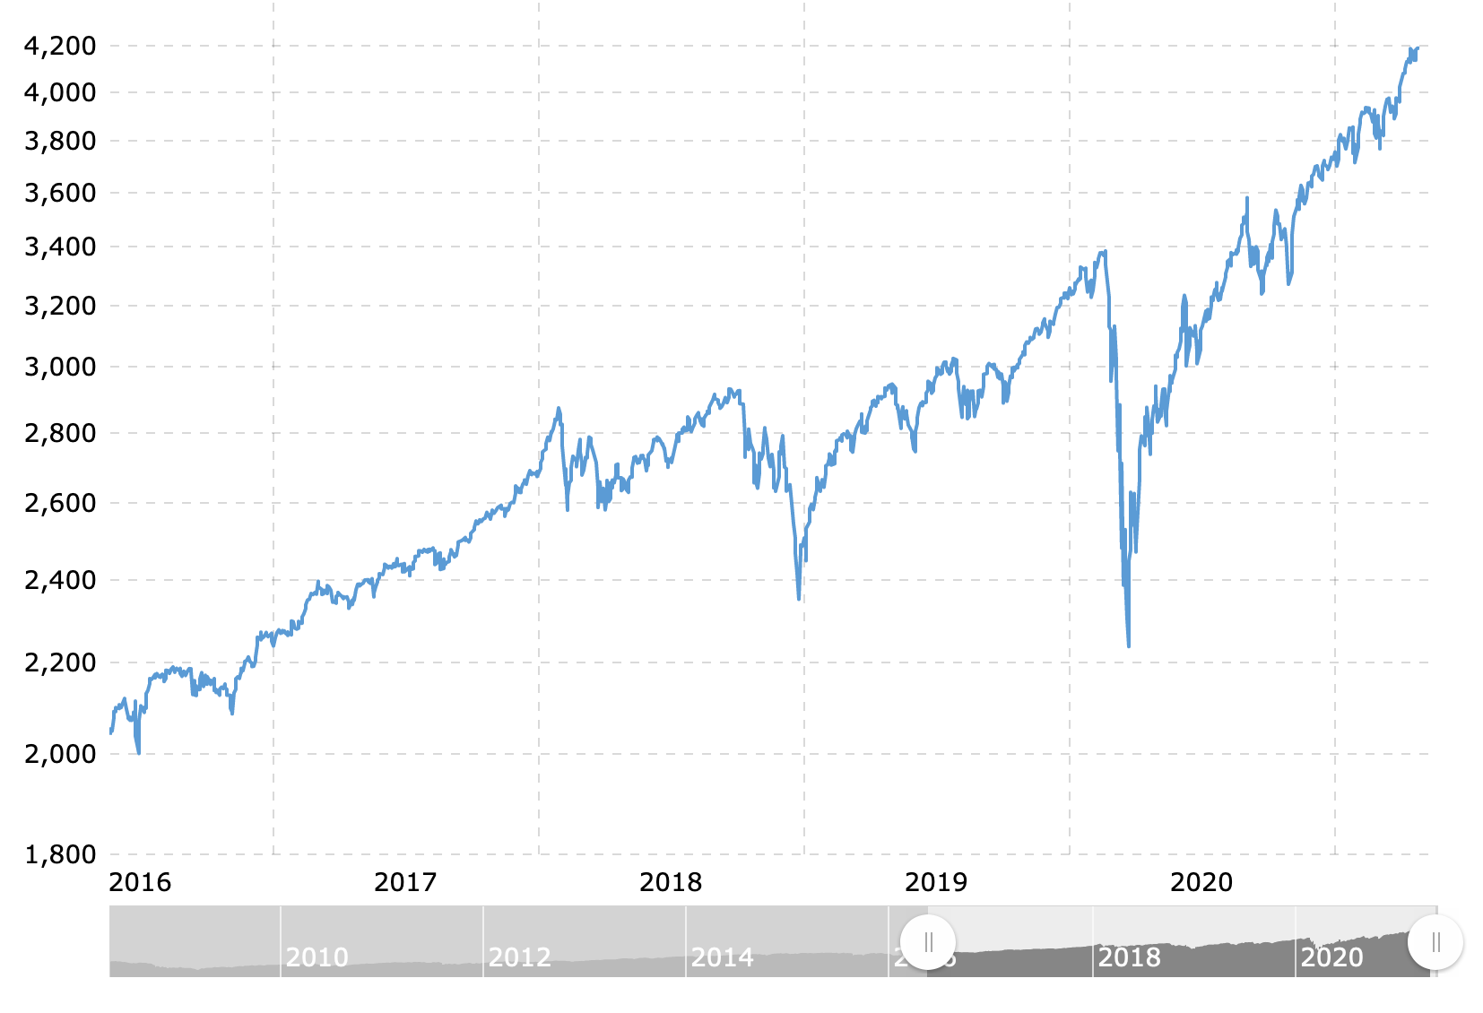
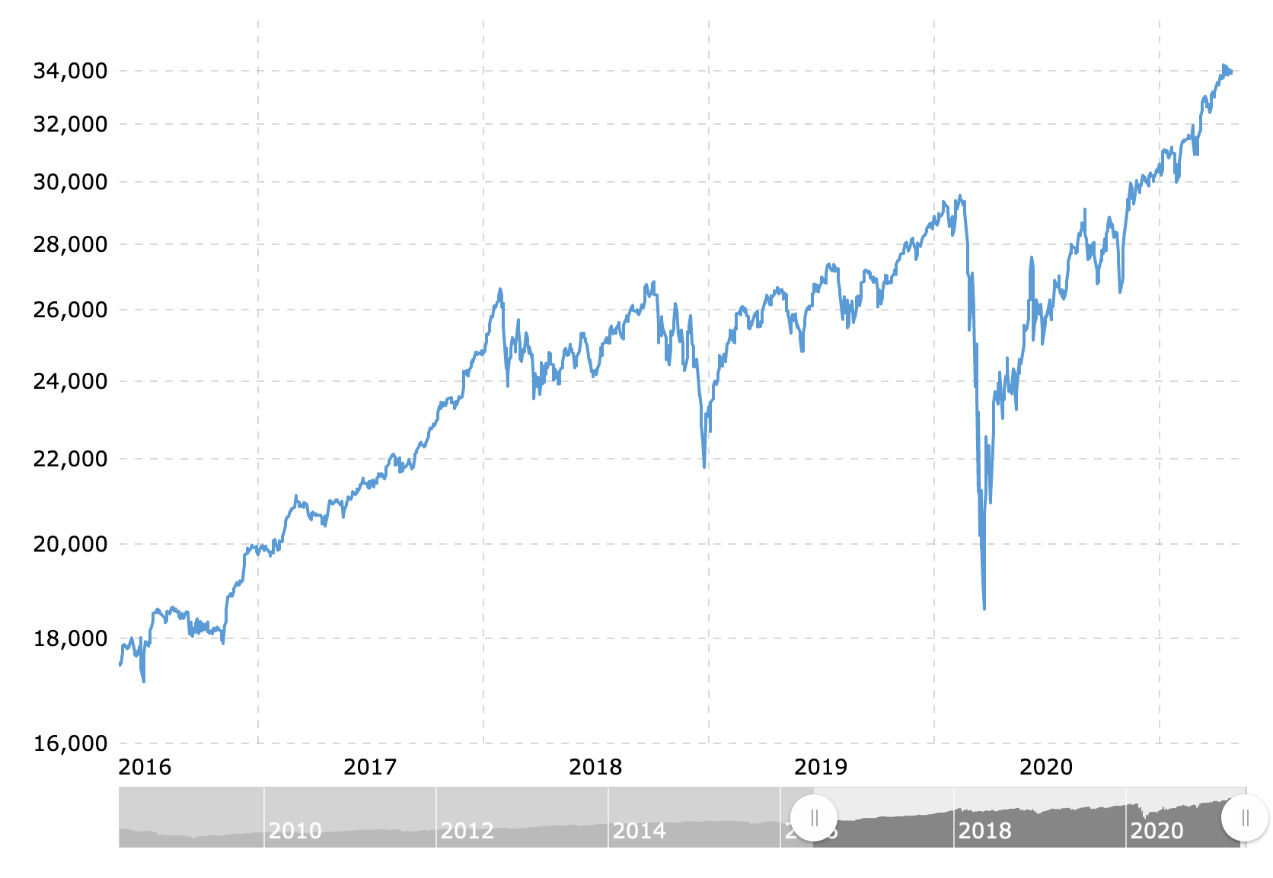
What is a Stock Index?
A stock index is any collection of stocks that fit a certain theme and replicate (track) an overall economy, market, or sector.
Indexes allow investors to more broadly track the market.
Most common indexes:
  S&P 500
  Dow Jones Industrial Average (DOW)
  Nasdaq Composite (NASDAQ)
Notes:
As we saw, there are the three most common Indexes are
S&P 500
Dow Jones Industrial Average (DOW)
Nasdaq Composite (NASDAQ)
These indexes are most often used to get a daily, quick sense of “how the market is doing”
Here you see the graphs of how each of these indexes have performed since 2016.
- What do you notice about the three indexes? [All go up, They look almost identical]
You’ll note they look almost identical and look much like the graph of the entire stock market - which is why investors look to those indexes as a way to see how stocks and “the market” are performing. The market – since 1928 (which includes the great depression, has averaged 10-11% annual growth – which is why we need to be invested in it!
So let’s look at how these indexes differ from each other.

Slide 7
Stock Indexes - S&P 500
Standard and Poor’s 500
  500 of the top companies in the U.S. Stocks
  Market-cap weighted – Apple and ExxonMobil - have greater influence
  Represents about 80% of the total value of the U.S. stock market
  Good indicator of movement in the U.S. market as a whole
Notes:
The S&P 500 index is rebalanced four times a year
With the capitalization-weighted method, the index components with a higher market cap will receive a higher weighting in the index. Proportionally, the performance of companies with a small market cap will have less of an impact on the performance of the overall index.
- Critics of cap-weighted indices argue that the overweighting toward larger companies gives a distorted view of the market.
A company's market capitalization is calculated by multiplying its outstanding shares by the current price of a single share.
(https://www.investopedia.com/terms/c/capitalizationweightedindex.asp)
The larger companies on this list are Apple ($2.318 T), Microsoft ($1.769 T), Google [Alphabet] (1.314 T), Amazon ($1.187 T), and Tesla (647.36 T).
- Fall 2022: Smallest 11.50 B - C. H. Robinson (CHRW)
(https://companiesmarketcap.com/usa/largest-companies-in-the-usa-by-market-cap)
Each year, about 20 to 25 stocks leave the S&P 500 and are replaced with other stocks that meet the guidelines for index membership. These changes usually are announced five trading days before the index change.
Source: https://www.investmentnews.com/inside-the-sp-500-adds-drops-and-tall-tales-63227

Slide 8

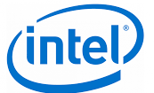


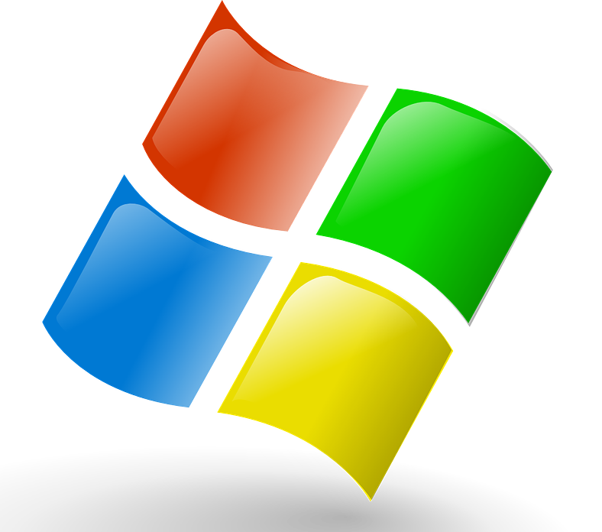








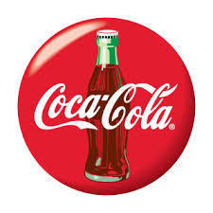

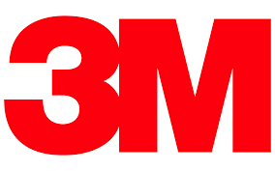
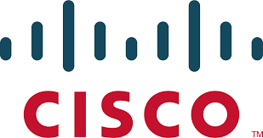
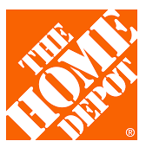
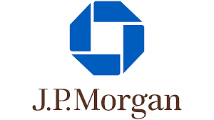


Stock Indexes - DOW
Dow Jones Industrial Average
  30 of the top companies in the U.S. Stocks
  All the companies are considered major players in their respective industries
  Price weighted – higher priced stocks have greater influence
Notes:
These are the logos of 22 of the 30 companies on the Dow Index. Most are familiar to the students. It may be helpful to ask students what each company produces.
The DOW index is rebalanced usually annually in the fall.
Includes “blue chip” stocks: an established, stable, and well-recognized corporation. Blue-chip stocks have a history of reliable growth and dividend payments and are seen as relatively safe investments
With the price-weighted method, a stock with a higher price is given more weight than a stock with a lower price and will thus have a greater influence on the index's performance.
- Price-weighted indexes are useful because the index value will be equal to (or at least proportionate to) the average stock price for the companies included in the index. (https://www.investopedia.com/terms/p/priceweightedindex.asp)

Slide 9


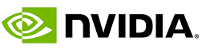
Stock Indexes - NASDAQ
Nasdaq Composite
  High concentration of companies in the technology sector
  3700 stocks - does not include ETFs or mutual funds
  Weighted by Market Cap – Top 10 account for 1/3 of the performance
Notes:
The technology sector accounts for just over half the index; consumer services and consumer goods account for about 25%
Five mega-cap companies account for about 40% of index weight. That means the performance of those five companies have a heavy impact on the index overall.
Includes non-US companies.
The students may notice that some companies appear in more than one of these indexes. The Pepsico logo provides an opportunity to talk about holding companies and when students like particular companies, they may have to find out who the parent company is.

Slide 10
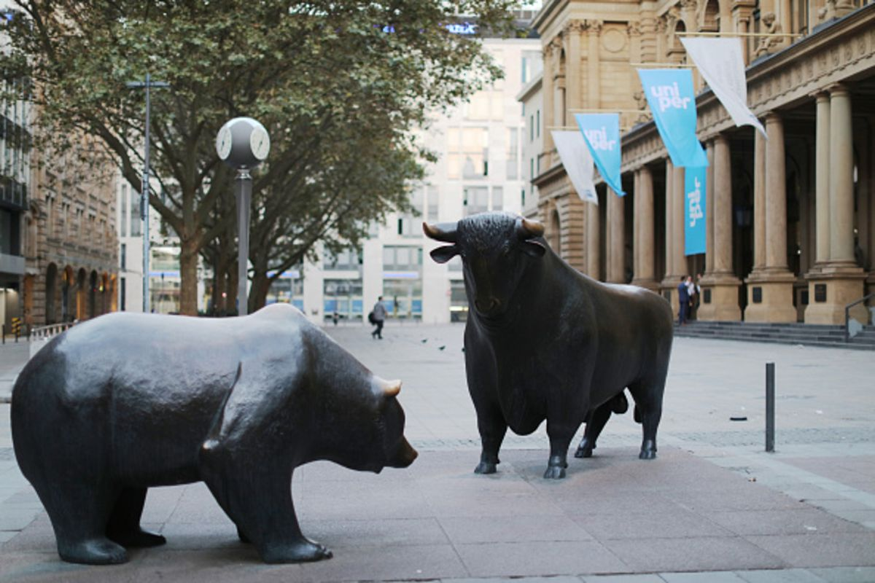
How did the Market do today?
Indexes:
  S&P 500
  Dow Jones Industrial Average (DOW)
  Nasdaq Composite (NASDAQ)
Notes:
This is a very good slide to start any SMG session by asking the students, “How did the Market do today?”
Note: Before the session, fill in the actual results for the day…up, down and how much.
Talk to the students about the day’s activity.
Whether the market is up/down and whether it’s a lot or not.
Talk about what may be driving the market for the day or week.

Slide 11
Other Indexes
Nasdaq 100 - focused on the largest 100, roughly 3% of the NASDAQ
Russell 2000 - 2,000 small-cap companies – average $2.3 billion
Russell 3000 - provides exposure to the entire U.S. stock market
S&P 500 Value Index - mature, slower-growing companies
S&P 500 Growth Index - generally above-average sales growth and relatively high price-to-earnings ratios (PE)
S&P MidCap 400 – restricted to market caps between $1.6 - $6.8 billion.
Wilshire 5000 - represents the entire U.S. stock market
Notes:
Do not try to explain all these Indexes. This is included to help students understand there are other indices, some of which are subsets of other indexes.

Slide 12
How to buy Indexes
“Index funds are the best investment choice for the majority of Americans”
~ Warren Buffett
Mutual Funds are a managed portfolio of stocks
ETF – Exchange Traded Funds usually track an index or sector of the market
  VOO: Vanguard S&P 500 ETF
  QQQ: tracks NASDAQ 100 Index
  DIA, IYY, DDM: Track the Dow (DJIA)
SPDR (Standard & Poor's Depositary Receipt) are a sector ETF
  SPY – represents the S&P 500 stocks
Notes:
Warren Buffett’s (Berkshire Hathaway) quotation is useful to help students understand there are other, and perhaps better, ways to invest in the market than purchasing individual stocks.
Index funds can be purchased through Mutual Funds, ETF’s and SPDR. These securities appear to be a single security, but in fact are a broad set of multiple stocks, usually grouped by a sector or particular strategy for investment (especially mutual funds),
Mutual funds and many ETFs are professionally managed.

Slide 13
How to buy Indexes
“Index funds are the best investment choice for the majority of Americans”
~ Warren Buffett
Instead of buying individual stocks, investors can diversify their holdings by purchasing shares of ETFs, SPDRs and mutual funds as if they were individual stocks.
VTI - Vanguard Total Stock Market Index Fund – The entire Market
  Tracks the performance of the index, representing approximately 100% of the stocks regularly traded on the New York Stock Exchange and Nasdaq
SPY - S&P 500
QQQ - Stocks in the NASDAQ-100 Index
VBR - a broadly diversified index of value stocks of small U.S. companies.
Notes:
The first bullet is key.
ETFs provide a good “first purchase” for students in the Stock Market Game. Students can choose one of these ETF’s when they start the game. This purchase will also provide a point of reference for the students to make a comparison on how their chosen stocks are doing relative to a larger market index.
ETFs are also a GREAT starting point for students looking to invest their own funds in a real stock market account. Reference back to the performance of the Market overall, 10% annually the Index funds should provide a satisfying, if not very volatile purchase.
There is evidence, per the Buffett quote, that indexes are the way to go for individual investors.

Slide 14
Stock Market Game
Following “the Market”

