Slide 1
Stock Market Game
Stock Charts & Analysis
Notes:
For this lesson, provide students with a blank copy of the Stock Analysis Sheet. Explain that students should use a Stock Analysis Sheet for each stock they purchase (in the best case).
Explain to students, the information on the slide is dated and may not reflect current data. The intent is to teach rudimentary analytical concepts.
Alternatively, you may decide to recapture current charts.

Slide 2
How did the Market do today?
Indexes:
S&P 500 –
Dow Jones Industrial Average (DOW) –
Nasdaq Composite (NASDAQ) –
Down – 96.41 points (2.5%)
Down – 505.44 points (1.54%)
Down – 366.05 points (3.36%)
Notes:
This is a very good slide to start any SMG session by asking the students, “How did the Market do today?”
Note: Before the session, fill in the actual results for the day…up, down and how much.
Talk to the students about the day’s activity.
Whether the market is up/down and whether it’s a lot or not.
Talk about what may be driving the market for the day or week

Slide 3
Stock analysis
Stock analysis can be a bit like painting by the numbers
The more information you have, the clearer the picture becomes
Notes:
This slide provides a thought about conduction stock analysis, comparing stock analysis to a paint by the numbers picture.
The second bullet is revealed through animation and then a colored-in version of the picture. [one click]

Slide 4
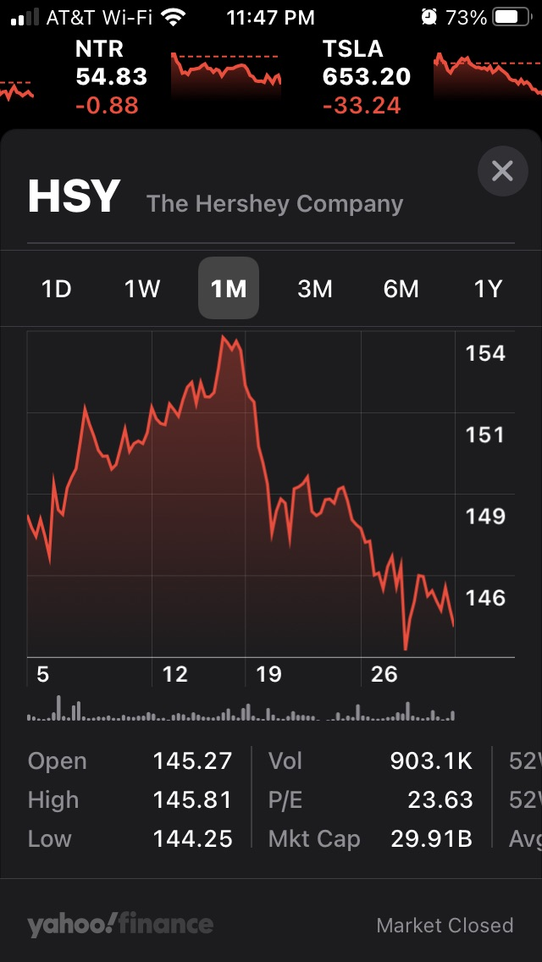
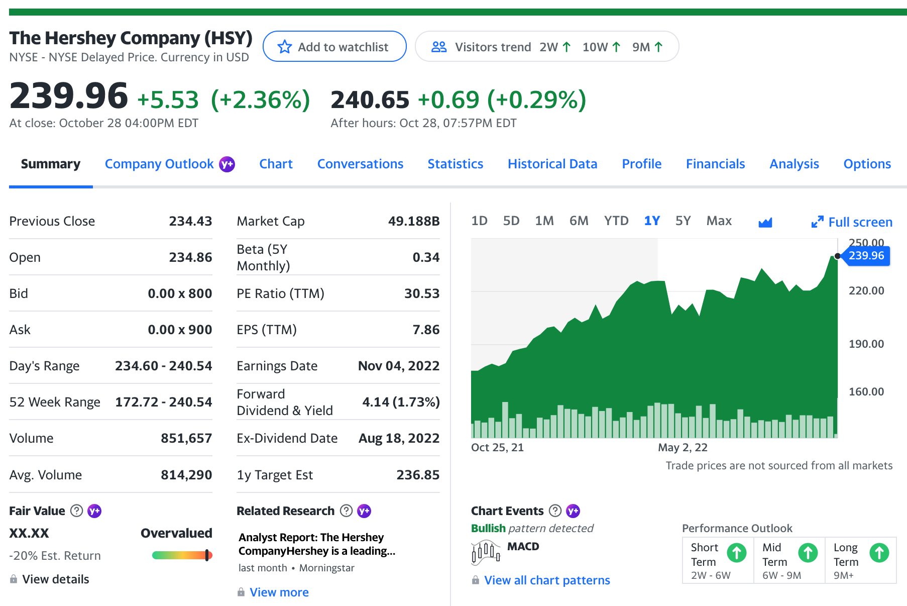
Stock Charts
Recommend using finance.Yahoo.com
Stock Apps are also available on smart phones
Notes:
In order to decide whether a stock purchase is wise or not, we need to conduct some basic analysis.
One of the most readily available websites available is Yahoo.com – specifically, finance.yahoo.com
Have the students find the website, finance.yahoo.com. This presentation uses the Hershey Company (ask the students what Hershey makes) to look at the different pieces of information they might use to conduct rudimentary analysis.
Note the image on the left is the webpage version of the website; the picture on the right is representative of what the information will look like on a phone app, specifically the “Stocks” app on iPhone.

Slide 5
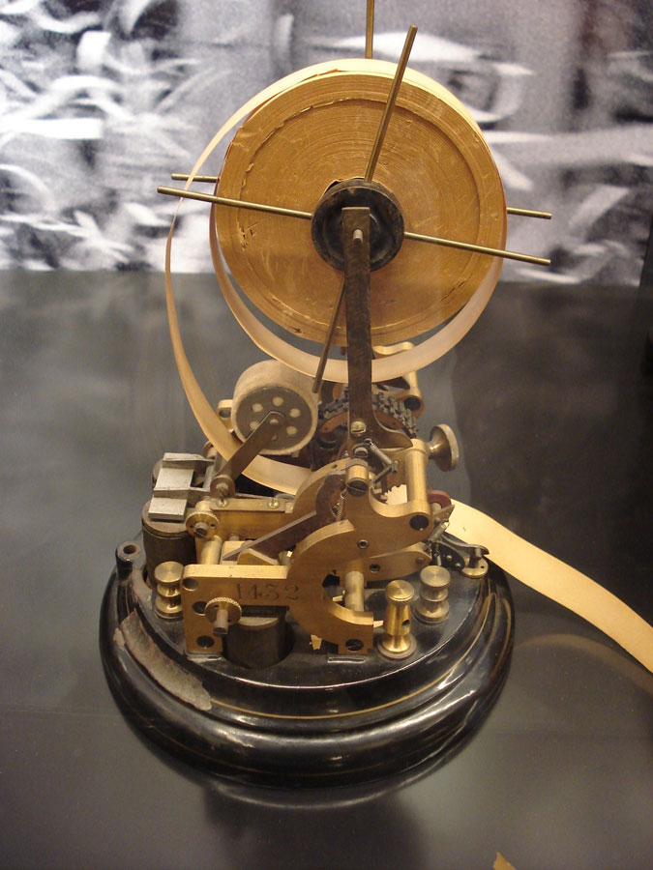
Stock Charts - Stock Information [Fill in the Stock Analysis Sheet]
Company Name:
The Hershey Company
Stock Symbol:
(HSY)
Exchange: NYSE [or NASDAQ]
Notes:
Each company has a unique “ticker symbol”. The ticker symbol is a shorthand way to identify the company.
[click] The ticker machine printed stock quotes - the ticker symbol and price on streams of paper. The ticker, which caught on quickly with investors, got its name from the sound its type wheel made.
[click] Today stock informatoin are of course digital, but the format is essentially the same.
HSY is the ticker symbol for The Hersey Company. Have students:
Locate the Compay name
Locate the ticker symbol
Locate the Stock Mark (NYSE or NASDAQ) We need to check on what exchange the stock is traded since SMG only allows trades on the NYSE and the NASDAQ.

Slide 6
Stock Charts – Stock price
Stock Price:
Current Price
Today’s activity:
Red – Stock is down from open
Green – Stock is up from open
(Daily percentage of change)
Notes:
Next we need to look at the price of HSY. The stock chart makes it easier to understand if the stock is up (green) or down (red).
The information also informs how much the stock is up/down for the day and the percentage change for the day. Point out that the stock chart also may provide “after hours” information (the second, smaller set of numbers (if present)). Students should use the current market day information, not after hours.
Have students fill in the stock price on their sheet.

Slide 7
Stock Charts - Stock price
Stock Price at the Opening:
Previous Day Close
Open – price at which stock opened
Note: there is usually after-hours activity, so the opening price may be higher or lower than the previous close
Notes:
The stock chart also tells student how the trading day started: Previous day close and opening price for the stock. The information is good to know, but ultimately should not be a determinant for whether they purchase the stock or not as it is a single day’s activity.
[no information to enter]

Slide 8
Stock Charts - Stock price
Day’s Range:
Today’s High & Low
52 Week Range:
High & Low for the past year
Range is important:
How close is the stock to it’s 52-week high?
Notes:
The stock chart also tells student what various trading ranges are. Here we can see the current trading day range and the 52-week [how long is 52 weeks?].
Have students enter the 52-week range on the Stock Analysis Sheet. Also have students evaluate the 52-week trend and circle the indicator on the Analysis Sheet (up, down, or basically even)
The 52-week trading range is important because if give the investor historical information on the stock trading range. As the slide indicates, investors should be aware how close the stock price is to the 52-week high or low. This might inform whether the stock has room to grow.

Slide 9
Stock Charts - Stock price
Stock Chart: A quick visual indicator of performance
1D – Current day
5D – Previous 5-days
1M – Previous Month
6M – Last 6 months
YTD – Activity since 1 January
1Y – Previous year
5Y – Last five years
**Very important to understand the current trend
Notes:
The stock chart provides a useful visual for quick analysis as to how the stock is performing. The next slide show the various view so the stock chart. This view is 1Y or 1 year.

Slide 10
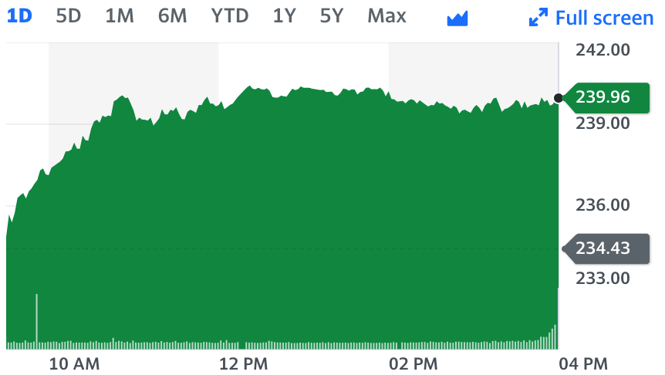
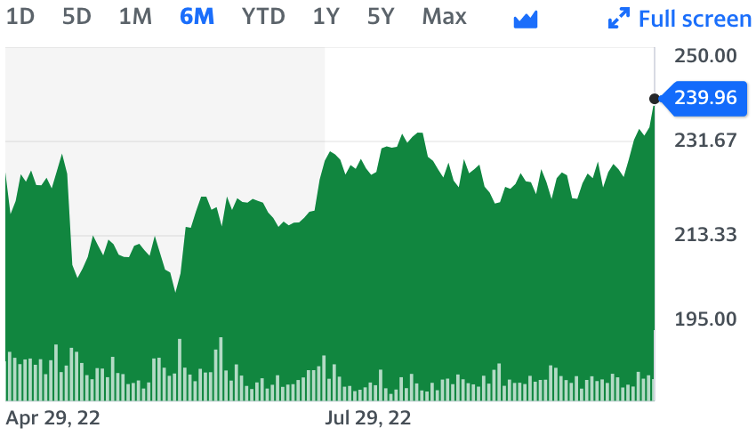
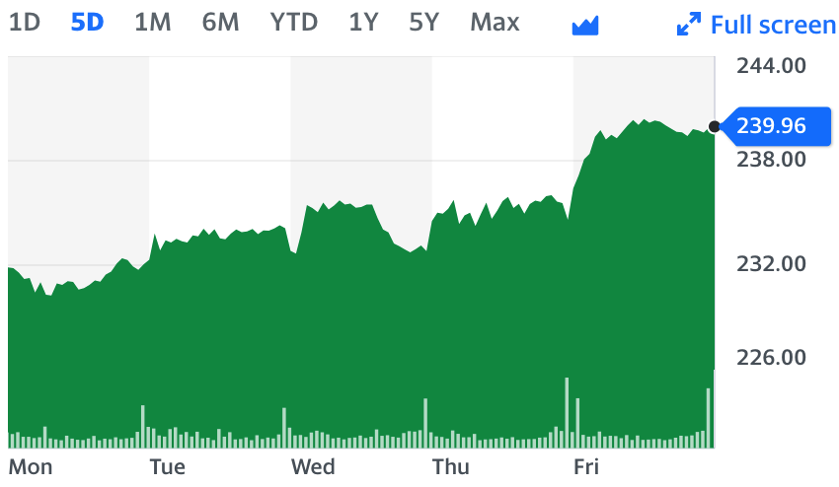
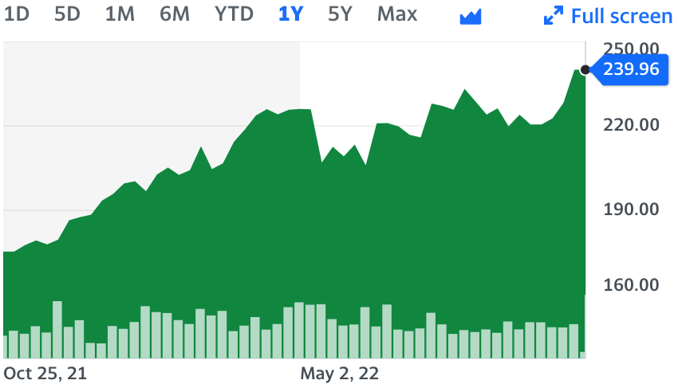
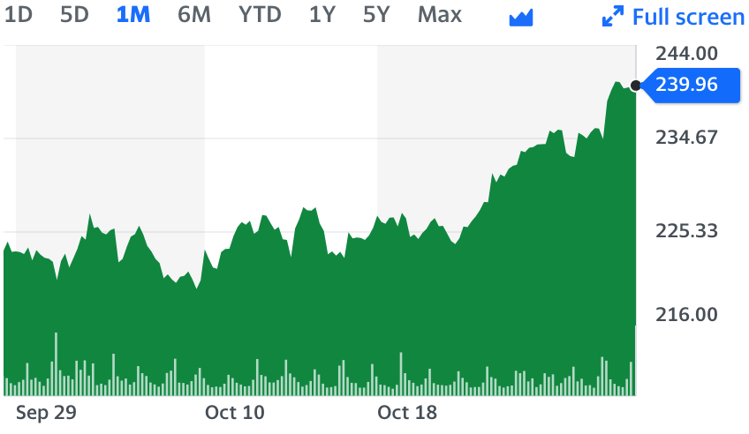
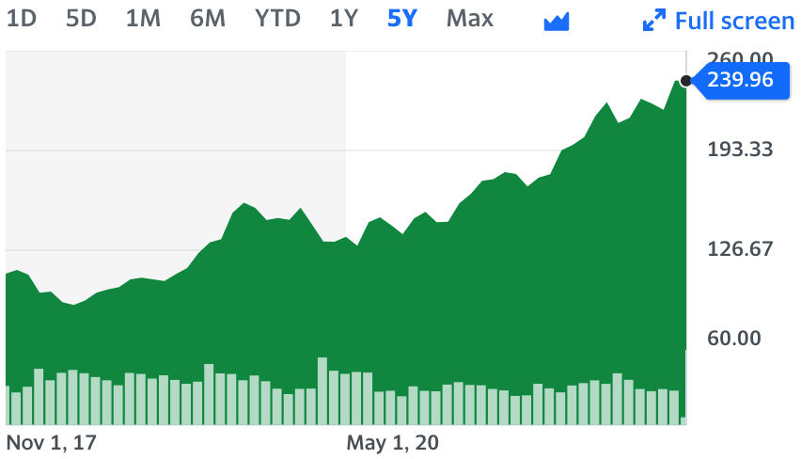
Stock Charts – The Chart
Stock Chart - A quick visual indicator of performance
1D – Current day
5D – Previous 5-days
1M – Previous Month
6M – Last 6 months
YTD – Activity since 1 January
1Y – Previous year
5Y – Last five years
**Very important to understand the current trend
Notes:
This is the view of each stock chart for the period indicated.
The following charts highlight various periods. The key is, WHAT IS THE TREND?!?

Slide 11
Stock Charts – The Chart
Stock Chart - A quick visual indicator of performance
1D – Current day
5D – Previous 5-days
1M – Previous Month
6M – Last 6 months
YTD – Activity since 1 January
1Y – Previous year
5Y – Last five years
**Very important to understand the current trend
Notes:
1D or the current trading day. Ask students how the stock is doing based on this chart?
Have students evaluate the 1-day trend and circle the indicator on the Analysis Sheet (up, down, or basically even)

Slide 12
Stock Charts – The Chart
Stock Chart - A quick visual indicator of performance
1D – Current day
5D – Previous 5-days
1M – Previous Month
6M – Last 6 months
YTD – Activity since 1 January
1Y – Previous year
5Y – Last five years
**Very important to understand the current trend
Notes:
5D or the last 5 trading days. Ask students how the stock is doing based on this chart?
Have students evaluate the 5-day trend and circle the indicator on the Analysis Sheet (up, down, or basically even)

Slide 13
Stock Charts – The Chart
Stock Chart - A quick visual indicator of performance
1D – Current day
5D – Previous 5-days
1M – Previous Month
6M – Last 6 months
YTD – Activity since 1 January
1Y – Previous year
5Y – Last five years
**Very important to understand the current trend
Notes:
6M or the past six months of trading. Ask students how the stock is doing based on this chart?

Slide 14
Stock Charts – The Chart
Stock Chart - A quick visual indicator of performance
1D – Current day
5D – Previous 5-days
1M – Previous Month
6M – Last 6 months
YTD – Activity since 1 January
1Y – Previous year
5Y – Last five years
**Very important to understand the current trend
Notes:
1Y or the current year’s trading. Ask students how the stock is doing based on this chart?

Slide 15
Stock Charts – The Chart
Stock Chart - A quick visual indicator of performance
1D – Current day
5D – Previous 5-days
1M – Previous Month
6M – Last 6 months
YTD – Activity since 1 January
1Y – Previous year
5Y – Last five years
**Very important to understand the current trend
Buy Low
Sell High
Notes:
The point to emphasize is we are looking for trends in the stock price, not simply what the price is today.
As always, Buy Low – Sell High
Have students evaluate the 1-month trend on their own and circle the indicator on the Analysis Sheet (up, down, or basically even)

Slide 16
Stock Charts – Dividends
Dividend Information:
Does the stock pay a dividend?
What is the Yield?
When does it pay the next dividend?
1y Target Est.
What is the 1-Yr Target Stock Price?
Rule of 72
Notes:
IF the Earnings information says N/A, that means the stock does not pay a dividend.
Many investors like dividends and reinvest to buy more stock. This is a form of compounding – remember the Rule of 72 discussion.
Have students enter the stock dividend information on the Analysis Sheet. Does the stock pay a dividend? Yes or No (circle). What is the dividend?
Note the dividend information is for the entire year. If the stock pays quarterly, divide to understand the quarterly dividend.
The Yield accounts for the percent of interest you earn and dividends you receive from a specific stock or bond.
Also look at the Target estimate for the stock price. This is an indicator of what analysts think the stock will do going forward.

Slide 17
Stock Charts – Price to Earnings
PE Ratio:
Price of the Stock
Earnings per share
15-19 is a solid range
A higher P/E ratio may indicate investors are willing to pay a higher share price today because of an expectation of higher growth from the company compared to the overall market.
Notes:
TTM “trailing twelve months,” pulls from the last twelve consecutive months from the date of the request rather than using the financial data of the previous fiscal year or relying only on the financial reporting you have for the most recent quarter of the current calendar year. TTM smooths out the data doing a better job of representing seasonality and/or one-time events that impact recent reporting.
Price to earnings ratio (P/E ratio) compares the price per share of a company's stock with the company's earnings per share (EPS), allowing investors to determine whether a stock is overvalued or undervalued.
A higher P/E ratio means a stock is more expensive relative to its earnings, and a lower P/E ratio means a stock is less expensive relative to its earnings; stocks or mutual funds having a high P/E ratio are usually classified as "growth" investments, and those having lower P/E ratios are usually classified as "value" investments.
(https://seekingalpha.com/article/4494467-pe-ratio)
Earnings per share is a widely watched metric that many investors use to estimate a company's value.
In simple terms, EPS is a calculation that shows how profitable a company is, per share. So, EPS can be described as the amount of money each share of stock would receive if a company's profit was distributed to shareholders at the end of the year.
(https://seekingalpha.com/article/4444681-eps-earnings-per-share)
As shown, many advisors consider a PE range between 15-19 to be an indicator of a solid performance. This is not to say stocks outside the range are bad.

Slide 18
Stock Charts – Analysis
Value and Performance Estimates
Is the stock over or under valued?
If under, there is generally a higher likelihood the price will rise
What is the Short -, Mid -, and Long-term performance outlook?
Notes:
These are additional indicators of what analysts, who follow and advise the general market on some stocks think of the stocks performance.
Have students look at the rainbow chart on the left side and enter the analysis of the value of the stock (under-, over-, or fair-value)
Students should understand this information is not ”set in stone.” This is part of the “art of investing.” Sometimes the analysts are wrong.

Slide 19
Company Profile
Company | Hershey Company
Symbol | HSY | Industry
1. What does the company do?
2. Who are its competitors?
3. What is the Company’s history?
Notes:
Next we’ll look at the company’s Profile – a brief look at basic information about the company. Have students access the > Profile tab
[Next slide]

Slide 20
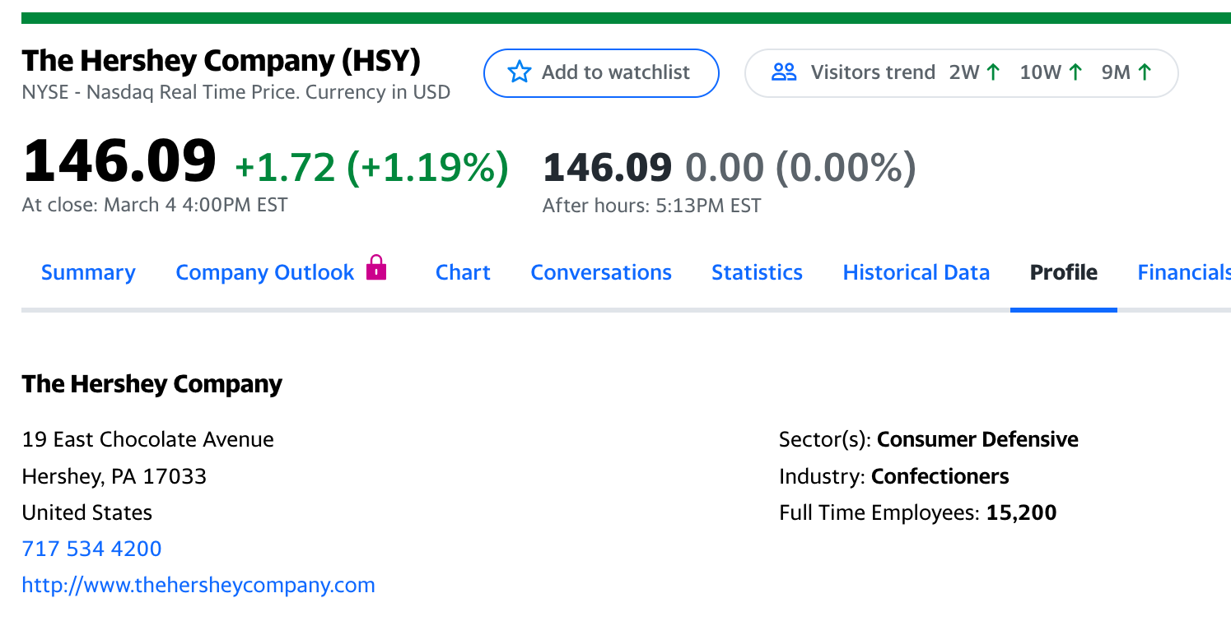
Company Profile
Competitors:
Mars, Nestlé, Mondelez International (Cadbury, Milka, Toblerone).
Company | Hershey Company
Symbol | HSY | Industry | Consumer Defensive/ Confectioners
1. What does the company do?
2. Who are its competitors?
What is the Company’s history?
Products, services.
Why does this company stand out?
Who do people buy from this company?
Check the Summary tab
or
Google competitors
Where and when did the company start?
What were it’s first products?
Has the company been purchased or bought other companies?
Notes:
Jot down some basic information about the company.
What is the industry sector?
What does the company do/make?
What is the history of the company?
Switch back to the >Summary tab to find out similar companies or competitors, or simply google it.
We want to look at competitors potentially to find other stock opportunities – especially if the one we’ve chosen doesn’t have promising performance. Competitors may be a better purchase..

Slide 21
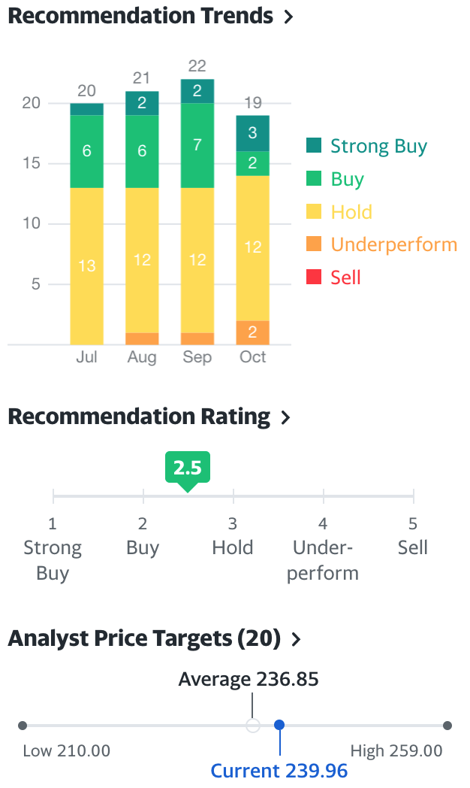
Stock Charts – Analyst's predictions
Analyst predictions
What do the analysts think of the stock?
Also provides a quick view of the current price vs the average and historical prices
Look at the Analysis tab, too.
Scroll down the Summary page on the right side
Also look at the Analysis Tab
Notes:
We can also look to see the purchase recommendation for the stock from analysts who follow the stock.
Have students scroll on the >Analysis or >Summary page. The information above is available on the right side. It is another piece of information to consider

Slide 22
Stock Charts – Financial Information
Market Cap – What is the size of the company?
B – billion M – million
Market Capitalization is the value of the company:
Market Cap = Number of shares outstanding* x current share price
Example: If there are 3,000,000 shares and the share price is $4 $4 x 3,000,000 = $12,000,000
*To find the number of shares, look in the <Statistics> tab

Slide 23
Stock Charts – Financial Information
Beta – measures a stock's volatility
Less than 1.0 – moves less than the market
High-beta stocks are riskier but provide higher return potential;
Low-beta stocks pose less risk but also lower returns
Risk vs Return

Slide 24
Stock Charts – Stock price
What is your analysis?
Now that you have looked at some “technical” indicators, do you think this stock is a good buy or not?
Risk vs Return
Notes:
What do you think of this stock? Do you think it is a good buy or not? A basic analysis is important to understand how a stock is performing. The more you know, the better you can evaluate whether to purchase the stock or not.
Ultimately, purchasing stocks is a decision about Risk vs. Return. Sometimes the risk is worth it; sometimes not. The higher the risk, the higher likelihood for greater gains or greater losses.
As the disclaimer always says, “The past performance of a security, an industry, a sector, a market, a financial product, a trading strategy or the individual trade does not guarantee any future results or returns.”

Slide 25
Stock Market Game
Stock Charts & Analysis

