Slide 1
Stock Market Game
What Stocks Purchase

Slide 2
How did the Market do today?
Indexes:
S&P 500 –
Dow Jones Industrial Average (DOW) –
Nasdaq Composite (NASDAQ) –
Up – 96.41 points (2.5%)
Up – 505.44 points (1.54%)
Up – 366.05 points (3.36%)
Notes:
This is a very good slide to start any SMG session by asking the students, “How did the Market do today?”
Note: Before the session, fill in the actual results for the day…up, down and how much.
Talk to the students about the day’s activity.
Whether the market is up/down and whether it’s a lot or not.
Talk about what may be driving the market for the day or week

Slide 3
Company, Brand, & Products
Company Name | Parent or Subsidiary | Ticker Symbol Price | Brands | Products
Adapted from the 2019 SIFMA Foundation activity, Activity Sheet 2: Companies, Brands & Products
Notes:
Instructions: Using a financial news site like Yahoo! Finance find the companies whose logos appear in the table and complete the chart. - If the company is a subsidiary (belongs to a larger company), provide the name of the parent company or write “parent” if the company is a parent company.. - What is the Ticker symbol of the company or its parent company? - Brands and products are typically found in the company’s Profile information

Slide 4
Company, Brand, & Products
Company Name | Parent or Subsidiary | Ticker Symbol Price | Brands | Products
 | Parent | GPS $20.89 | Old Navy, Gap, Banana Republic, Athleta, Intermix, and Janie and Jack | denim, tees, fleece, and khakis; eyewear, jewelry, shoes, handbags, and fragrances; and fitness and lifestyle products for use in yoga, training, sports, travel, and everyday activities
 | Subsidiary of Disney | DIS $90.71 | None | Daytime shows, ABC News, broadcasting rights to Academy Awards, Emmys, American Music Awards, and Country Music Association Awards
 | Parent | PEP $172.91 | Cheetos, Doritos, Fritos, Lay's, Ruffles, Tostitos, Aunt Jemima, Cap’n Crunch, Life, Quaker, Rice-A-Roni, Aquafina, Mountain Dew, Pepsi, Gatorade, Sierra Mist, Tropicana, 7UP | Dips, cheese-flavored snacks, and tortillas, as well as corn, potato, and tortilla chips; cereals, rice, pasta, mixes and syrups, granola bars, grits, oatmeal, rice cakes, simply granola, and side dishes; beverage concentrates, fountain syrups, and finished goods; ready-to-drink tea, coffee, and juices; and dairy products
Adapted from the 2019 SIFMA Foundation activity, Activity Sheet 2: Companies, Brands & Products
Notes:
Instructions: Using a financial news site like Yahoo! Finance find the companies whose logos appear in the table and complete the chart. - If the company is a subsidiary (belongs to a larger company), provide the name of the parent company or write “parent” if the company is a parent company.. - What is the Ticker symbol of the company or its parent company? - Brands and products are typically found in the company’s Profile information

Slide 5
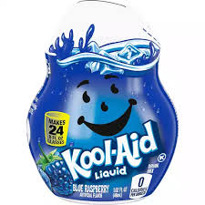
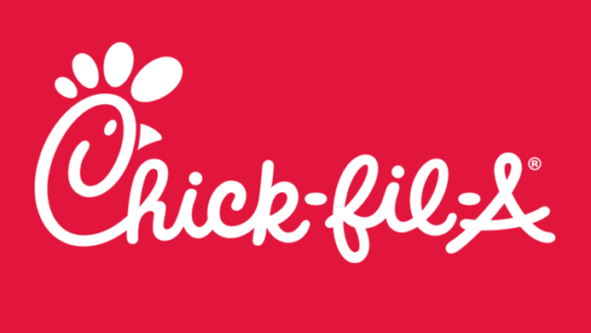
Company, Brand, & Products
Company Name | Parent or Subsidiary | Ticker Symbol Price | Brands | Products
Adapted from the 2019 SIFMA Foundation activity, Activity Sheet 2: Companies, Brands & Products
Notes:
Instructions: Using a financial news site like Yahoo! Finance find the companies whose logos appear in the table and complete the chart. - If the company is a subsidiary (belongs to a larger company), provide the name of the parent company or write “parent” if the company is a parent company.. - What is the Ticker symbol of the company or its parent company? - Brands and products are typically found in the company’s Profile information

Slide 6
Company, Brand, & Products
Company Name | Parent or Subsidiary | Ticker Symbol Price | Brands | Products
 | Subsidiary of Kraft-Heinz | KHC $38.12 | None | Kool-Aid drinks and drink mixes
 | Parent | YUM 129.03 | Taco Bell, KFC, Pizza Hut, The Habit Burger Grill | Restaurants which specialize in chicken, pizza, made-to-order chargrilled burgers, sandwiches, Mexican-style food categories, and other food products.
 | Parent | Not Publicly Traded
Adapted from the 2019 SIFMA Foundation activity, Activity Sheet 2: Companies, Brands & Products
Notes:
Instructions: Using a financial news site like Yahoo! Finance find the companies whose logos appear in the table and complete the chart. - If the company is a subsidiary (belongs to a larger company), provide the name of the parent company or write “parent” if the company is a parent company.. - What is the Ticker symbol of the company or its parent company? - Brands and products are typically found in the company’s Profile information

Slide 7
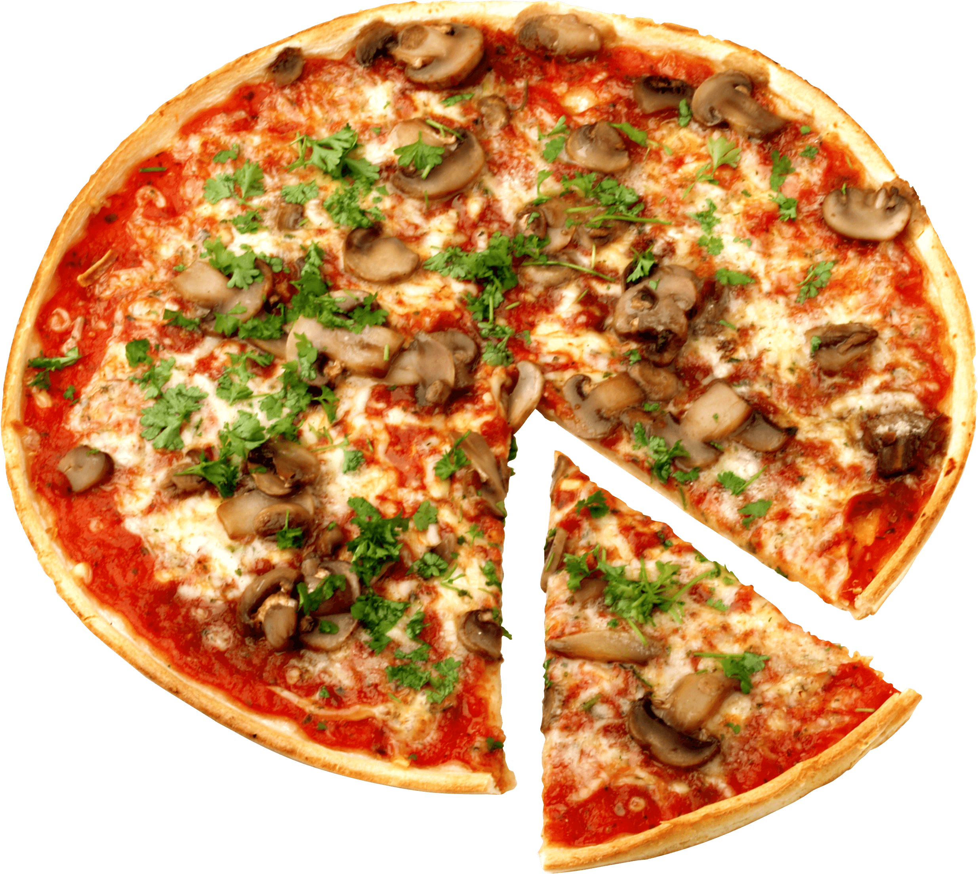
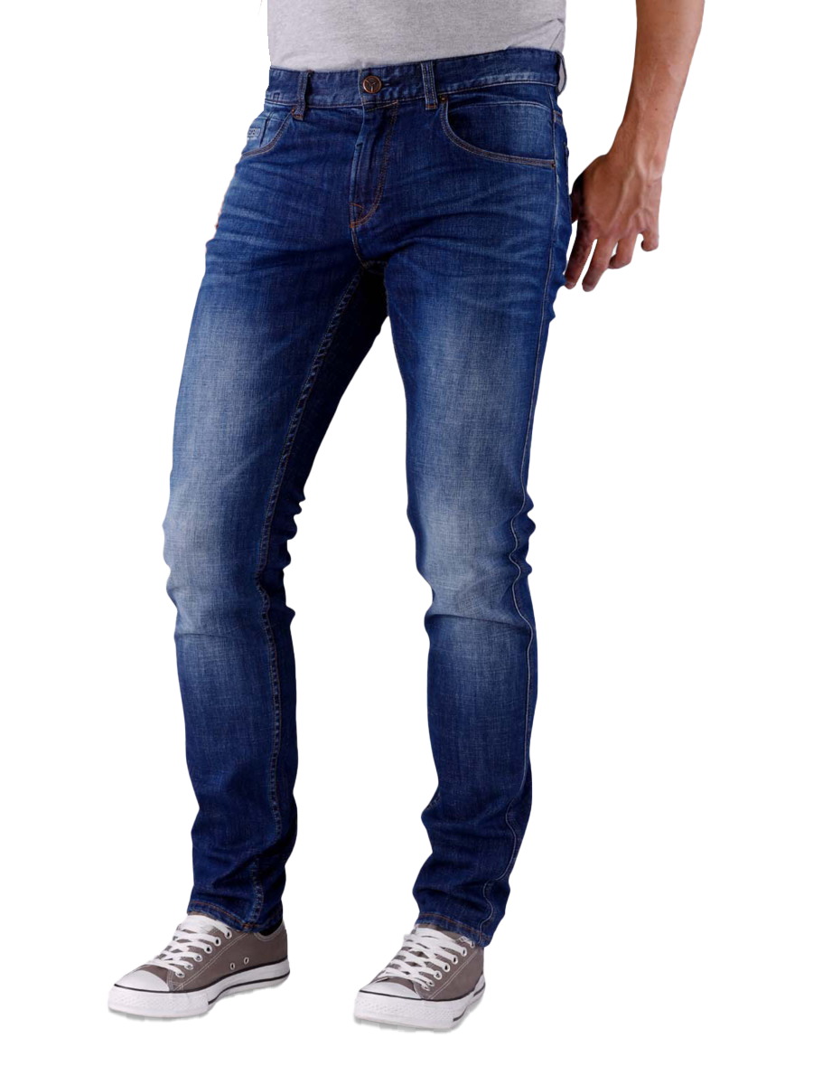
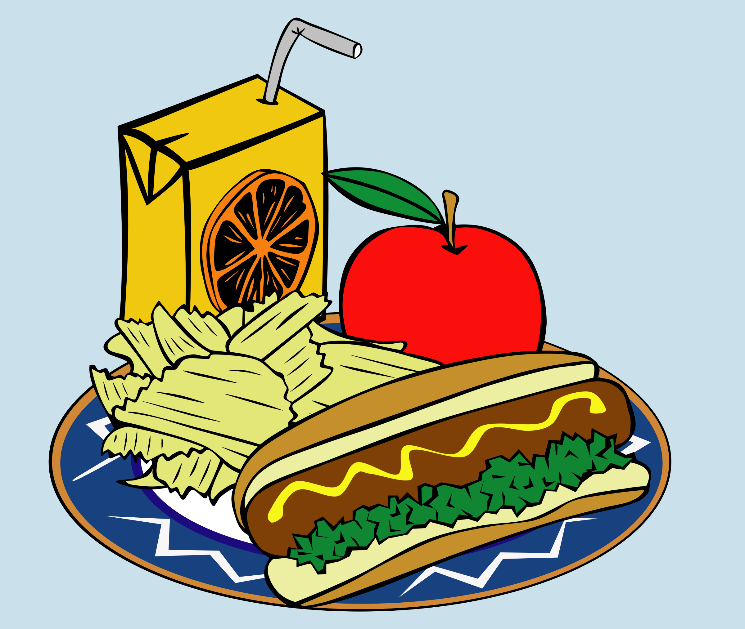
What to Buy?
What is in your closet?
Choose a company you like or your family uses
Consider the competitors
This Photo by Unknown Author is licensed under CC BY-NC
Notes:
Have students think about these questions.
What brands do the students have at home – clothes, cars, food, things in their houses
Often the best stocks to purchase initially are the ones students themselves use.
Once students identify products and companies they like, they can look for those companies’ stocks. Encourage students to google the company and look at the corporate webpage for information.
Remember: Is the company publicly traded? In other words, can you actually buy it on a market exchange?
Chik-fil-A is a popular fast food restaurant, but it is not publicly traded.
Taco Bell is popular, but it is owned by a holding or parent company, Yum! Brands, Inc. The corporation is traded on the NYSE under the ticker symbol, YUM. The company also owns KFC and Pizza Hut.
Adidas is a popular sportswear brand, the second largest in the world. It is a German company, traded in Europe and cannot be purchased on US exchanges, and therefore not in the SMG
Is the company part of a larger corporation, such as Taco Bell. What other brands do they own? Walt Disney is a huge conglomerate. Students may be surprised to learn all the companies Disney owns.

Slide 8
Quick Review – Analysis Tools
Recommend using finance.Yahoo.com
Why do you want to purchase the stock?
Is it a company you know?
Do you or your friends use the product?
What is the performance trend (1-month, 6-month, 52-week)?
Does the stock pay a dividend? What is the yield?
Revenue (Earnings Per Share) – Is the company making money?
What is the Price-to-Earnings (PE)?
1-yr target price – is there room to grow? What price do analysists estimate?
How are the competitors doing?
Notes:
In order to decide whether a stock purchase is wise or not, we need to conduct some basic analysis.
Recommend the students pick a company they like or know. They should consider completing an Analysis Sheet on the company.

Slide 9
Market vs. Limit Order
What is a market order?
A request to buy or sell a security without being specific about the prices → “at cost”
What is a limit order?
A request to buy or sell a security at a specific price
Buy: Specify the highest price you are willing to pay
Sell: Specify the lowest price you are willing to pay
SMG Rule: Limit orders expire at the end of the trading day.
Notes:
For the most part, students should use market order, not because they can’t attempt to buy at a specific price, but because unlike normal brokerages, SMG limit orders expire if they are not executed.
We don’t want students to miss trades because they ”guessed” wrong. If a student is accessing their account every day, then a limit order is more likely to work because they are watching the trading prices closely.

Slide 10
SMG Reminders
You have $100,000
Buy stocks in large lots - $5000 - $7500 - $10,000
Divide the amount by the stock price
Log each purchase – portfolio tracker
Update prices weekly
Remember trades entered after 1pm register tomorrow
Check your trade after you enter it to ensure it executed
No more than 1/3 of the portfolio in one stock
Notes:
One of the big mistakes students make is not buying stocks in big enough lots. They tend to buy very small amounts of stocks and end up with more cash than equities
In addition to conducting basic analysis, students should log their purchases in a Portfolio Tracker (next slide). Each week, they should enter the date and updated price.

Slide 11
Portfolio Tracker
Notes:
Have students update or build their portfolio tracker

Slide 12
Stock Market Game
What Stocks Purchase

