Slide 1
Building a Credible Management Team
    “My model for business is the Beatles.
    They kept each other’s…negative tendencies in check.
    The total was greater than the sum of their parts.
    Great things in business are never done by one person;
    They’re done by a team of people.”
    – Steve Jobs

Slide 2
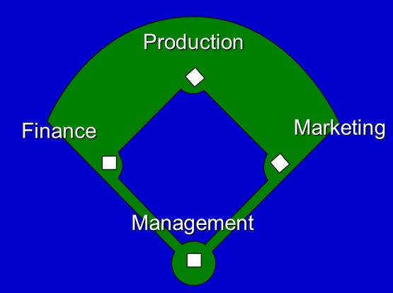
Teams Outperform Solopreneurs
    Experience has proven that teams that cover all the bases are the most successful.

Slide 3
Traits to Look For in Co-Founders and Key Employees
Team players
Self-motivated and self-directed
Have similar working styles.
Share a common vision and commitment..
Integrity.
Complementary skills.
Notes:
Team players.
Self-motivate and self-direct and don’t need to be told what to do every minute.
Have similar working styles. Do you like to get up at 5:00, jog for an hour and then work from 6:00 am to 5:00 pm. You probably will never see your partners if they are ex-rockers accustomed to rising at noon.
Share a common vision and commitment. If you want to feed the world’s poor, and he or she wants to make billions selling food to the third world, you’ll never agree when it comes to pricing the product.
Are honest. If your new partner has ideas on how to hide income from the IRS, he’ll also steal from you the first chance he gets. Integrity is not a relative term.
Have complementary skills. If everyone on the team is expert at coding, in a year you’ll have a warehouse full of great unsold software.

Slide 4
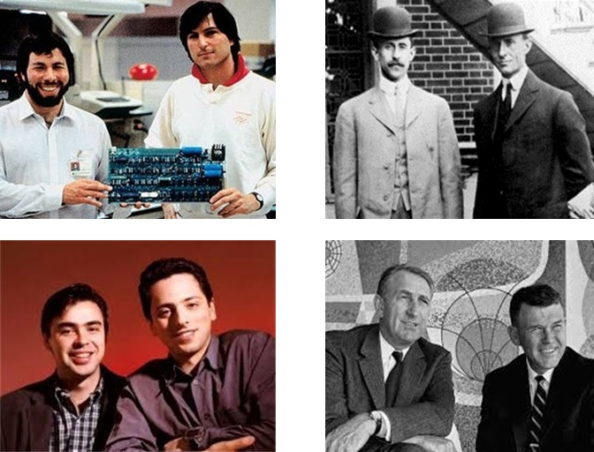
How many of these successful team can you identify?
Notes:
1 Steve Jobs/ Steve Wozniak (top left)
2 Orville Wright/ Wilbur Wright (top right)
3 Sergay Brin / Larry Page (bottom left)
4 David Packard/ Bill Hewlett (bottom right)

Slide 5
Keep Some Dry Powder
Don’t give out all your shares to co-founders and key hires immediately.
You’ll need at least a third of shares available for investors in first funding round.
Consider 2-5% per key person. And insist they earn even that over time.

Slide 6
Not all members of the team need to be paid or receive shares
Consider forming an ADVISORY BOARD of volunteer mentors to ask as a sounding board.
Advisory Board members do not have any liability as a result of their association – as do members of an official Board of Directors.

Slide 7
Well-Known Service Providers Also Add Prestige to a Letterhead
Ask your attorney and account if you can list their firms on your letterhead and website.
List them on same page as advisory board in their capacities:
Attorney: Dewey, Cheatam & Howe
Accountant: Cooke & Hyde LLP

Slide 8
Blank Slide

