Slide 1
Branding
  Naming the Company
  Graphic Standards
  Logo design

Slide 2
Naming The Company
Don’t Rush This Decision.
Think of all the places a company name appears:
Letterhead and business cards
Signage
Marketing brochures
Product labels
URL and email address
Legal documents
Bank accounts and checks

Slide 3

What Makes For A Good Company Name?
The personality of the words in your name will color the consumer opinion of your company.
Your company or product name may be the critical first impression.
Don’t get cute: Differ3nt as a URL is too different.
No one will remember this spelling.
Let people know what you do and who you are

Slide 4
Criteria for the perfect name
Short and easy to remember (easy to type into a browser).
  Of the top 100 web sites, 72% have 6 or fewer letters;
  only 3% have more than 15
  No one wants to type www.TheWorldsGreatestWidget.com
Name Generating Sites
Name generator 1 - http://www.namestation.com/
Name generator 2 - http://www.123finder.com/

Slide 5
Spelling is easy and unambiguous
Don’t get clever with words like Muunglow.
Select a name that people will spell correctly the first time, so they find you in a search, and not your competitor.

Slide 6
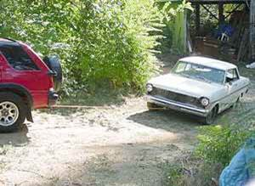
Does not have a negative connotation in another language
No Va means “It doesn’t go” in Spanish.

Slide 7
Is not used by a competitor in current or future market
Made-up names are usually safe. “Xerox, Yahoo,” “Google” and “EBay” are original names.
Using your own name, as long as it’s not J. C. Penney or Ronald McDonald, may also be a safe bet.

Slide 8
It conforms to legal requirements and restrictions
  You cannot use LLC, Corp, Corporation, Ltd, Inc. or Incorporated unless your company is organized under one of those legal structures.
  You cannot use Corp, Corporation, Ltd, Inc. or Incorporated in the name of an LLC as those adjectives designate and are restricted to full corporations, also known as C Corps.
  The name cannot include words that are prohibited by most state laws (e.g. "Bank" or “Insurance” unless of course your company is a bank or insurance company).

Slide 9
Places to Check for Conflicts with Name
[ ] A. CT Secretary of State www.concord-sots.ct.gov/concord
[ ] B. Facebook, Twitter, LinkedIn
[ ] C. Google.com
[ ] D. URL availability .com____ .co____ .net____ .us ____
[ ] E. Search for product name at uspto.gov/trademarks
to make sure no one has trademarked the name.
Check www.KnowEm.com (for B-E)

Slide 10
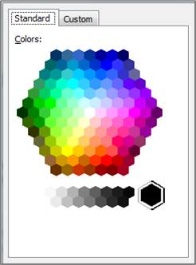
Graphic Standards
Typestyle
    Pick a common font
    Use consistently
      MyCompany
      MY COMPANY
      MyCompany
      Color Scheme
    Max 2 colors
    Pick Microsoft “Standard” colors
    Write down RGB and HEX values

Slide 11
Logo Design
    Keep it clean and simple
    To add a graphic element search key words at Google.com/images
    DIY Logo Sites:
FreeLogoServices.com. $40 to download if you like results.
DesignMatic.com. $37 to download.
      Add Tag Line to pre-sell customers and clearly explain what you do and how you are superior”
    “Fifteen minutes can save you ...”

Slide 12
Blank Slide

